Slide 1

Progress on Powering Options
Satish Dhawan, Adrian Au Yale University
Richard Sumner , CMCAMAC LLC
SiD workshop, SLAC
Jan 12 - 14, 2015

Slide 2
Agenda
2014 Liverpool Test Results
Toroid vs Planar Coil
Shielding Electrostatic & RF.
ATLAS Tracker Upgrade Converters
Need simple DAQ for Testing Converters

Slide 3
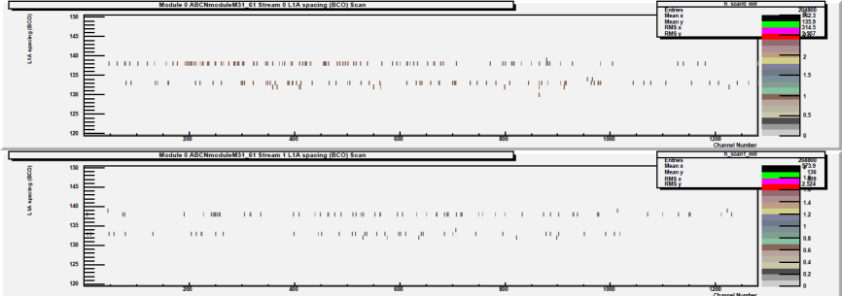
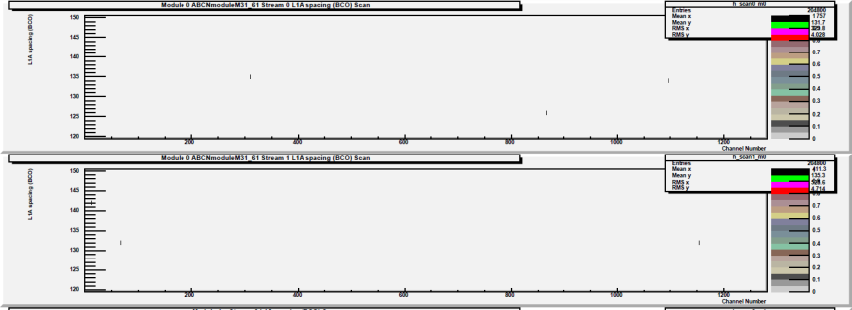
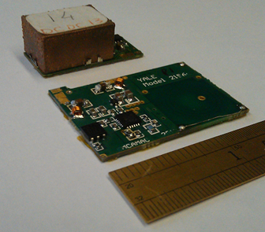
Planar Coil – “Up Close and Personal”
Double Trigger Noise (DTN)
With Toroid Converter
With Planar Converter
Reference measurement (CERN STV10 converter) @ 0.5fC
Approx <3mm from wire bonds with improved reference @ 0.5fC
US ATLAS Moved towards Dc-Dc.
Ashley Greenall , UK Group
CERN converter registers zero occupancy until 0.5fC,
then registers 528/244 hits
For conducted noise configuration, Planar
coil registers zero occupancy(even at 0.5fC)
Only when close to asics are hits registered,
3/2 counts at 0.5fC, see above
Above picture is Double trigger noise
i.e. after a hit ; spurious counts are registered
Comments inserted by Yale University
Noise in Electrons Measured @ Liverpool
cern stv10 noise 589, 604 average = 601
yale planar noise 587, 589 average = 588
noise with dc supplies (no dcdc) = 580
assuming the noise adds in quadrature, extract noise due to dcdc converter:
cern stv10 Additional noise = 157
yale planar Additional noise = 96
Planar Converter uses the same components except Inductor coil
CERN stv
Yale Planar
Thickness of stv = 8 mm vs 3mm for Planar
Shield to Silicon strips are Electrostatics & Eddy current
Bottom side shield 2 mm from Planar coil traces
Can be mounted on the sensor with 50 µm Kapton
Cooling via sensor
Notes:
3

Slide 4
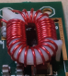
Toroid vs Planar Coil
Embedded Spirals
Disabled for the hand wound coil
Height = 2 mm plus shield
Toroid Inductor with Shield on toroid
height = 8 mm
Lower Mutual Coupling if turns are further apart but adds to DC Resistance

Slide 5
Radiation Length Comparison Toroid vs Planar
 |  |  | Cu wire |  |  |  | Rad Length %
 | L | wire length | milliohms | wire dia mm | vol cubic mm | Mass, grams | Avrg 100 cm2
Cern toroidal coil | 413.000 | 341.632 | 32.455 | 0.480 | 128.727 | 1.150 | 0.09%
planar coil, same L, same R | 415.000 | 203.472 | 34.387 | 0.361 | 57.661 | 0.5151 | 0.04%
planar coil, same L, same mass | 415.000 | 203.472 | 8.546 | 0.723 | 115.482 | 1.0316 | 0.08%
planar coil, same R, same mass | 967.000 | 310.860 | 32.951 | 0.455 | 111.031 | 0.9918 | 0.08%

Slide 6
Nosie Coupling from Dc-Dc to Readout
2 MHz 10 Volta
Thin Al Foil
Si Strips – Q amps
Parasitic Capacitance
Readout + DAQ
Dc_Dc Converter
EM
Bonding Wires act as the Secondary of the Transformer
Bonding Wire Loops

Slide 7
Top view
Fluke Digital Multimeter
10V Power Supply
A
Eddy Current Shield Measurements
Driver Panel (encased in an Aluminum box)
Twisted Pair
Translation Stage
Far Side Shield
Near Side Shield
Coil under Test
Side View
Probe2 100A Beehive 0.40 inch loop
Near Side Shield
The Shields
Support
Coil under Test
Far side Shield H3H: Half Oz/ 3 mil thick/ Half Oz
Far Side Shield
4 Types of Near Side Shield
Half Oz/ 3 mil thick/ Half Oz
One Oz/ 3 mil thick/ One Oz
One Oz/ 5 mil Thick/ Zero Oz
One Oz/ 10μm/ One Oz
Center of Coil
Shaft
Translation Stage
1 mm
1.27mm

Slide 8
10 mV = 1 µT @ 2 MHz
Shielding Measurements
Yale University
January 07, 2015

Slide 9
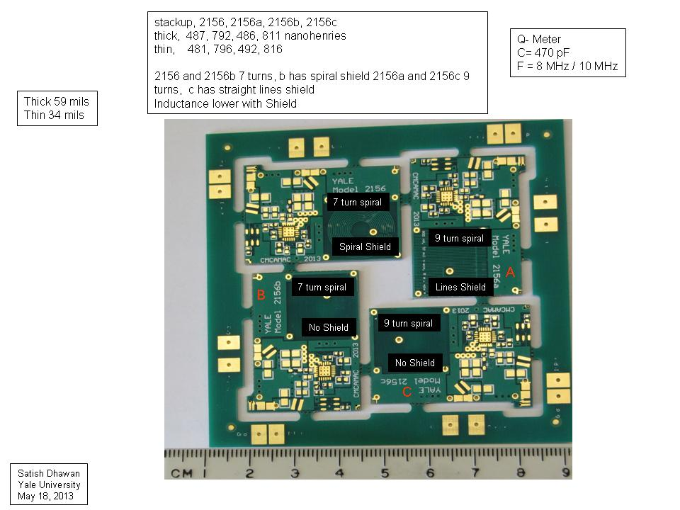
Vin_A
GND
Vin_D
GND
GND
Vout_D
Vout_A
GND
GND
Vout_B
Vin_C
GND
GND
Vin_B
GND
Vout_C

Slide 10
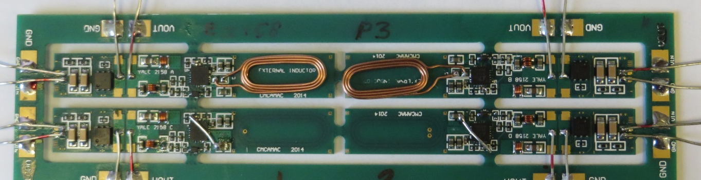
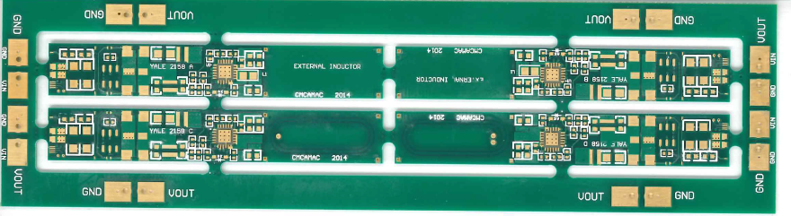
Each Converter PCB 10 mm x 63 mm. Different Coil Configuration
Channel D: Embedded Coil with 2 via: 687 nH, 83 mΩ
Channel C: Embedded Coil with 1 via: 703 nH, 83 mΩ
Channel B: External Coil: Wurth 540 nH* with short Leads
Channel A: External Coil: Wurth 540 nH* with short Leads
* With BK Precision LCR Meter
GND
Vout_A
Vout_B
GND
A
Yale E-2158
P #
B
Vin_A
Vin_B
GND
GND
GND
Vin_D
Vin_C
GND
C
D
GND
GND
Vout_C
Vout_D
GND
DC-DC Converter Model E-2158
Yale University
October 19, 2014

Slide 11
System Testing
DcDc Converter @ Yale
Thickness of Converters – Shield thickness!
Detector + Readout @ SLAC Liverpool for ATLAS Strip Upgrade
DAQ: RAL, Liverpool, BNL HSIO, SLAC
Very difficult to use & NOT portable without the experts.
We need a simple to use DAQ. Is it possible ?
Prospects for Future
Lower Mass @ 5 MHZ
Topology Change Charge pump, Buck or something else?
GaN Power switches have lower losses but the Driver is an issue

Slide 12
The END

Slide 13
The coil dimensions are approximately those of the toroid used in the feast DC DC converter (coil radius 1.7 mm, toroid radius 4.5 mm). The formulas are for circular coils so I used the average toroid radius. For the planar coil I used the approximate dimensions of our latest oval coil made by Wurth, again using the average coil radius. The dimensions are adjusted to give a coil with the same inductance as the toroid, about 400 nano Henry. I calculated the approximate length of wire needed in both cases. The toroid wire has a diameter of 0.48 mm.
In the first example I adjusted the wire size of the planar coil to give the same DC resistance as the toroid. Then the total mass of the copper wire in the planar coil is less than half of the mass of the copper in the toroid coil.
In the second example I adjusted the wire size of the planar coil so the mass of copper is the same as in the toroid, the DC resistance of the planar coil is about 25% of the toroid coil. For the same load current this will reduce the the power loss of the planar coil to about 25% of the loss in the toroid coil. For large load currents, this will substantially improve the overall efficiency.
In the third example, I adjusted the number of turns and wire size to get about the same mass of copper and the same resistance. The result is about twice the inductance. This reduces the ripple current to half. But the turns have increased from 6 to 9, so the ripple magnetic field (the EMI) is reduced to about 75% of the field in the first two examples.

Slide 14
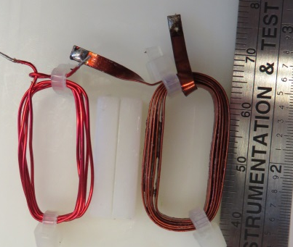
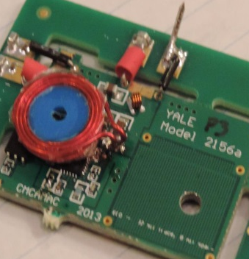
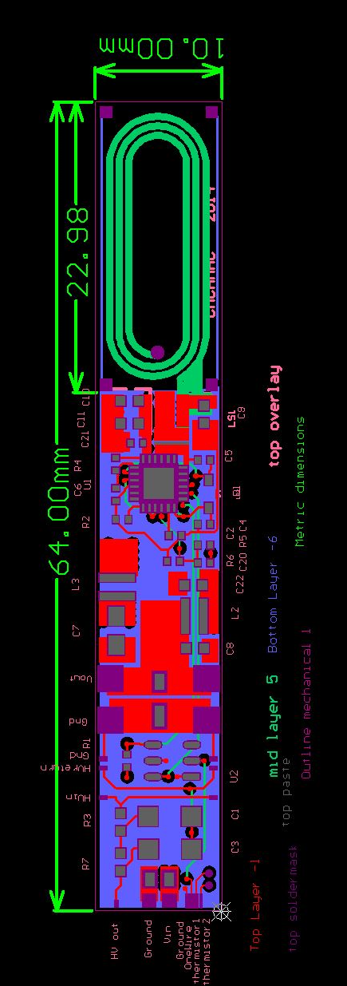
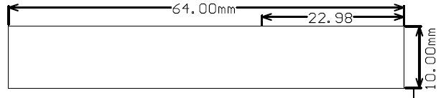
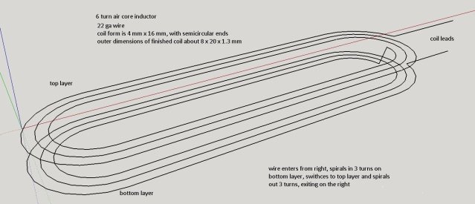
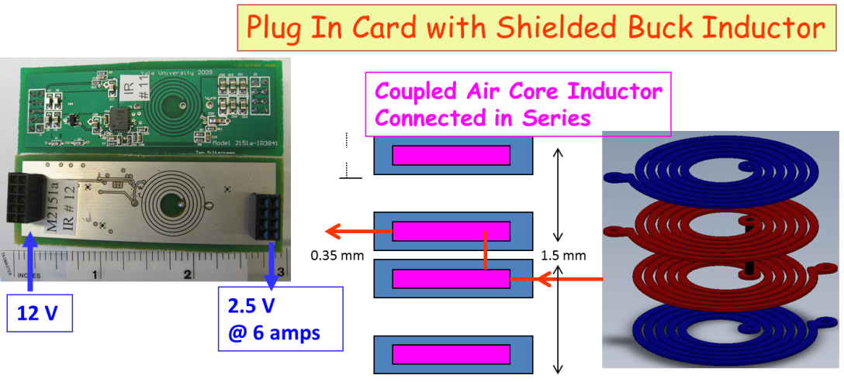
Some Coil Ideas
Coil
Shield Box
Coil
4mm
Yale Model 2151- Year 2009
New design with dimensions
10 mm gives tight fit, 9 mm is desired
Yale University
August 02, 2014
This shield is less effective.
We have different shield for top & bottom
Silicon Strips &
Readout ASICs

