Slide 1
4.1/9.1m L* Optics & Performance
Glen White, SLAC
SiD Meeting, SLAC
Jan 13, 2015

Slide 2
Overview
Assessing impact of changes RDR->TDR
FFS optics
  Single L* @ 4.1m (QF1 L*=9.1m)
  Optimal lattice configuration
MDI-related studies
  BDS collimation
  IR detector solenoid compensation
  IR diagnostics

Slide 3
RDR->TDR BDS Challenges
Detailed studies of RDR configuration concluded BDS can deliver design lumi given 6nm emittance growth budget.
  Including impact of all static & dynamic error sources, inter & intra-bunch timescales.
  This level of study not yet complete for TDR changes.
Changes from RDR make BDS tuning more challenging
  40 -> 35nm ε_{y} delivered emittance assumption
  Increased IP β_{x}
    Tighter BDS magnet tolerances (poorer tuning performance)
    ATF2 experience has shown poorer performance with larger β_{x}*
  Larger QF1-QD0 separation
    Tighter BDS magnet tolerances (poorer tuning performance)
  2 IR optics solutions (2 L* configs)
    Poorer tuning performance (tuning time & collimation optimisation etc.)
  No overhead from “waist shift”
    Baseline lumi now includes vertical waist-shift effect, RDR did not.

Slide 4
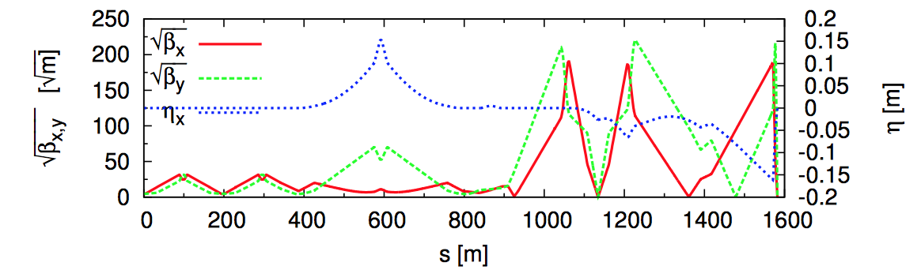
L*=4.1m Optics
Tools: MADX, MAPCLASS, SAD, Lucretia
IP
L(QF1m) <2m?
QF1A
QF1B
QD0A
QD0B
L*=4.1m
L* (QF1) = 9.5m or 9.1m?
Have optics solutions for E_{CM} = 250 GeV with improved collimation performance by powering front halves of QF1 & QD0 magnets only.
Tuning performance driven by QD0->QF1 distance
  Prefer QF1 closer to QD0, also shorter QF1

Slide 5
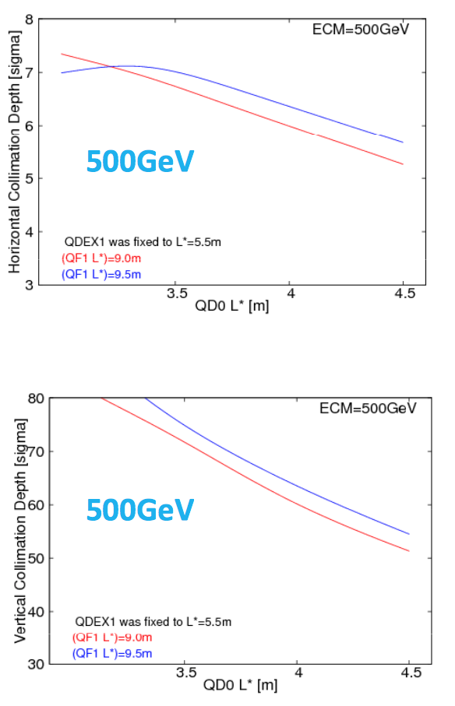
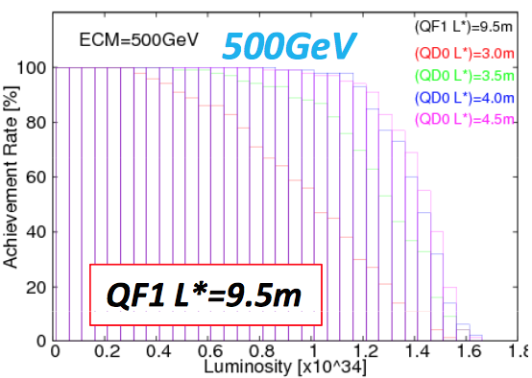
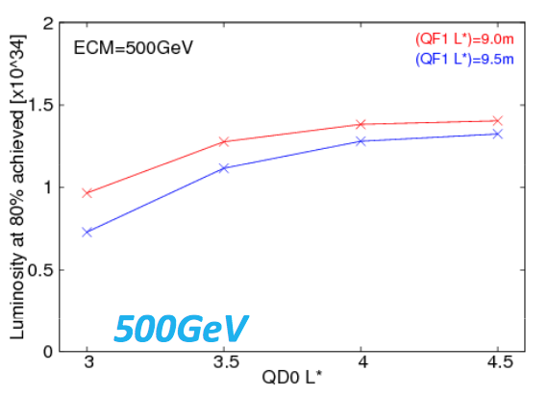
Collimation depth & beam tuning simulation
For different L* (T. Okugi, KEK)

Slide 6
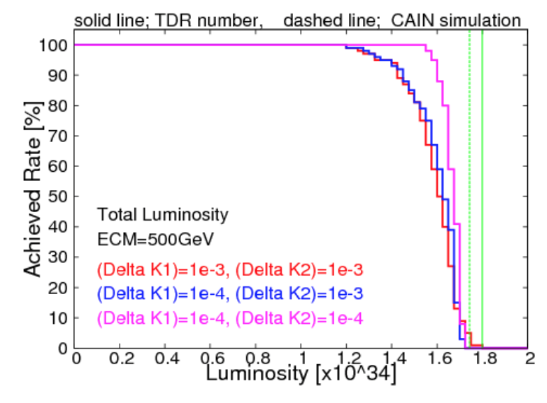
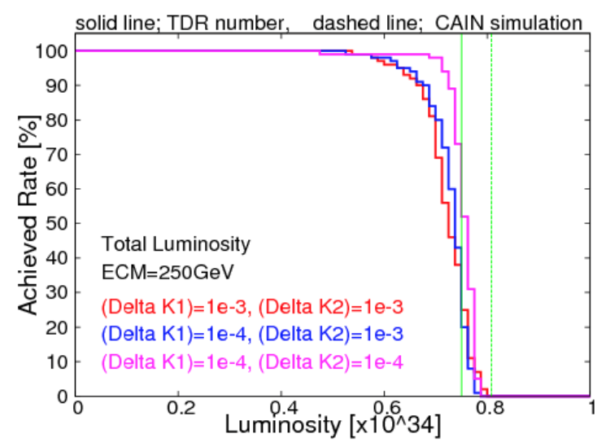
MC Tuning Simulations
(T. Okugi, KEK) – SAD + CAIN
Tuning simulation results for E_{CM}=250,500 GeV
  Compare magenta lines to outer green lines depicting design lumi
4.1, 9.1m QD0, QF1 L* configuration
Standard tuning algorithms no longer sufficient to deliver design luminosirty, more work required in the future to specify a tuning system and/or improved assumption of BDS delivered beam quality.

Slide 7
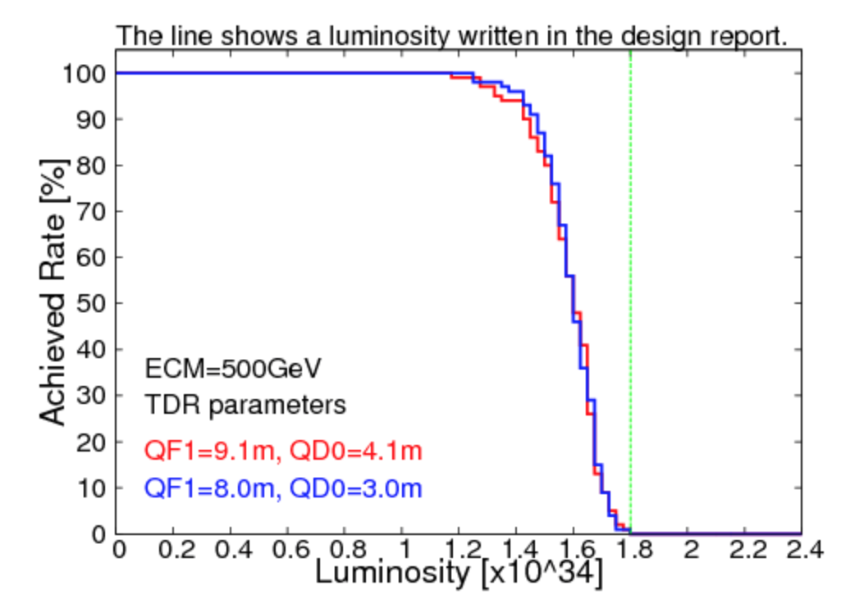
Recover Tuning Performance @ Smaller L* by Moving in QF1
Can recover lumi performance at small L* by moving QF1 closer to IP.
  Improved collimation depth
Would require moveable QF1 to be compatible with push-pull operations…
(T. Okugi, KEK)

Slide 8
Software Improvements for Backgrounds & IR Studies
2 “new” tools, merging standard accelerator tracking options with GEANT-4 for RK style tracking through complex fields and/or materials.
G4 interface added to Lucretia (supported by SLAC)
  Control of G4 materials, fields and tracking through Lucretia Matlab data structures.
BDSIM (supported by RHUL)
  Standard accelerator tracking added within G4 framework
  Writing ability to call BDSIM from within Lucretia.
Collaboration: SLAC & RHUL
In-use or planned for ILC BDS work:
  Collimation system design
  Muon flux calculations and collimation design
  Detector solenoid tracking and compensation design

Slide 9
Lucretia + G4
Developed to study collimation system for LCLS-II
Currently studying losses in LCLS to verify modeling and possible improve LCLS collimation system.
Will be useful for ILC BDS collimation modeling.

Slide 10

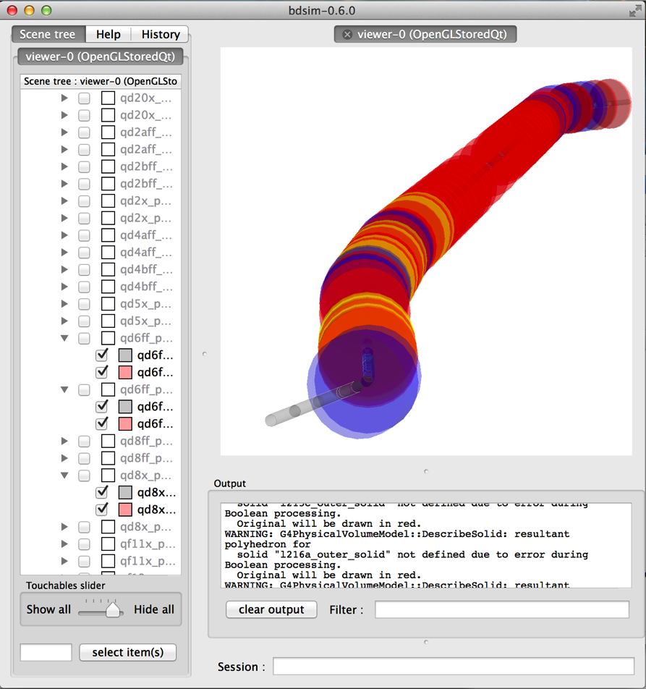
A BDSIM Accelerator Model
Beamline built from ASCII input
Geant4 model of accelerator automatically created
Generic geometry created by default
  typically cylinders of iron
  more specific geometry can be specified or imported
Normal Geant4 Runge-Kutta steppers are replaced
  vacuum steppers replaced by maps for specific magnet types
  much faster and more accurate for known fields – ie quadrupolar
Hits on accelerator recorded
Integrated analysis for energy loss histograms
  both ASCII and ROOT output supported
L. Nevay, S. Boogert, H. Garcia-Morales,
S. Gibson, R. Kwee-Hinzmann, J. Snuverink
ATF2 example

Slide 11
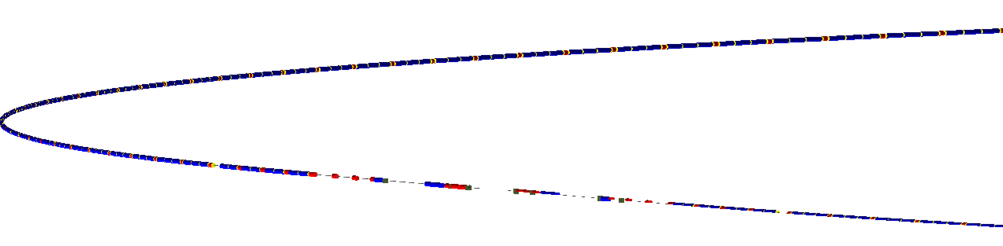
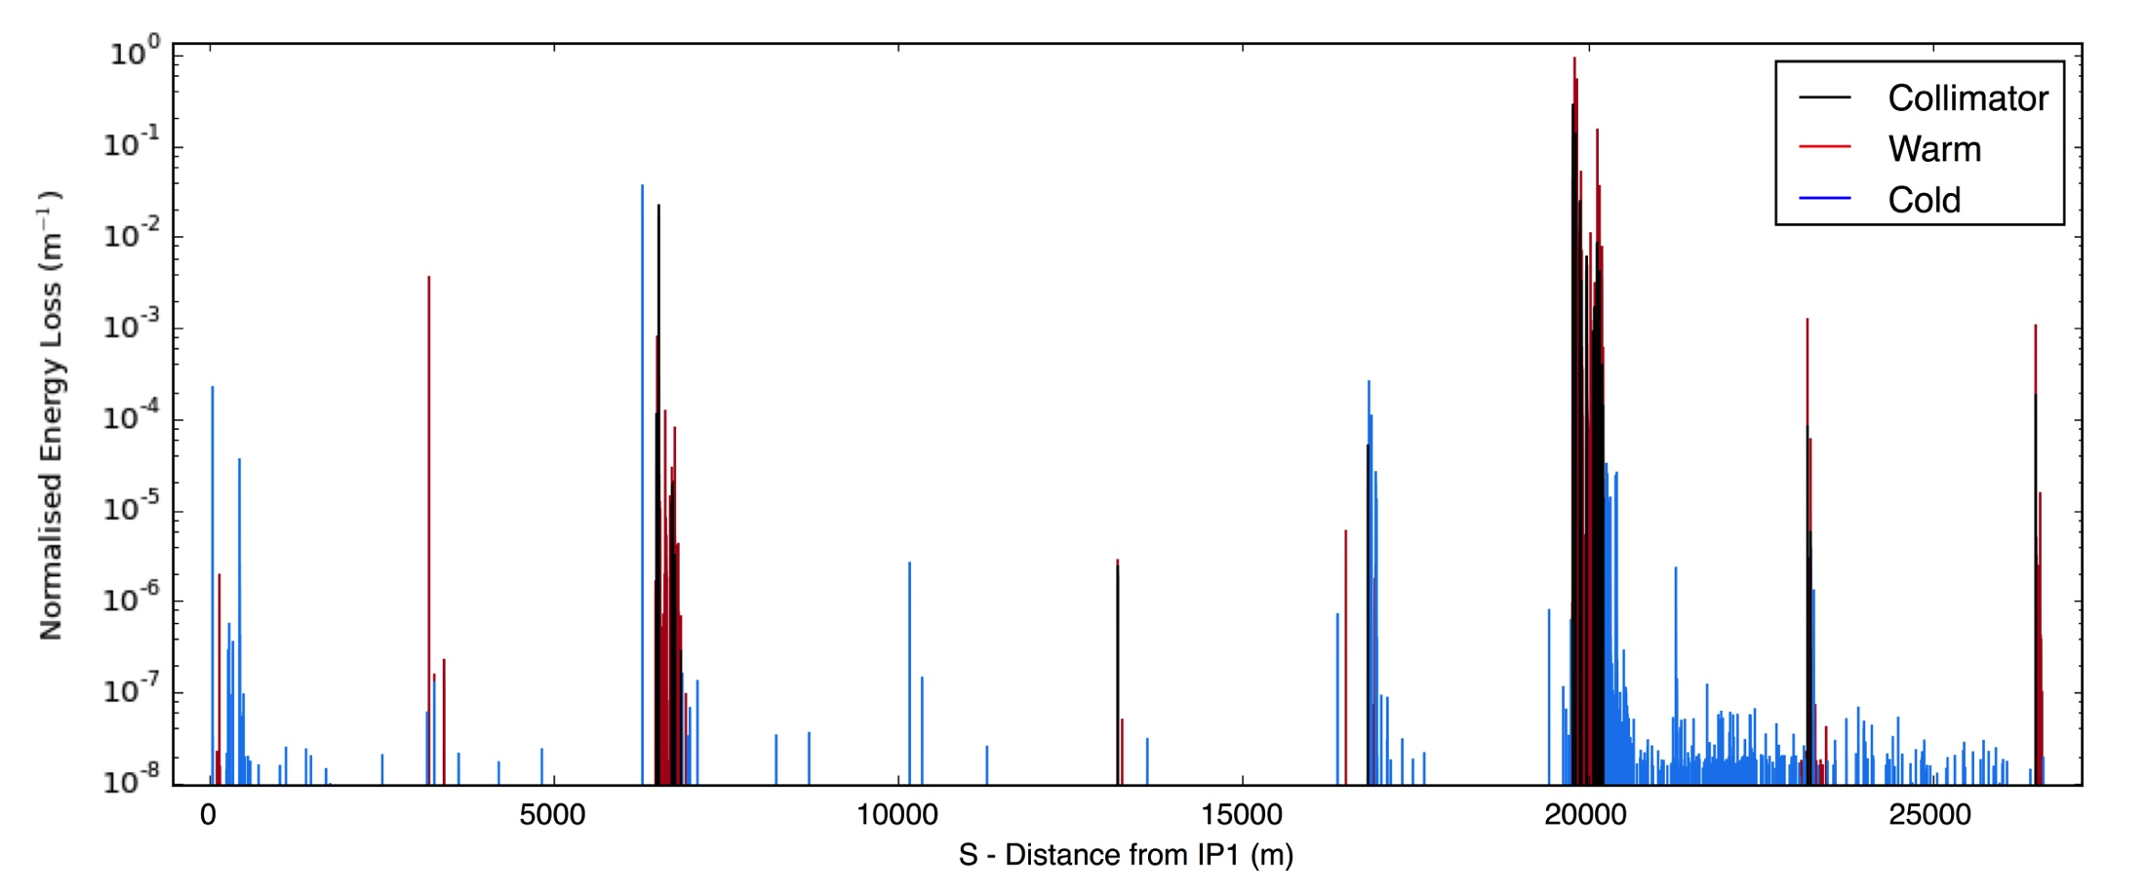
BDSIM LHC Model
Created model of existing LHC for comparison
  before using for HL-LHC simulations
3.5 TeV 2011 & 4TeV 2012 physics run lattices
pybdsim – python tools used to prepare inputs
  supplied with BDSIM
  allows easy conversion of inputs
  can easily aggregate input information from various sources
NB no perspective
BDSIM ➔ the full energy deposition from secondaries
Here, normalised to maximum loss
334400 primaries simulated
215984 primary hits
9.467 x 109 energy loss ‘hits’

Slide 12
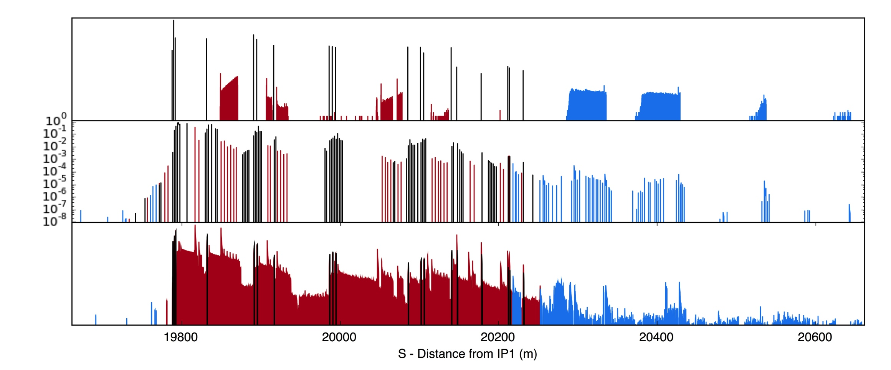
Comparison with LHC BLM Data
Data from R. Bruce et al, Phys. Rev. ST Accel. Beams 17, 081004 (2014)
Favorable comparison with Beam loss monitor data
SixTrack
Beam Loss Monitors
BDSIM

Slide 13
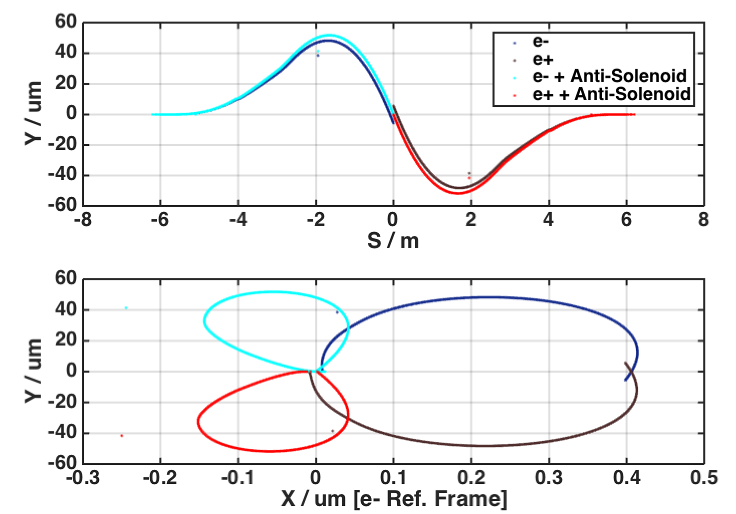
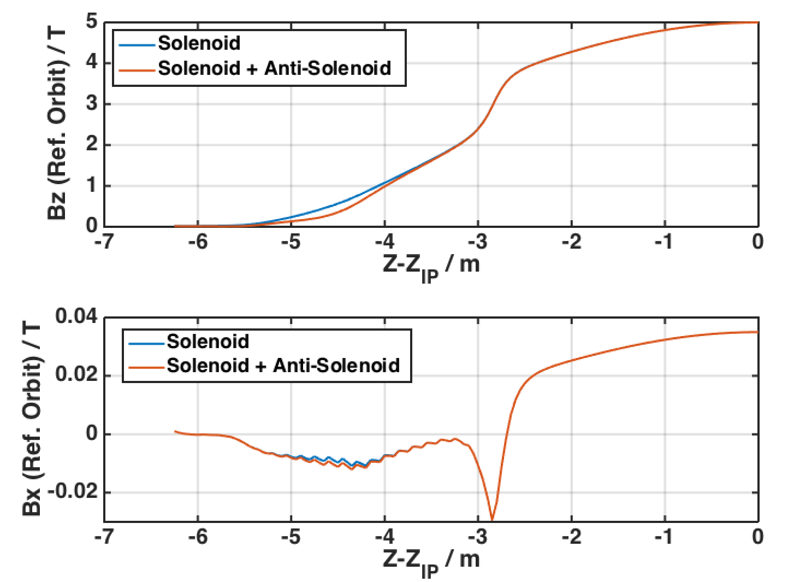
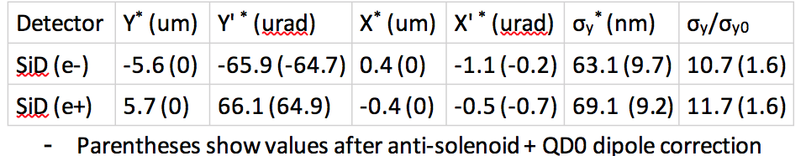
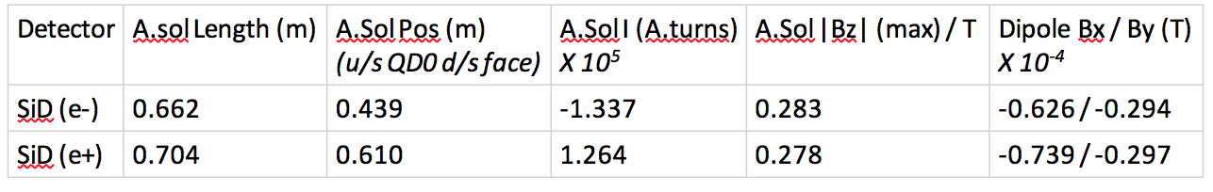
Detector Solenoid Compensation
SiD – Solenoid Only (E_{CM}=500GeV)
IP
IP
QD0
A.SOL
QD0
QD0
IP
A.SOL
QD0
Reduces to design 5.9nm
After applying <x’y>, <xy> & <Ey>
Linear correction knobs

Slide 14
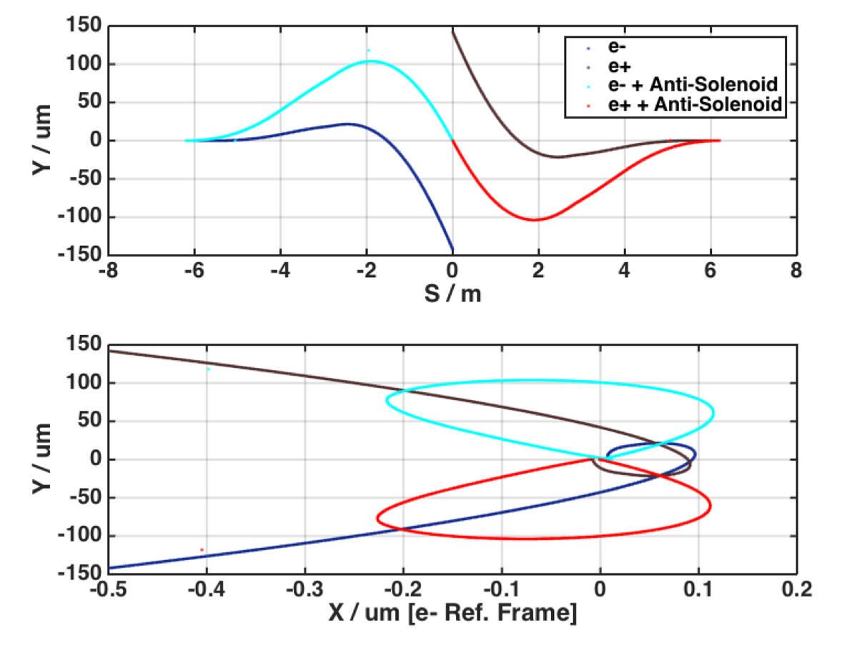
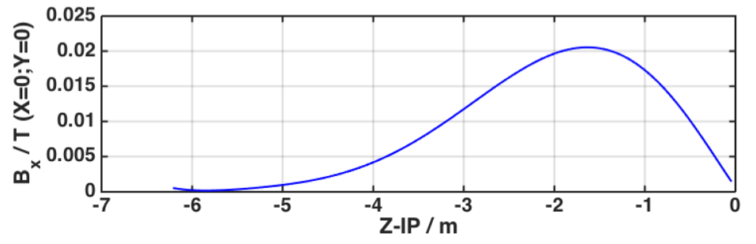
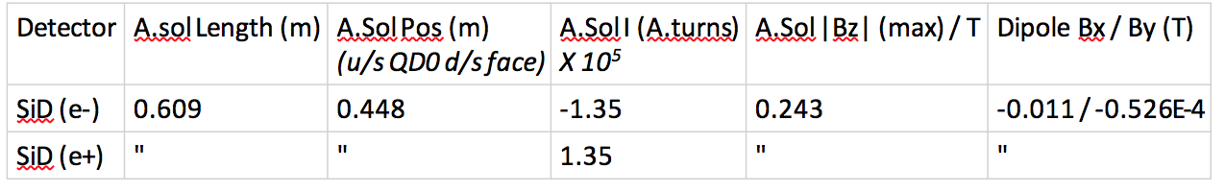
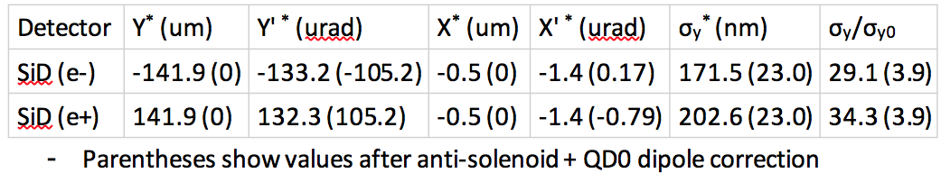
Detector Solenoid Compensation
SiD – Solenoid + Anti-DID (E_{CM}=500GeV)
Anti-DID Field
A.SOL
QD0
Reduces to design 5.9nm
After applying <x’y>, <xy> & <Ey>
Linear correction knobs

Slide 15
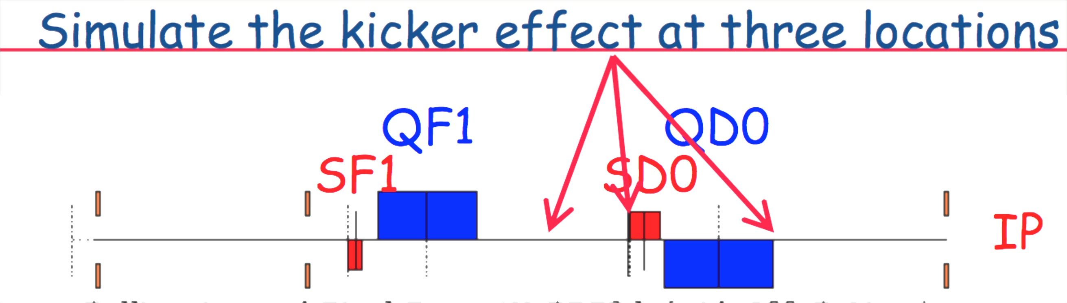
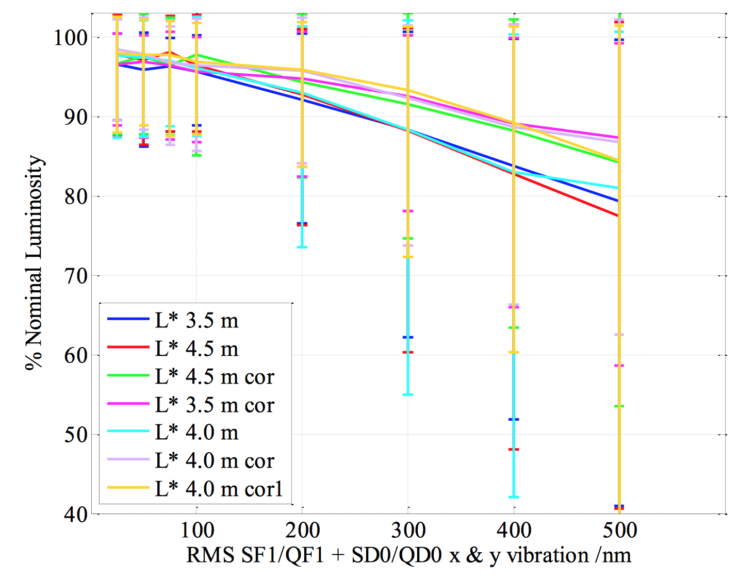
IP Feedback Tolerances / IP Diagnostics
M. Wang, SLAC
Negligible impact for
rms jitter ~<100nm
No significant improvement for moving IP kicker to u/s QD0 location
Jitter tolerance similar to RDR estimates
  ~<100nm
Still consider d/s QD0 location for BPM to determine IP beam position

Slide 16
Summary
FD configuration studies
  Smaller L* better for vertical collimation depth
  Larger L* (smaller QF1-QD0 distance) better for tolerances and lumi tuning performance
  L* ~ 4m seems optimal, 4.1m proposed
  Prefer smaller QF1-QD0 distance, and shorter QF1 magnet would also be benefical
    Proposed QF1 L*=9.1m (0.4m closer to IP than baseline)
  http://atf.kek.jp/twiki/bin/view/Main/ILCBDSOpticsStorage
More work required on tuning algorithms to realize design luminosity
IP diagnostics, FB kicker
  Happy with FB kicker location between QF1 & QD0
  Still would like to consider BPM option d/s QD0 for IP position information.
New software tools for backgrounds & IR studies
  Work started to specify collimation configuration & study backgrounds.
  Study muon flux and consider more compact collimation system
  Tools constructed to design IR solenoid compensation system
More detailed report on these activities @ Asian LC workshop in April (KEK).

