Slide 1
IP BPM resolution study proposal
N. Blaskovic, P. Burrows, G. Christian, C. Perry
John Adams Institute, Oxford University

Slide 2
Introduction
Plan assumes existing IP BPMs with Honda’s electronics
Two parts:
Estimating Honda’s electronics system noise by using 2 processors on one BPM
Performance of IPB and IPC with waist at IP
N. Blaskovic

Slide 3
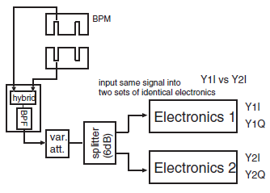
2-on-1 resolution study
Use 2 processors on one BPM to estimate resolution limit due to electronics noise (Inoue et al., 2008):
N. Blaskovic

Slide 4
2-on-1 resolution study
Shift time would be required to:
Calibrate with beam waist on BPM
Get 2-on-1 resolution data on and off-waist
Get 2-on-1 resolution data vs. mover position
Study resolution vs. attenuation
Permute pairs of electronics
Repeat but have a common Honda 1st stage and then split into two Honda 2nd stages
N. Blaskovic

Slide 5
2-on-1 resolution study
Study will require single FONT5 board (which will be brought from Oxford) for local digitisation at IP
Study also requires IP BPM mover control
N. Blaskovic

Slide 6
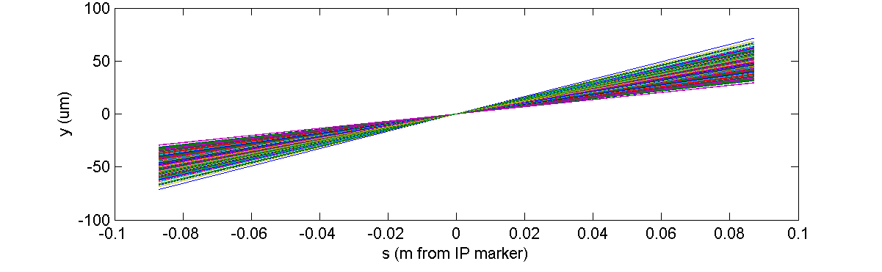
IPB and IPC resolution study
With waist at nominal IP, propagation of upstream P2 and P3 positions gives
8 um jitter at IPB & IPC; 9 nm jitter at IP
~100 % position correlation of IPB to IPC
IPB
IPC
N. Blaskovic

Slide 7
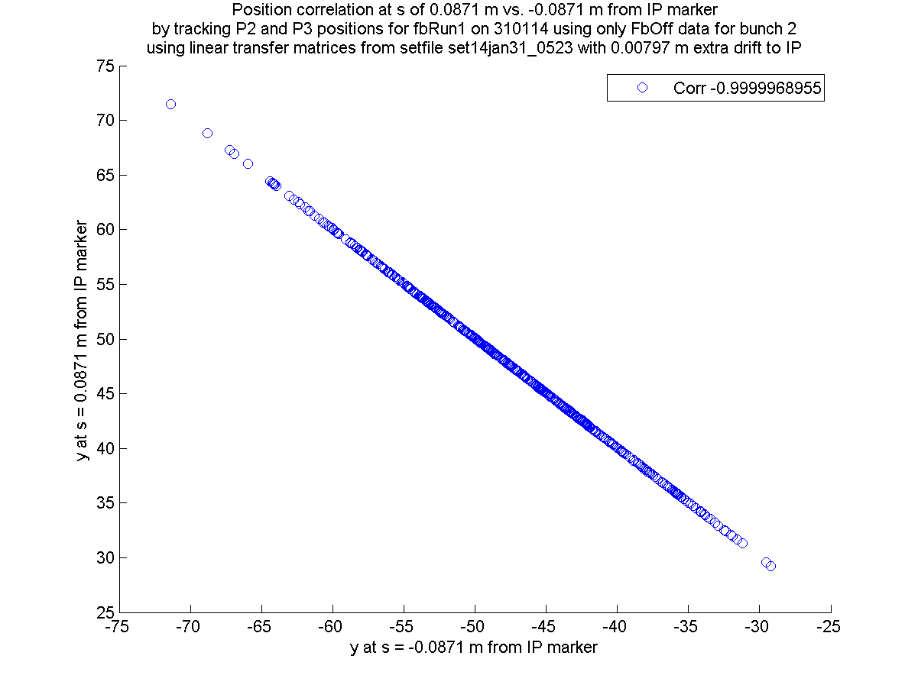
(IPC)
(IPB)
N. Blaskovic

Slide 8
IPB and IPC resolution study
Parasitic study with beam waist at IP:
Centre IPB and IPC around beam
Measure jitter at IPB and IPC vs. attenuation
Estimate system resolution vs. attenuation (given ~100% IPB-to-IPC position correlation, IPB & IPC are ~ measurements of the same)
Assess limitation of dynamic range
Shift time would be required to:
Calibrate with beam waist on each BPM
N. Blaskovic

Slide 9
IPB and IPC resolution study
For digitisation:
FONT5 board to digitise upstream P2 and P3
SIS digitiser to record IPB and IPC
Study would require IP BPM mover control
Study preferentially performed with tuned beam of known spot size
If beam at IPB and IPC lies outside mover dynamic range, beam would have to be re-steered – incompatible with ATF tuning?
N. Blaskovic

Slide 10
Summary
Study with 2 processors on one BPM
Requires shift time
Tuned beam not critical
Performance of IPB & IPC with waist at IP
Mostly parasitic if beam within mover range
Tuned beam preferred
N. Blaskovic

