Slide 1


Progress towards nanometre-level beam stabilisation at ATF2
N. Blaskovic, D. R. Bett, P. N. Burrows, G. B. Christian, C. Perry
John Adams Institute, University of Oxford

Slide 2
Outline
Introduction
Feedback at a linear collider
International Linear Collider
Feedback on Nanosecond Timescales
Experimental setup at Accelerator Test Facility
Position jitter on waist
Interaction point feedback results
Neven Blaskovic 2

Slide 3
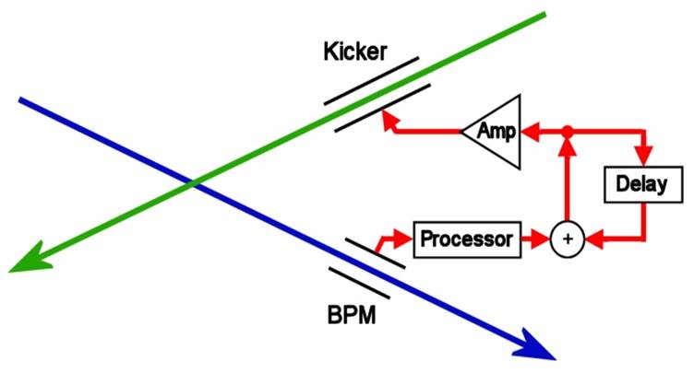
Introduction
Feedback at a Linear Collider
Successful collision of bunches at a linear collider is critical
A fast position feedback system is required
Misaligned beams at interaction point (IP) cause beam-beam deflection
Neven Blaskovic 3

Slide 4
Introduction
Feedback at a Linear Collider
Successful collision of bunches at a linear collider is critical
A fast position feedback system is required
Misaligned beams at interaction point (IP) cause beam-beam deflection
Measure deflection on one of outgoing beams
(beam position monitor)
Neven Blaskovic 4

Slide 5
Introduction
Feedback at a Linear Collider
Successful collision of bunches at a linear collider is critical
A fast position feedback system is required
Misaligned beams at interaction point (IP) cause beam-beam deflection
Measure deflection on one of outgoing beams
Correct orbit of next bunch (correlated to previous bunch due to short bunch spacing)
(beam position monitor)
Neven Blaskovic 5

Slide 6
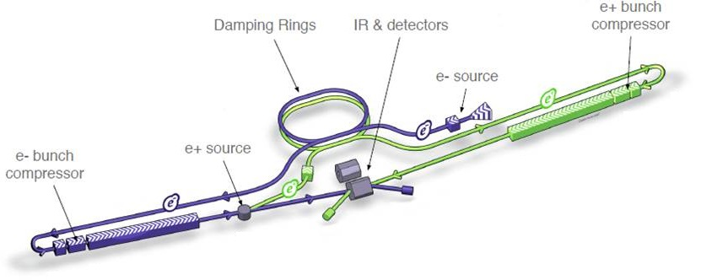
Introduction
International Linear Collider (ILC)
Proposed linear electron-positron collider
Centre-of-mass energy: 250-1000 GeV
Vertical beamsize: 5.9 nm
Bunch separation: 554 ns
(ILC Technical Design Report)
Neven Blaskovic 6

Slide 7
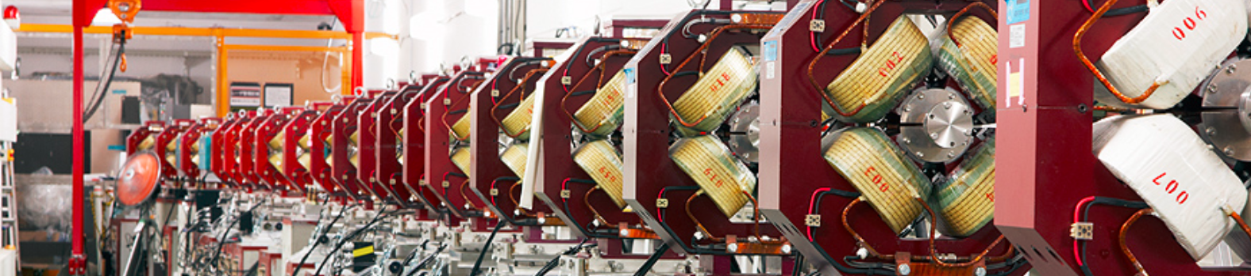
Introduction
Accelerator Test Facility (ATF) at KEK
Test bed for the International Linear Collider
Facility located at KEK in Tsukuba, Japan
Goals of the present accelerator (ATF2):
37 nm vertical spot size at final focus
Nanometre level vertical beam stability
Neven Blaskovic 7

Slide 8
Introduction
Accelerator Test Facility (ATF) at KEK
Electron source
90 meters
Neven Blaskovic 8

Slide 9
Introduction
Accelerator Test Facility (ATF) at KEK
Electron source
1.28 GeV linear accelerator
90 meters
Neven Blaskovic 9

Slide 10
Introduction
Accelerator Test Facility (ATF) at KEK
Damping ring
Electron source
1.28 GeV linear accelerator
90 meters
Neven Blaskovic 10

Slide 11
Introduction
Accelerator Test Facility (ATF) at KEK
Final focus
Extraction line
Model interaction point (IP) of a collider (location of feedback system)
Damping ring
Electron source
1.28 GeV linear accelerator
90 meters
Neven Blaskovic 11

Slide 12
Introduction
Accelerator Test Facility (ATF) at KEK
ATF can be operated with 2-bunch trains in the extraction line and final focus
The separation of the bunches is ILC-like (tuneable up to ~300 ns)
Our prototype feedback system:
Measures the position of the first bunch
Then corrects the path of the second bunch
Train extraction frequency: ~3 Hz
Neven Blaskovic 12

Slide 13
Introduction
Feedback on Nanosecond Timescales (FONT)
Low-latency, high-precision feedback system
We have previously demonstrated a system meeting ILC latency, BPM resolution and beam kick requirements
We have extended the system for use at ATF
We aim for nanometre level beam stabilisation at the ATF IP
Neven Blaskovic 13

Slide 14
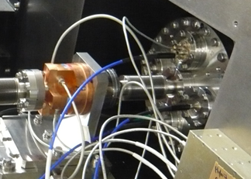
Experimental Setup
beam
IPB
IPB
Cavity BPM at beam waist
C-band: 6.4 GHz in y
Low Q: decay time < 30 ns
Resolve 2-bunch trains
Neven Blaskovic 14

Slide 15
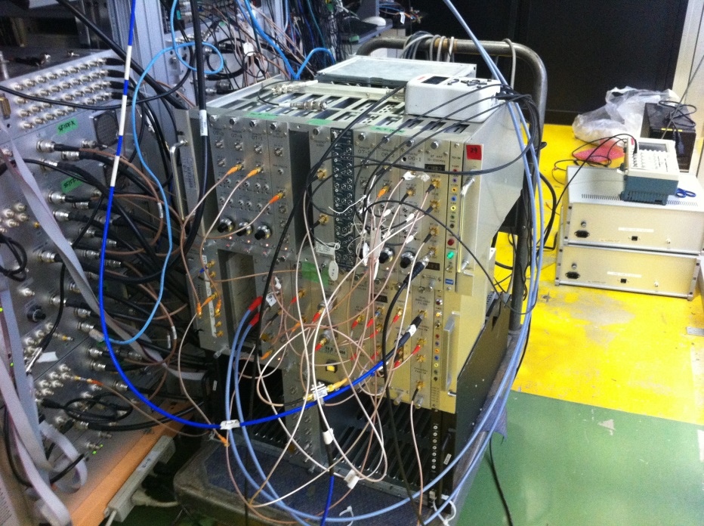
Experimental Setup
beam
IPB
Processor
for cavity BPM
Processor
Analogue, 2-stage downmixer
Resolution of < 80 nm
Developed by Honda et al.
Neven Blaskovic 15

Slide 16
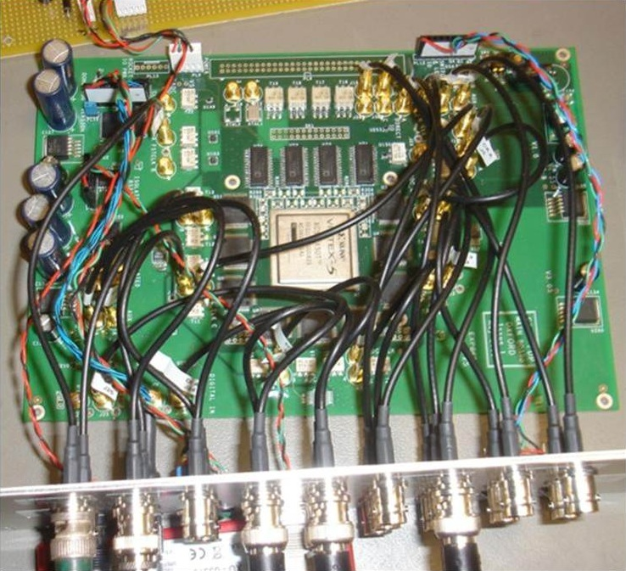
Experimental Setup
beam
IPB
Board
Processor
Board
9 ADC channels at 357 MHz
2 DAC channels at 179 MHz
Xilinx Virtex 5 FPGA
Neven Blaskovic 16

Slide 17
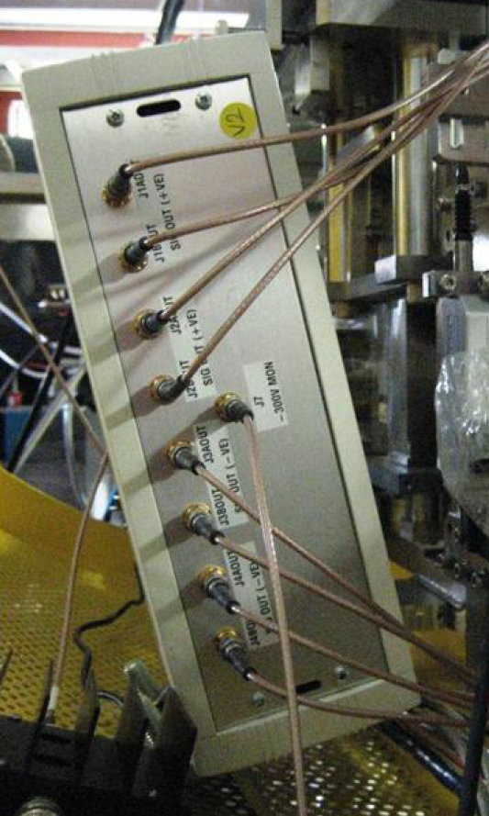
Experimental Setup
beam
IPB
Amplifier
Processor
Amplifier
Board
Made by TMD Technologies
± 30 A drive current
35 ns rise time (90 % of peak)
Neven Blaskovic 17

Slide 18
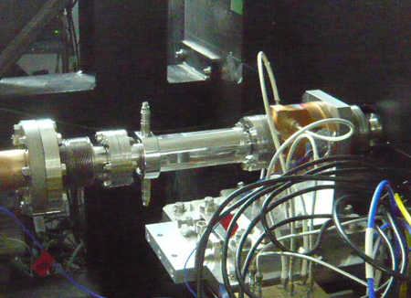
Experimental Setup
beam
IPB
IPK
IPK
Kicker
Processor
Amplifier
Board
Vertical stripline kicker
12.5 cm long strips for IPK
Just before IP chamber
Neven Blaskovic 18

Slide 19
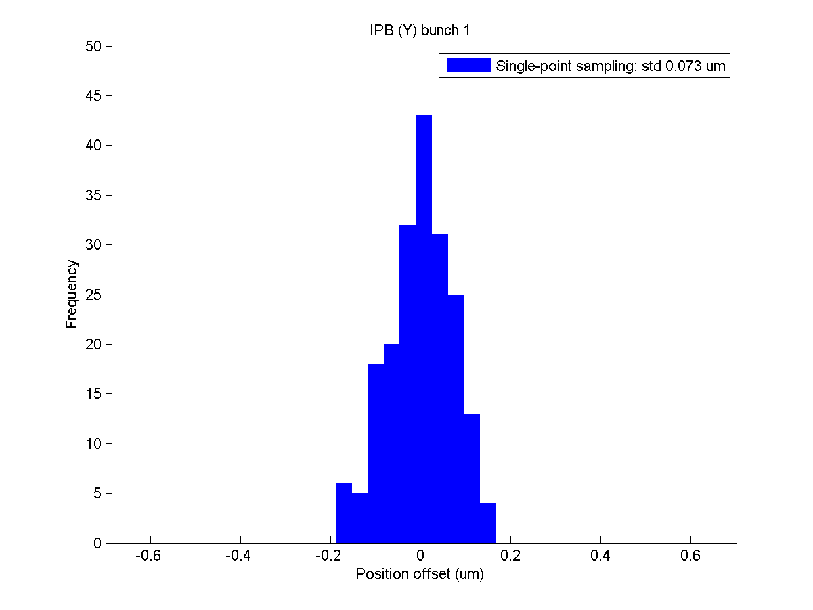
Position Jitter
Measured position jitter on waist ~ 75 nm
Neven Blaskovic 19

Slide 20
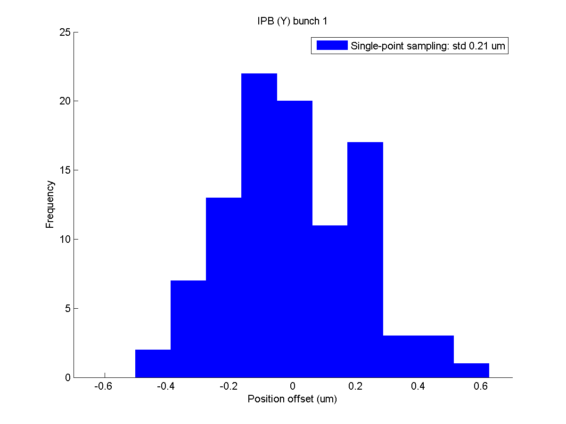
Position Jitter
A few hours later, measured position jitter > 200 nm
Neven Blaskovic 20

Slide 21
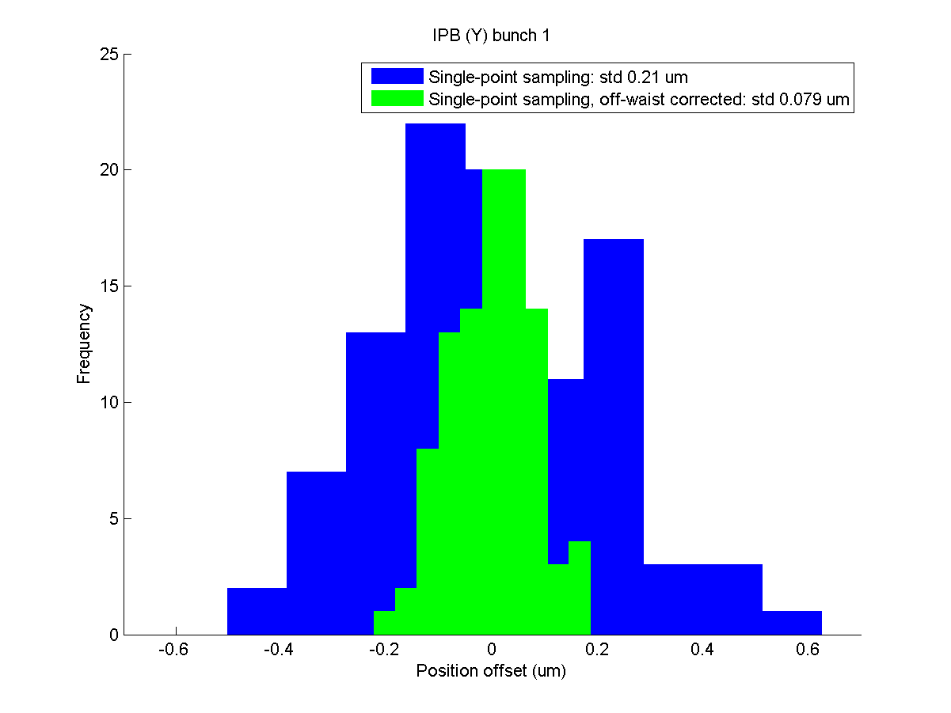
Position Jitter
Using a downstream BPM, the waist position was found to have drifted
Correcting for waist drift off-line recovers waist beam jitter ~ 75 nm
Neven Blaskovic 21

Slide 22
Resolution
The ~75 nm measured jitter is an upper limit to the resolution of the BPM, for the single-point sampling used in the feedback firmware
Neven Blaskovic 22

Slide 23
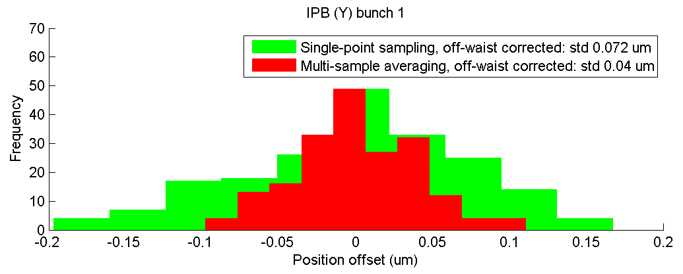
Resolution
The ~75 nm measured jitter is an upper limit to the resolution of the BPM, for the single-point sampling used in the feedback firmware
Off-line analysis shows that multi-sample averaging improves the resolution to under 40 nm
Neven Blaskovic 23

Slide 24
Interaction Point Feedback
beam
IPB position is used to drive the local kicker IPK
Latency: 212 ns
Effect measured at IPB
IPB
IPK
Processor
Amplifier
Board
Neven Blaskovic 24

Slide 25
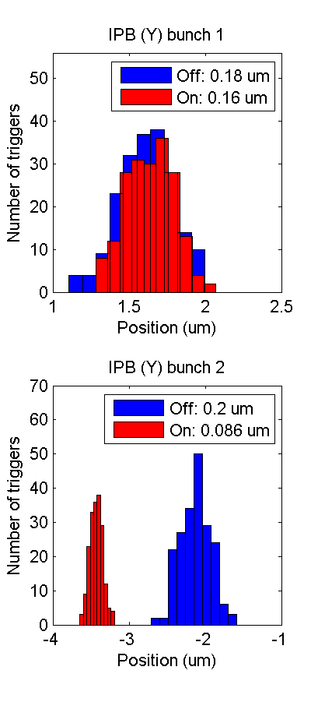
Interaction Point Feedback
Neven Blaskovic 25

Slide 26
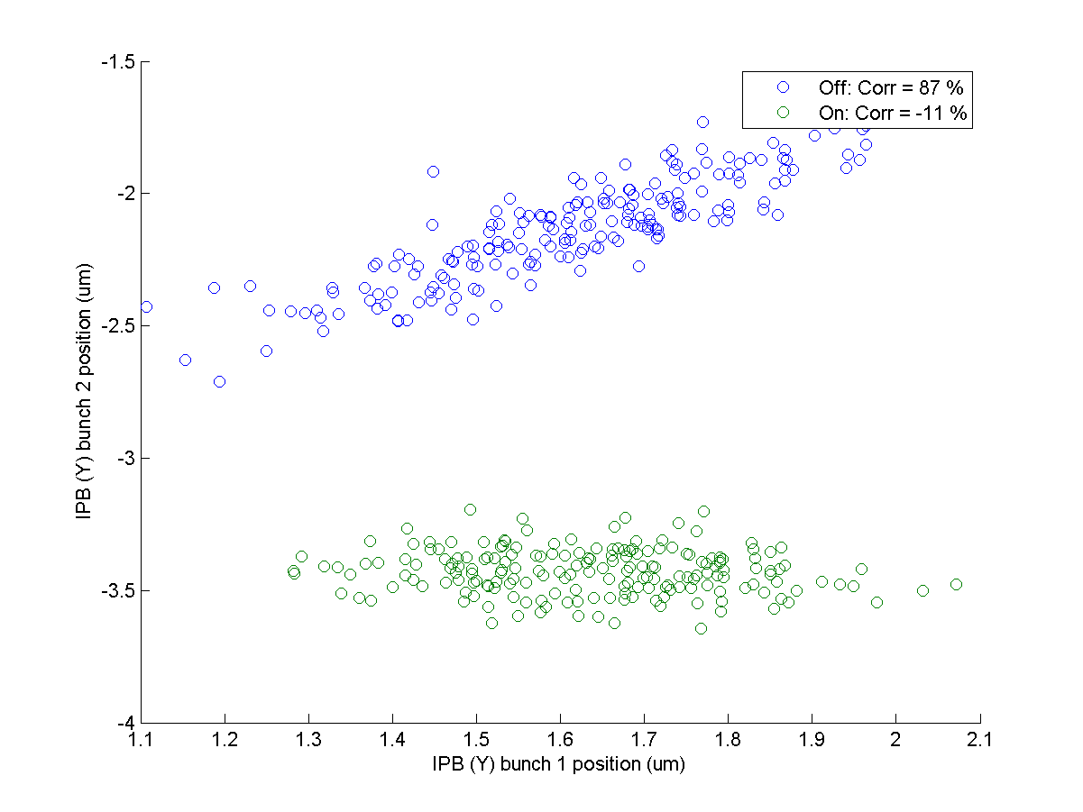
Interaction Point Feedback
Neven Blaskovic 26

Slide 27
Conclusions
Demonstrated low-latency, high-precision, intra-train feedback systems
Cavity BPM feedback latency: 212 ns
Cavity BPM resolution
Single-point sampling: < 80 nm
Multi-sample averaging: < 40 nm
Achieved beam stabilisation at the ATF IP, reducing the jitter to < 90 nm
Neven Blaskovic 27

Slide 28
Thank you for your attention!
Neven Blaskovic 28

Slide 29
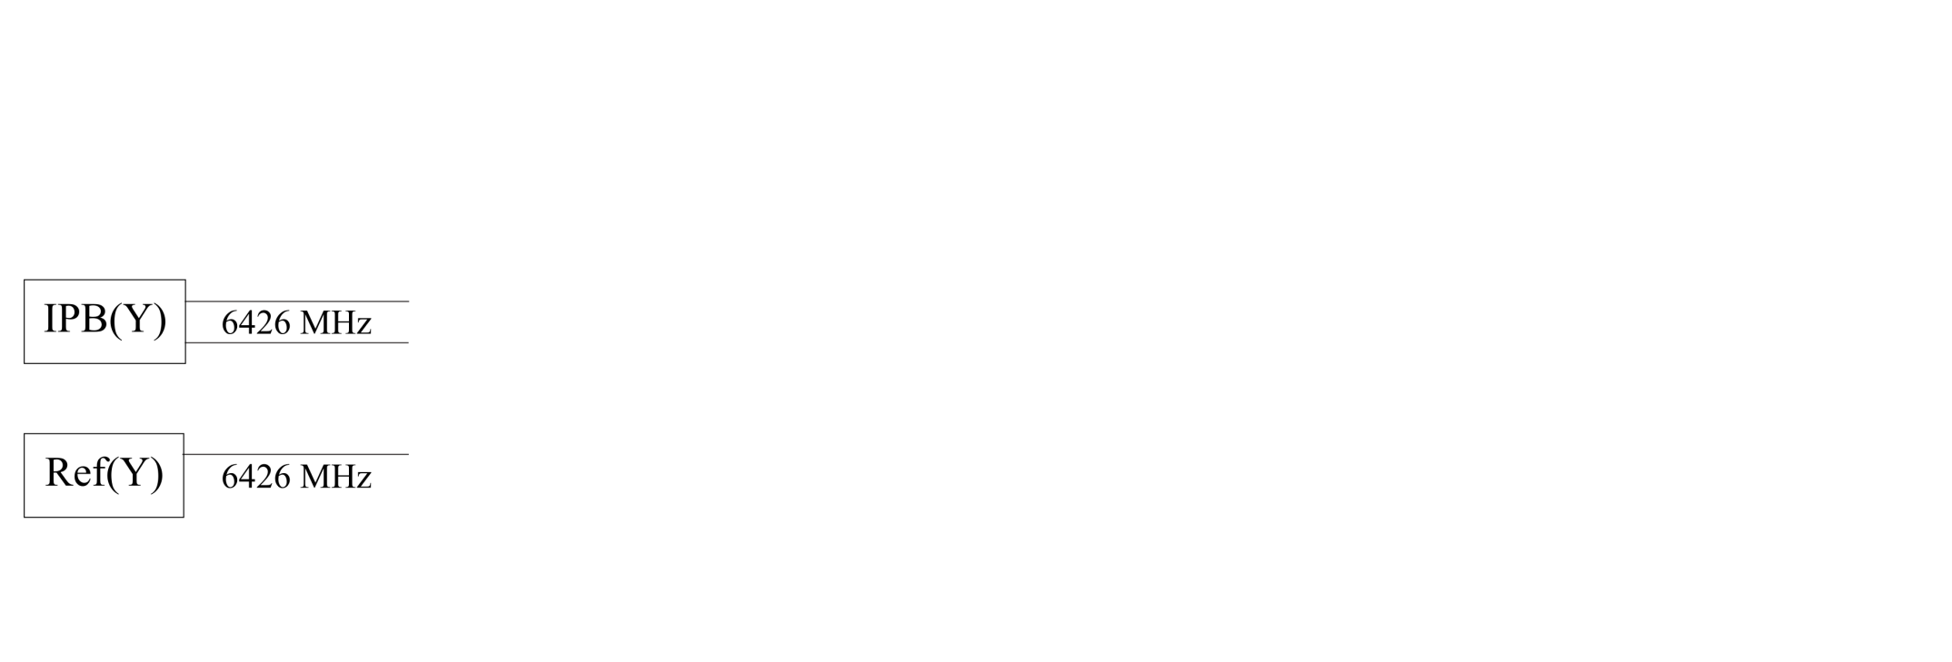
Cavity BPM Signal Processing
IPB cavity
Dipole mode frequency (in y)
~6426 MHz
Reference cavity
Monopole mode frequency (in y)
~6426 MHz
Neven Blaskovic 29

Slide 30
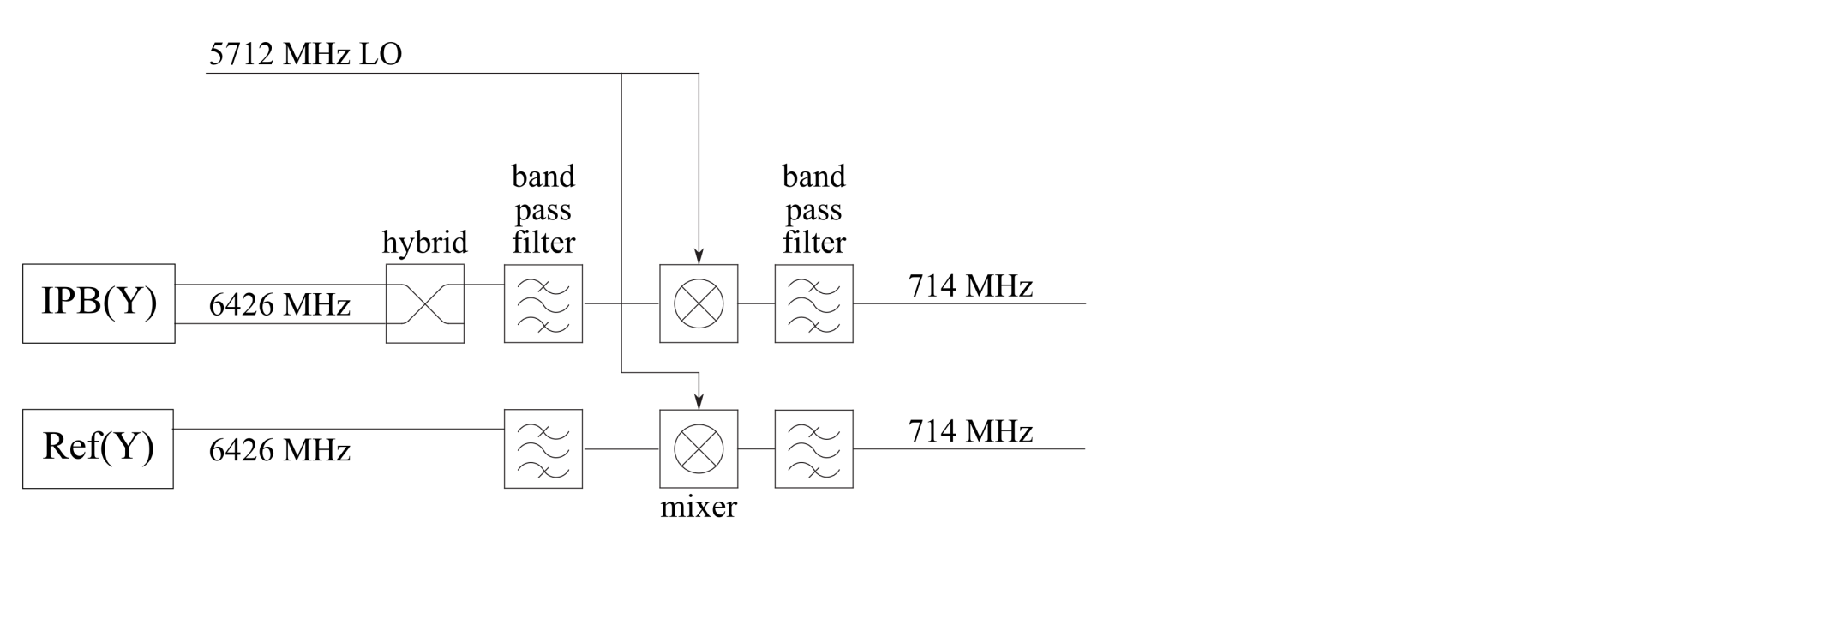
Cavity BPM Signal Processing
simplified schematic
The IPB and reference cavity signals are downmixed using a common, external 5712 MHz local oscillator (LO)
Neven Blaskovic 30

Slide 31
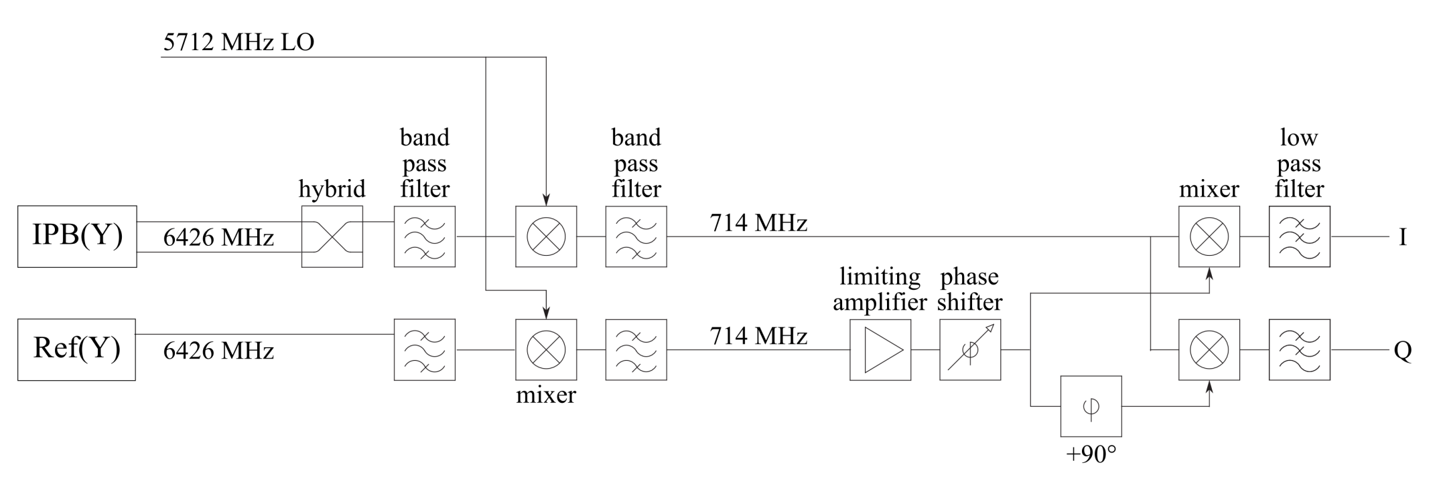
Cavity BPM Signal Processing
simplified schematic
The IPB signal is downmixed using the reference cavity signal as LO
The I and Q output signals at baseband are used to obtain the beam position
Neven Blaskovic 31

Slide 32
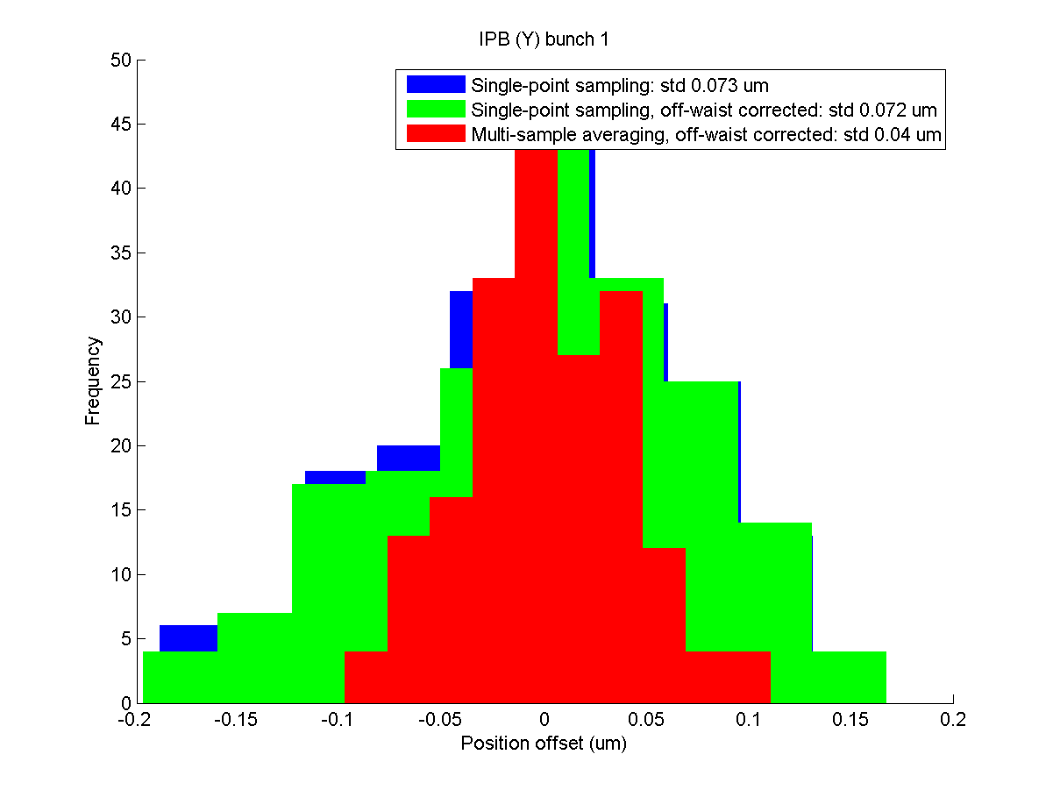
Methods to Improve Resolution
Using multi-sample averaging takes the measured jitter from ~75 nm to ~40 nm
Neven Blaskovic 32

Slide 33
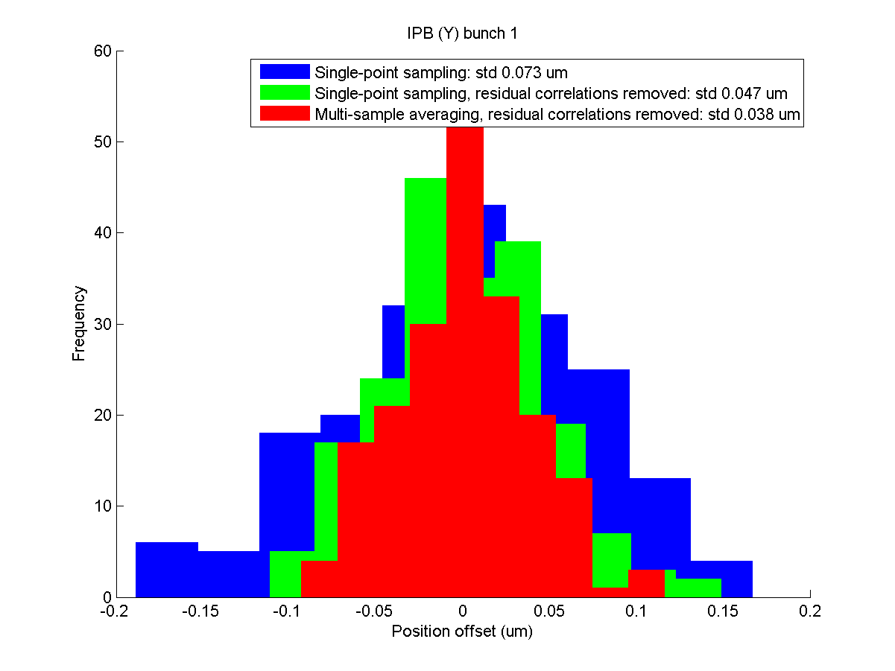
Methods to Improve Resolution
Removing correlation with bunch phase, charge and off-waist BPM takes the measured jitter from ~75 nm to ~50 nm and <40 nm with averaging
Neven Blaskovic 33

Slide 34
Methods to Improve Resolution
On-waist jitter measurement gives upper limit on BPM resolution
Jitter (nm) | Remove correlation with
 | off-waist BPM | bunch phase, charge & off-waist BPM
Single-sample | 76 | 49
Multi-sample | 42 | 39
In green, the level of resolution used in feedback so far
Neven Blaskovic 34

Slide 35
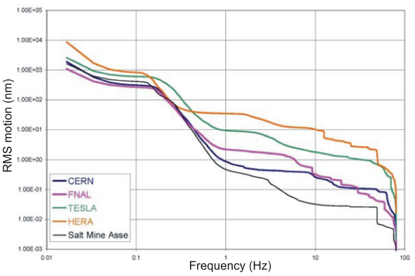
Ground Motion vs. Frequency
Vertical ground motion power spectral density integrated up from a range of cut-off frequencies to give the RMS ground motion as a function of frequency
R. Amirikas et al.
Neven Blaskovic 35

Slide 36
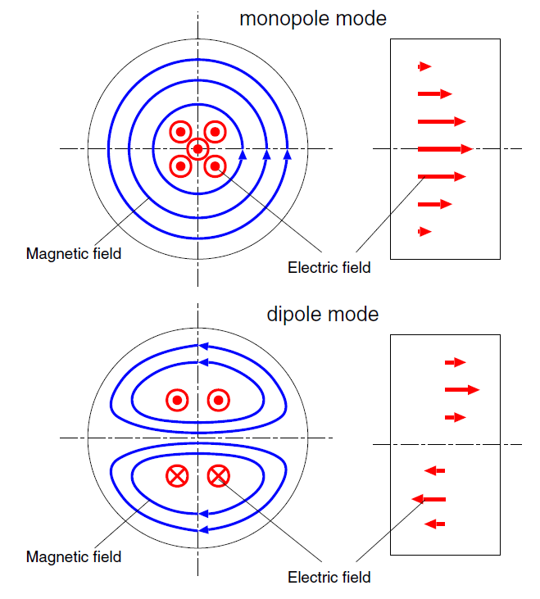
Monopole and Dipole Cavity Modes
Monopole mode
TM_{rφz} = TM₀₁₀
Electric field position independent
Dipole mode
TM_{rφz} = TM₁₁₀
Electric field proportional to position
Y. Inoue et al.
Neven Blaskovic 36

Slide 37
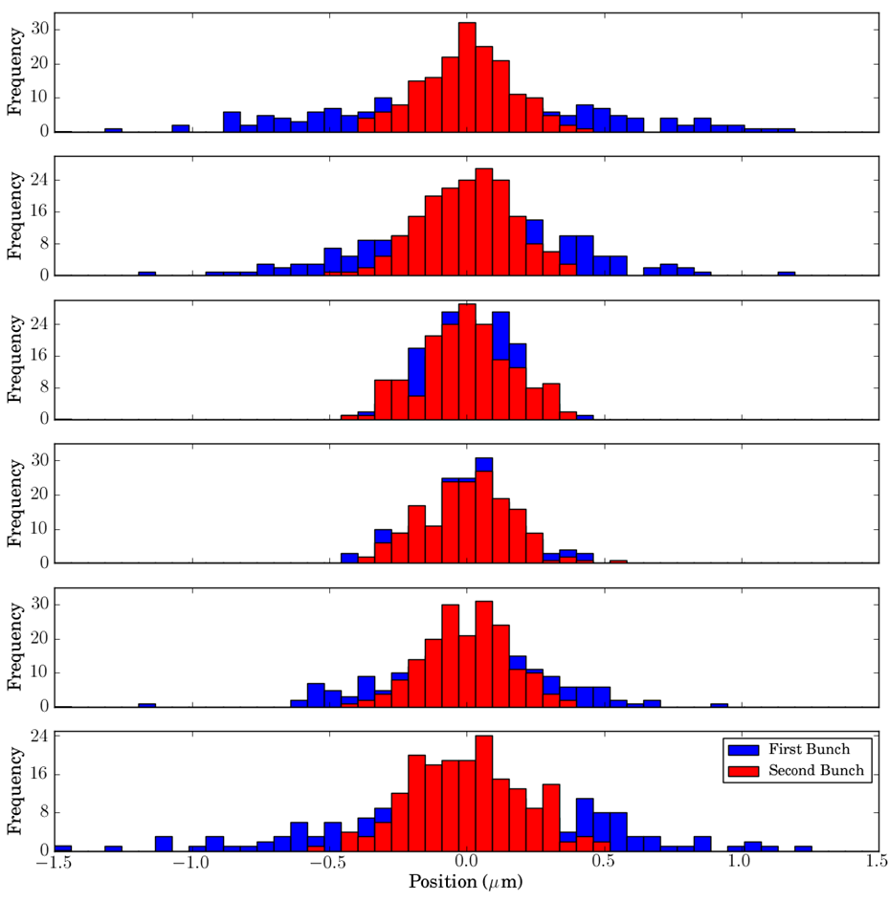
Interaction Point Feedback
first bunch uncorrected
Beam waist scan
second bunch corrected
Neven Blaskovic 37

