Slide 1
FONT5a Tests
16/10/14

Slide 2
Adc Baseline noise

Slide 3
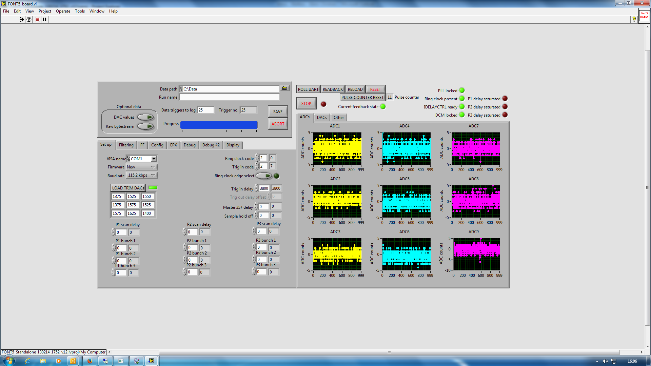

Slide 5
 | Ch1 | Ch2 | Ch3 | Ch4 | Ch5 | Ch6 | Ch7 | Ch8 | Ch9
Mu | 0.95 | 0.84 | 0.91 | 1.26 | 1.07 | 1.19 | 1.00 | 1.24 | 1.26
sigma | 0.03 | 0.02 | 0.03 | 0.02 | 0.02 | 0.02 | 0.02 | 0.03 | 0.04

Slide 7
ADC Integrity checks

Slide 8
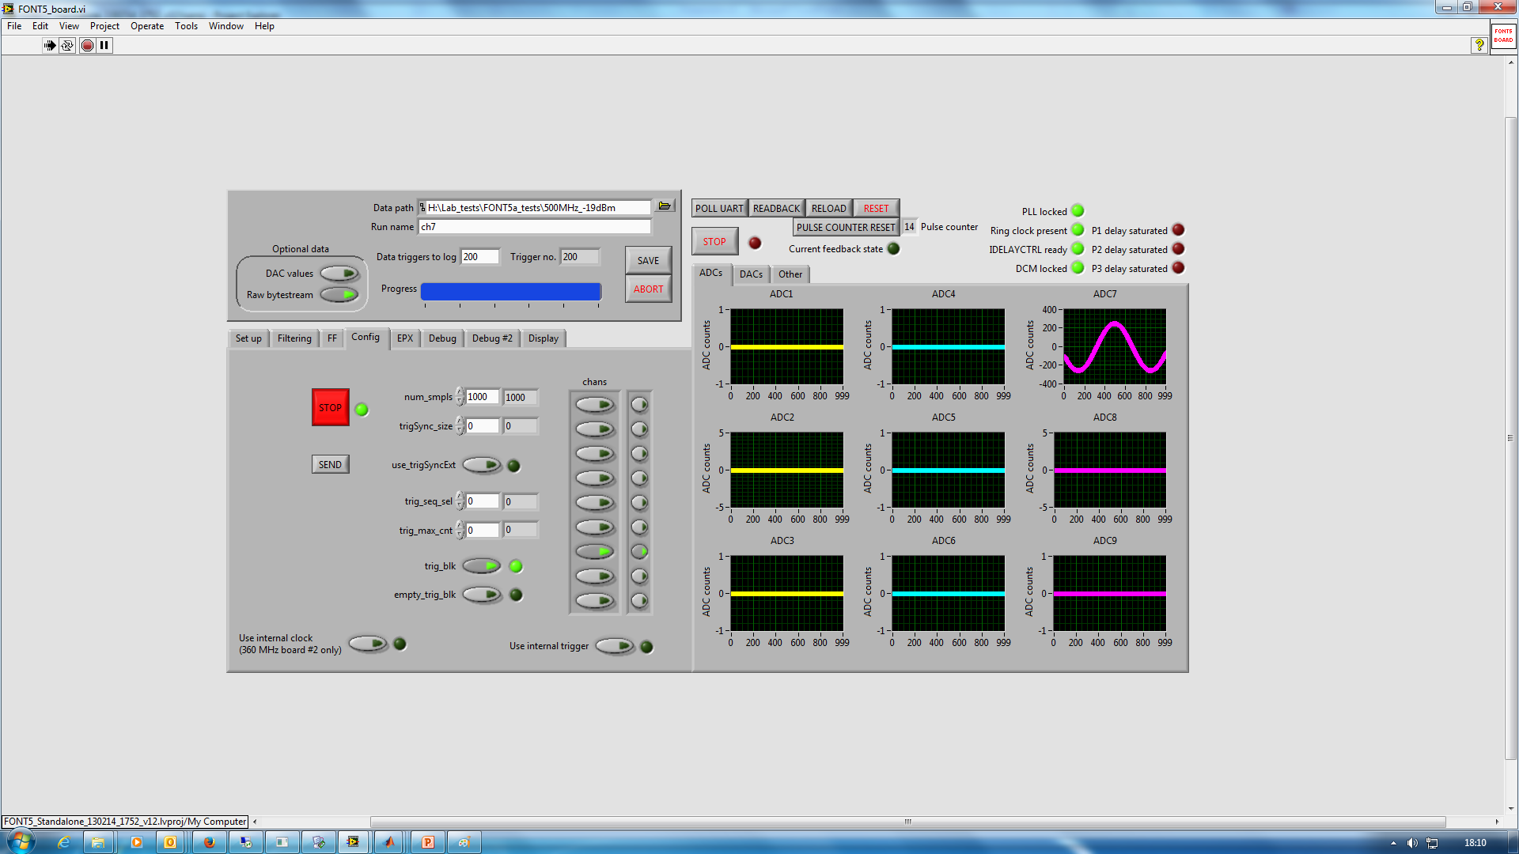

Slide 9
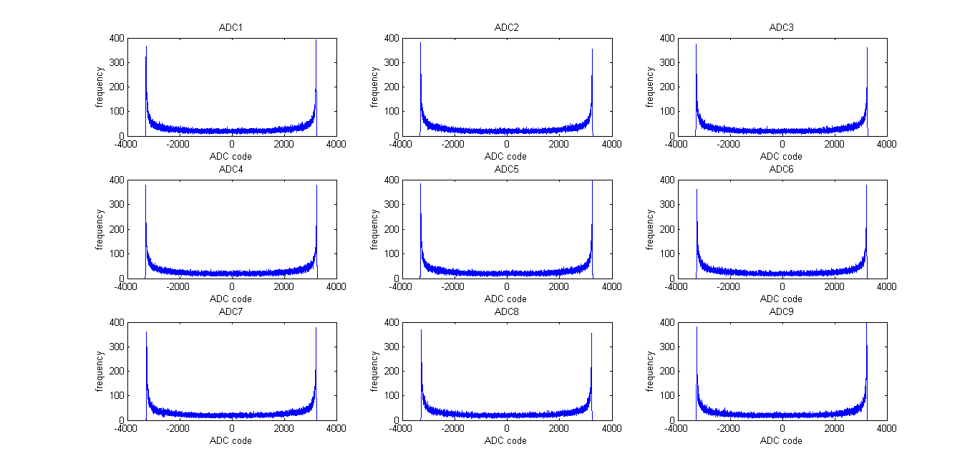
500 kHz, 3 dBm, sine

Slide 10
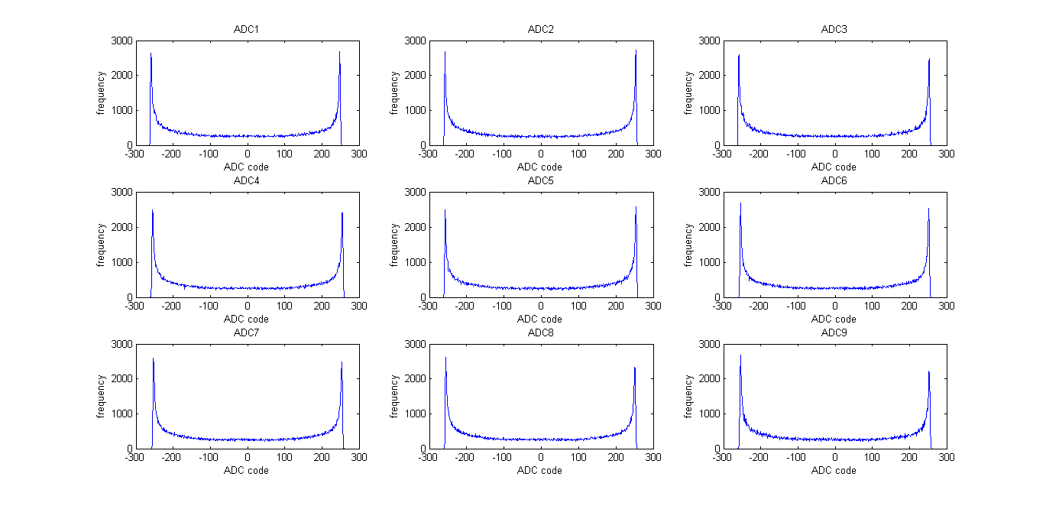
500 kHz, -19 dBm, sine

