Slide 1
Sliding Contact Cooling
Overview:
We will demonstrate that we can control the temperature of a spinning object through heat transfer by contact while using low coefficient of friction materials.
The ANL Tribology section, in a parallel path, will demonstrate and optimize low coefficient of friction material for use in vacuum.
We will combine our results and demonstrate that we can control the temperature of a spinning object through heat transfer by contact while using low coefficient of friction materials in vacuum.
What have we done?
When can we start?

Slide 2
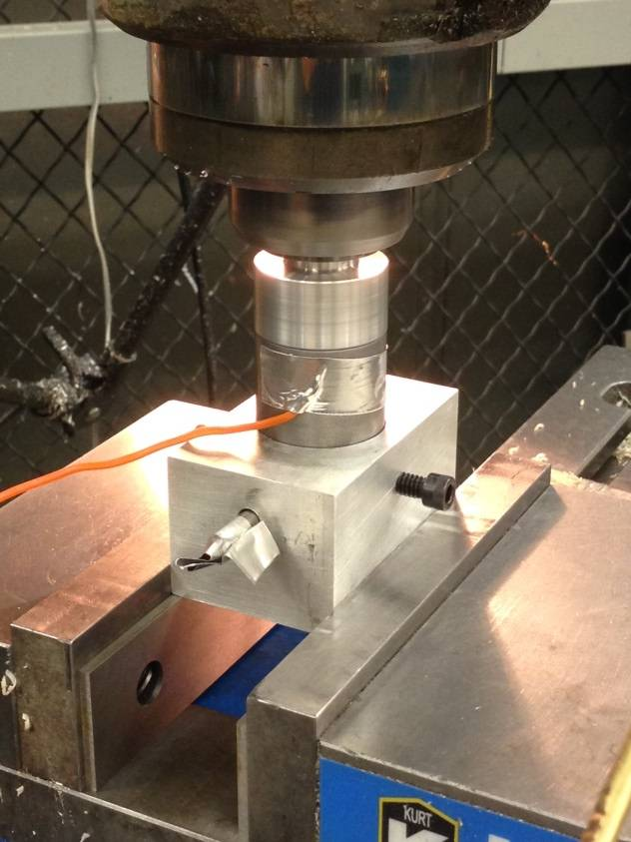
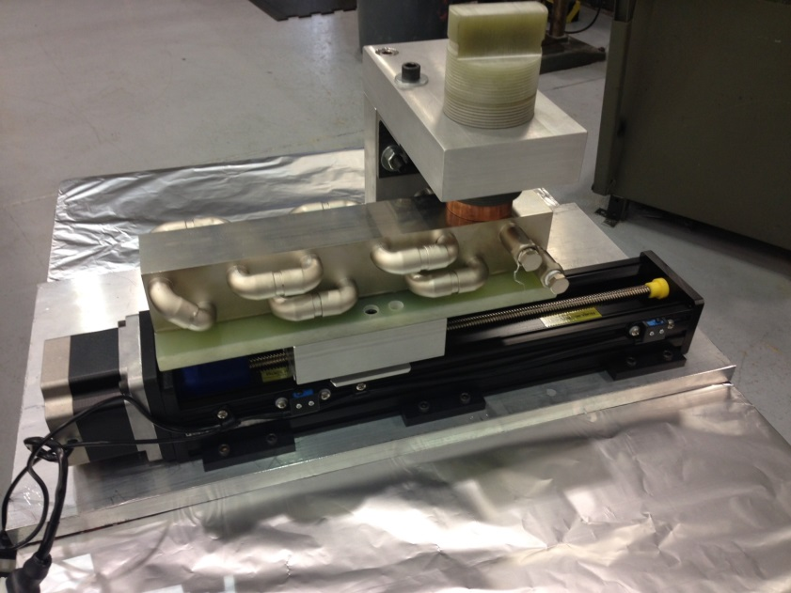
Sliding Contact Cooling
Low Speed Linear Slide Demonstration - Where we were able to control the temperature rise of the copper cylinder by transferring heat (while sliding) from the copper cylinder to the titanium nitride coated copper block the block under the cylinder. We used a cartridge heater in the cylinder and water to cool the block
High Speed Contact Demonstration - Where we successfully spun dissimilar metals together at 1000 rpm for three hours with only moly disulfide coating separating the metals.
Sliding Contact Cooling Preliminary Investigation

Slide 3
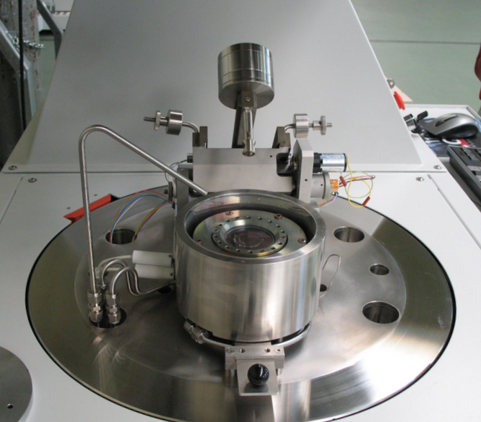
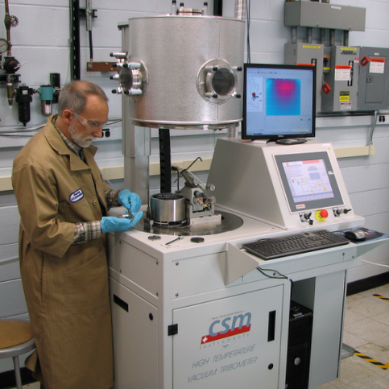
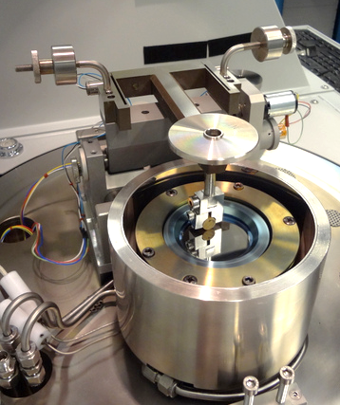
Sliding Contact Cooling
CSM high temperature vacuum, air, N2, CH4 and H₂ Tribometer
Ball sliding against rotating disk
Standard 2” diameter disks
Counterface: ball, cylinder, flat
Accessory holder for 4” diameter disks
Temperature to 800 C
Rotational speed to 2000 rpm
Loads to 20 N
Vacuum to 2e-7 torr
Having already invested several million dollars
in equipment and having years of experience,
the ANL Tribology Group is well positioned to
demonstrate low coefficient of friction and
hardened materials for use in vacuum that
meet our application requirements.
Load
Arm
Friction sensor
Displacement sensor
Disk holder/clamp
Heater
Cooling shroud
Internal view of tribometer
ANL Tribology Section Capabilities

Slide 4
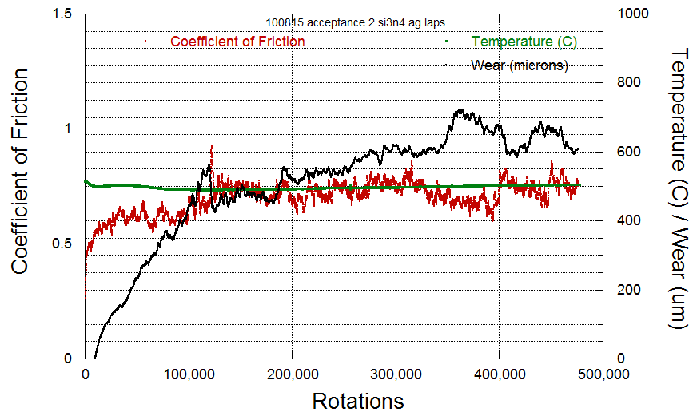
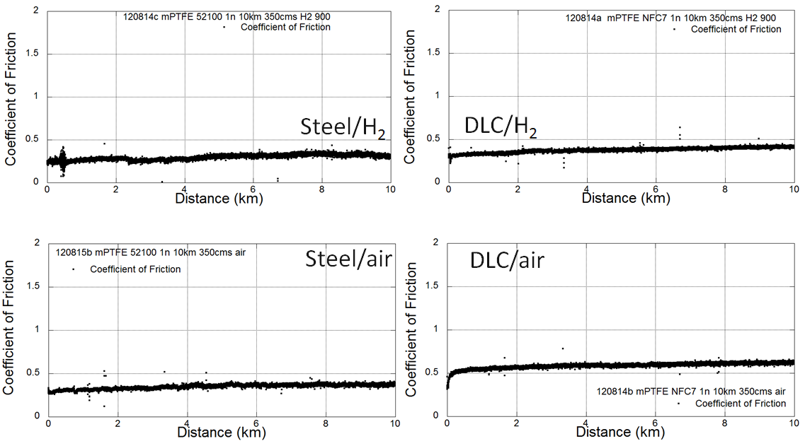
Sliding Contact Cooling
Vacuum Tribometer Typical Data
The test machine is controlled by a computer. These sample graphs give an indication of type of data that the computer acquires for analysis. Acquisition rate is multiple samples/second.
1) Clock time
2) Number of specimen rotations
3) Immediate friction force
4) Vertical displacement (wear)
5) Temperature
Coefficient of friction = (friction force)/(load) and is commonly used to characterize frictional forces in sliding systems

Slide 5
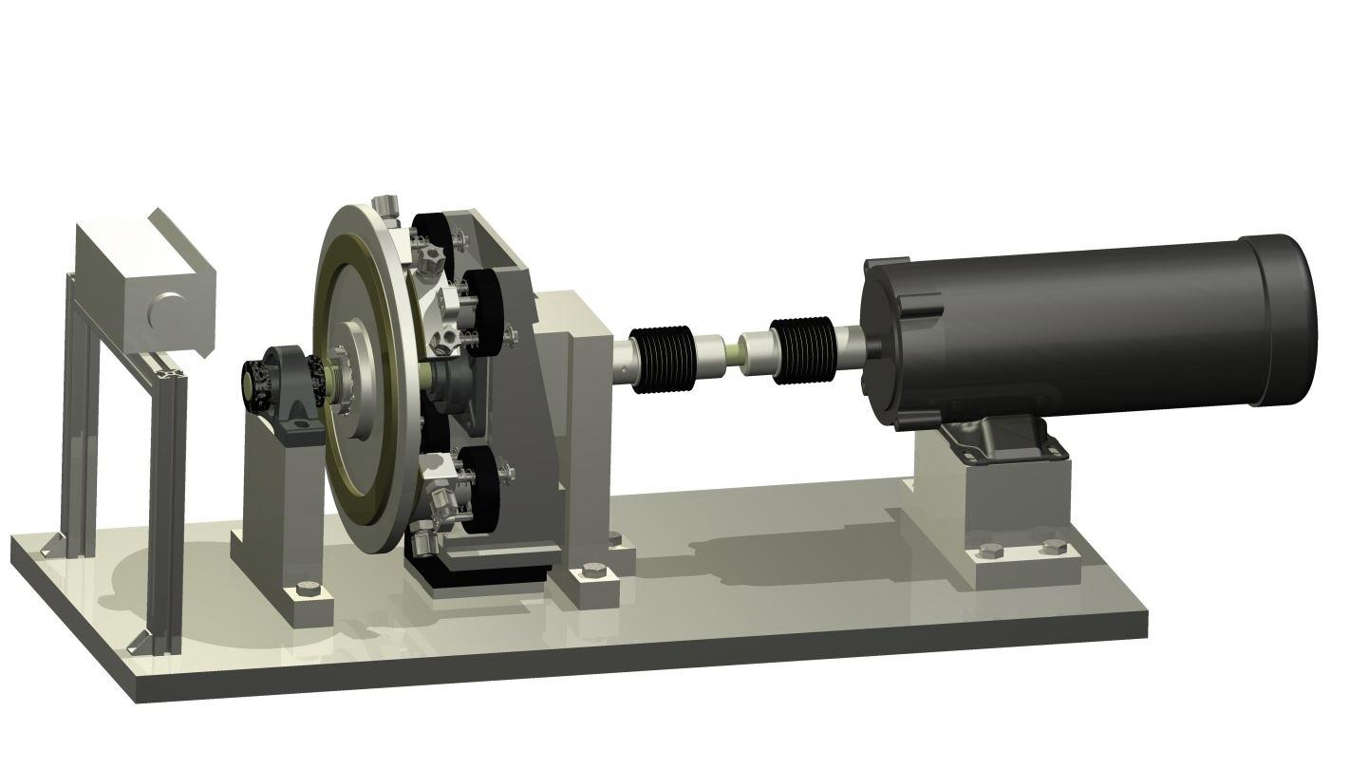
Sliding Contact Cooling
Heater Unit
(moved for clarity)
30cm Dia Disk Shown - Temp Monitored by Infrared Sensor
Water Cooled Contact Pads
Contact Pads Mounted to Motor Controlled Slide with Feedback from Pressure Sensors
Having in house engineering, machine shop, and manufacturing experience, HEP is well positioned to demonstrate heat transfer through sliding contact.
Sliding Contact Cooling Heat Transfer Demonstration

Slide 6
Sliding Contact Cooling
Summary:
Having the in-house cross-discipline expertise, equipment, and manufacturing capabilities, ANL is uniquely positioned to implement and demonstrate that we can control the temperature of a spinning object through heat transfer by contact while using low coefficient of friction materials in vacuum.
Discussion

