Slide 1
High Gradient cavities for the ILC
R&D program @ DESY derived from global effort for ILC and well in phase with effort elsewhere
Motivation and goal
European EXFEL/ILC-HiGrade program
Results of cold RF test of the EXFEL/ILC-HiGrade cavities
Ongoing R&D work
  OBACHT optical inspection of cavities
  Replica surface study
  T-mapping and “Second sound” quench localization
  Centrifugal barrel polishing and local grinding
  Influence of cooling rate on the Q₀ quality factor
  Further work toward high Q₀
Limitations?
Treatment and repair
High Q0
Aliaksandr Navitski *aliaksandr.navitski@desy.de

Slide 2
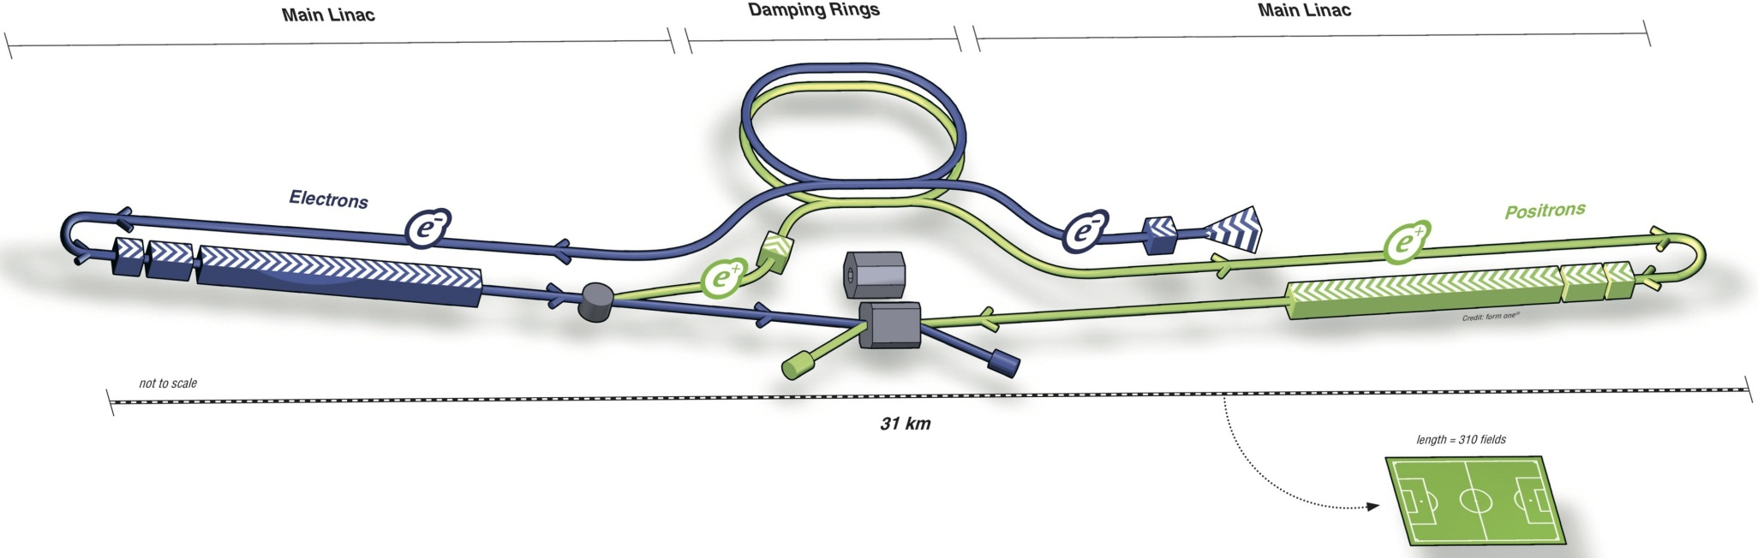
Motivation for high gradient superconducting (SC) cavities:
The International Linear Collider ILC [1]
  Centre-of-mass energy: 500 GeV, 31 km long, TDR 12 June 2013
  16,000 1.3 GHz 9-cell SC cavities capable of reproducibly achieving at least 35 MV/m
  Average accelerating gradient in the cryomodule: E_{acc} = 31.5 MV/m @ Q₀ > 10¹⁰
European X-ray Free Electron Laser EXFEL [2]
  800 SC 1.3 GHz 9-cell cavities, production is ongoing
  Nominal gradient E_{acc} = 23.6 MV/m @ Q₀ > 10¹⁰
  17.5 GeV beam energy, 3.4 km long
International Linear Collider –
Gateway to the Quantum Universe
  An excellent large-scale prototype for the ILC
[1] http://www.linearcollider.org [2] www.xfel.eu

Slide 3
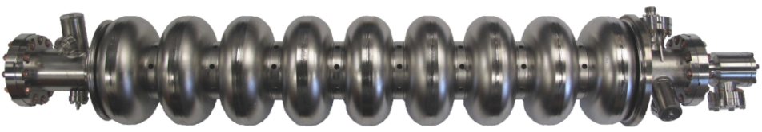
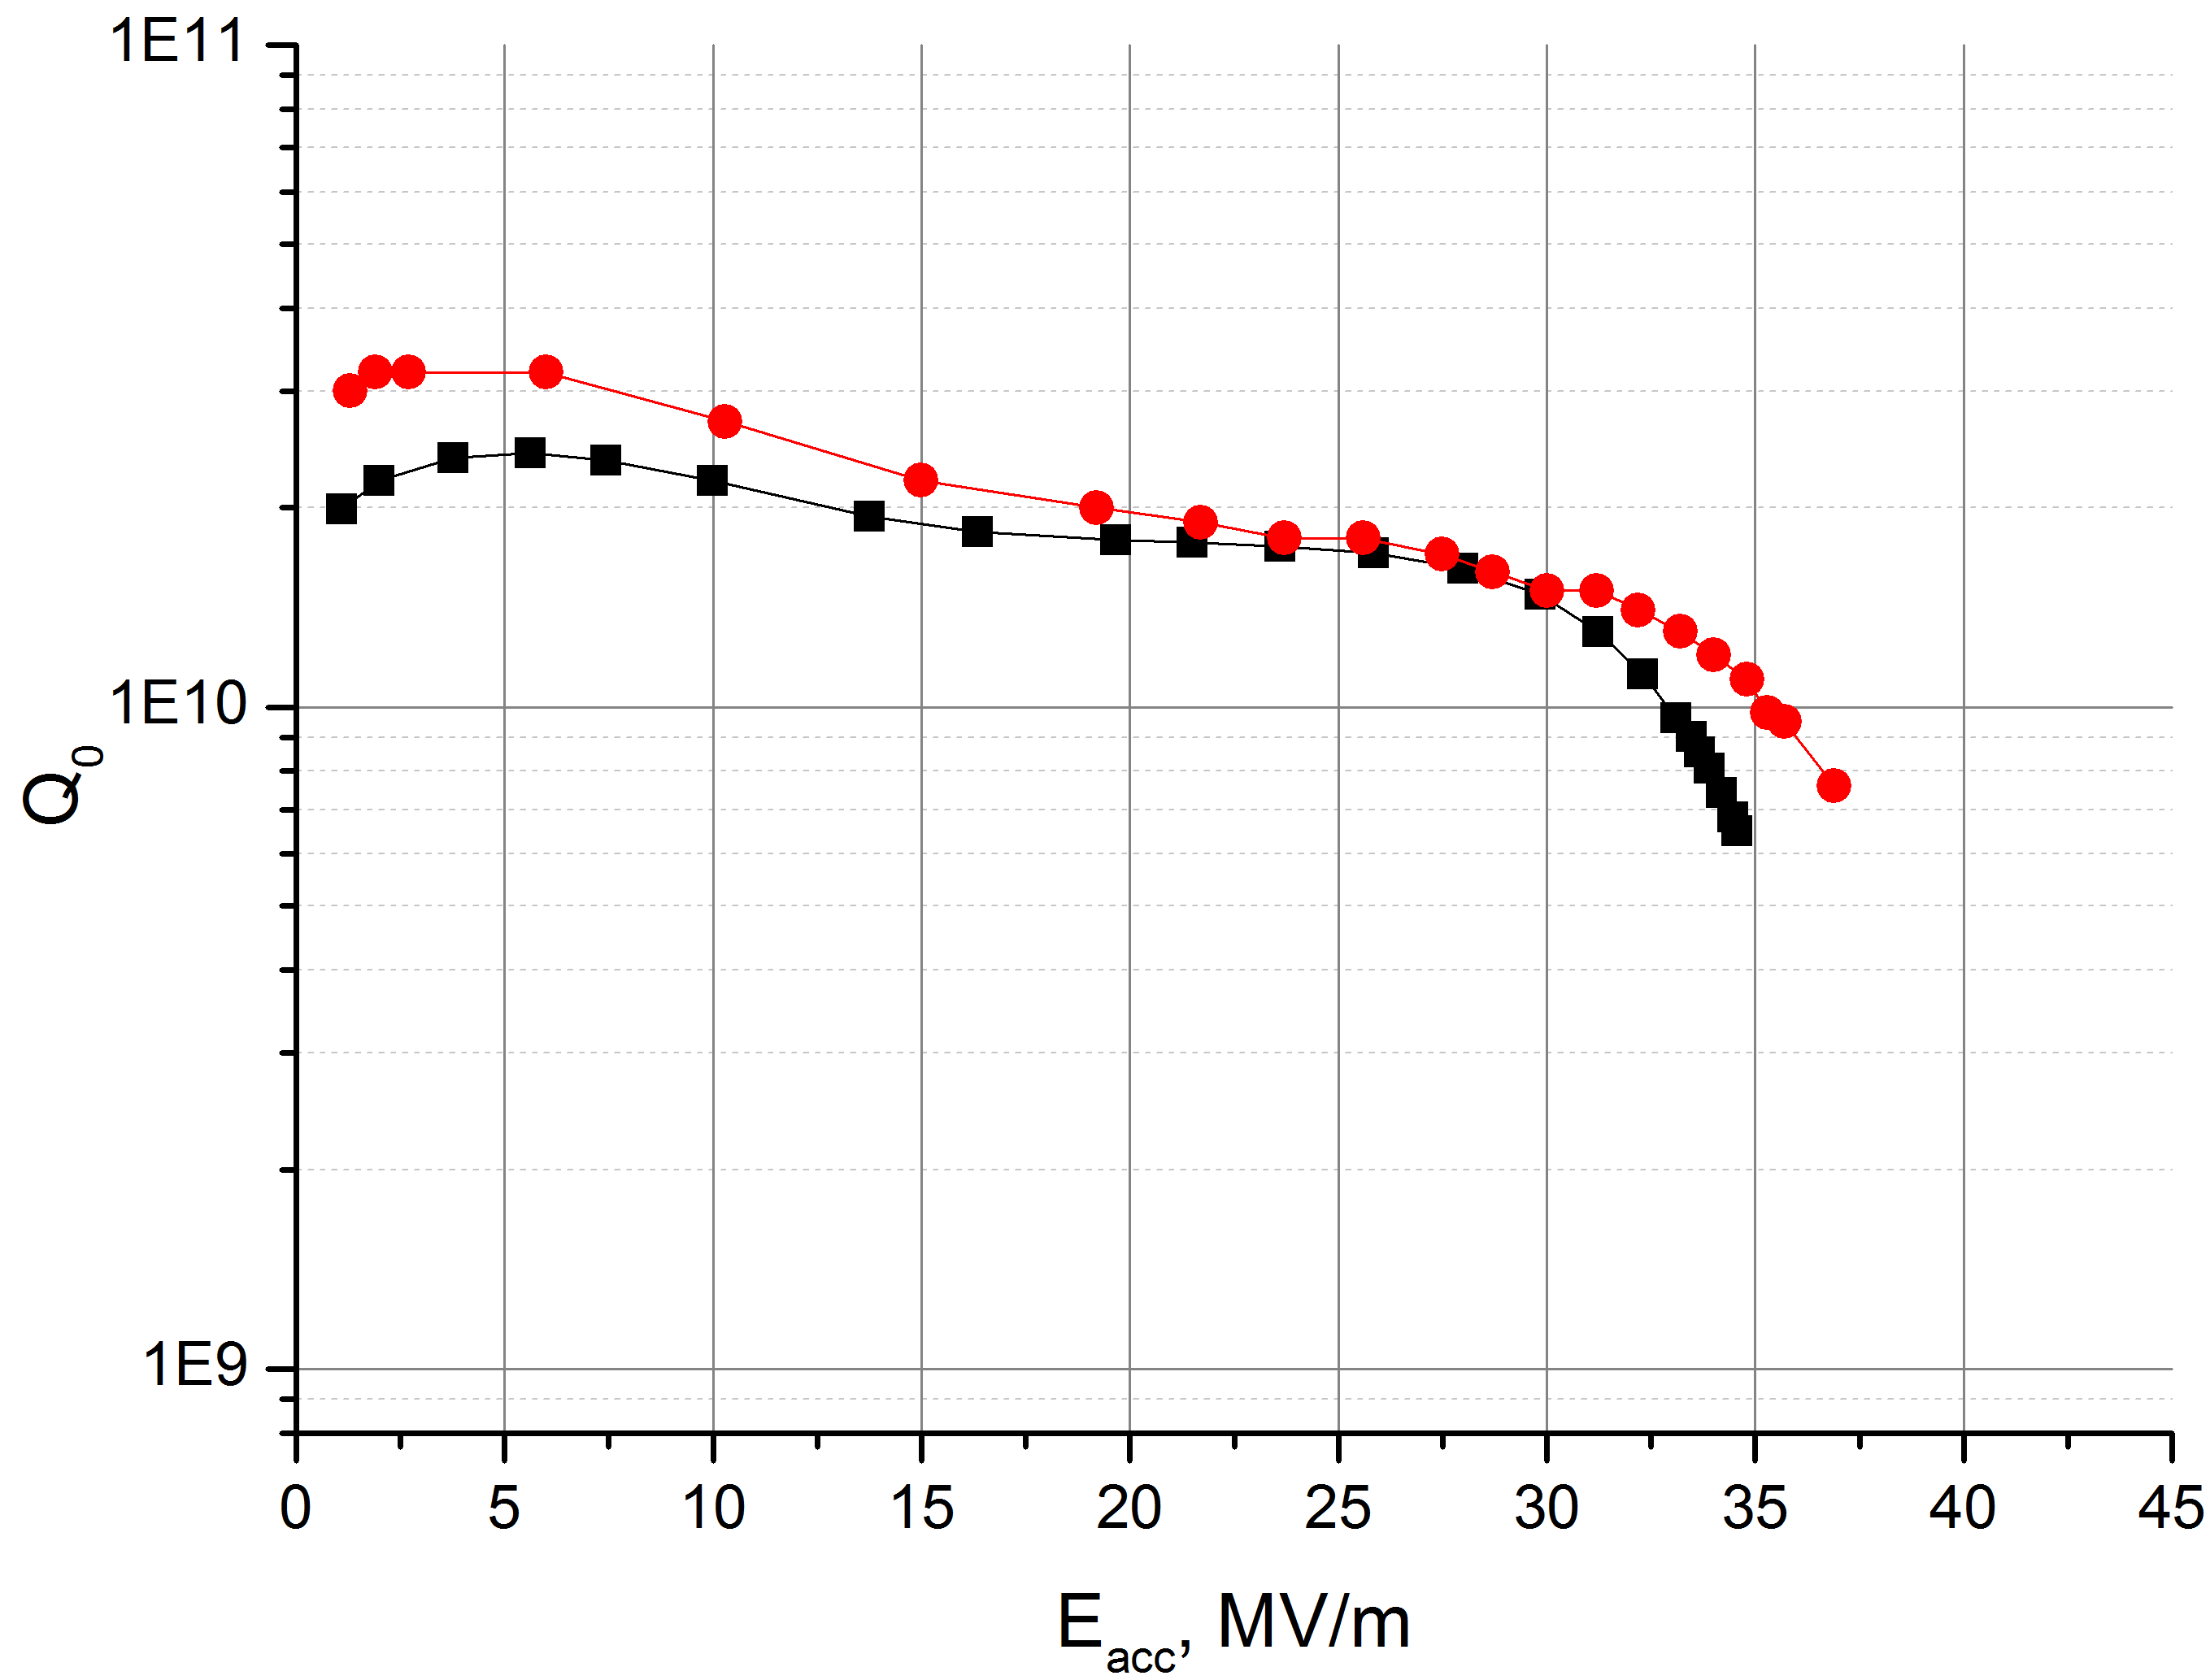
Goal of the SRF R&D
Solid understanding/control of the industrial mass-production process
(with 800 EXFEL +24 ILC-HiGrade cavities)
Clear identification of the gradient limiting factors
Elaboration of cavity treatment providing
at least Eacc > 35 MV/m @ >90% yield
Examples of cold rf tests of the European XFEL cavities
The EXFEL production process has provided cavities with 35 MV/m gradient
Goal:
establish high yield at high field
Improve further the quality control to reduce the retreatment rate
ILC
EXFEL
CAV00532 (■) & CAV00550 (●)
- no FE
- RF power limited at 200 W Pin

Slide 4
European ILC-HiGrade programme
24 cavities are added to the EXFEL order as a part of the ILC-HiGrade program:
Initially, serve as quality control (QC) sample for the EXFEL
- extracted regularly, ~one cavity/month: 22/24 cavities arrived!
- after the normal acceptance test are taken out of the production flow --> R&D
Delivered with full treatment but no helium tank
-> maximize the data output from the test
Further handling within ILC-HiGrade as feasibility study for ILC goal:
- ”Second sound” and T-mapping from the 2nd cold RF test
- Optical inspection (OBACHT) and replica
Further treatment options:
- Centrifugal Barrel Polishing (CBP)
- Local Grinding repair
- additional EP polishing
Eventually aim 3 world record modules from the 24 ILC-HiGrade cavities
22 out of 24 already delivered

Slide 5
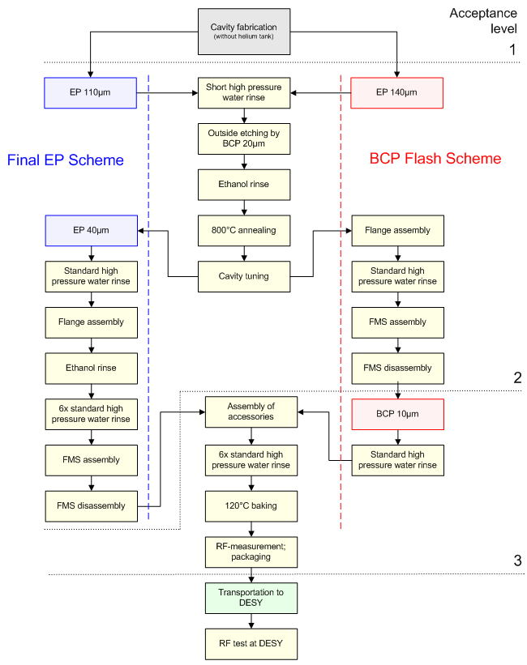
Fabrication scheme of the ILC-HiGrade cavities
“ILC recipe”
Includes all processing steps of the XFEL cavities except helium tank welding
After the RF test -> out of flow Components (e.g. fixed power coupler) disassembled and returned to the contractor as for the XFEL cavities
Further handling is within the frame of the ILC-HiGrade/CRISP program in close collaboration with the XFEL experts

Slide 6
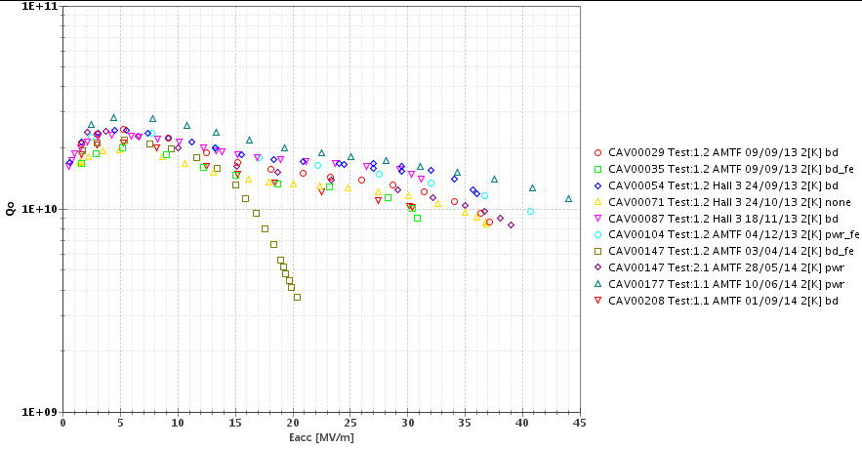
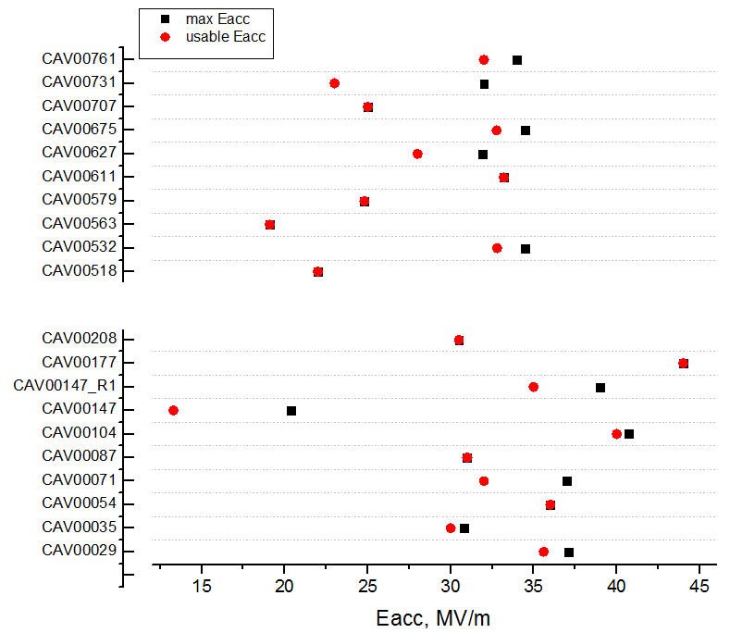
Cold RF results of ILC-HiGrade cavities
+HPR
+HPR
ILC recipe
Definition of usable gradient:
- E_{acc} of quench or
- E_{acc} at Q₀ ≤ 1x10¹⁰ or
- E_{acc} at excess of X-ray radiation:
>0.01 (0.12) mGy/min for upper(lower) det.
“ILC recipe” provides cavities with maximum usable gradient of ~31.9±8.2 MV/m and 34.9±4.7 MV/m after retreatment
some achieve >40 MV/m
- Main limitation is FE

Slide 7
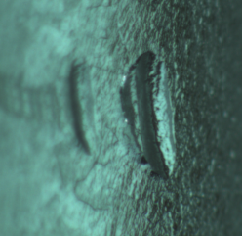
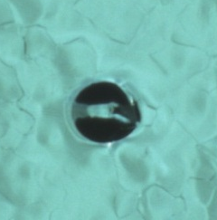
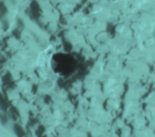
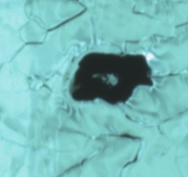
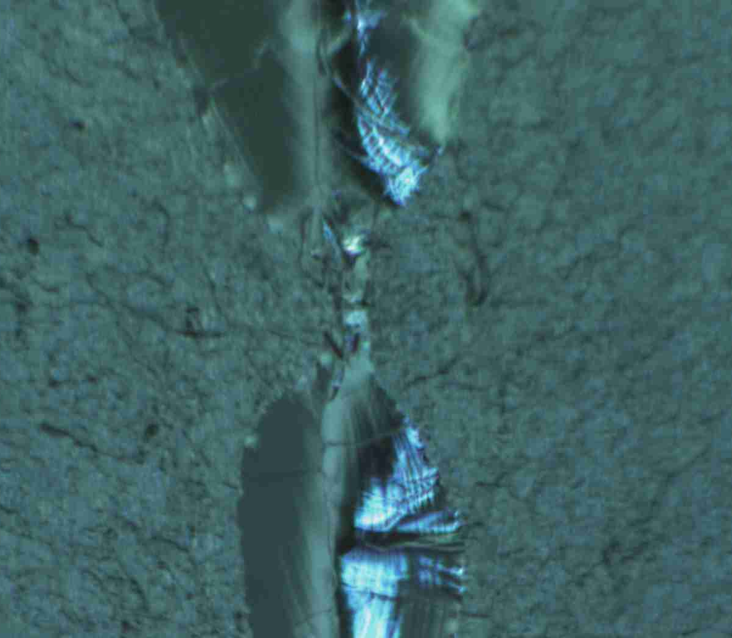
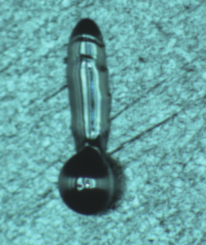
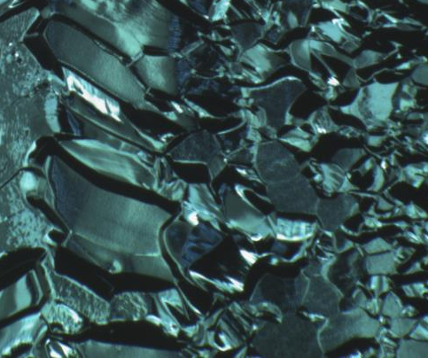

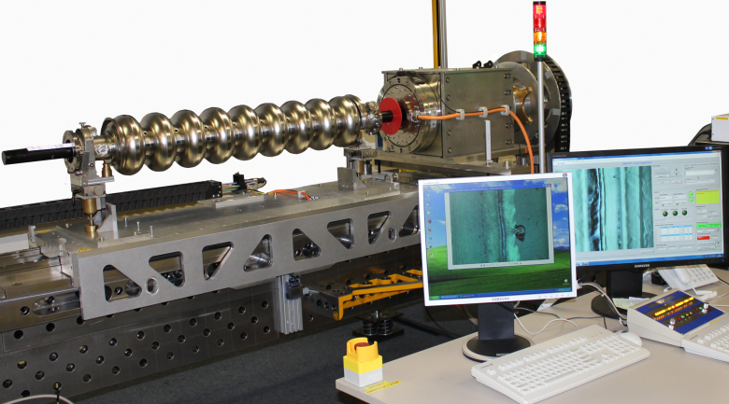
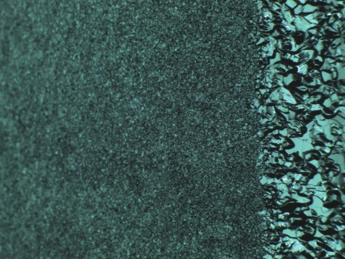
Optical inspection of the cavities
OBACHT (for optical scan of inner cavity surface) is in routine and successful operation for all ILC-HiGrade and suspicious EXFEL cavities
Quality control (-> correct QA scheme is an essential issue)
Valuable feedback to the production
Failure reason clarification
Examples of defects:
Scratches
“Cat eyes”
Pits Inclusions
Incomplete weld
“Spatters”
“Very rough polishing”
1 mm
1 mm
1 mm
1 mm
1 mm
1 mm
3 mm
OBACHT

Slide 8
Progress in quality assurance for industrial cavity production
OBACHT (for optical scan of inner cavity surface) is in routine and successful operation for all ILC-HiGrade and suspicious EXFEL cavities
Quality control (-> correct QA scheme is an essential issue)
Valuable feedback to the production
Failure reason clarification
Examples of defects:
Scratches
“Cat eyes”
Pits Inclusions
Ruled out
Incomplete weld
“Spatters”
“Very rough polishing”
1 mm
1 mm
1 mm
1 mm
Harmless
???
1 mm
Still an issue
Rarely, still an issue
1 mm
Ruled out
Rarely, seems under control, repair required
Similar system/QC at the companies would reduce significantly re-tests and re-treatments by earlier detection
The actual system is to be speedup at least factor 3-4 and automated to be production-friendly
OBACHT

Slide 9
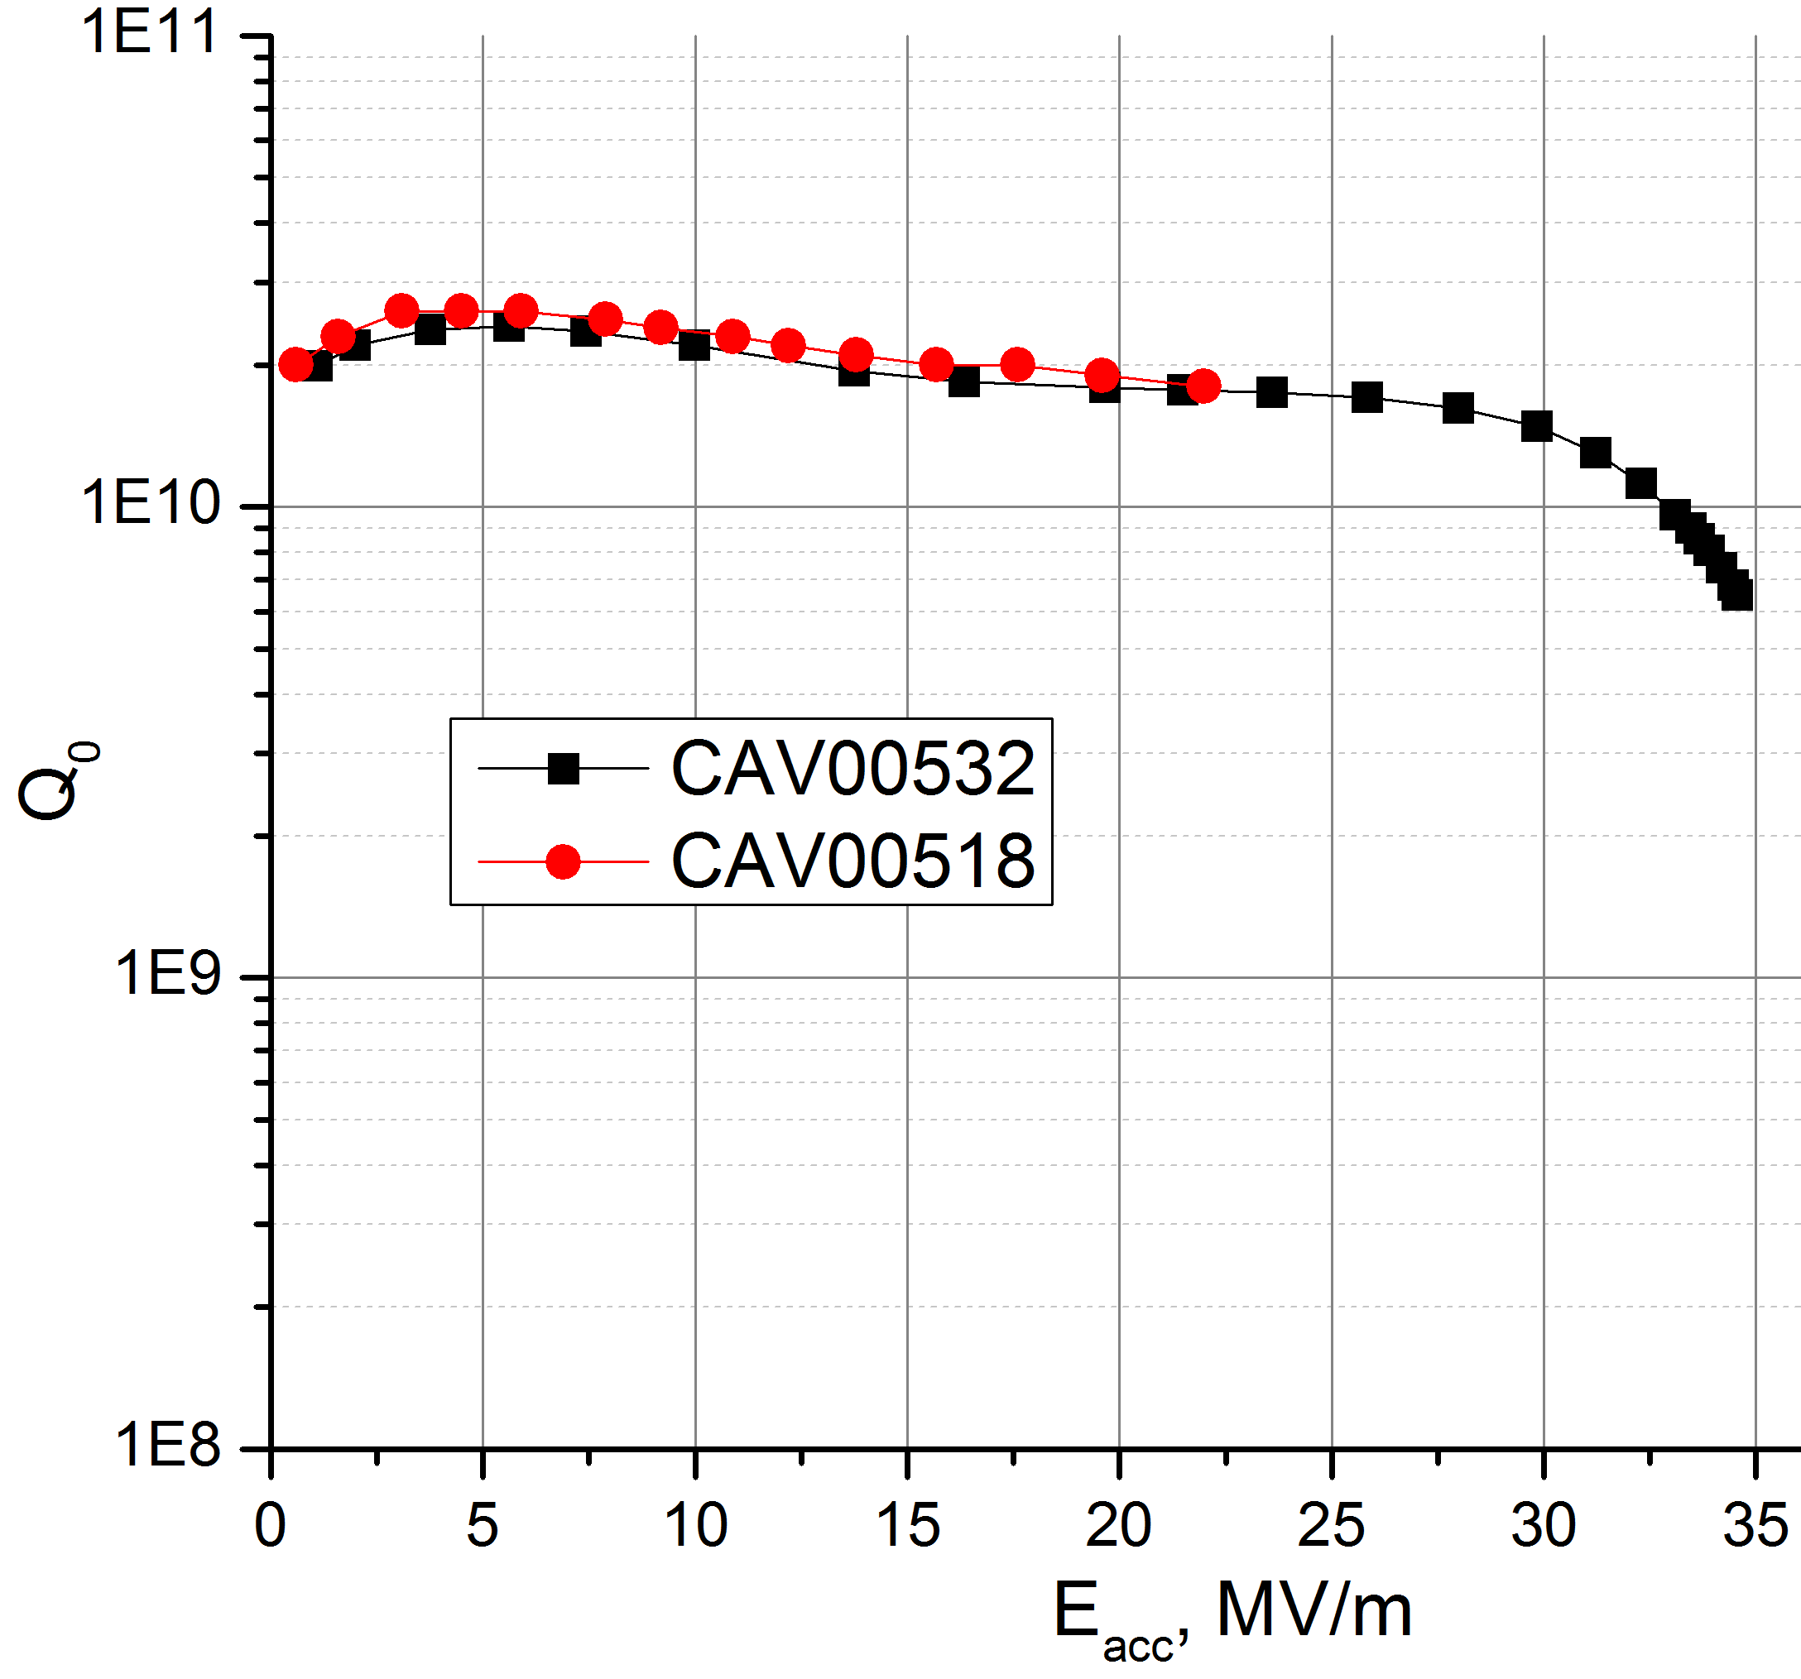
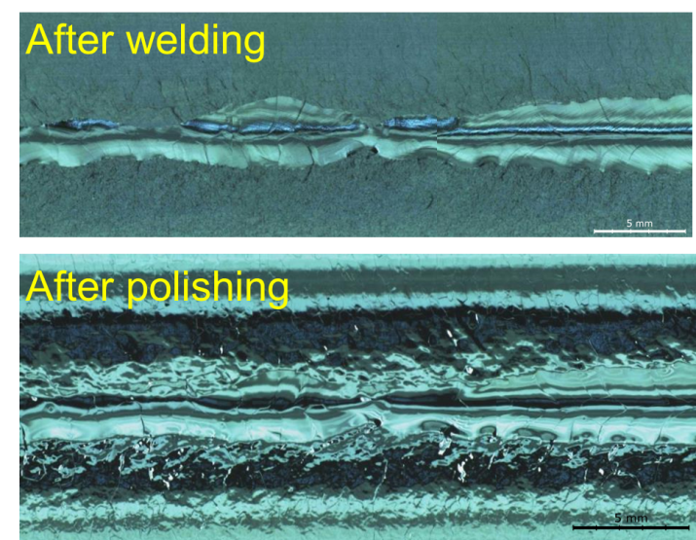
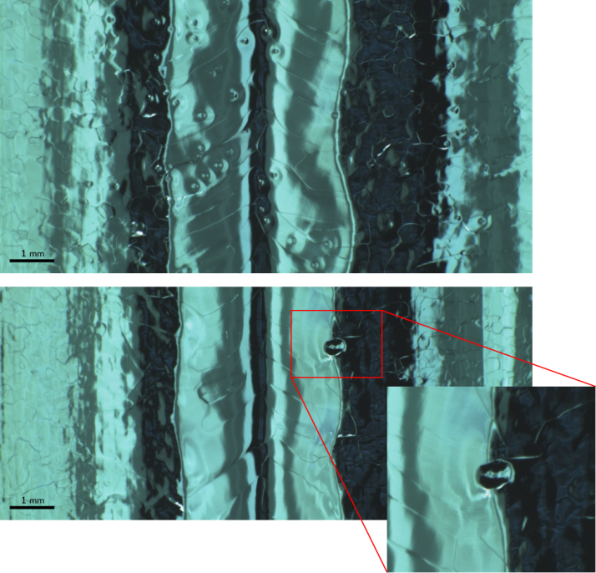
Cold RF tests vs. surface quality
CAV00532:
CAV00518:
→ Successful cold RF test result with no FE, RF power limited at 200W Pin)
→ Unsuccessful cold RF test result with
quench at 22 MV/m, no FE
-> Nice RF result despite of “pits” and “cat-eyes” on the surface
-> OBACHT indicates defective welding as a
possible quench reason
→ Second Sound & T-mapping is applied for the quench localization and further studies

Slide 10
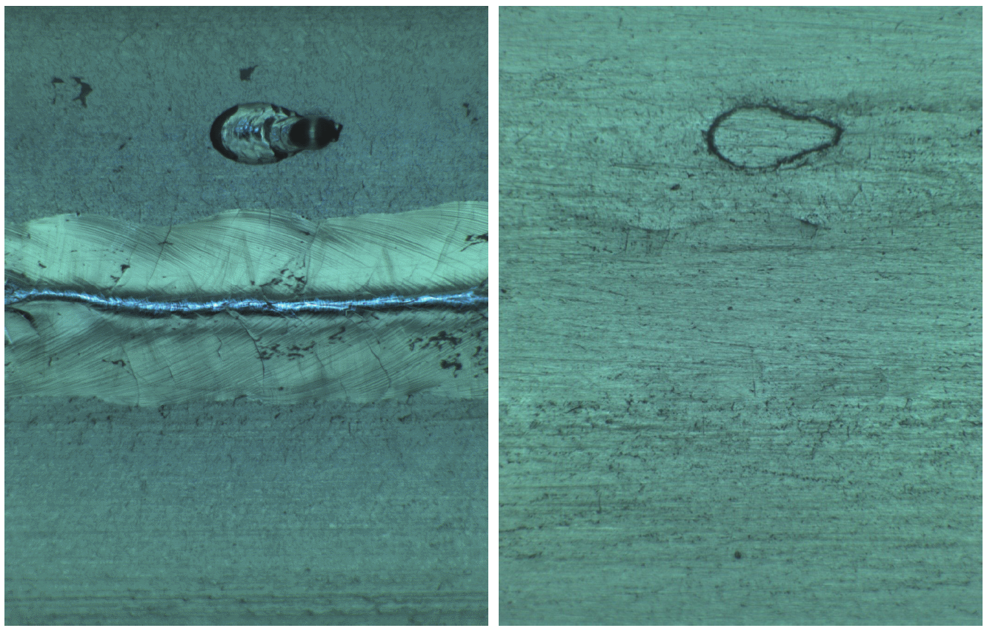
Typical surface defects: welding spatters
Endoscopes & OBACHT (shown here) inspections discover some “spatters” occasional occurring during the welding:
After final polishing:
→ max E_{acc} = 30.5 MV/m
→ no FE
→ reason is under investigation
→ an additional grinding/repair is required
→ optimum repair procedure (here shown a manual one) is under study

Slide 11
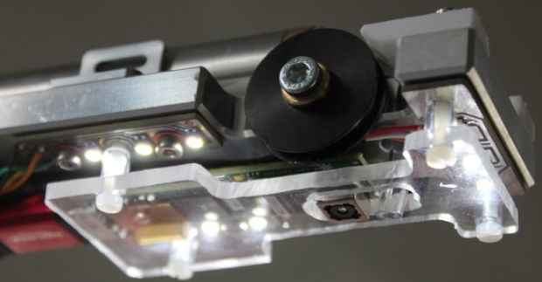
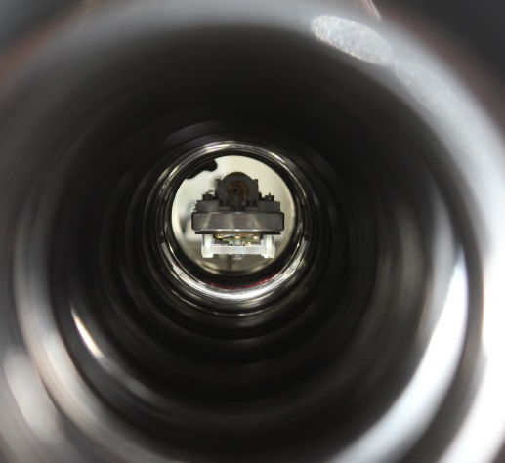
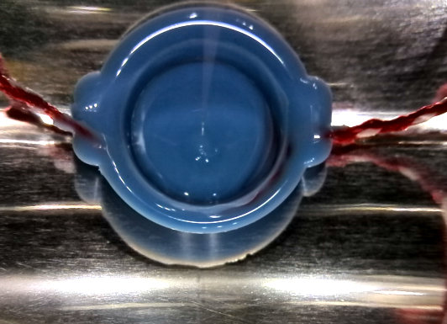
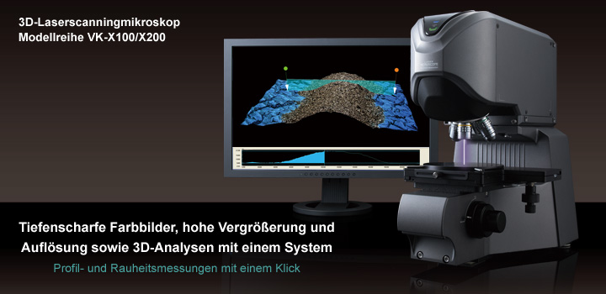
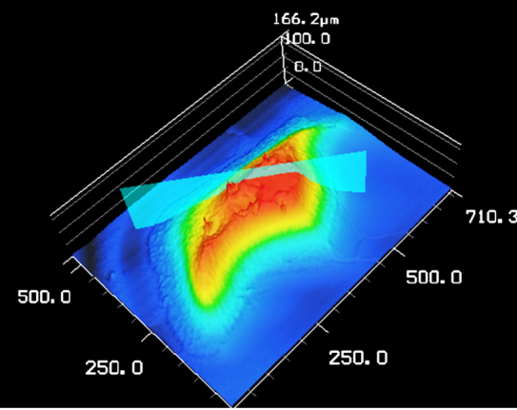
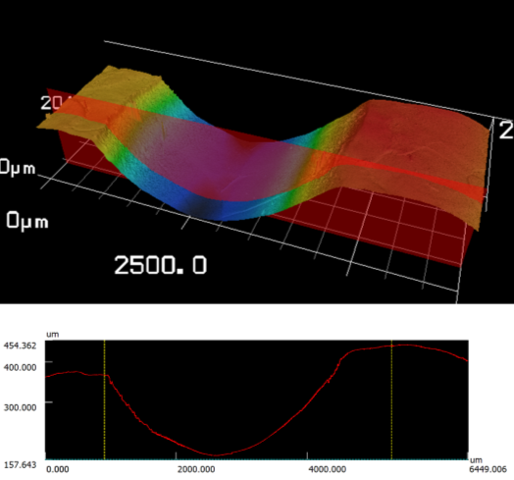
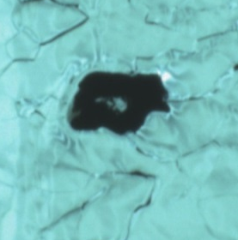
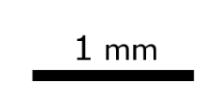
Surface profilometry by using “Replica”
“Replica” setup is used for profilometry studies of inner surface, conspicuous welding seams, and defect areas on cavities
“Replica” tool with camera
Silicon rubber on the surface
“Replica” tool in the cavity
* Keyence 3D Laser scanning microscope
OBACHT + 3D Laser profilometry of a defect and welding seam using replica

Slide 12
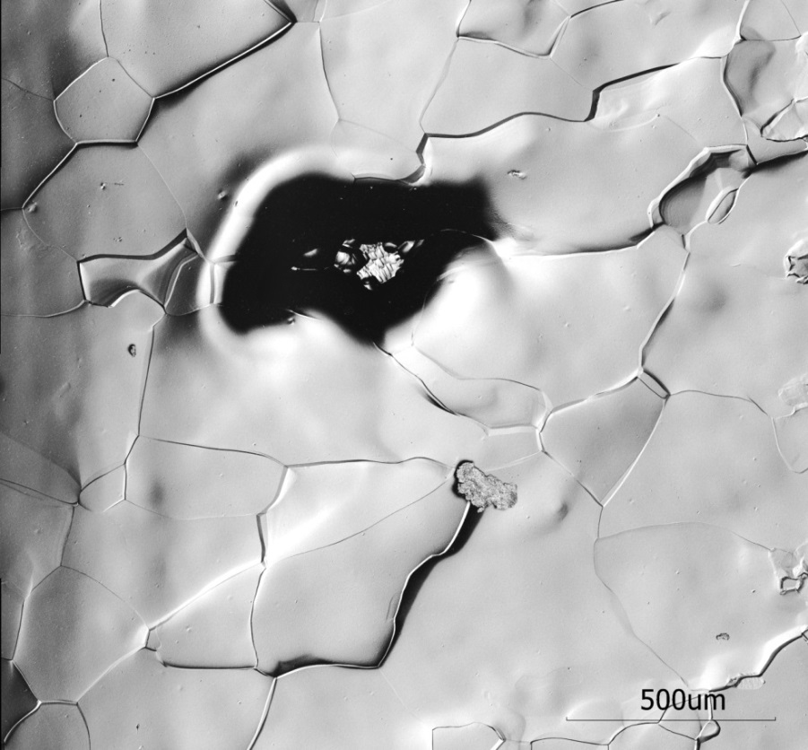
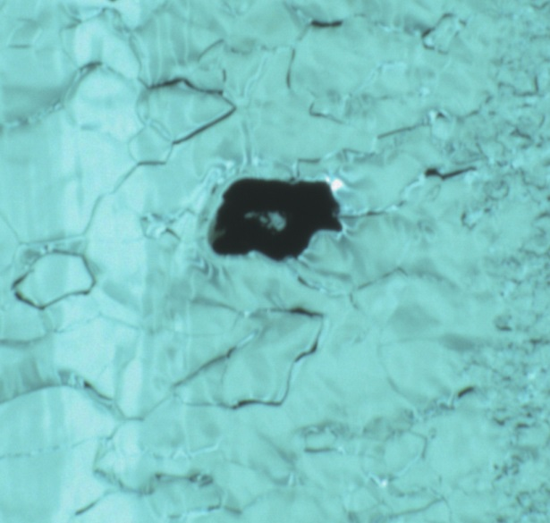
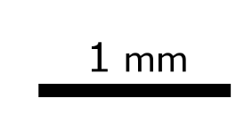

Typical surface defects: foreign inclusions
OBACHT image
C1, 156°
E_{max} = 16 MV/m at low Q-value of 1.6e10
limited by Quench
height of the defect is ~124 µm
Most probably a foreign inclusion not affected
by polishing
No inclusion was seen by Eddy current scans

Slide 13
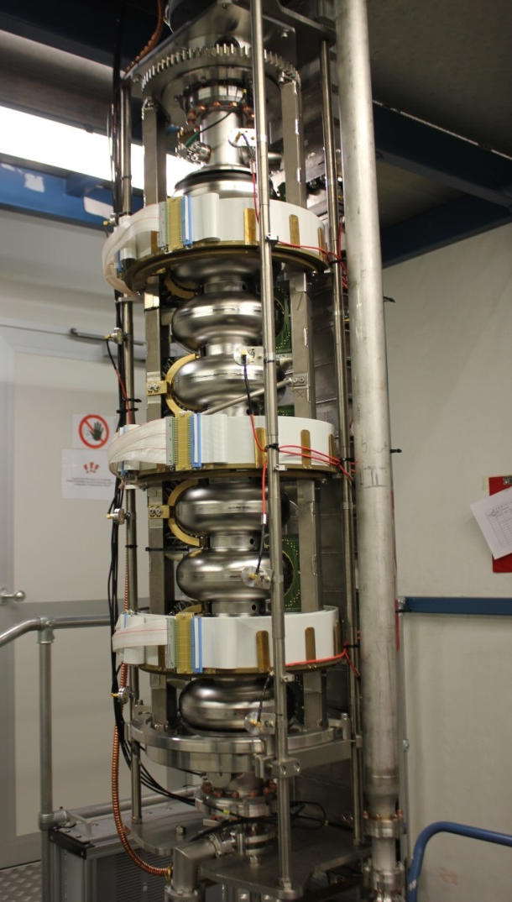
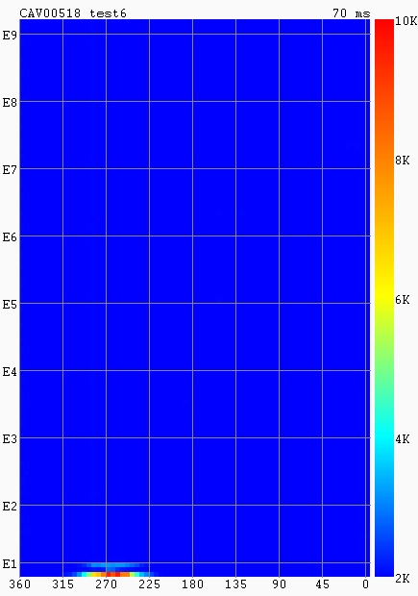
Quench localization: T-mapping
The new “Rotating temperature mapping” system for detection of local cavity surface temperature during the 2K RF test
Quench at 24MV/m
Localized on the E1, 270⁰

Slide 14
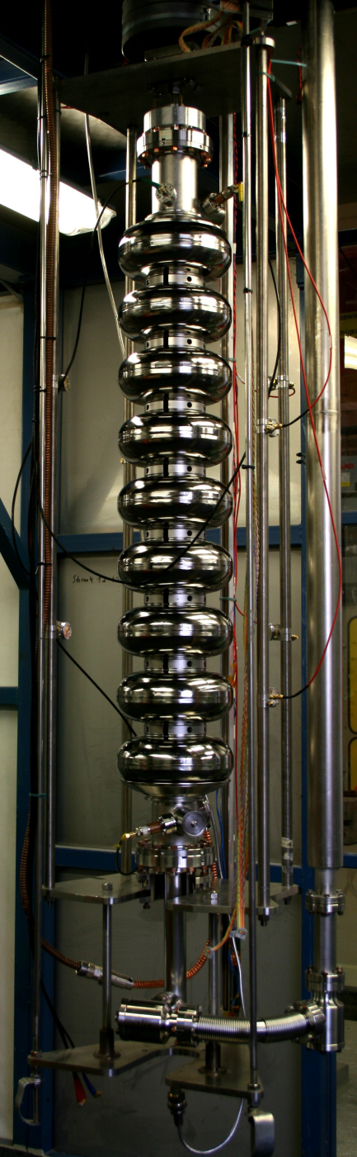
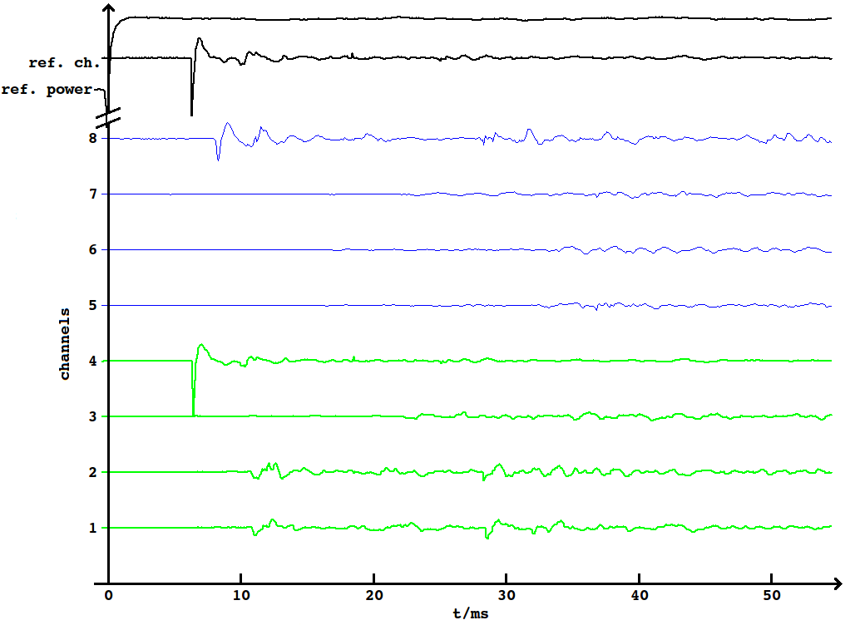
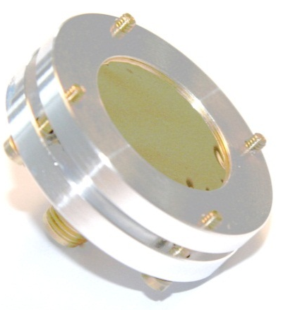
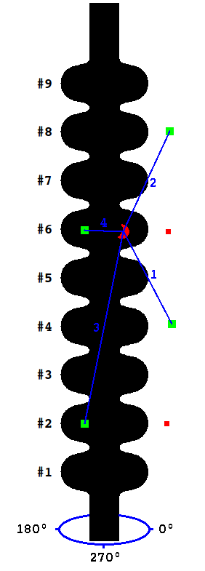
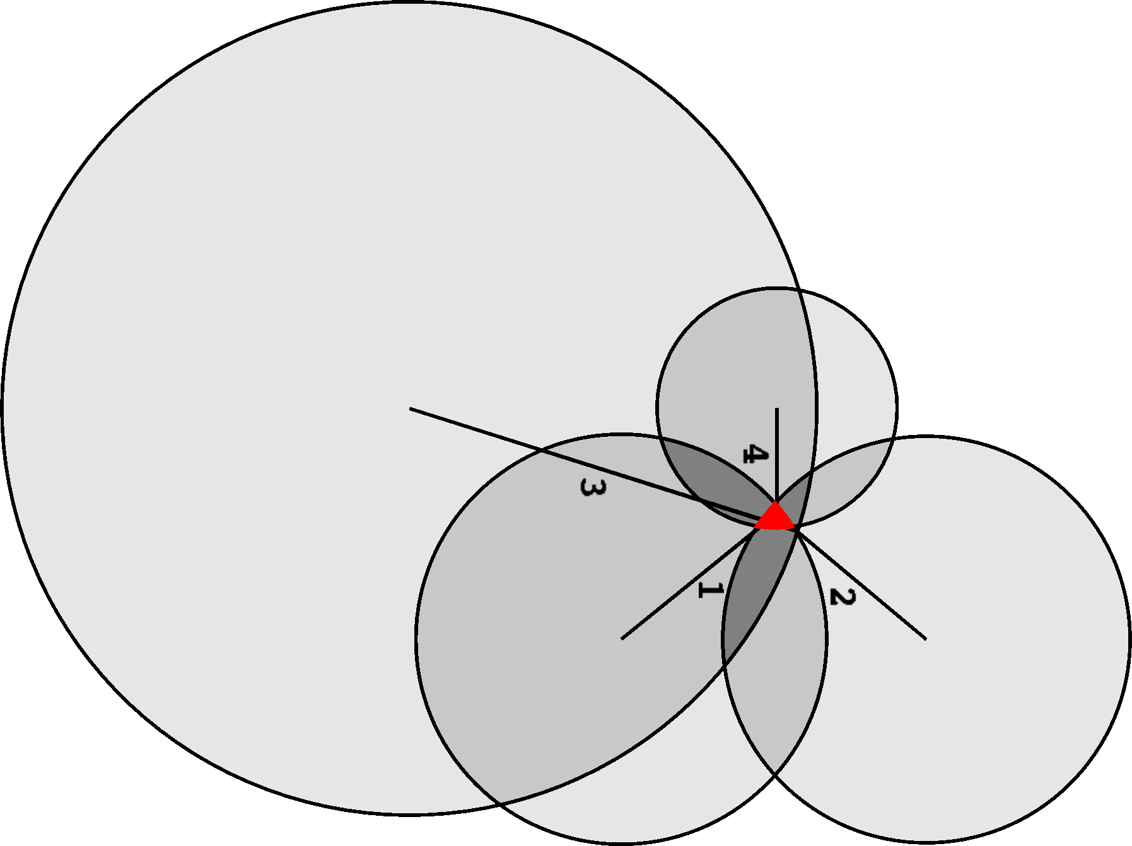
Quench localization by “Second sound”
OST signals
16x
x ~20 m/s
Schematic drawing of determination of the
intersecting volume
Calculation result
* F. Schlander, PhD Thesis 2013

Slide 15
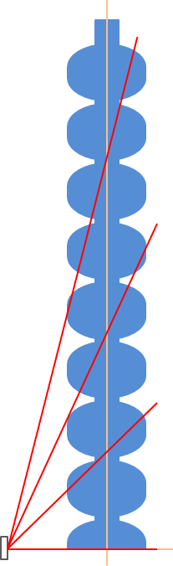
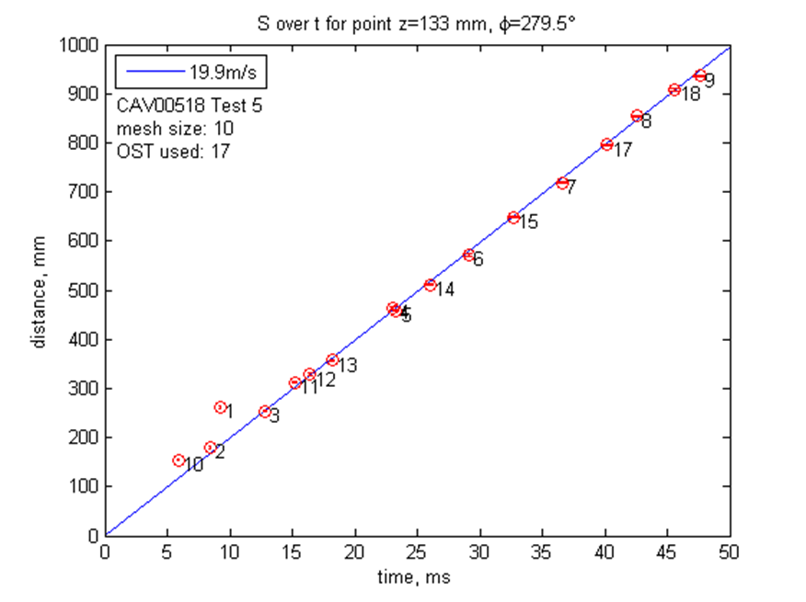
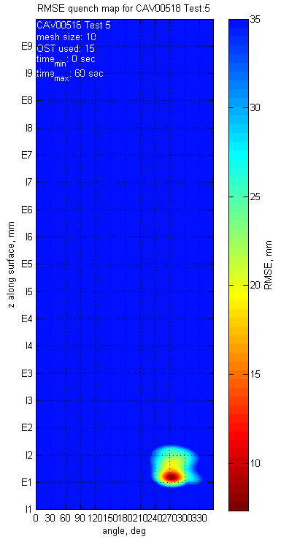
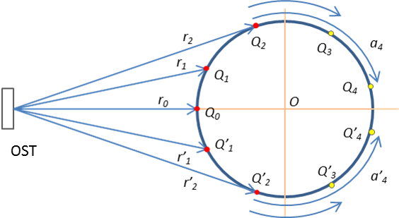
“Mapping” new approach the 2nd sound quench localization
Calculated distance
Heat propagation effect
measured time
All signals are fitted by the 2nd speed (19.9 m/s at 1.8 K)
The region with the lowest fitting error shows the most
probable quench position
angle
15

Slide 16
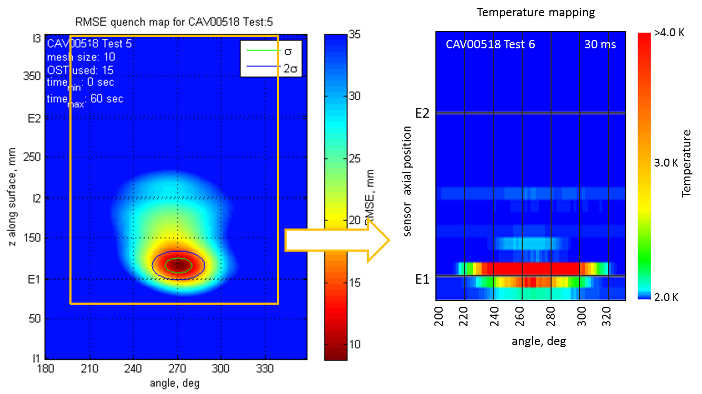
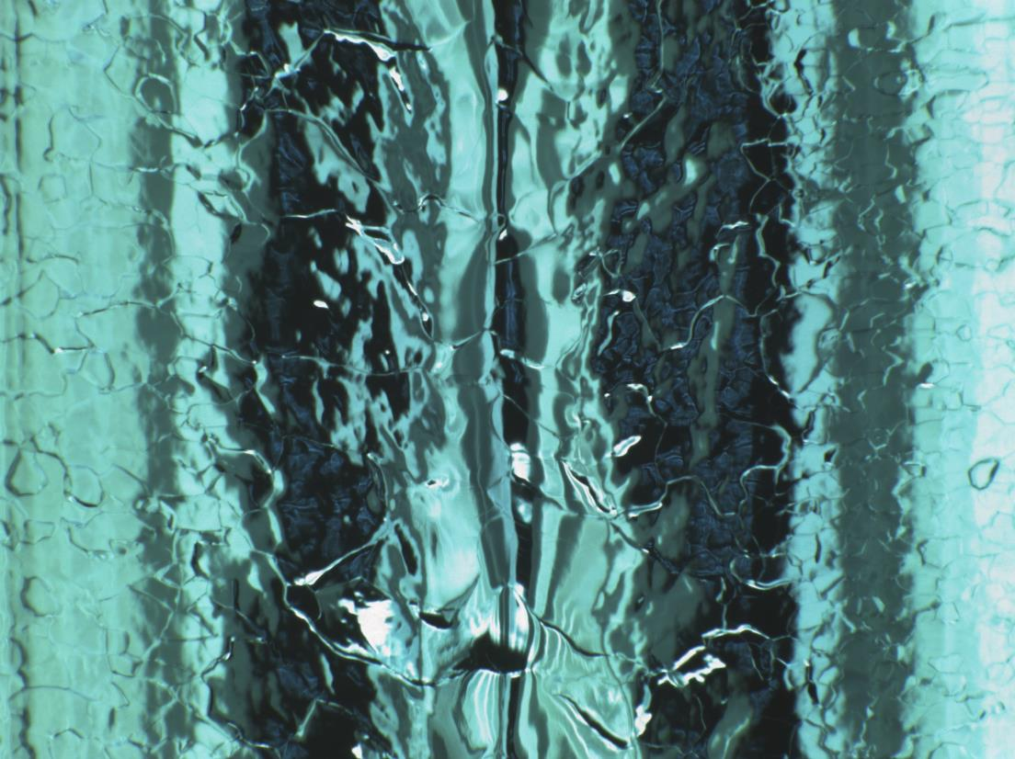
T-mapping vs. Second sound
Second Sound map
T-map
OBACHT
Quench at 24MV/m, localized on the E1, 270⁰
Good agreement between T- and 2nd-sound mapping
OBACHT indicates defective welding as a possible quench reason

Slide 17
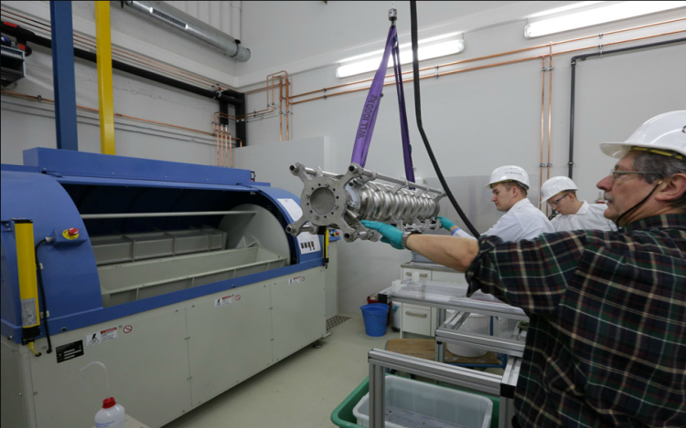
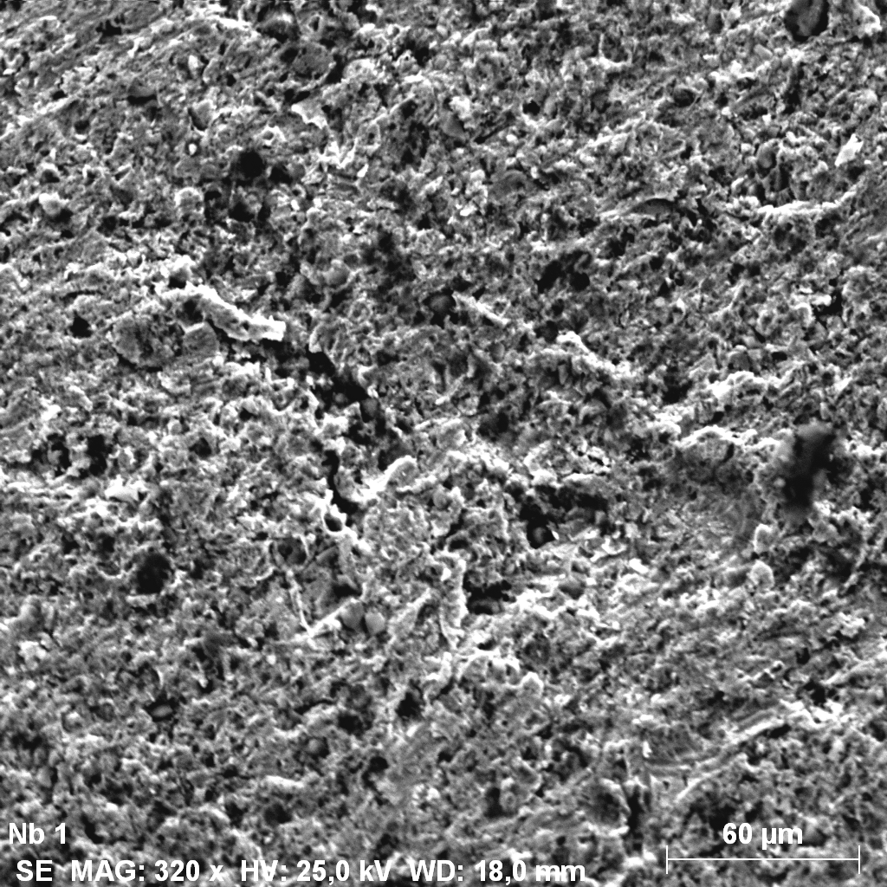
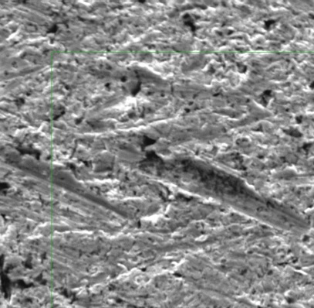
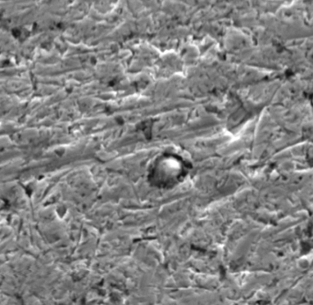
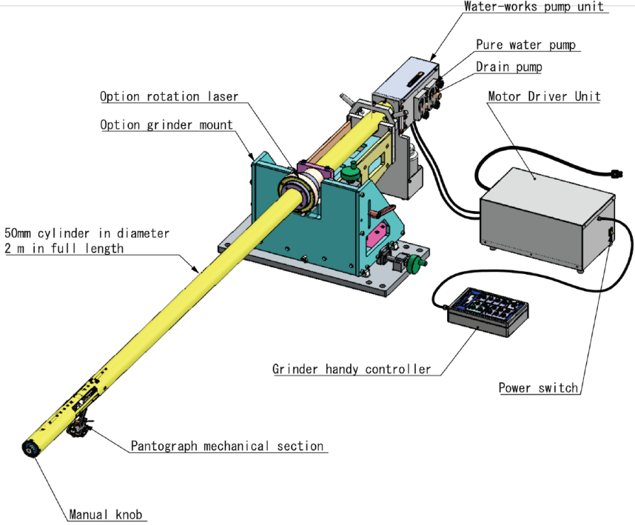

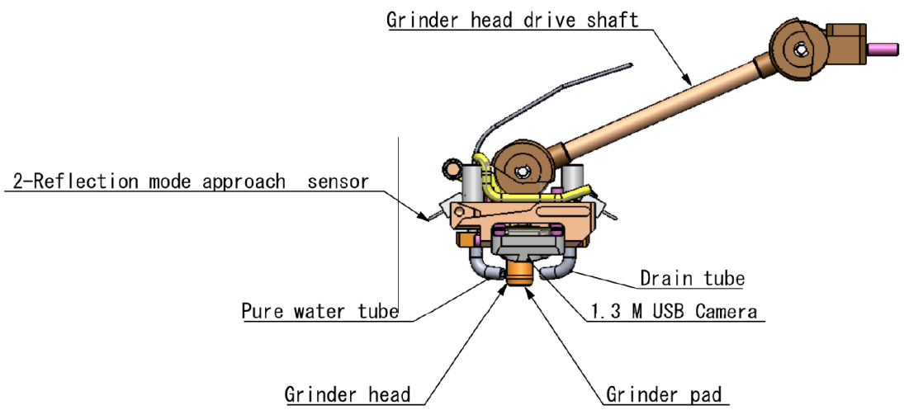
Cavity treatment and repair techniques
A machine for acid-free abrasive surface polishing (“Centrifugal Barrel Polishing”) is commissioned and is considered as a repair or a standalone polishing tool
-> R&D on optimum cavity polishing recipes is ongoing.
Step 1
Step 2
Step 3
60 um
30 um
30 um
Al₂O₃
A special grinding tool for the posteriori removal of recognized single defects is under assembly, commissioning coming soon
SEM

Slide 18

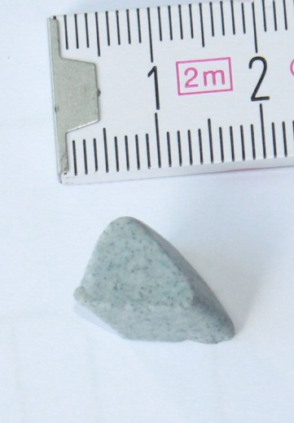


Centrifugal Barrel Polishing (CBP) of Nb cavities
How to repair cavities?
Can we replace bulk EP?
Which kind of defects can be removed by CBP?
How does CBP influence cavities performance?
Can CBP be used to remove Nb damaged layer (~150 µm) instead of bulk EP?
-> cheap, safe, “green”
-> no sulphur contamination?
->…….
Can CBP be integrated in the existing production flow?
The CBP machine is being commissioned based on the polishing recipes derived from best FNAL, JLAB, and previous DESY experience
1) 8h cutting
2)15h I. polish.
3)30h II. polish.
4) 40+ h final polish.
+
bake
light EP
HPR
+ water
+ water
+ water/Al₂O₃
+ water/SiO₂

Slide 19




CBP of Nb cavities: OBACHT+SEM+EDX+
Replica/3D Laser profilometer analysis
Step 1
Step 2
Step 3
Step 4
OBACHT inspection
Cavity Z110
Equator 9 0°
Embedded Al₂O₃
Laser profilometry
60 um
SEM
60 um
30 um
30 um
Embedded polishing media is an issue
Better investigations of the removal profile required
Matching of the polishing steps not optimal yet
-> some scratches and polishing media still present
Polishing time and mechanical stress to be reduced
Welding seam profile

Slide 20


CBP optimization using a coupon cavity
Mirror finish surface of the coupon cavity:
* pictures of Y. Tamashevich
1-cell coupon cavity
6 removable samples (coupons, 2 each for equator, cell side, and end tube)
Facilitate polishing optimization:
--> direct measurements of the surface roughness, removal rate, removal profile
--> material analysis in the interesting regions

Slide 21



Profilometry of coupons
* courtesy of Y. Tamashevich
Amount of removed material can be directly measured with submicron resolution
Removal profile can be directly determined by comparing 6 coupons

Slide 22




Surface/material analysis of coupons
Al₂O₃ particle
Nb
C
Al
O
Si
Nb
Embedded media will deteriorate RF performance and is to be avoided

Slide 23

High Q₀ R&D
Higher efficiency (Q₀ quality factor) for ILC would allow
  longer pulses with more bunches and thus higher luminosity
  smaller dynamic heat load and potential cost savings by purchasing smaller cryogenic plants and requiring smaller energy consumption
Ongoing R&D:
Study of the influence of the cooling dynamics on Q₀
  Efficient magnetic flux expulsion (Meissner effect in superconductivity) and
  prevention of the flux trapping seems to be the main effect
  (trapped flux -> normal conducting core -> more RF losses)
  Large temperature gradient:
  - improve trapped flux mobility and expulsion
  - lead to high thermal currents and magnetic field generation if applied wrong
An optimization of the heat treatment procedure of the cavities
  - in nitrogen atmosphere (N-doping)
  -> improved efficiency of Nb cavity by a factor of 3
  - at the presence of titanium
S. Aull et al., PRST AB 15, 062001
BMBF proposal submitted

Slide 24
Thank you for your attention !
Acknowledgements:
- FLA/ILC, MPL, MKS 1, MKS 3, and MHF-sl groups
- all DESY and INFN colleagues involved in the XFEL cavity fabrication, treatment and tests
KEK colleagues and especially to Takayuki Saeki and Shigeki Kato for help with the fabrication of the coupon cavity
FNAL colleagues and especially A. Romanenko, A. Grassellino, and C. Cooper for valuable discussions
*aliaksandr.navitski@desy.de

