Slide 1
ALCW2015
Guidance
Akiya Miyamoto

Slide 2
Registration
 | Credit Card | Cash by Yen
20^{ｔｈ} Monday | OK | OK
21st Tuesday | OK | OK
22nd Wednesday | NO | NO
23rd Thursday | NO | OK
24th Friday | NO | OK
Please complete
by Tuesday
Banquet ticket for accompanying person :
Available at the registration desk. Please purchase by 21th lunch time.

Slide 3
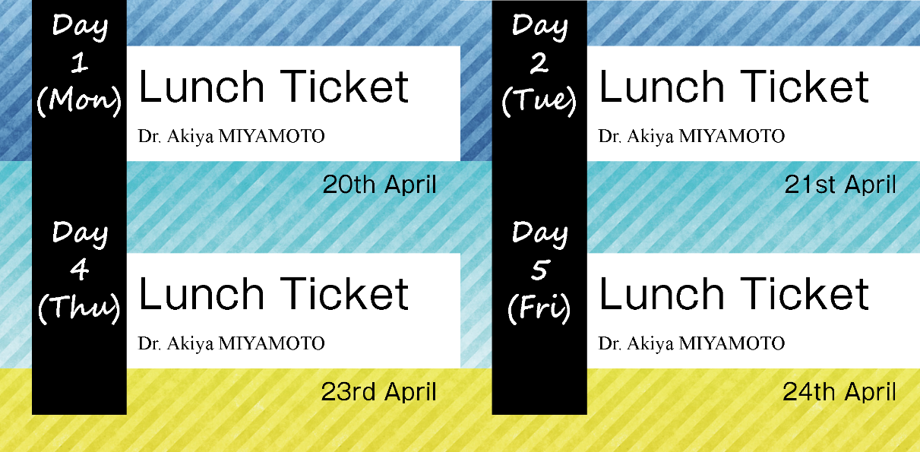
Lunch
Lunch box hour: 12:15 – 13:30, pick up at the Employee’s Center
Lunch box for lunch time meetings:
Please tell LOC the number of boxes needed
by the end of the break in the morning.
Lunch ticket: Inside your name tag case
No Wednesday

Slide 4
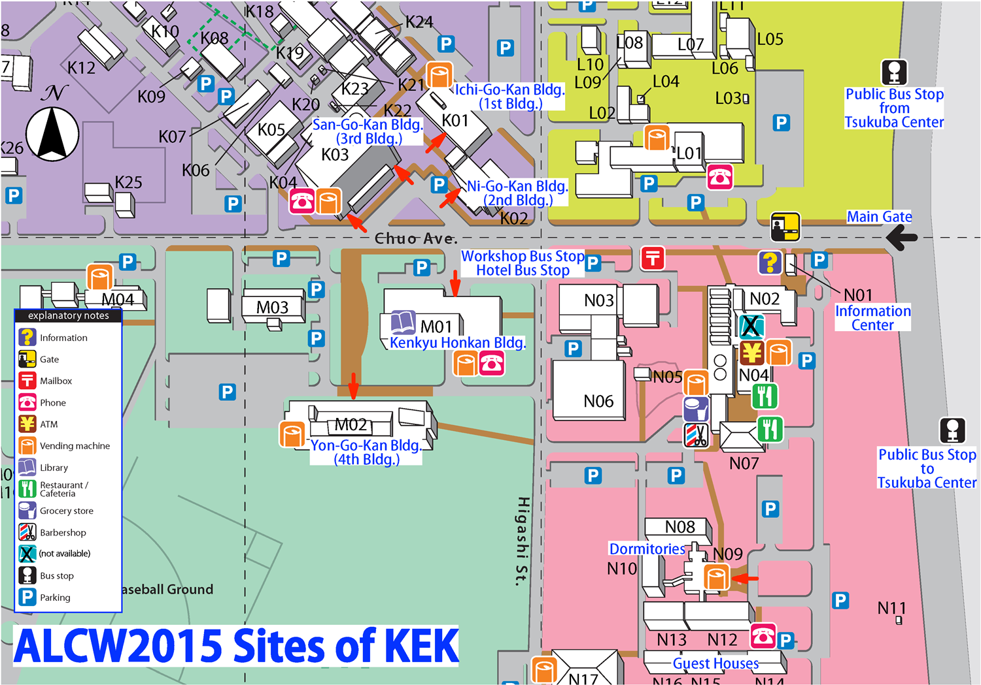
Lunch
Lunch Box

Slide 5
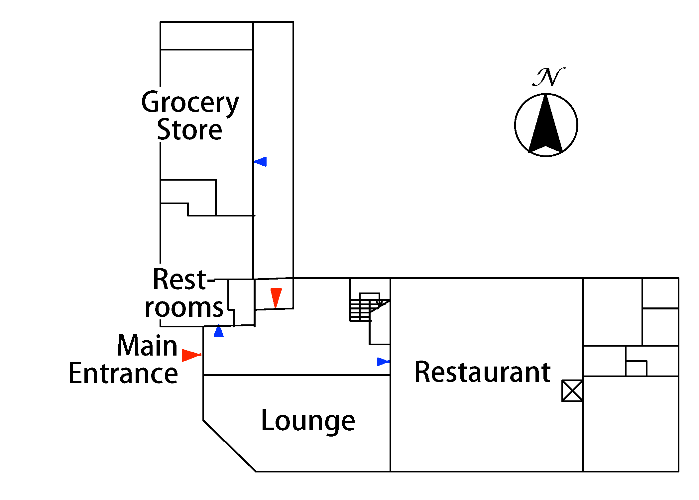
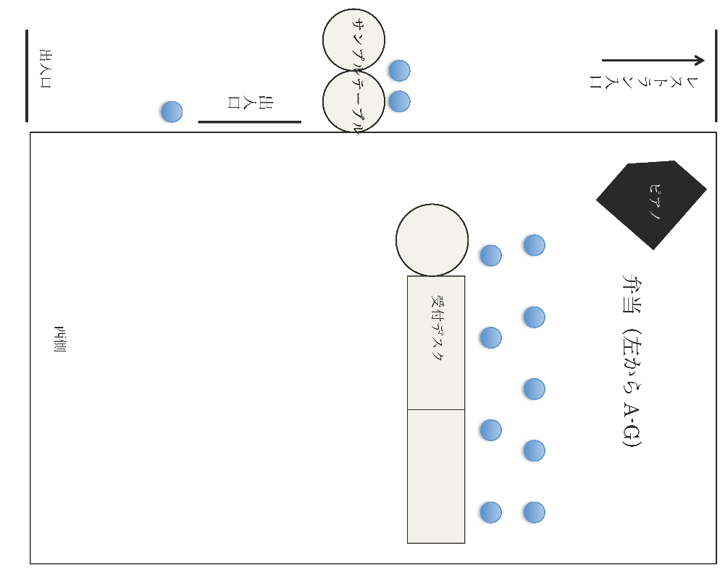
~100 sheets
Sample Table
Requested
Lunch
A
Standard
Lunch
A-G
G

Slide 6
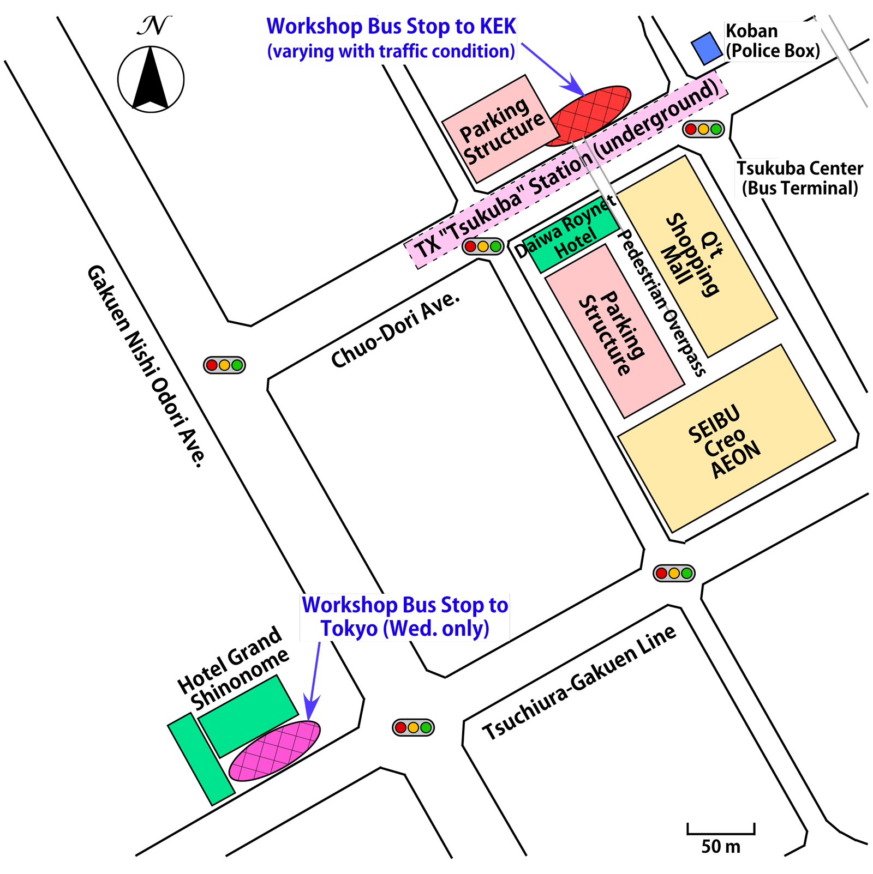
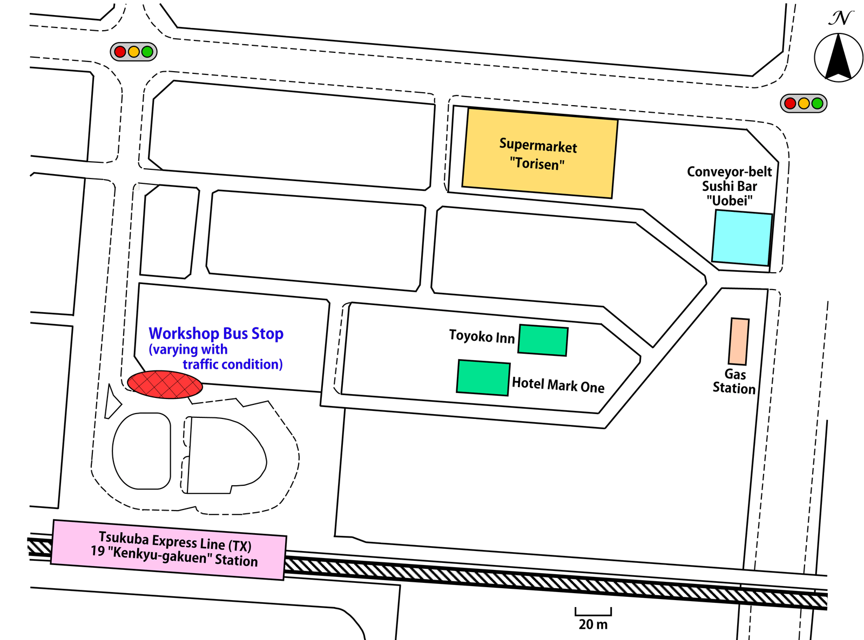
Workshop Bus Schedule
Departure time on Mon, Tue, Thu, Fri
From/to : Urban Hotel, Hotel Grand Shinonome,
Tsukuba Sta., Kenkyu-Gakuen-Sta.
 | To KEK | From KEK
20th Monday | 8:00 | 18:15
21th Tuesday | 8:00 | 19:00
23th Thursday | 8:00 | 19:00
24th Friday | 8:00 | 18:00
Bus stop maps in side conference bag.

Slide 7
Bus on Wednesday
ILC Tokyo Event
at Tokyo
6 workshop buses have been arranged.
Bus route:
A) KEK → Urban Hotel → Univ. Tokyo
B) Shinonome (Tsukuba Center )
→ Kenkyu Gakuen Eki Sta. → Univ. Tokyo
Departure time: 8:00.
Expected to arrive around 10:00 (Dep. on traffic condition)
The number of sheets are limited. Please sign up
by 14:00, 21th (Tuesday)
Return : Leave the banquet venue around 21:00.
All buses stop at Kenkyu-Gakuen-Eki Sta. →
Shinonome → Urban Hotel → KEK (~23:00)

Slide 8
~10 min. walk

Slide 9
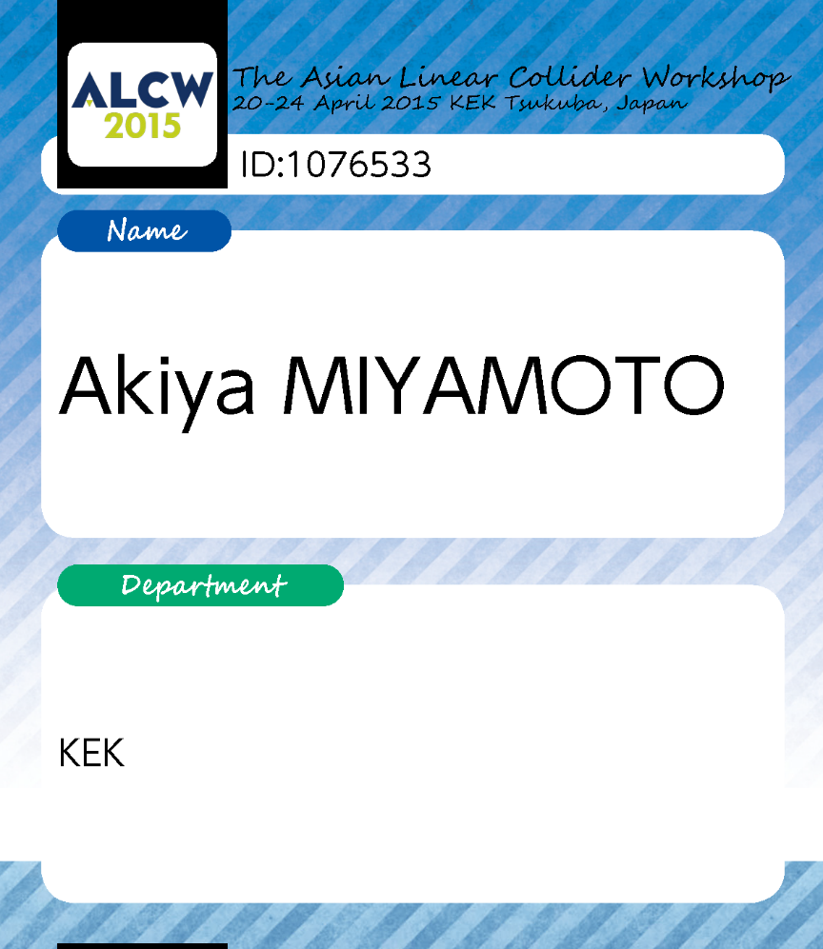
Name tag is your ticket for Banquet, Wednesday
Don’t forget
KEK

Slide 10
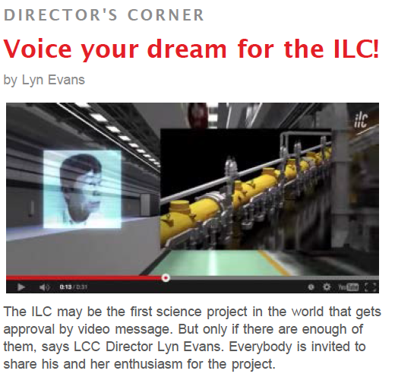
Video Campaign
#mylinearcollider
Barbara, Saeki, and Araki take your message at the lounge

Slide 11
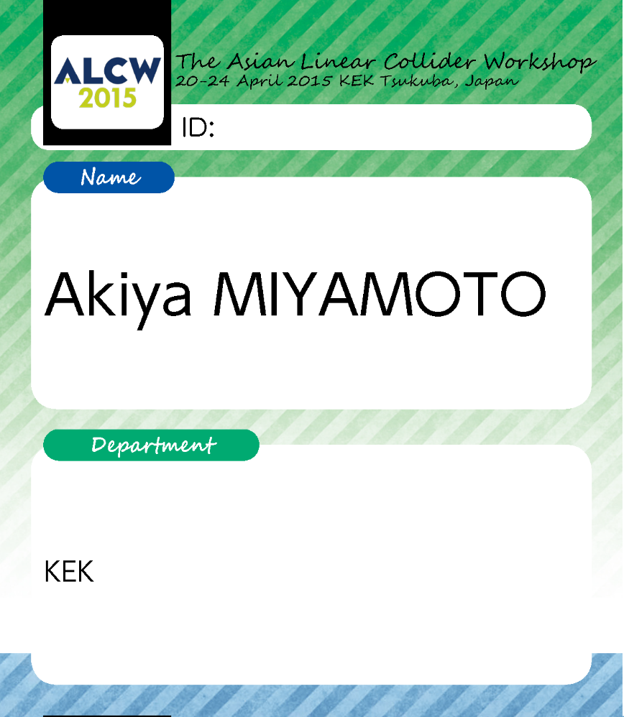
LOC Green Card
KEK

Slide 12
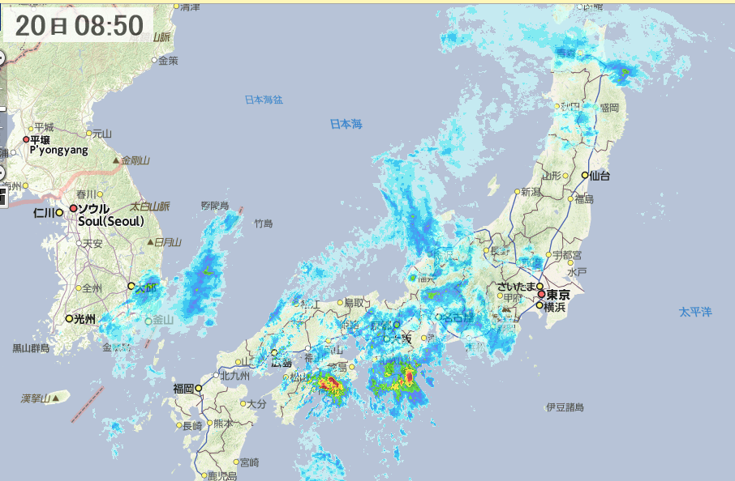
Weather
Heavy rain is expected this evening and tonight !

