Slide 1



Search for Charged Higgs Production
Associated with W boson with the ILD at the ILC
Akimasa Ishikawa for Yuko Shinzaki
(Tohoku University)
Jan Strube, Hitoshi Yamamoto,
Keisuke Fujii^{A}, Shinya Kanemura^{B}, Kei Yagyu^{C}
Tohoku, KEK^{A}, Toyama^{B}, Southampton^{C}

Slide 2

Introduction
Charged Higgs bosons can exist in the extended Higgs models.
  2HDM
  Higgs Triplet models
    Explains neutrino mass
    Georgi-Machacek model
      Real Y=0 and complex Y=1 triplet Higgs fields
        Additional 3 and 6 physical higgs bosons
      ρ = 1 at tree level
Which can have HWV coupling
  One loop in 2HDM
  Tree level in triplet models
Effective Lagrangian can be expressed in terms of form factor f_{HWV} which can be constrained from the e⁺e⁻→W⁺H⁻ search and can be used for model discrimination

Slide 3
Condition for the Simulation
Full Simulation
Process : e⁺e⁻→ WH
f_{HWZ} = 1 and f_{HWγ} =0
  Only couples to Z
Decay : H→τν or H→W⁽*⁾Z⁽*⁾→ lννν
Ecm = 250GeV
M_{H+} = 150GeV
  Pair production very suppressed
  Almost maximal cross sections
L_{int} = 250fb⁻¹
P(e-,e+) = (+0.8, - 0.3)
  Right handed to suppress WW backgrounds

Slide 4
Dominant Backgrounds
Irreducible
  WW→jjlν
  eνW→enjj
Reducible
  ZZ → jjll
Large Cross section
  Di-jet

Slide 5
Cross Section
 | Process | Cross section (fb) | Events (k)
Sig① | WH (H→τν) | 214 | 54
Sig② | WH (H→WZ) | 214 | 54
SM BG | Di-jet | 46200 | 12000
 | eνW →eνjj | 445 | 110
 | WW →jjlν | 758 | 190
 | ZZ →jjll | 467 | 120
 | WW →jjjj | 600 | 150
 | Zee →jjee | 300 | 74
 | ZZ → jjjj | 402 | 100
 | ZZWWmix → jjjj | 565 | 140
 | Zh → ffh | 205 | 51
Dominant background

Slide 6
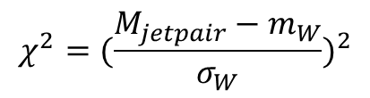
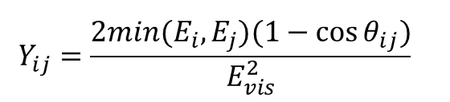

Reconstruction
Forced three jet analysis with Durham (somewhat inclusive)
  Final states for both channels are di-jet and lepton with missing energy
W boson mass with χ²
Recoil mass
$$Y_{ij}={\frac{2min(E_{i},E_{j})(1−\cos{θ_{ij}})}{E_{vis}^{2}}}^{}$$
$$χ^{2}={(\frac{M_{jetpair}−m_{W}}{σ_{W}})}^{2}$$
$$m_{H}^{2}=\left(P_{Ecm}−P_{W}\right)2$$

Slide 7
H→τν

Slide 8
W mass and Recoil Mass
Signal
70 < Mw < 90 (GeV)
cut
cut
cut
cut
110
110
110 < Mrec < 190 (GeV)
cut
cut
cut
cut
110
110

Slide 9
Transverse Momentum
Suppress neutrinoless processes
15 < total Pt (GeV)
Signal
cut
cut

Slide 10
Visible Energy
Suppress neutrinoless processes
Evis < 170 (GeV)
cut

Slide 11
Production angle of W boson
Suppress dijet
0.95 < | cosθWangle|
cut
cut

Slide 12

BDT inputs
Input variables
  Y23, thrust, nPFO, No of charged, Missing mass, max(E_{PFO})/E_{3jet}
Y23
thrust
nPFO(3rd jet)
青…信号 赤…背景
No of charged
Missing mass
$$\frac{{max(E}_{PFO})}{E_{3jet}}$$

Slide 13
BDT output
Keeping 70% signal while reducing 80% backgrounds
-0.675<BDTG

Slide 14
Cut-flow Table for H⁺→τν
 | WH(τν) | Di-jet | eνW→eνjj | WW→jjlν | ZZ→jjll | others
no cut | 53618 | 11553700 | 111356 | 189596 | 116797 | 518315
mw&mrec | 31958 | 1307060 | 23795 | 35671 | 28561 | 18920
pt | 29624 | 31281 | 22005 | 32323 | 21021 | 4873
Evis | 27255 | 9375 | 11437 | 21191 | 18580 | 1219
Wangle | 26177 | 5421 | 10423 | 19408 | 17205 | 1147
BDTG | 17961 | 1459 | 2131 | 5025 | 1834 | 230

Slide 15
Recoil mass distribution for H⁺→τν
Efficiency 26.6%
Significance S=105
 | WH(τν) | Di-jet | eνW→eνjj | WW→jjlν | ZZ→jjll | others
no cut | 53618 | 11553700 | 111356 | 189596 | 116797 | 518315
after cut | 14276 | 581 | 837 | 1729 | 863 | 95

Slide 16
H⁺→WZ

Slide 17
Process
Final states used is H→WZ →lννν
  The BF is about 6%
  Not major decay process but easy to extend from H→τν
 | Z→qq (~70%) | Z→ll (~10%) | Z→νν (~20%)
W→qq (~70%) | 49% | 7% | 14%
W→lν (~30%) | 21% | 3% | 6%

Slide 18
W mass and Recoil Mass
cut
cut
cut
cut
110
70 < Mw < 90 (GeV)
110
cut
cut
cut
cut
110
110 < Mrec < 190 (GeV)
110

Slide 19
Other Selections for H→WZ
Selections are same as H→τν analysis except
  Evis was loosened from 170 GeV to 200 GeV
  No BDT since we quickly tried it but sensitivity not improved.
    Need more study
cut
cut
15 < total Pt (GeV)
cut
cut
cut
Evis < 200 (GeV)
0.95 < | cosθWangle|

Slide 20
Cut-flow Table for H⁺→WZ
 | WH(WZ) | Di-jet | eνW→eνjj | WW→jjlν | ZZ→jjll | others
no cut | 53613 | 11553700 | 111356 | 189596 | 116797 | 518315
mw&mrec | 13399 | 1307060 | 23795 | 35671 | 28561 | 18920
pt | 11575 | 31281 | 22005 | 32323 | 21021 | 4873
Evis | 10435 | 14339 | 19568 | 30155 | 20351 | 2677
Wangle | 9938 | 10048 | 17827 | 27496 | 18853 | 2511

Slide 21
Recoil Mass
 | WH(WZ) | Di-jet | eνW→eνjj | WW→jjlν | ZZ→jjll | others
no cut | 53613 | 11553700 | 111356 | 189596 | 116797 | 518315
after cut | 4768 | 4792 | 5835 | 8697 | 5438 | 987
Efficiency ε = 8.89%
Significance S = 27.29
(FHWZ=1, FHWγ=0, BR(H→WZ)=100％)

Slide 22
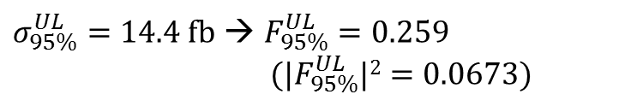

Upper Limits on σ and F_{HWZ}
From the obtained efficiency and number of backgrounds, upper limits are calculated.
H→τν
H→WZ
$σ_{95\%}^{UL}=1.92 fb$ → $F_{95\%}^{UL}=0.0974$
$({|F}_{95\%}^{UL}|2=0.00897)$
$σ_{95\%}^{UL}=14.4 fb$ → $F_{95\%}^{UL}=0.259$
$({|F}_{95\%}^{UL}|2=0.0673)$

Slide 23

Interpretation to 2HDM type-X with H→τν
$${|F}_{95\%}^{UL}|2=0.00897$$
2HDM type-X
  Lepton specific
  H⁺→τν can be dominant
  Type-II is strongly constraint by LHC
Shaded region (tanβ < 1) is constraint from B-B-bar mixing
We cannot set better limit on 2HDM type-X
  Since loop suppressed
(figures by Kanemura)

Slide 24
Georgi-Machacek model
GM
  Additional complex Y=1 and real Y=0 triplet fields
    H₁⁰, (H₃±, H₃⁰),(H₅±±, H₅±, H₅⁰)
  ρ=1 at tree level
    Due to custodial symmetry
    Large (a few 10GeV) triplet VEV, v_{Δ}, possible
  H₅ mainly decays to gauge bosons if triplet VEV is not small (v_{Δ} >~ MeV) and H₅ lighter than H₃.
    H₃ mainly to fermion pairs.
  Tree level ZWH₅± coupling
Current LHC result can make a constraint from κ_{F} and κ_{V}, and also from direct searches for H₅⁰ → WW,ZZ H₅±→WZ and H₅±± →WW
  (see Chiang’s talk slides at this workshop)
Chiang, Yagyu, JHEP 01, 026 (2013)

Slide 25
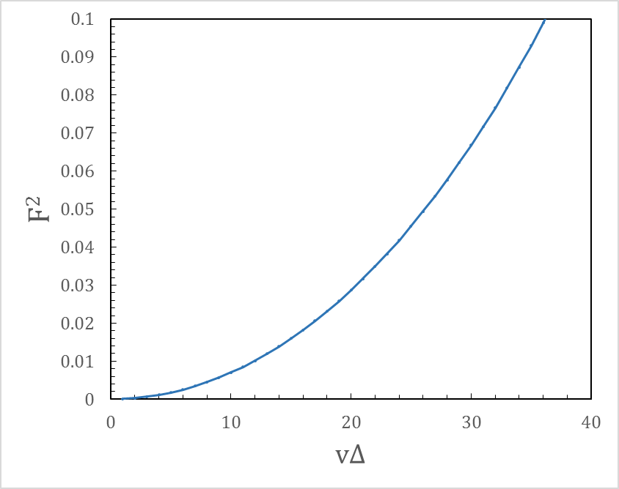




Interpretation to GM model with H→WZ
$${|F}_{95\%}^{UL}|2=0.0673$$
Relation btw triplet VEV and FF
Our result
This study can set a limit on triplet VEV $v_{Δ}$ < 30 GeV for M_{H} = 150GeV
$$F^{2}=\frac{4v_{∆}^{2}}{\cos{2θ_{W}}(v^{2}+4v_{∆}^{2})}$$
$v^{2}+8v_{∆}^{2}=\left(246GeV\right)2$
Kanemura, Yagyu, Yanase, PRD 83 075018 (2011)
$$F_{95\%}^{UL}=0.259$$
$$({|F}_{95\%}^{UL}|2=0.0673)$$

Slide 26
Summary
We studied charged Higgs production associated with W boson.
Two charged Higgs decays are considered
  H→τν
  H→WZ → lννν
Interpretations to 2HDM type-X and GM model.
  No constraint on 2HDM type-X with H→τν
  Give constraint on GM model with H→WZ
Possible Improvements
  Exclusive analysis
  Inclusion of other decay processes H→WZ→lνll
  Ecm=500GeV with heavier H⁺

Slide 27
backup

Slide 28
Cross Section
 | Process | Cross section (fb) | Events (k)
Sig① | WH (H→τν) | 214 | 54
Sig② | WH (H→WZ) | 214 | 54
SM BG | Di-jet | 46200 | 12000
 | eνW →eνjj | 445 | 110
 | Zee →jjee | 300 | 74
 | WW →jjlν | 758 | 190
 | WW → jjjj | 600 | 150
 | ZZ →jjll | 467 | 120
 | ZZ → jjjj | 402 | 100
 | ZZWWmix → jjjj | 565 | 140
 | Zh → ffh | 205 | 51

