Slide 1
SiD Hadron Calorimeter System
The purpose of this talk:
⬄ Describe the current design of the SiD HCal System
⬄ List the possible alternative technology options
⬄ Discuss “baseline” choice
⬄ Discuss issues/ideas for improvement
⬄ Invite your participation in future development

Slide 2
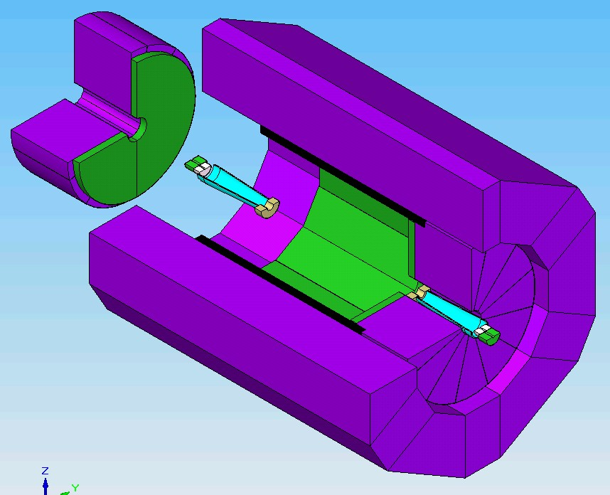
SiD Calorimeter System
Hcal-F 38t
Fcal 2t
Hcal-b 453t
Ecal-b 60t
Ecal-F 9t

Slide 3
SiD Calorimetry – Design Criteria
-> PFA-based system
-> Integrated part of SiD with tracking, muon systems
-> Calorimetry optimized for jet reconstruction and energy resolution
-> “Tracking calorimeters”, compact showers in ECAL, highly segmented (longitudinally and transversely) ECAL and HCAL.
-> Compact design – radially inside the superconducting solenoid
-> Iron flux return/muon identifier/energy leakage indicator

Slide 4
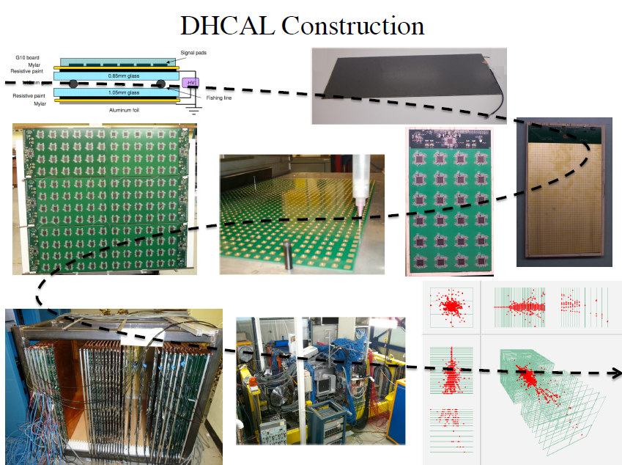
SiD - HCal RPC Baseline

Slide 5
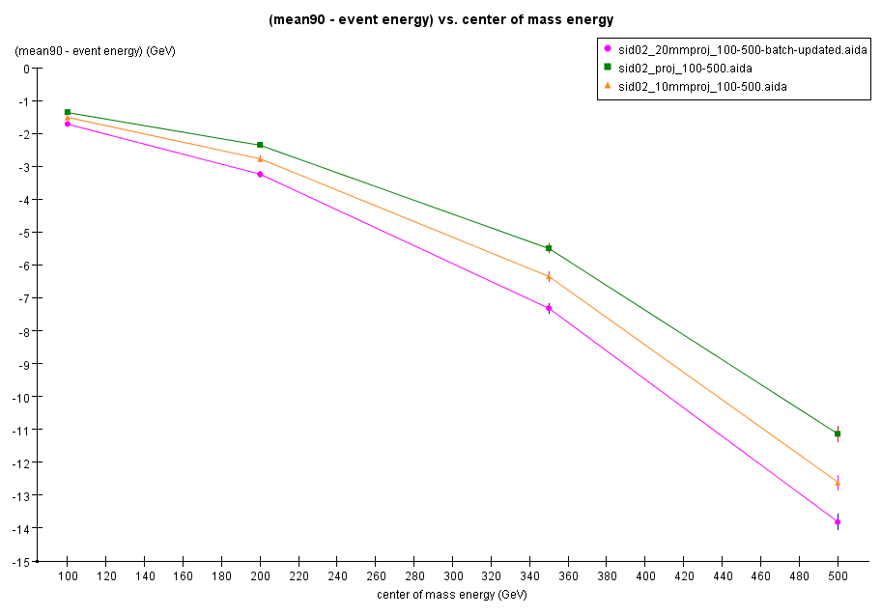

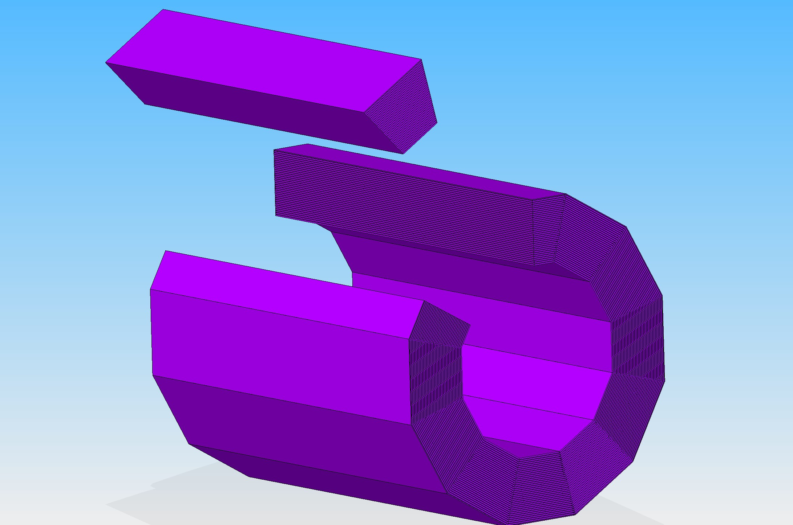
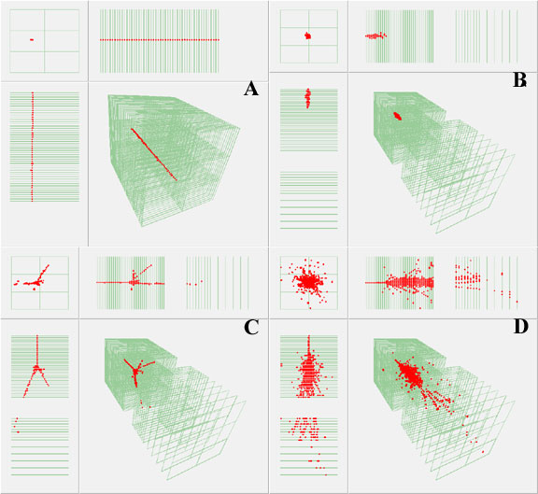
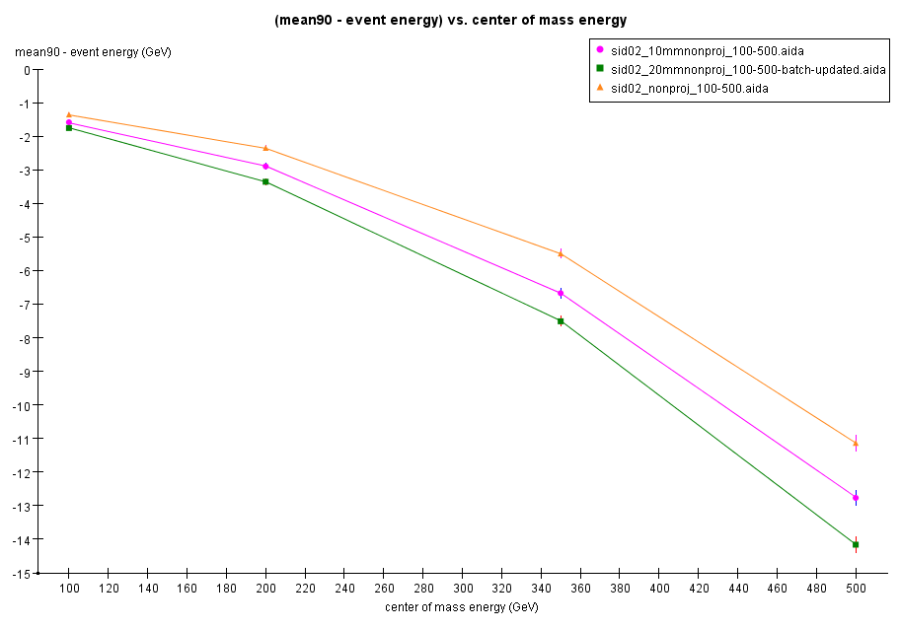
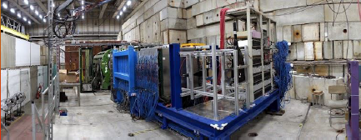
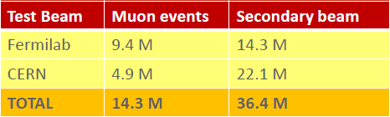
SiD Detector - Hadron Calorimeter
Proj.
Non-proj.
RPC has been SiD Baseline

Slide 6
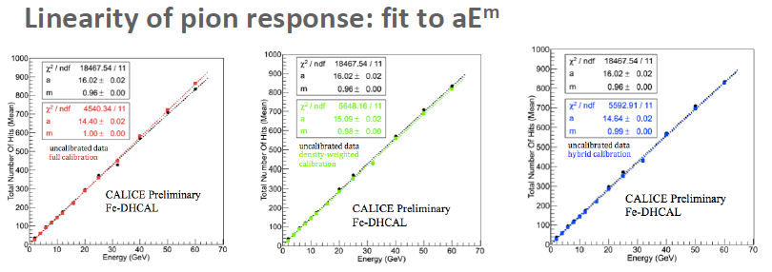
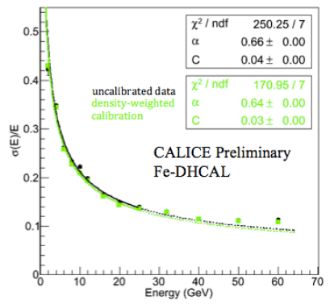
SiD Detector - Hadron Calorimeter - RPC
Many results!
Some examples:
Calibration somewhat improves pion resolution

Slide 7

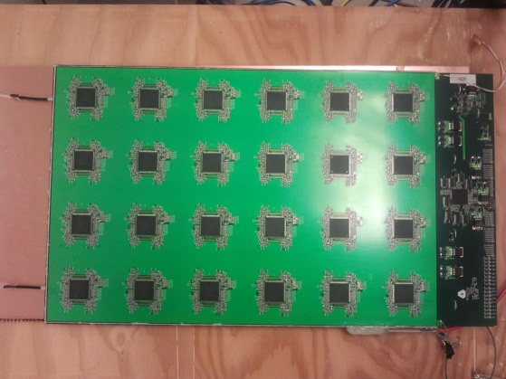
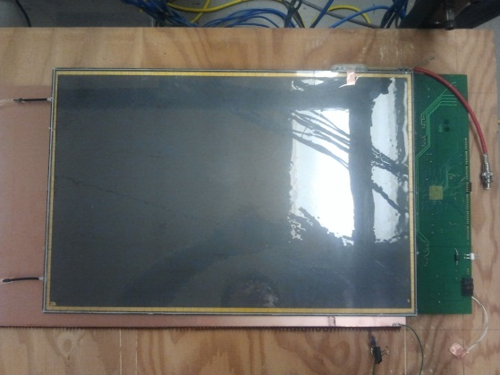
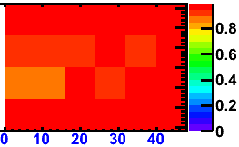
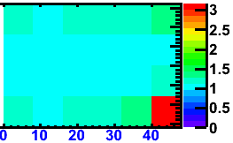
SiD Hadron Calorimeter – RPC new
1-glass RPCs
Offers many advantages
Pad multiplicity close to one
→ easier to calibrate
Better position resolution
→ if smaller pads are desired
Thinner
→ saves on cost
Higher rate capability
→ roughly a factor of 2
Status
Built several large chambers
Tests with cosmic rays very successful
→ chambers ran for months without problems
Both efficiency and pad multiplicity look good
Efficiency
Pad multiplicity

Slide 8
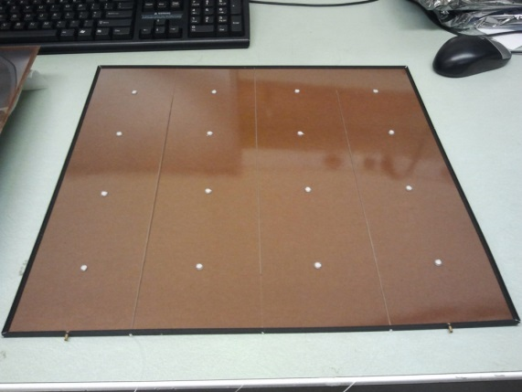
SiD Hadron Calorimeter – RPC new
High-rate Bakelite RPCs
Resistive layer for HV
Bakelite does not break like glass,
is laminated
but changes R_{bulk} with dependence on humidity
but needs to be coated with linseed oil
Gas
Fishing line
Use of low R_{bulk} Bakelite with
R_{bulk} ~ 10⁸ - 10¹⁰ and/or Bakelite
with resistive layer close to gas gap
Several chambers built at ANL
Gas flow
direction
Sleeve
around
fishing line
Additional
spacer
Gas inlet
Gas outlet
 All activity is now stopped on the RPC-DHCAL

Slide 9
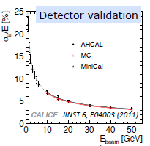
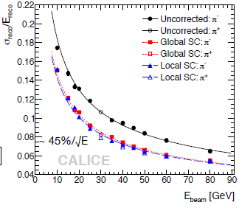
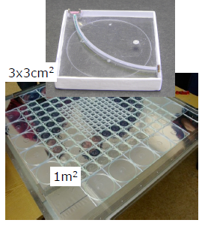

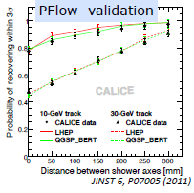
SiD Hadron Calorimeter - Options
Scintillator AHCAL
e-
hadron
GEM DHCAL

Slide 10
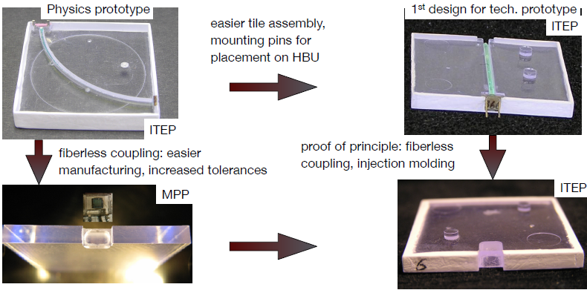
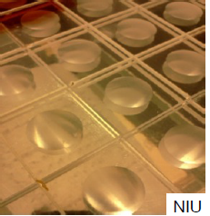
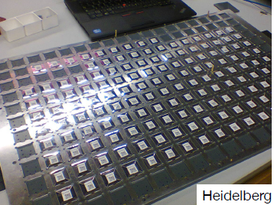
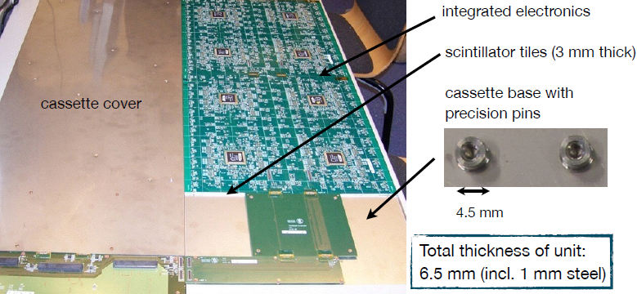
SiD Hadron Calorimeter - Options
Tile evolution
“Megatile”
Large-scale production - automation
 Study the scintillator AHCAL as a possible technology for SiD HCal

Slide 11
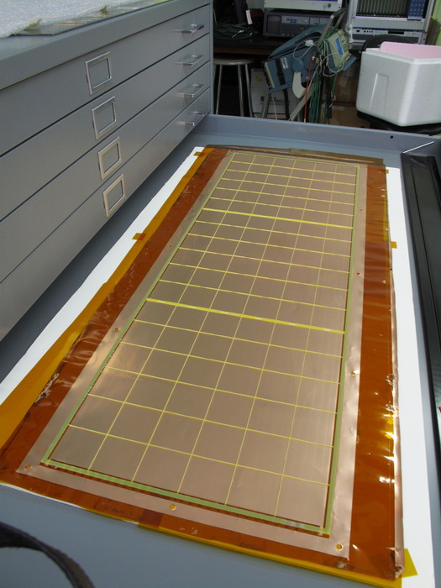
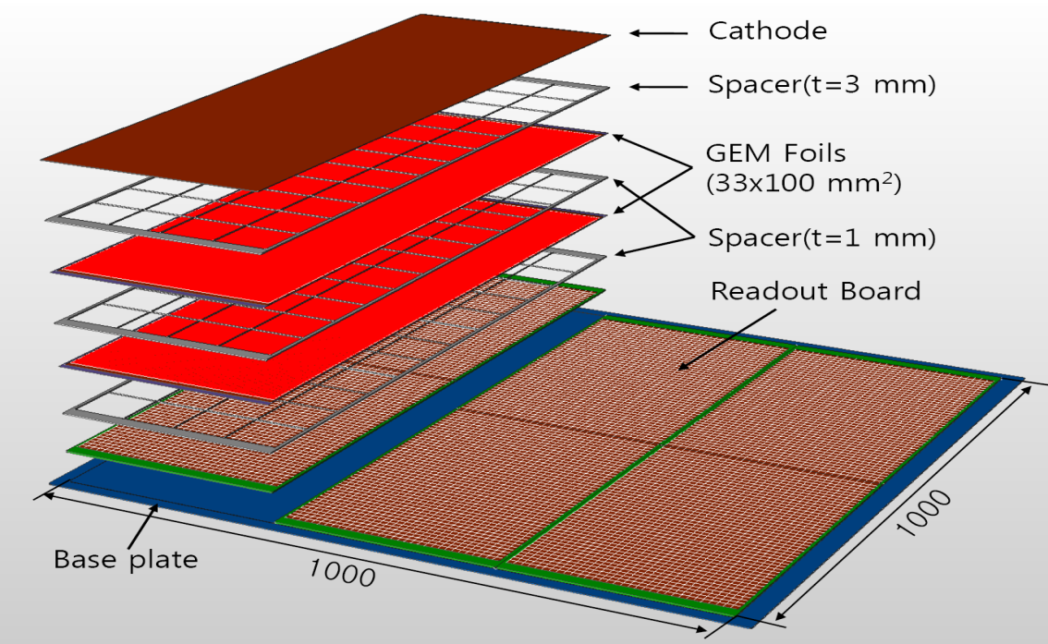
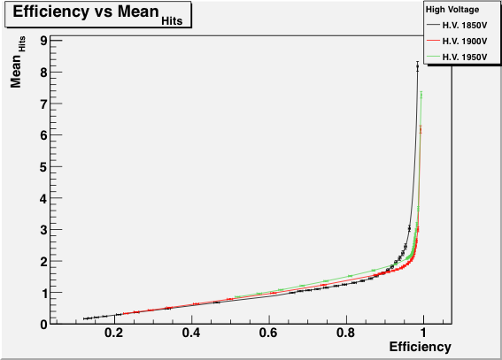
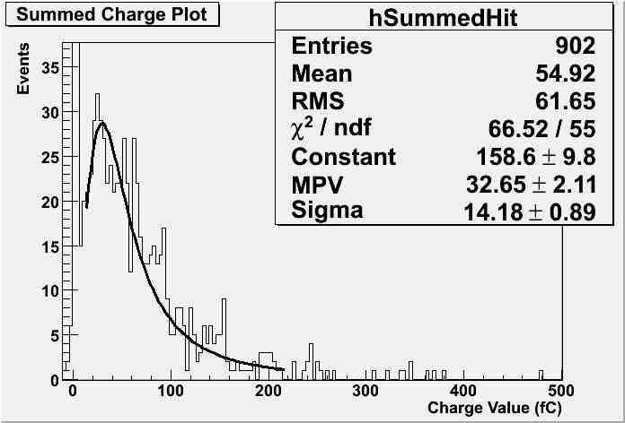
SiD Hadron Calorimeter - Options
GEM DHCAL
Stalled by lack of detector R&D support

Slide 12
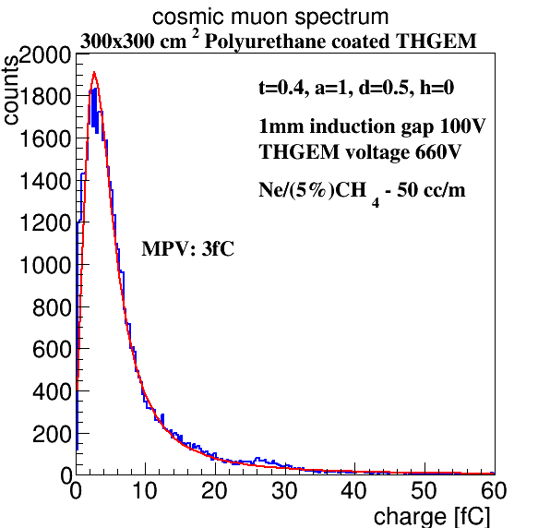
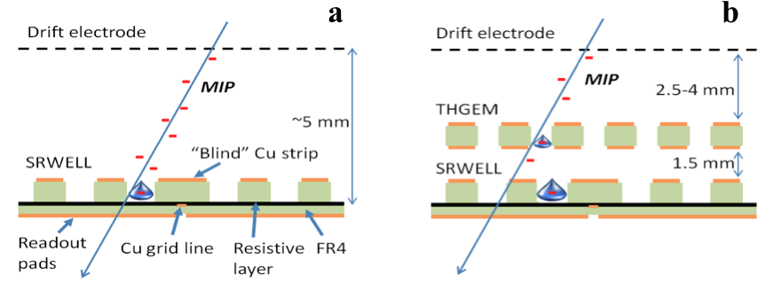
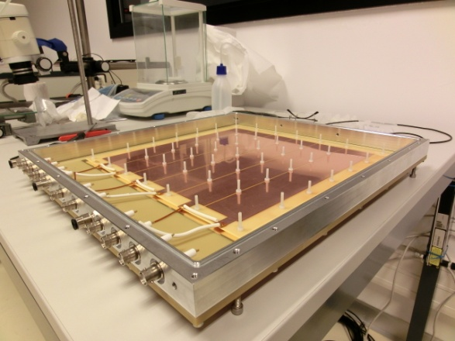
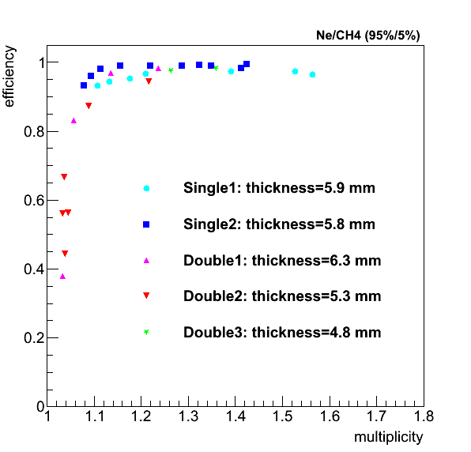
SiD Hadron Calorimeter - Options
ThickGEM
The DHCAL requirements were met
(Near) future plans
Build meter-scale single-stage detector
One prototype in collaboration with Israeli industry
Prototype(s) to test within CALICE’s DHCAL module
Study extensively THGEM concepts with broader dynamic range
RPWELL
Using newly developed techniques
Test in beam of 100 x 100 mm² prototype
Rubin 2013 JINST 8 P11004
Single; 5.9 mm
Single; 5.8 mm
Double; 6.3 mm
Double; 5.3 mm
Double; 4.8 mm
Bressler 2014 JINST 9 P03005
Development of large boards? Tiling, dead regions?

Slide 13
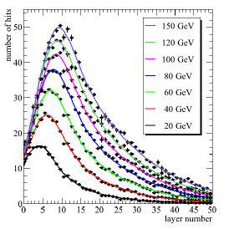
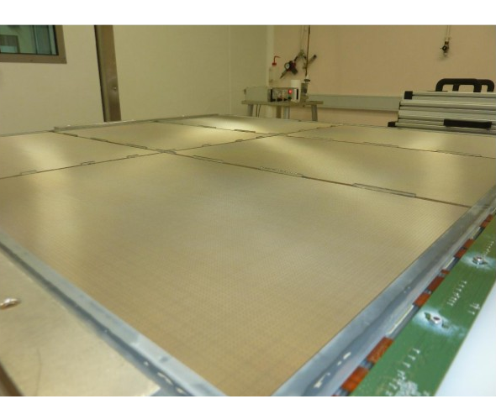
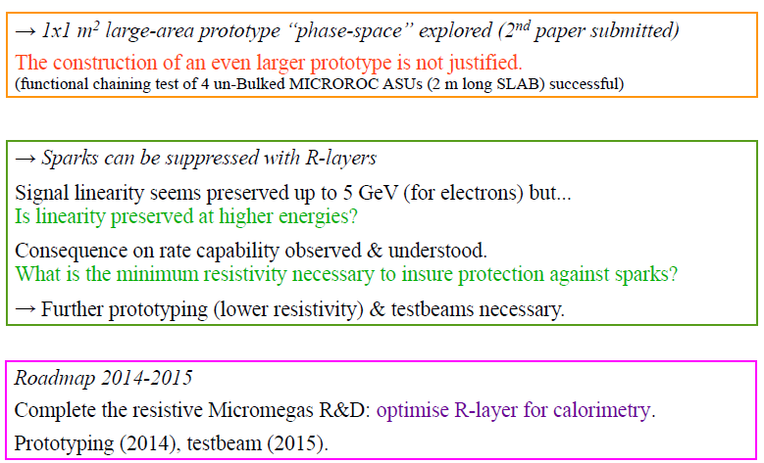
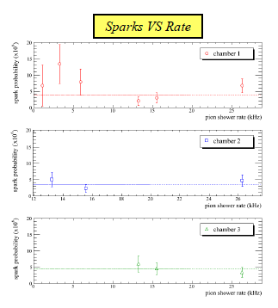
SiD Hadron Calorimeter - Options
Micromegas

Slide 14
SiD Hadron Calorimeter - Options
A number of technologies have demonstrated the essential characteristics required for hadronic calorimetry as part of an integrated PFA-based system.
Technology selection will focus on:
- Efficiency/hit multiplicity performance
- Scalability of technology
- Robustness of technology
- Assembly issues
- Cost/m²
- Long –term performance/stability
- Calibration issues (initial, ongoing)
- % dead regions
- Barrel/endcap rate requirements
- Compatibility with other subsystems
- Maintenance/access requirements

Slide 15
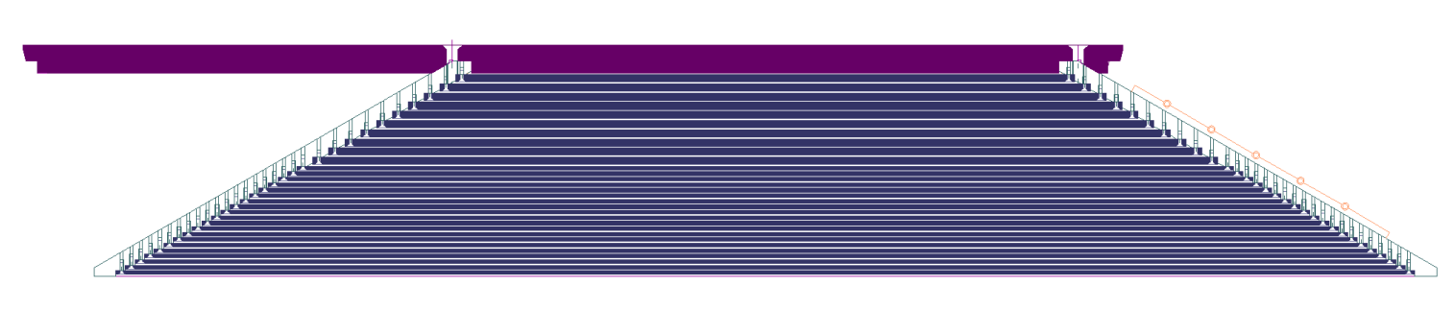
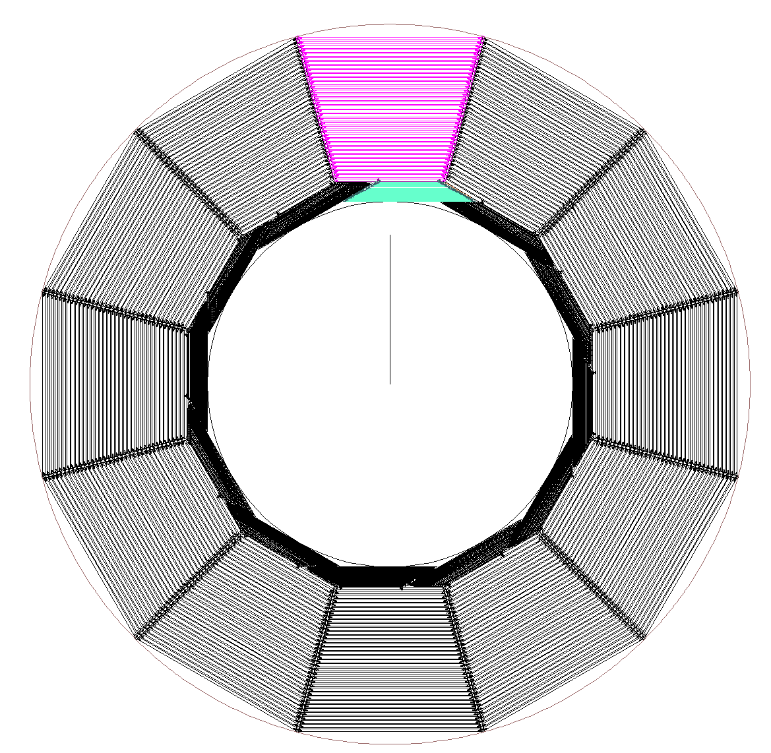
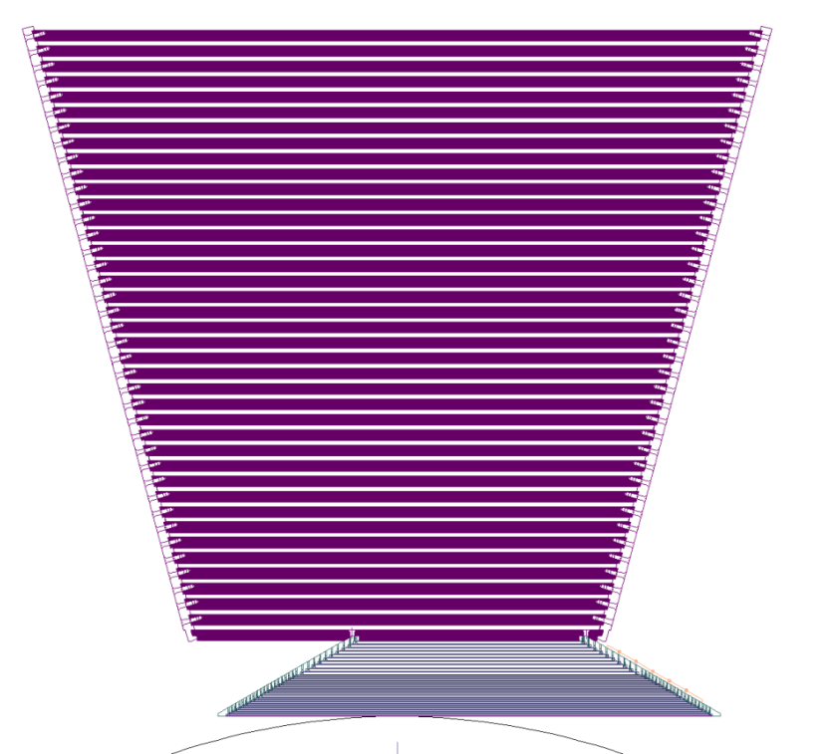
Mechanical Progress
SiD Calorimeter - mechanics
ECAL module is built on first layer of HCal
HCAL module supports ECAL module
Note module overlap: No gaps; service cables at ends.

Slide 16
SiD Calorimeter System
Questions
The basic calorimeter system design is 10 years old.
And we know (see the DBD) that we can deliver good results for the ILC Physics program, but…
Is the present ECal + HCal arrangement optimized for PFA?
If we started with our present knowledge from PFA studies, would we arrive at the same calorimeter system design?
Is the aspect ratio optimized?
Are the ECal and HCal depths optimized?
What are the optimum cell sizes for ECal, HCal?
What are the issues with a detailed (= realistic) implementation of the HCal in the SiD simulation?

Slide 17
SiD Calorimeter System
New Ideas ??
- Can we design a better integrated tracking/calorimeter system oriented for PFA
- Layer to layer intelligence – PFA ?
How much of the PFA can we move into the “front-end”?
For ILC, we have a large time interval (199ms) between bunch crossings – can we use this for PFA style processing?
Could we use continuous feedback to do on-the-fly calibrations?
What have we missed?

Slide 18
SiD Calorimeter System
Conclusions
We have a number of alternative technology choices for HCal.
How do we best optimize the design and implementation of the system?
Are there new ideas we should consider/test before embarking on the TDR?
We welcome your ideas and input!
Let us know if you would like to join this work in any aspect.

