Slide 1
LCC Physics and Detector Report
Hitoshi Yamamoto
ALCW 2015
April 22, 2015

Slide 2
LCC PD Structure
http://www.linearcollider.org/P-D
PD Advisory Panel
Regional Contacts
SiD
ILD
PD Associate Director
CLICdp
Detector R&D Liaison
Physics WG
MDI WG
Conference talks group
Software&computing WG
ILC Infrastructure and Planning WG
PD Executive Board
ILC parameter joint WG
2

Slide 3
PDAP (Physics and Detector Advisory Panel)
Chair: Paul Grannis
Possible issues to review:
    Technical readiness of the detector designs
    Physics case for LC
    Synergy with CLICdp
Discussions on-going at LCC Physics and Detector EB
  Concerns:
    No clear benchmarks such as DBD or LoI
    Depending on the charge, it may require too much time and effort for PDAP members
Clear charges needed
  Paul and HY are currently working on detailed charges
    Focus on well-defined issues

Slide 4
Physics WG
Making Physics Case for ILC
Members:
  16 total: strong members in theory and experiment
  3 co-convenres: Keisuke Fujii, Christophe Grojean. Michael Peskin
  + 1 observer: Hitoshi Murayama (LCC deputy director)
For the MEXT particle&nuclear physics WG
  Prepared material
    Through Sachio Komamiya (a member of the MEXT WG)
  Produced documents on the ILC physics case
    ‘Precis of the Physics Case for the ILC’
    ‘Scientific motivations for the ILC’

Slide 5
Physics Document 1
‘Precis of the Physics Case for the ILC’ (~27 pages)
  Maybe a bit too technical to be submitted directly to the MEXT committee members → utilized through Sachio
  Excellent introductory document for HEP physicists

Slide 6
Physics Document 2
LCC physics WG produced a document for ‘more’ general audiences
  ’Physics Motivation of the ILC’ (~15 pages)
    Given to Sachio
  Planning to turn it into a nice-looking brochure
    with the communicators

Slide 7
Higgs Couplings
Model-independent
No assumptions on universality, no BSM, or unitarity
  Apart from top and gamma, ILC can reach 1% level in ~15 yrs (up to 500 GeV) (required level to be meaningful in distinguishing models)
ILC500-up 15 yrs
When combined with
Br(ZZ)/Br(γγ) by LHC
Higgs-self coupling
  500 GeV : 25~30% (20 yrs)
  1 TeV : ~10%
  (HL-LHC : ~50%)

Slide 8
Higgs Couplings
Model-dependent:
Assume,
  κ_{u}=κ_{c}=κ_{t}
  κ_{d}=κ_{s}=κ_{b}
  κ_{e}=κ_{μ}=κ_{τ}
  No BSM final states
  Unitarity
  → fit
Comparing HL-LHC with 500 GeV ILC (lum up)
  Typically 3~10 times better errors for ILC (apart from γ)
  Naively, ILC ~ 10 to 100 HL-LHCs
  More favorable for the ILC if include effect of systematic errors

Slide 9
Top Physics
e+e- → t tbar (@500 GeV)
Right-handed e- does not couple to B⁰
Use polarization to separate Z and γ
in S-channel
Top quark mass (msbar)
(@350 GeV)
top-Z coupling
Stat+Sys
Stat+Sys
Stat
Stat
HL-LHC
3000 fb⁻¹
√s=14 TeV
ILC
100 fb⁻¹
√s=350 GeV
Different new-physics models
Indicated by tL and tR

Slide 10
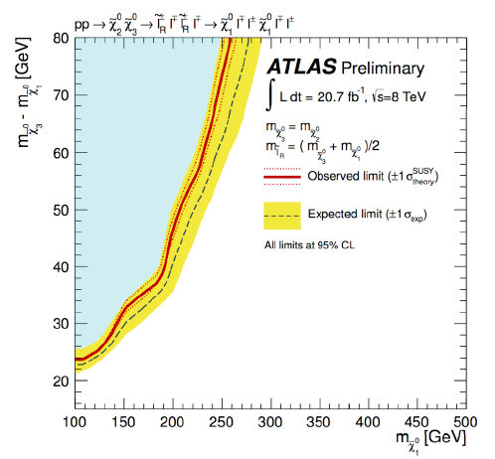
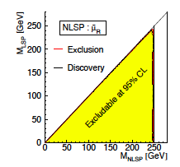
New Particle Search
ILC:
Good sensitivity up to kinematic limit for
(essentially) any mass difference
LHC:
Difficulty when mass difference is small
In general (even when no near degeneracy):
LHC can reach higher energy but could miss important phenomena:
  NB: At Tevatron, ~20000 Higgs were produced, but no clear signal was seen
Once found, ILC can measure its properties ~completely
ILC is good at unexpected phenomena

Slide 11
ILC Running Scenario
Need for a single ‘official’ running scenario
  Consistency among ILC presentations
  Realistic ramp up profiles and down times for upgrades
    Proof that stated luminosities can be taken in stated time
  Actual running scenario will depend on physics outcomes from LHC and ILC
ILC parameter joint WG
  Physics/Detector: Tim Barklow, Jim Brau (co-convener), Jenny List, Keisuke Fujii
  Accelerator: Gao Jie, Nick Walker (co-convener), Kaoru Yokoya

Slide 12
ILC Running Scenarios
ILC parameter WG produced two documents
  250 GeV start up ‘ILC staging and running scenarios’
  500 GeV start up ‘500 GeV ILC operating scenarios’
Merits for 500 GeV startup
  It is the TDR baseline
    TDR costing and construction schedule assume starting with 500 GeV
    (construction takes 1.5 yr longer than 250 GeV starup)
  Competitiveness vis a vis circular machine
    Higgs-top, Higgs-Higgs coupling
    Top physics (Z-top_{LR} for new physics)
    Absolute Higgs couplings (W-fusion Higgs production)
    New particle searches

Slide 13
Recommended ILC Running Scenario
After examining various channels, one scenario (500 GeV startup, 20 yr) is recommended (H20)
  To be approved by LCB
‘H20’
Reference:
Snowmass study

Slide 14
ILC Change Requests
A set of well-defined rules for updating the baseline design
Change Management Board
  Members:
    The ILC accelerator technical board members
    Two from the physics and detector community
      Jenny List (ILD, Physics)
      Tom Markiewicz (SiD, MDI)
MDI working group
  Actual work related to machine-detector interface issues
Change requests relevant to Phys&Det, so far
  Vertical shaft to detector hall (CR3)
  Common L* (CR2)
  Linac extension (new) (CR4)

Slide 15
Vertical Access (CR3)
Merits
  Allows CMS style detector assembly
    Assembled mostly on surface
    Shorten the overall schedule by ~1 year
    Cost is also reduced (probably)
    Safety (ease of escape)
Approved. Now it is part of the baseline

Slide 16
Common L* (CR2)
ILD
    Accelerator people want a common L* at around 4 m
SiD can accommodate a L* between 2.6-4.5m
  Minimum L* probably dictated by QD0 technology, not SiD
ILD needs some work
  Vacuum pump in front of QD0 can be removed?
  Studies (incl. beam backgrounds) are under way

Slide 17
Other WGs
Detector R&D liaison
  Compiling LC-related detector R&Ds
  Software efforts to be included
Software&computing
  Evaluating computing needs for the ILC
  Common software for ILD/SiD/CLICdp
ILC Conference talks
  Coordinating ILC-related talks at workshops
  To be extended to include ILC-related publications: under discussion
ILC infrastructure&planning
  Cost, manpower, and scheduling of the ILC detectors
  Input to the MEXT subcommittee

Slide 18
Possible Timeline of ILC Detectors
2014 2016 2018 2020’s
Deliberation by the Expert Committee
International Talks
ＩＬＣ lab extablished
Detector Proposals:
Open call, Submission, and Review
TDR completion
Construction
Detector groups are preparing for this period by
Re-optimizing their detectors and re-organizing.
Detector subsystem R&Ds are moving ahead.

Slide 19
SiD
SiD Workshops
Tokyo, Sep 2-3, 2014
SLAC, Jan 12-14, 2015
Critical review of SiD concept
Review technology options
How to proceed
P5 Recommendation 11 :
Motivated by the strong scientific importance of
the ILC and the recent initiative in Japan to
host it, the U.S. should engage in modest and
Appropriate levels of ILC accelerator and
detector design in areas where the U.S. can
contribute critical expertise. Consider higher
levels of collaboration if ILC proceeds.
Funding level for ILC detector Is, however, very low

Slide 20
SiD Organization
Adopted a formal organization: SiD consortium
  20 institutions signed

Slide 21
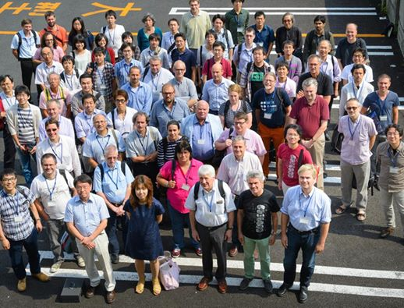
ILD
ILD Workshop
Oshu, Tohoku
Sep 6 – 9, 2014
85 registered participants
from 32 institutes
This meeting represented the start of a coherent optimization effort for ILD and the start of reorganisation.

Slide 22
ILD Organization
Current ILD member-list: grown to 63 institutes
Have established
membership
Chair of the Institute
assembly:
Jan Timmermans
NIKHEF

Slide 23
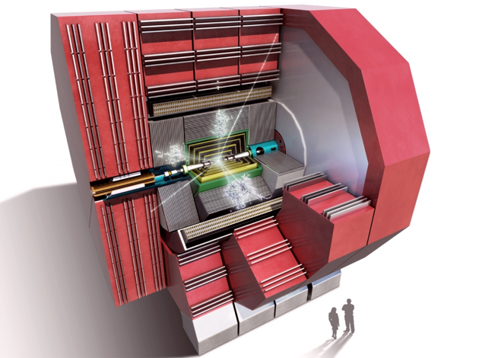
CLICdp: Synergy with ILC
ILC/CLIC synergies in many areas
CLIC CDR detector concepts are based on ILC concepts, adapted for CLIC
Common software tools
  Major upgrade of tools ongoing through a common ILC/CLIC effort
Overlapping physics case below 1 TeV
  Sharing methods; making cross-checks
Large overlap in detector technologies
  Strong synergies within CALICE and FCAL
  Synergies in engineering and magnet design
Ongoing detector optimisation for ILC and CLIC
  Overlapping activities; cross-checks
Flows are both ways
  e.g. 350 GeV study of CLIC → ILC
http://clicdp.web.cern.ch/
currently 25 institutes

Slide 24
Summary
We are working intensively to update the physics case of the ILC
One ILC running scenario is being defined
Overall, LCC PD working groups are very active
ILD and SiD are progressing ‘reasonably’ well
    Both groups are moving toward more well-defined organizations
    Overall detector designs are being re-optimized
  Lack of funding is particularly serious for SiD
Synergy of ILC detector efforts and CLICdp efforts are working out
productively and efficiently

