Slide 1
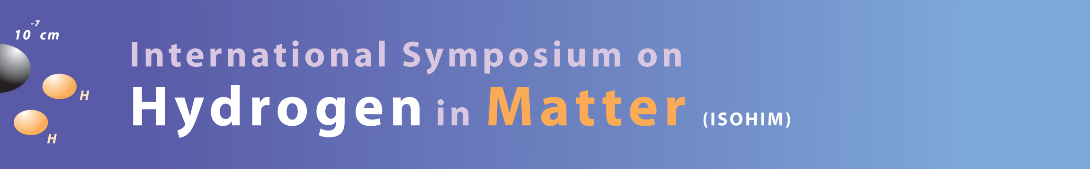
Environmental effects on the performance of high efficiency SRF cavities
Ganapati Myneni
& JLab
ALCW15-SRF-WG
KEK, Tsukuba, Japan
April 24, 2015

Slide 2
Introduction
Contamination from environment surrounding the SRF cavities always limits the performance of the linacs at all stages
  Intrinsic and extrinsic contamination
  Flux trapping
  Potential remedies
  Conclusions

Slide 3
Environmental contamination of Nb surfaces determines the performance of the cavities
Extrinsic
Intrinsic
Surface contamination
  Molecular and particulate
  During cavity processes
  Cryomodule assembly
  Operations (field emission enhancement)
Magnetic flux trapping
Niobium is a prolific hydrogen absorber in the absence of the natural surface oxide
  Hydride formation
  (Ti and N alloying help
  to prevent hydrides)
  Dislocations (residual stress)

Slide 4
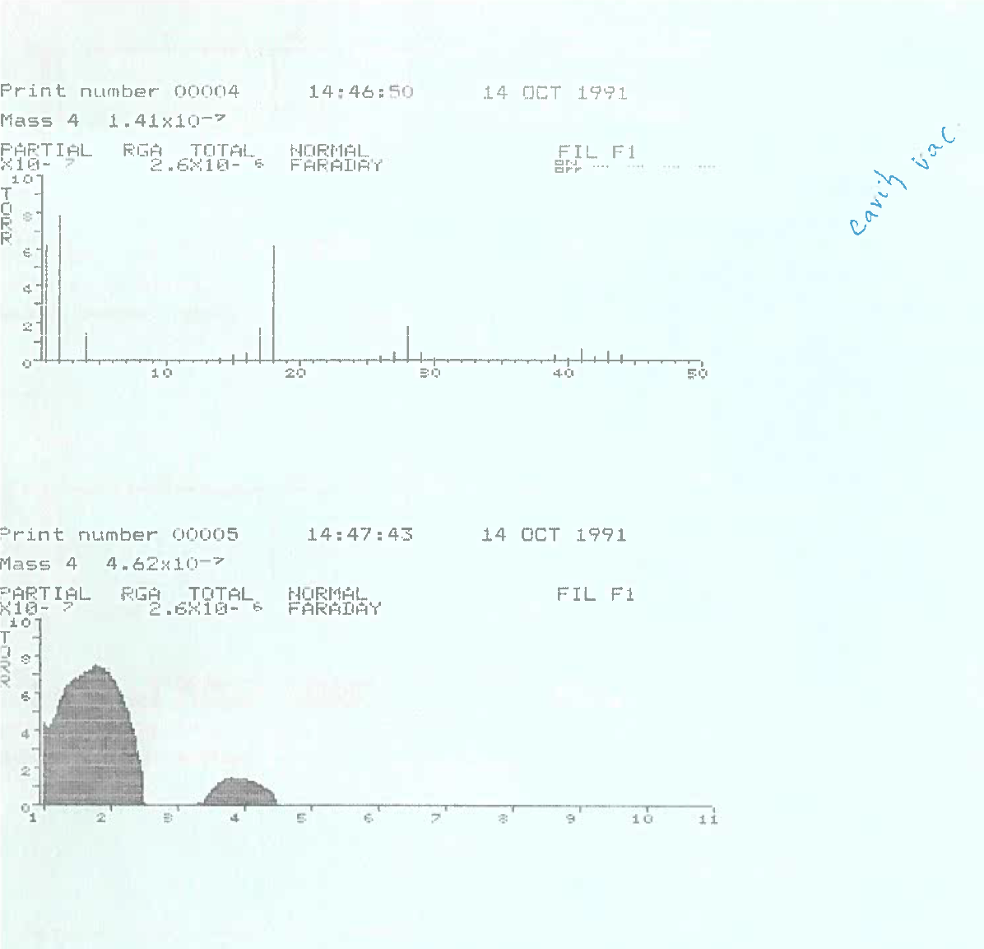
Oil contamination and vacuum leaks

Slide 5
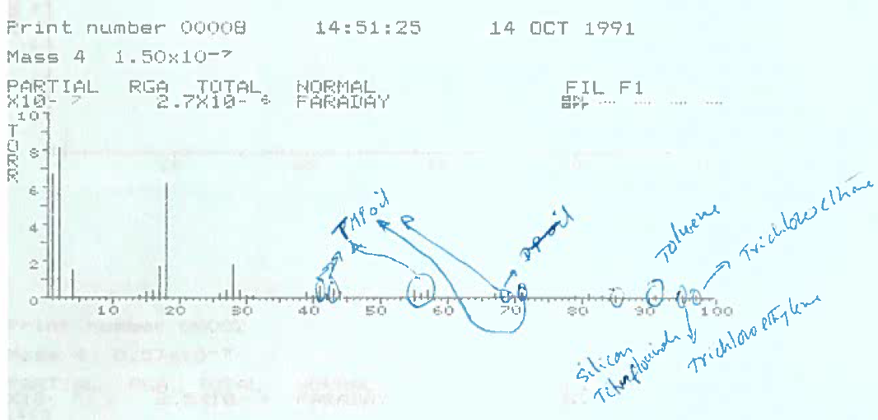

Slide 6
Multipactoring problem
T-map showing MP at equator
Gigi Ciovati
Re-contaminating vacuum systems drastically degrade the performance of the cavities

Slide 7
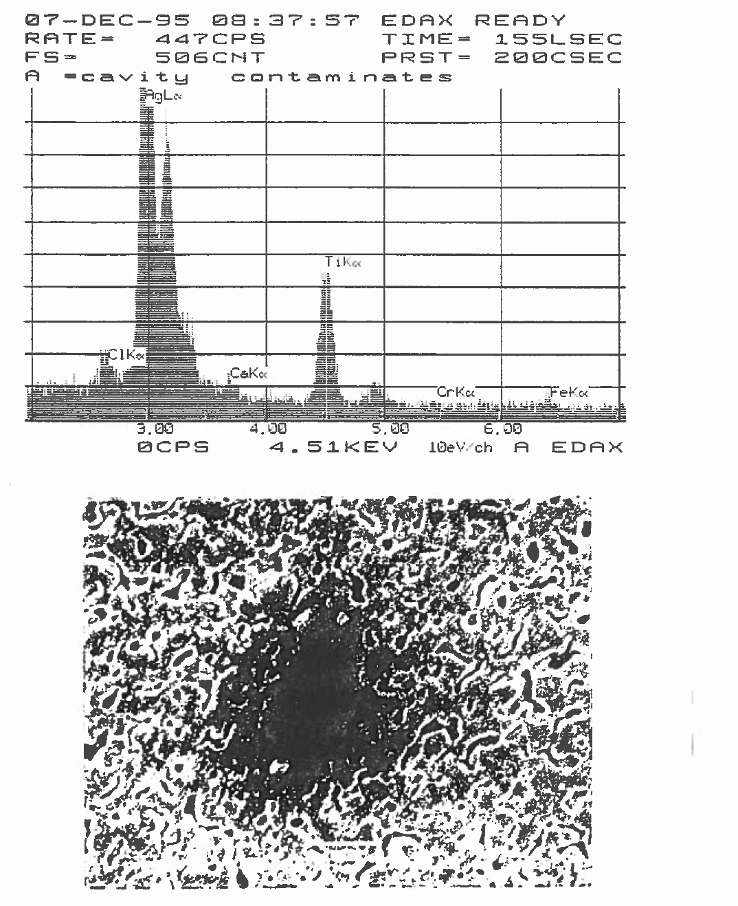

Slide 8
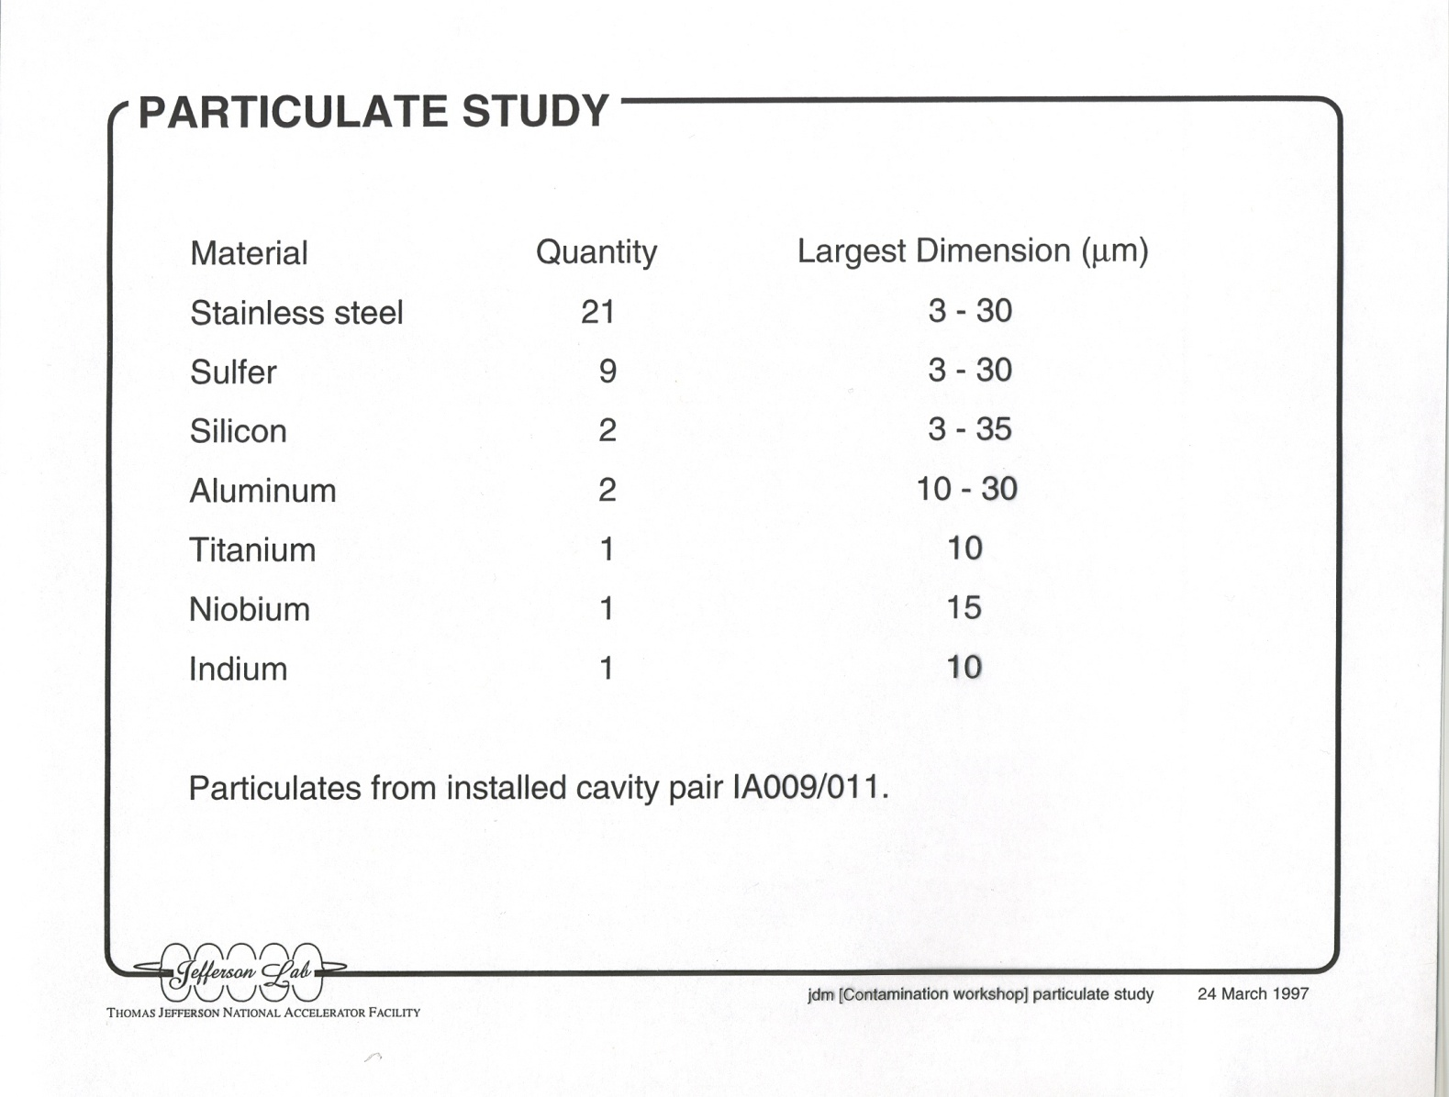
Particulates in the Cavity Pair

Slide 9
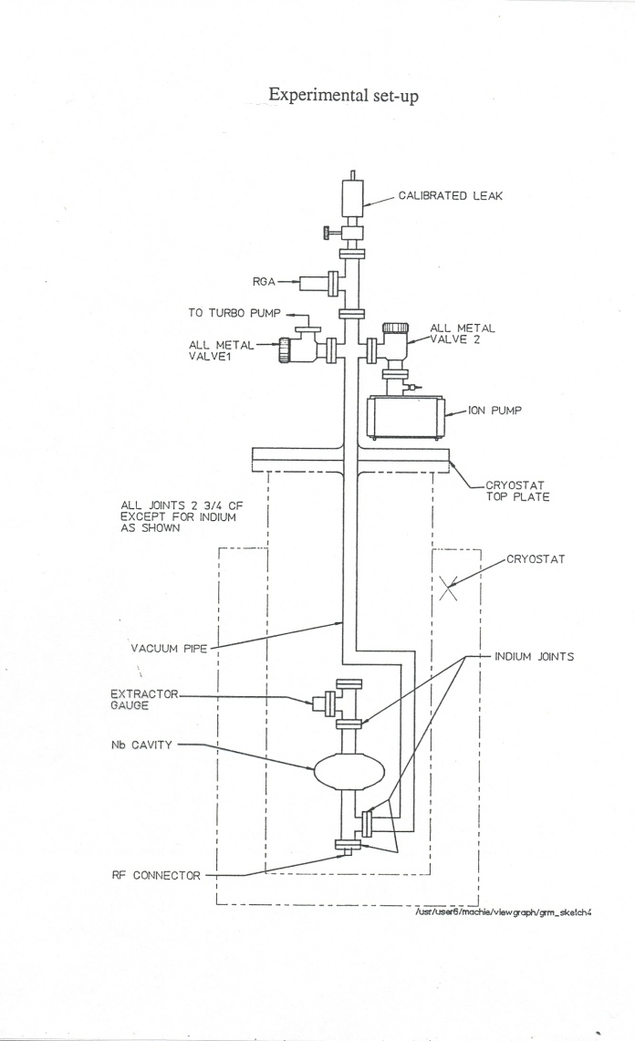
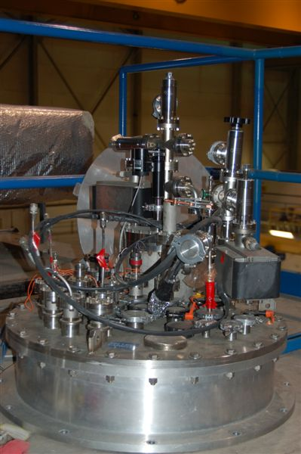
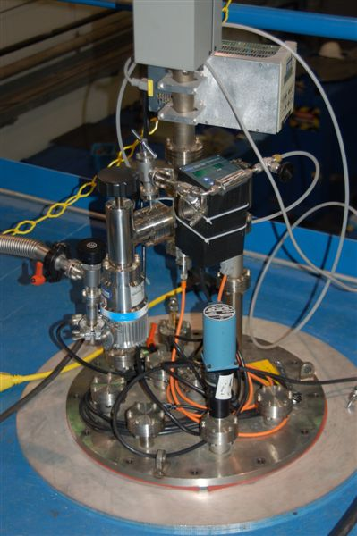
Evacuation is the Final Process step
Schematic of the cavity
test system
Ion-Turbo system
cross contamination,
particulate & hydro carbon problems
Improved turbo
pump system with minimum
contamination
Recontamination from vacuum systems is a major problem with SRF linacs

Slide 10
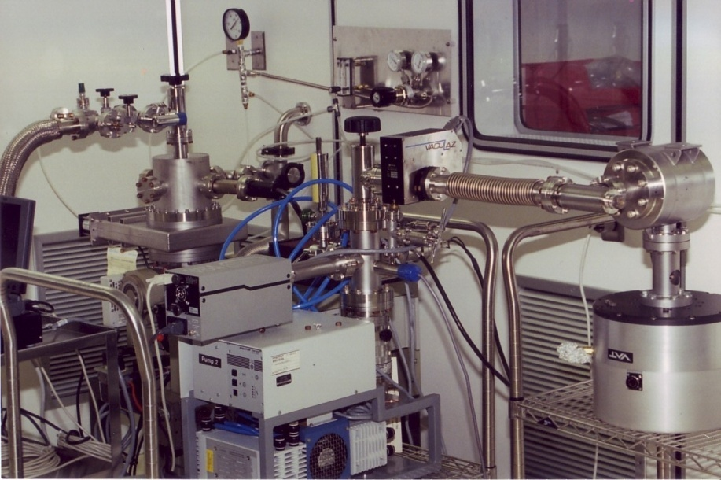
Comparison of oil and oil free vacuum systems
Minimizing organic and particulate recontamination is crucial

Slide 11
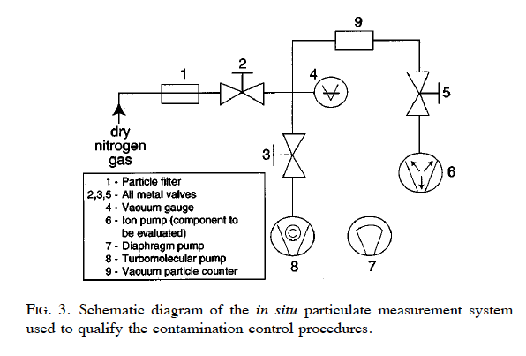
JLab’s FEL was the first SRF linac that implemented contamination control procedures

Slide 12
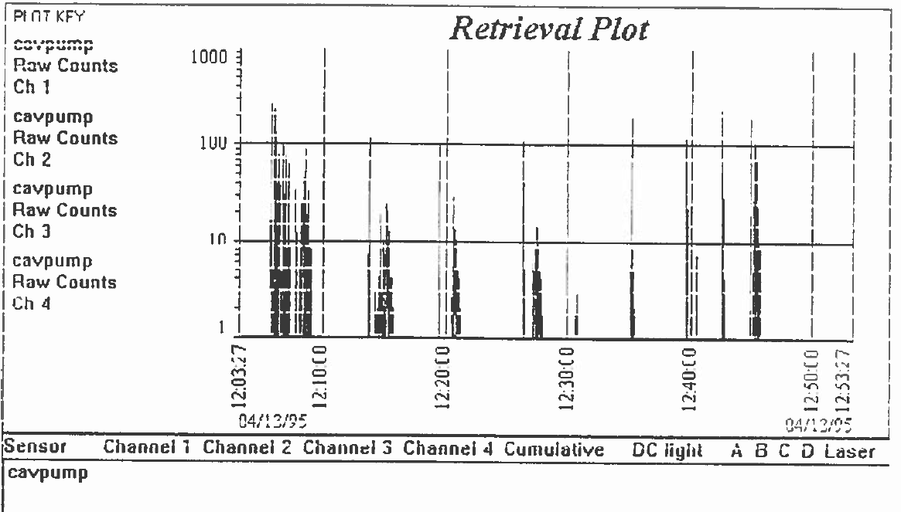

Slide 13
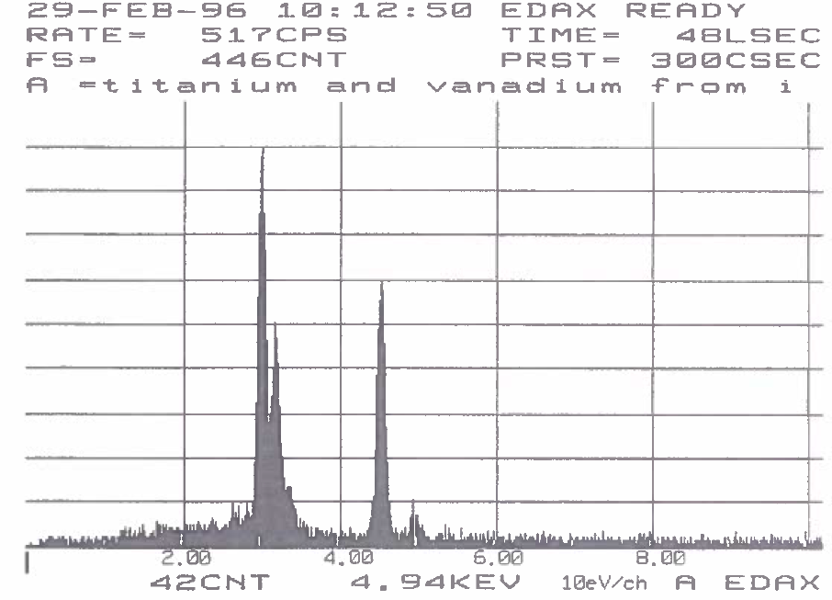

Slide 14
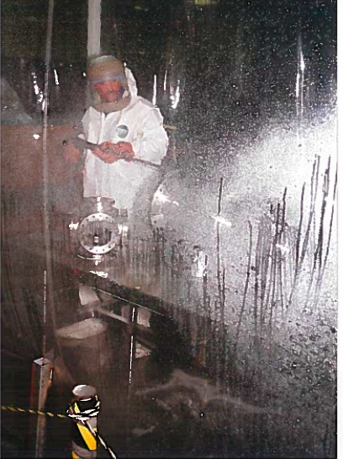

Slide 15
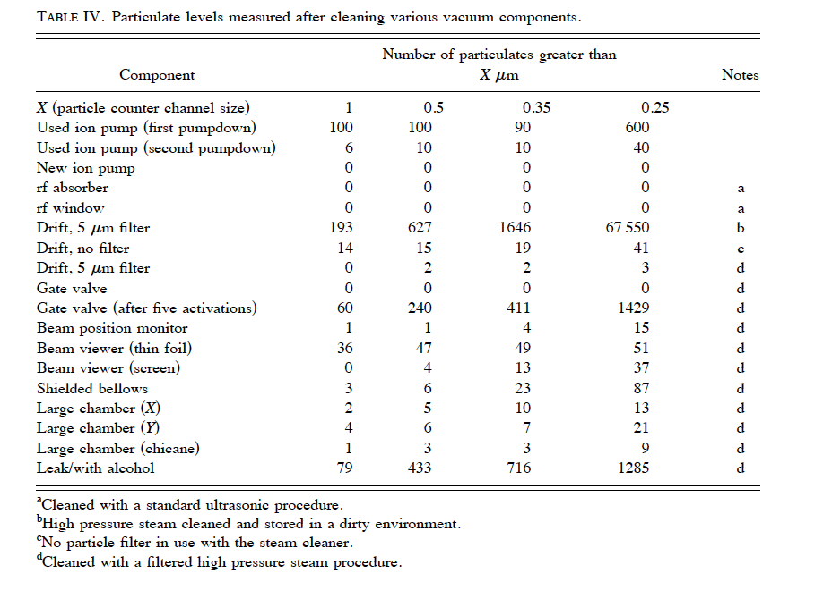

Slide 16
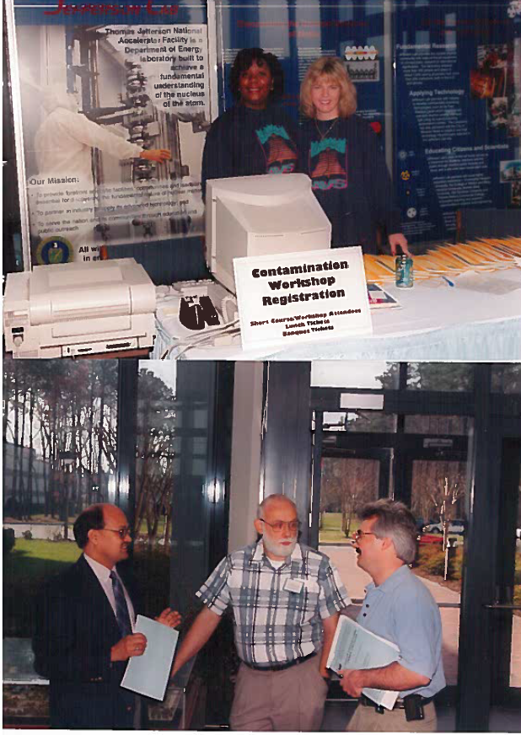
Contamination control workshop
was organized by Jlab - March 1997
JLab and DESY procedures were
reviewed during the first decade
of 21st century
CEA Saclay’s 2014 workshop
resurrected the contamination control
strategies
ILC project needs to convene periodic
review of environmental effects as it
requires very high gradient
sustainability at high Q’s
Re-contamination prevention short courses were
organized at JLab in 1997, 2000 and 2005

Slide 17
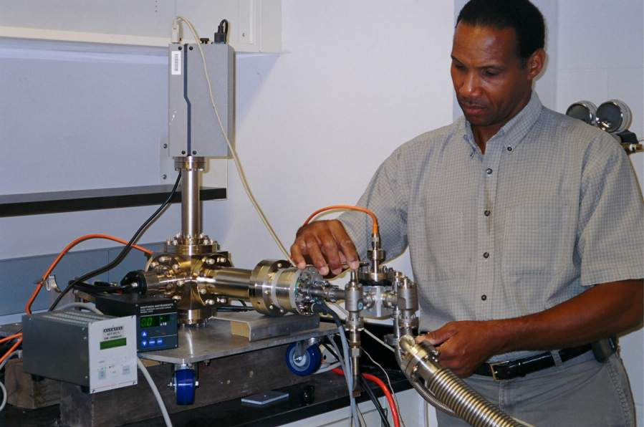
Active NEG backed turbo pump
Low contamination pumping system
with nano filter gas inlet and high sensitivity He leak detection <1e-12 atm ccs⁻¹

Slide 18
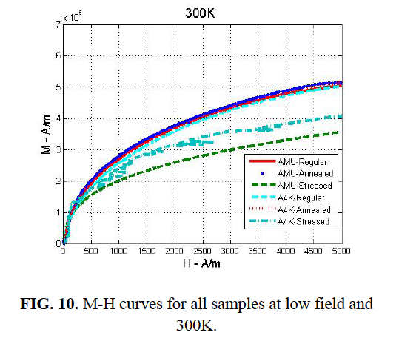
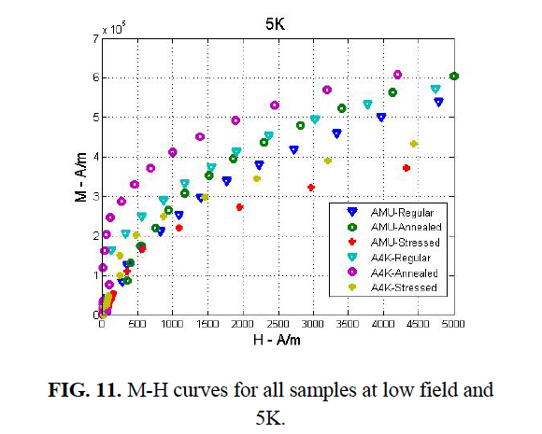
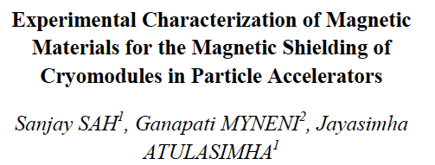
JLab-VCU magnetization studies
In press

Slide 19
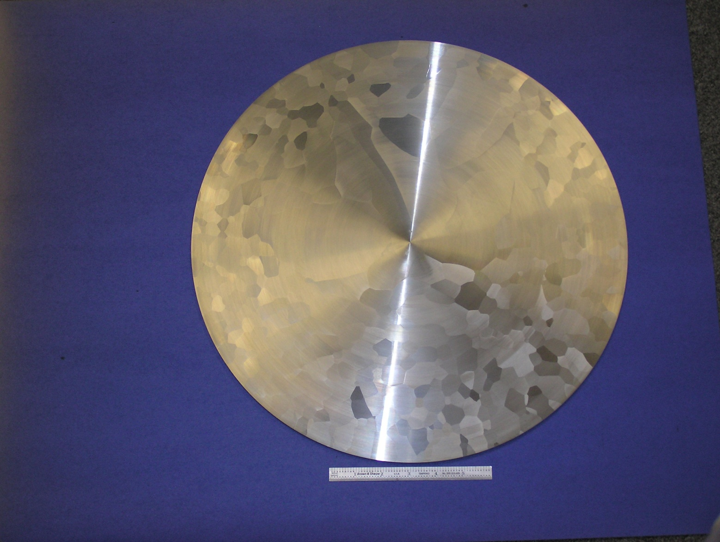
Low RRR uniform grain niobium ingot slice

Slide 20
Conclusions
Contamination free vacuum systems & particulate free components and processes are crucial for creating and sustaining high performance SRF linacs
Magnetic shielding sub-systems must be annealed for minimizing the trapped flux
Uniform grained ingot niobium technology can be expected to generate high performance, low cost and sustainable SRF accelerator systems

Slide 21
International Symposium On Hydrogen In Matter (ISOHIM) Publications
Hydrogen in Materials and Vacuum Systems AIP CP 671
http://www.virtualjournals.org/dbt/dbt.jsp?KEY=APCPCS&Volume=671&Issue=1
Hydrogen in Matter AIP CP 837
http://www.virtualjournals.org/dbt/dbt.jsp?KEY=APCPCS&Volume=837&Issue=1
Single Crystal Large Grain Niobium AIP CP 927
http://www.virtualjournals.org/dbt/dbt.jsp?KEY=APCPCS&Volume=927&Issue=1
Superconducting Science and Technology of Ingot Niobium AIP CP 1352 http://scitation.aip.org/dbt/dbt.jsp?KEY=APCPCS&Volume=1352&Issue=1
Science and Technology of Ingot Niobium for Superconducting Radio Frequecy Applications to be released Dec 2015

Slide 22
Worldwide network of collaborators
Tadeu Carneiro, Rogerio Ribas, Marcos Stuart – CBMM ingot niobium technology
F. Stevie, P. Maheswari (grad student), D. Griffis – NCSU niobium surface science
R. Ricker – NIST hydrogen-niobium system
J. Wallace – Casting Analysis Corporation co-PI DOE ONP ARRA Q₀ improvement program
Björgvin Hjörvarsson – Uppsala University hydrogen-niobium system
B. Lanford – UNY, Albany nuclear reaction analysis
R. Pike and summer student interns – W&M XRD analysis of niobium
Hani Elsayed-Ali, Ashraf Hassan Farha (grad student) – ODU niobium nitride
Asavari Dhavale & J. Mondal (grad students) – BARC/HBNI ingot niobium properties
Sindhunil Roy – RRCAT SC properties of niobium
Saravan Chandrasekaran – MSU ingot niobium properties
International Symposium On Hydrogen In Matter (ISOHIM) non profit organization for education/training
Acknowledgements to all colleagues at JLab

