Slide 1



TDR lattice (2015a)
review and status

Slide 2
Perspective
the last “official” release of ILC lattice description files (MAD8 Extended Standard Input Format), corresponding to the RDR, was designated “ILC2007b”
  http://www.slac.stanford.edu/accel/ilc/lattice/edr/ILC2007b
since then others have carried on the lattice work (SB2009, 2012 updates for CFS, the TDR)
goals of present work:
  collect set of most up-to-date decks which reflect the lattice described in the TDR
  integrate deck sets for major subsystems (eSource, pSource, DRs, ELET, PLET)
  reproduce TDR CFS geometry (EDMS Treaty Point coordinates)
  perform β-matching through all systems
last status report was at LCWS14 … I’ve been promising this release for more than a year!

Slide 3
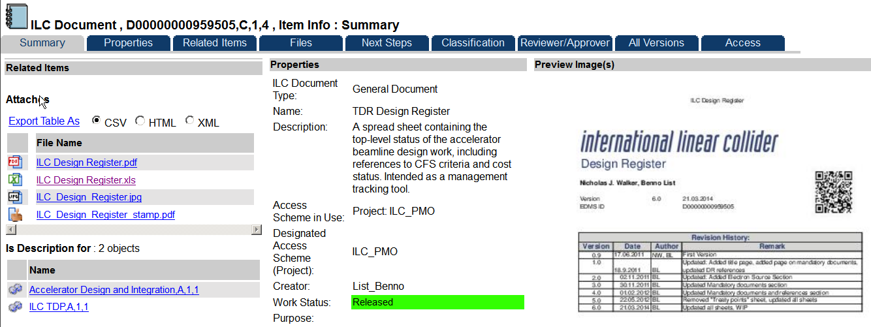
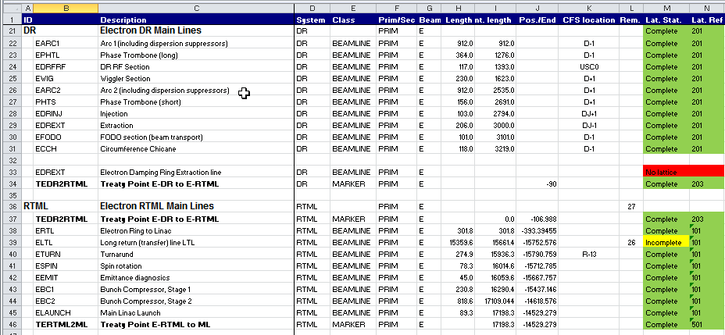
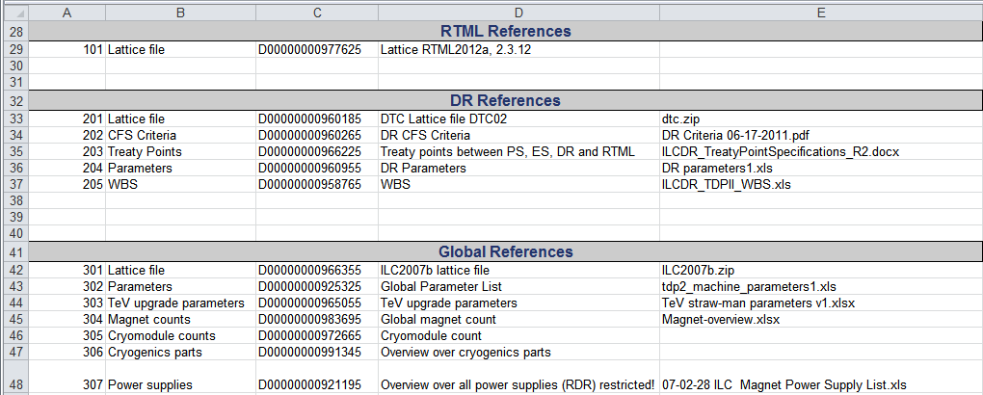
EDMS: ILC TDR Design Register
Thanks to Benno and to all
who helped to assemble the
brilliantly cross-referenced
EDMS document archive!

Slide 4
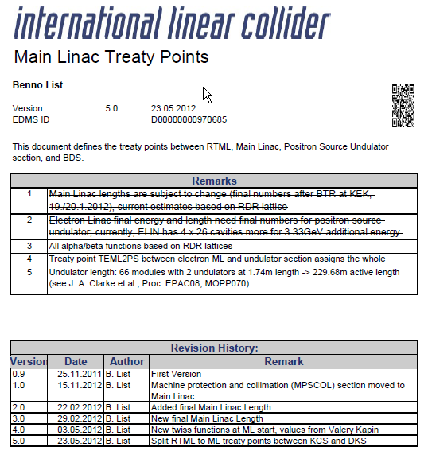
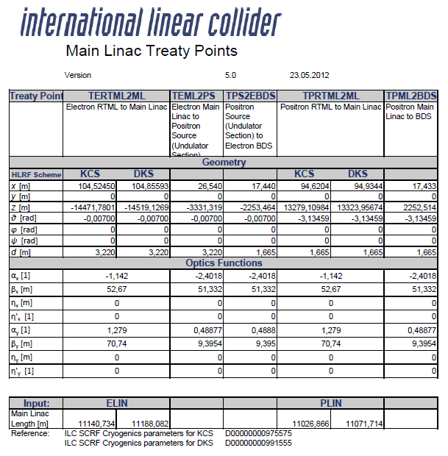
EDMS: Treaty Point Definitions
Absolutely essential!

Slide 5
Deck Files Obtained and Integrated
subsystems | source | doc / file | comments
ESOURCE | EDMS | D*0976695,B,1,1 ES2012a.zip | Design registry (exit of bunchers to end of ELTR)
EDR / PDR | EDMS | D*0960185,G,1,1 dtc04.zip | DTC04 lattice (3238.7 m DR circumference)
ERTML / PRTML | EDMS | ILC2021e_AV.zip from A. Saini | KCS lattice
EML / PML | DESY svn | ilclattice-ml-dks _BL20120608 .r234.tar.gz | A. Valishev / B. List DKS lattice: svn branch: ILC2012dks_ML_3RFU_VK201206 svn folder: ml-dks-BL20120608
EBDS / PBDS | EDMS | D*0972985,B,1,2 BDS2012b.zip | Glen White, Toshiyuki Okugi, Edu Marin, and others are updating the BDS lattices (tuning, collimation, MDI issues, etc.)
PSOURCE | EDMS | D*0977535,B,1,1 ps-lattice-2012a.zip | W. Liu / W. Gai TDR lattice described in IPAC2012 paper TUPPR041

Slide 6
Recreating the TDR CFS geometry
subsystems | comments
EDREXT / PDREXT EDRINJ / PDRINJ | created by MDW from: I. Reichel documents TDR text Treaty Point coordinate definitions
ETURN/PTURN | small geometry changes in horizontal and vertical doglegs
ELTL / PLTL | converted by MDW for DKS: shorten ELTL FODO cell: 36.809 m to 36.688 m (to keep LTL dogleg in previous location) lengthen PLTL FODO cell: 36.016 m to 36.149 m (ΔL = 47.224 m)
UPT | created by MDW (August 2014): END_EUND to target drift: L= 372.044 m
EBSY1 / EBSY2 PBSY1 / PBSY2 | Redefinition errors discovered during “deck integration”: polarimeter chicanes were copied from *BSY2 to *BSY1 as separate laserwire detection chicanes names of elements (bends and drifts) were not changed names of parameters that defined bend and drift lengths were not changed values of parameters that defined bend and drift lengths were changed in *BSY1 files when *BSY1 file is loaded, LW chicane is 45.1 m long when *BSY2 file is loaded, LW chicane is redefined to be 76.9 m long (ΔL = 31.8 m) TDR CFS coordinates include BSY LW chicanes that are each 31.8 m too long PBDS was 0.95 m shorter than EBDS due to rematching between PBSY and PFFS, so: shorten PMPSCOL by 0.95 m modify PBSY2 such that EBDS and PBDS are now identical redefine TDR CFS coordinates for TPML2BDS Treaty Point (e+) to be symmetric w.r.t. IP with TPS2EBDS treaty point (e-)

Slide 7
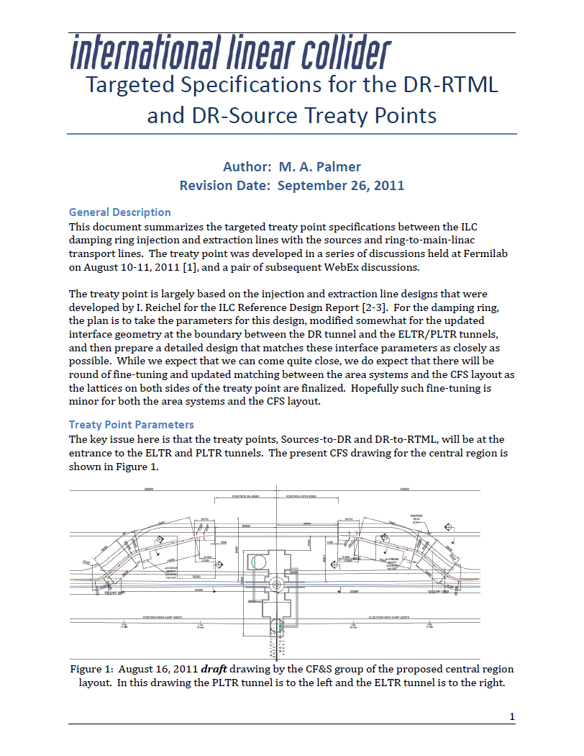
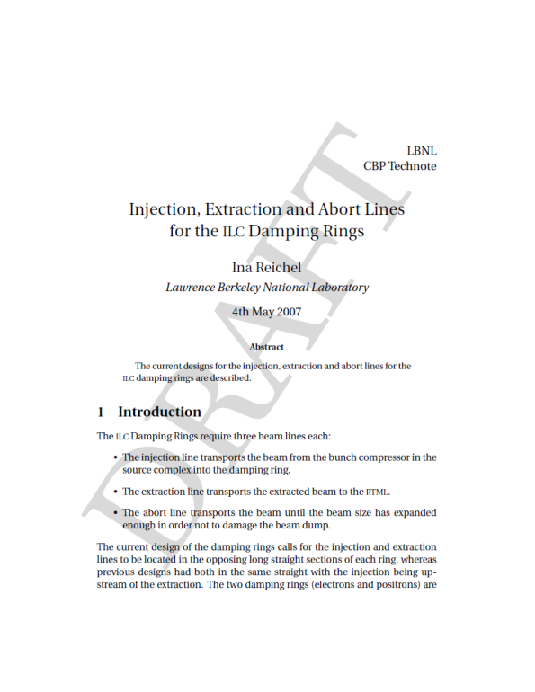
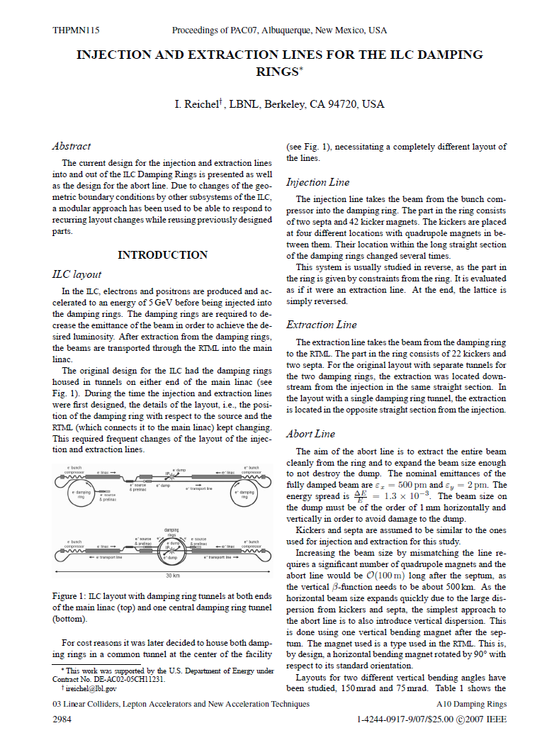
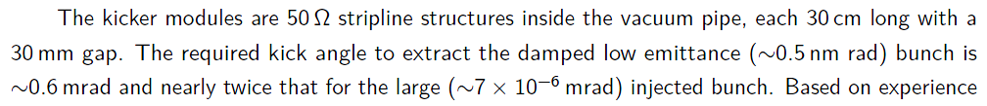
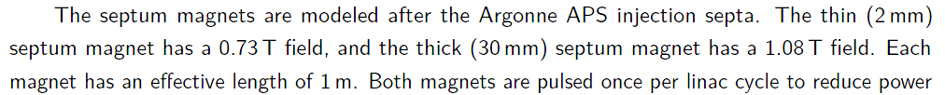
Damping Rings: Injection / Extraction
From the TDR (v3.II, section 6.9):

Slide 8
Positron Damping Ring (DTC04): Injection
bend
BL = 21.9 kG
septum 1 & 2
BL = 18.1 kG-m
33 kickers
Σθ = 1.2 mrad
84 mm
TPS2DR
X = 94.410 m
Y = 0.350 m
Z = -112.103 m
θ = 0.240 rad
TPS2DR
septum 1
exit face
kicker #33
exit face
center
of PDR
INJ/EXT
straight

Slide 9
Positron Damping Ring (DTC04): Extraction
33 kickers
Σθ = 0.6 mrad
septum 1 & 2
BL = 18.1 kG-m
bend
BL = 21.9 kG
42 mm
TPDR2RTML
X = 94.410 m
Y = 0.350 m
Z = 106.988 m
θ = -0.240 rad
center
of PDR
INJ/EXT
straight
kicker #1
entrance
face
septum 1
entrance
face
TPDR2RTML

Slide 10
eSource + eDR + eLET + UPT + pSource + pDR + pLET
DR INJ/EXT straight
centerline
X = 100.000 m
Y_{e+} = 0.350 m
Y_{e-} = 1.650 m
Z = 0.000 m
θ_{e+} = 0.000 rad
θ_{e-} = π rad
IP
X = 0.000 m
Y = 0.000 m
Z = 0.000 m
θ_{e+} = π + 0.007 rad
θ_{e-} = -0.007 rad
undulator
photons
e- systems
e+ systems

Slide 11
Close-up: Central Region
TPS2DR
ΔX = 0.000 mm
ΔY = 0.000 mm
ΔZ = 0.000 mm
|Δ| = 0.000 mm
TES2DR
ΔX = 0.000 mm
ΔY = 0.000 mm
ΔZ = 0.000 mm
|Δ| = 0.000 mm
e+ target
ΔX = 0.645 mm
ΔY = 0.000 mm
ΔZ = 0.000 mm
|Δ| = 0.645 mm
IP (e-)
ΔX = 0.369 mm
ΔY = 0.000 mm
ΔZ = 0.003 mm
|Δ| = 0.369 mm
IP (e+)
ΔX = -0.085 mm
ΔY = 0.000 mm
ΔZ = 0.001 mm
|Δ| = 0.085 mm
PSUNDD
EBSYD
PBSYD

Slide 12
Close-up: Turnarounds
EBC1D
PBC1D
EBC2D
PBC2D

Slide 13
Close-up: Central Region (2)
e- side
e+ side

Slide 14
ILC2015a:
Treaty Points
Actual MAD8 SURVEY output:
eSource (to DR injection septa)
eLET (DR extraction septa to post-IP dump)
UPT (undulator end to e+ production target)
pSource (e + production target to DR injection septa)
pLET (DR extraction septa to post-IP dump)

Slide 15
e- Treaty Point Coordinates
Treaty Point | Description | S | X | Y | Z | Yaw
 |  | m | m | m | m | rad
TECHIC | after e- bunchers | 0.000000 | 8.918554 | 0.000000 | 814.111109 | 3.148593
TECHIC2BSTR | start of e- booster linac | 48.243465 | 8.582209 | 0.000000 | 766.062621 | 3.148593
TEBSTR2LTR | end of e- booster linac | 385.625704 | 6.220552 | 0.000000 | 428.688648 | 3.148593
TES2DR | eSource/eDR interface | 732.120294 | 97.812355 | 1.650000 | 98.199761 | 2.901593
TEDRISEPT | start of eDR injection septa | 751.737194 | 99.915998 | 1.650000 | 78.707370 | 3.141594
TEDRINJ | end of eDR injection kicker chain | 810.337194 | 100.000000 | 1.650000 | 20.107370 | 3.141593
TEDR | center of eDR Inj/Ext straight | 830.444564 | 100.000000 | 1.650000 | 0.000000 | 3.141593
TEDREXT | start of eDR extraction kicker chain | 0.000000 | 100.000000 | 1.650000 | -15.192630 | 3.141593
TEDRXSEPT | end of eDR extraction septa | 73.592630 | 99.958001 | 1.650000 | -73.592630 | 3.141594
TEDR2RTML | eDR/eRTML interface | 107.530061 | 94.410000 | 1.650000 | -106.988000 | 3.381593
TERTL2LTL | start of e- “getaway” | 409.335855 | 4.418560 | 1.650000 | -393.394549 | 3.134593
TELTL2TURN | start of e- turnaround | 15758.676700 | 115.617751 | 1.650000 | -15742.300760 | 3.134593
TETURN2SPIN | start of e- spin rotation | 16033.576700 | 108.708520 | 0.000000 | -15780.486230 | 6.414619
TESPIN2BC1 | start of e- bunch compressor #1 | 16156.697500 | 112.825741 | 0.000000 | -15657.657030 | 6.276185
TEBC12BC2 | start of e- bunch compressor #2 | 16387.542270 | 111.211172 | 0.000000 | -15427.003400 | 6.276185
TERTML2ML | start of e- Main Linac | 17295.468720 | 104.855930 | 0.000000 | -14519.126900 | 6.276185
TEML2MPSCOL | start of e- MPS collimation | 28401.188720 | 27.116525 | 0.000000 | -3413.678989 | 6.276185
TEML2PS | eML/pSource interface | 28483.550730 | 26.539996 | 0.000000 | -3331.319000 | 6.276185
TEMPSCOL2UND | start of e- undulator | 28483.550730 | 26.539996 | 0.000000 | -3331.319000 | 6.276185
TEUND2DOGLEG | start of e- dogleg | 29137.850940 | 21.959932 | 0.000000 | -2677.034820 | 6.276185
TPS2EBDS | pSource/eBDS interface | 29561.448190 | 17.440139 | 0.000000 | -2253.463999 | 6.276185
TEBDS2FF | end of e- BSY; start of e- FF | 30232.661660 | 12.741683 | 0.000000 | -1582.266996 | 6.276185
TEIP | Interaction Point | 31814.980730 | 0.000369 | 0.000000 | 0.000003 | 6.276185
TEDUMP | end of primary e- dump line | 32115.563200 | -2.103690 | 0.000000 | 300.575054 | 6.276185
TERTL2RTLD | start of e- RTL abort/tuneup line | 256.236465 | 56.964009 | 1.650000 | -250.762131 | 3.549593
TERTLD | end of e- RTL abort/tuneup line | 296.136464 | 45.813812 | 1.650000 | -288.541722 | 3.142033
TEBC12BC1D | start of e- BC1 abort/tuneup line | 16356.342270 | 111.429571 | 0.000000 | -15458.202640 | 6.276185
TEBC1D | end of e- BC1 abort/tuneup line | 16397.742270 | 105.850529 | 0.000000 | -15417.750220 | 5.868883
TEBC22BC2D | start of e- BC2 abort/tuneup line | 17251.368720 | 105.164627 | 0.000000 | -14563.225820 | 6.276185
TEBC2D | end of e- BC2 abort/tuneup line | 17319.068720 | 99.760977 | 0.000000 | -14495.946090 | 6.086972
TEUND2UNDD | start of e- undulator abort line | 28560.140150 | 26.003874 | 0.000000 | -3254.731459 | 6.276185
TEUNDD | end of e- undulator abort line | 28953.636050 | 19.726154 | 0.000000 | -2787.687740 | 6.267185
TEBSY2BSYD | start of e- BSY abort/tuneup line | 29972.315240 | 14.564093 | 0.000000 | -1842.607025 | 6.276185
TEBSYD | end of e- BSY abort/tuneup line | 30775.728206 | 8.293023 | 0.000000 | -1376.513271 | -0.016001

Slide 16
e+ Treaty Point Coordinates
Treaty Point | Description | S | X | Y | Z | Yaw
 |  | m | m | m | m | rad
TEUND2PTGT | end of e- undulator | 0.000000 | 21.959932 | 0.000000 | -2677.034820 | 6.276185
TPTGT | e+ production target | 372.043940 | 19.355645 | 0.000000 | -2305.000000 | -0.007000
TPTGT2CAP | start of e+ capture | 390.019040 | 19.229821 | 0.000000 | -2287.025340 | -0.007000
TPCAP2PPA | start of e+ pre-acceleration | 481.522929 | 18.590086 | 0.000000 | -2195.636160 | -0.007000
TPPA2TRANL | start of e+ low energy transport | 530.129437 | 18.249843 | 0.000000 | -2147.030843 | -0.007000
TPTRANL2BSTR | start of e+ booster linac | 941.729437 | 15.368667 | 0.000000 | -1735.440927 | -0.007000
TPBSTR2TRANH | start of e+ high energy transport | 1314.287815 | 12.760779 | 0.000000 | -1362.891677 | -0.007000
TPTRANH2LTR | start of e+ LTR | 2248.517095 | 6.221228 | 0.000000 | -428.685285 | -0.007000
TPS2DR | pSource/pDR interface | 2580.749942 | 94.410000 | 0.350000 | -112.103000 | 0.240001
TPDRISEPT | start of pDR injection septa | 2614.680336 | 99.915998 | 0.350000 | -78.707370 | -0.000002
TPDRINJ | end of pDR injection kicker chain | 2673.280336 | 100.000000 | 0.350000 | -20.107370 | 0.000000
TPDR | center of pDR Inj/Ext straight | 2693.387706 | 100.000000 | 0.350000 | 0.000000 | 0.000000
TPDREXT | start of pDR extraction kicker chain | 0.000000 | 100.000000 | 0.350000 | 15.192630 | 0.000000
TPDRXSEPT | end of pDR extraction septa | 15.192630 | 99.958001 | 0.350000 | 73.592630 | -0.000001
TPDR2RTML | pDR/pRTML interface | 49.130061 | 94.410000 | 0.350000 | 106.988000 | -0.240000
TPRTL2LTL | start of e+ “getaway” | 350.936762 | 4.423948 | 1.650000 | 393.372529 | 0.007000
TPLTL2TURN | start of e+ turnaround | 14505.068590 | 105.701928 | 1.650000 | 14547.130730 | 0.007000
TPTURN2SPIN | start of e+ spin rotation | 14779.968590 | 98.787051 | 0.000000 | 14585.316070 | -3.273026
TPSPIN2BC1 | start of e+ bunch compressor #1 | 14903.089380 | 102.904272 | 0.000000 | 14462.486870 | -3.134593
TPBC12BC2 | start of e+ bunch compressor #2 | 15133.934160 | 101.289636 | 0.000000 | 14231.833240 | -3.134593
TPRTML2ML | start of e+ Main Linac | 16041.860610 | 94.934400 | 0.000000 | 13323.956740 | -3.134593
TPML2MPSCOL | start of e+ MPS collimation | 27031.212610 | 18.009564 | 0.000000 | 2334.873978 | -3.134593
TPML2BDS | pML/pBDS interface | 27112.624580 | 17.439685 | 0.000000 | 2253.464002 | -3.134593
TPBDS2FF | end of e+ BSY; start of e+ FF | 27783.838060 | 12.741229 | 0.000000 | 1582.266999 | -3.134593
TPIP | Interaction Point | 29366.157130 | -0.000085 | 0.000000 | 0.000001 | -3.134593
TPDUMP | end of primary e+ dump line | 29666.739590 | -2.104144 | 0.000000 | -300.575051 | -3.134593
TPRTL2RTLD | start of e+ RTL abort/tuneup line | 197.837372 | 56.969398 | 1.650000 | 250.740110 | -0.408000
TPRTLD | end of e+ RTL abort/tuneup line | 237.737372 | 45.928849 | 1.650000 | 288.541636 | 0.004441
TPBC12BC1D | start of e+ BC1 abort/tuneup line | 15102.734160 | 101.508034 | 0.000000 | 14263.032480 | -3.134593
TPBC1D | end of e+ BC1 abort/tuneup line | 15144.134160 | 95.808605 | 0.000000 | 14222.606980 | -2.722435
TPBC22BC2D | start of e+ BC2 abort/tuneup line | 15997.760610 | 95.243097 | 0.000000 | 13368.055660 | -3.134593
TPBC2D | end of e+ BC2 abort/tuneup line | 16065.460610 | 89.586617 | 0.000000 | 13300.806080 | -2.939806
TPBSY2BSYD | start of e+ BSY abort/tuneup line | 27523.491650 | 14.563639 | 0.000000 | 1842.607017 | -3.134593
TPBSYD | end of e+ BSY abort/tuneup line | 28385.304580 | 8.285920 | 0.000000 | 1375.563309 | 3.157593

Slide 17
e- Treaty Point Twiss parameters
 |  | X |  |  |  | Y
Treaty Point | Description | β | α | η | η’ | β | α | η | η’
 |  | m |  | m |  | m |  | m
TECHIC | start of e- chicane | 8.692797 | -0.444200 | 0.000000 | 0.000000 | 15.953767 | -0.882300 | 0.000000 | 0.000000
TECHIC2BSTR | start of e- booster linac | 2.316036 | 1.174228 | 0.000000 | 0.000000 | 2.316036 | -1.174228 | 0.000000 | 0.000000
TEBSTR2LTR | start of e- LTR | 17.732206 | -2.748741 | 0.000000 | 0.000000 | 14.679337 | 1.230213 | 0.000000 | 0.000000
TES2DR | eSource/eDR interface | 45.941597 | 0.519403 | 0.000000 | 0.000000 | 11.197985 | 0.016646 | 0.000000 | 0.000000
TEDRISEPT | start of eDR injection septa | 70.022514 | -0.017843 | -0.002431 | -0.000090 | 6.330782 | -0.205809 | 0.000000 | 0.000000
TEDRINJ | end of eDR injection kicker chain | 70.972329 | -0.117871 | 0.000000 | 0.000000 | 17.279650 | -1.358325 | 0.000000 | 0.000000
TEDR | center of eDR Inj/Ext straight | 19.224365 | -0.135472 | 0.000000 | 0.000000 | 73.462831 | -0.034869 | 0.000000 | 0.000000
TEDREXT | start of eDR extraction kicker chain | 70.926197 | 0.115013 | 0.000000 | 0.000000 | 16.743229 | 1.325399 | 0.000000 | 0.000000
TEDRXSEPT | end of eDR extraction septa | 70.022063 | 0.017843 | -0.041848 | 0.001534 | 6.330940 | 0.205799 | 0.000000 | 0.000000
TEDR2RTML | eDR/eRTML interface | 11.934661 | 0.430680 | 0.000000 | 0.000000 | 14.831179 | 1.547110 | 0.000000 | 0.000000
TERTL2LTL | start of e- getaway | 1.655533 | 0.525789 | 0.000000 | 0.000000 | 8.822188 | -2.503966 | 0.000000 | 0.000000
TELTL2TURN | start of e- turnaround | 10.944657 | 3.039304 | 0.000000 | 0.000000 | 1.259472 | -0.425134 | 0.000000 | 0.000000
TETURN2SPIN | start of e- spin rotation | 6.704446 | 0.633287 | 0.000000 | 0.000000 | 6.963221 | 0.889879 | 0.000000 | 0.000000
TESPIN2BC1 | start of e- bunch compressor #1 | 3.399946 | -1.087918 | 0.000000 | 0.000000 | 3.764517 | 1.190676 | 0.000000 | 0.000000
TEBC12BC2 | start of e- bunch compressor #2 | 78.359911 | 2.329598 | 0.000000 | 0.000000 | 9.543245 | -0.733813 | 0.000000 | 0.000000
TERTML2ML | start of e- Main Linac | 64.068433 | 1.160769 | 0.000000 | 0.000000 | 75.297201 | -1.215643 | 0.000000 | 0.000000
TEML2MPSCOL | start of e- MPS collimation | 91.477652 | -1.707920 | 0.000000 | 0.000000 | 22.961751 | 0.815368 | 0.000000 | 0.000000
TEML2PS | eML/pSource interface | 53.912949 | -2.362881 | 0.000000 | 0.000000 | 13.918641 | 0.836408 | 0.000000 | 0.000000
TEMPSCOL2UND | start of e- undulator | 53.912949 | -2.362881 | 0.000000 | 0.000000 | 13.918641 | 0.836408 | 0.000000 | 0.000000
TEUND2DOGLEG | start of e- dogleg | 63.508534 | -0.000001 | 0.000000 | 0.000000 | 36.626566 | 0.000018 | 0.000000 | 0.000000
TPS2EBDS | pSource/eBDS interface | 51.329893 | -2.401762 | 0.000000 | 0.000000 | 9.395810 | 0.488825 | 0.000000 | 0.000000
TEBDS2FF | start of e- Final Focus | 120.319441 | -0.371588 | 0.000000 | 0.000000 | 200.149508 | -0.924637 | 0.000000 | 0.000000
TERTL2RTLD | start of e- RTL abort/tuneup line | 42.391657 | 2.310940 | 0.000000 | 0.000000 | 6.225783 | -0.845033 | 0.000000 | 0.000000
TEBC12BC1D | start of e- BC1 abort/tuneup line | 37.537934 | 2.304150 | 0.000000 | 0.000000 | 5.873474 | -0.777073 | 0.000000 | 0.000000
TEBC22BC2D | start of e- BC2 abort/tuneup line | 72.260666 | 2.221088 | 0.000000 | 0.000000 | 7.263371 | -1.448825 | 0.000000 | 0.000000
TEUND2UNDD | start of e- undulator abort line | 287.855263 | 3.201118 | 0.000000 | 0.000000 | 65.703007 | 2.023820 | 0.000000 | 0.000000
TEBSY2BSYD | start of e- BSY abort/tuneup line | 287.855263 | 3.201118 | 0.000000 | 0.000000 | 65.703007 | 2.023820 | 0.000000 | 0.000000

Slide 18
e+ Treaty Point Twiss parameters
 |  | X |  |  |  | Y
Treaty Point | Description | β | α | η | η’ | β | α | η | η’
 |  | m |  | m |  | m |  | m
TEUND2PTGT | end of e- undulator | 63.508534 | -0.000001 | 0.000000 | 0.000000 | 36.626566 | 0.000018 | 0.000000 | 0.000000
TPTGT2CAP | start of e+ capture | 1.667821 | 0.000000 | 0.000000 | 0.000000 | 1.667821 | 0.000000 | 0.000000 | 0.000000
TPCAP2PPA | start of e+ pre-acceleration | 1.667821 | 0.000000 | 0.000000 | 0.000000 | 1.667821 | 0.000000 | 0.000000 | 0.000000
TPPA2TRANL | start of e+ low energy transport | 5.009221 | 0.455210 | 0.000000 | 0.000000 | 28.195546 | -2.407300 | 0.000000 | 0.000000
TPTRANL2BSTR | start of e+ booster linac | 28.195546 | -2.407300 | 0.000000 | 0.000000 | 5.009221 | 0.455210 | 0.000000 | 0.000000
TPBSTR2TRANH | start of e+ high energy transport | 38.938852 | -1.068935 | 0.000000 | 0.000000 | 38.938852 | 1.068935 | 0.000000 | 0.000000
TPTRANH2LTR | start of e+ LTR | 9.750866 | -3.306658 | 0.000000 | 0.000000 | 16.710181 | 1.848814 | 0.000000 | 0.000000
TPS2DR | pSource/pDR interface | 7.886916 | 1.052761 | 0.000000 | 0.000000 | 9.476504 | -1.239600 | 0.000000 | 0.000000
TPDRISEPT | start of pDR injection septa | 70.022514 | -0.017843 | 0.004004 | 0.000148 | 6.330782 | -0.205809 | 0.000000 | 0.000000
TPDRINJ | end of pDR injection kicker chain | 70.972329 | -0.117871 | 0.000000 | 0.000000 | 17.279650 | -1.358325 | 0.000000 | 0.000000
TPDR | center of pDR Inj/Ext straight | 19.224365 | -0.135472 | 0.000000 | 0.000000 | 73.462831 | -0.034869 | 0.000000 | 0.000000
TPDREXT | start of pDR extraction kicker chain | 70.926197 | 0.115013 | -0.000060 | 0.000001 | 16.743229 | 1.325399 | 0.000000 | 0.000000
TPDRXSEPT | end of pDR extraction septa | 70.022063 | 0.017843 | 0.041848 | -0.001534 | 6.330940 | 0.205799 | 0.000000 | 0.000000
TPDR2RTML | pDR/pRTML interface | 11.931984 | 0.430958 | 0.000000 | 0.000000 | 14.839667 | 1.546689 | 0.000000 | 0.000000
TPRTL2LTL | start of e+ “getaway” | 1.655533 | 0.525789 | 0.000000 | 0.000000 | 8.822188 | -2.503966 | 0.000000 | 0.000000
TPLTL2TURN | start of e+ turnaround | 10.944657 | 3.039304 | 0.000000 | 0.000000 | 1.259470 | -0.425128 | 0.000000 | 0.000000
TPTURN2SPIN | start of e+ spin rotation | 6.704446 | 0.633287 | 0.000000 | 0.000000 | 6.963221 | 0.889879 | 0.000000 | 0.000000
TPSPIN2BC1 | start of e+ bunch compressor #1 | 3.399946 | -1.087918 | 0.000000 | 0.000000 | 3.764517 | 1.190676 | 0.000000 | 0.000000
TPBC12BC2 | start of e+ bunch compressor #2 | 78.359911 | 2.329598 | 0.000000 | 0.000000 | 9.543245 | -0.733813 | 0.000000 | 0.000000
TPRTML2ML | start of e+ Main Linac | 60.495848 | -1.097760 | 0.000000 | 0.000000 | 79.077841 | 1.270972 | 0.000000 | 0.000000
TPML2MPSCOL | start of e+ MPS collimation | 72.467322 | -1.543842 | 0.000000 | 0.000000 | 36.223728 | 1.105583 | 0.000000 | 0.000000
TPML2BDS | pML/pBDS interface | 51.329718 | -2.401757 | 0.000000 | 0.000000 | 9.395846 | 0.488830 | 0.000000 | 0.000000
TPBDS2FF | start of e- Final Focus
TPRTL2RTLD | start of e+ RTL abort/tuneup line | 42.391657 | 2.310940 | 0.000000 | 0.000000 | 6.225783 | -0.845033 | 0.000000 | 0.000000
TPBC12BC1D | start of e+ BC1 abort/tuneup line | 37.537934 | 2.304150 | 0.000000 | 0.000000 | 5.873474 | -0.777073 | 0.000000 | 0.000000
TPBC22BC2D | start of e+ BC2 abort/tuneup line | 76.478088 | 2.363521 | 0.000000 | 0.000000 | 7.864067 | -1.506466 | 0.000000 | 0.000000
TPBSY2BSYD | start of e+ BSY abort/tuneup line | 287.855263 | 3.201118 | 0.000000 | 0.000000 | 65.703007 | 2.023820 | 0.000000 | 0.000000

Slide 19
ILC2015a:
Lattice Repository

Slide 20
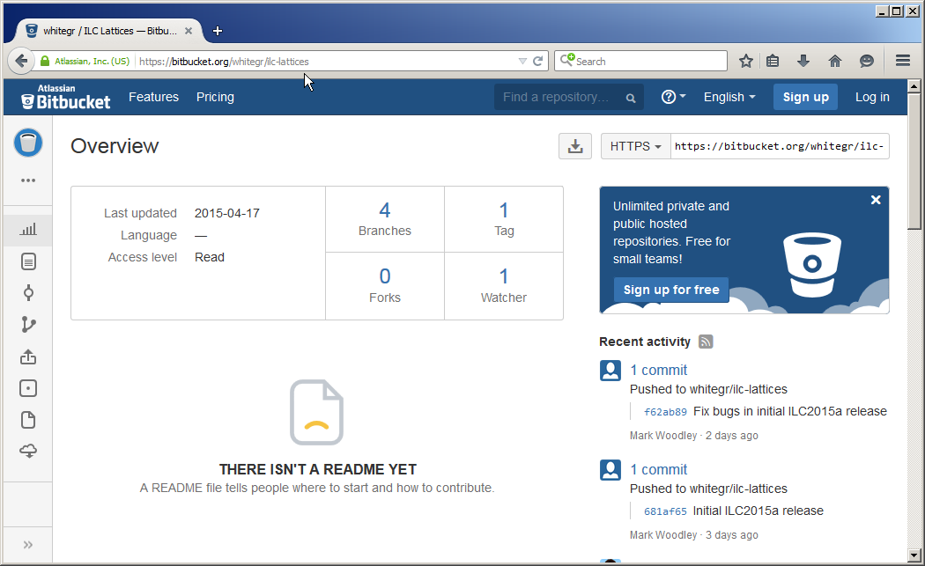
https://bitbucket.org/whitegr/ilc-lattices
downloads
no account (user ID, password) required to download

Slide 21
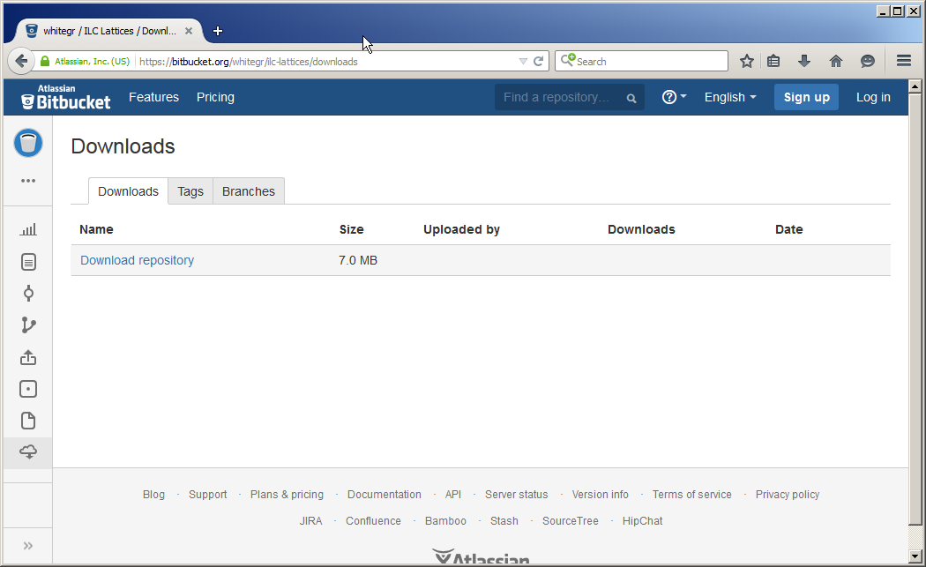
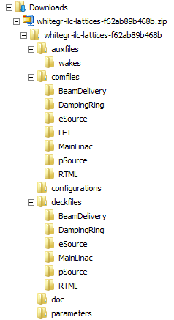
https://bitbucket.org/whitegr/ilc-lattices/downloads
download the
main branch
(complete set of
ILC MAD input files)

Slide 22
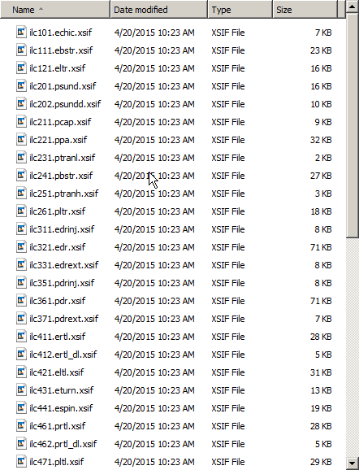
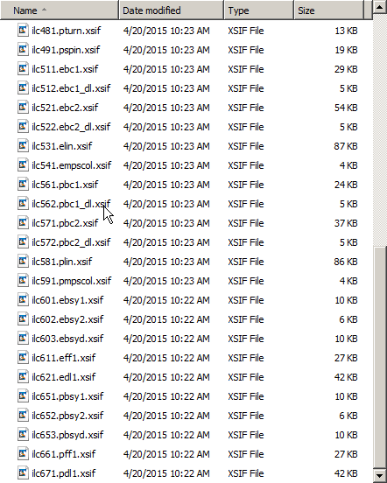
ILC2015a lattice description files (49)

Slide 23
e- Source |  |  | e+ Source
 |  |  | PSUND | 201
 |  |  | PSUNDD | 202
 |  |  | PCAP | 211
 |  |  | PPA | 221
ECHIC | 101 |  | PTRANL | 231
EBSTR | 111 |  | PBSTR | 241
 |  |  | PTRANH | 251
ELTR | 121 |  | PLTR | 261
 |  |  | KAS | 271
e- DR |  |  | e+ DR
EDRI | 311 |  | PDRI | 351
EDR | 321 |  | PDR | 361
EDRX | 331 |  | PDRX | 371
e- RTML |  |  | e+ RTML
ERTL | 411 |  | PRTL | 461
ERTLD | 412 |  | PRTLD | 462
ELTL | 421 |  | PLTL | 471
ETURN | 431 |  | PTURN | 481
ESPIN | 441 |  | PSPIN | 491
e- ML |  |  | e+ ML
EBC1 | 511 |  | PBC1 | 561
EBC1D | 512 |  | PBC1D | 562
EBC2 | 521 |  | PBC2 | 571
EBC2D | 522 |  | PBC2D | 572
ELIN | 531 |  | PLIN | 581
EMPSCOL | 541 |  | PMPSCOL | 591
e- FF and dump |  |  | e+ FF and dump
EBSY1 | 601 |  | PBSY1 | 651
EBSY2 | 602 |  | PBSY2 | 652
EBSYD | 603 |  | PBSYD | 653
EFF | 611 |  | PFF | 661
EDL | 621 |  | PDL | 671
input file numbering
ilcnnn.<name>.xsif

Slide 24
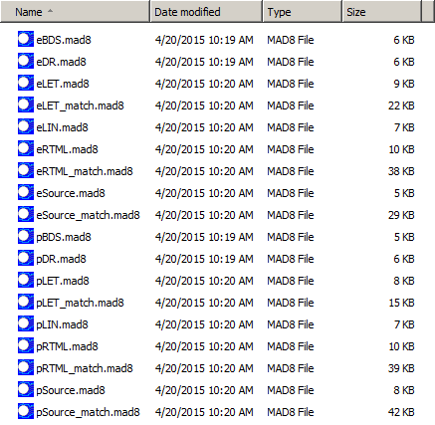
ILC2015a MAD command files (18)
MAD matching files
define layout and
1st order optics
(Twiss parameter)
matching
What to match,
where to match,
match values,
what to vary

Slide 25
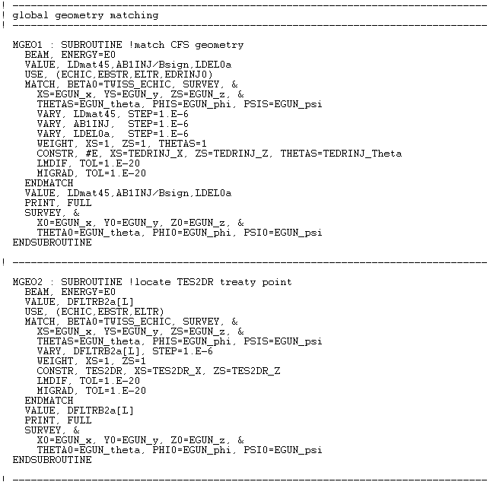
Example: eSource_match.mad8
Layout (SURVEY ) matching
Twiss parameter matching
MAD8 v8.52 (SLAC) includes SURVEY
matching (courtesy of Martin Donald)

Slide 26
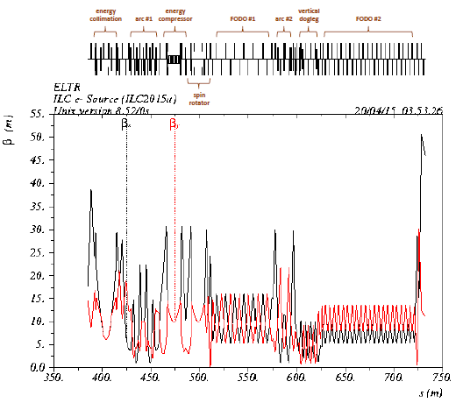
Optics_Plots.pdf
The doc folder includes a PDF-file that contains a set of annotated MAD8 optics plots. The annotations specify the functional units that comprise each ILC subsystem. There are 100 plots. Abort/tuneup lines are not included.

Slide 27

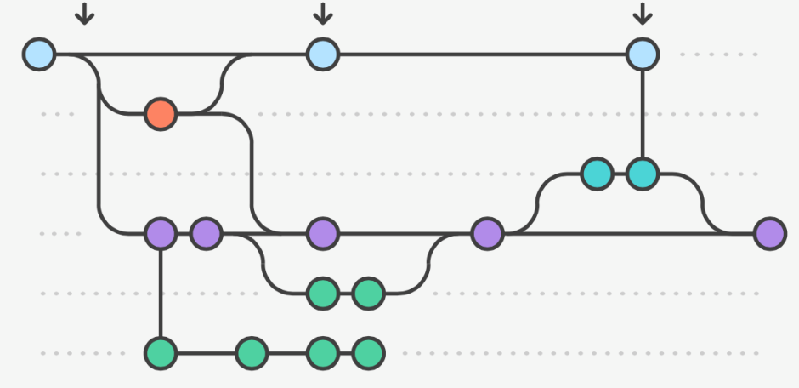
Software Management of ILC Lattice Repository
Repository (GIT) branches with access control and actions governed by branch type. Master repository hosted at Bitbucket site, with documentation etc. on co-hosted wiki. User base and privileges managed by master repository web site.
Master branch
  World read access
  Write access by “repository manager” only
  Should correspond to currently accepted ILC “baseline” designs
  Only merge-able with “release candidate” or “hotfix” branches
Hotfix & Release Candidate Branches
  Read/write access only be “core s/w development team” or users designated by these
  Apply s/w fixes or prepare releases, including applying unit test procedures to ensure e.g. Twiss parameters correct and representative beams track to give conditions specified in interface documents.
  Final merge done with master branch by “repository manager” and tagged with a release code and changes fully documented and checked with EDMS document procedures etc.
Development branch
  read/write by “core s/w develelopment team” and invited users (including CR branch managers)
Change Request Branch
  Generated by “repository manager” for approved change requests and control handed over to required users as designated by the ILC CR process.
  Merges in to development branch upon completion and sign-off of CR process.
Feature Addition Branch
  As above, but generated and controlled for s/w management purposes by “core s/w devel team”.
R2015a
R2015b
R2016a
CR-i
CR-j

Slide 28
To Do List
gather and integrate the remaining files
  eSource and pSource abort/tuneup lines, auxiliary source (?), …
deck “cleanup”
  remove unused stuff
  eliminate redefinitions
  make sure names are unique and follow some kind of naming convention
  make sure magnet L,TYPE, APERTURE attributes agree with EDMS lists
  split magnets consistently
  check that all quadrupole pole-tip field magnitudes are less than 9.6 kG @ 500 GeV
  provide consistent definitions of input Twiss parameters for each file
  verify earth’s curvature following and vertical dispersion compensation
merge repository into EDMS
documentation
ramp up interaction with CFS group
  check locations of beamlines in the tunnel
  coordinate systems: is our Cartesian system centered at the IP the best system for defining a machine that follows the earth’s curvature?

Slide 29
Conclusions and Outlook
using DESY EDMS system and SVN repository, MAD8 input files corresponding to the TDR for the major accelerator systems of ILC have been gathered and integrated
  eSource, pSource, DRs, eLET, and pLET
the geometry of these systems has been verified to match the current CFS layout (sub-millimeter errors at Treaty Points)
1st order re-matching (Twiss) is complete for all subsystems
  BDS subsystems downstream of BSY abort/tuneup extraction have not been matched … waiting for the results of the CR002 approval
  MAD matching subroutines define the matching (what/where/how)
next comes “deck cleanup” and standardization
  magnet type definitions should agree with Benno’s list
  split all magnets in half
then comes documentation
start-to-end simulations, tuning simulations, …
NOTE: the “final” initial release to the repository hasn’t happened yet … I’ll do it tonight. Those who are interested should download tomorrow or after …

Slide 30
End
Thanks!

