Slide 1
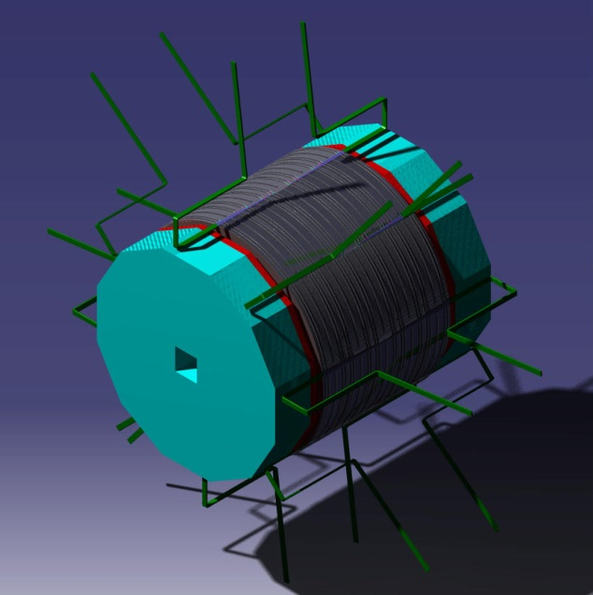
ILD Integration
DHCAL Barrel and Endcaps
Jean-Christophe Ianigro & Imad Laktineh
- IPN Lyon -

Slide 2
ILD integration
Barrel integration
Endcaps integration

Slide 3
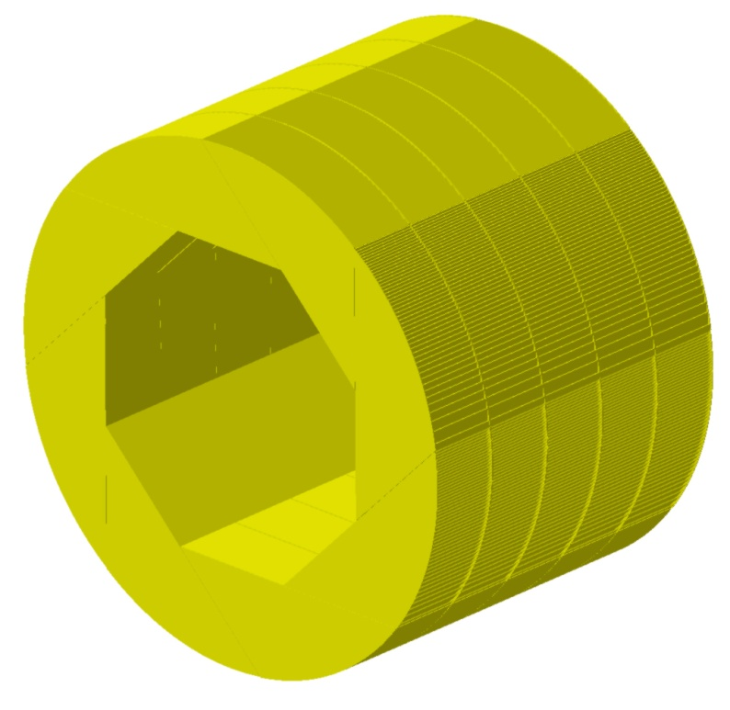
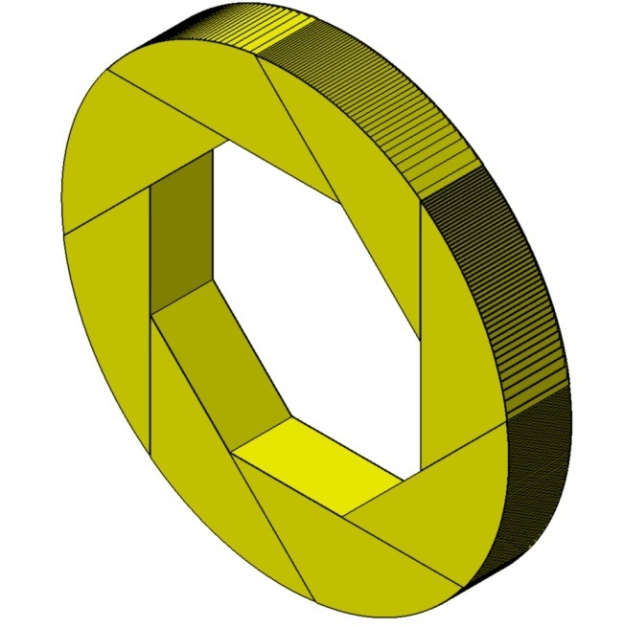
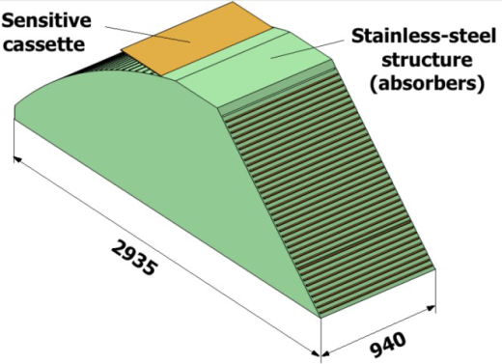
Barrel integration : design
Ext. Diameter 6770 mm
Int. Diameter 4116 mm
Lenght 4700 mm
Thickness wheel face = 10 mm
Thickness absorbers= 15 mm
Ext. Diameter : 6770 mm
Int. Diameter :4116 mm
Lenght : 940 mm
x8
Stainless steel 1 wheel (8 mod.) 5 wheels (Barrel)
Weight (t): 88 t 440 t
Detectors W. (t): 36.8 t 184 t
Total Weight (t) : 124.8 t 624 t

Slide 4
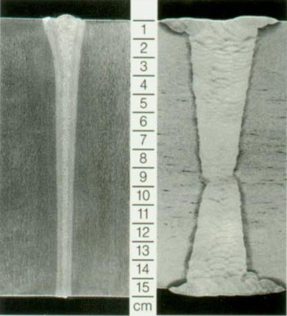
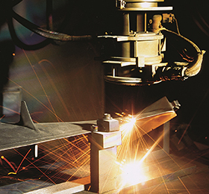
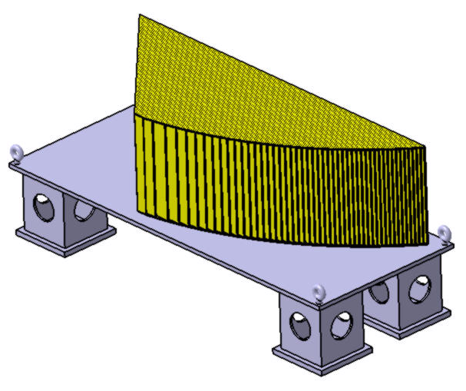
Barrel integration : Module building
Building in Industry: 40 parts
Welding method : Electron Beam Welding
Tight continuous weld
Accuracy and repeatability
Low distortion
Narrow weld and narrow heat affected zone
Filler metal is not required
Technology adapted to larged skin & repeatable structure
Module done one by one
49 absorbers plates welded on 2 flanges
Weight = 11 t

Slide 5
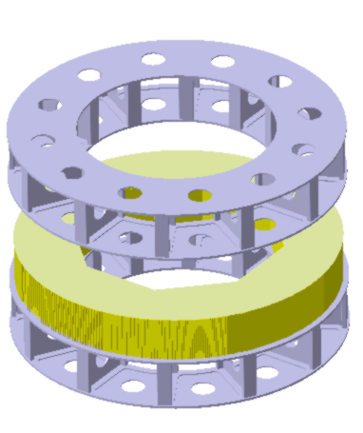
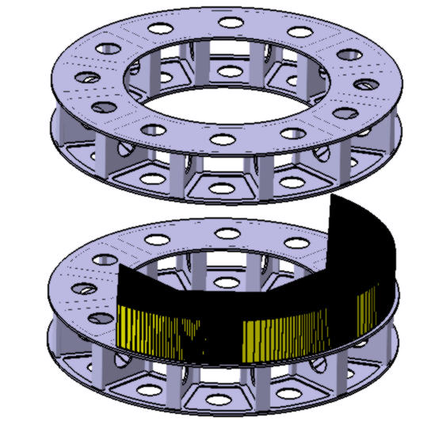
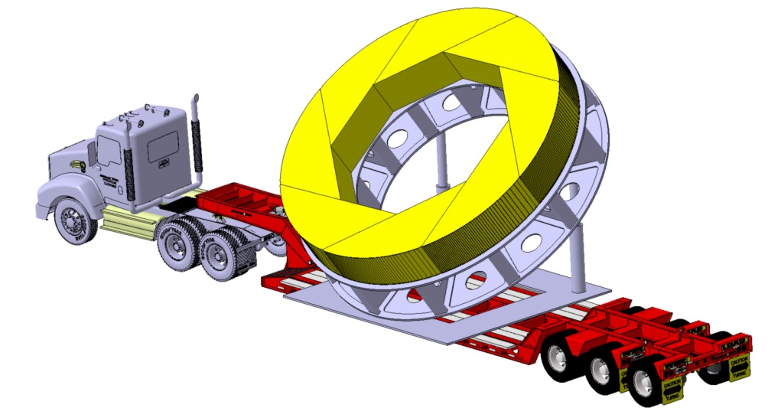
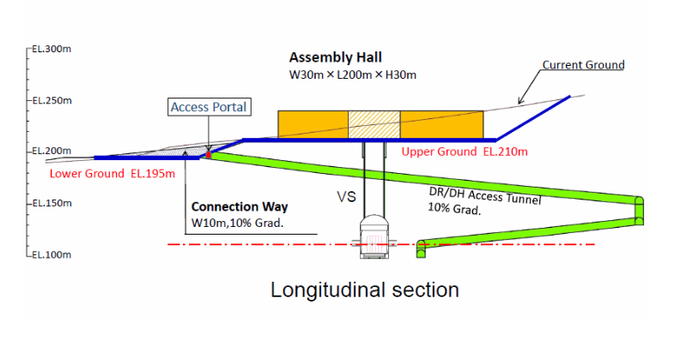
Barrel integration : scenario 1
Wheel Building in Industry / Campus : 8 modules => 5 wheels
Building Method
Step 1 : Modules assembly to wheel
  8 modules in position on specific tool
  welding / screwing and rotation
Step 2 : Wheel on specific tool
Step 3 : Special convoy to Assembly Hall
180°
Road to
Wheel weight = 88 t

Slide 6
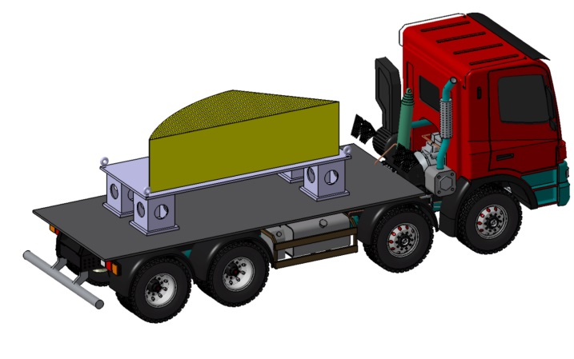
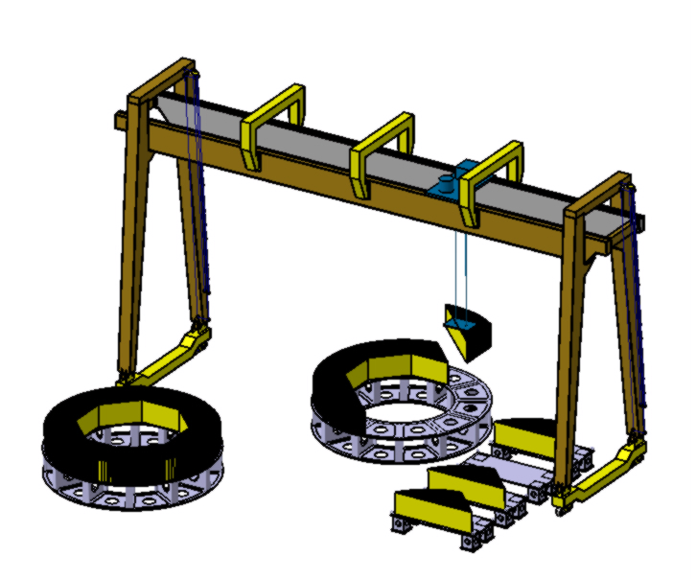
Barrel integration : scenario 2
Wheel Building in Assembly Hall : 8 modules x 5
Building Method
Step 1 : Modules transport by normal truck to Assembly Hall
Step 2 : Wheel structure transport
Step 3 : Modules assembly on the wheel
  8 modules in position on specific tool & screwing
Module weight = 11 t
Road to

Slide 7
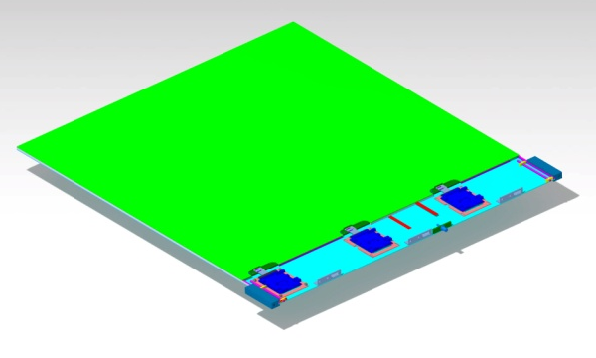
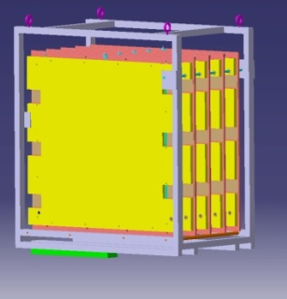
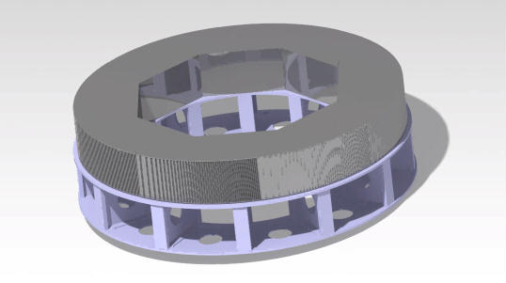

Barrel integration : detectors integration
Barrel Building & GRPC Detectors insertion
5 x Wheels built in assemby hall
368 GRPC insertion for each of the 5 wheels = 1840 GRPC
Connection of gaz, HT, datas and cooling for each GRPC
Services installation on each 8 spaces in zone A, ready to be connected for 5 wheels
Damper transport structure for GRPC
Zone A
GRPC insertion
with specific tool
Common services
Ready to be connected
Notes:
7

Slide 8
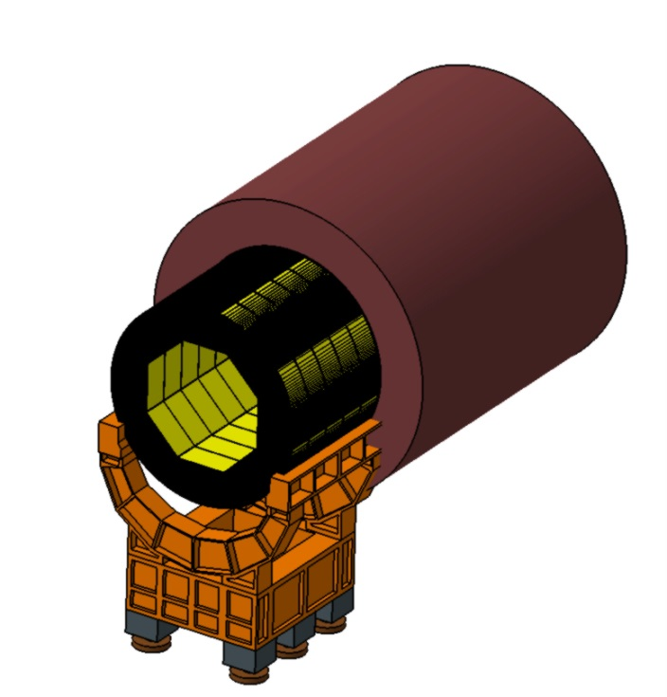
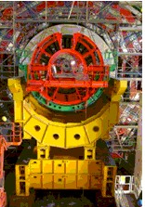
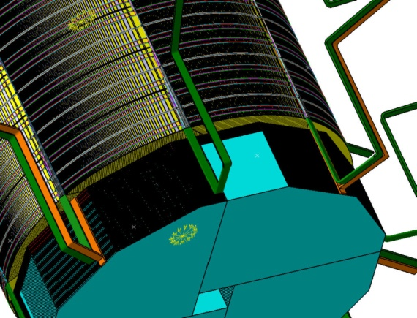
Barrel integration : insertion
Barrel insertion & services connecting
Wheels put on the structure one by one
Barrel with 5 linked wheels on same sub-structure as ECAL (similar to CMS)
Rails inside the yoke
Insertion « push-pull »
Fixation inside the yoke on both sides
Services installation along the yoke to patch pannels
Barrel insertion
CMS « enfourneur »
Services issues to patch pannels
Notes:
8

Slide 9
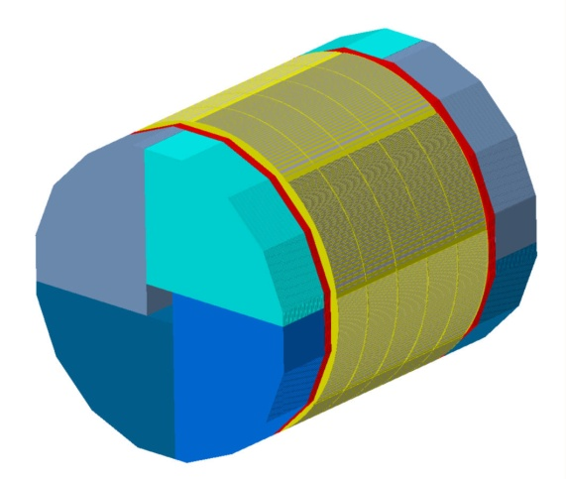
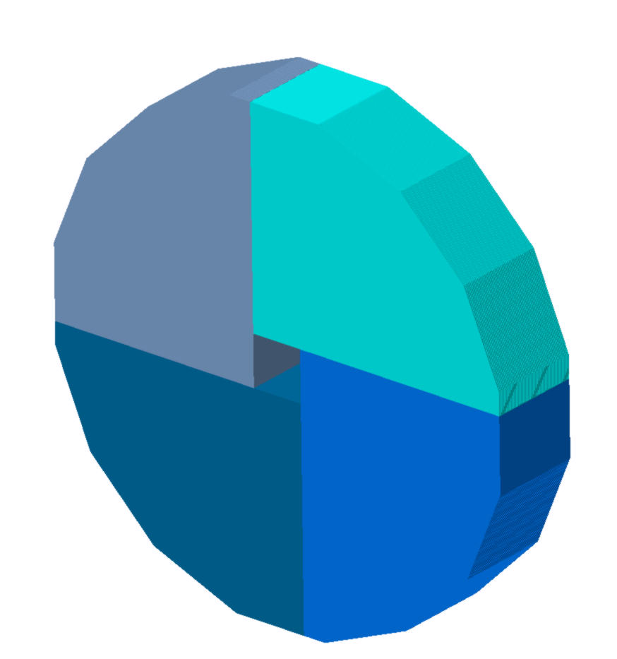
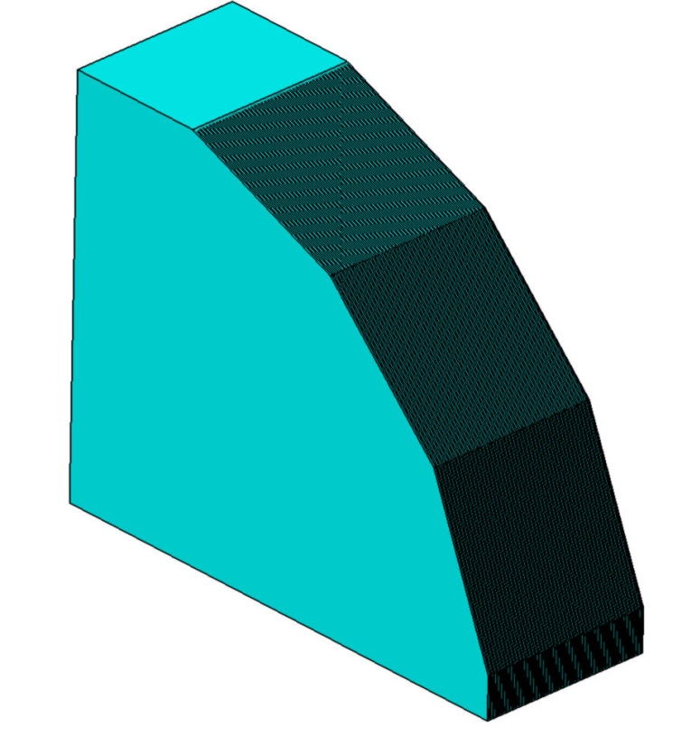
End caps integration : 2 endcaps
8 sides -> 16 sides
Encap : 48 detectors
Endcap
2 endcaps
Material : stainless steel
EBW welded structure
Idem barrel
Modules built in Industry
One module
Module Weight : 50 t
Detectors weight : 22.5 t
Total weight : 72.5 t
One endcap made of 4 modules
Endcap Weight : 200 t
Detectors weight : 90 t
Total weight : 290 t

Slide 10
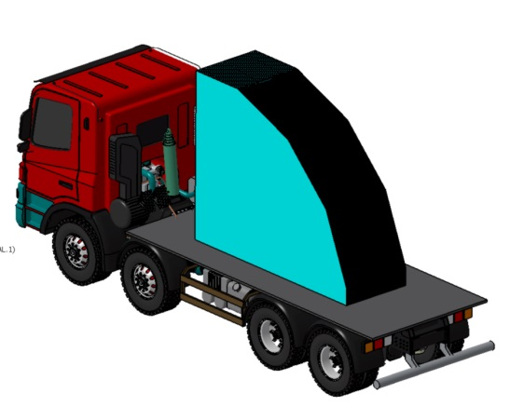
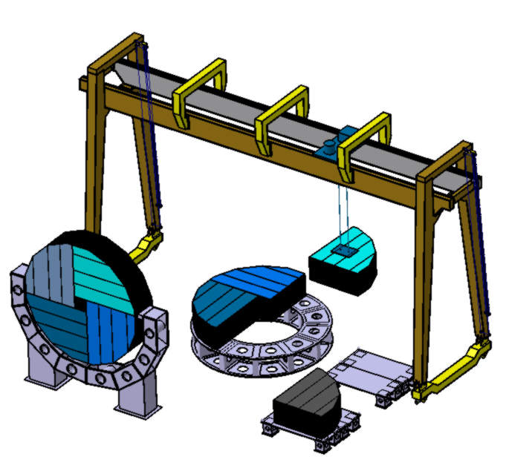
Barrel integration : scenario
Endcap Building in Assembly Hall : 4 modules x 2
Building Method
Step 1 : Modules transport by normal truck to Assembly Hall
Step 2 : Endcap structure transport
Step 3 : Modules assembly on the structure
  4 modules in position on specific tool & screwing
Module weight = 50 t
Road to

Slide 11

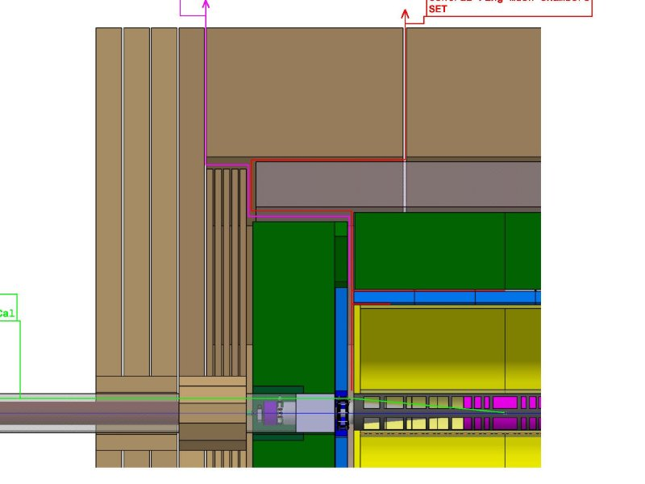
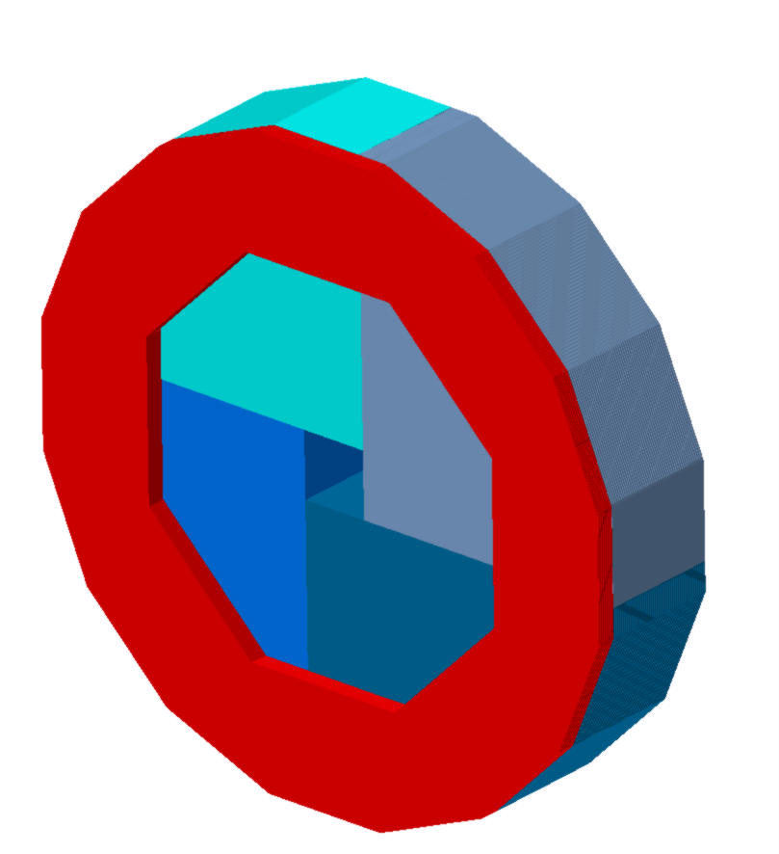
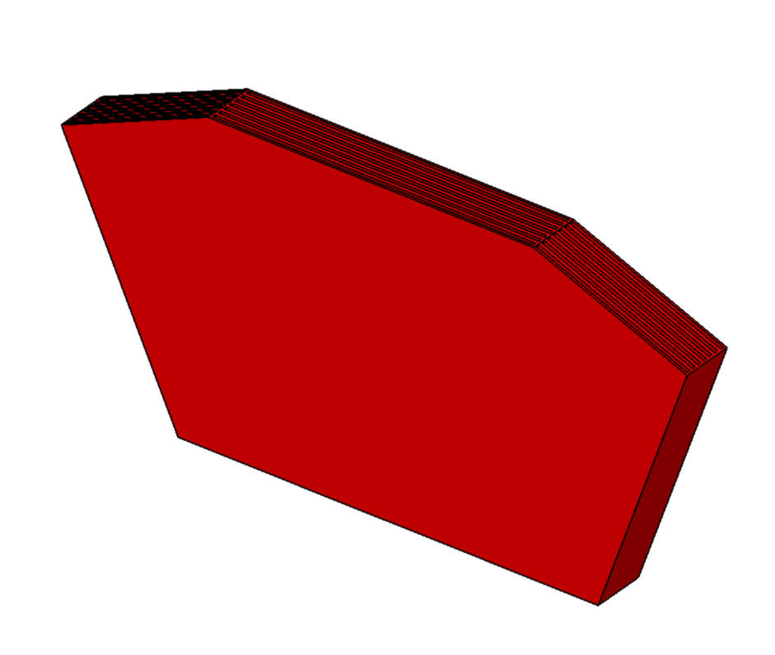
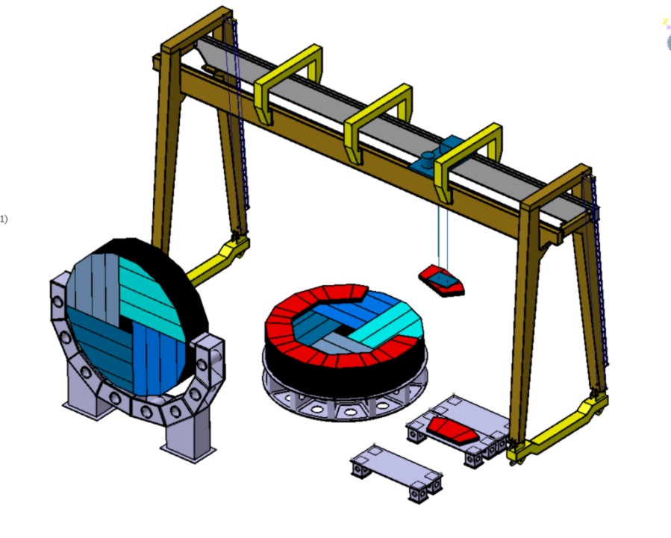
End caps Integration - Ring
2xrings
Ring built in Industry :
  Placed around the ECAL endcap
8 modules x 2
2541
1092
1704
Ring weight : 2.3 x 8 = 18.4 t
Ring ( 18.4 + 8 ) + Barrel endcap (290 ) = 316.4 t
Screwed on endcap

Slide 12
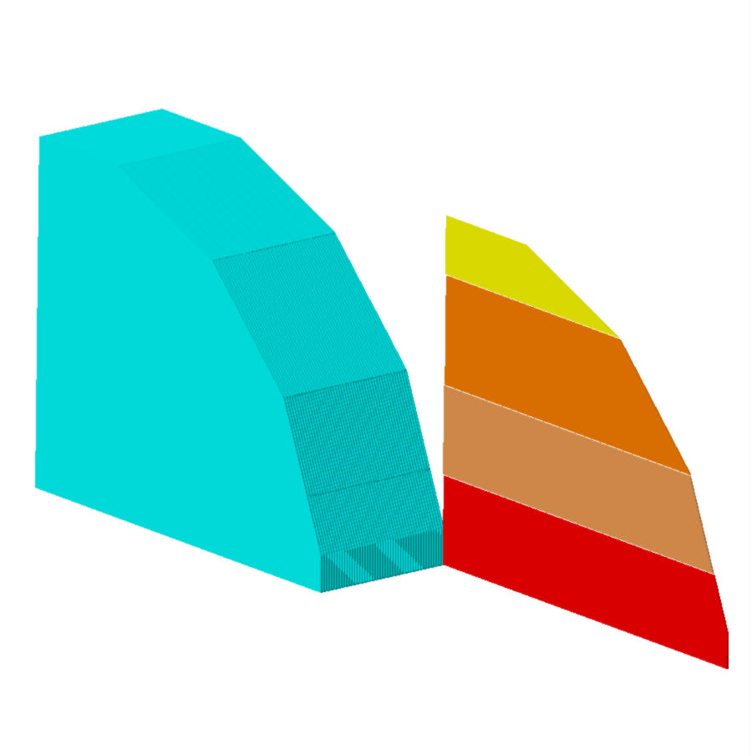
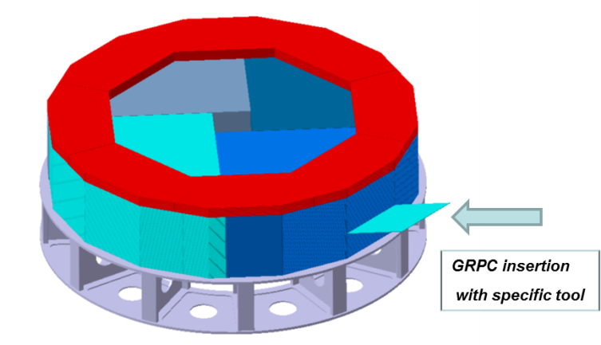
End caps integration
One module : 192 GRPC inserted in Assembly Hall
3153
2218
493
933
750
GRPC plane : S = 8.5 m²
P = 467.5 Kg
P/module = 22.5 t
48 detection planes
One detection plane consisted of 4 detectors planes
750
3655

Slide 13

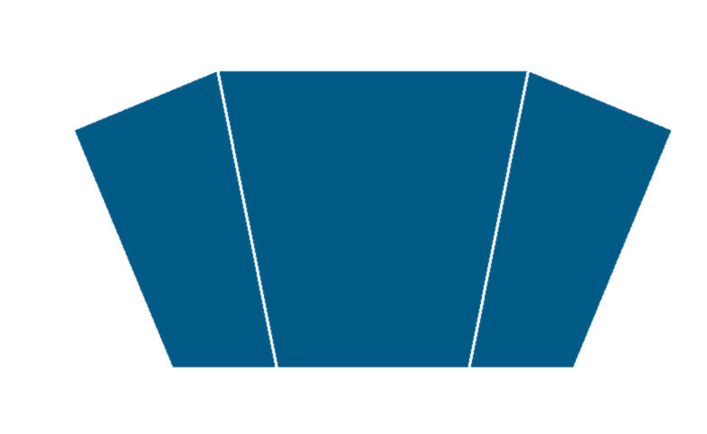
End caps design - Ring
Ring between barrel and endcap : GRPC insertion
  3 GRPC planes by module 24 / Ring
1298
648
1086
1006
432
800
GRPC : S = 2.55 m² P = 140 Kg
P/module = 980 Kg

Slide 14
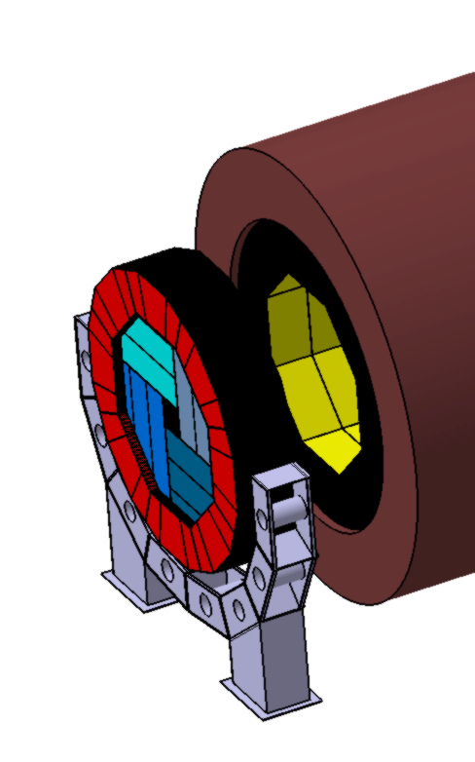
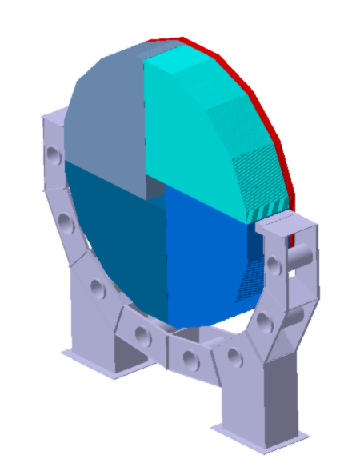
End caps insertion
Endcap + Ring : insertion on tool
Support structure for
One endcap made of 4 modules
Total weight : 290 t
Endcap + Ring
Probably linked to Yoke Endcaps

Slide 15
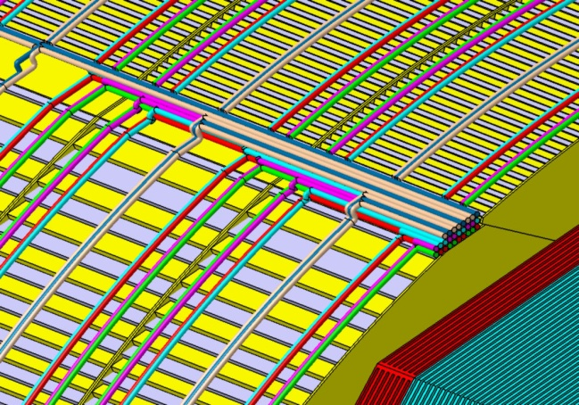
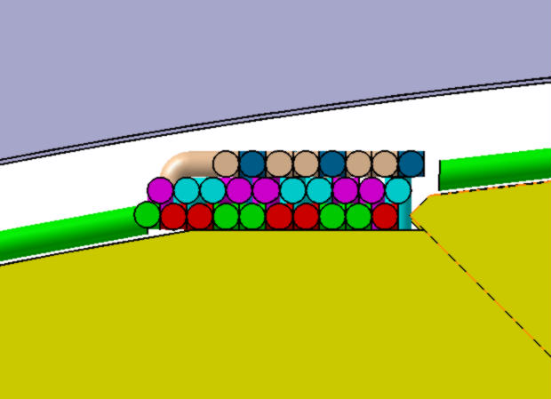
Barrel Services integration
Cooling for Dif : Blue / Red
  2 loops by module
  Ø14 for principal
  Ø2 for distribution alternative
Gaz For GRPC : green / pink
  2 loops by module
  Ø14 for principal
  Ø4 for distribution alternative
  High Voltage : Brown
  Ø14 for supply
  Data acquisition : Beige
  Ø14 for collecting
  Issues : 8 zones 168 x 47
Services Connections: Barrel
168
47

Slide 16
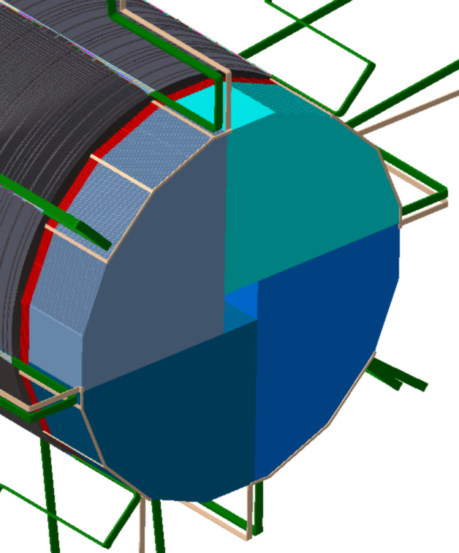
Endcaps Services integration
Cooling for Dif : Blue / Red
  2 loops by GRPC
  14 for principal
  Ø2 for distribution alternative
Gaz For GRPC : green / pink
  2 loops by GRPC
High Tension : Brown
  Ø14 for supply
Data acquisition : Beige
  Ø14 for collecting
Services : Endcap+ring
  Issues : 8 tubes outing 98 x 47

Slide 17
ILD Integration Resume.
Scenarii
  Modules of Barrel & Endcaps made in industry
  Transport of modules to Assembly Hall
  5 Barrels wheels & 2 Endcap-Ring mounting
  GRPC detectors insertion
  Barrel & Endcaps-Ring insertion with specific tools
Surface needed for operations
  First the barrel & then Endcaps-Ring building and services, one after the other
  1000 m² for assembly of modules, specific structures, Services & GRPC detectors
  Zone for barrel on structure storage : 200 m²
  Time schedule
  Wheel transport & assembly : 1 week by wheel -> 5 weeks for barrel
  GRPC insertion & test : 6 weeks by wheel -> 30 weeks for barrel
  Connecting wheels, test & insertion in Yoke : 4 weeks
  Total time for Barrel = 39 semaines
  Approximately same time for both Endcaps-Ring

