Slide 1
A Silicon Pixel Tracker for ILC
Konstantin Stefanov
20 November 2014

Slide 2
Introduction
Silicon Pixel Tracker (SPT) – an idea by Chris Damerell
First presented in 2008 at the annual Asian ILC Workshop in Tohoku, Japan
  Positive reaction by the community
  Further refined by Chris since
  This presentation borrows a lot of his original material
The main driver is low detector mass
  Low mass is enabled by low detector power
  Benefits to the forward tracker from the reduced cooling, cables and mechanical structure
  Could equally well be called “low mass pixel tracker”
  The concept includes barrel and forward trackers using the same technology

Slide 3
Innovations
“Separated function” – SPT combines tracking and timing layers
  Non-homogeneous design
  Timing layers : fast, with bunch stamping
  Tracking layers : slow, integrating over the bunch train, or with multi-bunch timing resolution (time slicing)
Track finding and fitting algorithm uses information from the vertex detector and combines the timing and tracking layers of the SPT
  A good performance study is crucial
Low power, low noise, large pixel sensors
  Large pixels with low noise are challenging in principle
  Prompt charge collection and efficient data sparsification with high detection efficiency
  Low average and peak power
Precision, large and very light support mechanics
  A good challenge
  Lots of experience and expertise, further developed from the LCFI days

Slide 4
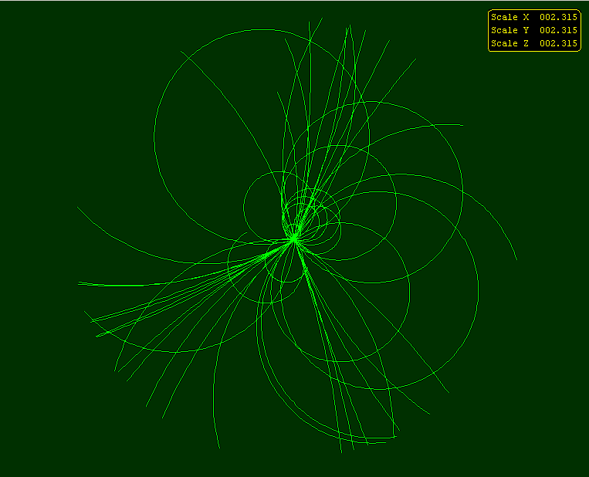
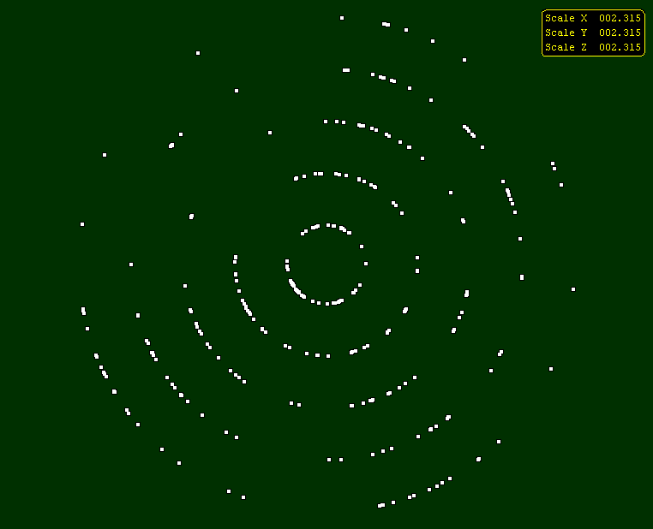
Trackers at ILD and SiD
Simulated TPC
Simulated microstrip detector
Time Projection Chamber (TPC), in ILD
  Measures many rφ coordinates along a track
  Point resolution in rφ ≈ 100 μm, resolution in z ≈ 0.5 mm
5 layers of Si microstrip sensors, 25 μm pitch / 50 μm readout (in SiD)
  Measures 5 rφ coordinates
  Resolution rφ ≈ 5 μm, resolution in z ≈ 5 mm (with charge division)

Slide 5
Considerations for the SPT
0.2 s
337 ns
Beam structure at the ILC
2820 bunch crossings and multiple collisions
≈1 ms
Considering the barrel :
Physics event rate is tiny: 1.5 hits/BX over all of layer 1 (20 cm radius)
Background is photons:
  Converted on 300 μm Si gives 0.002 hits/cm².BX, or 6 hits/cm² for the train (in the barrel)
  On 100 μm thick Si this is 2 hits/cm² for the train
With 50 μm × 50 μm pixels (point resolution ≈14 μm) the occupancy in L1 would be only 0.005% for the whole bunch train!

Slide 6
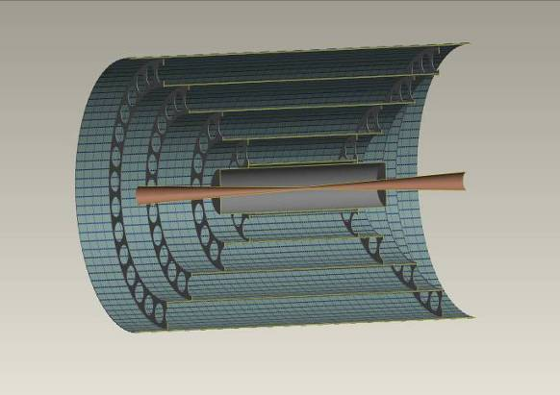
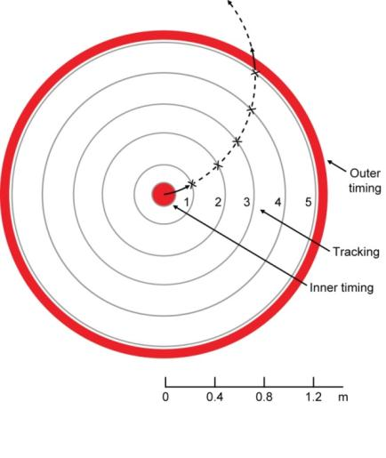
The SPT Concept
Timing layers
Vertex detector
Tracking sensor (one of 11,000), 8x8 cm², 2.56 Mpixels each
Matching endcaps (only one shown)
Barrels: SiC foam ladders
  Tracking layers: 5 cylinders, ~0.6% X₀ per layer, 3.0% X₀ total, over full polar angle range ~50 μm square pixels
  Outer timing layers: ~3 cylinders as an envelope, ~2% X₀ per layer if evaporative CO₂ cooling ~150 μm square pixels
Endcaps: 5 tracking and ~3 timing layers, closing off the nested barrels
Tracking layers are read out between bunch trains (5 Hz or 50 Hz for ILC or CLIC)

Slide 7
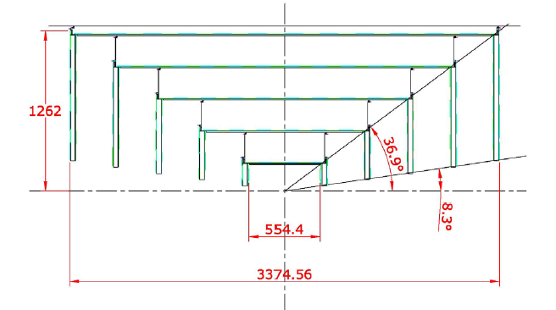
SPT based on the SiD design
Barrel and Forward trackers, total area = 70.3 m²
With 50 μm × 50 μm pixels – 28.1 Gpix system
Low mass support, gas cooling
If each chip is 8 cm × 8 cm (2.6 Mpix): 11,000 sensors is total

Slide 8
Track Reconstruction
Start with mini-vectors from on-time tracks found in the triplet of outer timing layers, together with an approximate IP constraint. 3 timing layers provide sufficient redundancy
Work inwards through each successive tracking layer, refining the track parameters as points are added
Fine granularity (i.e. pixel systems) can to a great extent compensate for coarse timing. Precision time stamping costs power, hence layer thickness
‘Special methods’ are envisaged for low momentum tracks, K-shorts, lambdas and photon conversions
Final track refinement, recovery of tiny inefficiencies, achieved by correlation with tracks found in the inner timing layers (the vertex detector)
A detailed feasibility study is badly needed

Slide 9
Detector Parameters
The main challenge is to reduce material and therefore power must be reduced
Sensors ≈100 μm thick, low mass support (<1% X₀ per layer in the SiD design)
Gas cooled, power dissipation ~O(100 W), in SiD < 500 W
Pixel size around 50 μm × 50 μm (point resolution ≈14 μm in binary mode)
Bunch stamping/time slicing tracker:
  Implies on-pixel intelligence and therefore more power
  Binary readout and sparsification most likely, but measurement of charge centroid is not excluded
Integrating:
  Lowest power (due to slow readout) and low mass
  Full pixel readout to local readout chip
  Resolution likely to improve below 14 μm due to the use of charge centroid
  Preferred if track reconstruction is fully efficient

Slide 10
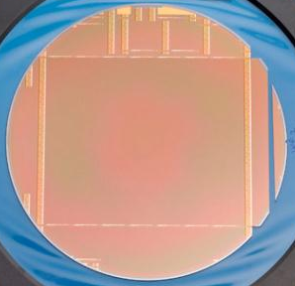
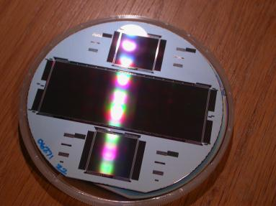
Detector Options
CMOS Active Pixel Sensors
  Can do all 3 readout schemes: integrating, time slicing, bunch stamping (relevant experience with CALICE)
Challenges:
  Large, low power pixels not easy (pinned photodiode not developed for large pixels)
  Full depletion for fast charge collection
Large, wafer scale devices have been demonstrated
4T/5T examples: 4 e- noise at 5 MHz readout (7 µm pixels, 10µm depleted)
CCDs
Can work as an integrating tracker layer
Large devices available
Large pixels are easy, little to no R&D required

Slide 11
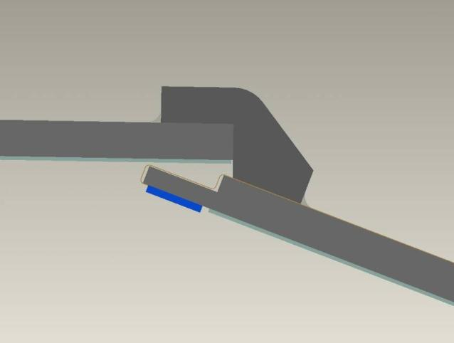
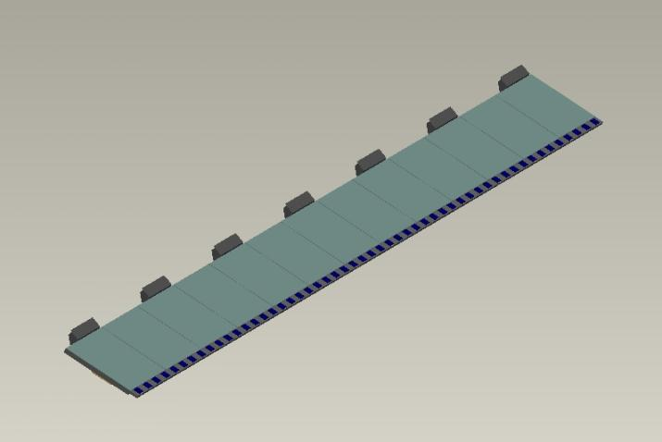
Mechanics
Based on the SiD mechanics:
  Long ladders made entirely from 5-8% SiC foam (5 mm thick = 0.45% X₀)
  Self-supporting barrel with SiC joining (interlocking) blocks, glued for low mass
  Additional rings (CF of SiC) and the endcaps keep it stable
  This is one of many possible implementations…
Joining blocks
Ladder

Slide 12
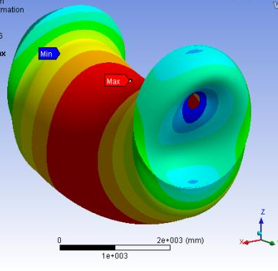
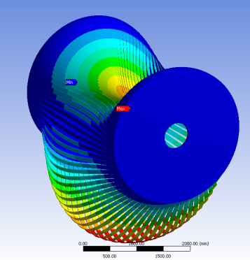
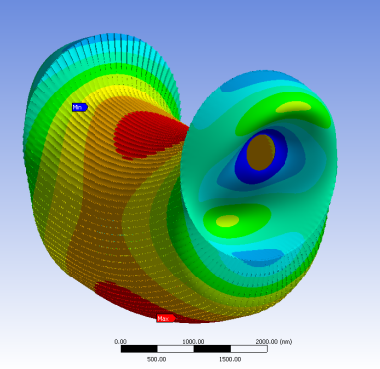
Deformations - simulated
Continuous foam cylinder
Max deflection 10 μm
Separate foam ladders
Max deflection 20.5 mm
Ladders joined by small foam piece every 40 cm
Max deflection 20 μm
Steve Watson - RAL

Slide 13
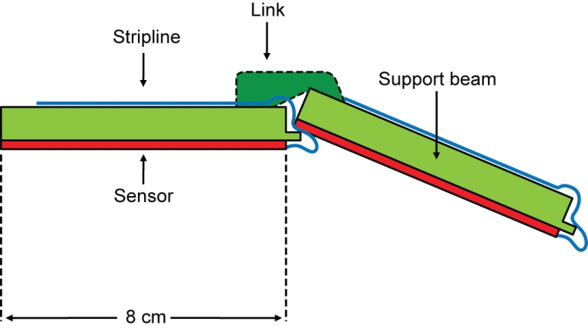
Mechanics – more detailed look
Adhesive-bonded non-demountable structure is not unheard of - SLD, astronomy
Wedge links at ~40 cm intervals, each ~1 cm in length
**
SiC foam, ~5% of solid density
Sensors: active width 8 cm, ~2 mm overlaps in rφ, thickness ~60 μm, 30 μm active epi layer
Thin Cu/kapton tab (flexible for stress relief), wire bonds to sensor
Devices will be 2-side buttable, so inactive regions in z will be ~ 200 μm (0.2%)
** Cu/kapton stripline runs length of ladder, plus tabs (~5 mm wide) which contact each sensor
Sparsified data transmitted on demand out of each detector (LVDS and optical fibres per end), continuously between bunch trains
Continuous (not pulsed) power for tracking layers, hence minimising cross-section of power lines
Tracking layers cooled by a gentle flow of nitrogen or air, hence no cooling pipes within tracking volume
Outer timing layers need pulsed power, and probably evaporative CO₂ cooling, to provide single-bunch readout

Slide 14
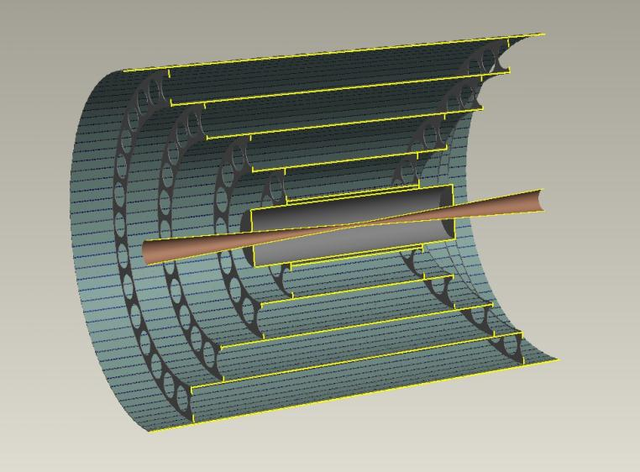
Forward Tracking
Continuous LOW power (integrating MAPS or CCDs)
Thin cables and no energy storage – lowest mass possible
Just one cable per layer?
Cut-out view without endcaps
Mass of cables, connectors and cooling adds up heavily in the forward region
Pulsed power (microstrips; time slicing or bunch stamping MAPS)
  Local energy storage (i.e. mass)
  Cables rated for the peak power (i.e. mass again)

Slide 15
Conclusions
Silicon Pixel Tracker for the ILC is very attractive:
  Low mass enabled by low power dissipation
  Increased performance in the forward region
  A combination of bunch stamping and integrating pixel layers – “separated function”
Challenges:
  Pattern recognition with different degrees of integration to be proven
  Detector technology giving the required power dissipation, pixel size, noise, charge collection time and sparsification algorithms
  Mechanical support structure
Opportunities:
  Excellent tracking performance, both barrel and forward
  Good science to be extracted
  International leadership by UK institutions

