Slide 1
Ideas for LC mechanics
(we will work on sensors as well – particular CMOS)

Slide 2
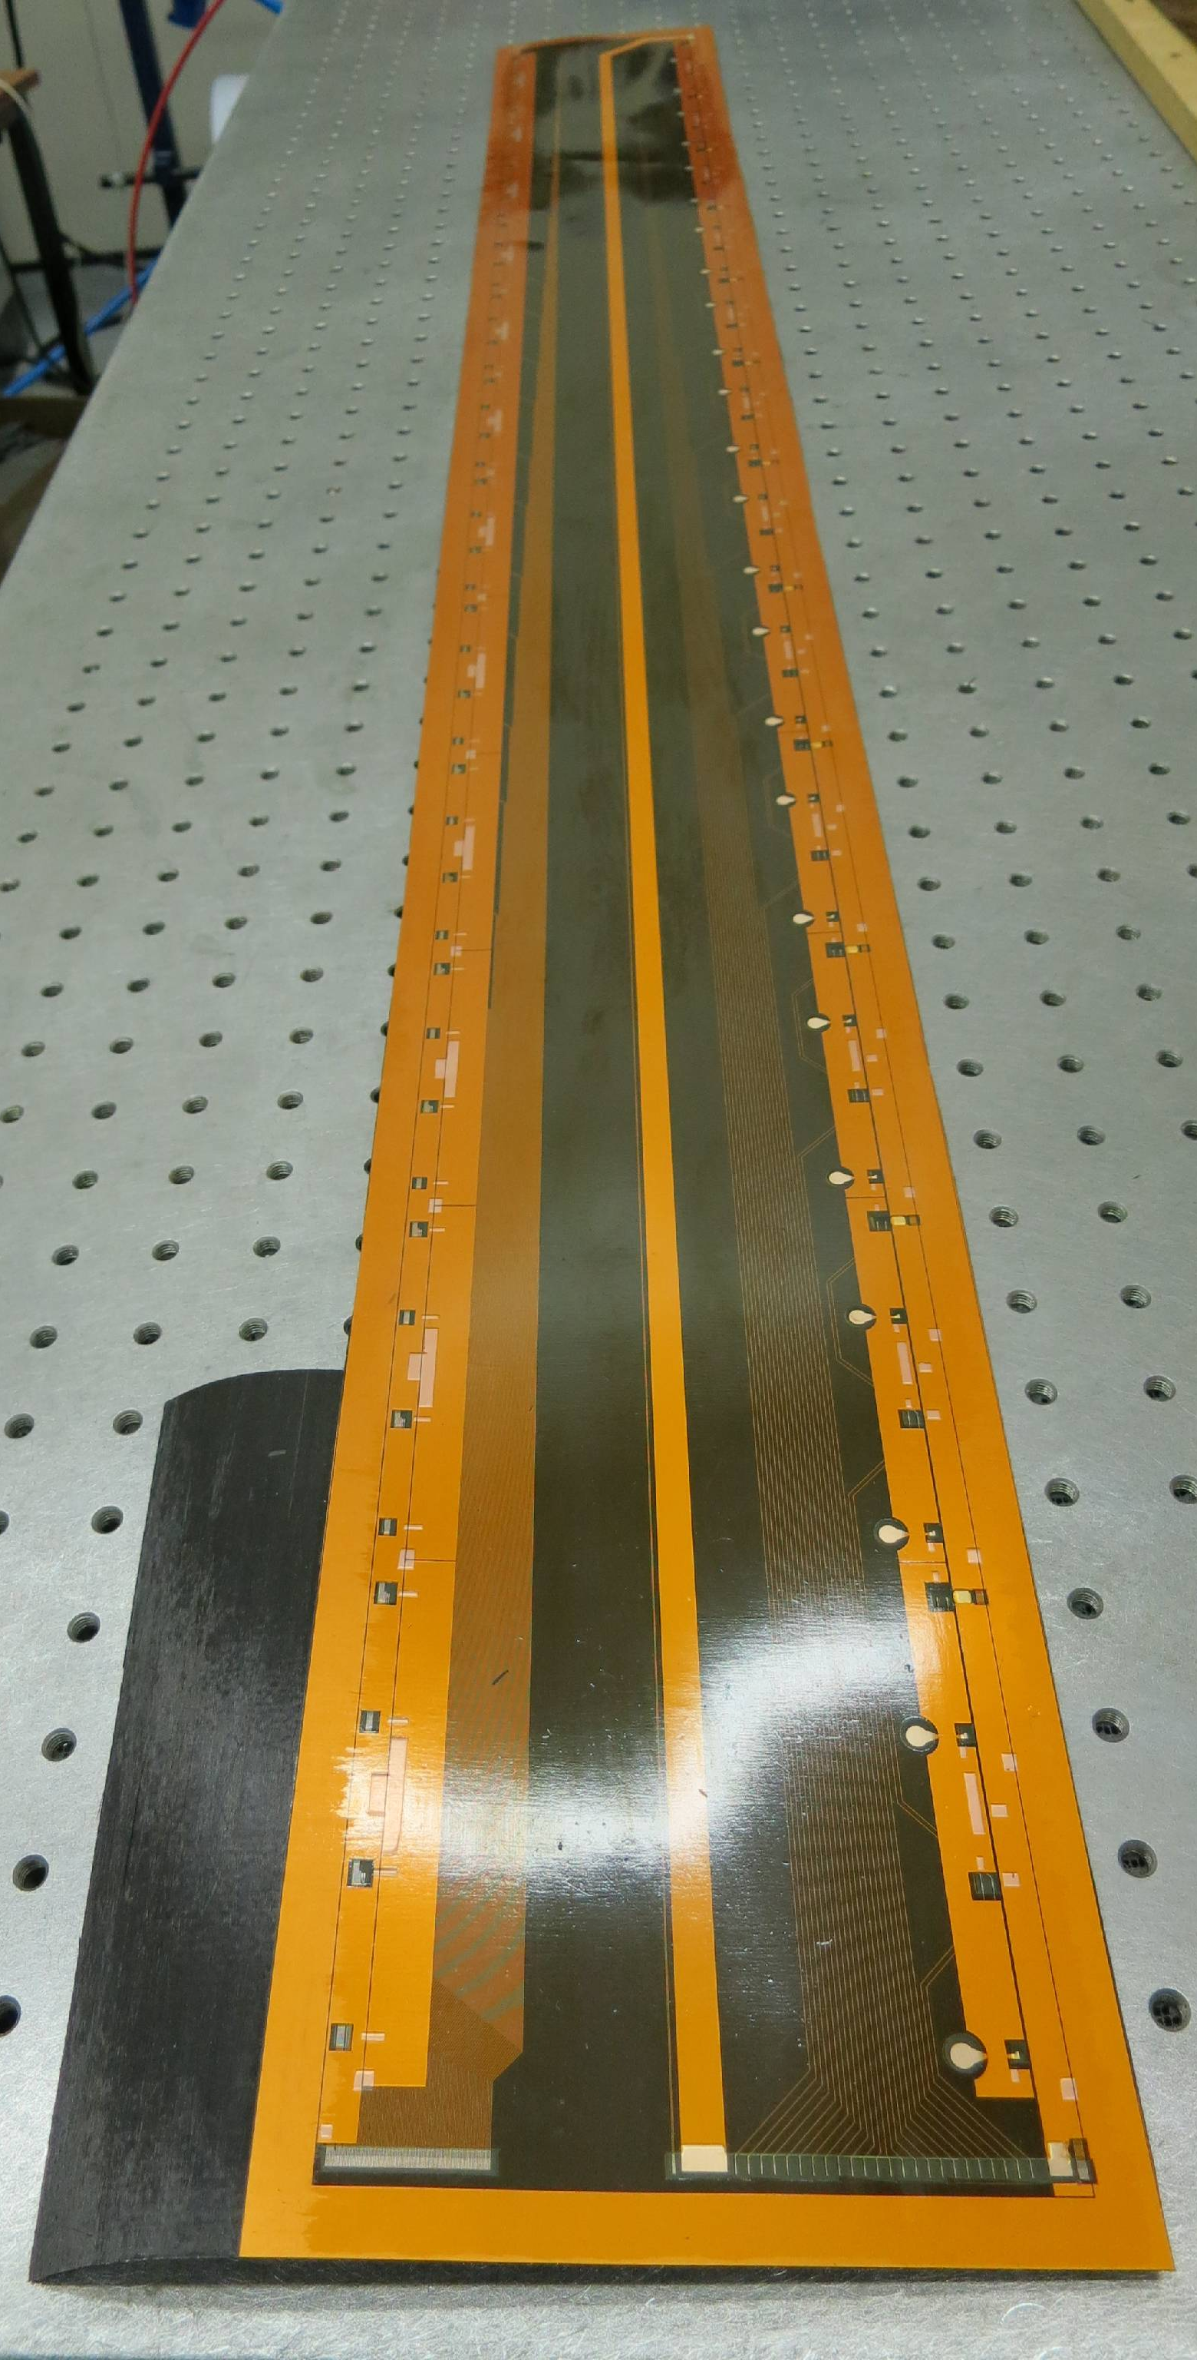
Current Oxford activities on composite structures
Oxford is contributing to the R&D for the ATLAS strip tracker upgrade
We are involved in the development of the local supports: barrel strip staves
  UHM CF/honeycomb structures with carbon foam (Allcomp) cooling channels with embedded thin-wall Ti tubes
  Kapton/Cu flex circuits co-cured with CF skins
And the design of the global CF support structure for the barrel strip system
Cu/Kapton tape co-cured with K13C2U

Slide 3
Our vision for future large trackers
Future sensor technologies (thinned down MAPS) promise material down to a few ‰ of a radiation length
  Structures and services need to match this
We do have a strong preference for liquid (evaporative) cooling
  Gas cooling is not a robust technology (difficult to predict)
  Gas cooling has limited capacity (might be ok for linear collider, but not much more)
  For comparison: ATLAS phase II >2.5% X₀, LC TDR ~1% X₀
  Support/service sandwich layer:
    Structural: UHM fibre (e.g. K13C2U, 4 layers of 45gsm)
    Cooling: Microchannel Kapton cooling
    Electrical services: Al/Kapton multilayer cables
    All the above are co-cured (this saves glue)
  Sensors: Thinned down to 50µm (MAPS)
  This would be a layer less than 1mm thick
→ Challenge: Is 0.5% X₀/tracking layer with evaporative cooling possible for a large ((2-3m)³) tracker?
Sensor
Al/Kapton tape
90°
UHM CF
Of course, we have ignored a few things,
but we think 0.5% is a conceivable aspiration…
0°
Kapton microchannels
0°
UHM CF
3
90°

Slide 4
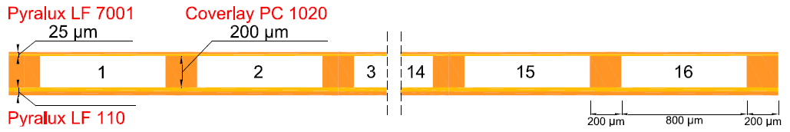
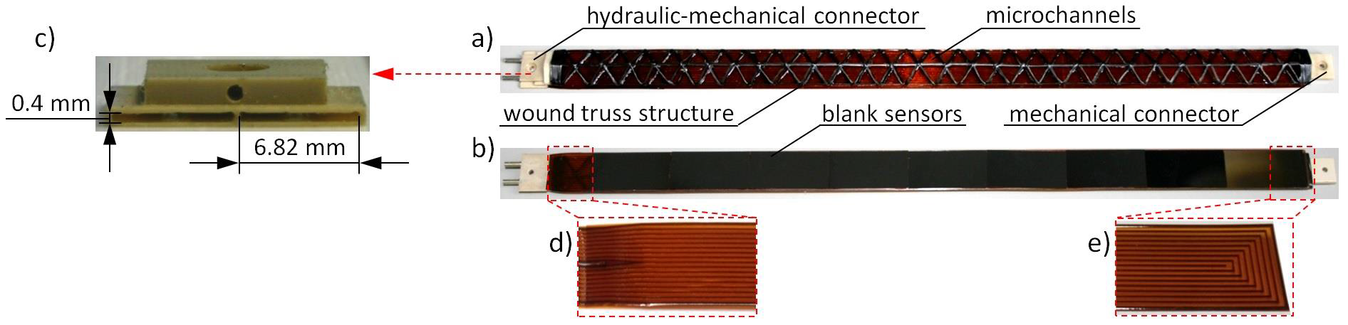
Kapton microchannel cooling
Developed for ALICE by CERN:
Tested to 10bar_{a} with water and C₆F₁₄ monophase cooling
Requires scaling to large tracker size, can we achieve higher pressures
At Oxford we have started to look into similar photo-etched and machined structures…
G. Fiorenza et al., 5th IEEE International Workshop on Advances in Sensors and Interfaces (IWASI), 2013, p. 81-85, 10.1109/IWASI.2013.6576065.
4

Slide 5
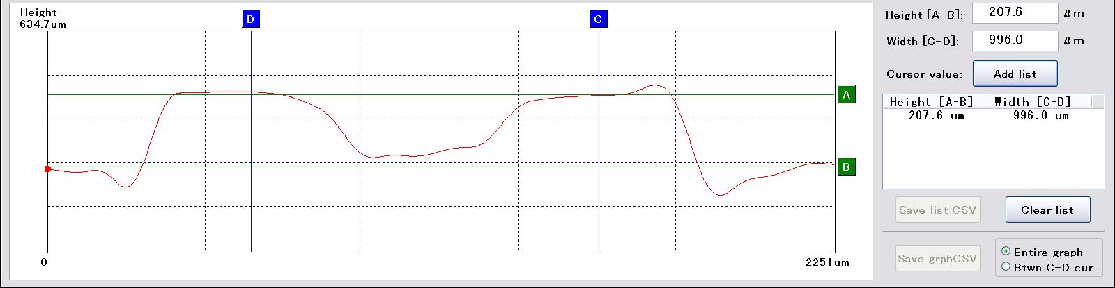
First attempts
Prototypes of 40×100mm²
Machined (milled with a tool at 45°)
Photo-etched as ALICE
  One prototype has achieved 10bar_{a} (two channels delaminated at 5bar_{a}, but ultimate failure at 10bar_{a})
Next step is to co-cure a sample with CF

Slide 6
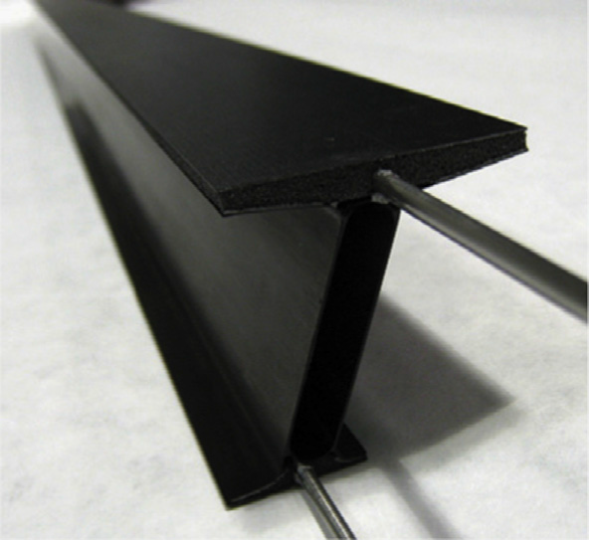
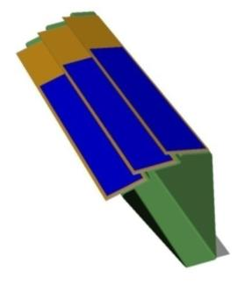
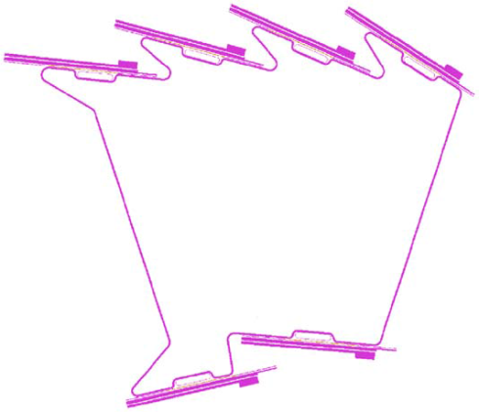
How can we achieve stiffness?
The key is design for large moment of inertia (together with high modulus)
  Ladders are poor
  Large cylinders are better
    But: hoop stiffness is now the challenge
    Also: integration of large cylinders has many disadvantages
      Large, valuable objects – difficult to move/transport
      Technologies get challenged late in the integration
Can one make smaller units which are clever structurally?
  Yes, exploit the mouldability of CF (and Kapton-based service elements)!
  Examples exist for vertex/pixel systems, need to scale by 10 in size
And, with 50μm sensors, the structures do not need to be flat…
BNL, doi:10.1016/j.nima.2013.07.005
STAR, doi:10.1016/j.nima.2010.12.006
ALICE, doi:10.1016/j.nima.2006.04.093
6

Slide 7
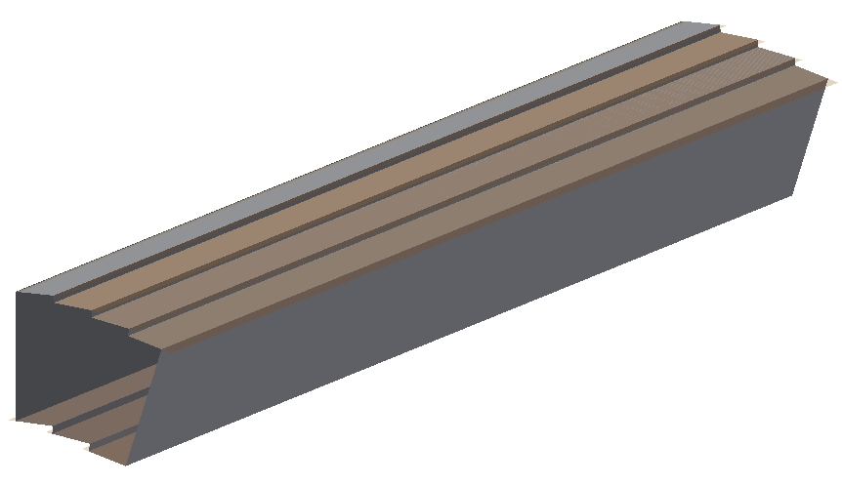
How could this look like?
Outer:
4:3
Inner:
3:2
This geometry is for ATLAS upgrade dimensions, but you get the picture

