Slide 1
STF CM-1/CM-2a cool-down test
H. Hayano 11252014

Slide 2
Cool-down test of CM-1( 8 cavities + quad ) + CM-2a(4 cavities)
Start cool-down : 7 October, 2014
Reached to 4K : 17 October, 2014
Will stop cool-down : 28 November, 2014
Cavities low-power-test at 2K : from 20 October to 28 November, 2014
Quad test : 17, 18, 19 November 2014
Cavity low-power-test
Tuner: tuning-range excursion measurement
Input coupler: coupling-range excursion measurement
QL, Qt, Qin, QHOM
Piezo: tuning-range excursion measurement
Piezo: Pulse response
Heat-load: measurement, by using heater for intentional high heating
Cavity position monitering by stretched wires
5 wire-sensors in CM-1 GRP
18 wire-sensors in CM-1 cavities & magnet
No wire sensors in CM-2a

Slide 3
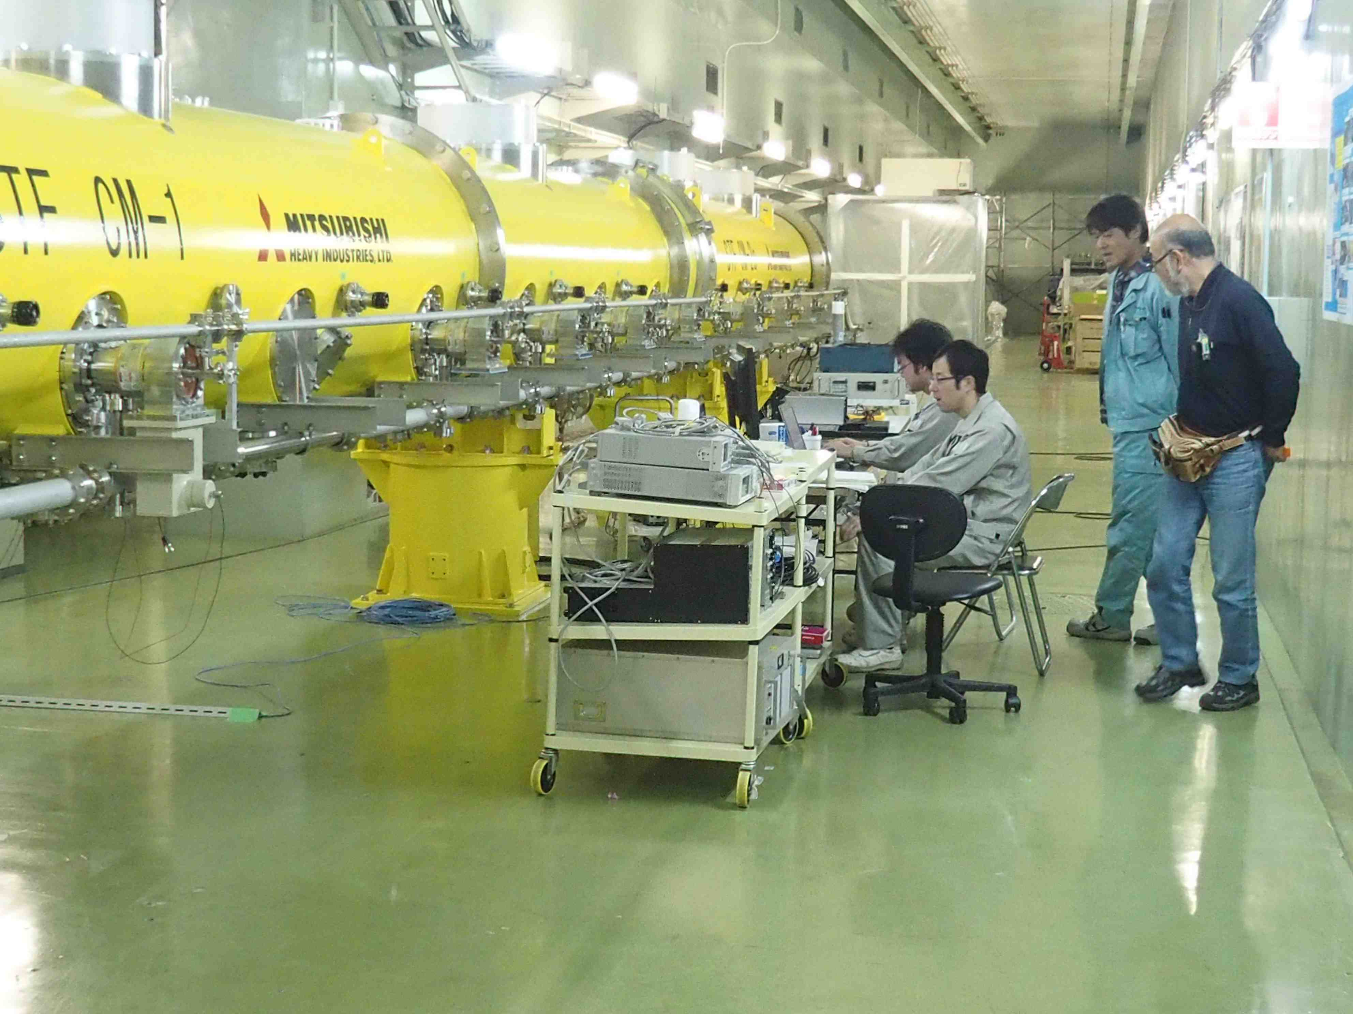
Cavity low-power-test close to the cryomodule

Slide 4
Conduction-cooled quadrupole magnet ( FNAL magnet )

Slide 5
SC lead extracted from side panel

Slide 6
Thermal conductor blades(pure Al) for Coils and SC wiring
Copper adapter
GRP
AL strips
2 phase pipe
AL strips
Beam pipe
AL strips attached to the coil-case,
then, laparound quad body,
to 2-phase pipe adapter.

Slide 7
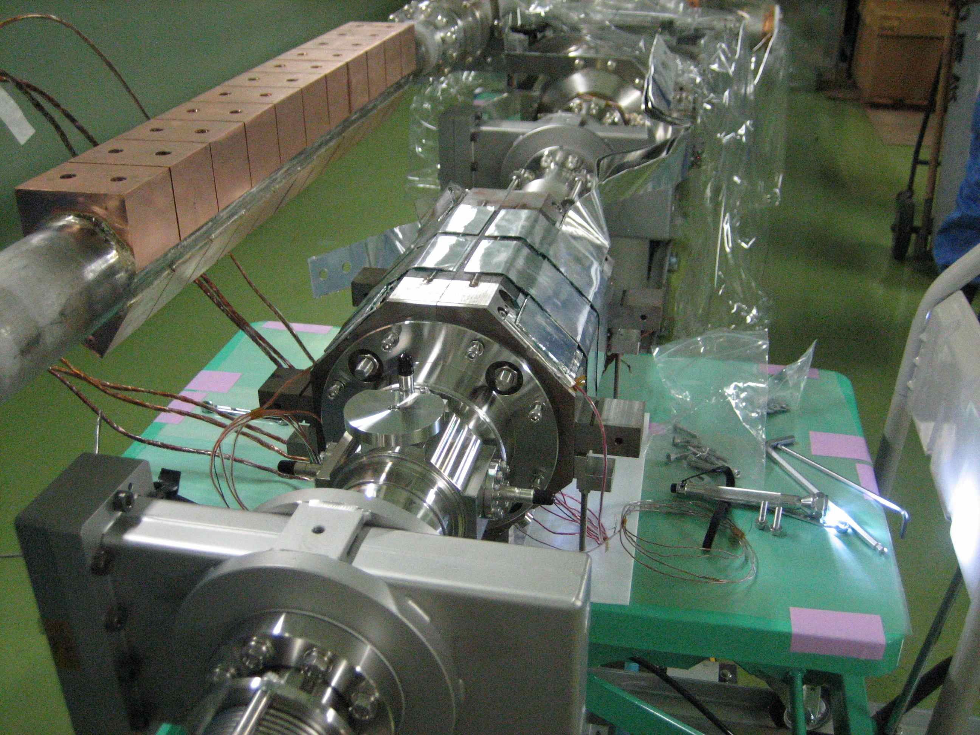
This copper block was welded upstream/downstream reversely!
So, we need different AL conductor adapter to touch SC wires, from the planned one.
No bolt taps
in this side.
But
other side.

Slide 8
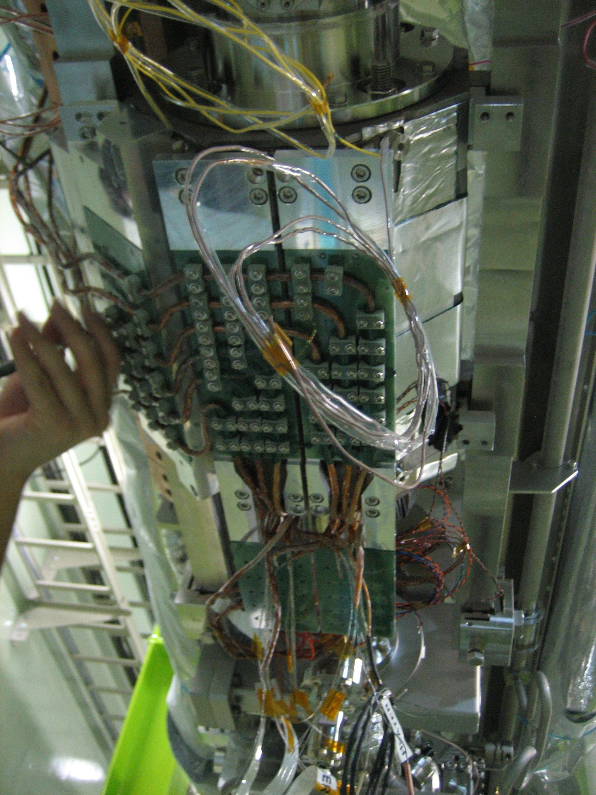
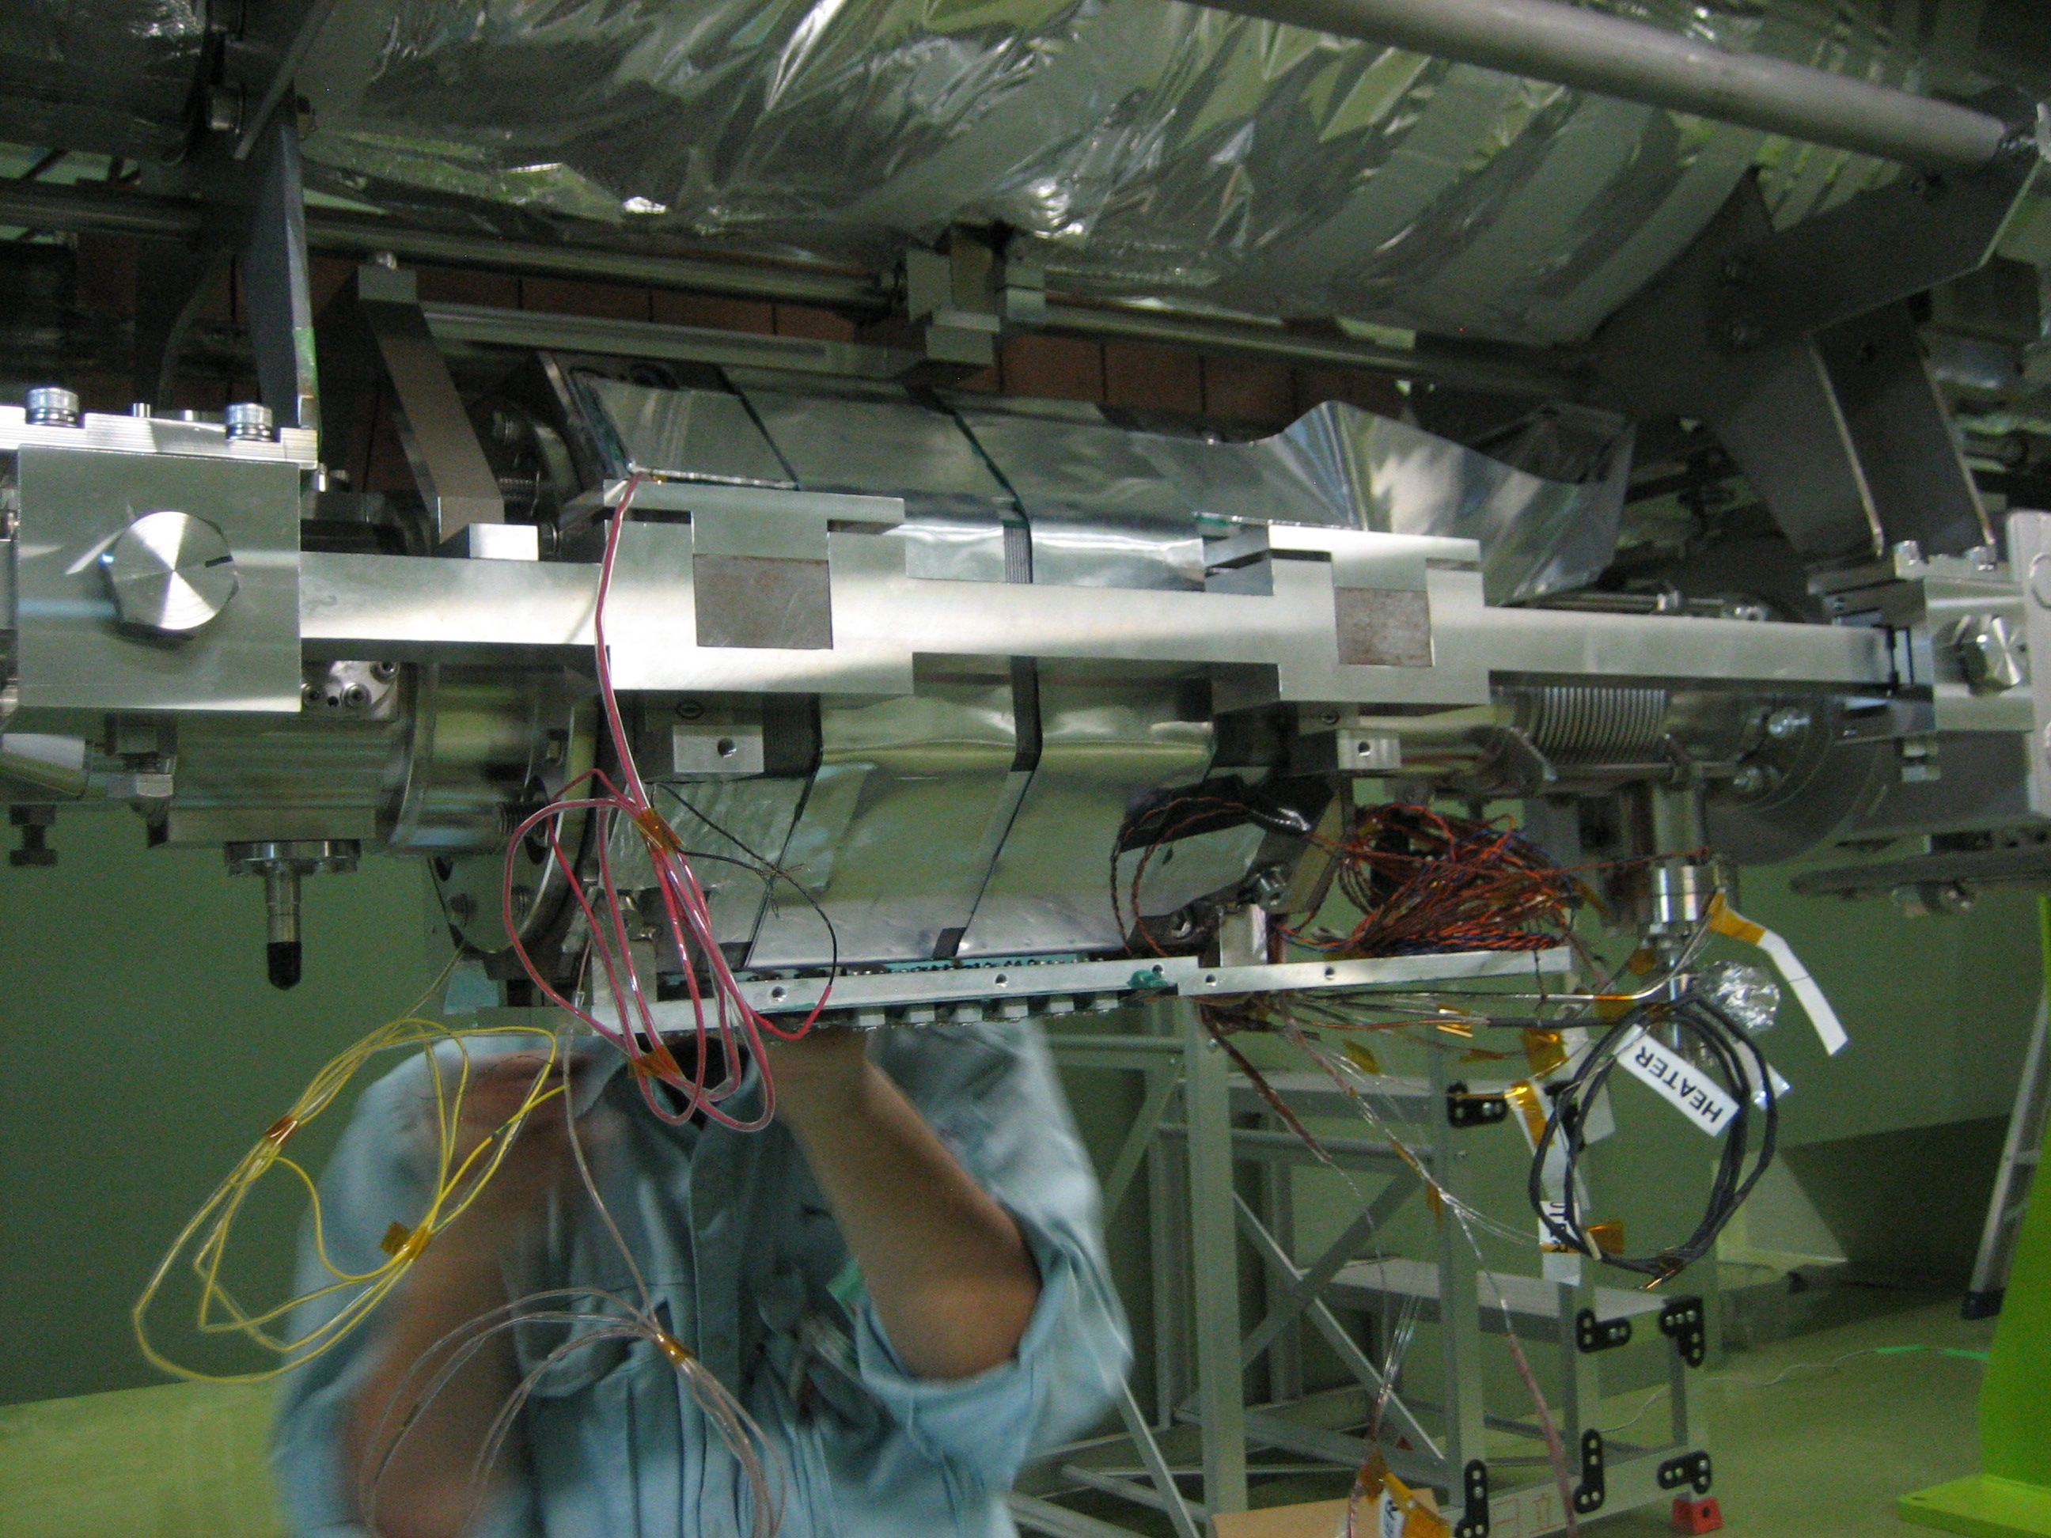
Pictures of SC wiring
See from bottom

Slide 9
SC wiring (see from side)
2K Pipe with AL adapter
2K Anchor
2K Anchor
Current
Feed-through
SC wiring (see from bottom)
SC-wire connection
80K Anchor

Slide 10
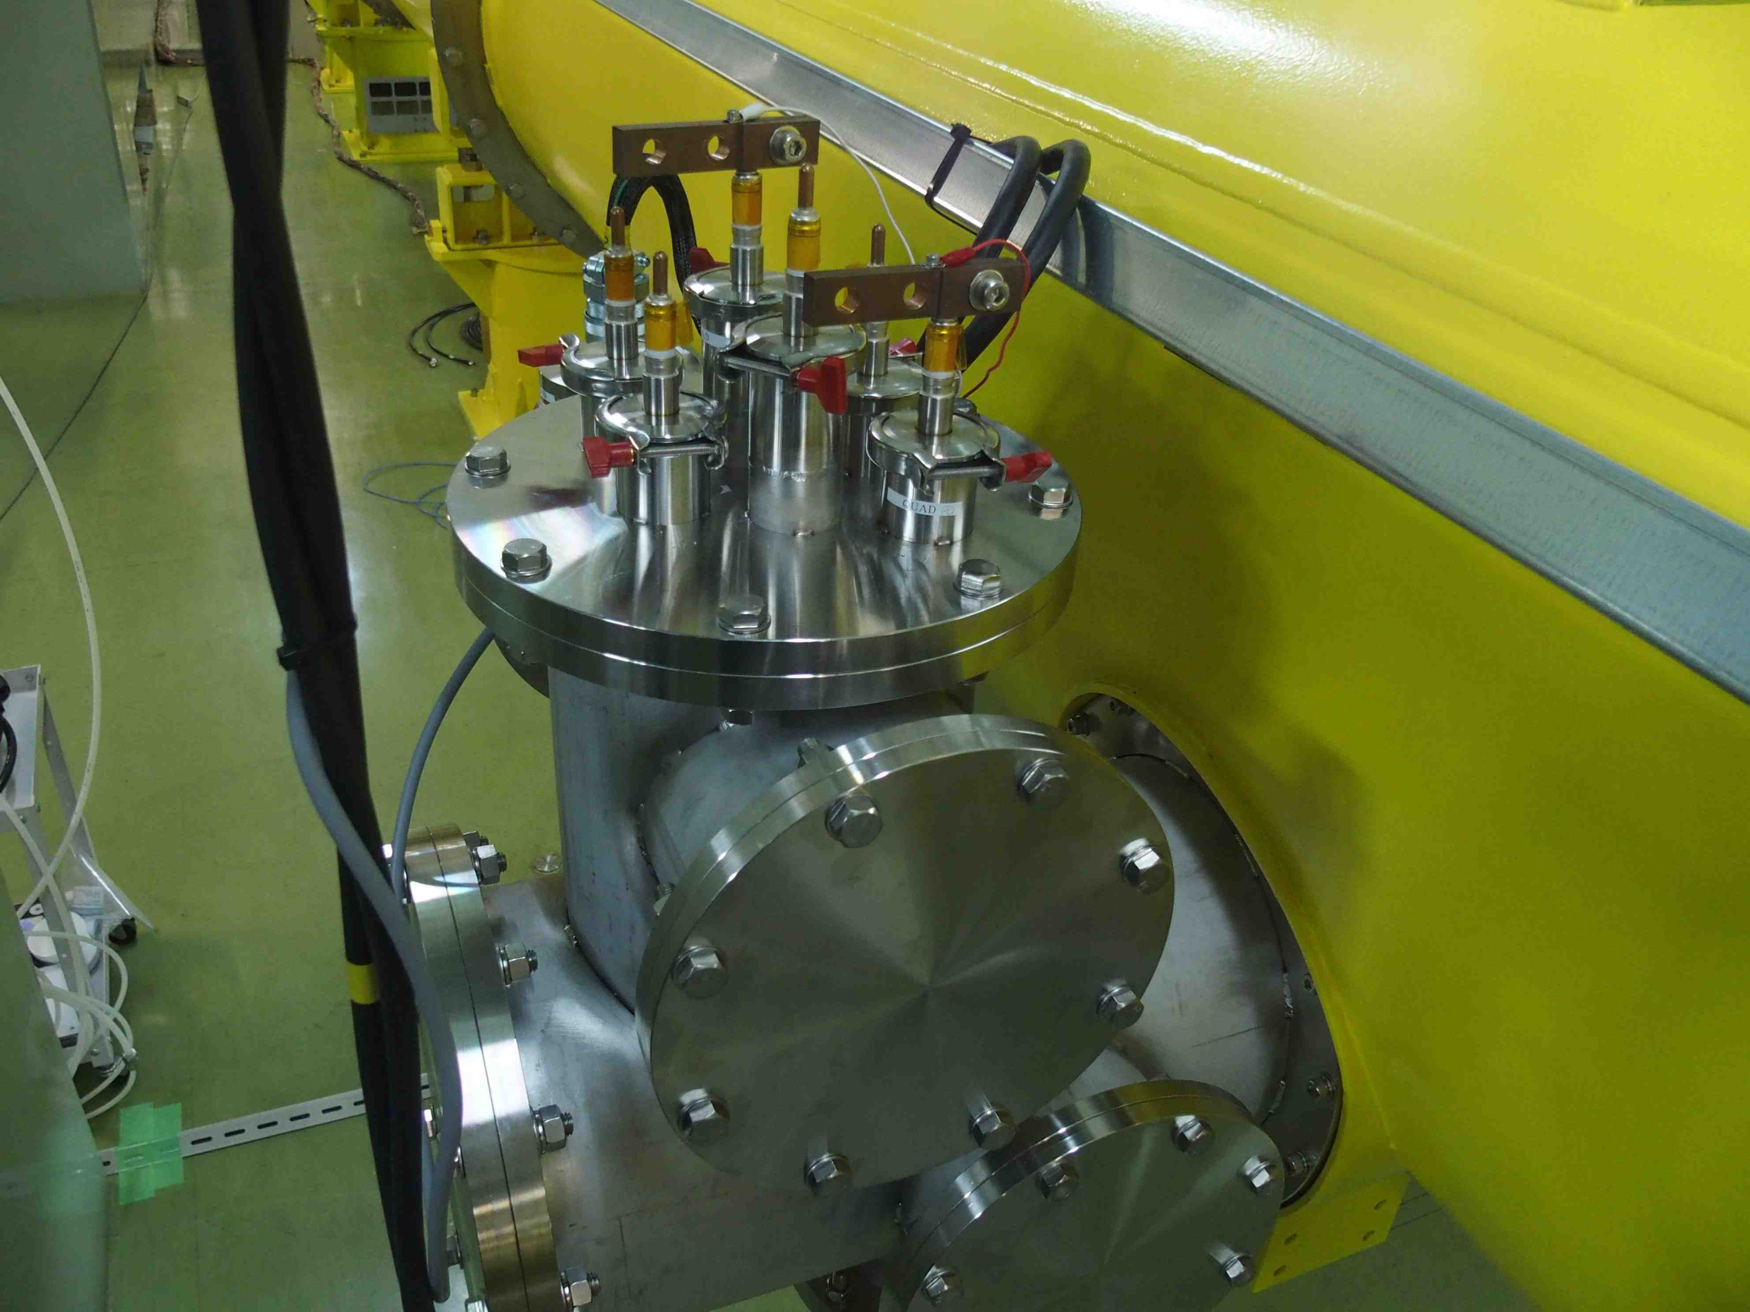
Current feedthrough adapter

Slide 11
Trial for more cool-down by increasing LHe level of 2k-pipe
Only 0.5K improvement
SC-coil#1-temp
SC-coil#3-temp
SC-coil#2-temp
SC-coil#4-temp
80K-anchor-temp
Target coil temperature
is 6K
Temp. reached:
coil=7 – 9K
2K anchor=7K
80K anchor=103K

Slide 12
A preliminary Test
Nov. 14, 2014, NK and AY
Time | Action | Lead-Q1 DV+~Q1+ | Q1 Q1+~Q1- | Q4 Q4+~Q4^ | Lead-Q4 Q4-~DV- | Total DV+~DV- | Note
19:26 | 0 → 1 A (@ 10 mA/s) |  |  | (+ 0.3) | 1.3 | -1.3 mV
19:40 | 1 → 2 A | -1.1? | +0.2 | +0.3 | -1.3 | -1.3
19:50 | 2 → 3 A | -1.9? | +0.3 | +0.7 | -2.1 | -2.2
19:57 | 3 → 4 A | - 2.9? | +0.5 | +1.4 | -3.2 | -3.2
20:10 | 4 → up
 | Quench at > 4.6 A
20:20 | 0 → 2 A | -1.1? | +0.2 | +0.4 | -1.3 | -1.3
20:28 | 2 → 4 A | -2.9? | -0.5 | +1.4 | -3.1 | -2.9
20:38 | 4 A → up
20:40 | Quench at > 4.6 A
21:00 | 0 → 2 A | -1.0? | +0.2 | +0.3 | -1.2 | -1.2
21:10 | 2 → 0 A | 0.0 | +0.2 | -0.1 | 0 | 0.0
20:15 | end

Slide 13
Test with Mike Tartaglia(FNAL)
Nov. 17,18,19 2014, NK and AY
Coil temperature was around 8K ( higher than expected 6K )
(2) Heat load was 2.7W ( consistent with calculated value 2.6W )
(3) Quench happened at 7A ( smaller than expected operation 50A )
(4) Excitation speed 1.5A/sec
We will improve the heat load by introducing HTS leads.

Slide 14
2015 Improvement plan for more Heat-load-reduction
Introducing HTS-lead (High-Tc-Superconducter),
With more strong connection to 5K & 80K shield

Slide 15
End of Slide

