Slide 1
ALCW2015 1st IOC
November 21, 2015: 23:00-24:00 (JST)
Agenda
Report on preparation done for ALCW2015 up to now by KEK and LOC
Discussion and decision on the basic concept and the overall structure of the WS
To-do list

Slide 2
Plan of ALCW2015
1. Co-hosted by LCC, KEK and ACFA
2. Date: April 20 (Mon) – April 24 (Fri) 2015, Venue: KEK
An ILC event is scheduled on April 22 (Wed) at the University of Tokyo including the industrial sector and policy makers . Although this event is hosted separately, the event program should be integrated in the ALCW2015 program.
3. Organization
International Organizing Committee (IOC)
Local Organizing Committee (LOC)

Slide 3
IOC members as of 2014.11.21
Mike Harrison,LCC
Steinar Stapnes, LCC
Hitoshi Yamamoto, LCC
Mitsuaki Nozaki, KEK, ACFA Chair
Yifang Wang, IHEP, Incoming ACFA Chair
Jie Gao, IHEP, ALCSC Chair
Geoffrey Tayor, Melbourne
Bum-Hoon Lee, Sogang Univ.
George Wei-Shu Hou, NTU
A representative from India (TBD)
Yasuhiro Okada, KEK, IOC Chair
Akiya Miyamoto, KEK, LOC Chair
Keisuke Fujii, KEK
Akira Yamamoto, KEK
Sachio Komamiya, Tokyo
Satoru Yamashita, Tokyo
Kiyotomo Kawagoe, Kyushu
Brian Foster, Oxford
Christophe Grojean, Barcelona
Maksym Titov, Saclay
Harry Weerts. ANL
Michael Peskin, SLAC
Ties Behnke, DESY
Andy White, Texas

Slide 4
4. Scope of the workshop
Accelerator, physics and detector aspects of future electron-positron linear colliders. A special focus on the ILC which Japan is considering to host.
Style of the workshop
The plenary session program is arranged by IOC
The accelerator session program is arranged by LCC
Physics and Detector: Omnibus meetings + Physics WG sessions
“Concept” group meetings (ILC, SiD , CLIC Physics &Detector) and
Detector R&D group meetings are invited as parts of parallel
sessions of ALCW2015. The program of each meeting is arranged
by organizers of each part.
In parallel to Detector R&D group meetings, physics WG sessions
are organized by physics WG conveners assigned by IOC.

Slide 5
Conceptual Time Table
Could be shorter because
we have another plenary session
in the Wed morning
A plenary session mostly intended
to researchers
Tokyo event
 | 4/20(Mon) | 4/21(Tue) | 4/22(Wed) | 4/23(Thu) | 4/24(Fri)
Morning | Registration | Acc/Phys/R&D | Plenary @Tokyo | Acc/Concept | Acc/Concept
 | Plenary
Afternoon | Acc/Phys/R&D | Acc/Phys/R&D | Symposium | Acc/Concept | Plenary
 |  | Plenary |  | Plenary
 |  |  | Party
Extra rooms are available on April 19 (Sun) and April 25(Sat) if necessary.

Slide 6
6. Registration fee
The registration fee will be collected and the workshop budget will be managed by ALCW2015. An estimated registration fee is 30,000-35,000 yen.
7. Schedule
November 21, 2014 : 1st IOC meeting
Mid-December: Start of online-registration
Late March: End of the early registration
Early April: Program final decision
8. To-do list before the online-registration
Arrange omnibus meetings
Select physics WG session conveners
Agree on the Tokyo event with its organizers

Slide 7
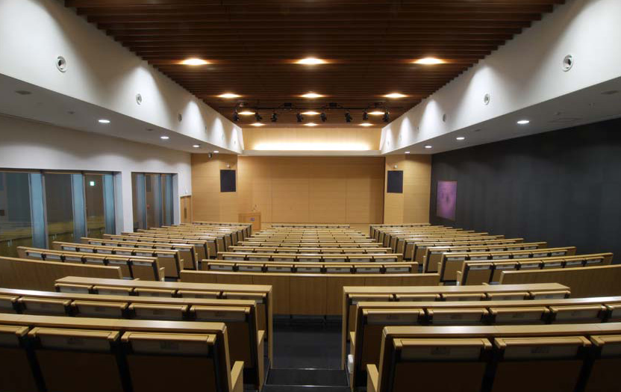
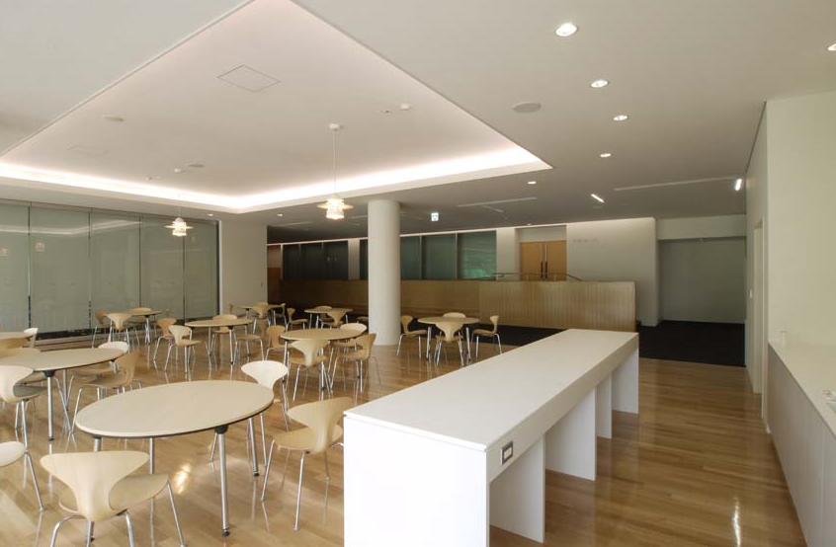
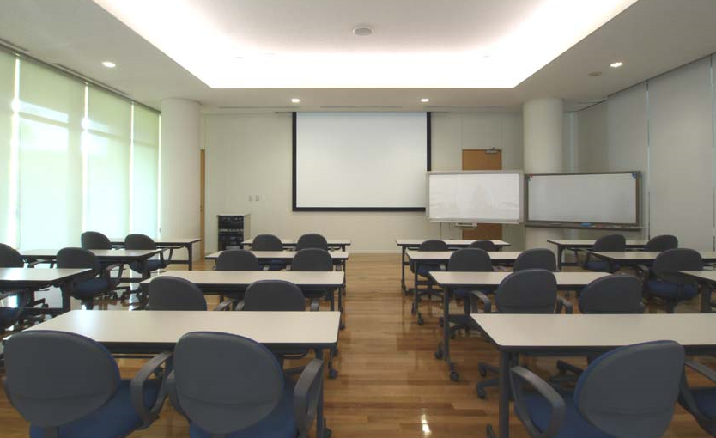
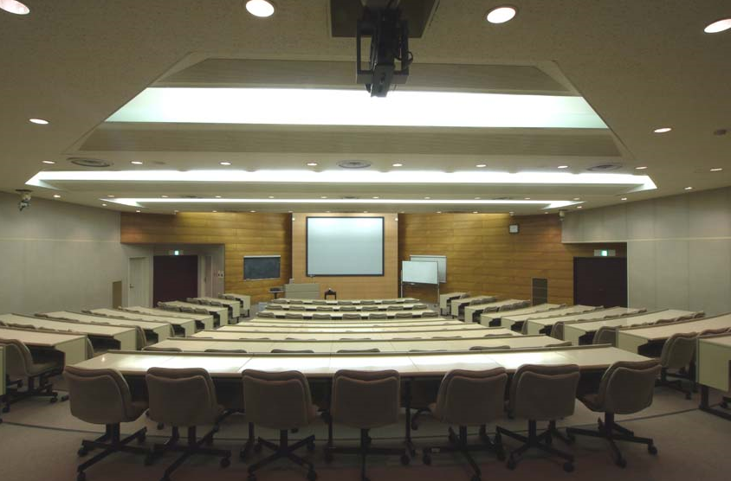
LOC status
Kobayashi Hall
1. Reserved Rooms
Name | Nb. of sheets
Kobayashi Hall | 248
3 Seminar hall | 120
4 Seminar hall | 120
Meeting room 2L | 46
Meeting room 2M | 34
Meeting room 2S | 12
Meeting room 3 | 45
Meeting room M1 | 30
Meeting room M3 | 24
removable
wall
lounge
- Reserved period: April 20 – April 24
- For a plenary with more than 300 participants,
Kobayashi hall, lounge in front and M1
( or 3 Seminar Hall) will be used with TV connection.
M1
2. Accommodation and transportation
- Early hotel booking is highly recommended because
3 major hotels familiar for us are fully booked already
for another bigger event in the same period. KEK dormitory
will be tight as well due to many PF users.
- LOC has secured 150 rooms for the moment though a
travel agency. It will be increased depending on demands
- Bus transportation between stations in Tsukuba city and
KEK will be arranged.
3 Seminar hall
3. The workshop web.
Under construction at http://www-conf.kek.jp/alcw2015

