Slide 1
Tunnel Length Issue
K.Yokoya
2014-1211 ADI
ADI/CFS Informal mtg at KEK on Dec.4

Slide 2
Physics Issue
TDR Design : Maximum energy E_{CM}=500GeV
  Decided before the discovery of Higgs at ~125GeV
500GeV is close to the threshold of e+ e- → t t H at E_{CM}=475GeV
E_{CM}~550GeV is preferable for measuring top-Yukawa coupling
  The crosssection at 550GeV is factor ~4 larger than at 500GeV
Parameter Group report (Oct.2014)

Slide 3
Accelerator Issue
The average operation gradient defined as G=31.5MV/m in TDR
→ linac length ~11km*2 for 500GeV
Can we guarantee 31.5MV/m?
  Vertical test for XFEL so far shows values somewhat lower than ILC spec 35MV/m
  Moreover, gradient reduction in cryomodule
    Average reduction of first 11 module = ~14% (but only 10 of full production)
If the actual gradient is lower, e.g., by 5%, ttH will be completely missed

Slide 4
TTC2014@KEK D. Reschke
Note:
Acceptance criterion at lower gradient
Power-limit 31MV/m

Slide 5
Timing Issue
( L₁ + L₂ + L₃ ) – L₄ = n x C_{DR}
TDR values give
( L₁ + L₂ + L₃ ) – L₄ = 9 x C_{DR} + 294m
It is possible to adjust the value either by
  Shortening the BDS by ~150m
or by
  Expanding the DR circumference by ~30m
This will nearly keep the TDR layout
But no margin for 500GeV, no way to reach 550GeV

Slide 6
What if longer linac is needed?
Perhaps, ~10% (sum of physics and accelerator demands) is a reasonable extension
10% fully equipped linac is probably out of concern
  Too expensive O(500M$)
But at least we can prepare additional empty tunnel
With TDR C_{DR}, ( L₁ + L₂ + L₃ ) – L₄ = 10 x C_{DR}
tells the positron tunnel must be lengthened by
ΔL_{Linac} = C_{DR} /2 – 294m/2 = 1473m = 14% of TDR linac tunnel
This is enough for the timing issue, but the electron tunnel should also be lengthened for E_{CM} issue
  Nearly 3km increase in total

Slide 7
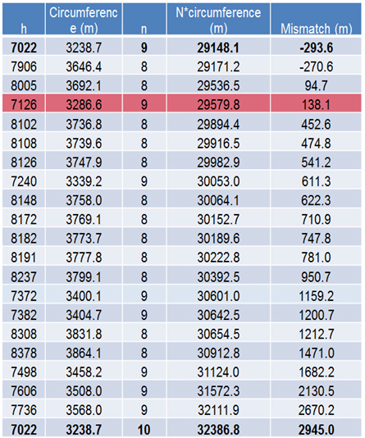
Another Solution
Keep n=9 and adopt longer C_{DR}
ΔL_{e+Linac}
= 9xΔC_{DR} /2 – 294m/2
For example, C_{DR} = 3508m gives
ΔL_{e+Linac} = 1064m = ~10%
(ΔL_{total} ~ 2.1km)
This requires 8.3% larger DR
  Slight modification of wiggler length and RF is needed

Slide 8
How to proceed?
Consensus to increase tunnel length
Some more detail of the design
  Modification of DR if needed
  Where to insert the empty section?
  Cryogenics system
  CFS issues : study started
  Cost estimation
    Empty tunnel ~25M$/km
    Beam line (high energy beam, RTML)
    Δcost of DR
Time line
  Change request early next year
  Final decision by ALCW at KEK in Apr.2015

Slide 9
Which is better?
ΔL_{total} =3km
  gives larger gradient margin (14%)
ΔL_{total} =2.1km with ΔC_{DR} =269m (8.3%)
  Requires less increase of tunnel length
  But 8.3% increase of C_{DR} (plus 8% wiggler length and RF power/voltage) may even be more expensive than 1km of linac tunnel
  Redesign of DR needed → manpower ?

Slide 10
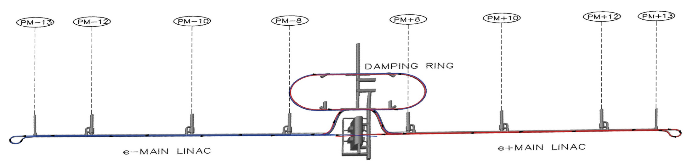
Where should the extra linac tunnel be inserted?
High energy ends of linacs
  Cryogenics station at PM+-8 can be reinforced later
  Additional access tunnel not needed

Slide 11
SCRF Experts Discussion at KEK after TTC (Dec.5)
Improvement of gradient reduction in cryomodule might be improved
  One of the important topics of TTC
Should wait 1-2 more years for the final decision

