Slide 1
TPC RESOURCES GUESSTIMATES
RS WP210 20141211

Slide 2
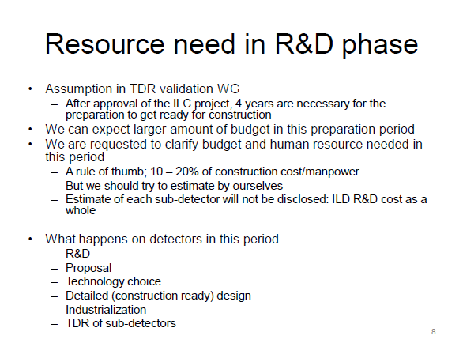
Yasuhiro at optimization meeting yesterday

Slide 3
TPC |  | Now | Y-4 | Y-3 | Y-2 | Y-1 |  | Y1 | Y2
Timeline |  | R&D | R&D | R&D | R&D | R&D
Budget
 | Annual budget (MILCU) | 0.5 | 0.6 | 0.6 | 0.6 | 0.6 |  | 1.1 | 3.59
FTE from external labs/univ
 | Item
 | Field cage |  | 1 | 1 | 1 | 2 |  | 3 | 3
 | End plate |  | 1 | 2 | 2 | 3 |  | 3 | 5
 | Modules |  | 5 | 5 | 5 | 5 |  | 5 | 5
 | Electronics |  | 5 | 5 | 5 | 5 |  | 5 | 5
 | Laser |  | 2 | 2 | 2 | 2 |  | 2 | 2
 | Power supply |  | 1 | 1 | 2 | 2 |  | 3 | 3
 | High voltage |  | 1 | 1 | 1 | 1 |  | 2 | 2
 | Gas and Cooling |  | 1 | 1 | 1 | 1 |  | 2 | 2
 | DAQ |  | 1 | 1 | 1 | 1 |  | 2 | 2
 | Monitor |  | 1 | 1 | 1 | 1 |  | 2 | 2
 | Software |  | 2 | 2 | 2 | 2 |  | 3 | 3
 | Management |  | 1 | 1 | 1 | 1 |  | 3 | 3
 | Total |  | 22 | 23 | 24 | 26 |  | 35 | 37

