Slide 1




Development of a combined TR/DR emittance station for future linear colliders
T. Aumeyr¹, M. Bergamaschi², E. Bravin²,
P. Karataev¹, R. Kieffer², T. Lefevre², S. Mazzoni², N. Terunuma and other members of ATF2
John Adams Institute at Royal Holloway, Egham UK
CERN European Organisation for Nuclear Research, Geneva, Switzerland
KEK: High Energy Accelerator Research Organization, Tsukuba, Japan

Slide 2
Personnel & Funding
Advanced researchers
  P. Karataev, T. Lefevre, E. Bravin and S. Mazzoni
Postdoctoral researchers
  R. Kieffer and T. Aumeyr
PhD student
  Michele Bergamaschi
Mechanical Engineer
  N. Chritin
Funding
  CERN will fund the hardware
  E-JADE EU funded project for EU-JAPAN staff exchange
  CLIC-UK Joint collaboration between CERN and UK Universities to develop accelerator instrumentation.
Notes:
Single station at ATF2:
- Two targets in one --> both phenomena used for different purposes
- Precise measurement: single bunch with TR, high resolution (<100 nm)
- Evolution from 1 bunch to whole train --> measure emittance DR (few μm)

Slide 3
Overview
Goal: High-resolution measurement system for LCs as an alternative or a supplementary equipment to LW
Pushing the limit of OTR high resolution further down to < 100 nm.
Developing ODR technology to measure beam size at the micron scale
  Use the past experience on ODR and OTR measurements at ATF/ATF2 beam lines;
  Present ODR studies @ CESR-TA (Cornell University, USA) and the corresponding target development;
  Develop a combined OTR/ODR diagnostic station with R&D capabilities;
Future OTR/UVDR tests at ATF2 (Tsukuba, JP)
Notes:
Single station at ATF2:
- Two targets in one --> both phenomena used for different purposes
- Precise measurement: single bunch with TR, high resolution (<100 nm)
- Evolution from 1 bunch to whole train --> measure emittance DR (few μm)

Slide 4
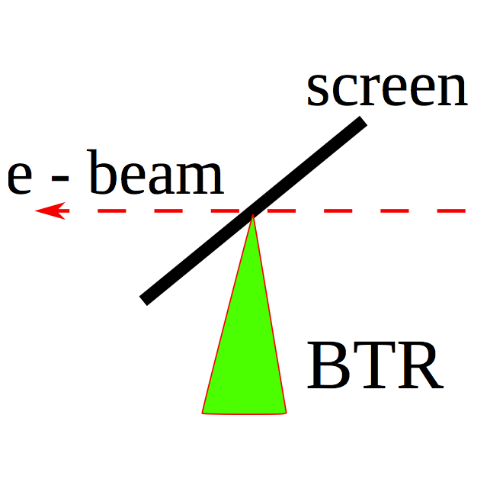
Transition Radiation
Transition radiation (TR) appears when a charged particle crosses a boundary between two media with different dielectric constants
The resolution is determined by the source dimensions induced by a single particle plus distortion caused by the optical system (diffraction of OTR tails, aberrations)
Notes:
TR: well known
- theory appeared 70 yrs ago
- useful tool
- Invasive method: High intensity destroys target

Slide 5
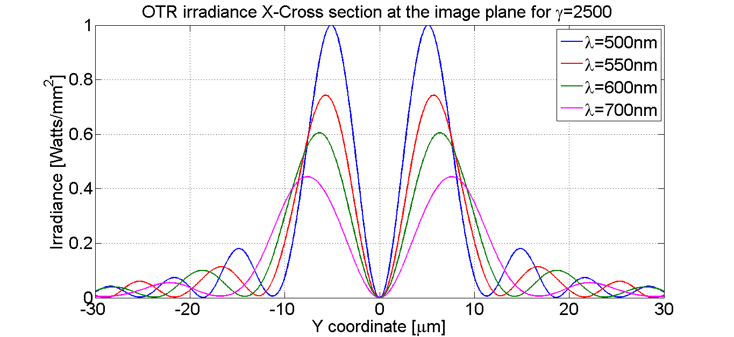
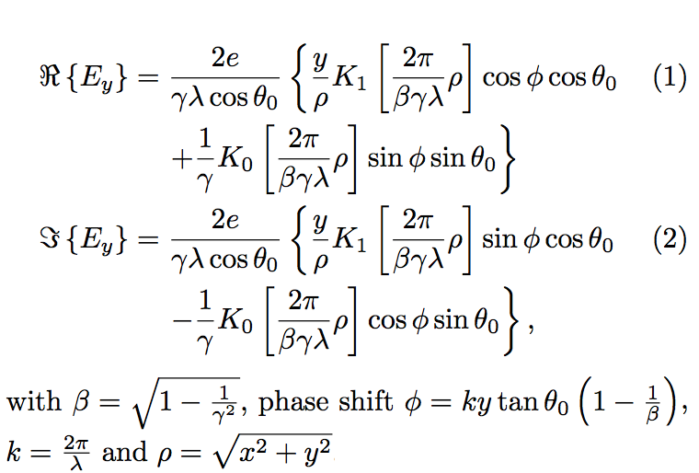
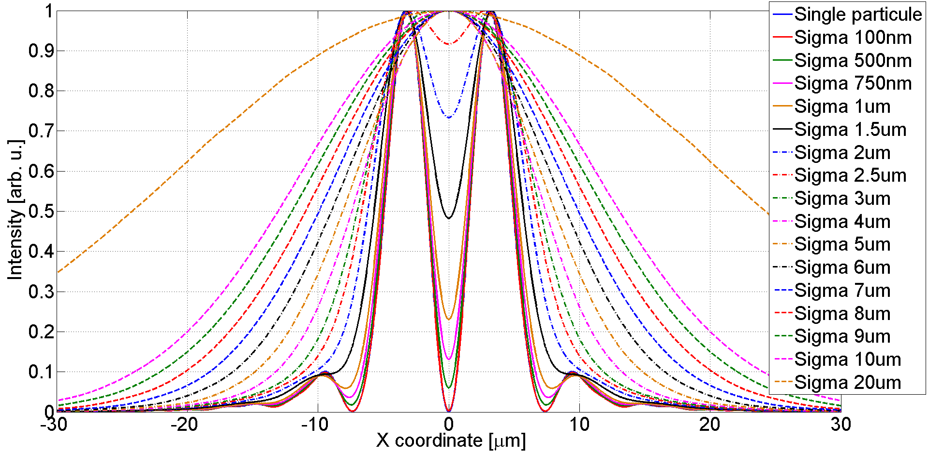
OTR development: Simulation of imaging system
Point Spread Function of OTR imaging system: Image generated by a single particle (propagating the OTR E-field in Zemax)
Simulation of images obtained for realistic beam size: Sub-micron beam sizes can be measured via the visibility of the PSF
Notes:
TR PSF:
- Discovered: TR resolution limited by PSF; source generated by single particle and projected by optical system onto CCD camera
- PSF has a structure: deduce beam size with sub-um resolution

Slide 6
Verification of simulation using ZEMAX code
TR in the pre-wave zone
V. Verzilov, Phys. Lett. A 273 (2000) 135
TR from a tilted target
A. Potylitsyn, NIM B 145 (1998) 169

Slide 7
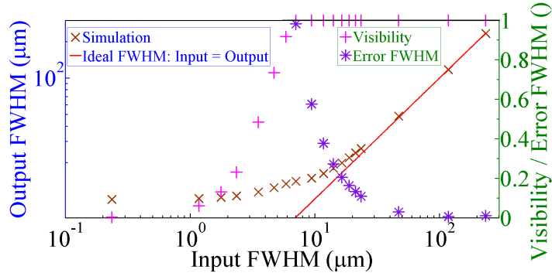
Estimation of systematic errors using OTR imaging system
Dark
area

Slide 8
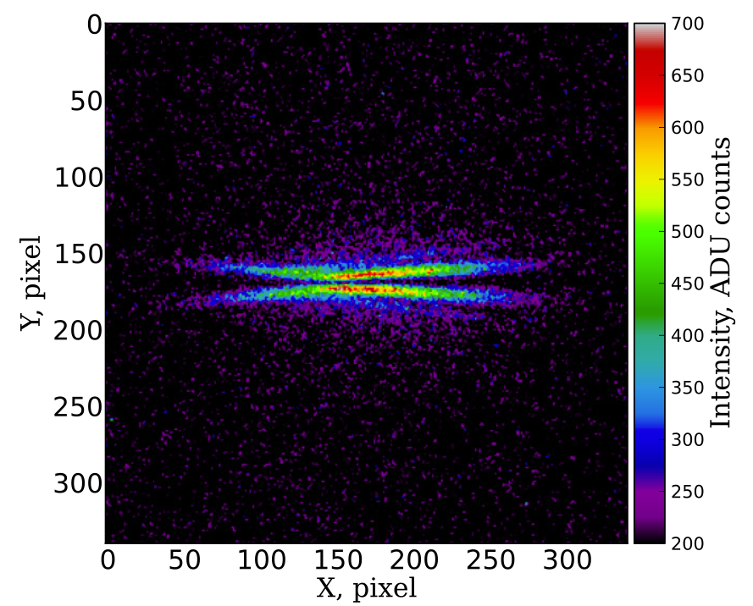
An example of the image measured with linear polarizer and 550±20 nm
First Observation: P. Karataev, et al., Physical Review Letters 107, 174801 (2011).

Slide 9
Horizontal Projection

Slide 10
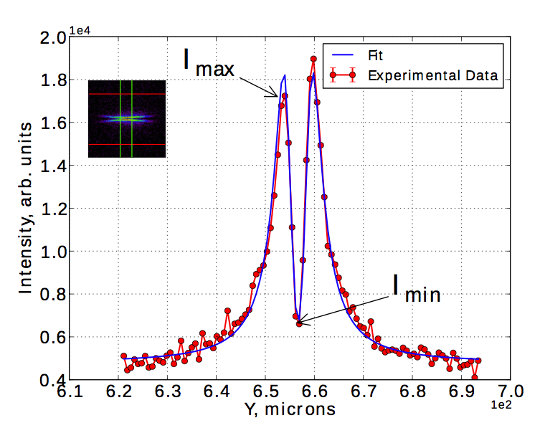
Vertical Projection

Slide 11
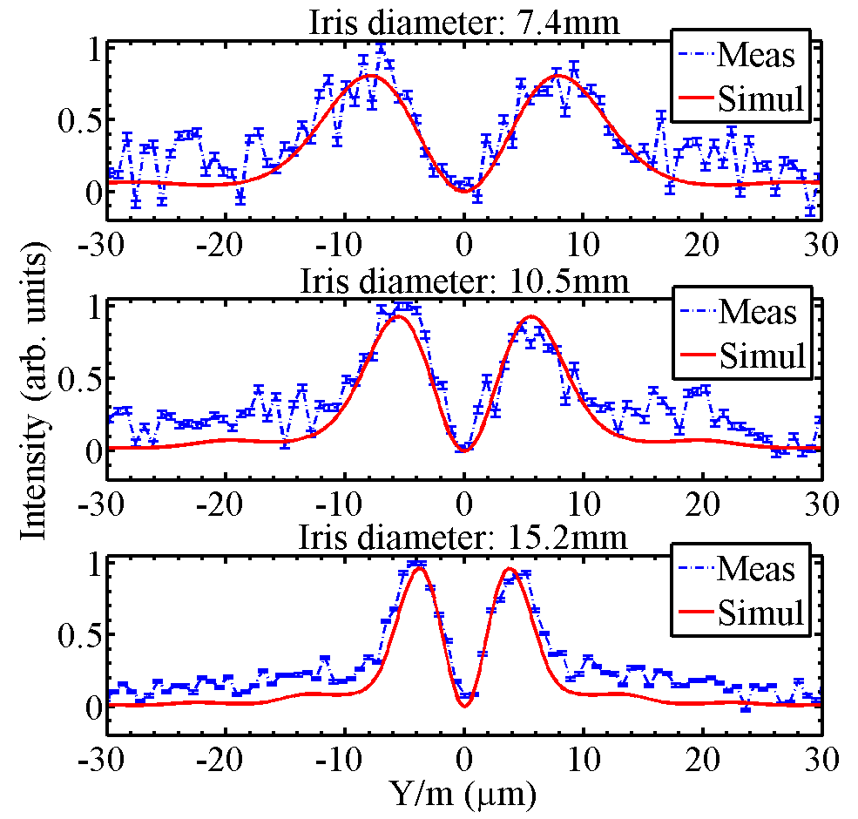
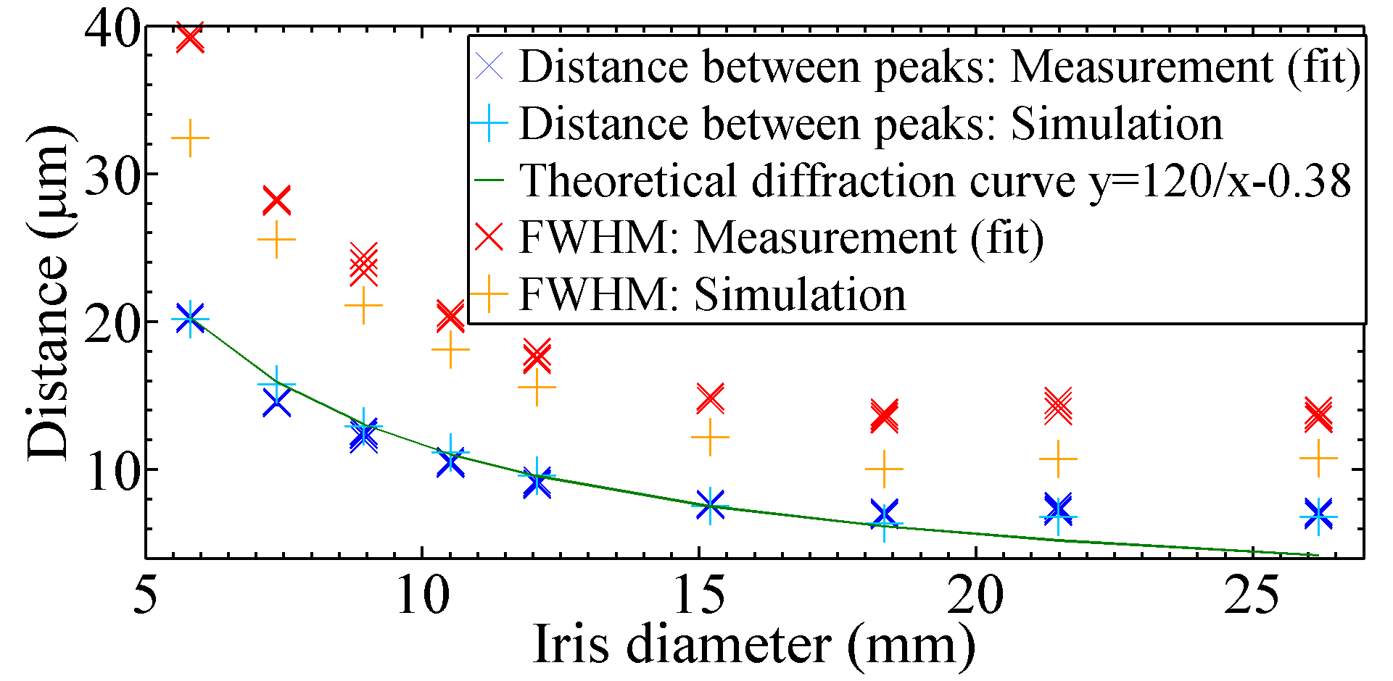
Comparison of experimental results with Zemax simulations
Investigation of the diffraction effect:
OTR PSF size (distance between peaks and FWHM) for different iris diameters

Slide 12
Fit function

Slide 13
Self-calibration procedure

Slide 14
Self-calibration procedure

Slide 15
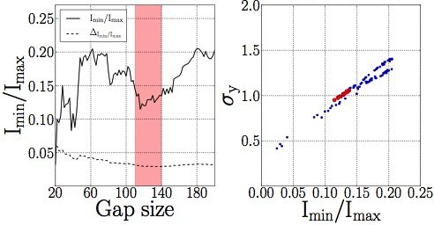
Selection of the integration window

Slide 16
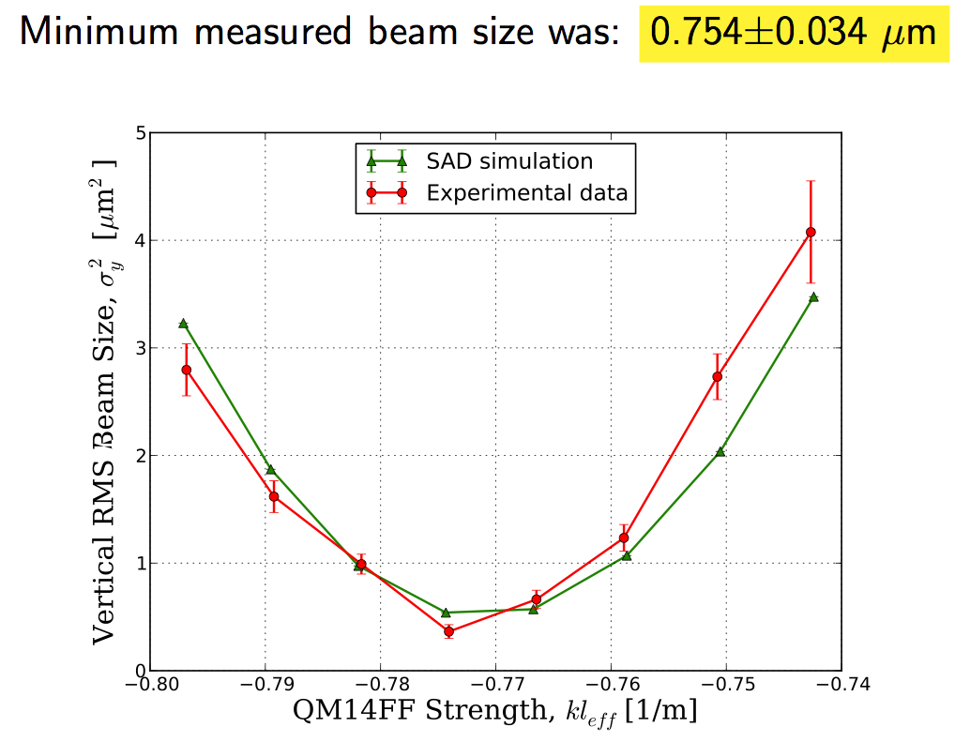
Comparison of the OTR and Laser-wire measurements

Slide 17
Emittance measurement

Slide 18
ODR principles
Diffraction radiation (DR) appears when a charged particle moves in the vicinity of a medium
Impact parameter, h, – the shortest distance between the target and the particle trajectory
- observation wavelength
γ = E/mc² – Lorentz - factor

Slide 19
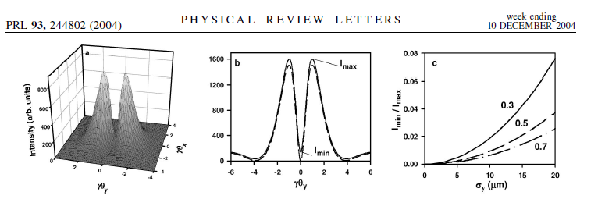
ODR principles
P. Karataev et al.

Slide 20
Typical CCD image measured in the back focal plane of the lens
Visibility of the ODR vertical Polarization component depends on the electron beam size

Slide 21
ODR at ATF
Fit function:

Slide 22
Limitations and Sensitivity
CTF3:
Photon yield:
CesrTA:
CLIC:
CTF3:
Optimal Sensitivity:
CesrTA:
CLIC:

Slide 23
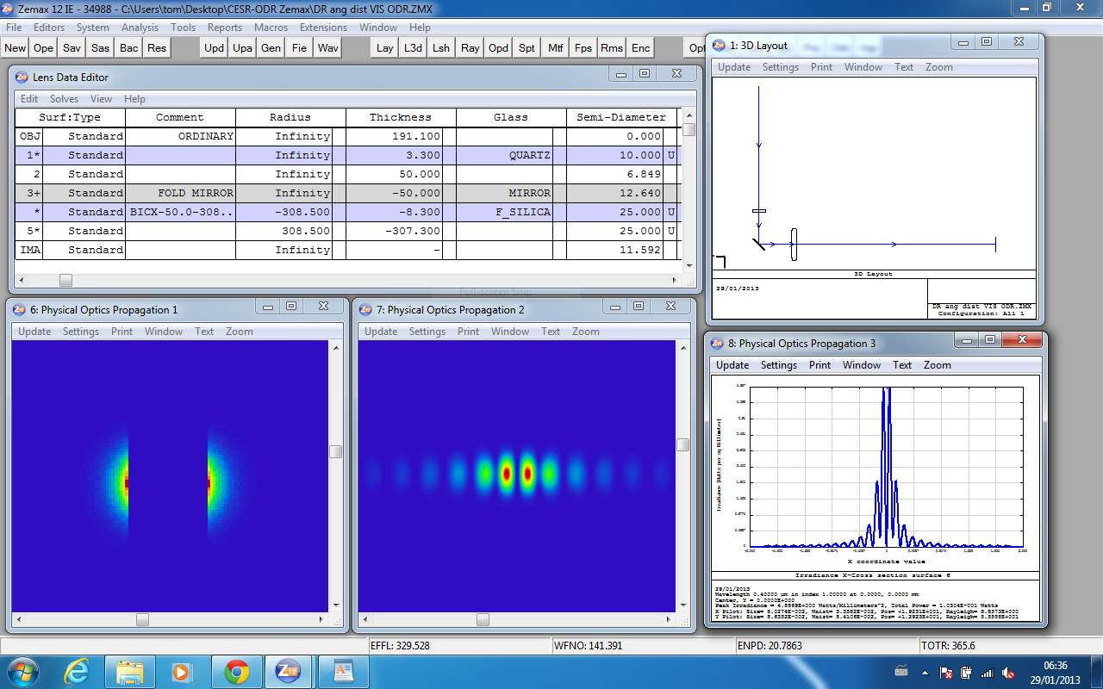
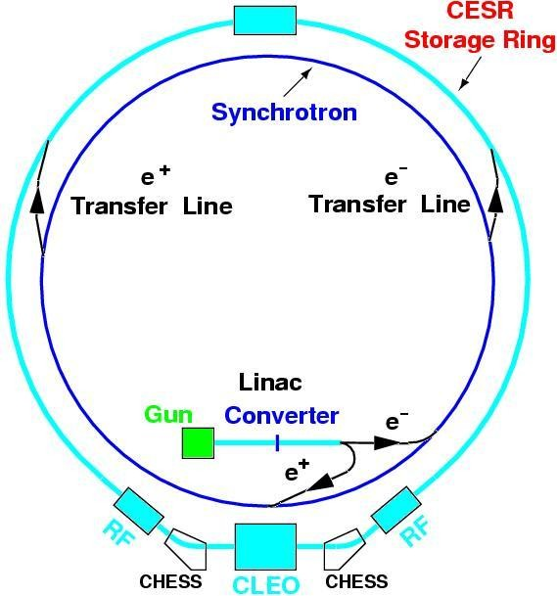
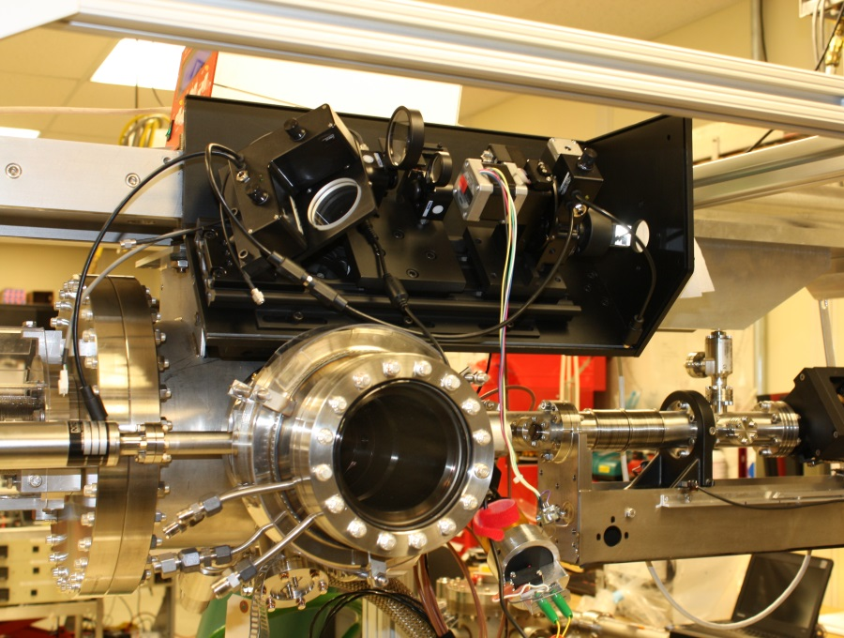
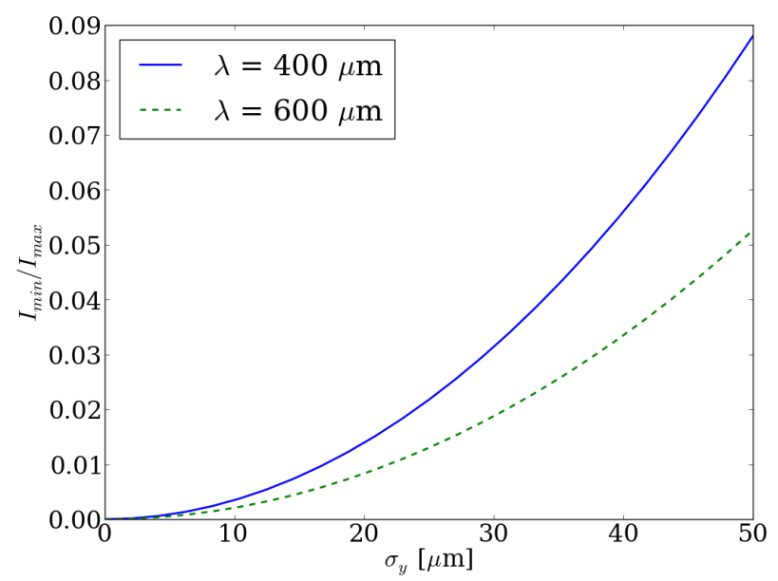
ODR development at CesrTA
Simulation using Zemax
Beam tests at Cornell Electron Storage Ring since Dec 2012
Single particle images
Image
Angular
0.5 mm slit
Beam size
E [GeV] | σ_{H} [µm] | σ_{V} [µm]
2.1 | 320 | 10
Notes:
DR:
- Same nature as TR --> slit; interference pattern produced by slit is used
UV/X-ray DR:
- DR resolution limited by diffraction limit --> lower wavelength

Slide 24
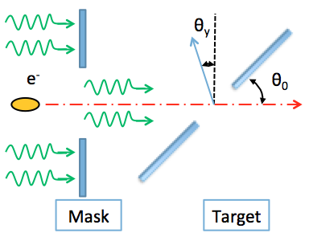
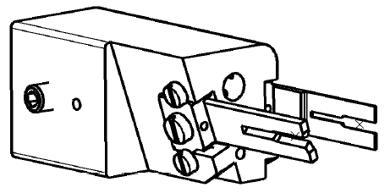
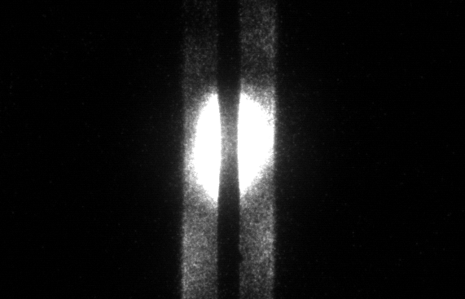
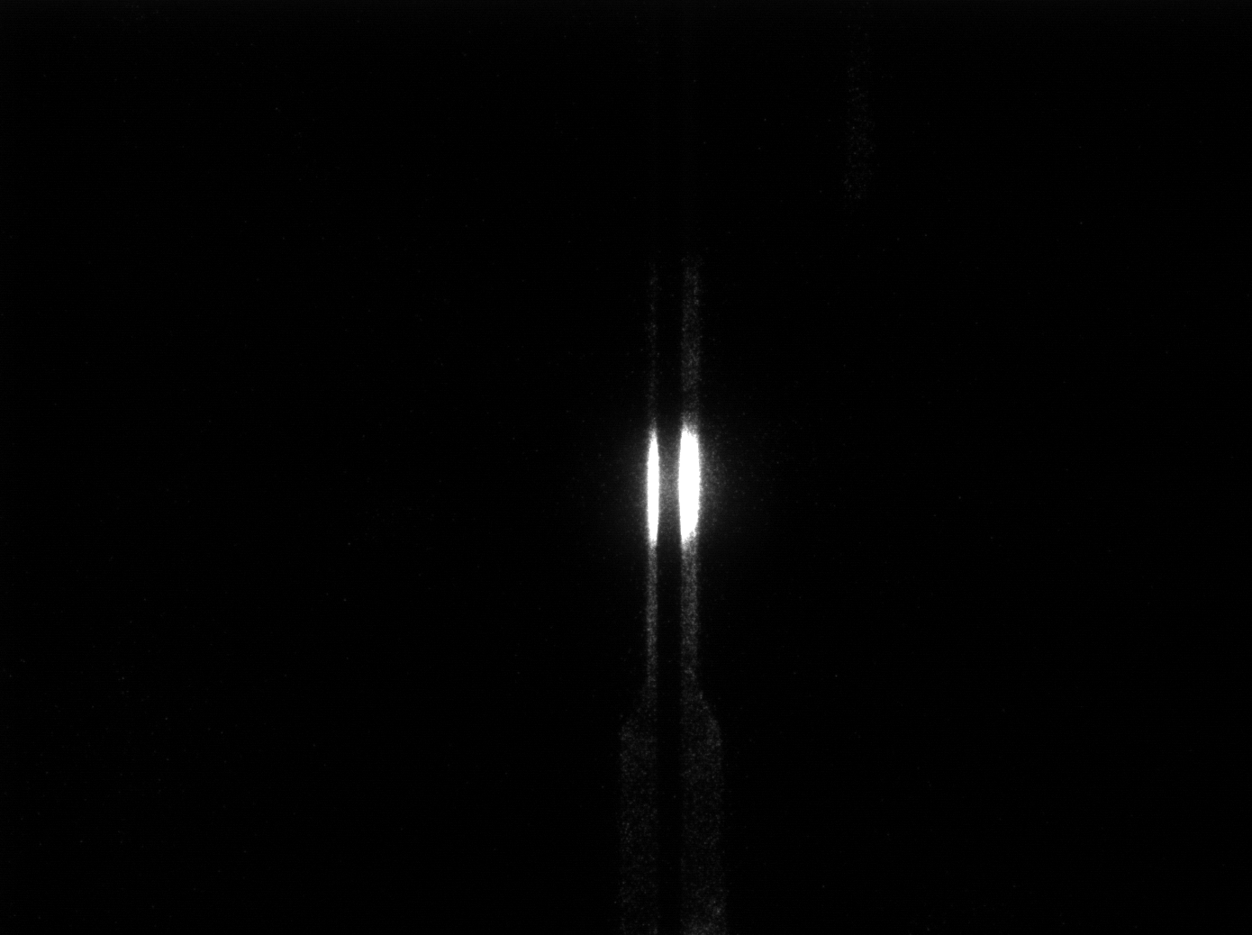
ODR target slit
Target Assembly
Si target for DR
  Ultra high precision: 0.1nm roughness, 40nm co-planarity
  Slit size: 0.5mm
SiC mask to suppress background from synchrotron radiation
  Mask aperture of 1 and 2 mm
  Small mask aperture leads to stronger interference between the DR of the mask and target
Target imaging at 600nm
Asymmetry in the distribution indicates a beam position offset in the slit
2mm mask aperture
1mm mask aperture

Slide 25
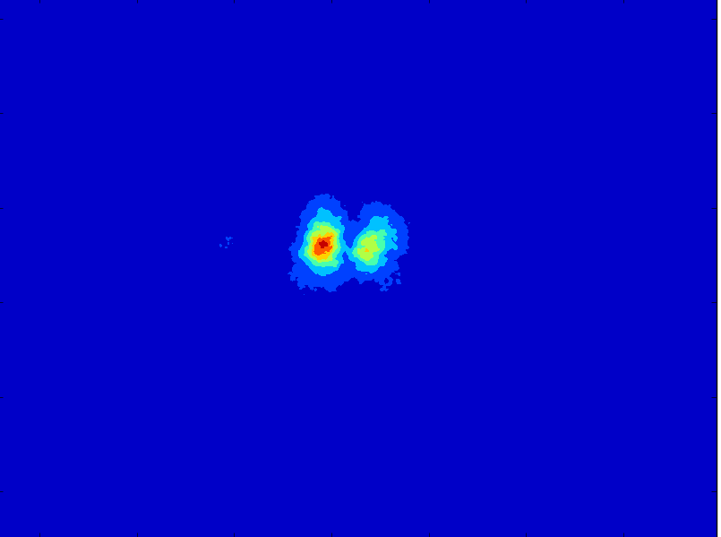
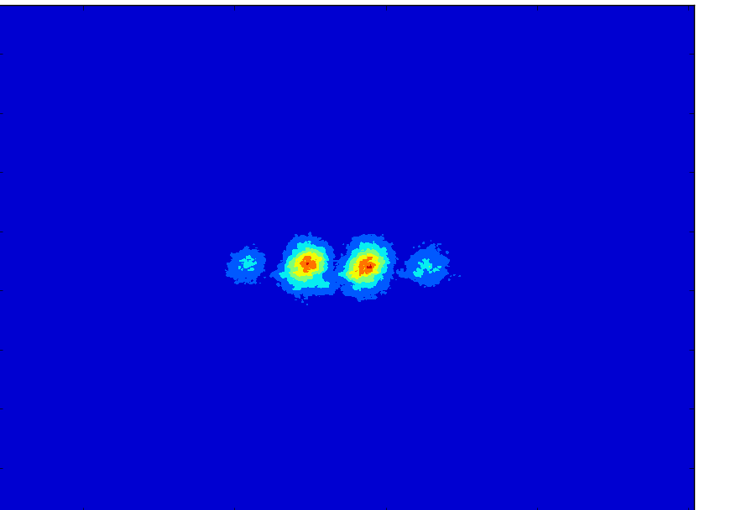
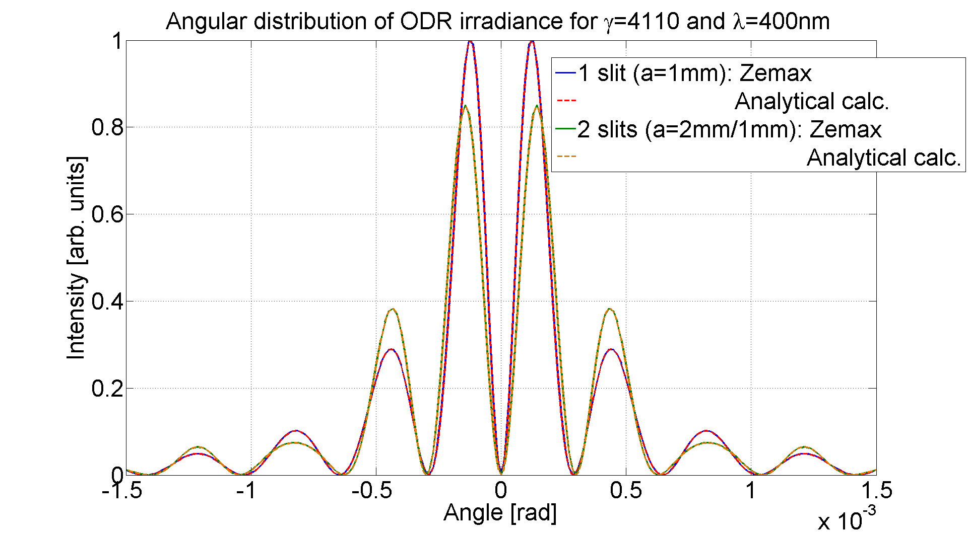
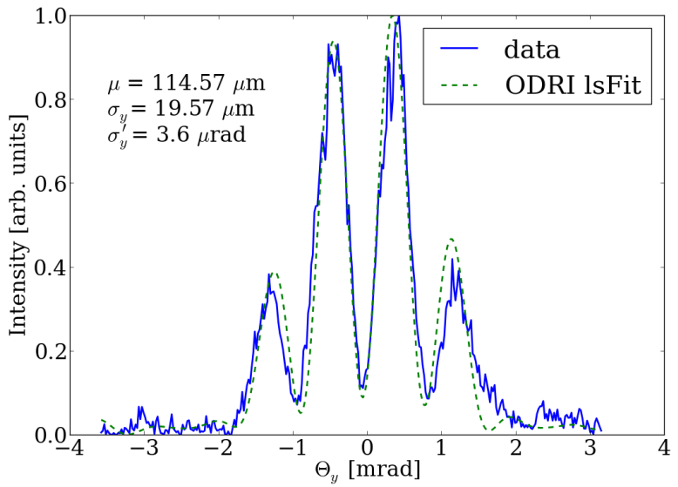
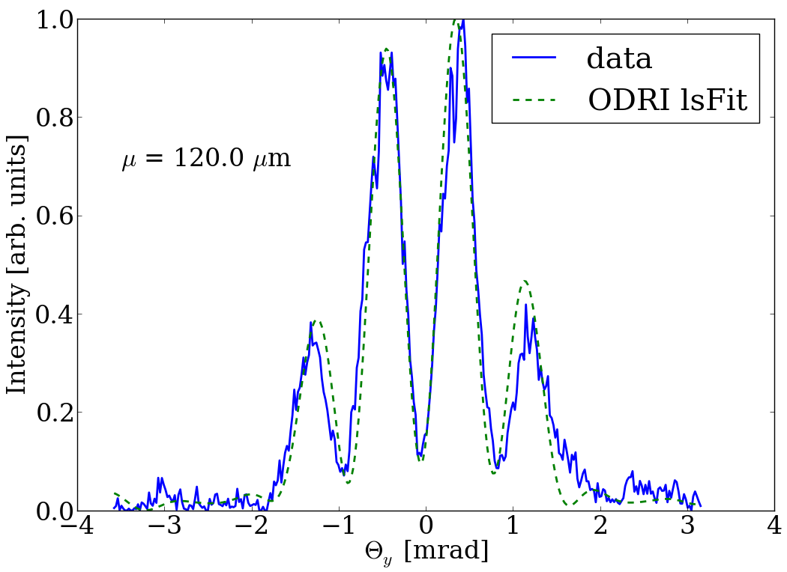
ODR @CESR-TA: data analysis
Angular distribution at 600nm
Zemax simulation ODR/ODRI
2mm mask, ODR
1mm mask, ODRI
Least Square Fit Analysis
Taking into account target co-planarity of 40nm
3 fit parameters: position, size and divergence
CESR measured beam parameters
ε_{y} [m] | σ_{y} (ODR) [μm] | σ_{y}’ (ODR) [μrad]
3.96e-11 | 17.6 | 4.08

Slide 26
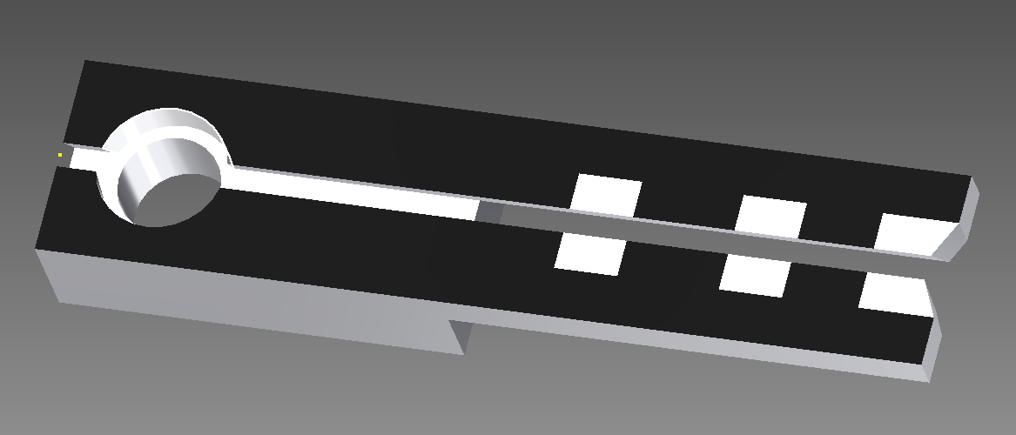
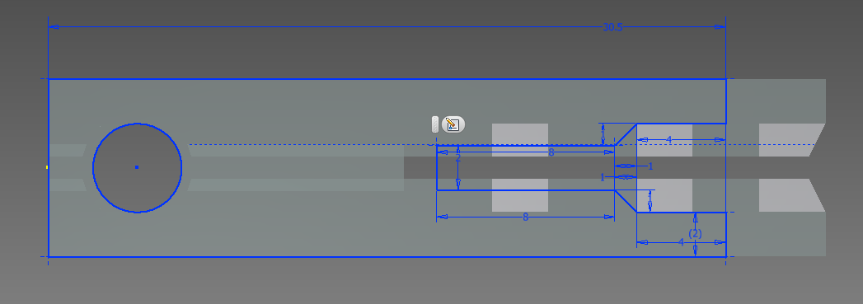
ODR @CESR-TA: new target
Beam size measurement through determining the visibility in the ODR angular distribution
Improvement: increase the signal to noise ratio by selective darkening of target surface
Shadowing leads to light reduction: OK for ring, but critical in linac (number of photons, S/N)
Techniques under investigation:
  Micro sanding of the target (increase diffusion)
  Carbon deposition by sputtering (absorption)

Slide 27
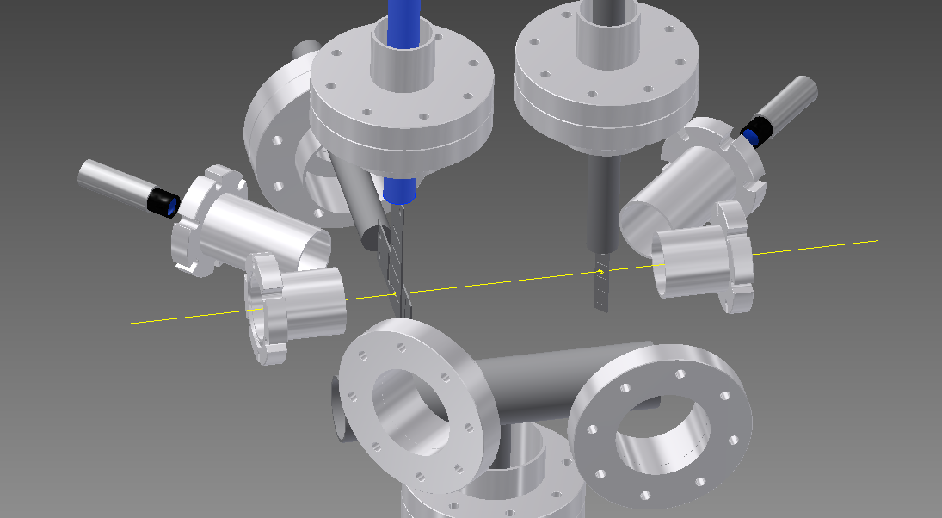
ATF2 ODR experiment (predesign step)
45deg View Port
Target laser alignment
45deg View Port
Mask Camera
Target
Actuator
Mask
Actuators
Camera
Beam
BPM Flange
(Beam)
BPM Flange
(Beam)
40 degrees
View Port on target (imaging)
90 degrees
View Port on target (angular)

Slide 28
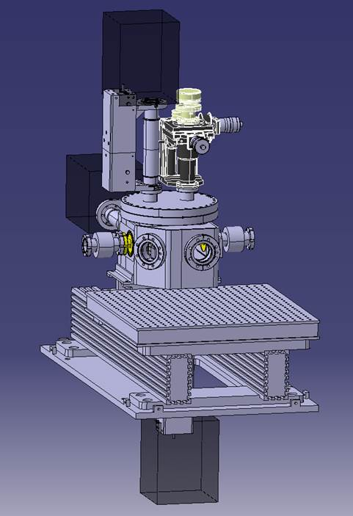
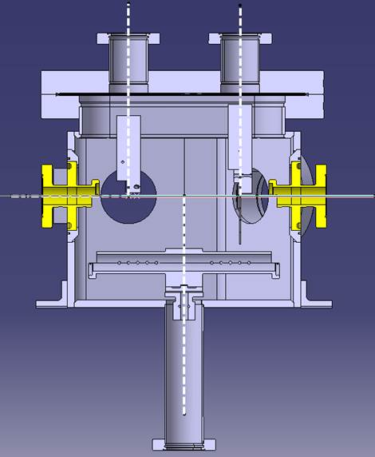
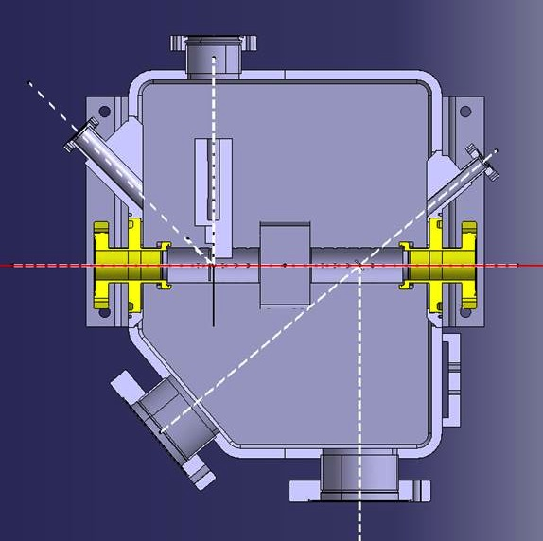
ATF2 ODR experiment (Tank design)
BPM
30cm as Laser Wire
BPM
Optical table

Slide 29
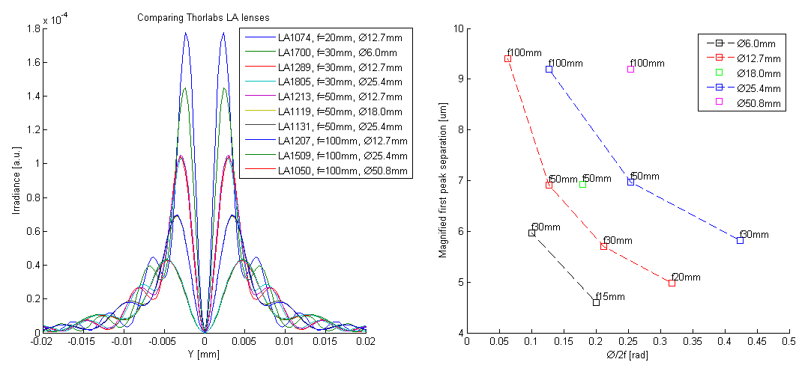
Optical system OTR PSF: finding the right lens
Limitation of this improvement: aberration & diffraction → need to study further

Slide 30
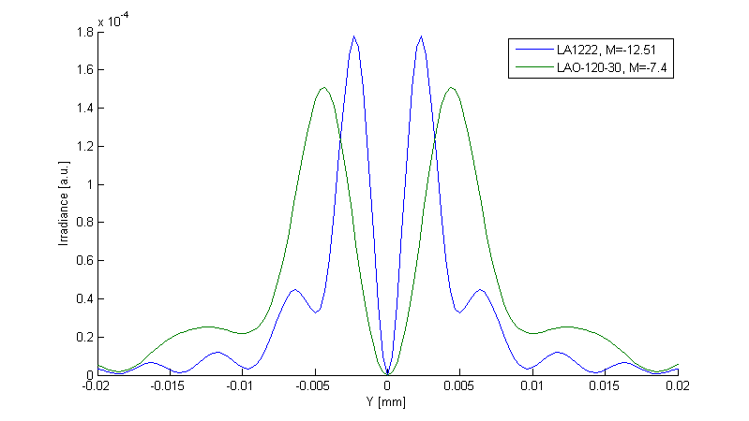
Optical system OTR PSF: comparison between the old and new system
Peak separation 8.7μm
Peak separation 4.6μm
Improved resolution by roughly 50%
BUT: lens in vacuum

Slide 31
ATF2 OTR/ODR hardware schedule

Slide 32
ATF2 OTR/ODR hardware schedule
design of vacuum chamber until mid April, then 90 days for procurement
design of mask and target until end of March, then 45 days for procurement
design of optical lines and camera selection until mid March, then 45 days procurement
We should be able to install in December 2015 at ATF2, to be discussed now.

Slide 33
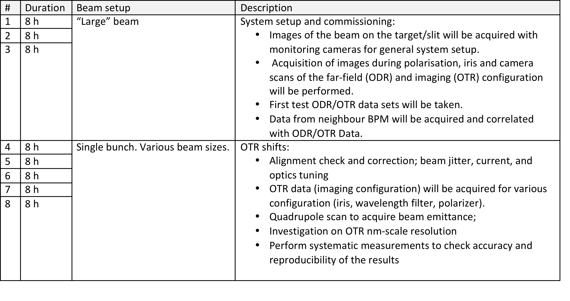
Shift schedule & Experimental Plan
1st set for 2015-2016 operation year

Slide 34
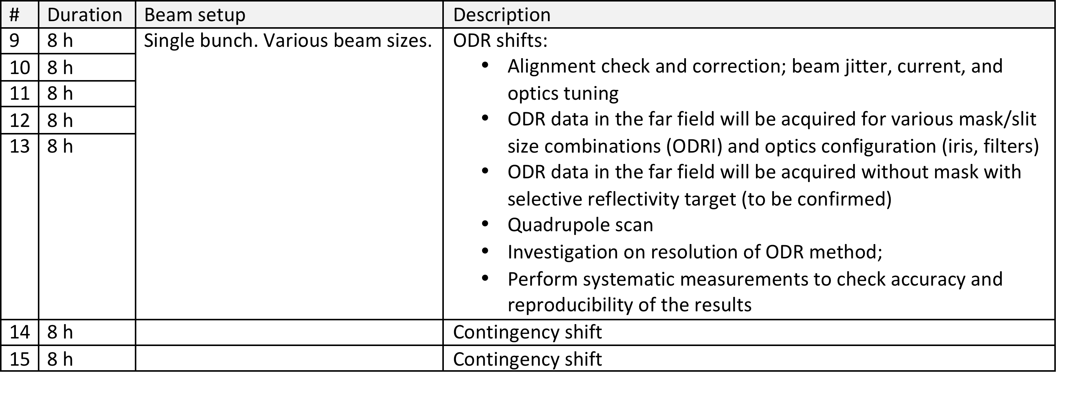
Shift schedule & Experimental Plan (cont)
1st set for 2015-2016 operation year

Slide 35
Conclusions & Outlook
The team is established;
Funding for development of hardware and for travel was secured;
Simulations are now fully predictive – match theory and measurements;
New chamber design is getting finalised;
Work on optical read-out system is on-going;
A detailed schedule for the project development has been created;
Beam optics: only one quadrupole need to be adjusted.
To go ahead with manufacturing and purchasing we need a formal OK from the TB.
Contribution to ATF operation and goals:
  Provide a source for bunch length diagnostics with a streak camera;
  Evaluate the PSF for the current OTRs used at ATF
  Participate in shifts for machine operation

Slide 36
Any Questions?
Thank you for your attention!

