Slide 1




Tests of DFS and WFS at ATF2
Andrea Latina (CERN), Jochem Snuverink (RHUL),
Nuria Fuster (IFIC)
18th ATF2 Project Meeting – Feb 24-26 2015 – LAPP, Annecy

Slide 2
Outline
Introduction and Motivations
  Intensity-dependent effects at ATF2
  BBA techniques for future LC
Results
  Tests of Dispersion-free steering
  Tests of Wakefield-free steering
Summary and Plans

Slide 3
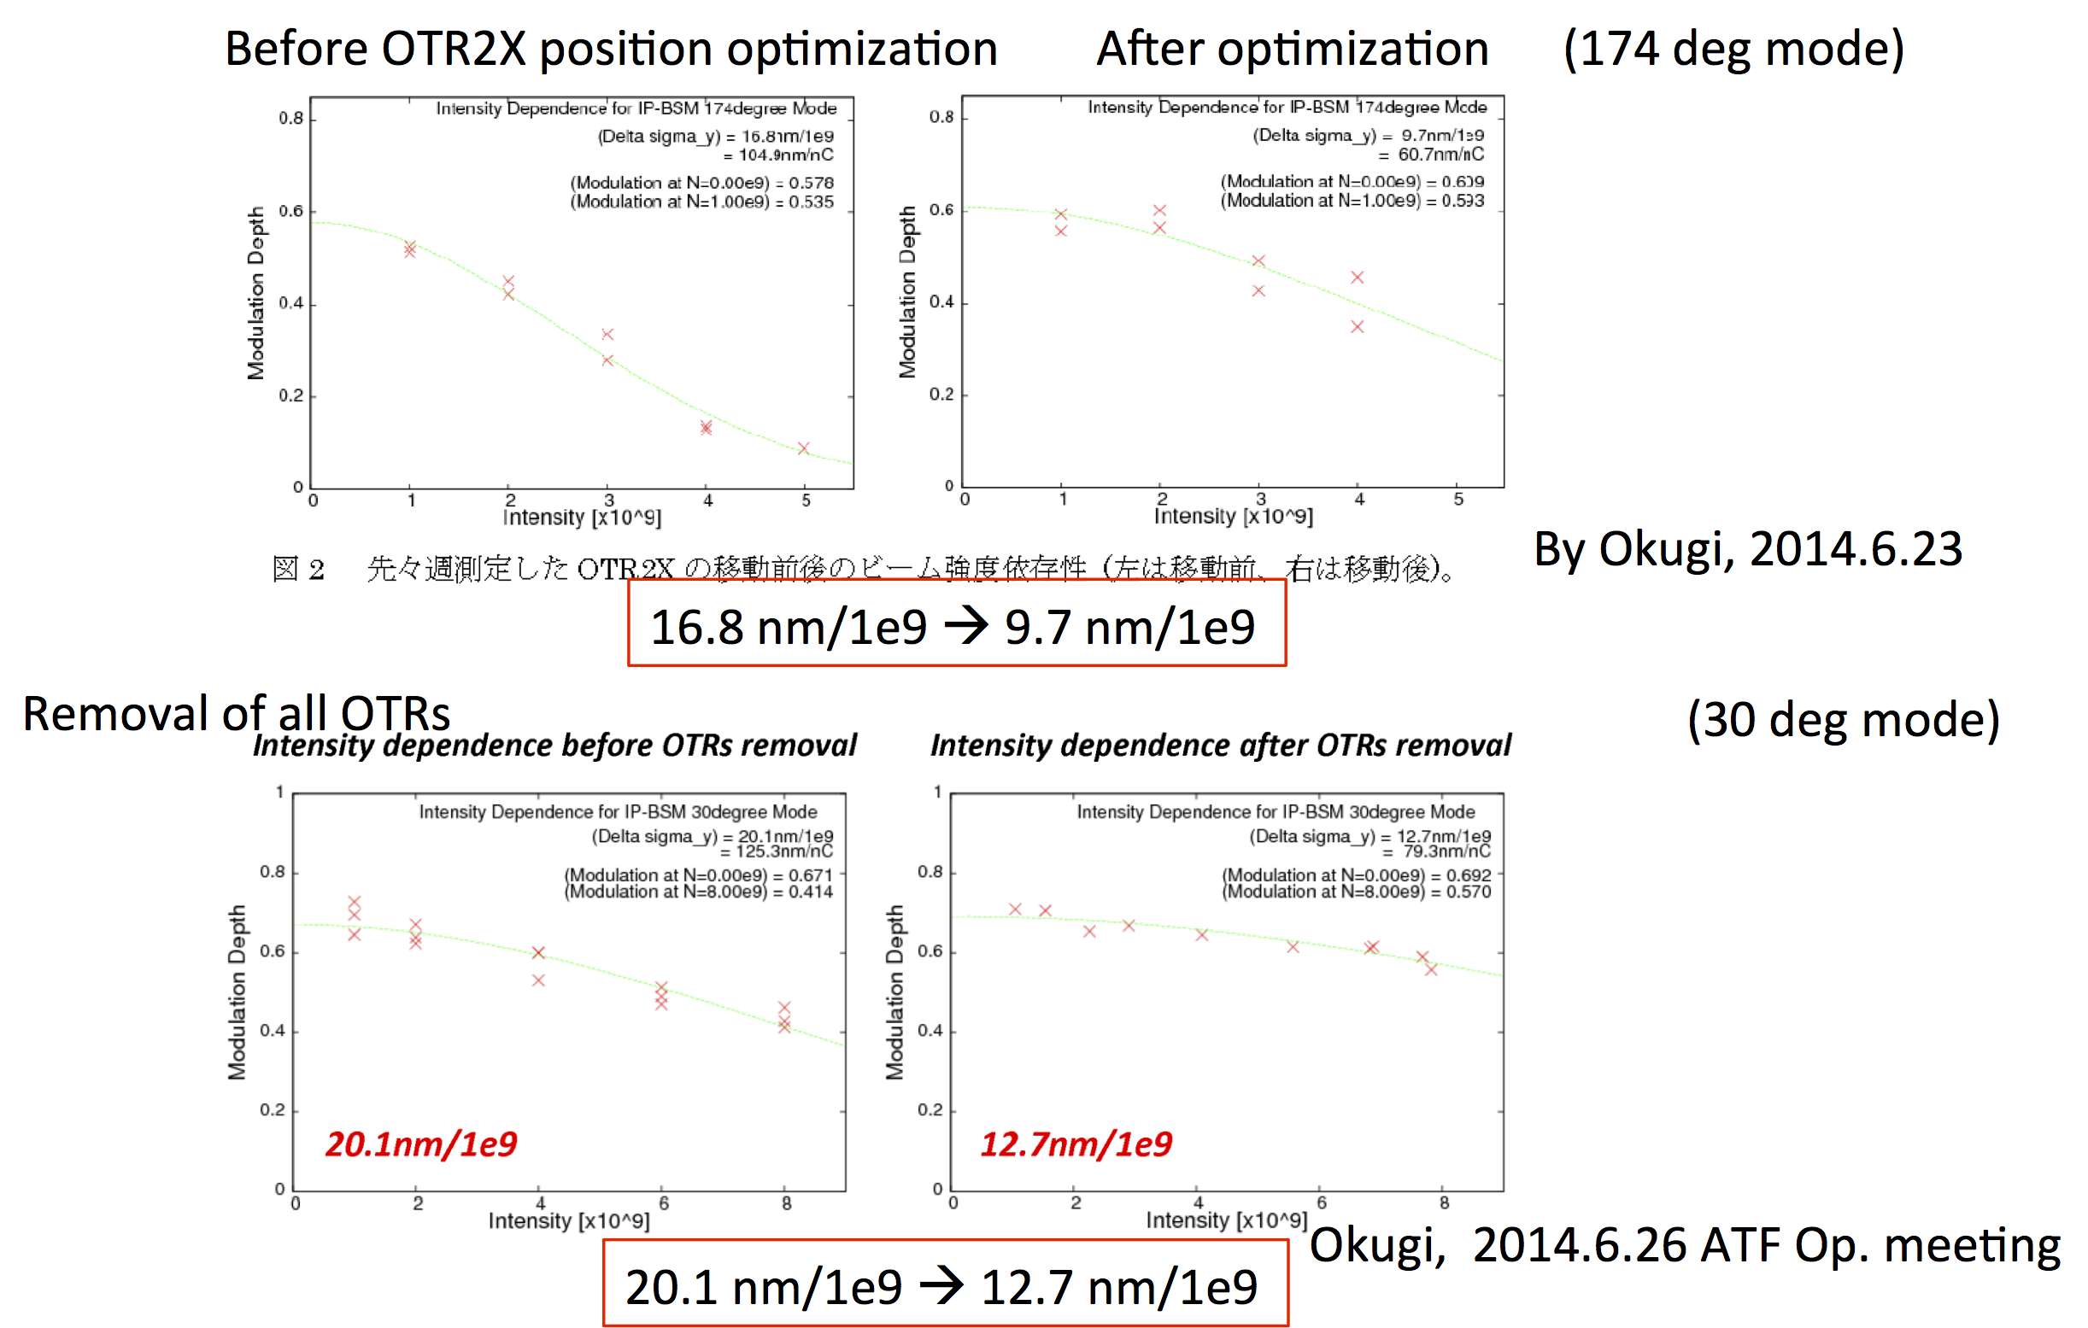
Motivation: help correct charge-dependent effects on orbit and beam size
Courtesy of K. Kubo – ATF2 operation meeting on November 7, 2014

Slide 4
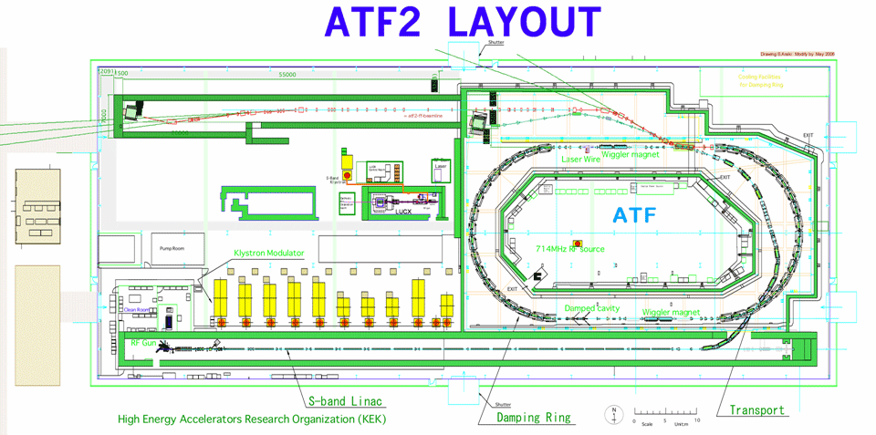
We focused on the extraction line: excluding the final focus
Used 22 correctors, all BPMs
Average of 20 shots to limit impact of fast jitter
Moved C-band reference cavity to excite wakefield
Switched off sextupoles

Slide 5
Automatic BBA tools
An automated beam-steering methods to improve the performance of linacs by correcting orbit, dispersion, and wakefields simultaneously: DFS, and WFS.
Our technique is:
Model independent
Global
Automatic
Robust and rapid
We base our algorithms operate in two phases: automatic system identification, and BBA.

Slide 6

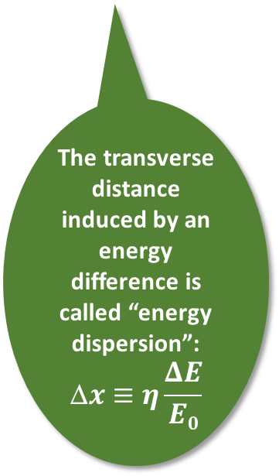
BBA: Recap on dispersion
Dipole
In real lattice, this dipole is replaced by:
Quadrupoles traversed off-axis
Steering magnets
Residual field in spectrometers
RF focusing, etc.
E>E₀
E=E₀
Single-particle eq. of motion with quads (k), dipoles (R) and energy deviation from nominal (δ):
E<E₀
Δx(E)
$$\text{D}z$$
The transverse distance induced by an energy difference is called “energy dispersion”:
$$\text{D}x≡η\frac{ΔE}{E0}$$
x
The solution of the complete e.o.m. describes the energy-dispersion, η_{x}.
We search the solution (i.e., the trajectory) that is independent from δ.
By definition, that is equivalent to a “dispersion-free” motion.
ref. particle
has energy E₀

Slide 7
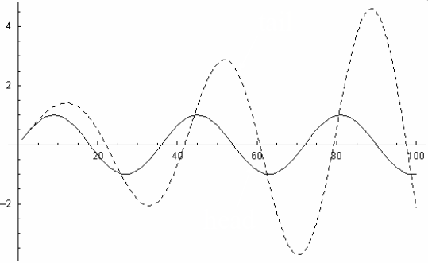
BBA: Recap on wakefields
Equation of motion for x(z,s) in the presence of w_{T} (exact):
acceleration
β-focusing
charge distribution
wake function
cavity displacement relative to the particle free β-oscillation
In the two-particle model, at constant energy, the bunch head drives resonantly the tail:
x
TAIL behaves as a resonantly driven oscillator
centroid lateral shift and
projected emittance growth
s
tail
head
HEAD obeys Hill’s equation
We search the solution (i.e., the trajectory) that is independent from charge (ρ).
By definition, that is equivalent to a “wakefield-free” motion.

Slide 8
Recap on Dispersion-Free and
Wakefield-Free Steering algorithms
DFS: measure and correct the system response to a change in energy
(changing klystron phase, voltage, )
WFS: measure and correct the system response to a change in the bunch charge
(use a fraction of the nominal bunch charge)
Recap of the equations
Application of BBA consists of two steps
Response matrix(-ces) measurement
Correction and parameters scan
⬅ H and V emittance reduction thanks to DFS at SLAC

Slide 9
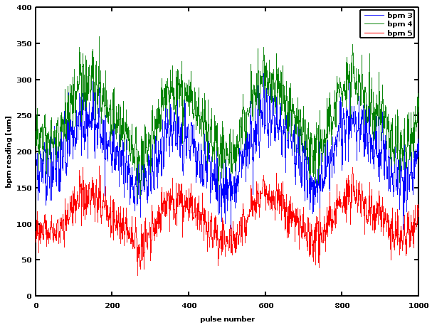
Step 0: Preparation
Interfaced our scripts with ATF2 DAQ, and debug
Measured orbit to assess stability
  Measures as average of 20 shots to reduce fast jitter
  Switched off sextupoles
  Observed slow periodic drift
  this affected response matrix reconstruction and correction (taken countermeasures in our analysis tools)
1 period :
  = ~ 229 pulses
  = ~ 1 min 13 sec

Slide 10
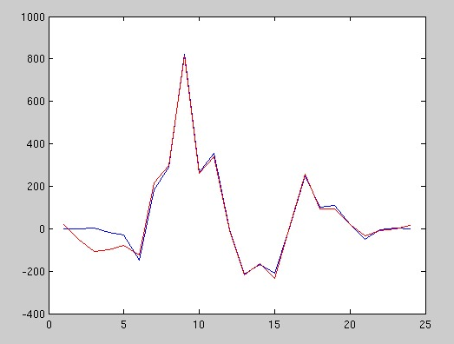
Step 1: Orbit control
Tested a new method to compute response matrix for counteracting slow drift
Test excitation of an orbit bump
Energy
fluctuation ?
Measured the response matrix for dispersive beam

Slide 11
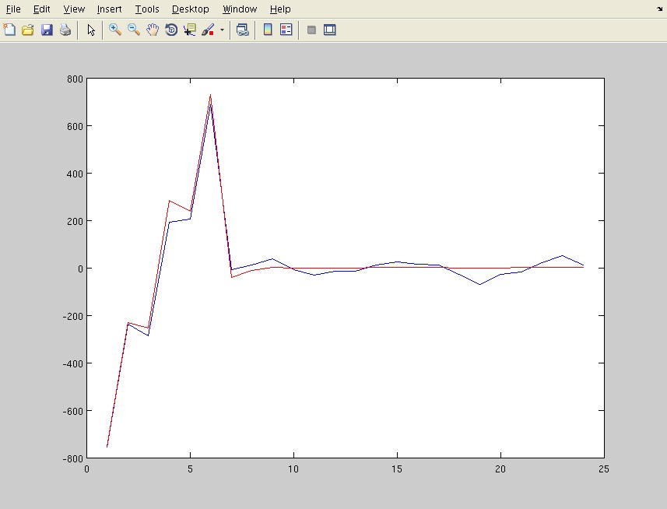
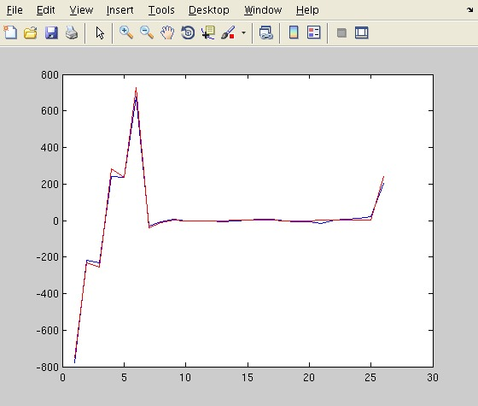
Step 2: DFS tests, h-axis
Energy difference for DFS: +2 kHz in DR
dE/E = -0.13% (4 MeV)
Matched-dispersion steering
Added 1 FF bpm
in dispersive region
Disp [um]
Before the correction
After the correction

Slide 12
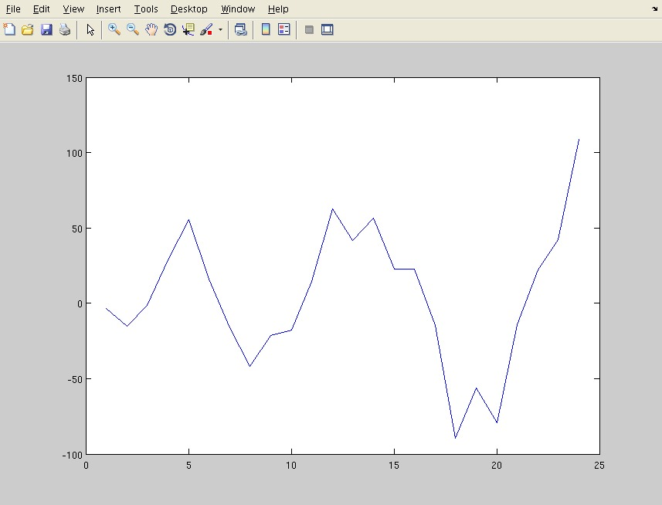
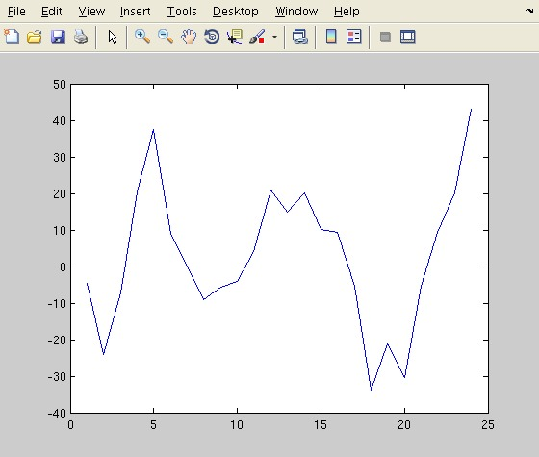
Step 2: DFS tests, v-axis
Performed a scan of the DFS free parameters
Vertical dispersion reduced by ~ 2
Before correction
After correction

Slide 13
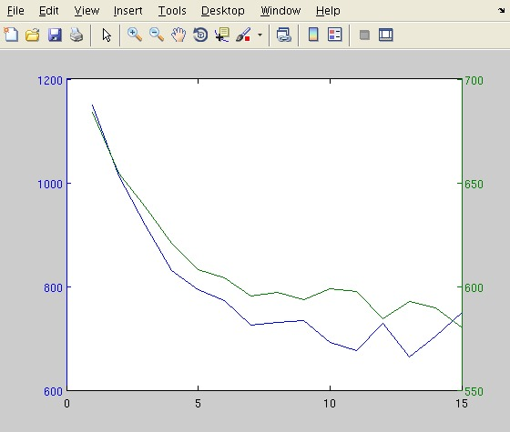
Shift 2: DFS tests - convergence
Weight=10
We performed a parameters scan to find the optimum working point
Convergence plot:
X
Y

Slide 14
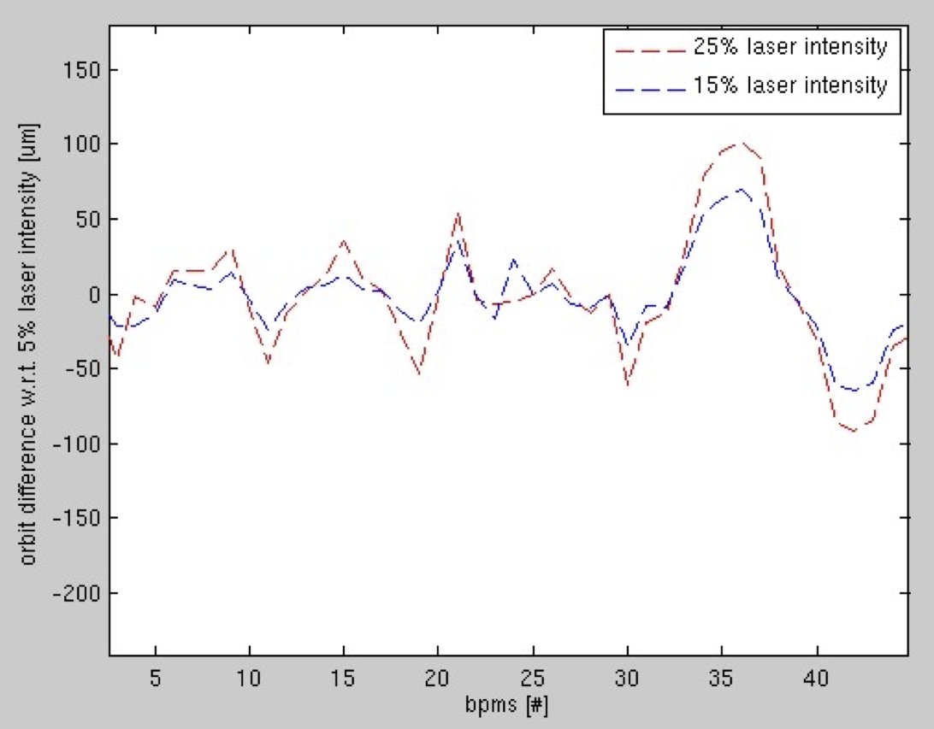
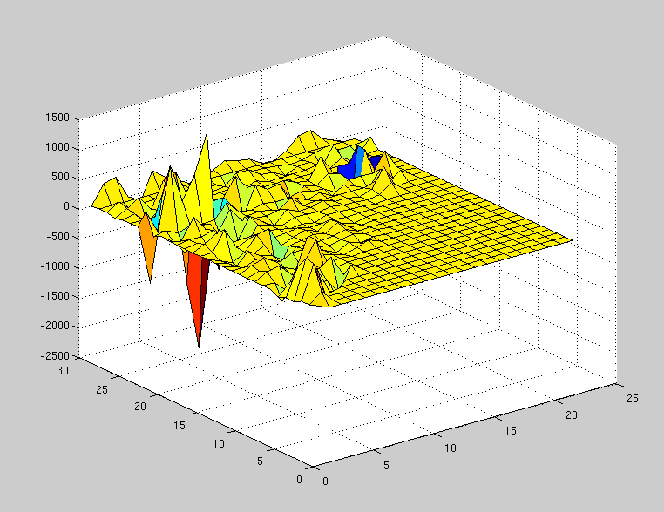
Step 3: WFS tests
Measured the response matrix
Charge modified moving laser intensity between three setups:
5%, 15%, 25%
(0.3e10, 0.6e10, 0.8e10 particles per bunch respectively)
bpms
correctors
Orbit for 2 different bunch charges (exciting a wake)
WFS response matrix

Slide 15
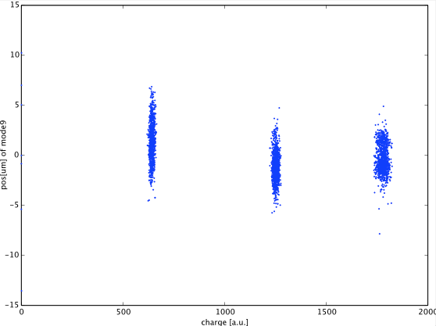
Charge-dependent effects on the orbit
We tested three different bunch charges: 0.3, 0.6, and 0.8 x 10¹⁰ particles per bunch
We couldn’t directly observe any significant charge-dependent effects on the orbit
SVD study of the charge-dependent effects: in the plot position of high-beta location QD10BFF wrt to SVD mode 9 (after subtracting all other modes)
The correlation of this mode with charge is 0.37 (for other modes this is nearly 0).
J. Snuverink

Slide 16
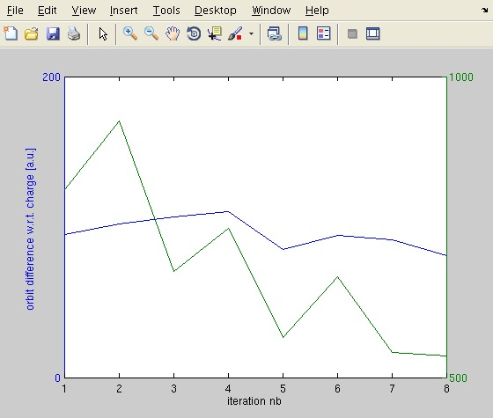
Shift 3: WFS tests - Convergence
Reference cavity and collimator moved vertically close to the beam to excite wakefield
We performed a parameters scan to find the optimum working point
Convergence plot:
X
Y

Slide 17
Future Work
Measure and Remove incoming offset
  Infer optics from BPM measurements
  Try to counteract incoming angles and offsets
Try different BBA techniques to correct not only Dispersion and Wakefields:
  Beta-beating correction, coupling correction
  Estimate in simulation impact of those errors
  Wakefield bumps?

Slide 18
Summary and plans
Motivation:
  Apply Beam-Based Alignment to help solve charge-dependent effect
  Charge-dependent effects on the orbit no longer very manifest
Tests of DFS and WFS performed (conservative approach):
  Dispersion-Free Steering improved horizontal dispersion and reduced vertical one by factor 2
  Wakefield excited moving reference cavity and collimator vertically
  Impact of wakefield significantly reduced
  > energy-independent and charge-independent orbits are found
  Slow drifts and jitter affected convergence, limiting the possibility to perform extended parameters scan
Plans:
  Perform detailed analysis of the data acquired (in progress)
  Study, in simulation, the effectiveness beam-based corrections such as beta-beating correction and coupling-correction
  We hope that BBA can help reducing the beam size at the IP !

