Slide 1
Status of Phase Feedforward Tests
Jack Roberts

Slide 2
Contents
Overview of shifts.
Hardware status.
General phase measurements and studies.
Constant kick/timing tests.
Feedforward tests.

Slide 3
Introduction
Phase feedforward has been the priority for CTF3 in November/December and we’ve been given the majority of the beam time.
We have a lot of data!
There’s been pressure to get results prior to the winter shutdown, so we maybe rushed in to feedforward tests a bit too quickly.
However, I think in the end this approach has been quite successful.
Overview of what has been done and the early stages of analysis from what was available in the logbook here.
If there’s anything in particular you’d like to see before Christmas let me know and I can try to look at it next week.

Slide 4
Quick Overview of Tests Late November
21st Nov: General phase measurements.
25th Nov: Constant kick measurements, response in BPMs.
26th Nov: Constant kick measurements, response in phase.
27th Nov: Feedforward tests, no (immediately) visible effect.
28th Nov: Constant kicks but only a short pulse, response in phase.

Slide 5
Quick Overview of Tests December
4th Dec: Beam setup, orbit closure from kicks. Data taking from FONT5 board with all phase signals attached.
5th Dec: Feedforward applied to only one kicker, response in BPMs. R56 tests.
10th Dec: Kicker timing tests. Feedforward tests with gain scan, promising.
11th Dec: FF whilst changing klystron phase to induce known (hopefully correlated) phase shift, inconclusive.

Slide 6
The quest for more gain
With original firmware setup and maximum feedforward gain we were not able to use the full range of the amplifier.
Wanted the ability to apply the maximum possible kicks even when using only a short section of the pulse.
Setups:
Original firmware + 10dB attenuator on DACs (max kick at 1600 DAC counts).
Original firmware without attenuator on DACs (max kick at 800 DAC counts).
Firmware with factor of 4 in gain, no attenuator.
Firmware with factor of 8 in gain, no attenuator.
Firmware with factor of 4 in gain, no attenuator, phase monitor signals only to FONT5 board (not split to SiS).
Overflow in feedforward calculation if Mixer/sqrt(Diode) rises above a certain limit, which is lower for the firmware versions with additional gain.

Slide 7
Other Hardware Comments
Generally everything ran very smoothly with the amplifier and FONT5 board. CTF3 has also been pretty stable in the last couple of weeks.
Overflow in feedforward calculation, glitch in first sample, machine drifts mean we have sent >>1.6V to the amplifier at times. What’s the limit above which it becomes a risk to the amplifier? Best way to safeguard against that?
DAQ glitch (appeared to lose all communication for a couple of triggers), disappeared by itself after the first week.
Not having communication between FONT and the control system makes life more difficult, I need to finalise it before beam next year. In particular it makes using interleaved mode unfeasible.
There have been a lot of developments in the phase monitor electronics set up (new filters, amplifier etc.), but I won’t go in to details here.

Slide 8
Comments on Phase Measurement Status
Mon1 = old monitor, end of linac.
Mon2 = new monitor, end of linac.
Mon3 = new monitor, after correction.
2nd monitor is noisier than 1st monitor, but looks like this is coming from the electronics not the monitor itself. Resolution ~0.5 degrees.
Correlation (mean phase)
Between Mon1 and Mon2 is generally >90%.
Between Mon2 and Mon3 is ~30-70% depending on the setup/day.
Correlation between 3rd monitor and PETS is generally ~90%.
Phase measurement in Mon3 visibly different to the linac:
Phase sag
Jitter in mean
Features within the pulse
By changing beam setup all these can be manipulated to some extent and have had similar looking signals to the linac at times.

Slide 9
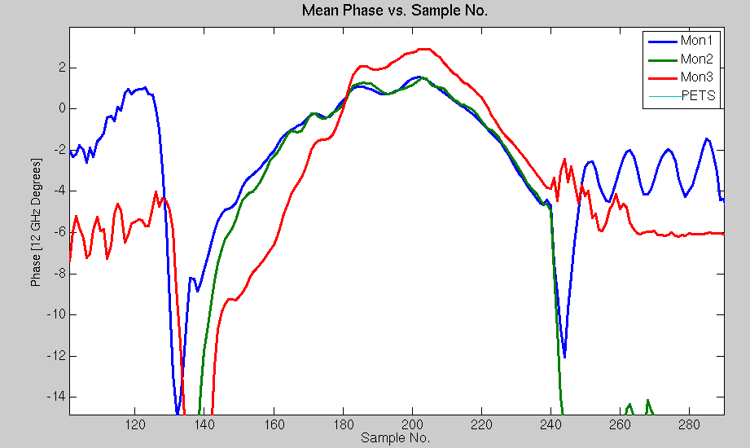
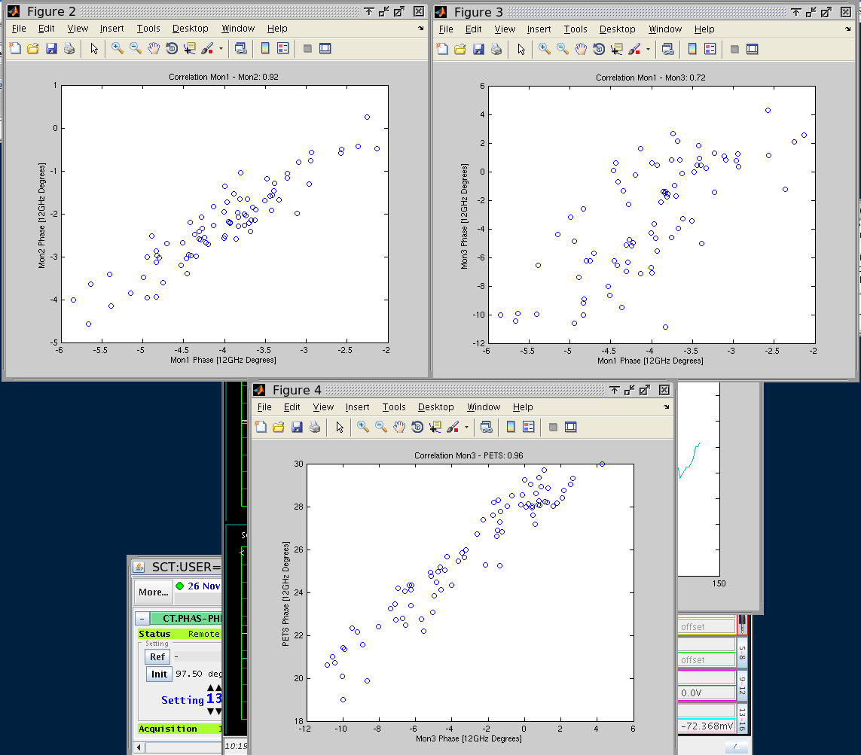
Phase Measurement Examples: 26th Nov
~Best case scenario.
Mon1-Mon2: 0.92
Mon1-Mon3: 0.72
Mon3-PETS: 0.96

Slide 10
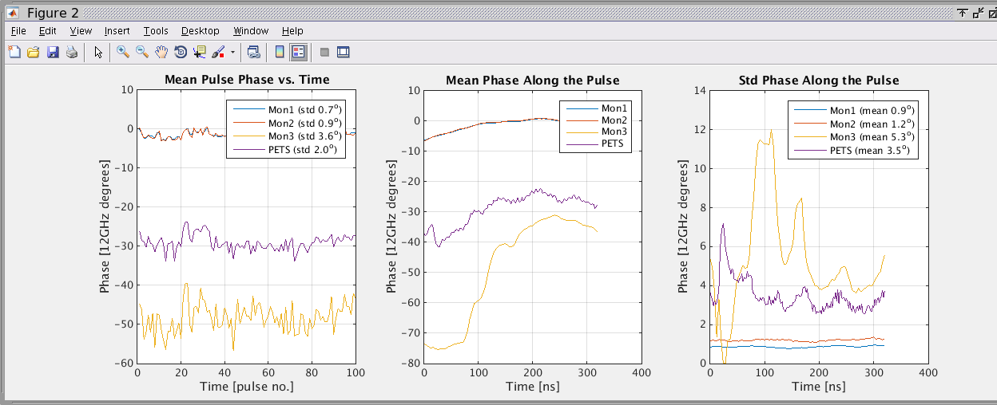
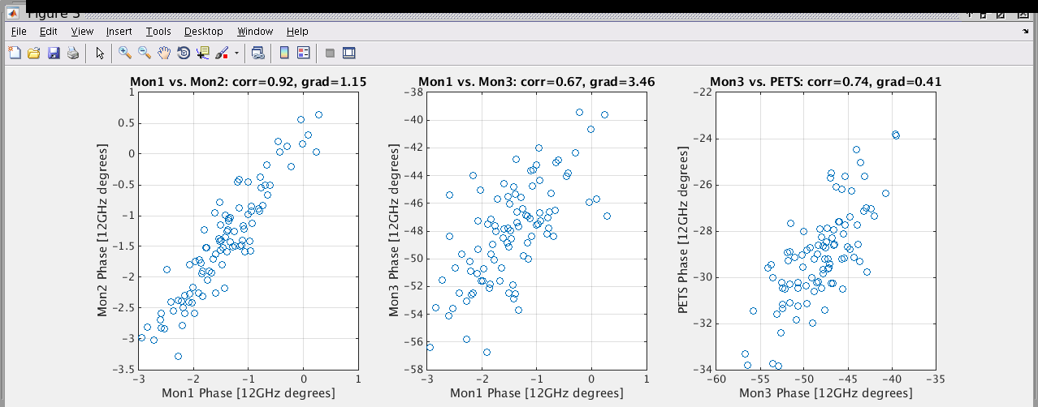
4th Dec
Bad Mon3-PETS correlation.

Slide 11
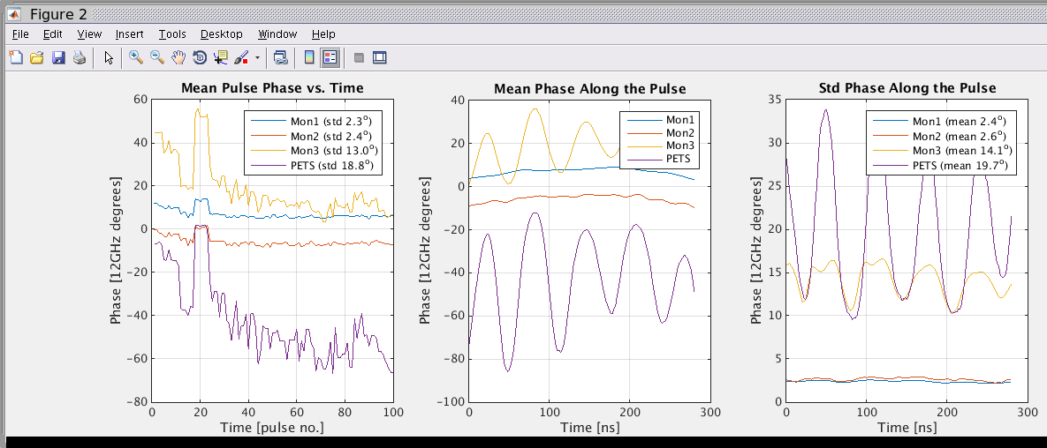
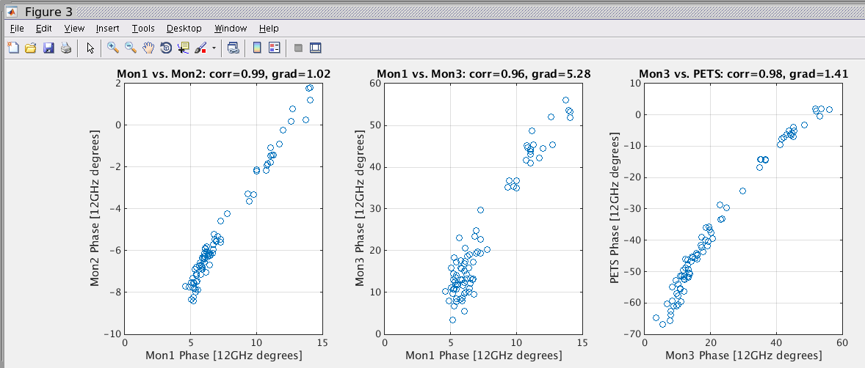
5th Dec
Large Mon1-Mon3 correlation but huge jitter.

Slide 12
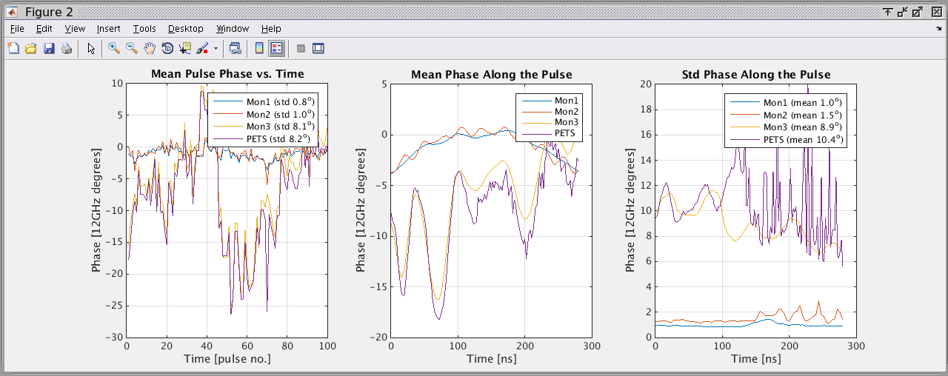
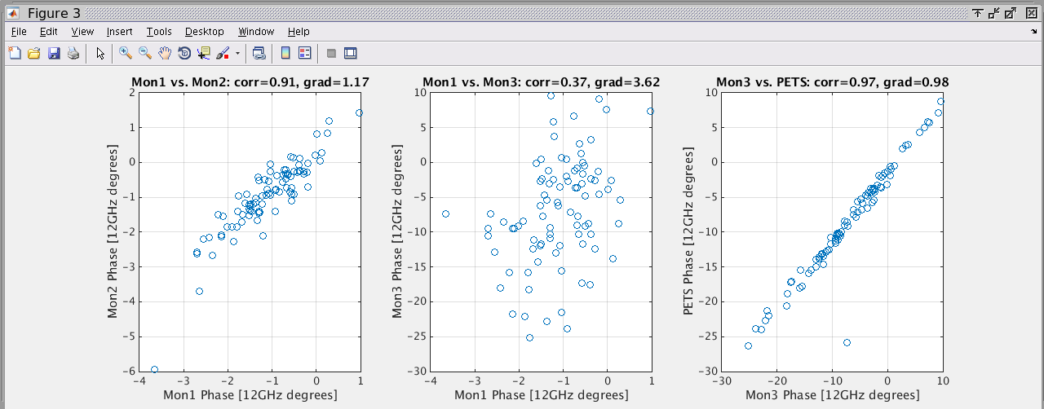
5th Dec
Low Mon1-Mon3 correlation but high Mon3-PETS correlation.

Slide 13
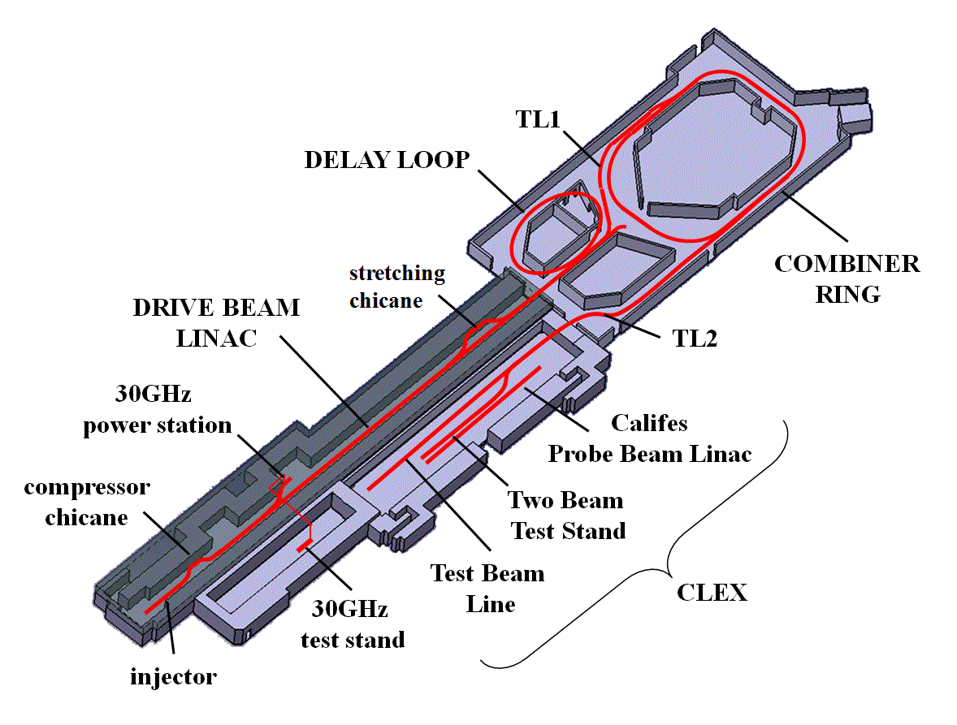
Effect of R56 in TL1 on Phase in TBL
Phase feedforward optics has non-zero R56 of -0.2 (relates phase to energy).
Any energy jitter can amplify/effect the phase jitter/shape in TL2 (correction) and TBL (last phase measurement).
TL1 is nominally R56 = 0.
Have tried varying the R56 in TL1 to compensate for the R56 in TL2 and the rest of the machine.

Slide 14
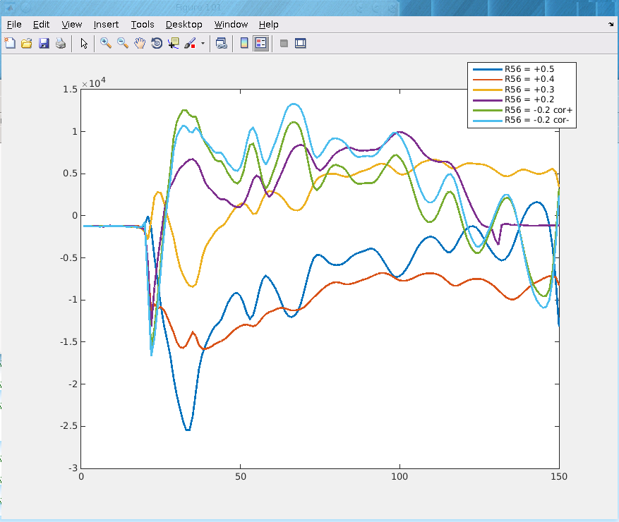
Effect of R56 in TL1 on Phase in TBL
Change in mean phase (pulse to pulse energy jitter).
Change in phase slope (energy variation along the pulse).
Just one plot but a lot of data taken and attempts to improve the stability of the phase in TBL.

Slide 15
Relative Kicker Timing (K1/K2 Trig Out Delay Scan)
Performed different configurations of constant kicks to identify the region in which we were kicking and to check whether K1 and K2 need different trig out times relative to each other.
Kick short pulse: Gated output from sample 375 to sample 435 on FONT5 board.
+/- 800 counts to use full range of amplifier.
Looking at one of the first BPMs after the chicane.

Slide 16
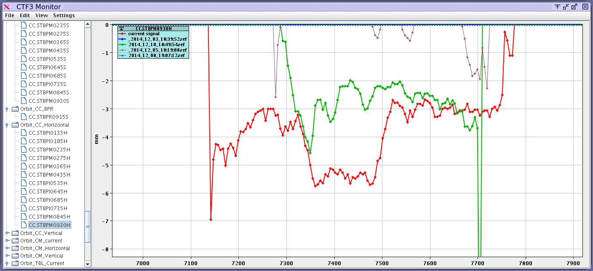
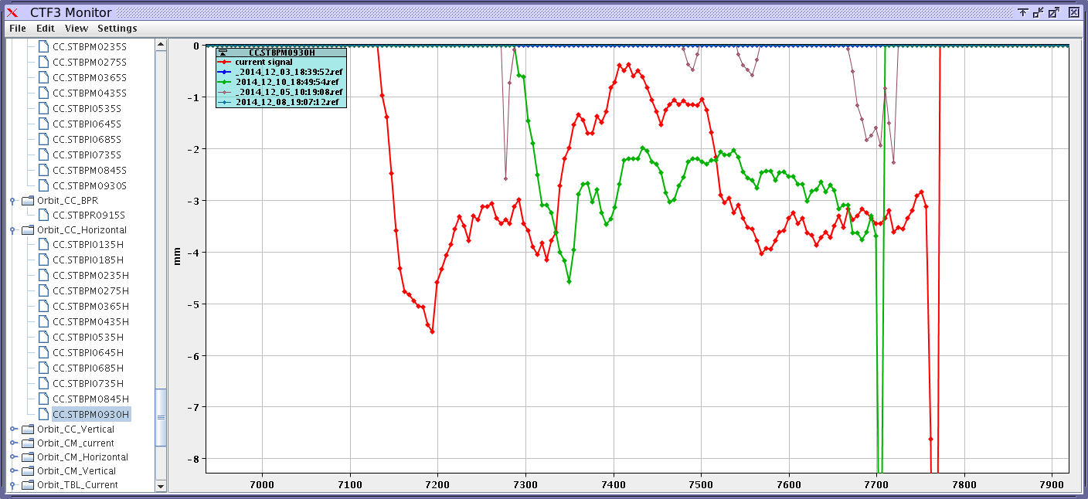
No Delay, both kicks same direction
NO CORR
Both Kicks +
Both Kicks -

Slide 17
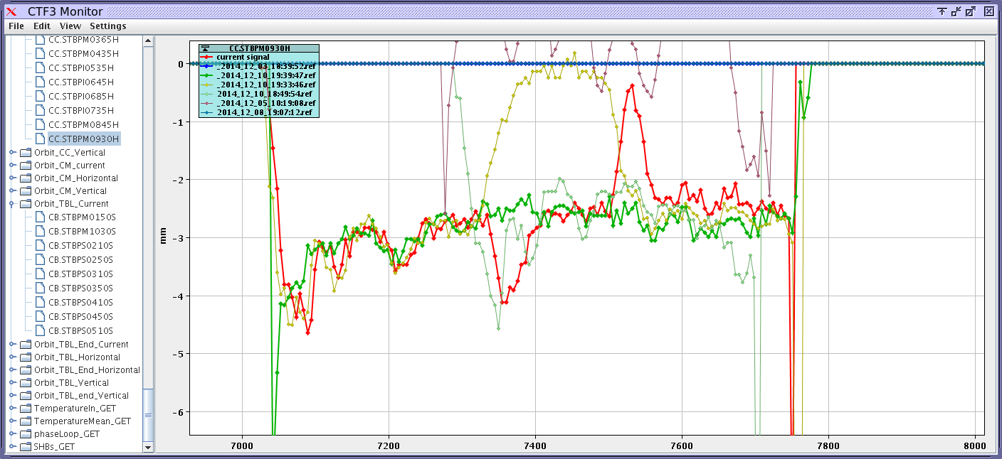
Opposite Kicks, K1delay=0, K2delay=28ns

Slide 18
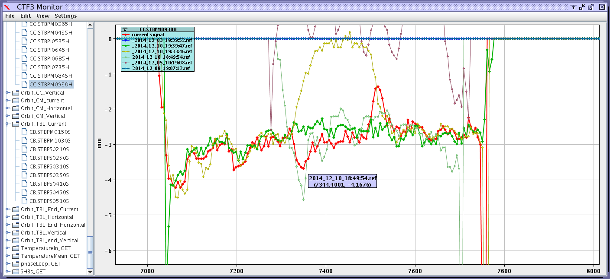
Opposite Kicks, K1delay=0, K2delay=14ns

Slide 19
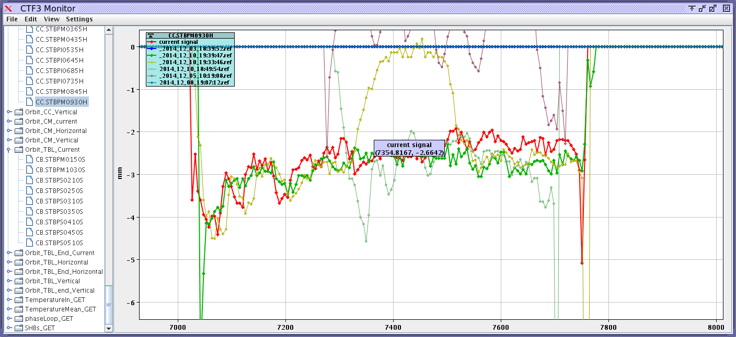
Opposite Kicks, K1delay=0, K2delay=5.6ns

Slide 20
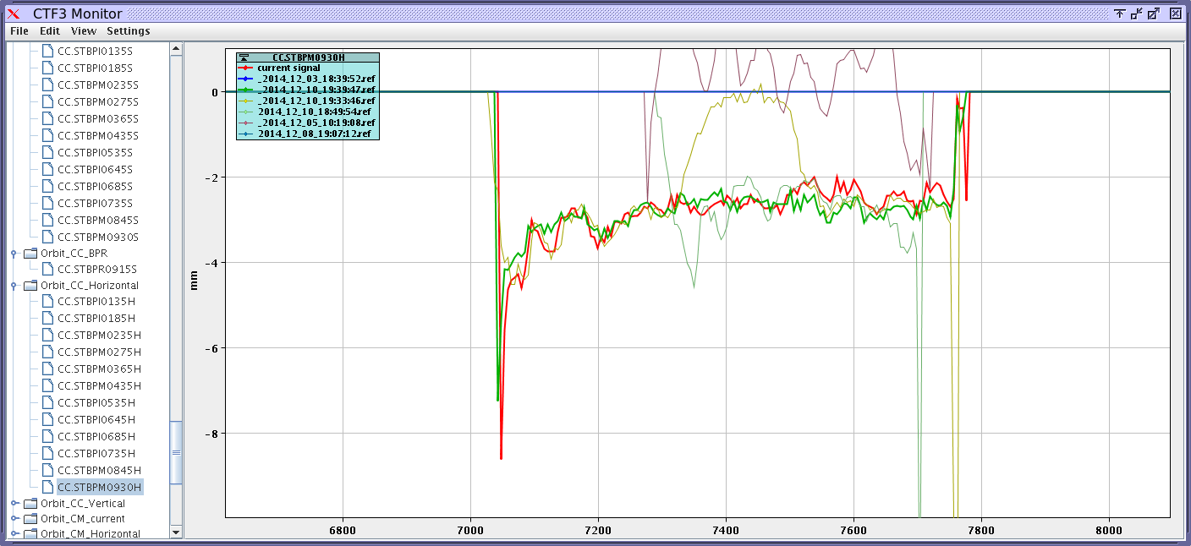
Opposite Kicks, K1delay=0, K2delay=0
Probably the best, so the difference in cable lengths is now the same as the difference in the beam time of flight between the two kickers (at least within 2 samples = 5.6ns).
N.B. Earlier tests suggested we needed a stronger kick from the 2nd kicker to close the orbit. Here equal magnitudes is ok.

Slide 21
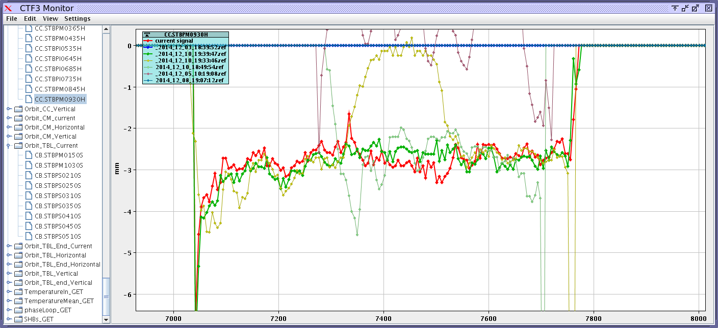
Opposite Kicks, K1delay=5.6ns, K2delay=0

Slide 22
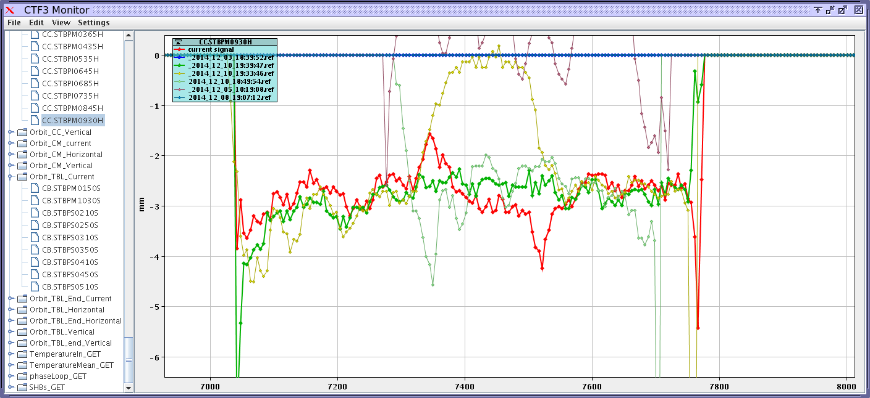
Opposite Kicks, K1delay=14ns, K2delay=0

Slide 23
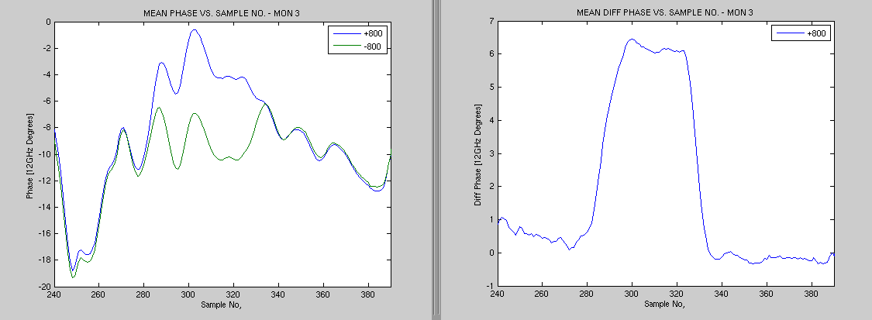
Constant kick as seen in the 3rd Phase Monitor
Using the same setup as before for the relative timing tests (gate sample 375 to 435 on FONT5 board).
Sample range (on SiS) of flat top is: ~300 to 323.
Sample range (on SiS) from/to switch on/off time is: ~279 to 333 .
Range of kick is +/- 3 degrees (6 degree diff between max and min). Expect roughly +/-2.5 degrees from model and current amplifier power.

Slide 24
Feedforward Gain Scan (10th Dec)
Using the same portion of the pulse as just shown for the constant kick/timing tests.
Feedforward tests with different gains (-63, -40, -20, 0, +20, +40 and +63).
Phase units are just counts on SiS digitiser (mixer channel only) in these plots.
Correlations are between monitor 2 (end linac, noisier measurement) and monitor 3 (in CLEX, after chicane). Monitor 1 connected directly to FONT5 board as FF input.

Slide 25
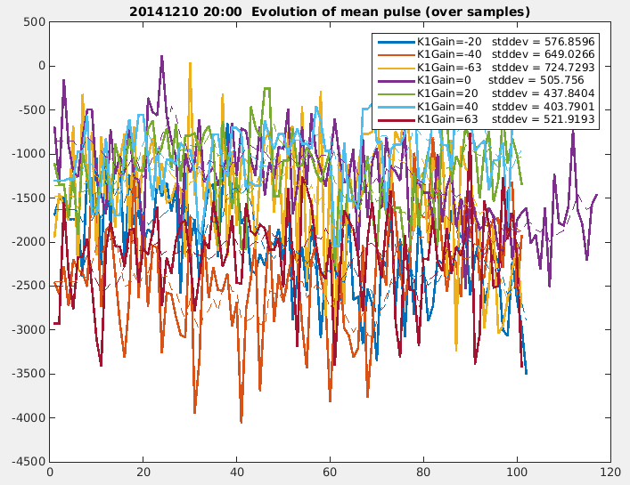
Mean Phase Pulse to Pulse

Slide 26
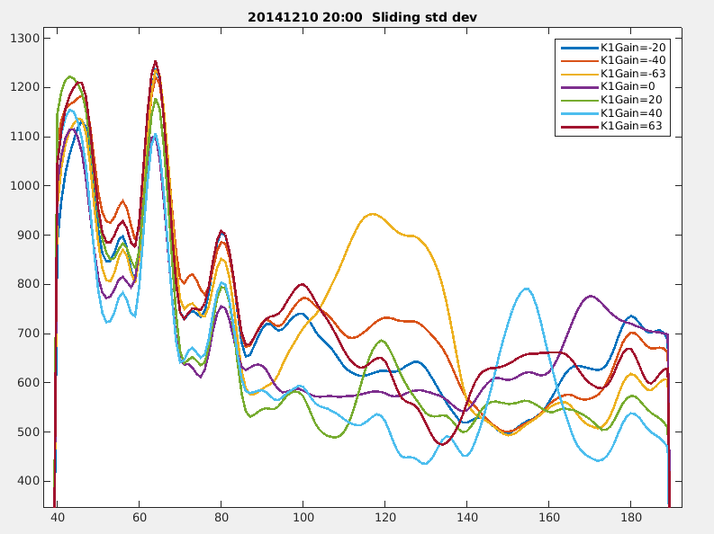
Phase Jitter within the Pulse
Variation of jitter in the correction region looks promising.
But note differences outside the correction region.
Approx. correction region.

Slide 27
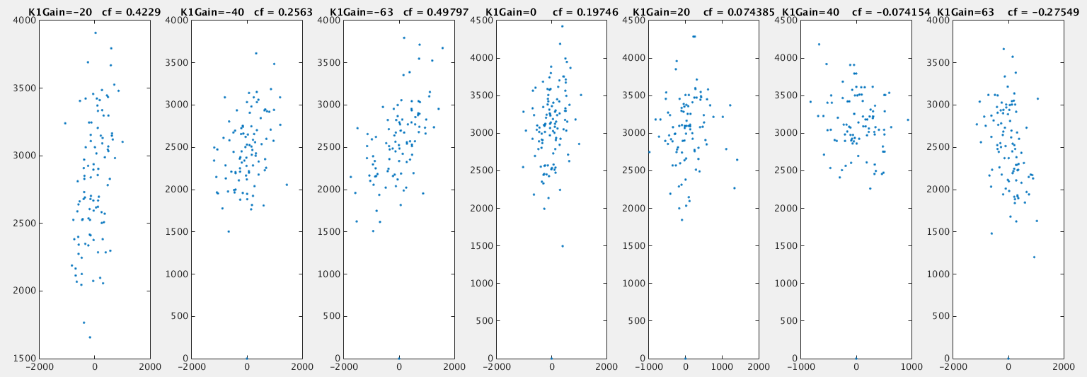
Mean Phase Correlation Plots
Correlation becomes anti-correlation as we change the gain.

Slide 28
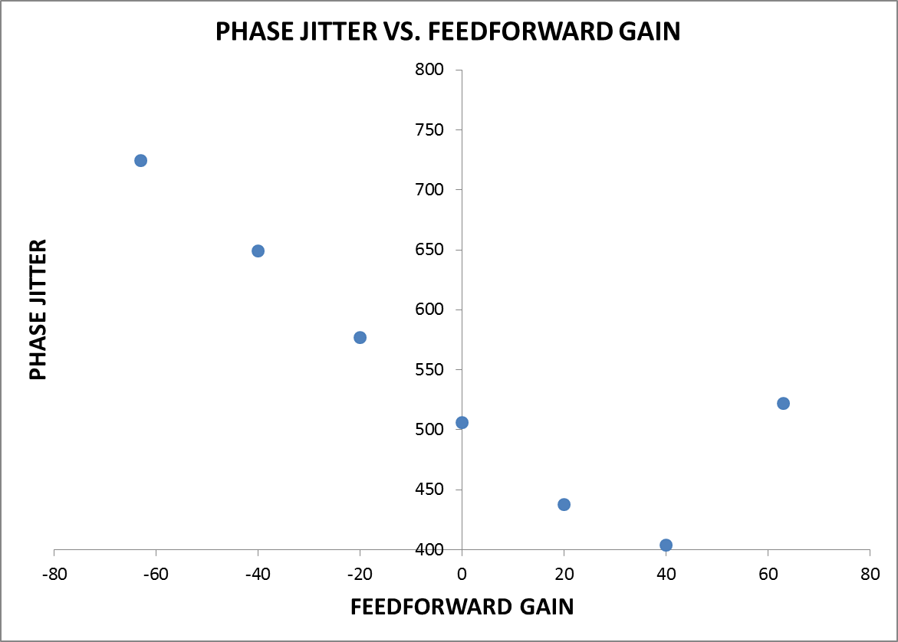

Slide 29
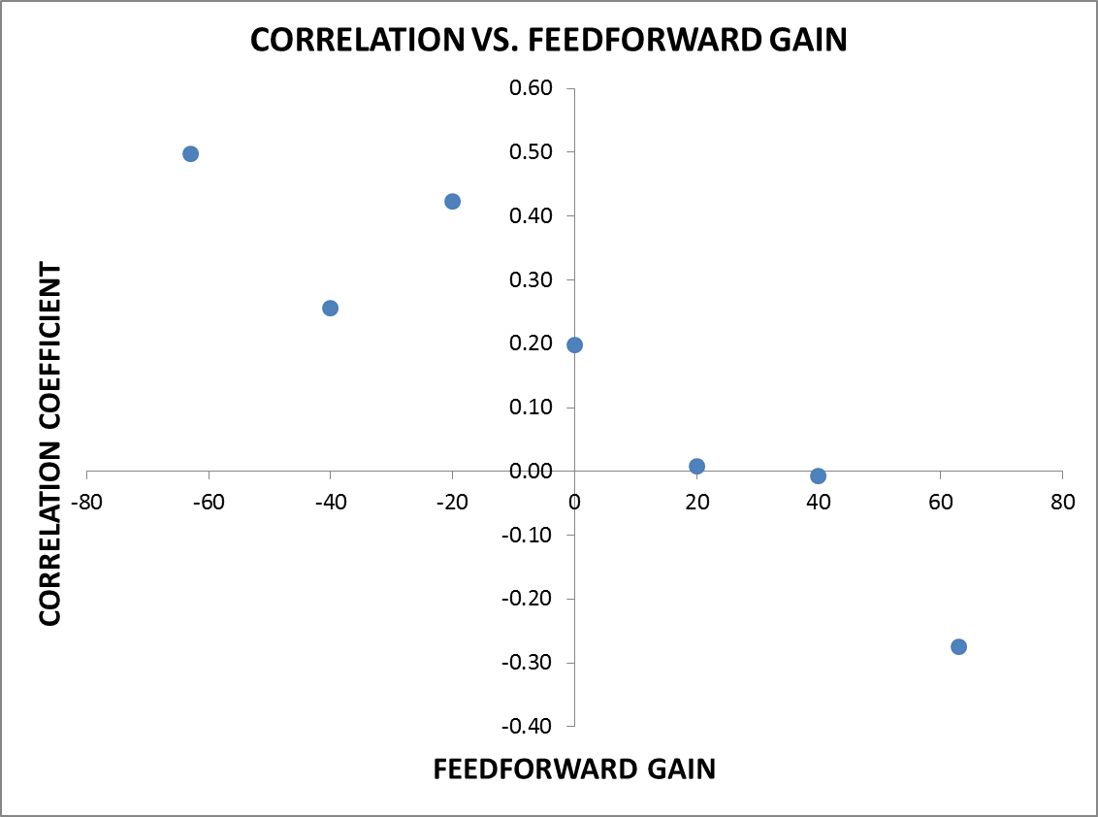

Slide 30
Gain Scan Results Table
Gain | STD | CORR
-63 | 725 | 0.50
-40 | 649 | 0.26
-20 | 577 | 0.42
0 | 506 | 0.20
+20 | 438 | 0.01
+40 | 404 | -0.01
+63 | 522 | -0.28
~45% reduction in jitter with a gain of +40 and removal of correlation.
My only slight concern would be whether it’s too good to be true considering how weak the correlation is with 0 gain.

Slide 31
Summary
After many attempts we’ve managed to extract what looks like a real reduction in the phase jitter from the feedforward system.
The results from constant kick tests are always clear and convincing. The +/-3 degree range we have is roughly in agreement with the optics and current amplifier power level.
The propagation in phase between the upstream and downstream monitors really is 70% in mean correlation at best. We can influence (but not necessarily greatly improve) it by varying the R56 in TL1.
CTF3 will stop operation Monday evening (and unlikely to be more PFF shifts between now and then).
A lot of data to analyse…
P.S. I’ve submitted an IPAC abstract for the phase feedforward system.

Slide 32
Backup

Slide 33
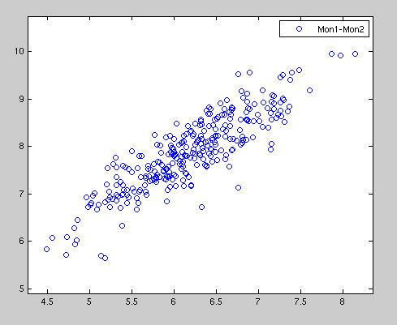
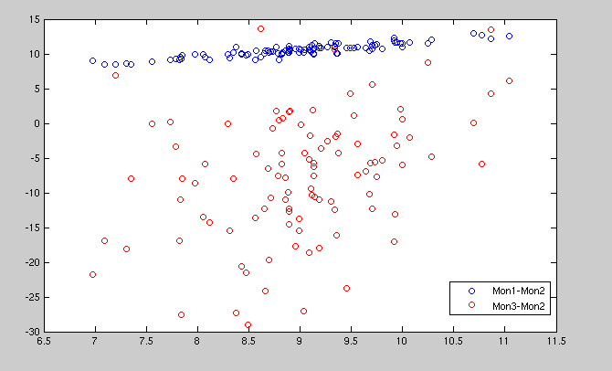
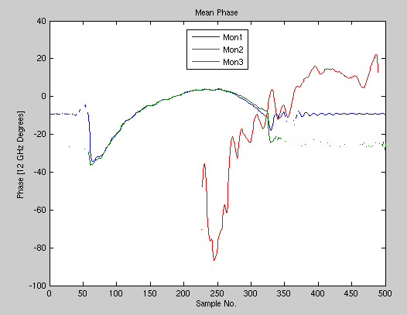
21st Nov 18:25
Correlation in mean pulse phase between two Frascati phase monitors end of linac. First monitor phase in degrees horizontal axis, second monitor phase in degrees vertical axis. Correlation is 92%.
Mon3-Mon1: 23% (PSk JR)

Slide 34
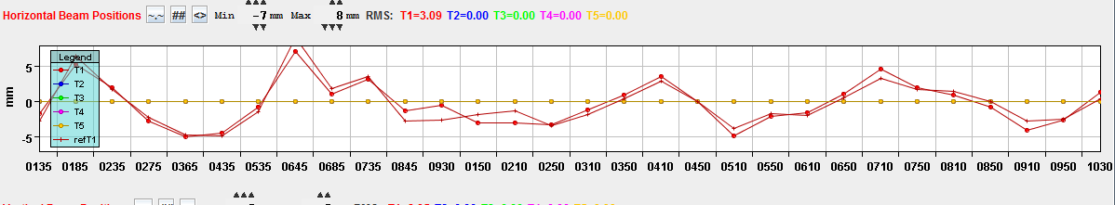
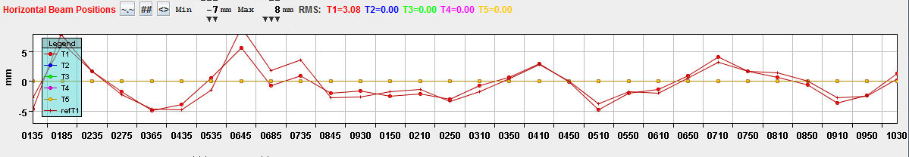
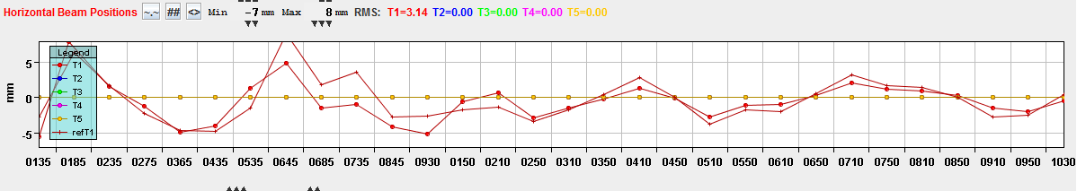
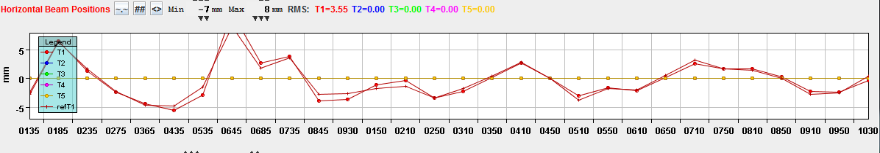
25th Nov
1st Kicker
2000
2nd Kicker
2000
1st Kicker 2000
2nd Kicker 2000
1st Kicker 2000
2nd Kicker -2000

Slide 35
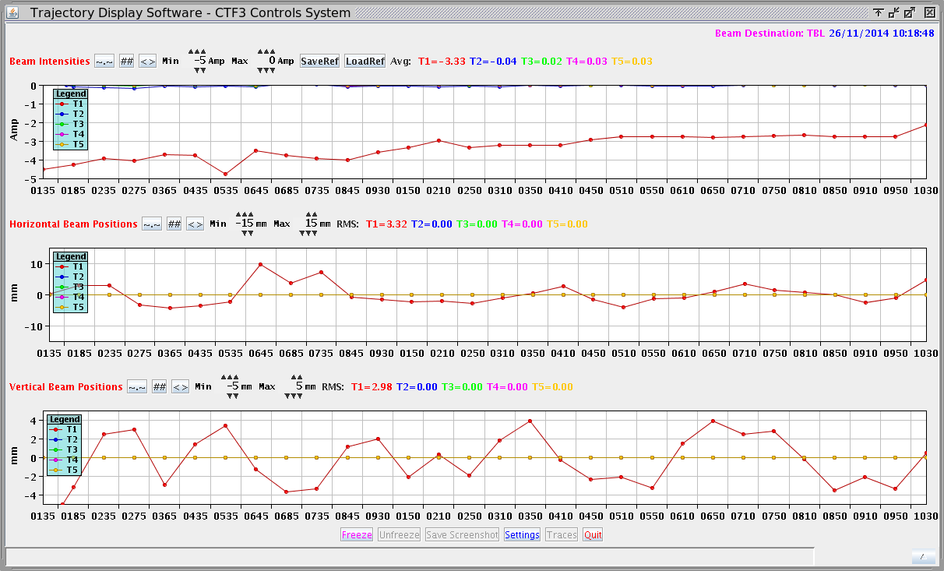
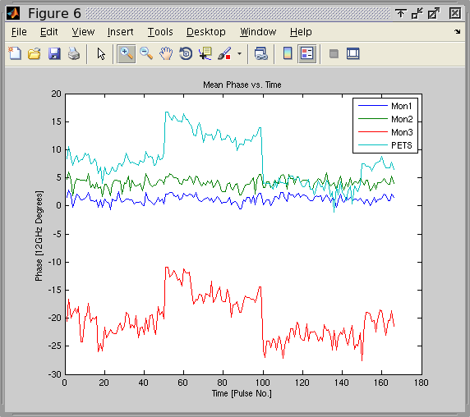
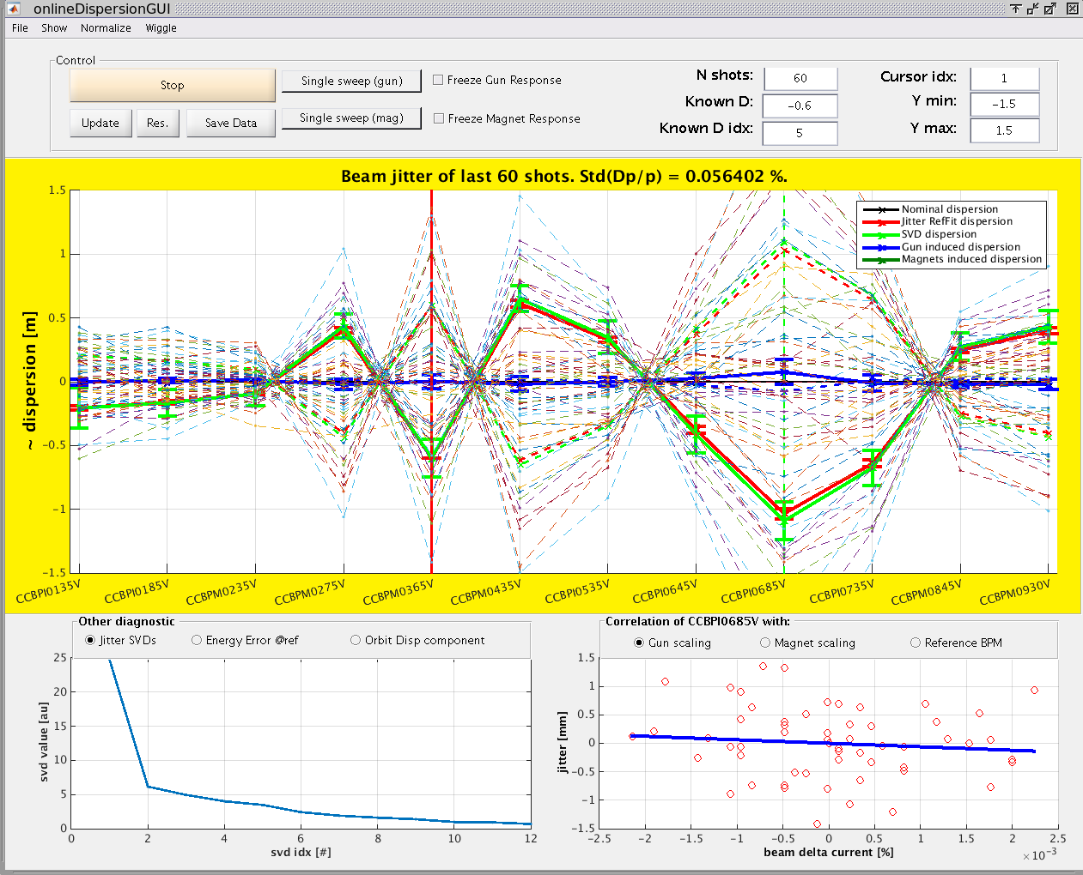
26th Nov (first R56 tests? Ended with +0.4?)

Slide 36
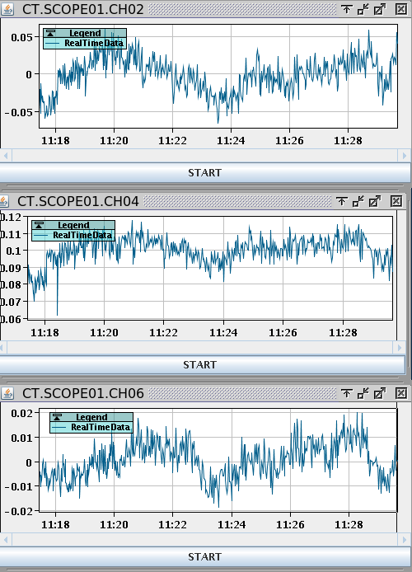
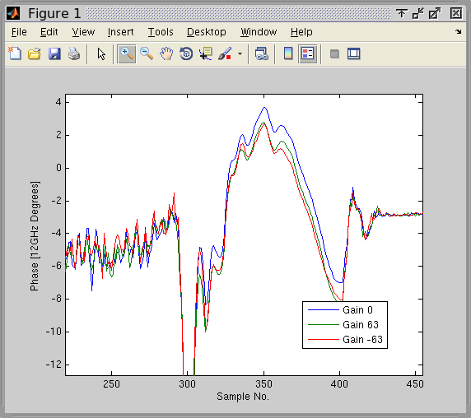
27th Nov

Slide 37
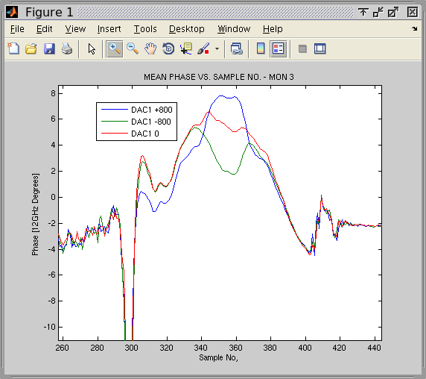
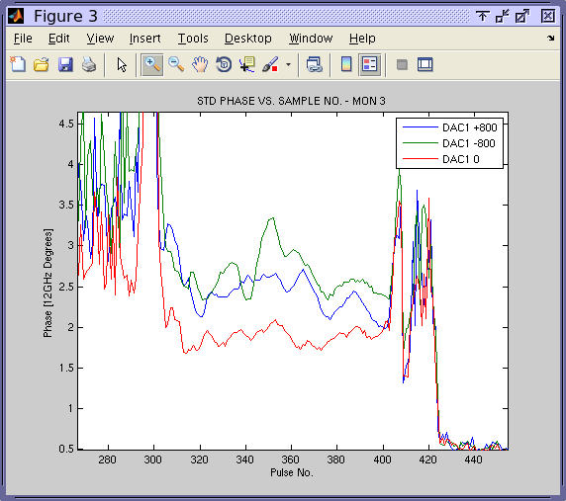
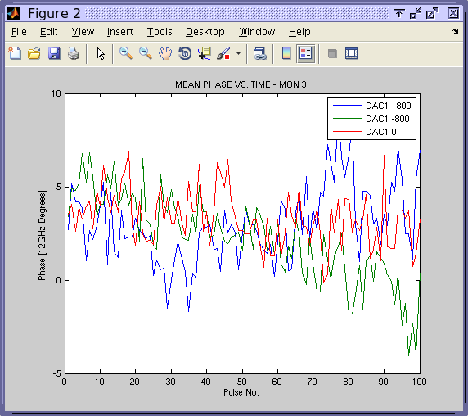
28th Nov

Slide 38
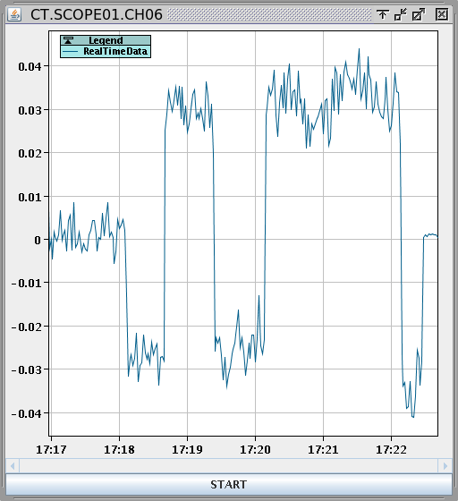
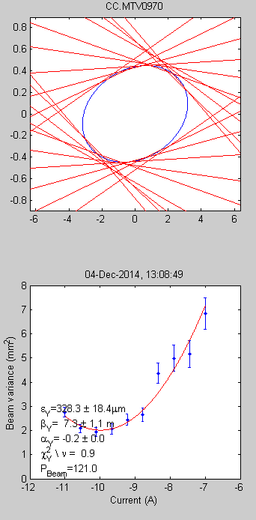
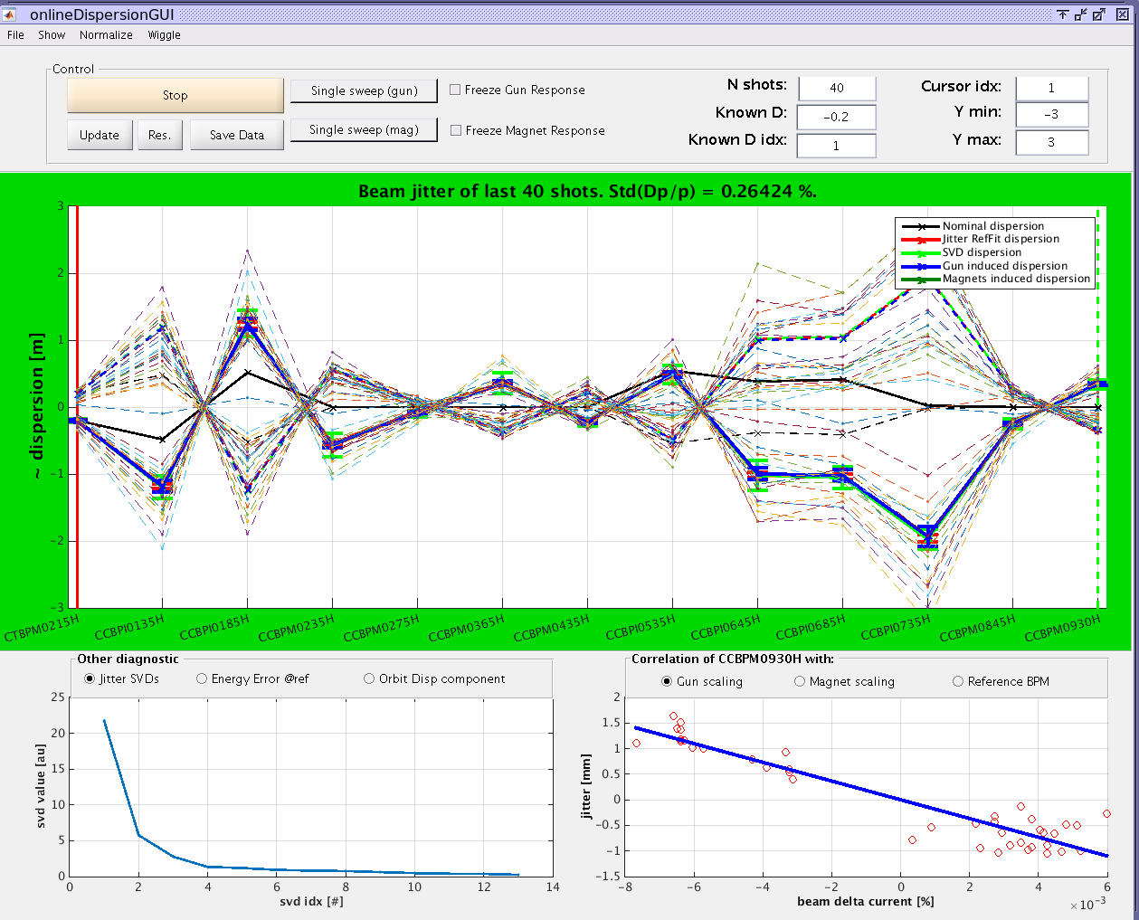
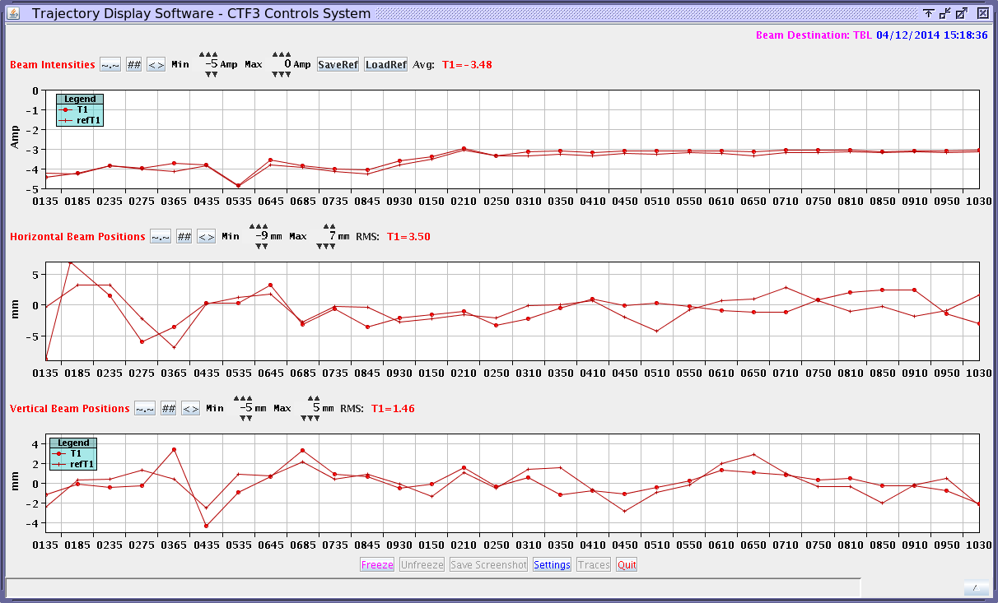
4th Dec, also gain ratio tests and data taking with just FONT5 board

Slide 39
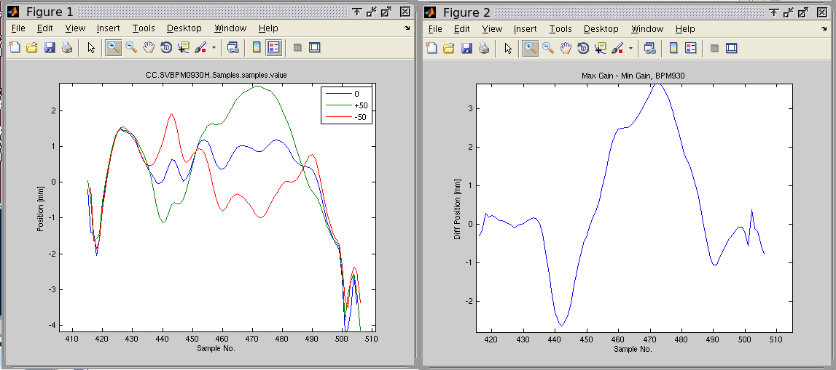
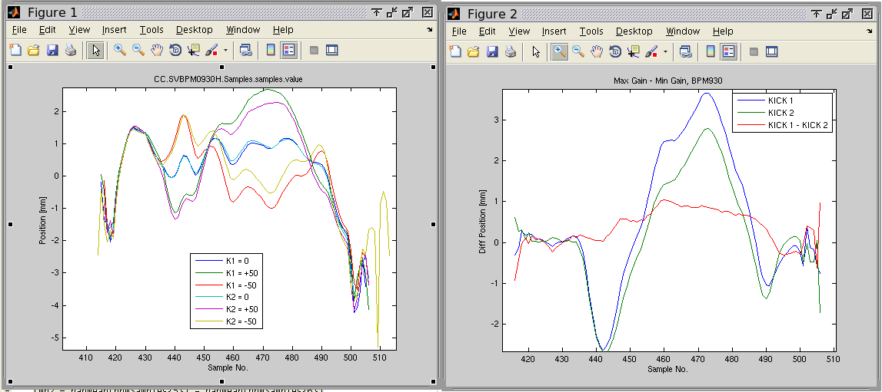
5th Dec

Slide 40
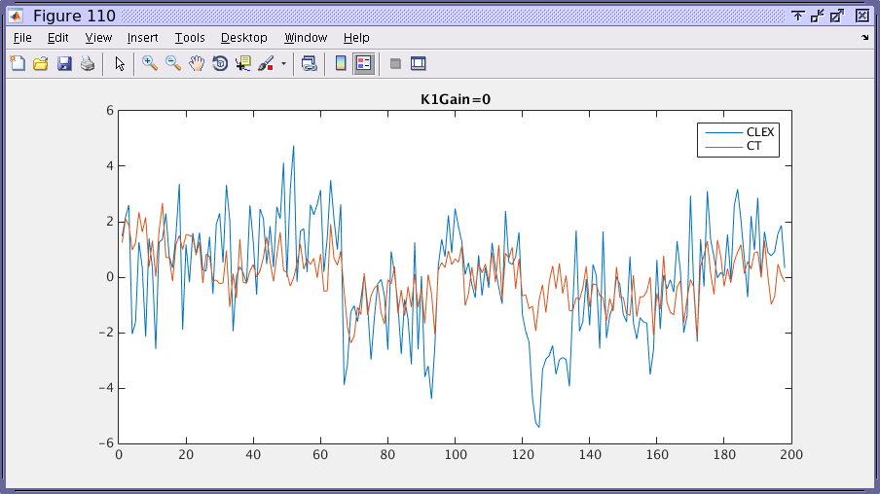
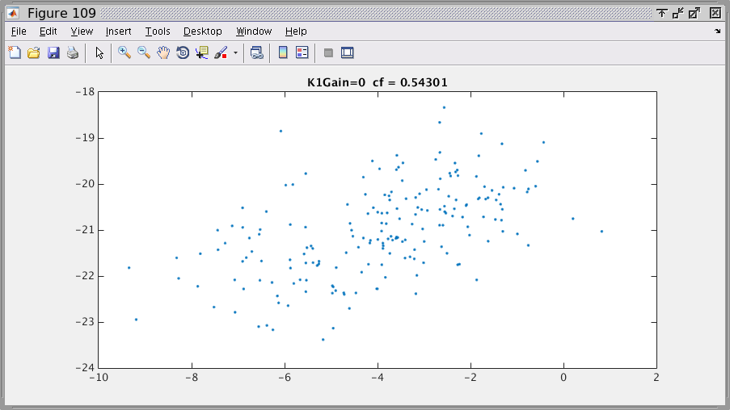
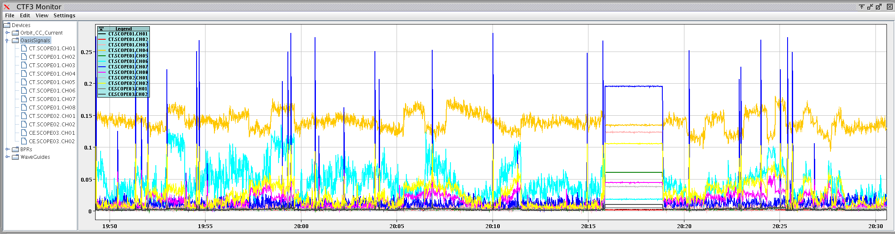
11th Dec (bad correlation, then 2 wiggling)
Took 3 more data sets with 500 pulses (gain +30, gain -30 and 0) whilst wiggling phase loop of 02. Were some losses in the BPMs for the largest phase shifts (-1.5 degrees in the +/-30 gain data, and 2 degrees in the 0 gain data). Times: 1950, 2000 and 2010. Haven't analysed the data but by eye it looks like the weakest correlation between the two monitors is with 0 gain, and the strongest with +30 gain.

