Slide 1
Jitter vs. attenuation
N. Blaskovic
N. Blaskovic

Slide 2
Contents
IPB (Y) data from 18 Dec 2014
At each IPB(Y) attenuation:
Calibration waveforms
Calibration control plots
Summary plots:
Calibration constant vs. attenuation
Jitter vs. attenuation
N. Blaskovic

Slide 3
Notes
Without 714 ± 10 MHz filter on IPB(Y) between Honda’s first and second stage
Using SIS digitiser:
Raw waveforms presented
Calibration analysis uses pedestal subtraction
IP ICT is 0.65 x 10¹⁰
Jitter calculated with 10 sample averaging (samples 66 to 75)
N. Blaskovic

Slide 4
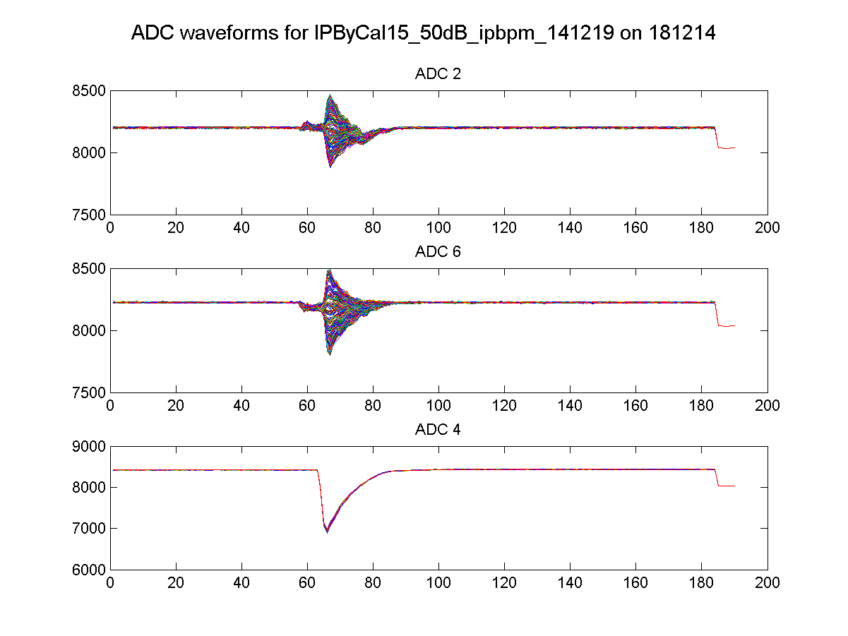
50 dB
IPB(Y) I
IPB(Y) Q
Ref(Y)
N. Blaskovic

Slide 5
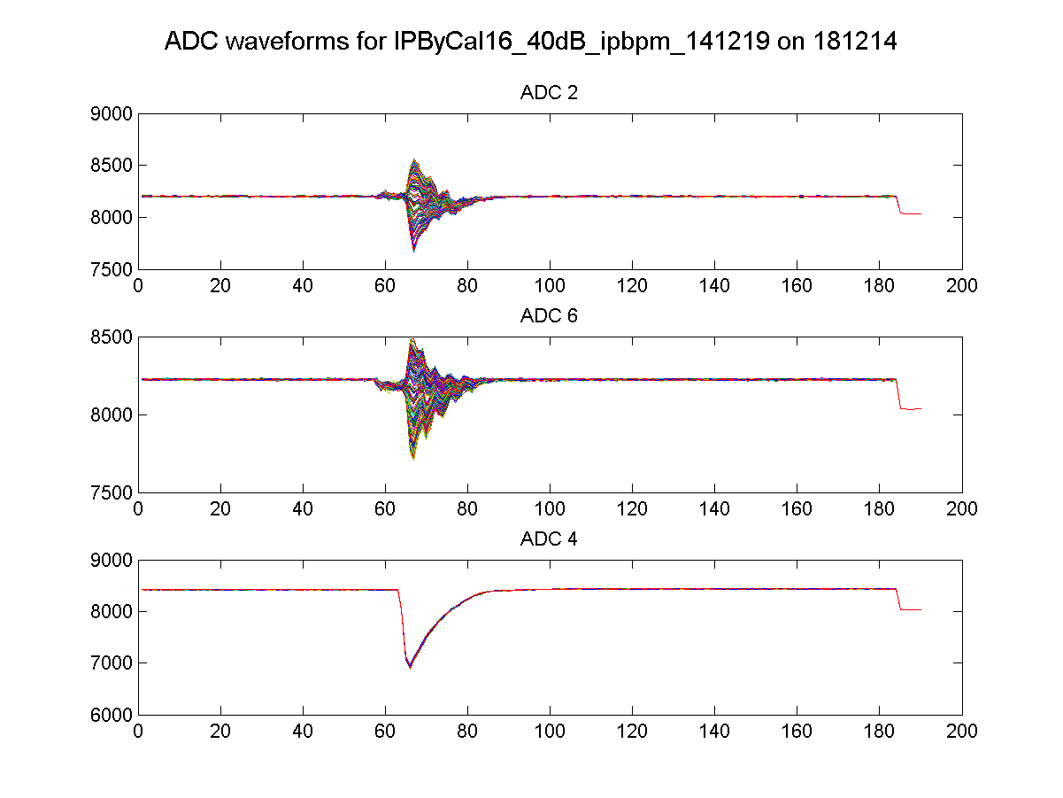
40 dB
IPB(Y) I
IPB(Y) Q
Ref(Y)
N. Blaskovic

Slide 6
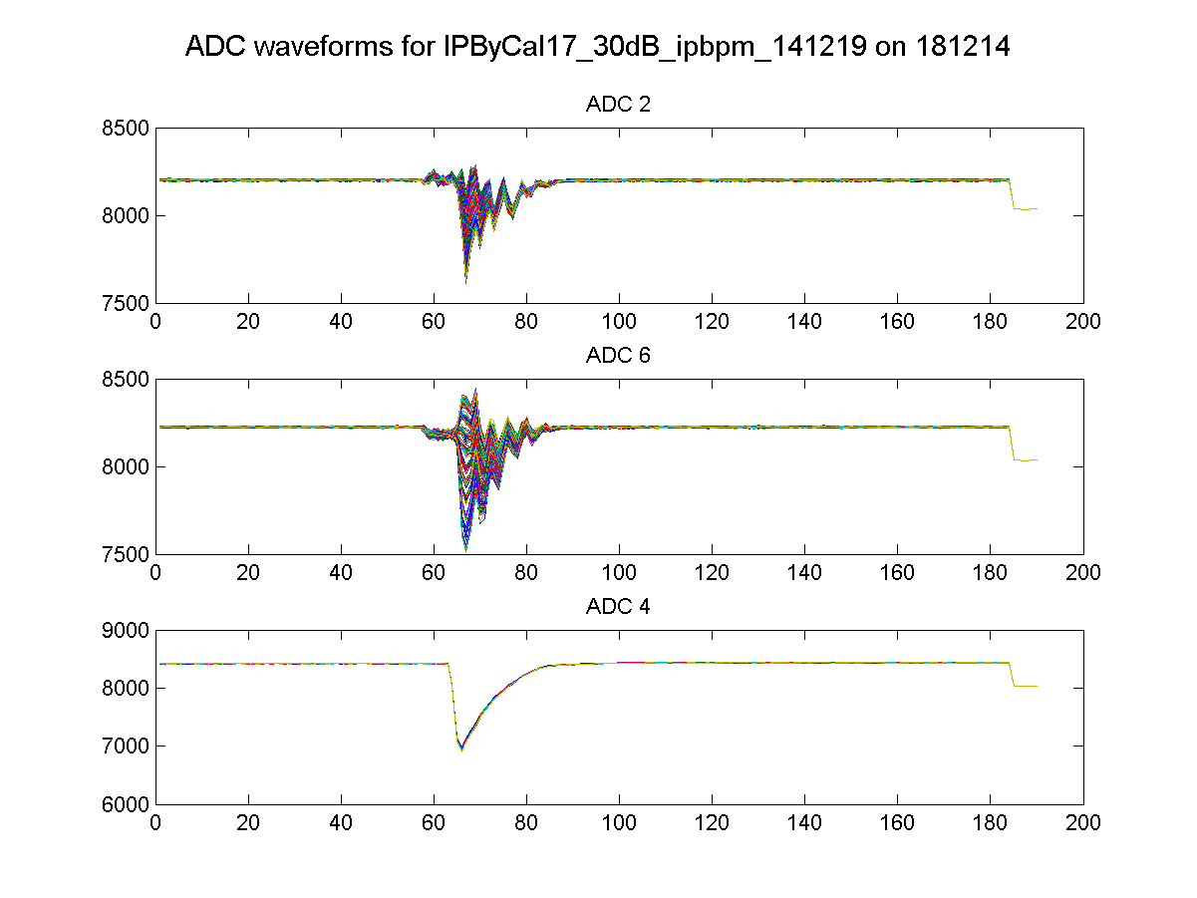
30 dB
IPB(Y) I
IPB(Y) Q
Ref(Y)
N. Blaskovic

Slide 7
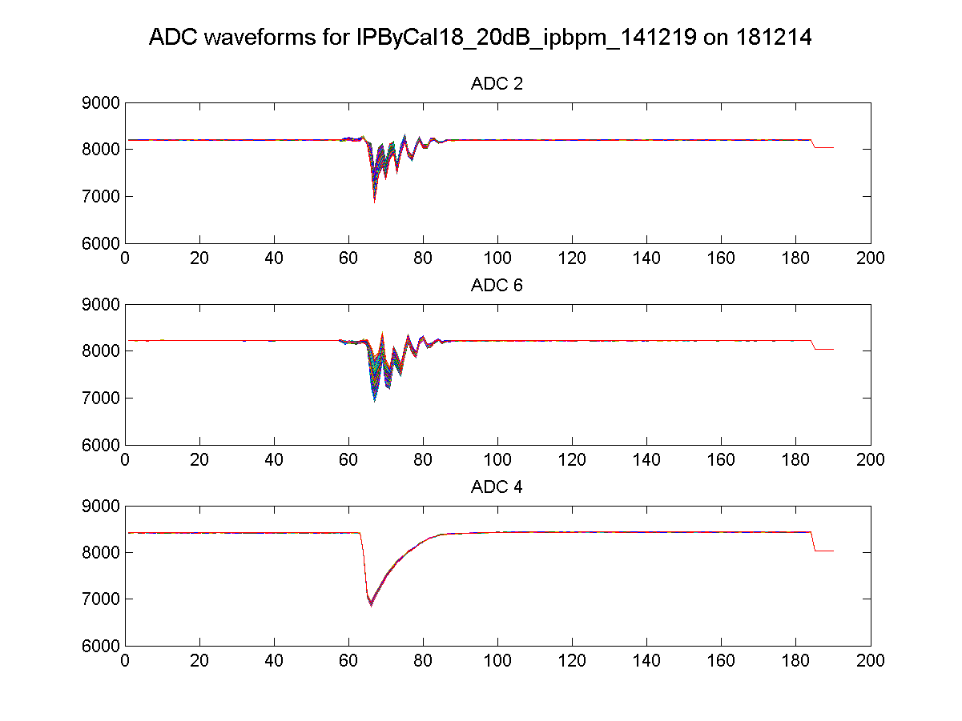
20 dB
IPB(Y) I
IPB(Y) Q
Ref(Y)
N. Blaskovic

Slide 8
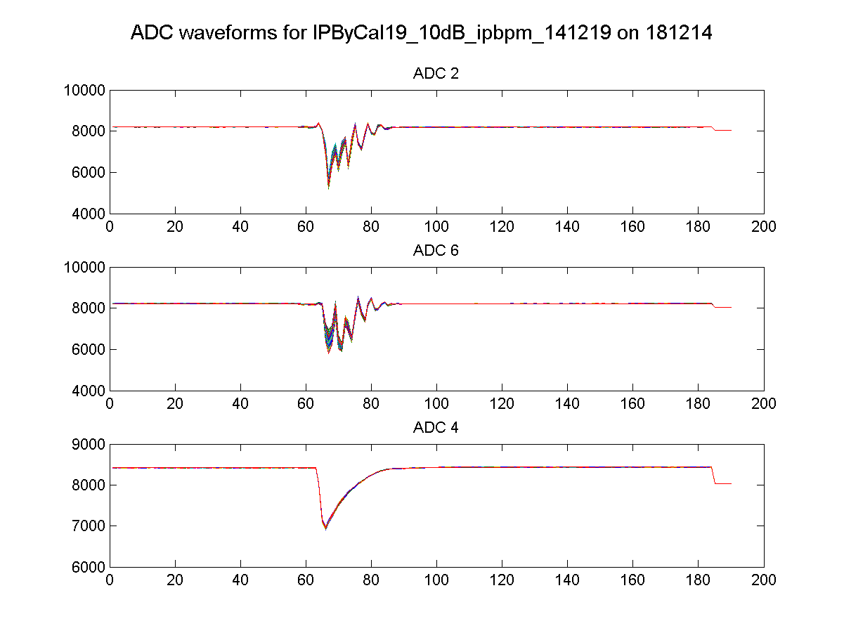
10 dB
IPB(Y) I
IPB(Y) Q
Ref(Y)
N. Blaskovic

Slide 9
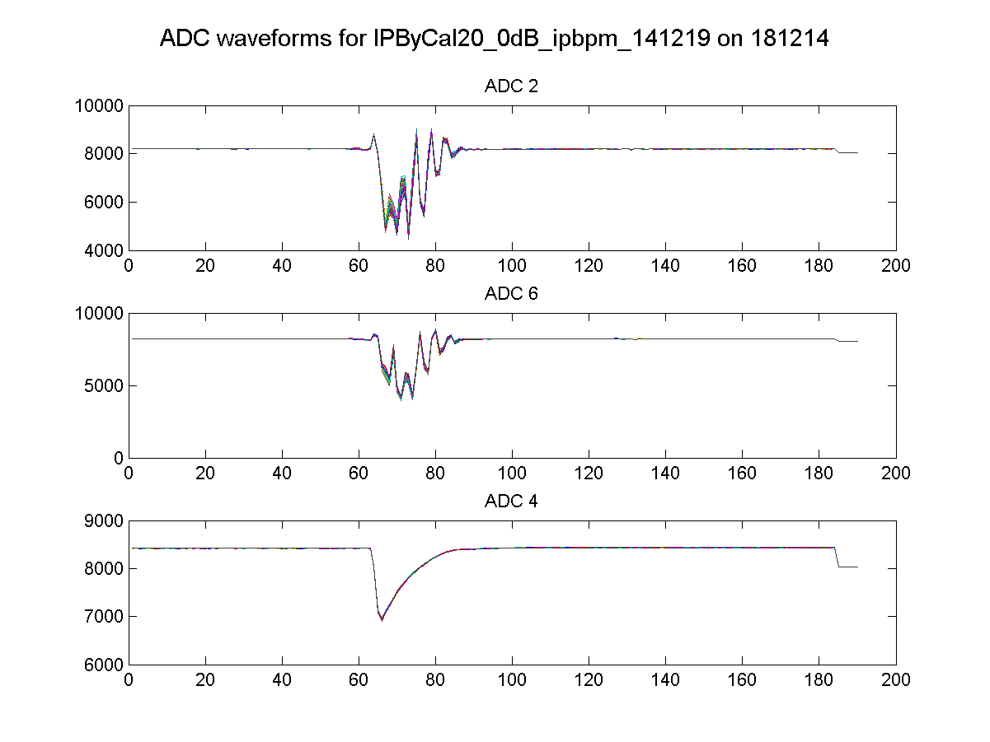
0 dB
IPB(Y) I
IPB(Y) Q
Ref(Y)
N. Blaskovic

Slide 10
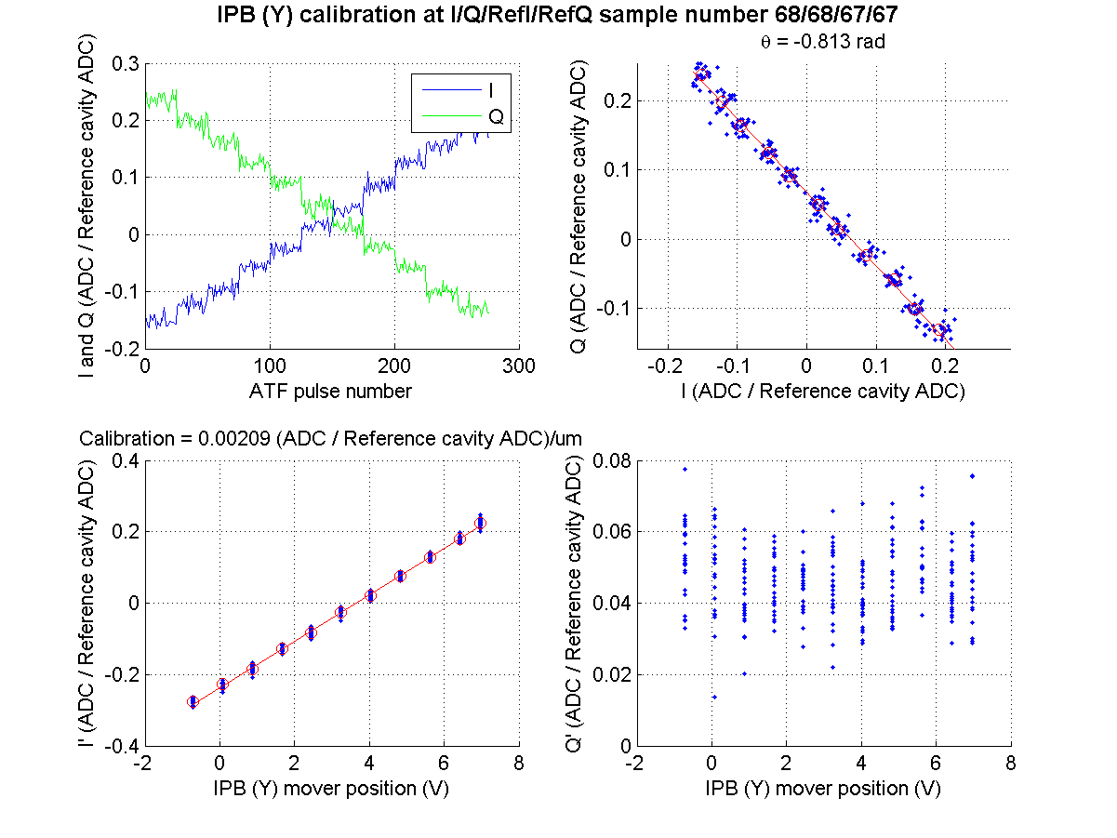
50 dB
N. Blaskovic

Slide 11
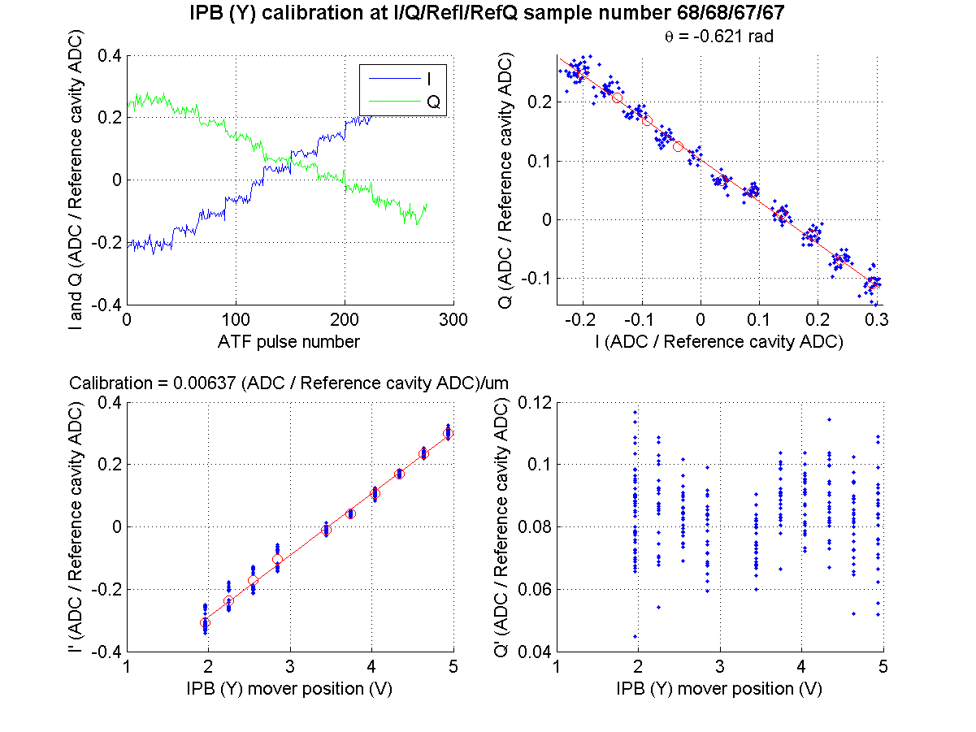
40 dB
N. Blaskovic

Slide 12
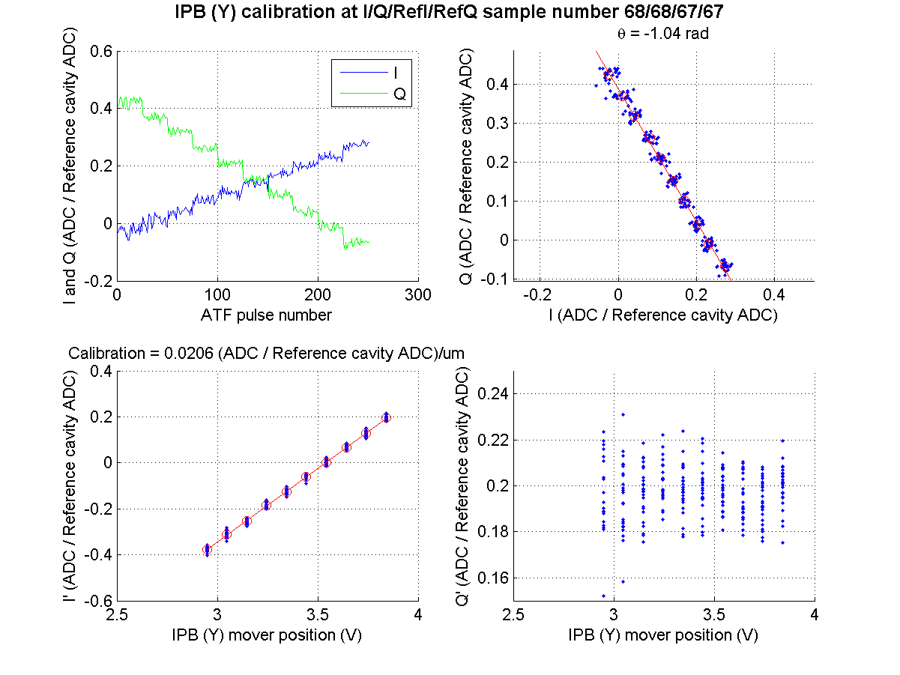
30 dB
N. Blaskovic

Slide 13
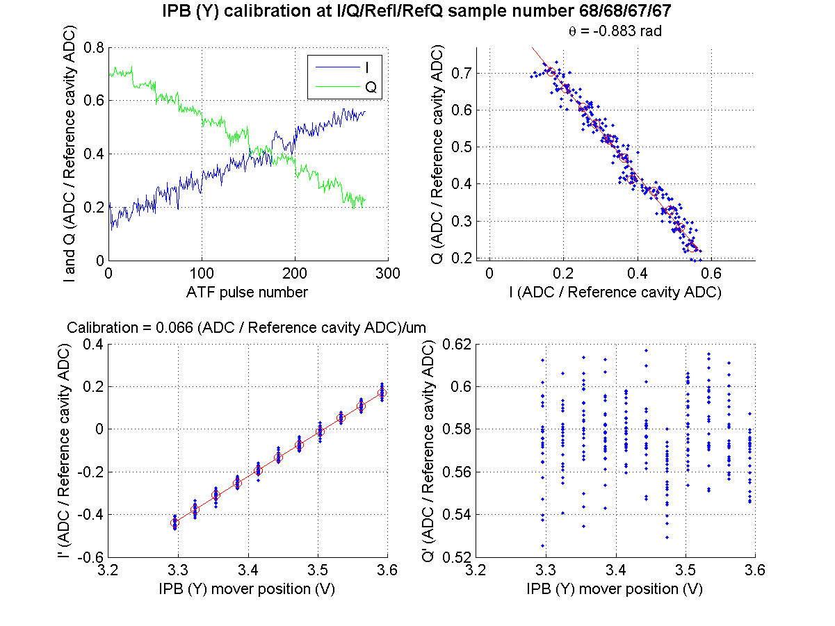
20 dB
N. Blaskovic

Slide 14
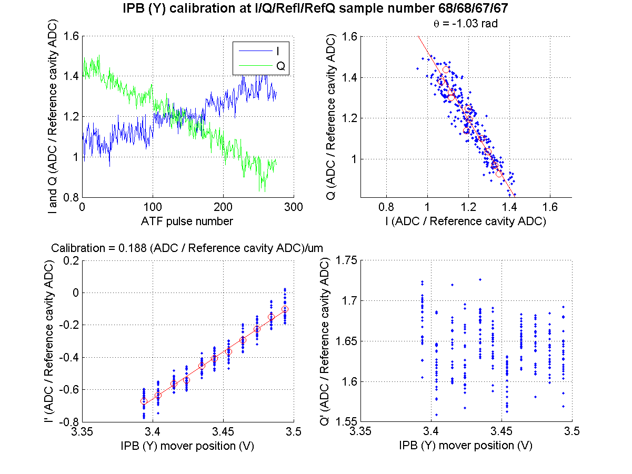
10 dB
N. Blaskovic

Slide 15
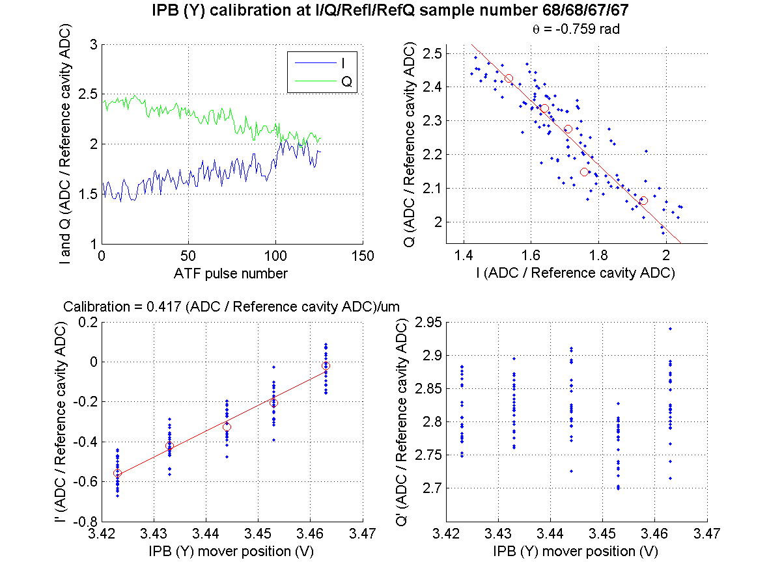
0 dB
N. Blaskovic

Slide 16
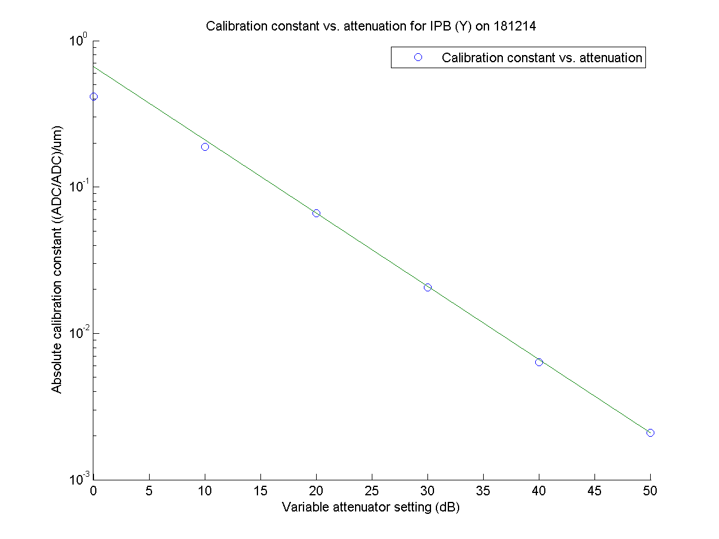
N. Blaskovic

Slide 17
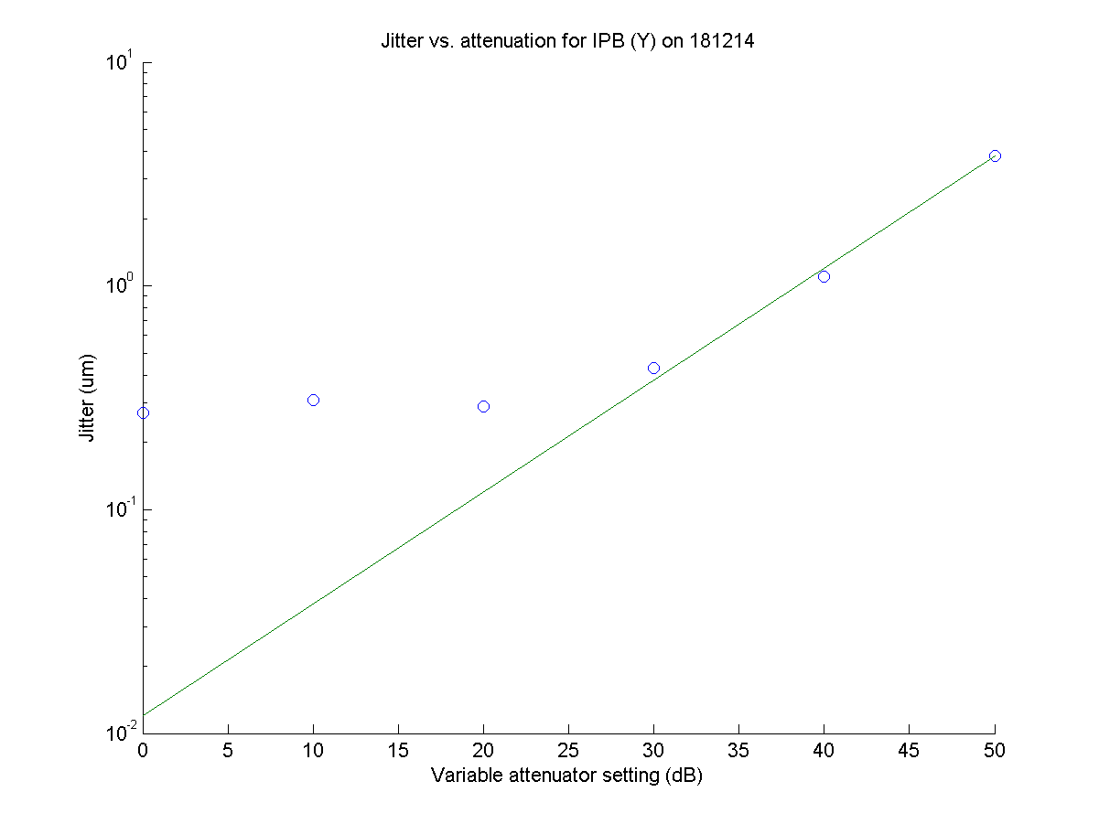
12 nm
N. Blaskovic

Slide 18
Summary
Calibration constant scales well but not perfectly with attenuation
Real beam jitter likely to be > 200 nm as beam not tuned (after extraction kicker recovery)
Assuming jitter at 50 dB is resolution, extrapolated resolution at 0 dB is 12 nm at 0.65 x 10¹⁰ charge
N. Blaskovic

