Slide 1
IP feedback waveforms and jitters
N. Blaskovic
N. Blaskovic

Slide 2
Contents
IP feedback results from 19 Dec 2014
Waveforms & jitter for feedback on/off for:
  QD0FF current scan
  IP K1B2 offset (‘banana correction’) scan
  IP K1B2 offset with feedback gains set to 0
N. Blaskovic

Slide 3
Notes
With 714 ± 10 MHz filter on IPB(Y) between Honda’s first and second stage
IP beam angle steered using AQF7FF(Y)
5 sample delay cables on ADCs 8 and 9
Position and jitter calculations use same single sample point as feedback firmware:
  Bunch 1: sample 24 for I, sample 29 for Q
  Bunch 2: sample 101 for I, sample 106 for Q
N. Blaskovic

Slide 4
Observations
Bunch 1 position well centred for all runs so expect feedback performing to same level for all runs
Variation in bunch 2 feedback-on jitter appears to depend largely on bunch 2 feedback-on position
Generally, bunch 2 measured jitter is smaller if better centred
N. Blaskovic

Slide 5
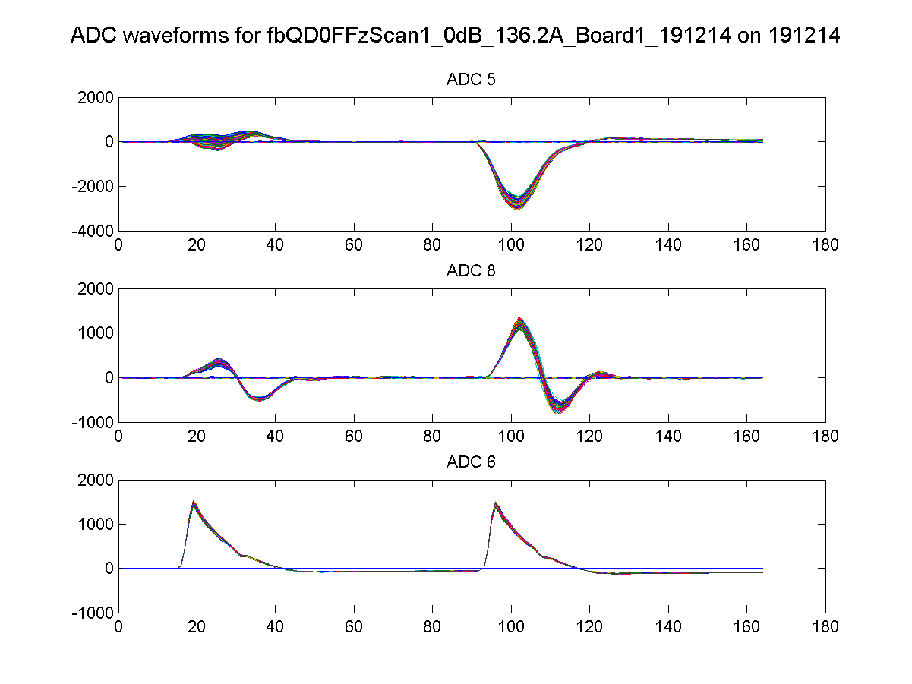
Attenuation 0 dB
QD0FF
136.2 A
Feedback
On
K1B2 offset
0
IPB(Y) I
IPB(Y) Q
Ref(Y)
N. Blaskovic

Slide 6
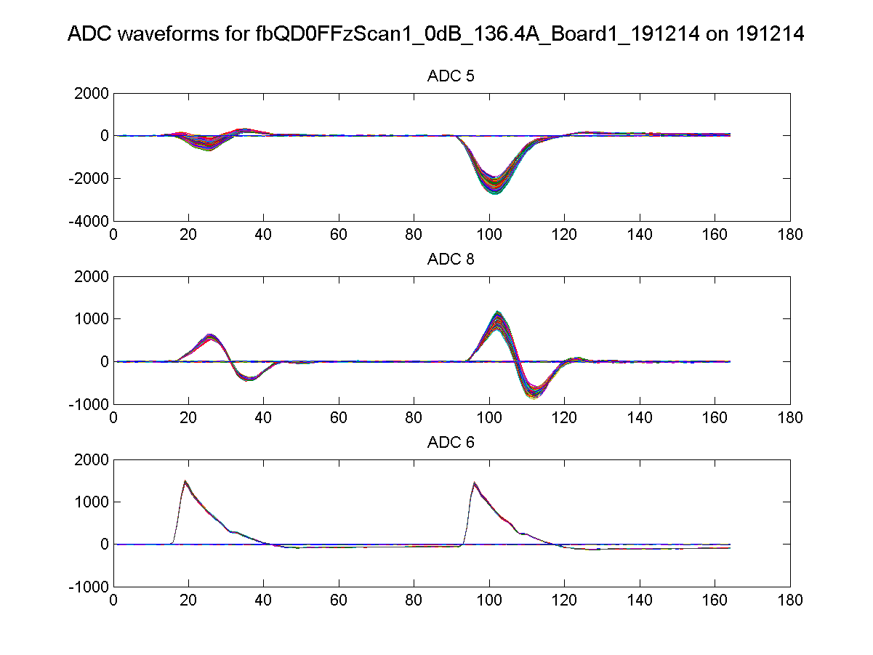
Attenuation 0 dB
QD0FF
136.4 A
Feedback
On
K1B2 offset
0
IPB(Y) I
IPB(Y) Q
Ref(Y)
N. Blaskovic

Slide 7
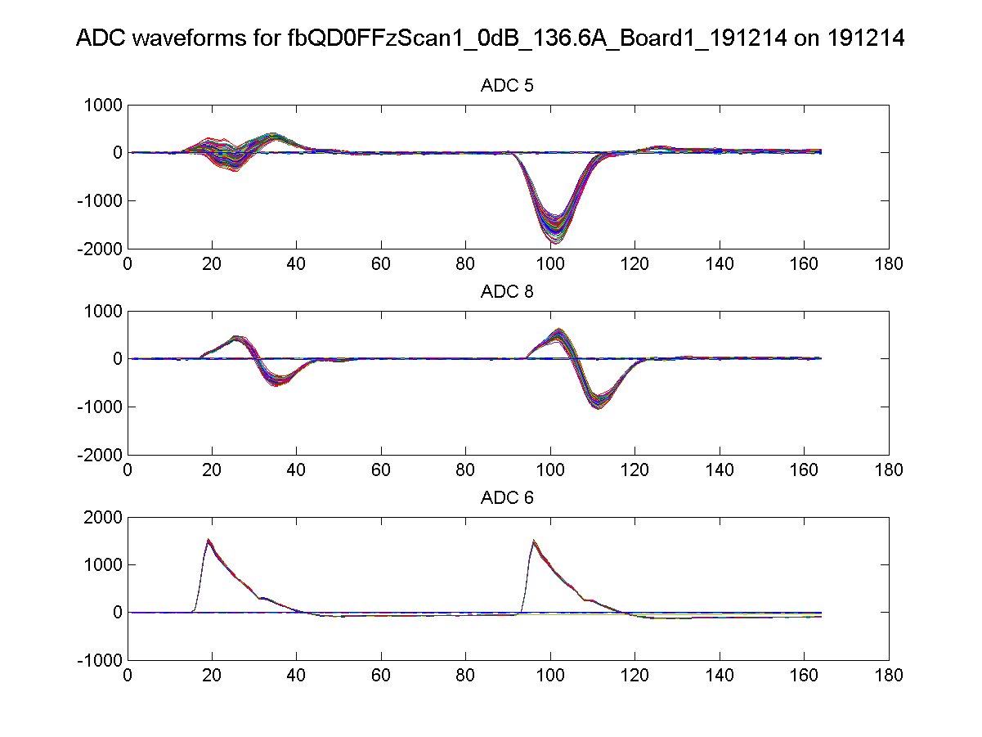
Attenuation 0 dB
QD0FF
136.6 A
Feedback
On
K1B2 offset
0
IPB(Y) I
IPB(Y) Q
Ref(Y)
N. Blaskovic

Slide 8
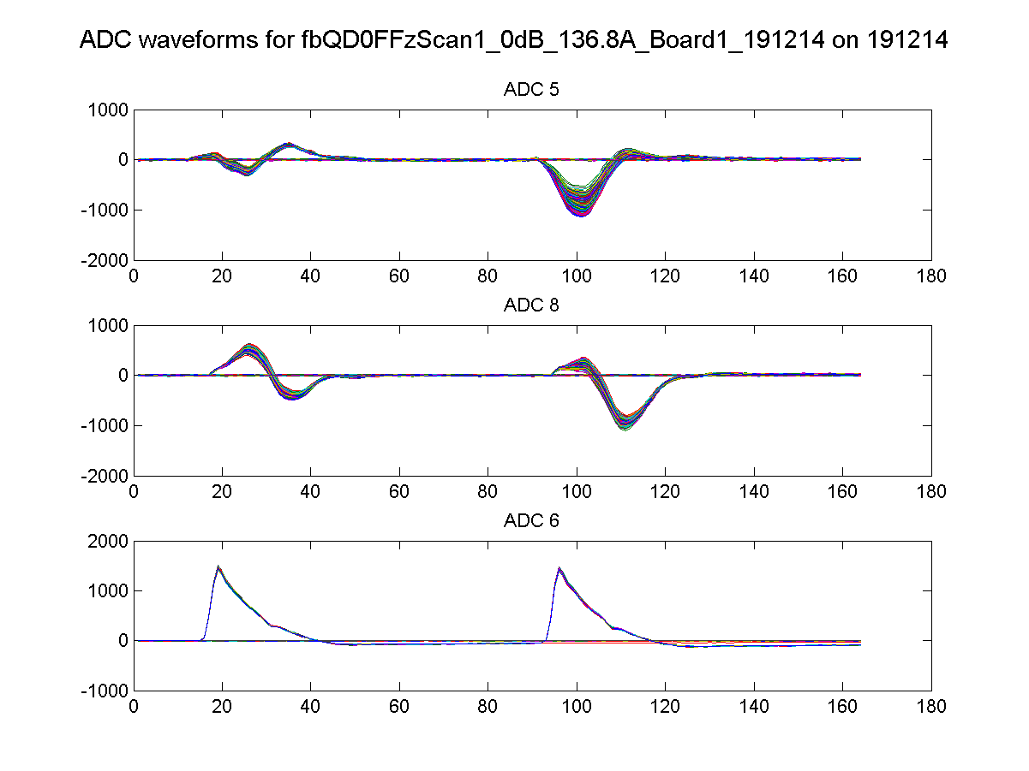
Attenuation 0 dB
QD0FF
136.8 A
Feedback
On
K1B2 offset
0
IPB(Y) I
IPB(Y) Q
Ref(Y)
N. Blaskovic

Slide 9
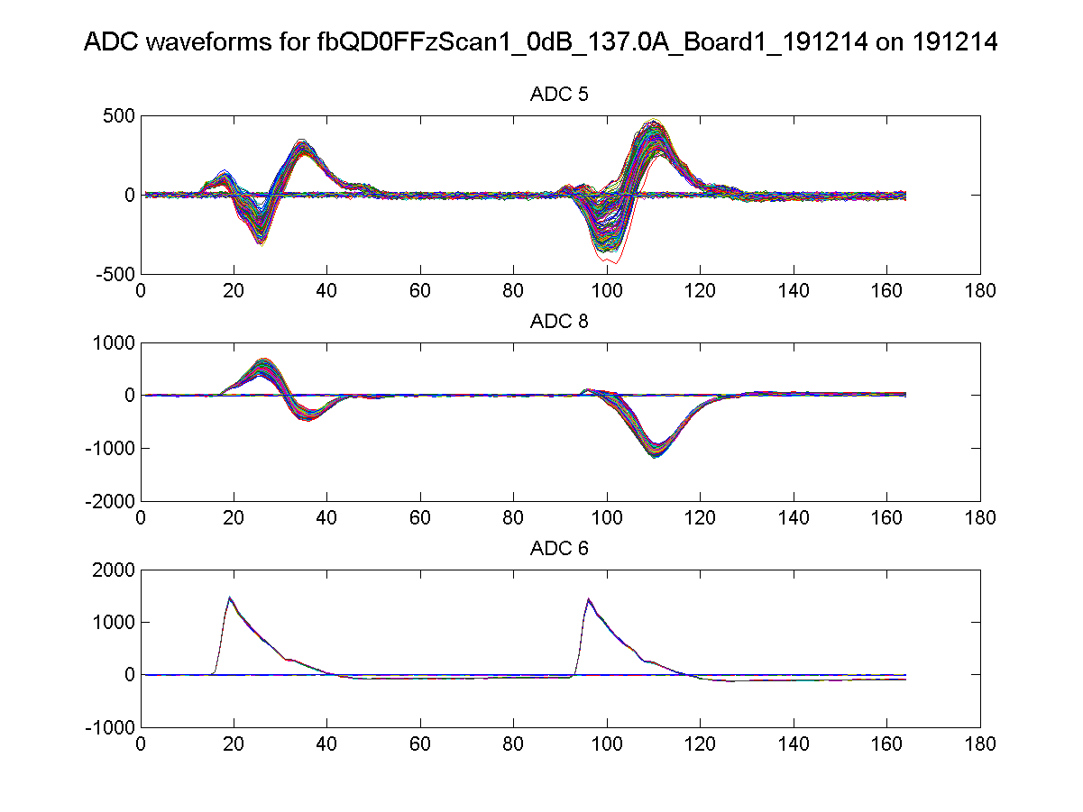
Attenuation 0 dB
QD0FF
137.0 A
Feedback
On
K1B2 offset
0
IPB(Y) I
IPB(Y) Q
Ref(Y)
N. Blaskovic

Slide 10
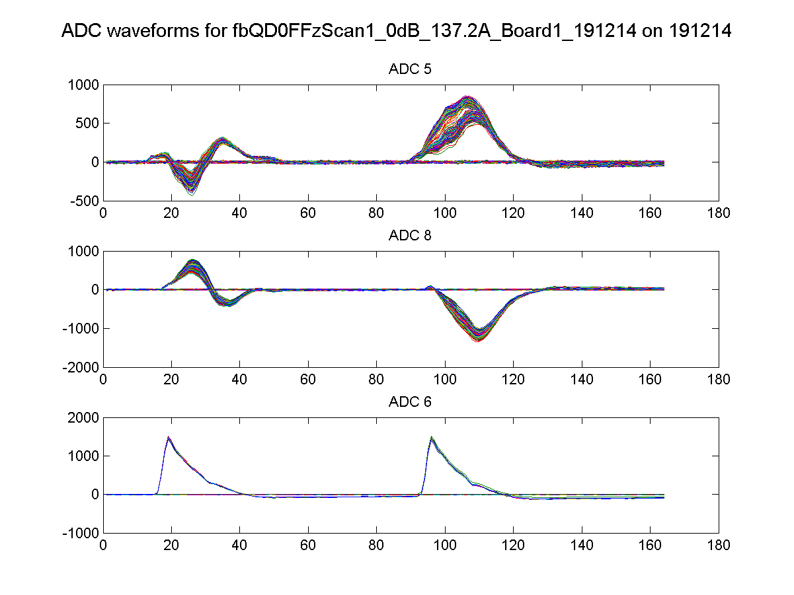
Attenuation 0 dB
QD0FF
137.2 A
Feedback
On
K1B2 offset
0
IPB(Y) I
IPB(Y) Q
Ref(Y)
N. Blaskovic

Slide 11
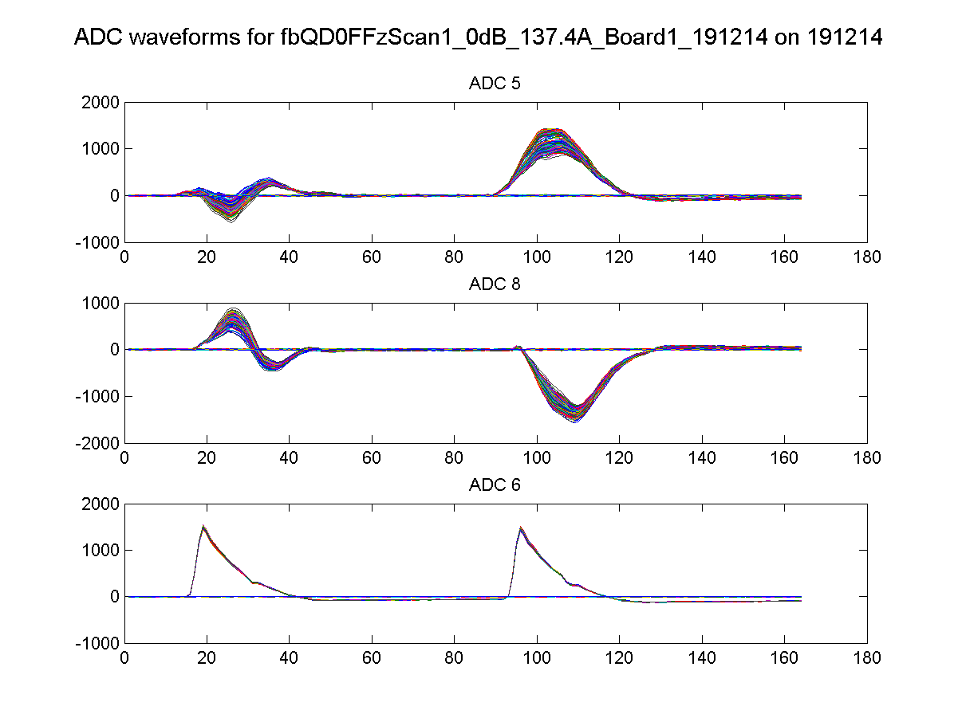
Attenuation 0 dB
QD0FF
137.4 A
Feedback
On
K1B2 offset
0
IPB(Y) I
IPB(Y) Q
Ref(Y)
N. Blaskovic

Slide 12
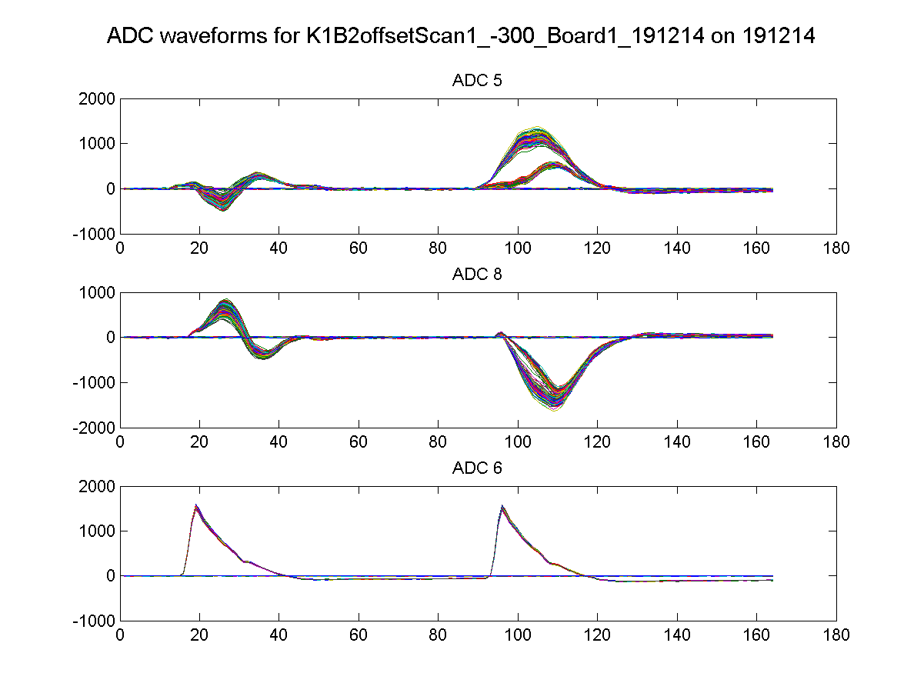
Attenuation 0 dB
QD0FF
137.4 A
Feedback
On
K1B2 offset
-300
IPB(Y) I
IPB(Y) Q
Ref(Y)
N. Blaskovic

Slide 13
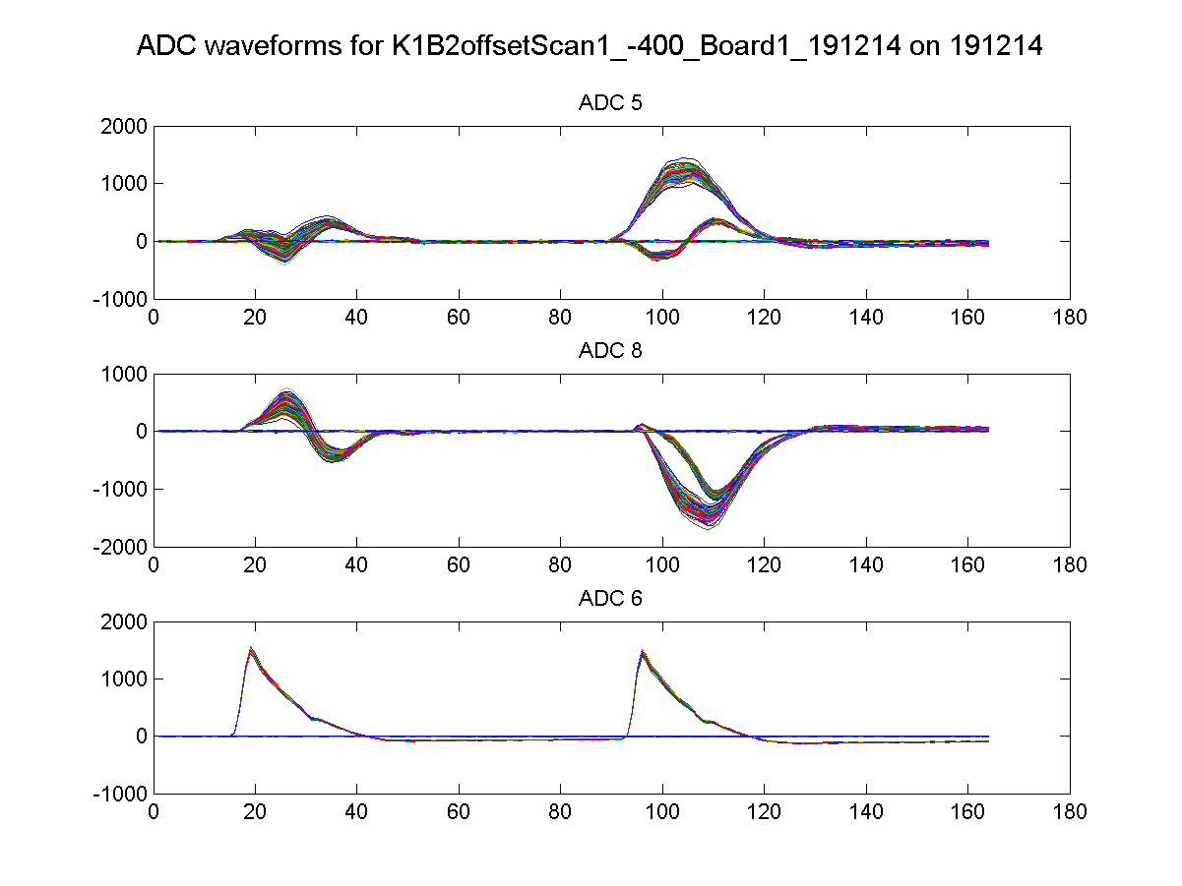
Attenuation 0 dB
QD0FF
137.4 A
Feedback
On
K1B2 offset
-400
IPB(Y) I
IPB(Y) Q
Ref(Y)
N. Blaskovic

Slide 14
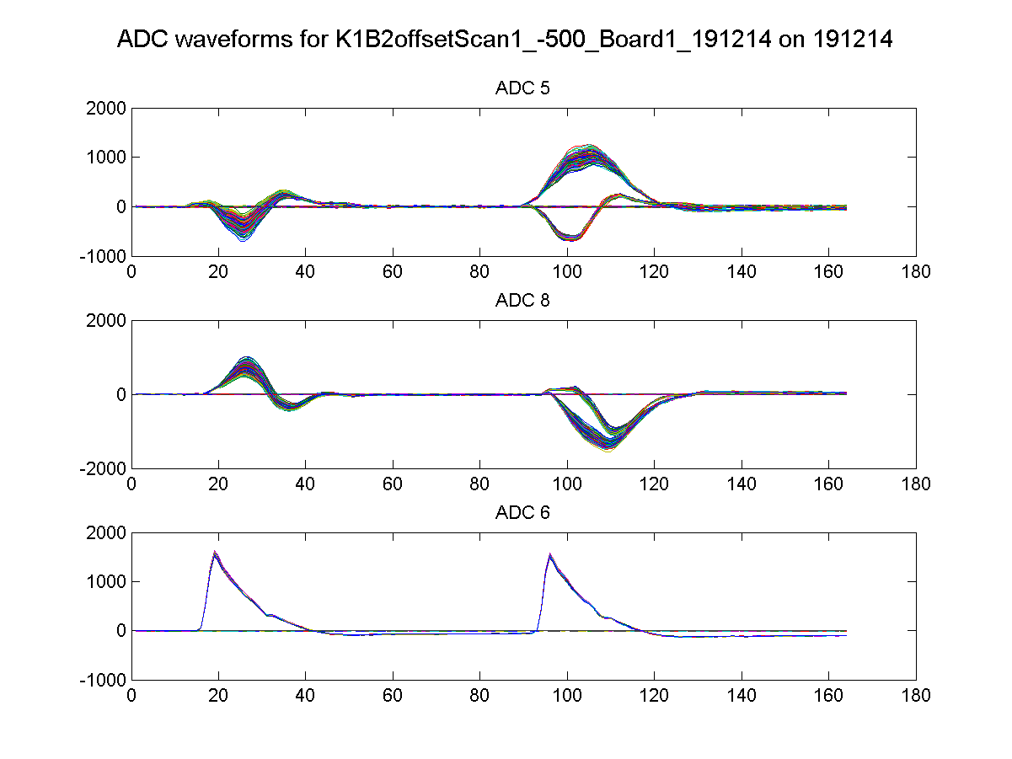
Attenuation 0 dB
QD0FF
137.4 A
Feedback
On
K1B2 offset
-500
IPB(Y) I
IPB(Y) Q
Ref(Y)
N. Blaskovic

Slide 15
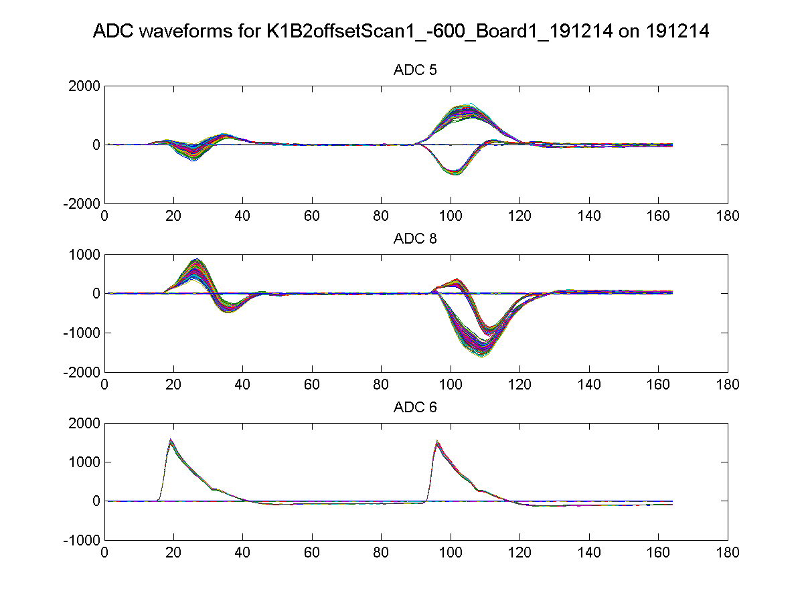
Attenuation 0 dB
QD0FF
137.4 A
Feedback
On
K1B2 offset
-600
IPB(Y) I
IPB(Y) Q
Ref(Y)
N. Blaskovic

Slide 16
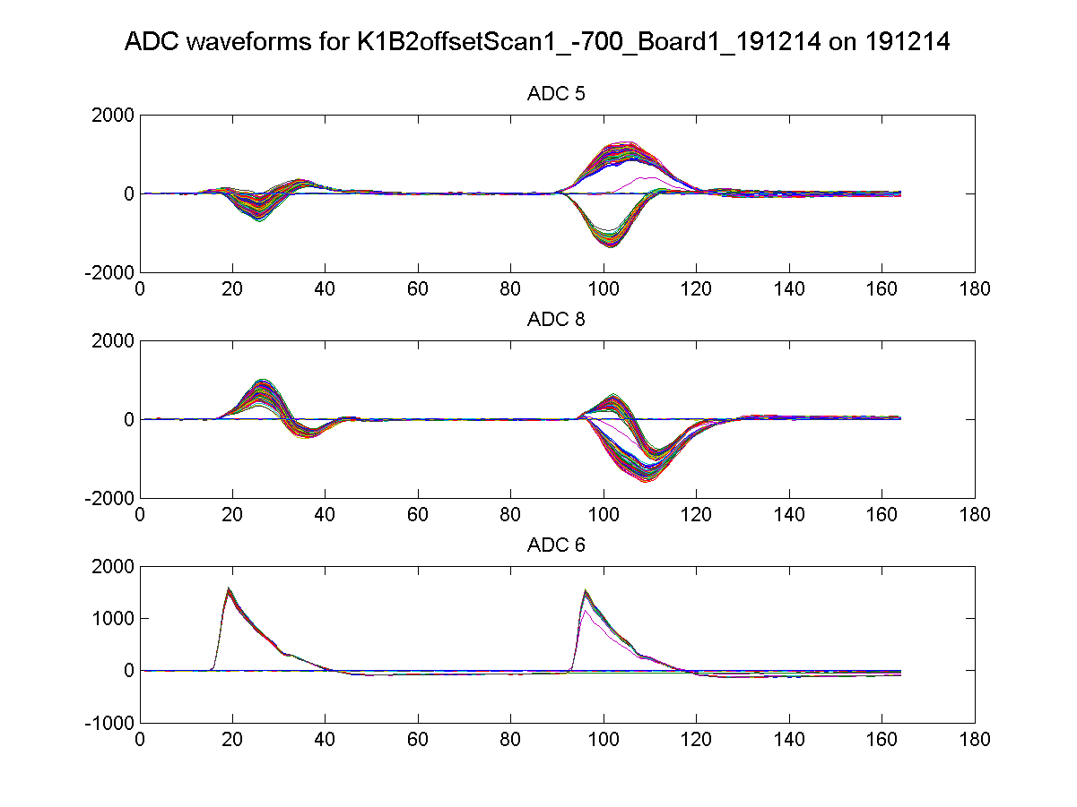
Attenuation 0 dB
QD0FF
137.4 A
Feedback
On
K1B2 offset
-700
IPB(Y) I
IPB(Y) Q
Ref(Y)
N. Blaskovic

Slide 17
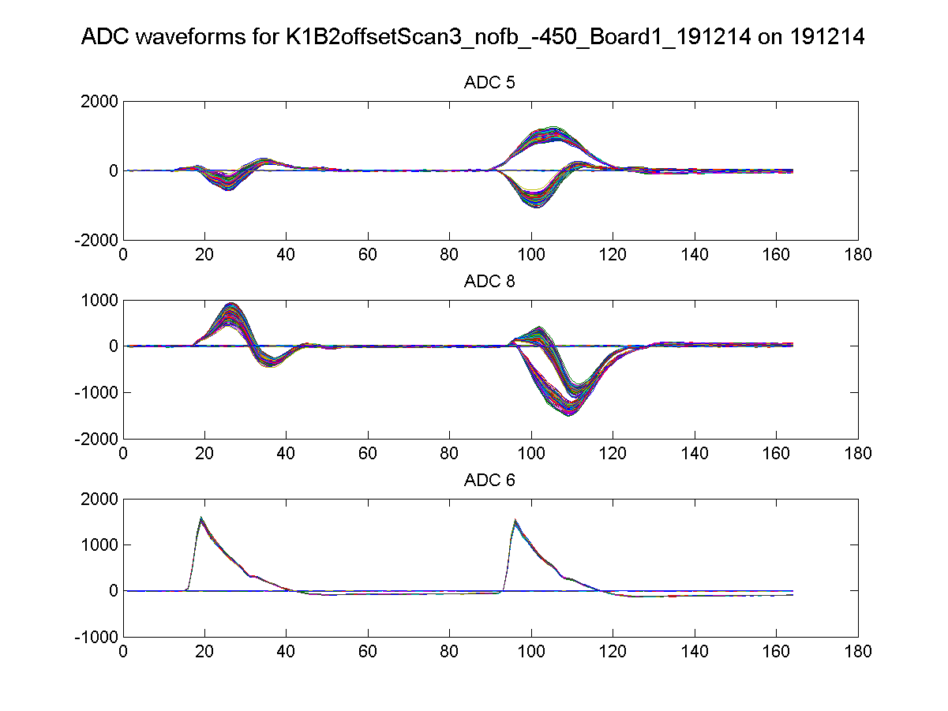
Attenuation 0 dB
QD0FF
137.4 A
Feedback
Off
K1B2 offset
-450
IPB(Y) I
IPB(Y) Q
Ref(Y)
N. Blaskovic

Slide 18
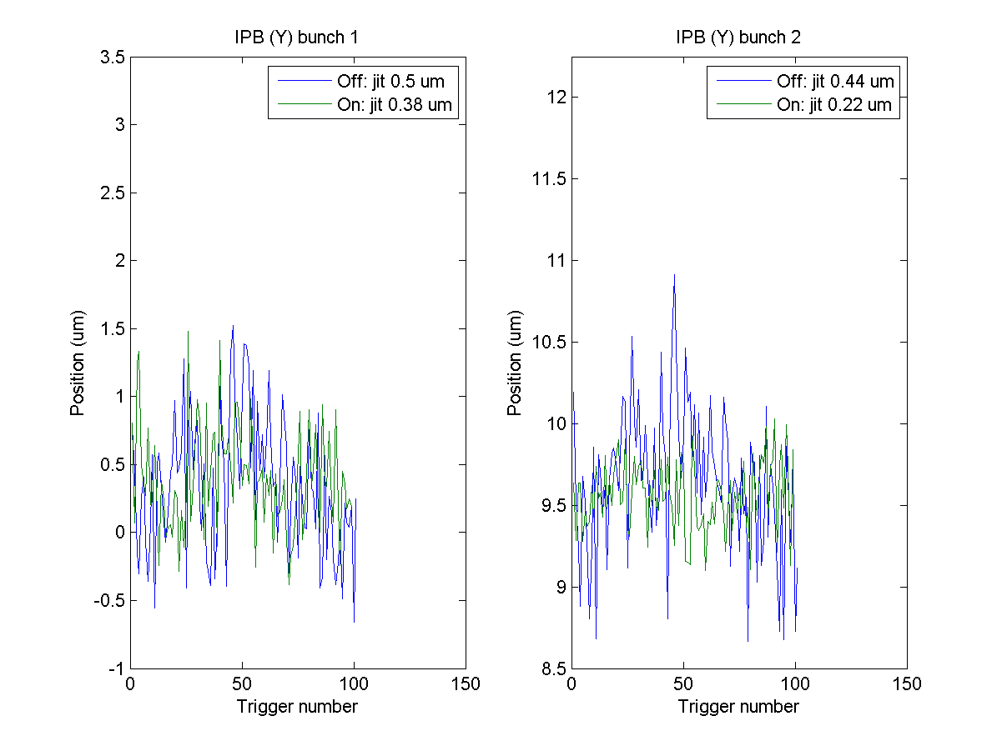
Attenuation 0 dB
QD0FF
136.2 A
Feedback
On
K1B2 offset
0
N. Blaskovic

Slide 19
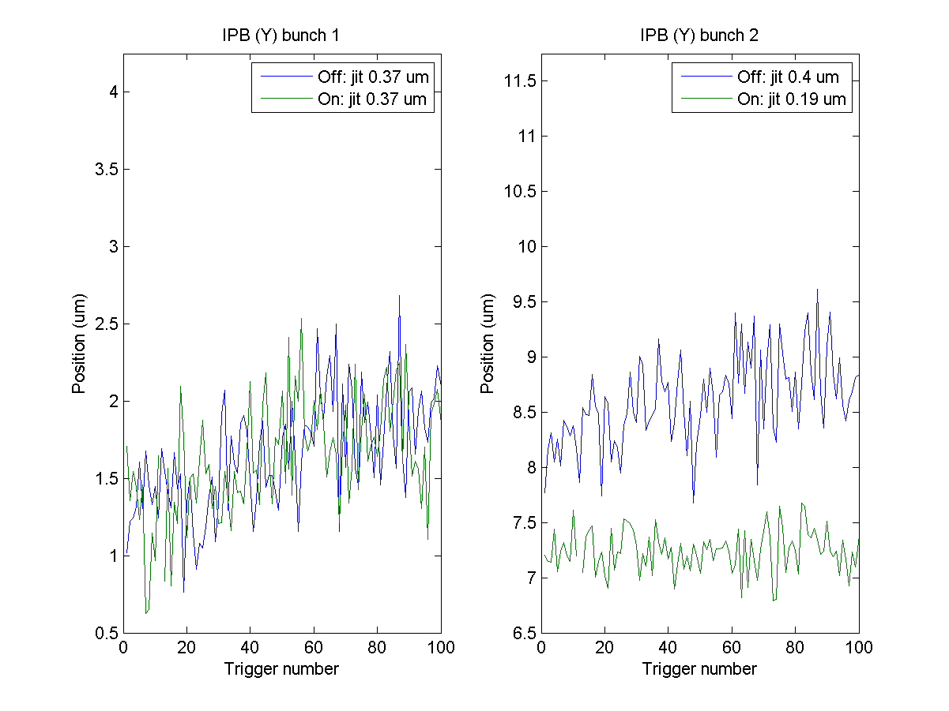
Attenuation 0 dB
QD0FF
136.4 A
Feedback
On
K1B2 offset
0
N. Blaskovic

Slide 20
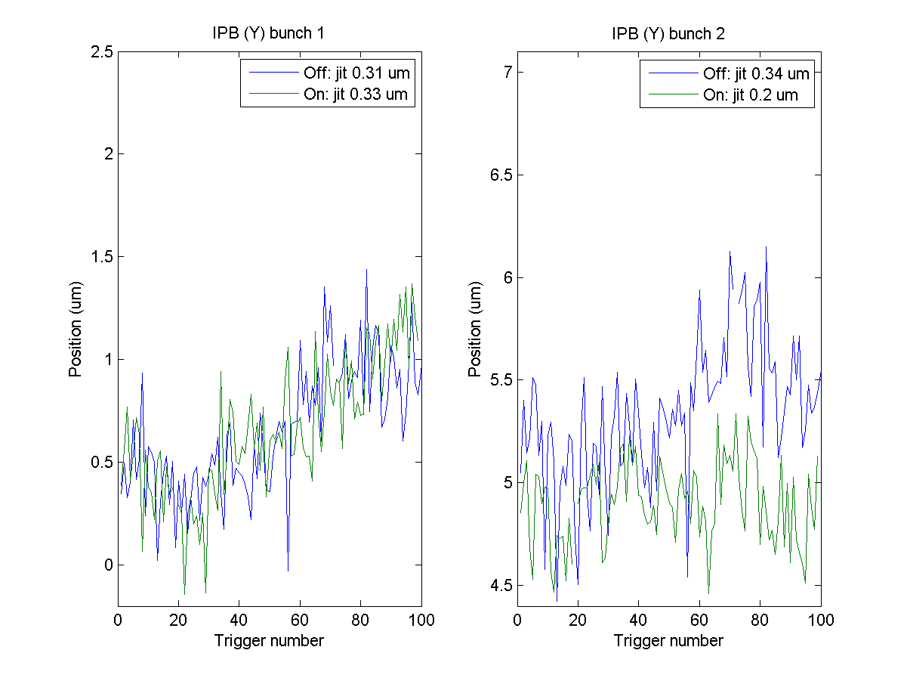
Attenuation 0 dB
QD0FF
136.6 A
Feedback
On
K1B2 offset
0
N. Blaskovic

Slide 21
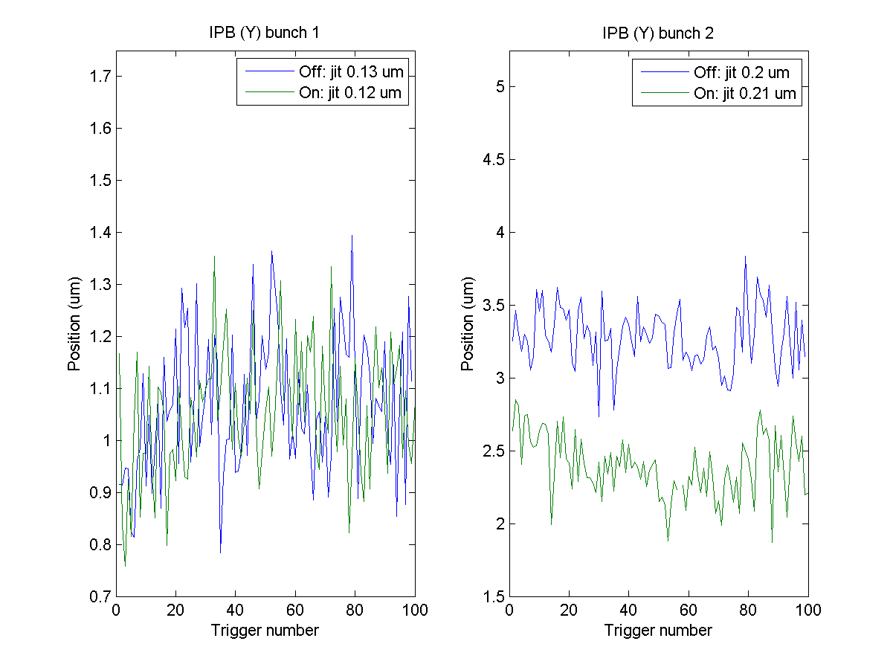
Attenuation 0 dB
QD0FF
136.8 A
Feedback
On
K1B2 offset
0
N. Blaskovic

Slide 22
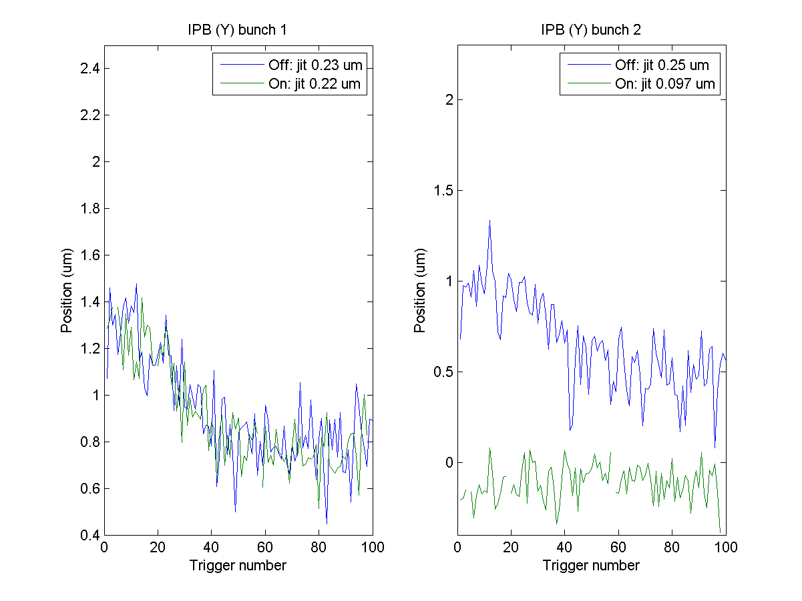
Attenuation 0 dB
QD0FF
137.0 A
Feedback
On
K1B2 offset
0
N. Blaskovic

Slide 23
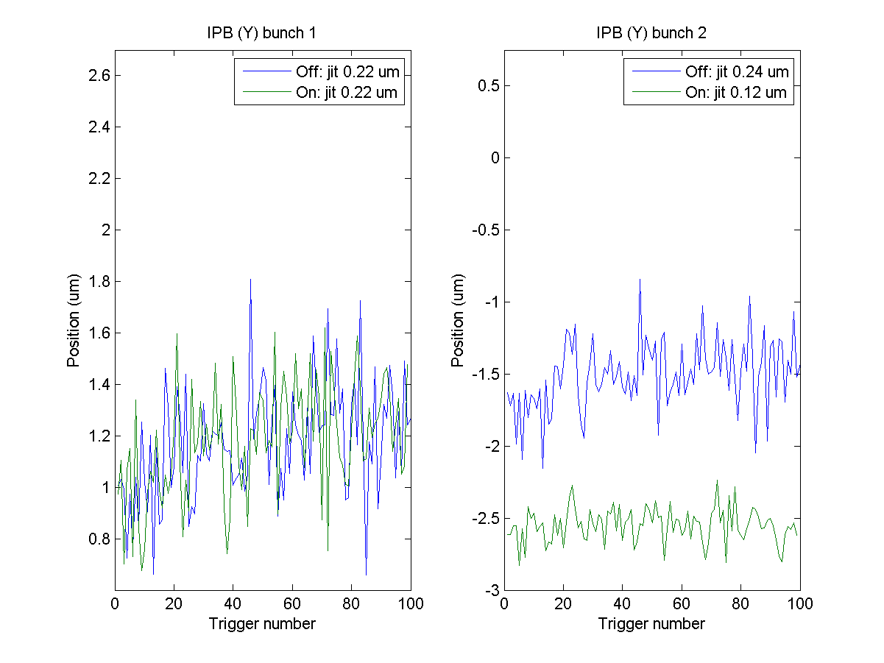
Attenuation 0 dB
QD0FF
137.2 A
Feedback
On
K1B2 offset
0
N. Blaskovic

Slide 24
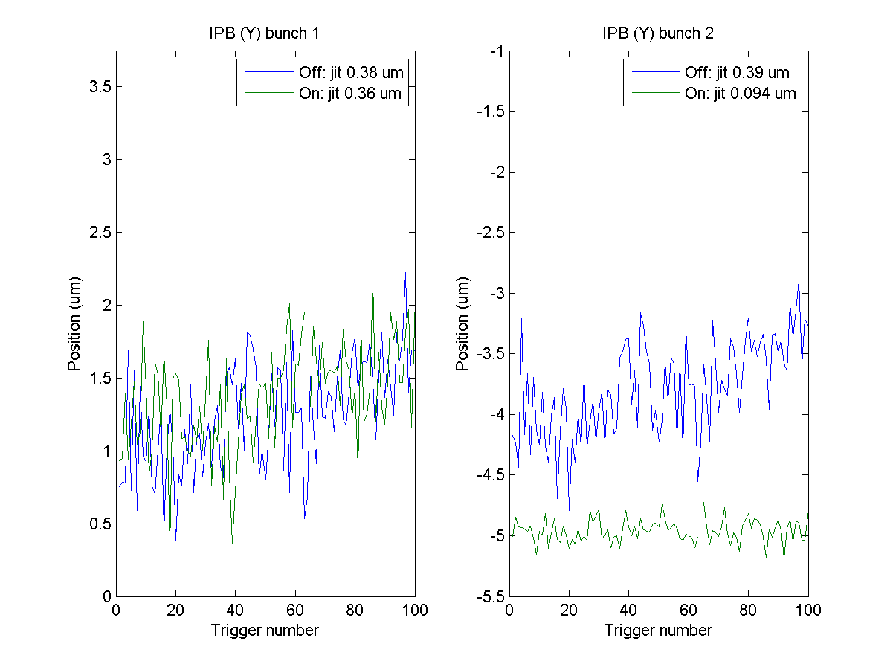
Attenuation 0 dB
QD0FF
137.4 A
Feedback
On
K1B2 offset
0
N. Blaskovic

Slide 25
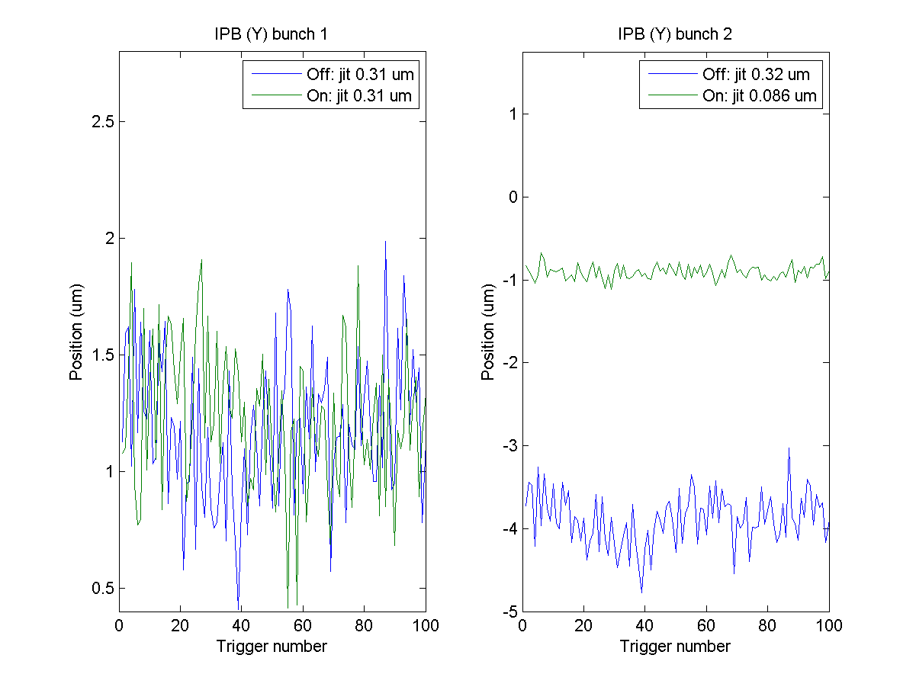
Attenuation 0 dB
QD0FF
137.4 A
Feedback
On
K1B2 offset
-300
N. Blaskovic

Slide 26
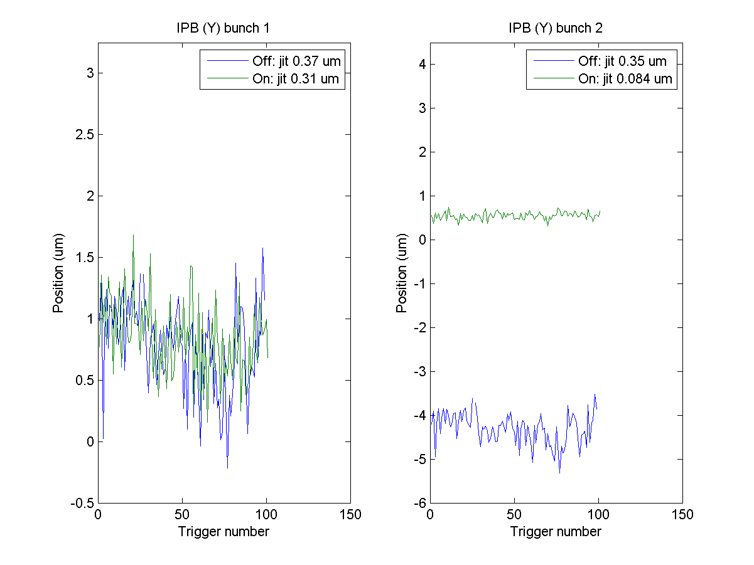
Attenuation 0 dB
QD0FF
137.4 A
Feedback
On
K1B2 offset
-400
N. Blaskovic

Slide 27
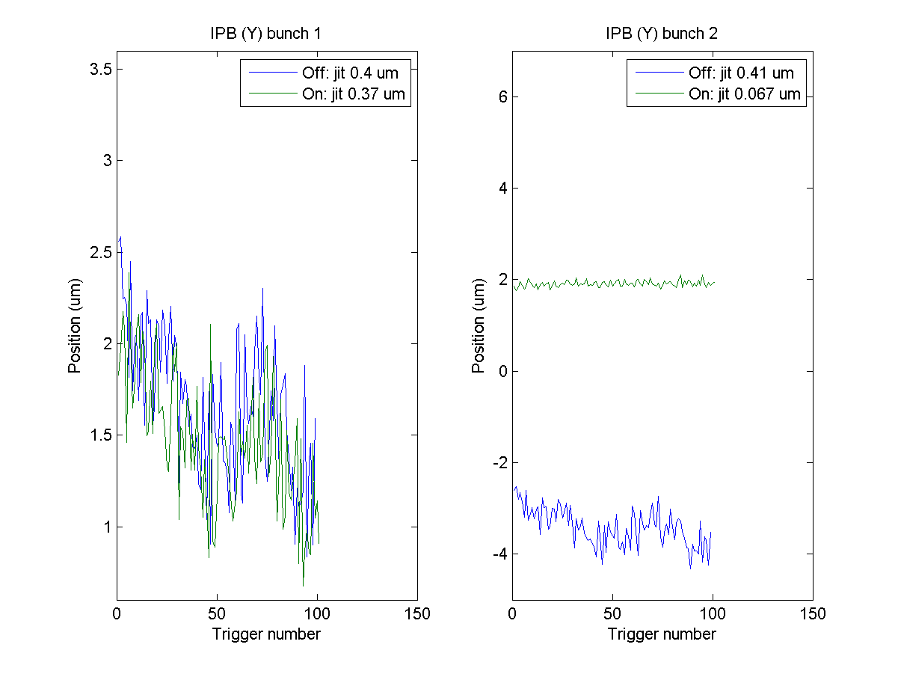
Attenuation 0 dB
QD0FF
137.4 A
Feedback
On
K1B2 offset
-500
N. Blaskovic

Slide 28
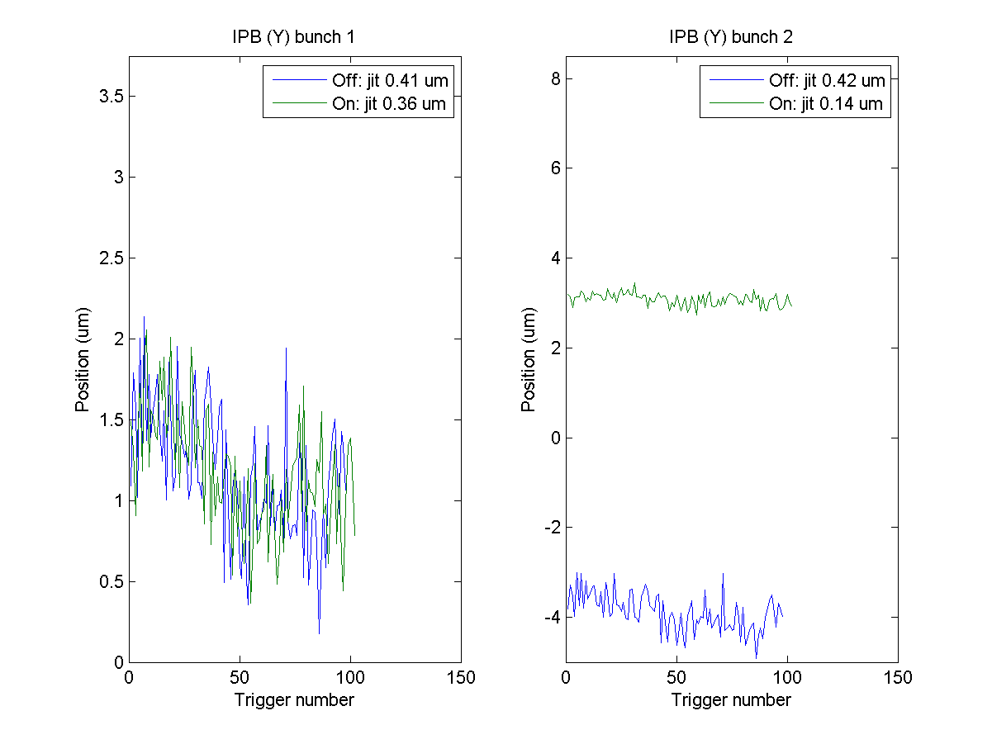
Attenuation 0 dB
QD0FF
137.4 A
Feedback
On
K1B2 offset
-600
N. Blaskovic

Slide 29
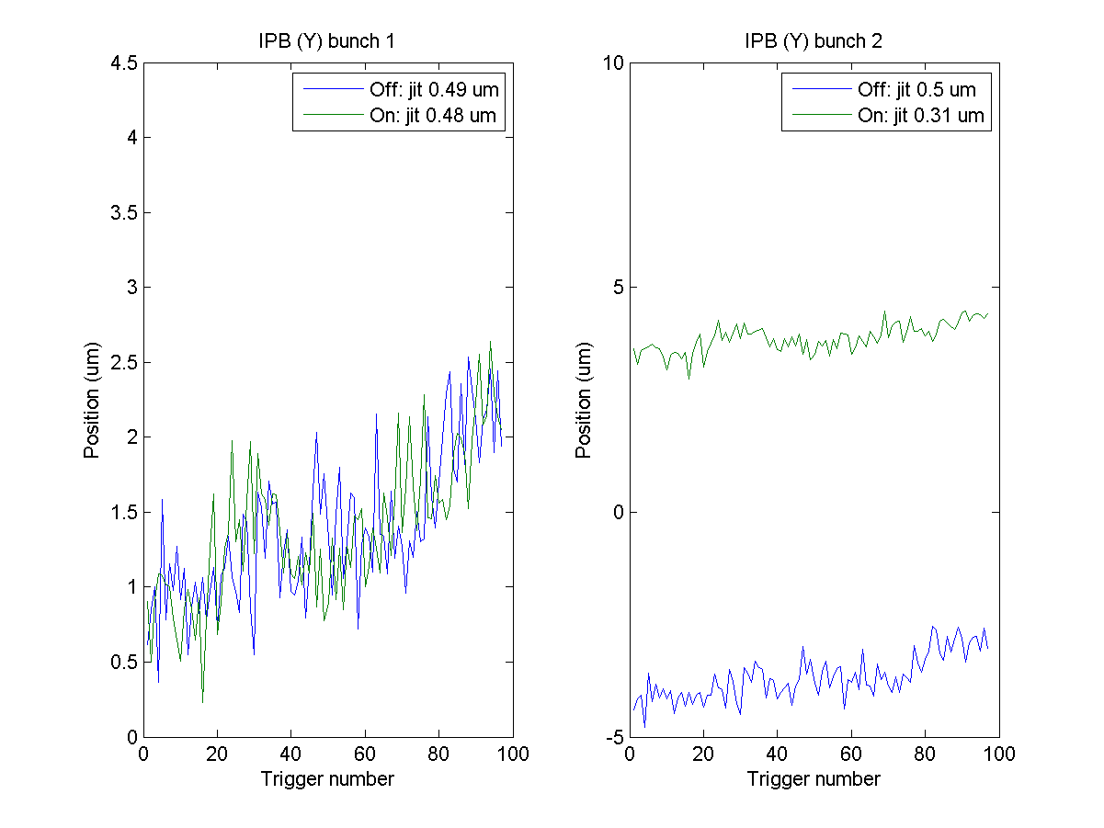
Attenuation 0 dB
QD0FF
137.4 A
Feedback
On
K1B2 offset
-700
N. Blaskovic

Slide 30
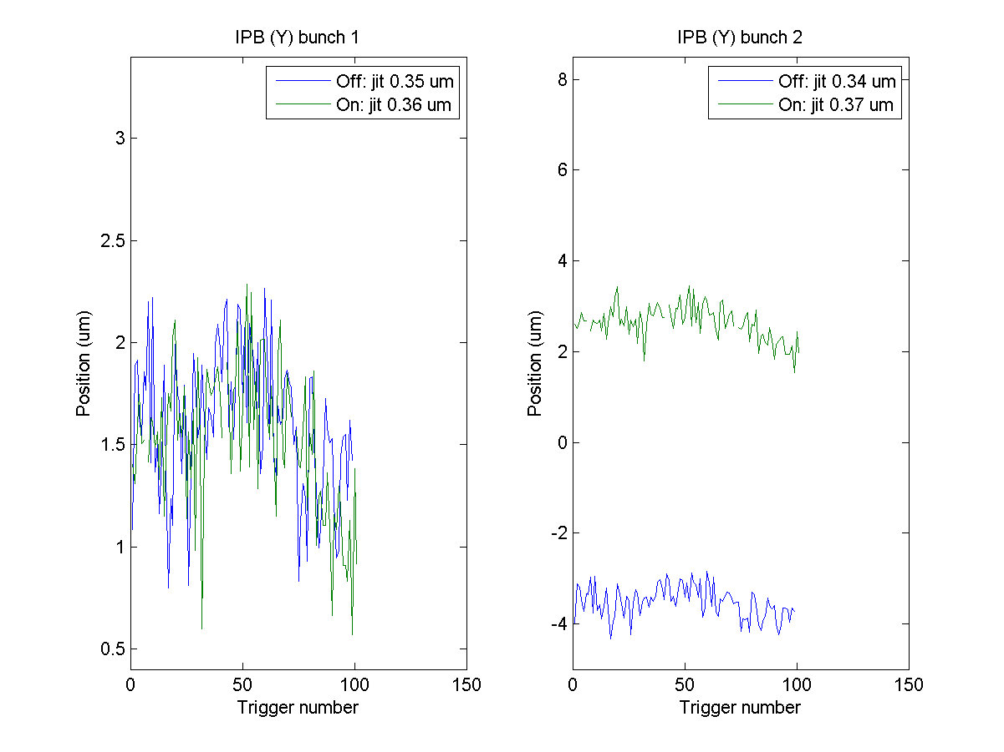
Attenuation 0 dB
QD0FF
137.4 A
Feedback
Off
K1B2 offset
-450
N. Blaskovic

