Slide 1
Status of Phase Feedforward Tests
Jack Roberts

Slide 2
Introduction
Most of this is the same as what I showed Phil & Glenn on the 12th Dec.
New parts are:
  A more detailed look at the phase signals for one data set.
  Feedforward tests with wiggling of klystrons.
We were unexpectedly able to take beam time Monday-Wednesday this week as the electrical tests caused no problems.
Sorry I haven’t had time to do much more than dump plots on slides.

Slide 3
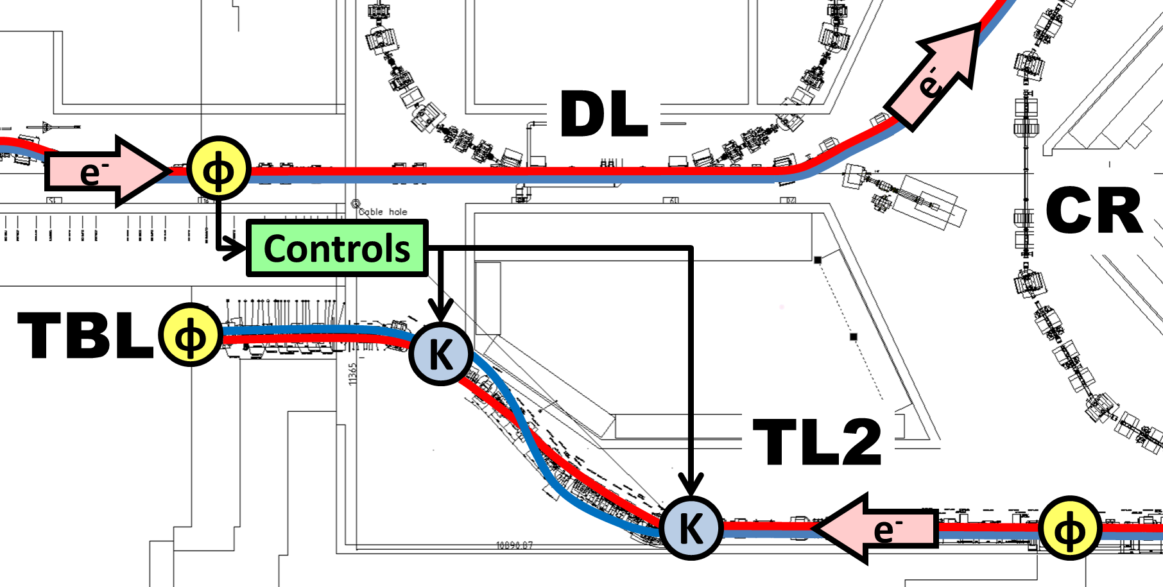
Phase Feedforward Refresher
Correct phase/time of drive beam by varying time of flight in the TL2 chicane using two kickers.
3 high resolution Frascati phase monitors (Mon1,Mon2,Mon3). Mon1 used as input to the feedforward system.
“Controls” = FONT5 board and amplifier.
Mon1
Mon2
φ
φ
PETS
Mon3
K2
K1

Slide 4
Quick Overview of Tests Late November
21st Nov: General phase measurements.
25th Nov: Constant kick measurements, response in BPMs.
26th Nov: Constant kick measurements, response in phase.
27th Nov: Feedforward tests, no (immediately) visible effect.
28th Nov: Constant kicks but only a short pulse, response in phase.

Slide 5
Quick Overview of Tests December
4th Dec: Beam setup, orbit closure from kicks. Data taking from FONT5 board with all phase signals attached.
5th Dec: Feedforward applied to only one kicker, response in BPMs. R56 tests.
10th Dec: Kicker timing tests. Feedforward tests with gain scan.
11th -12th Dec: FF whilst changing mean klystron phase to induce known (hopefully correlated) phase shift.
15th-17th Dec: Additional devices added to acquisition. FF whilst changing klystron waveform.
…Gigabytes of data to analyse!

Slide 6
Comments on Phase Measurement Status
Mon1 = old monitor, end of linac.
Mon2 = new monitor, end of linac.
Mon3 = new monitor, after correction.
2nd monitor is noisier than 1st monitor, but looks like this is coming from the electronics not the monitor itself. Resolution ~0.5 degrees.
Correlation (mean phase)
  Between Mon1 and Mon2 is generally >90%.
  Between Mon2 and Mon3 is ~30-70% depending on the setup/day.
  Correlation between 3rd monitor and PETS is generally ~90%.
Phase measurement in Mon3 visibly different to the linac:
  Phase sag
  Jitter in mean
  Features within the pulse
By changing beam setup all these can be manipulated to some extent and have had similar looking signals to the linac at times.

Slide 7
Phase Monitor Performance /
Phase Propagation
More detailed look at the phase measurements for one data set.
Only showing calibrated phases here – there are also interesting features in the calibrations and raw signals.
Data set: 20141128_1252_FF_Gate340to460_GainK1_0_GainK2_0.
Data from last day before we changed to connecting 1st monitor directly to the FONT5 board.
Correlations happen to be quite poor in this data set (at the lower end of the typical range we saw).

Slide 8
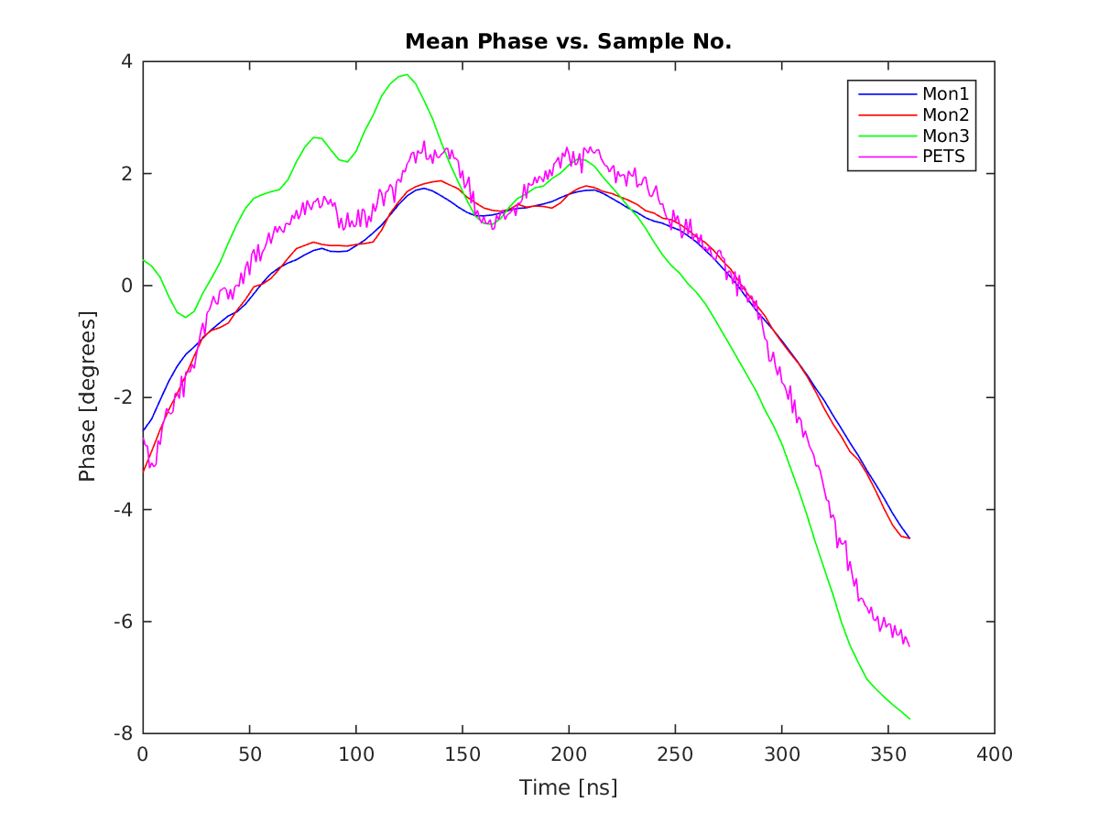
Mean Phase Along the Pulse

Slide 9
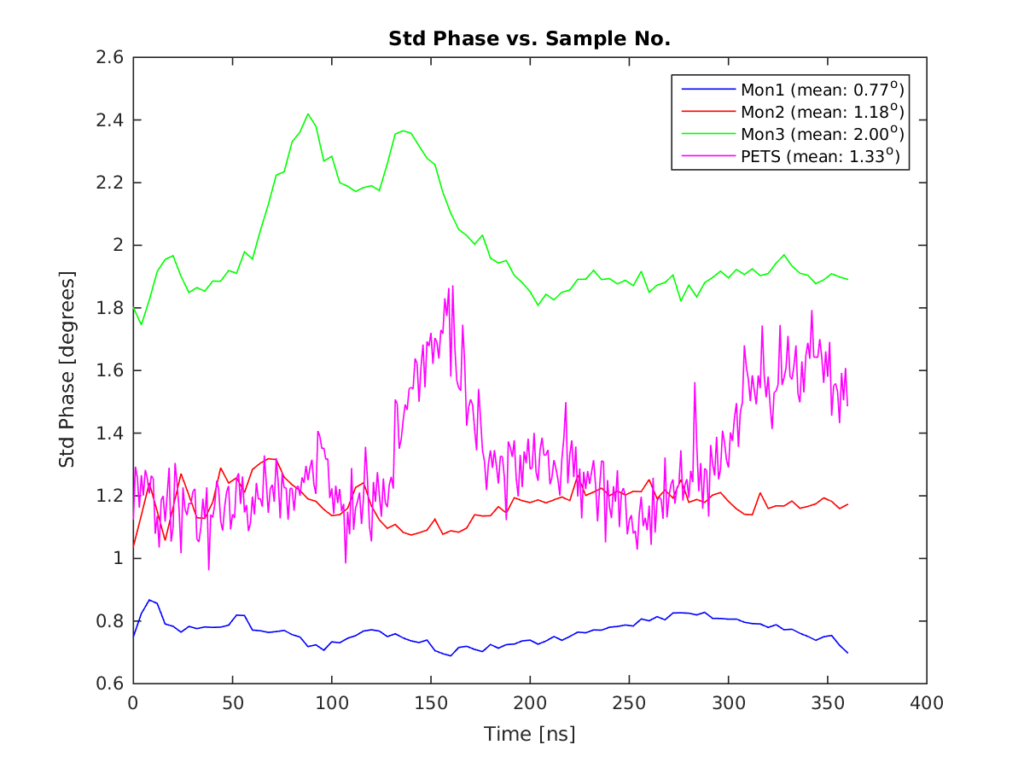
Phase Jitter Along the Pulse

Slide 10
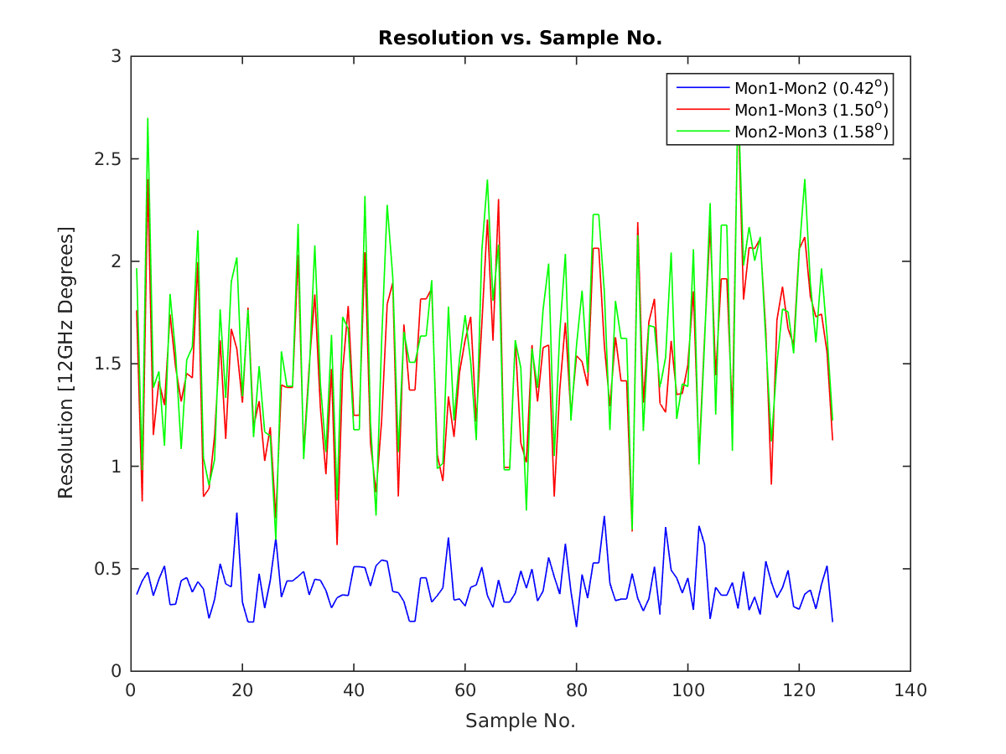
Resolution

Slide 11
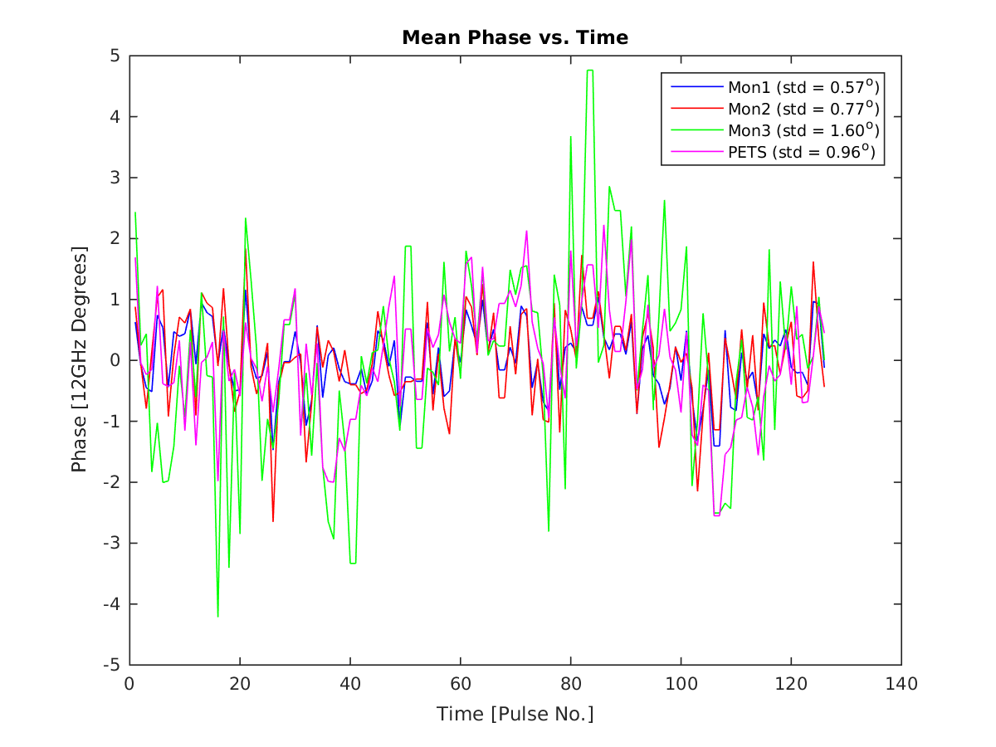
Mean Phase vs. Time

Slide 12
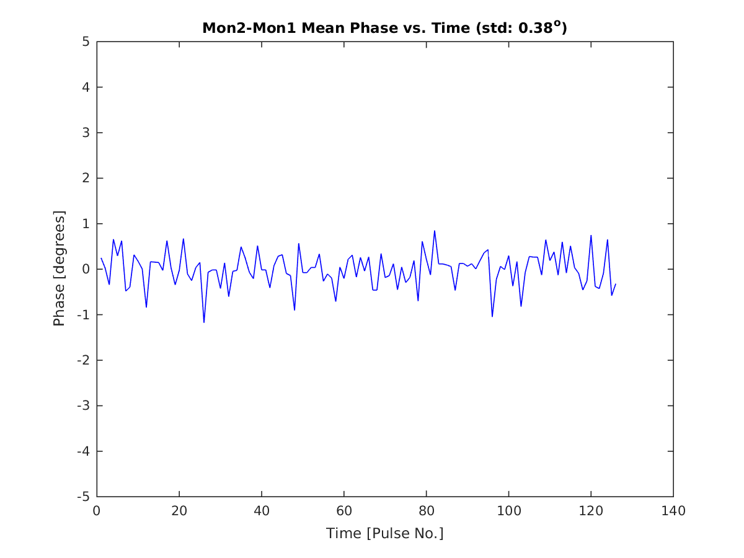
Mean Phase vs. Time: Mon2-Mon1

Slide 13
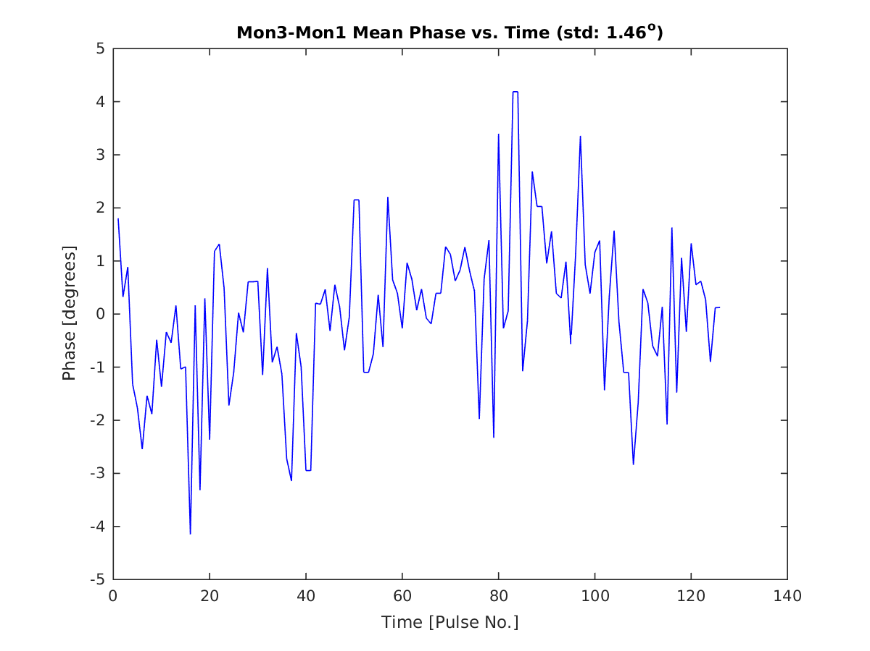
Mean Phase vs. Time: Mon3-Mon1

Slide 14
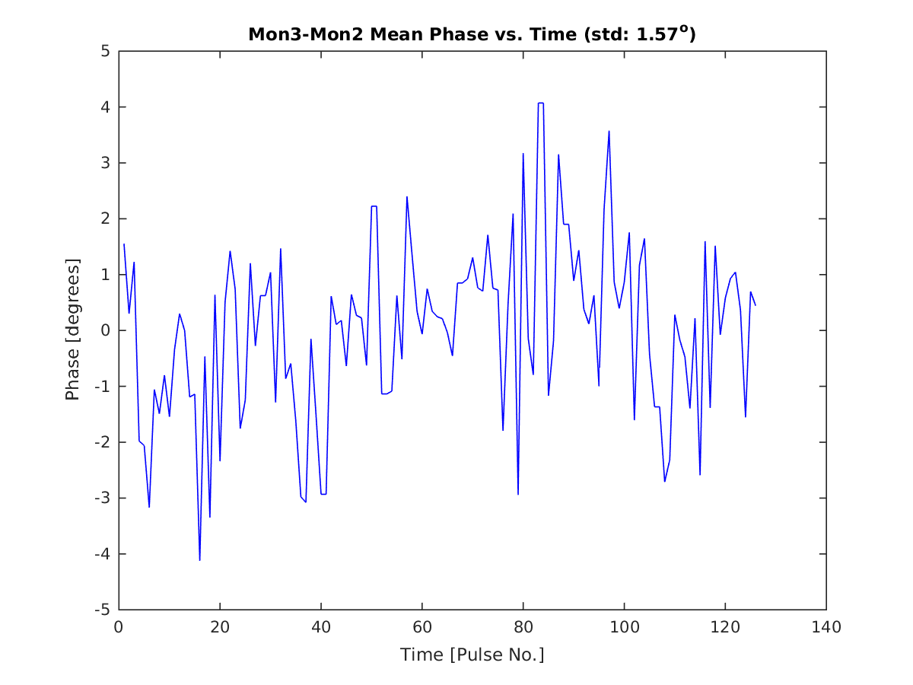
Mean Phase vs. Time: Mon3-Mon2

Slide 15
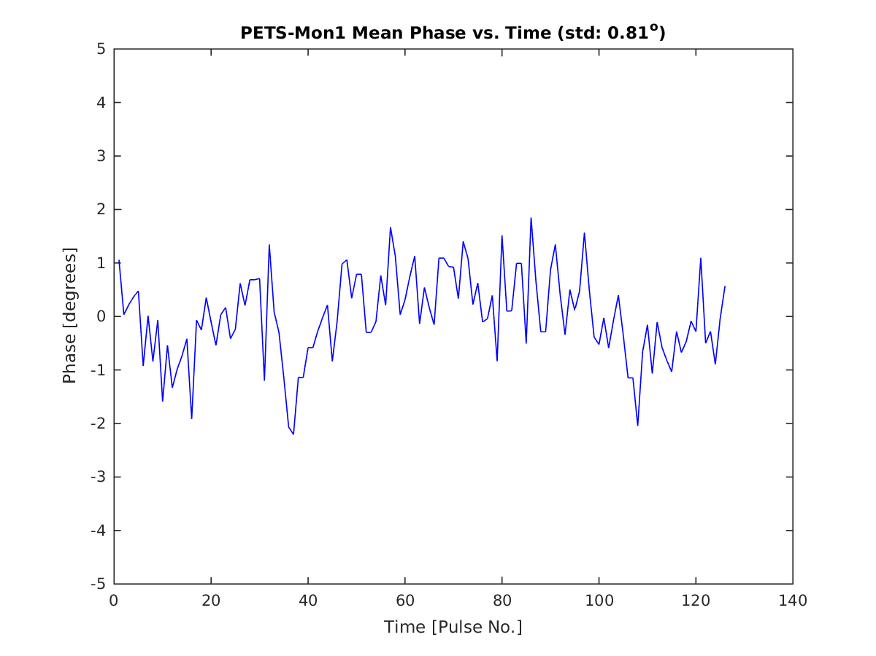
Mean Phase vs. Time: PETS-Mon1

Slide 16
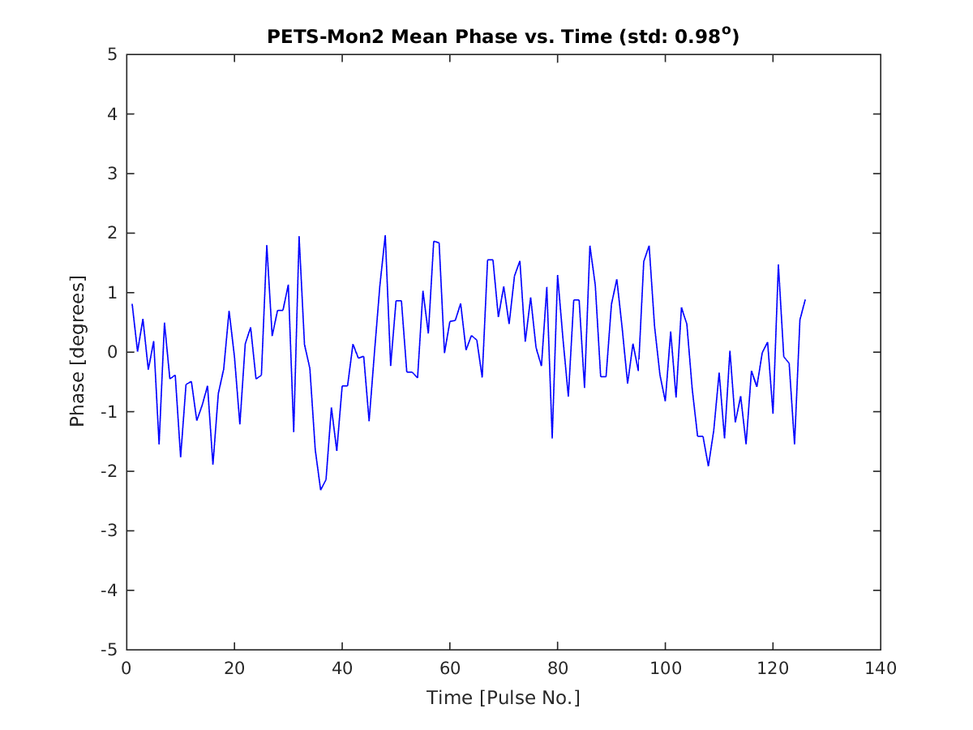
Mean Phase vs. Time: PETS-Mon2

Slide 17
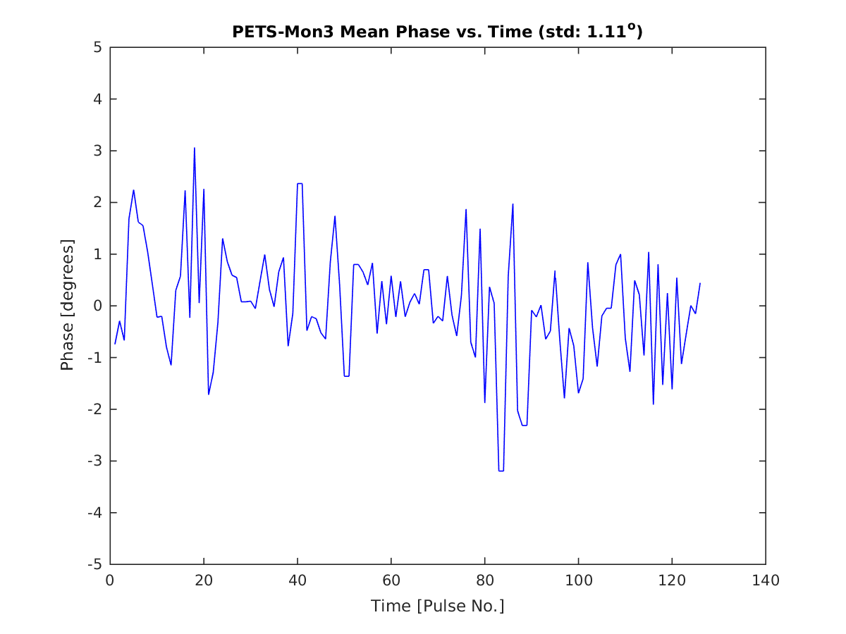
Mean Phase vs. Time: PETS-Mon3

Slide 18
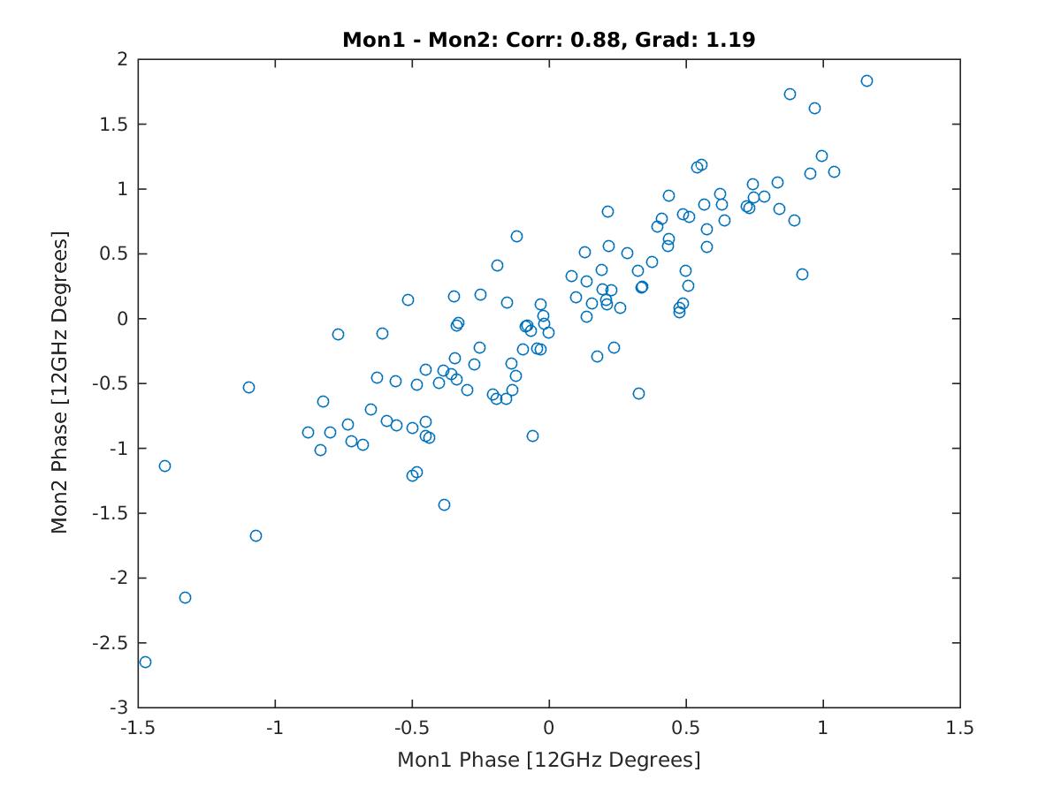
Correlation Mean Phase: Mon1-Mon2

Slide 19
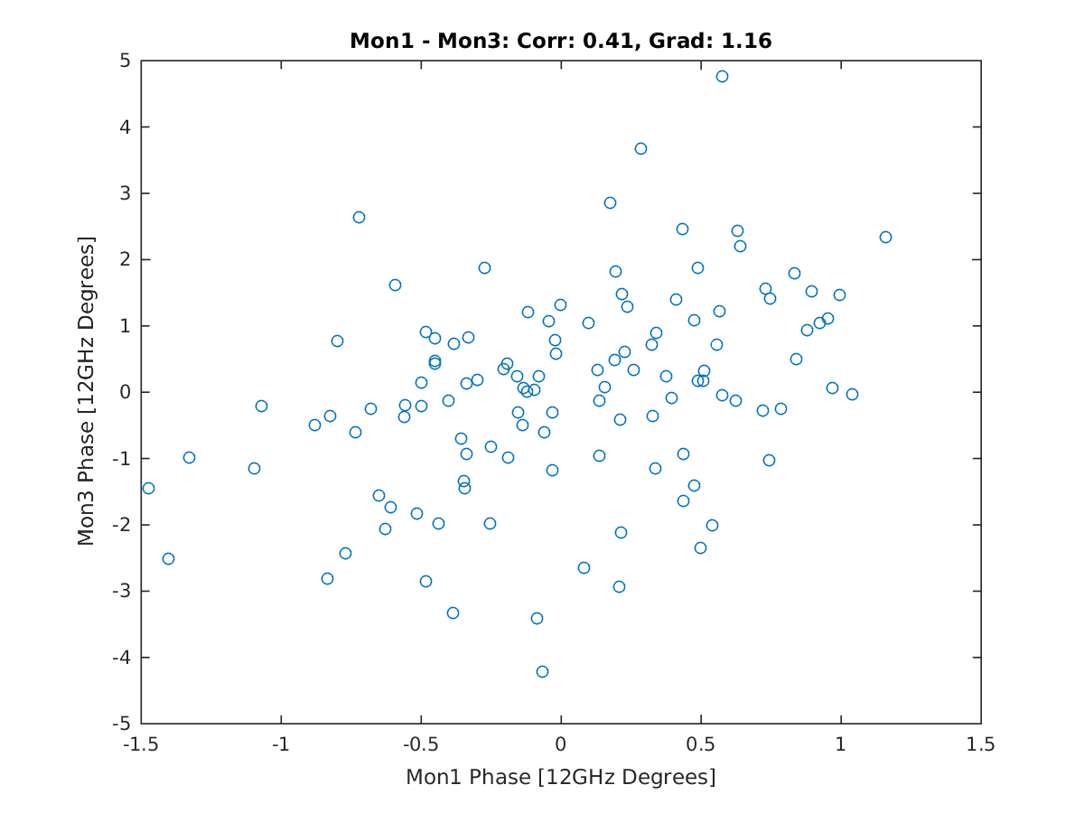
Correlation Mean Phase: Mon1-Mon3

Slide 20
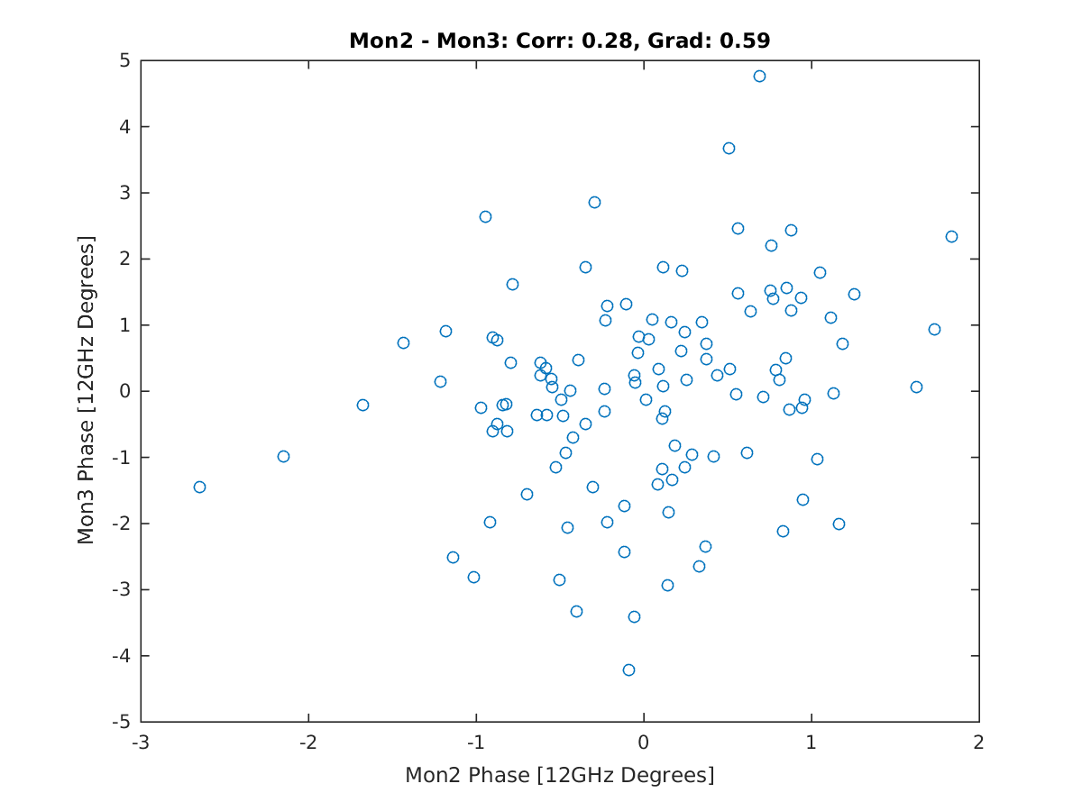
Correlation Mean Phase: Mon2-Mon3

Slide 21
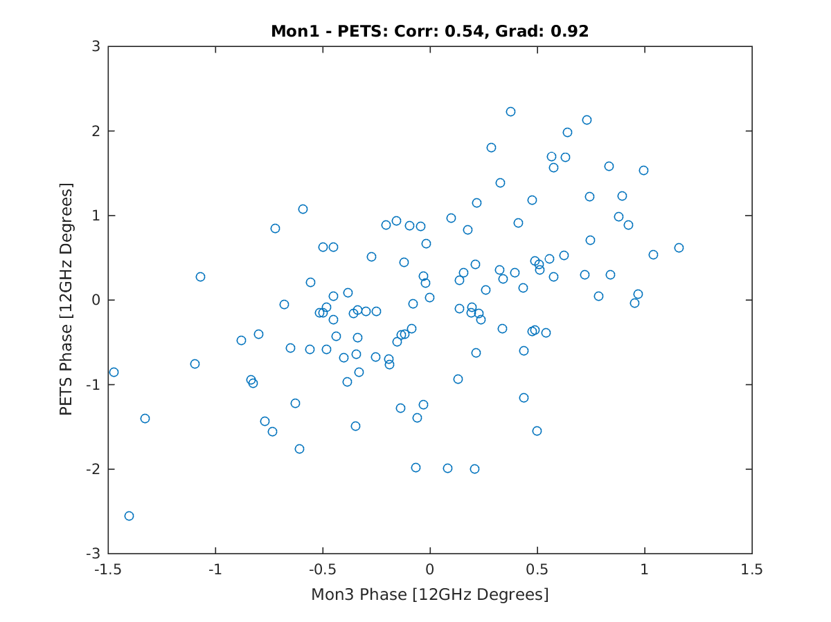
Correlation Mean Phase: Mon1-PETS

Slide 22
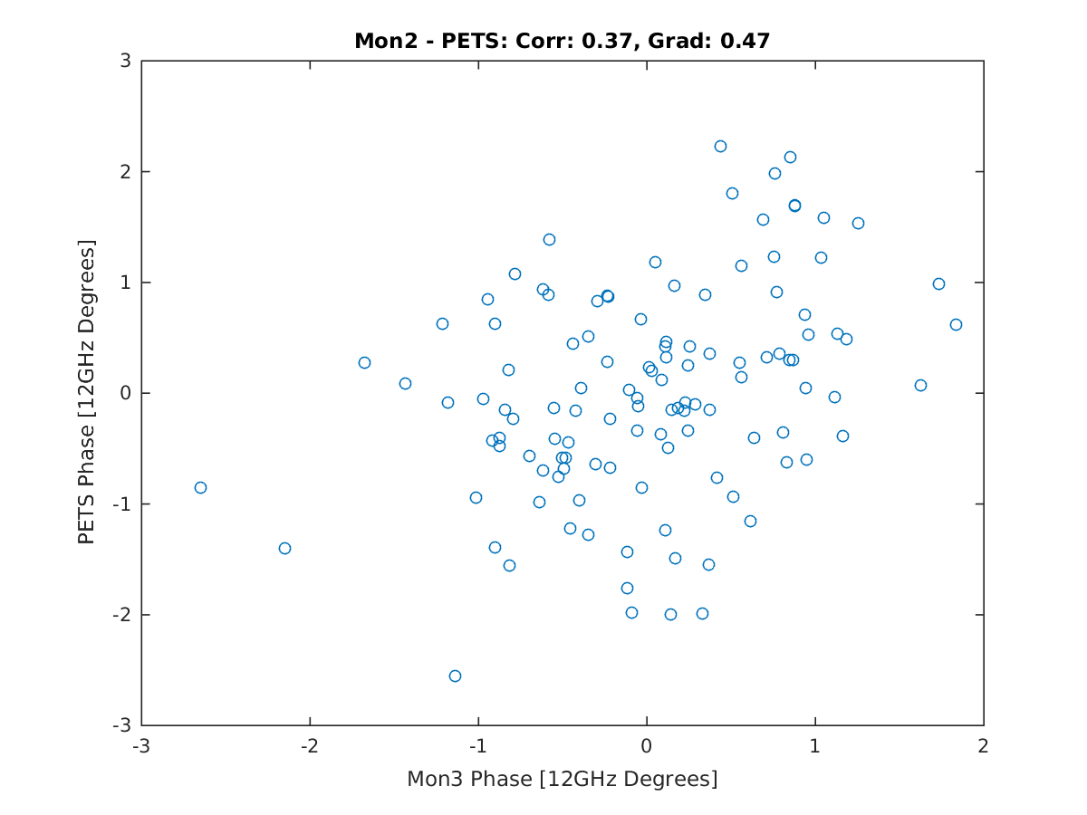
Correlation Mean Phase: Mon2-PETS

Slide 23
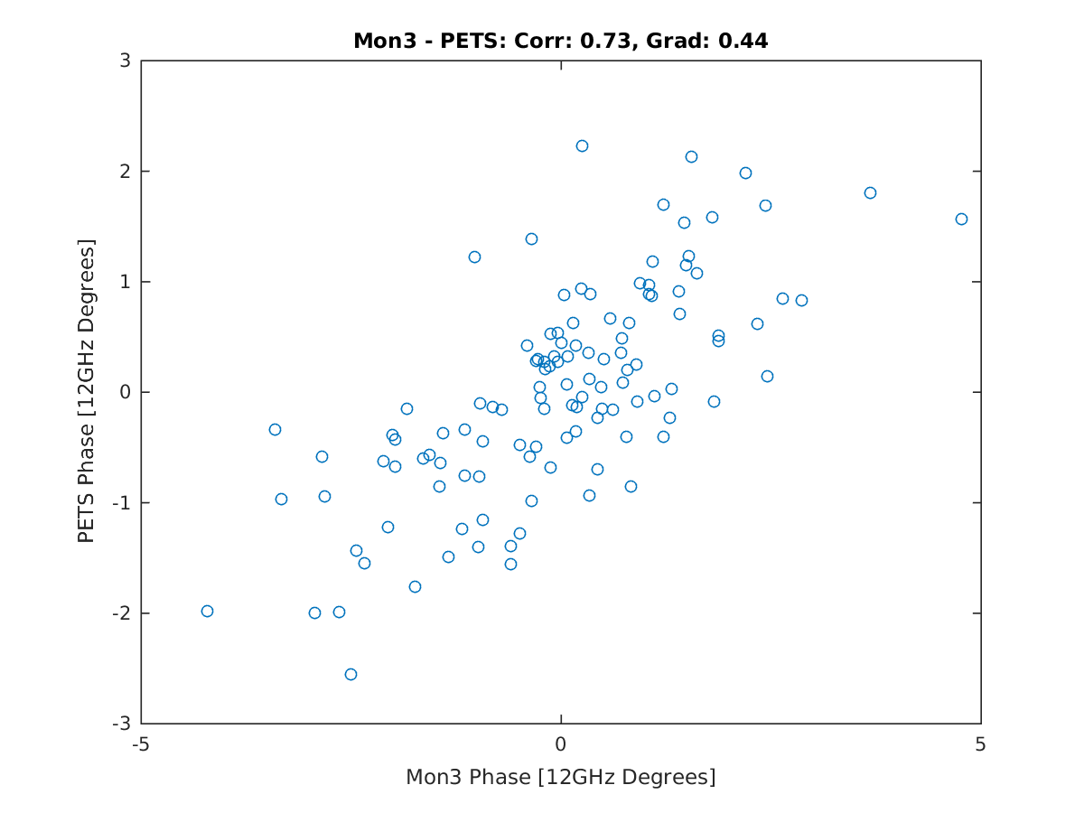
Correlation Mean Phase: Mon3-PETS

Slide 24
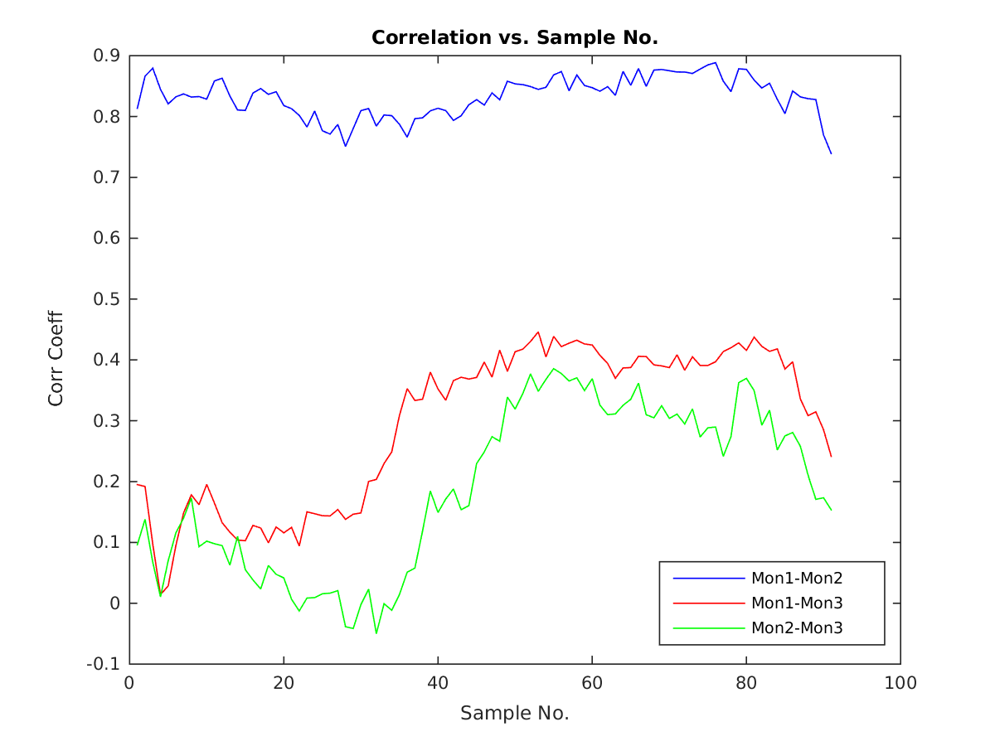
Correlation vs. Sample No.

Slide 25
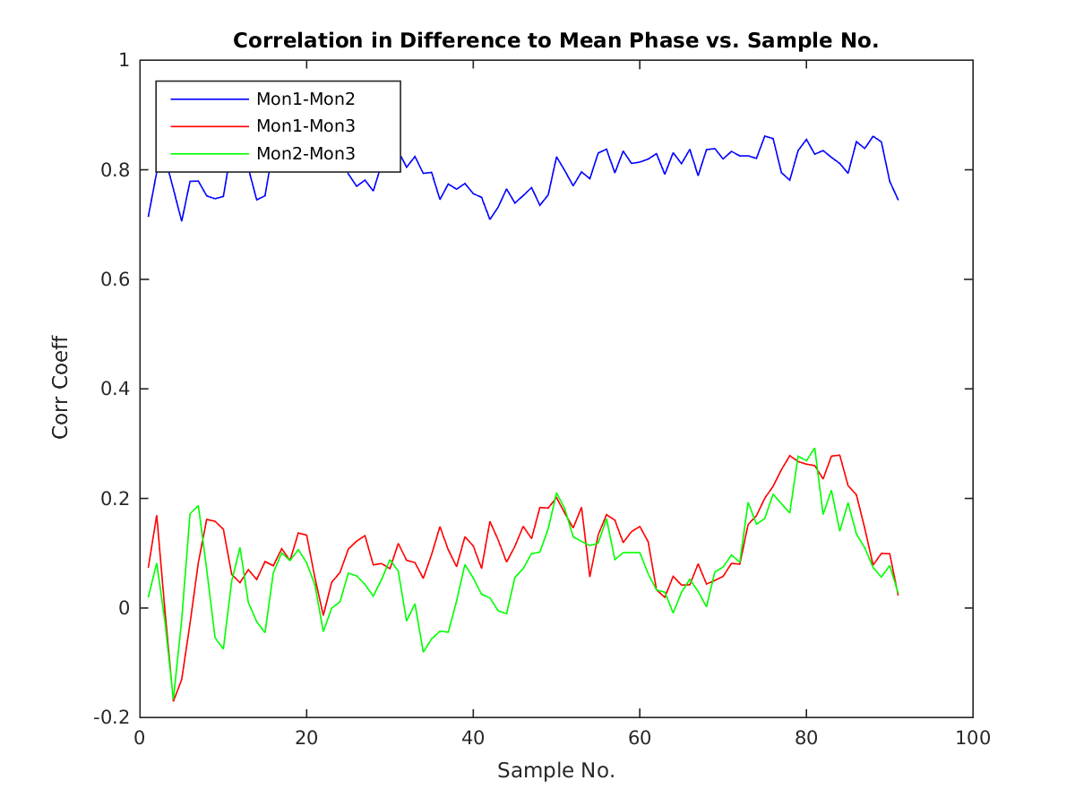
Correlation: Difference to Mean Pulse Phase

Slide 26
Relative Kicker Timing
(K1/K2 Trig Out Delay Scan)
Performed different configurations of constant kicks to identify the region in which we were kicking and to check whether K1 and K2 need different trig out times relative to each other.
Kick short pulse: Gated output from sample 375 to sample 435 on FONT5 board.
+/- 800 counts to use full range of amplifier.
Looking at one of the first BPMs after the chicane.

Slide 27
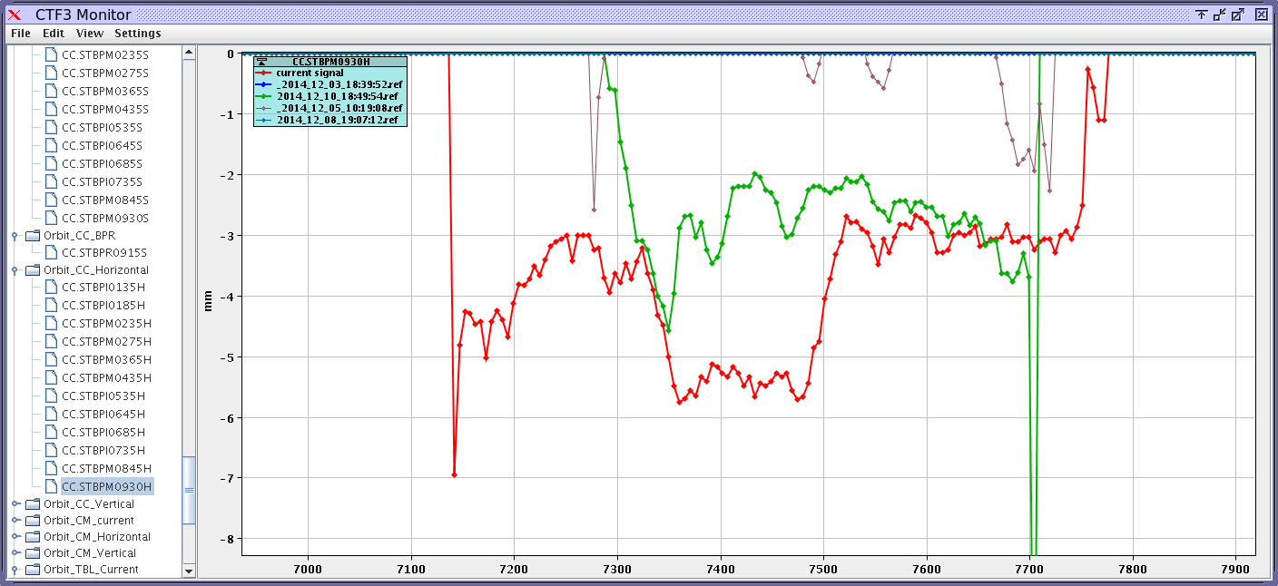
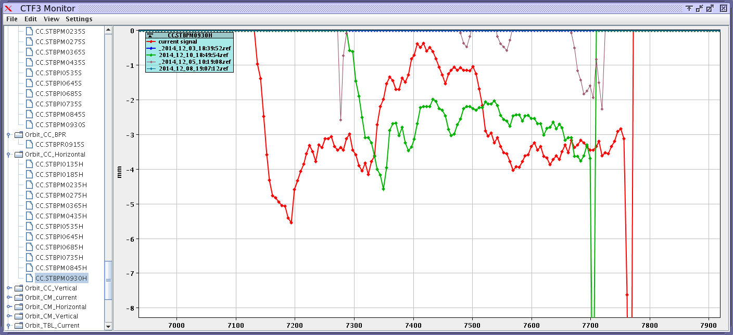
No Delay, both kicks same direction
NO CORR
Both Kicks +
Both Kicks -

Slide 28
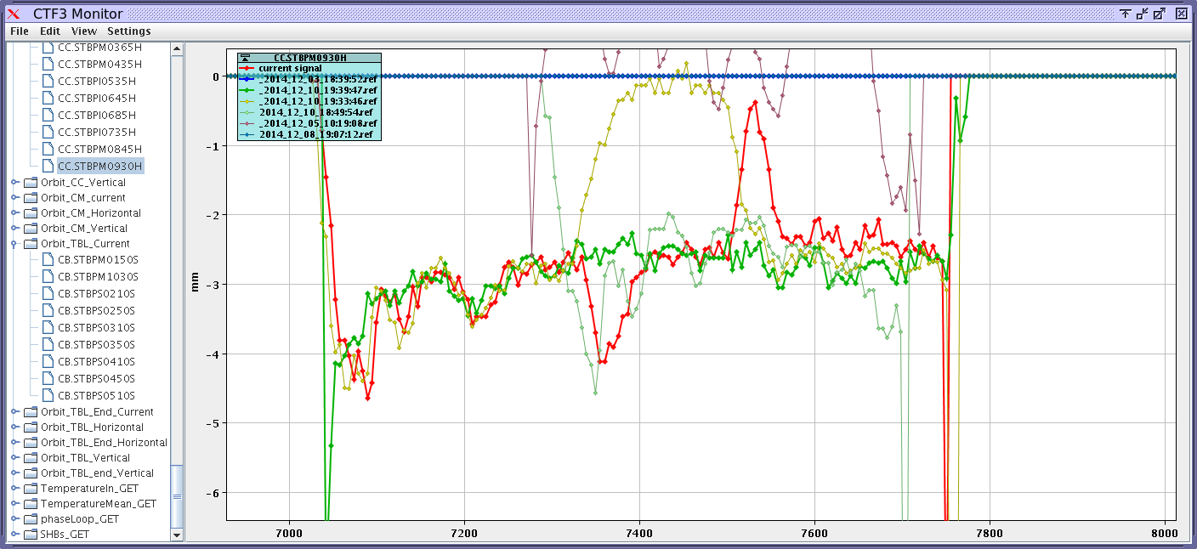
Opposite Kicks, K1delay=0, K2delay=28ns

Slide 29
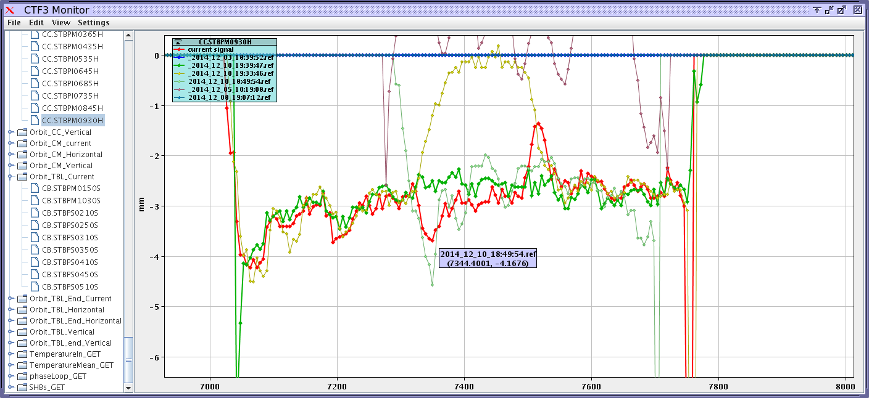
Opposite Kicks, K1delay=0, K2delay=14ns

Slide 30
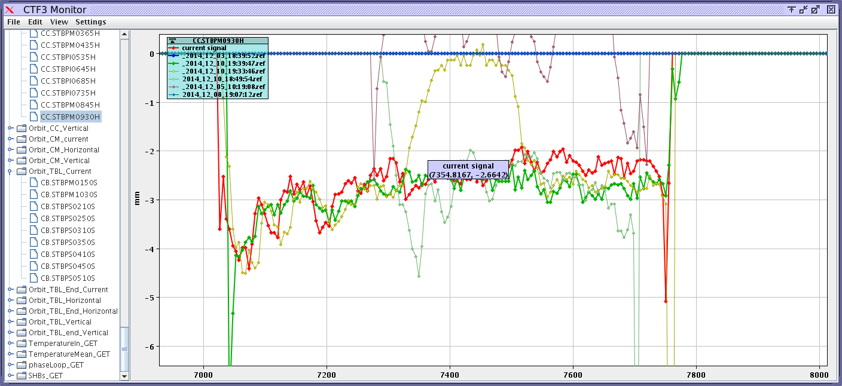
Opposite Kicks, K1delay=0, K2delay=5.6ns

Slide 31
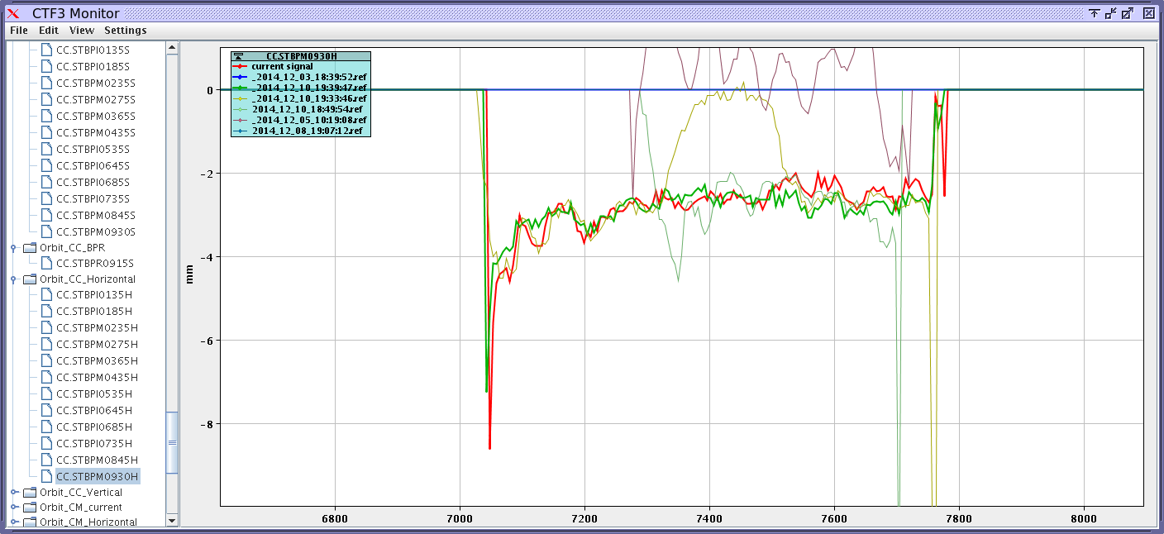
Opposite Kicks, K1delay=0, K2delay=0
Probably the best, so the difference in cable lengths is now the same as the difference in the beam time of flight between the two kickers (at least within 2 samples = 5.6ns).
N.B. Earlier tests suggested we needed a stronger kick from the 2nd kicker to close the orbit. Here equal magnitudes is ok.

Slide 32
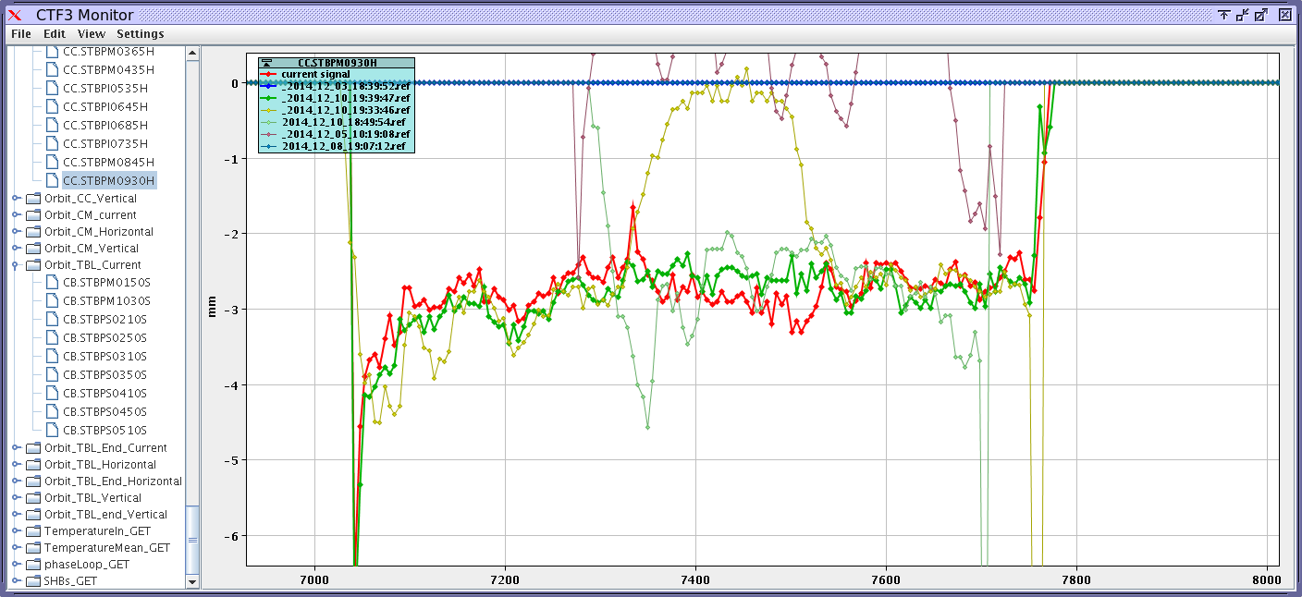
Opposite Kicks, K1delay=5.6ns, K2delay=0

Slide 33
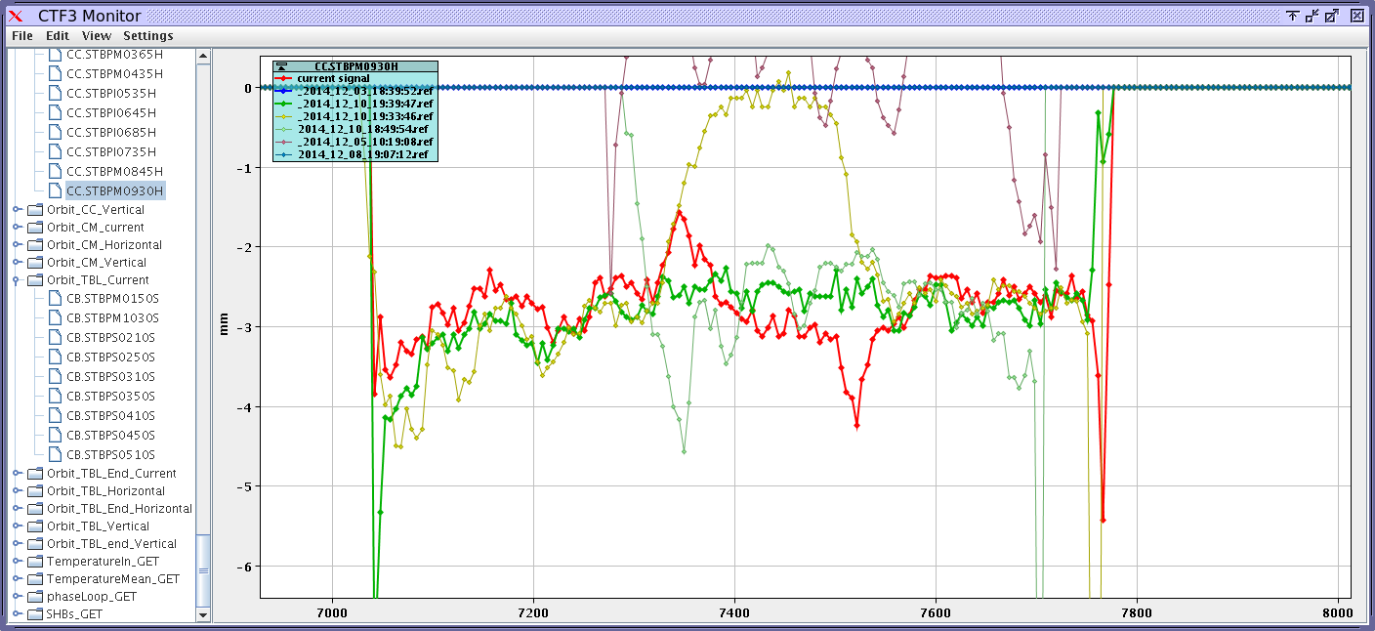
Opposite Kicks, K1delay=14ns, K2delay=0

Slide 34
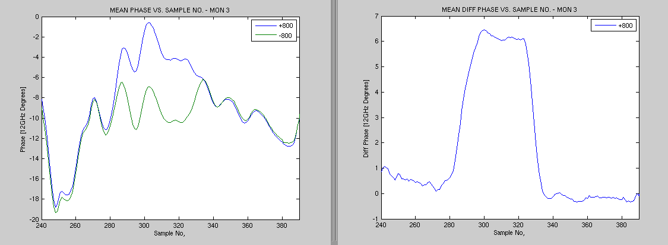
Constant kick as seen in the 3rd Phase Monitor
Using the same setup as before for the relative timing tests (gate sample 375 to 435 on FONT5 board).
Sample range (on SiS) of flat top is: ~300 to 323.
Sample range (on SiS) from/to switch on/off time is: ~279 to 333 .
Range of kick is +/- 3 degrees (6 degree diff between max and min). Expect roughly +/-2.5 degrees from model and current amplifier power.

Slide 35
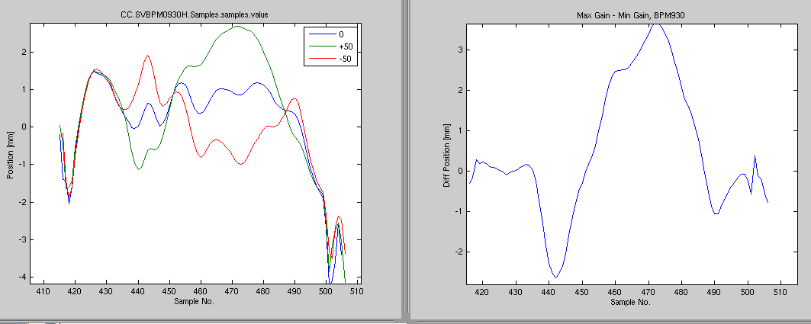
Response to FF Kick in BPMs: 1st Kicker

Slide 36
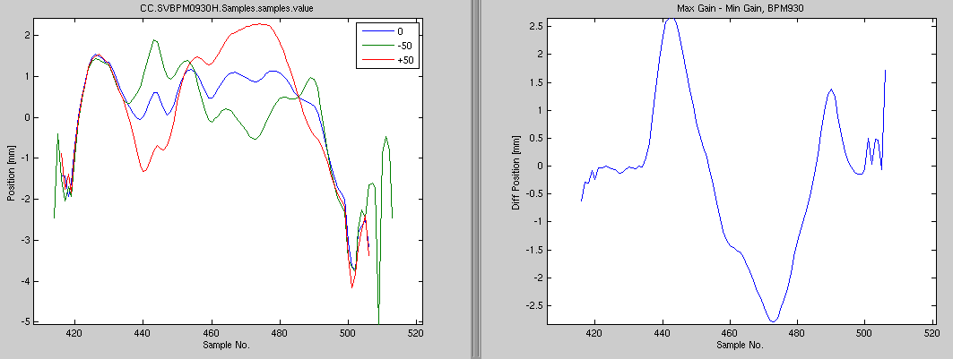
Response to FF Kick in BPMs: 2nd Kicker

Slide 37
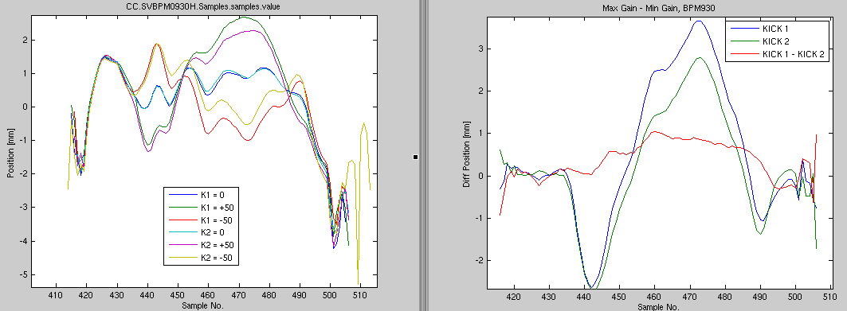
Response to FF Kick in BPMs: Both Kickers

Slide 38
Feedforward Gain Scan (10th Dec)
Using the same portion of the pulse as just shown for the constant kick/timing tests.
Feedforward tests with different gains (-63,
-40, -20, 0, +20, +40 and +63).
Phase units are just counts on SiS digitiser (mixer channel only) in these plots.
Correlations are between monitor 2 (end linac, noisier measurement) and monitor 3 (in CLEX, after chicane). Monitor 1 connected directly to FONT5 board as FF input.

Slide 39
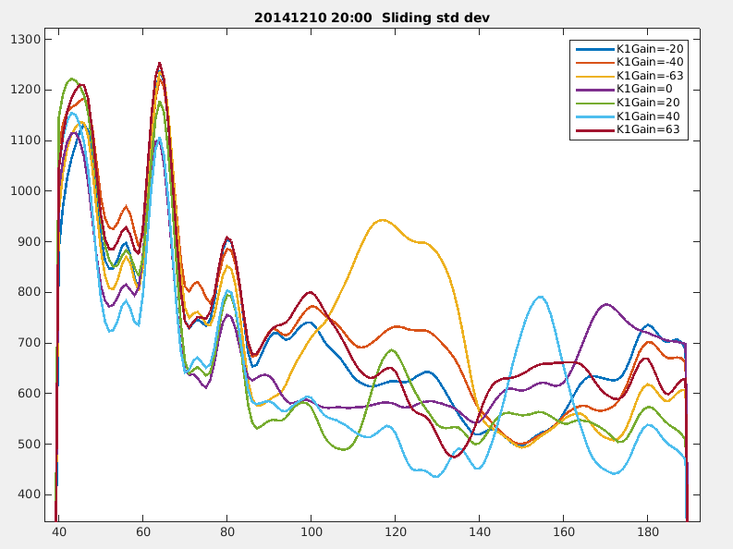
Phase Jitter within the Pulse
Variation of jitter in the correction region looks promising.
But note differences outside the correction region.
Approx. correction region.

Slide 40
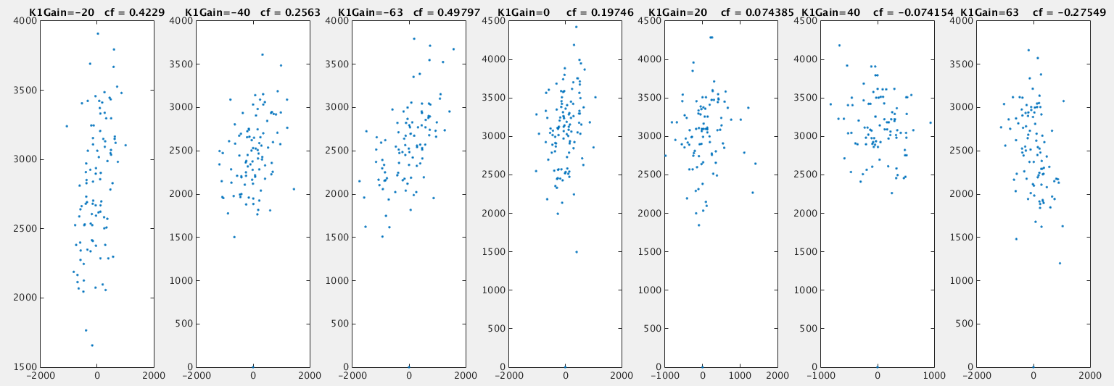
Mean Phase Correlation Plots
-20
-40
-63
0
+20
+40
+63
GAIN
Correlation becomes anti-correlation as we change the gain.

Slide 41
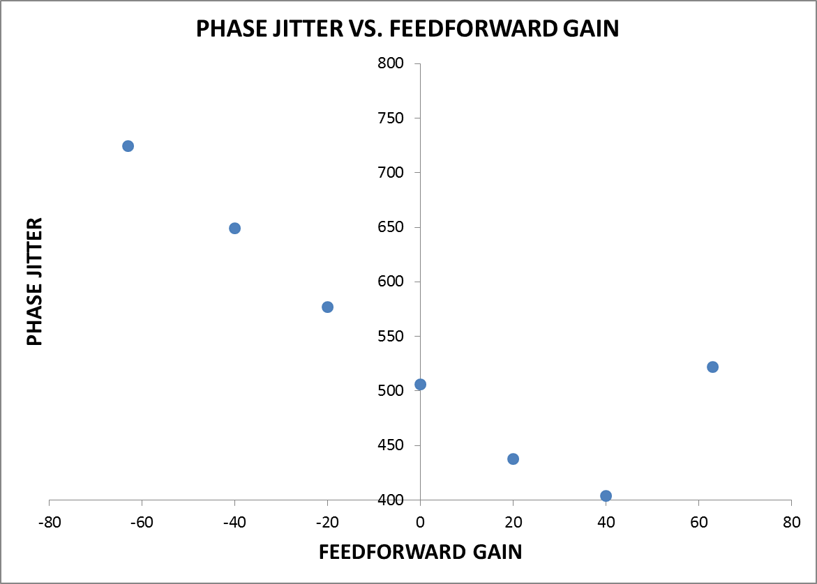

Slide 42
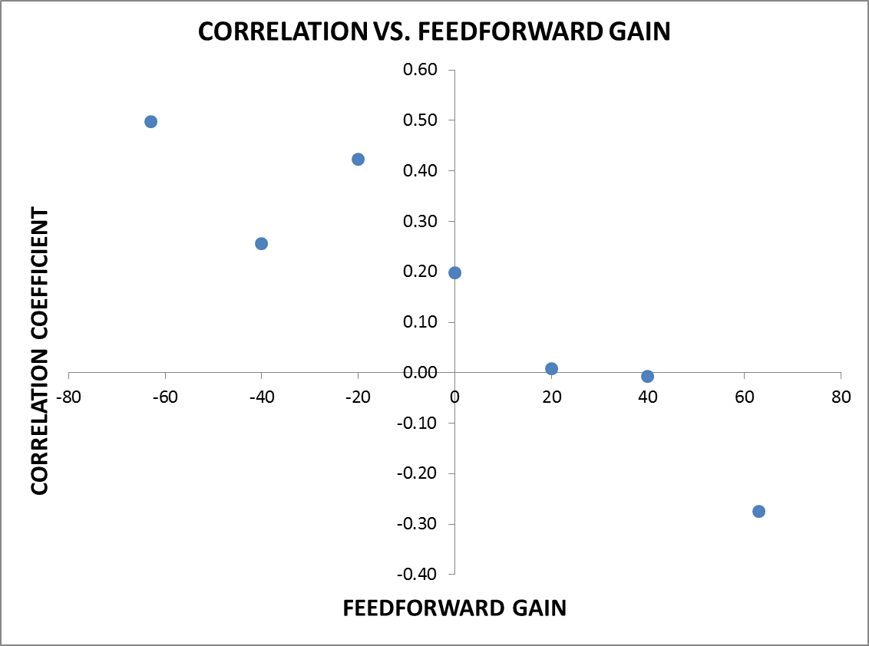

Slide 43
Gain Scan Results Table
Gain | STD | CORR
-63 | 725 | 0.50
-40 | 649 | 0.26
-20 | 577 | 0.42
0 | 506 | 0.20
+20 | 438 | 0.01
+40 | 404 | -0.01
+63 | 522 | -0.28
~45% reduction in jitter with a gain of +40 and removal of correlation.
My only slight concern would be whether it’s too good to be true considering how weak the correlation is with 0 gain.

Slide 44
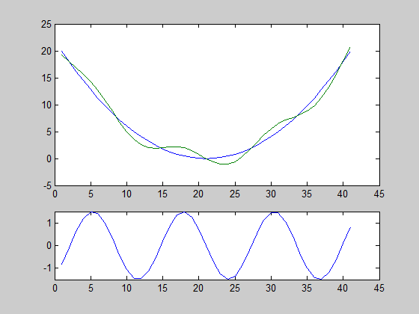
Wiggling Phase of Klystrons
Various tests wiggling the phase of one or both of the first two klystrons in an attempt to create a correlated phase jitter.
One example shown in the following slides: 2nd Klystron (MKS-3) waveform (within the pulse) wiggled with time.
Similar to animation but we used a saw tooth rather than a sine offset.

Slide 45
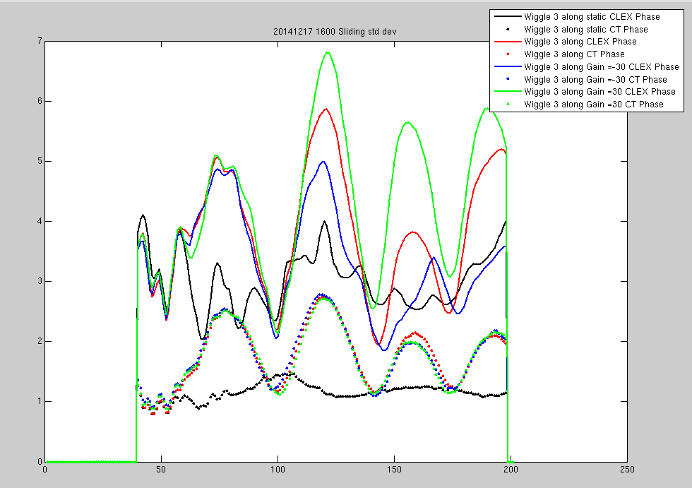
Wiggle Along 3: Phase Jitter
1st Peak
2nd Peak
3rd Peak
Correction region

Slide 46
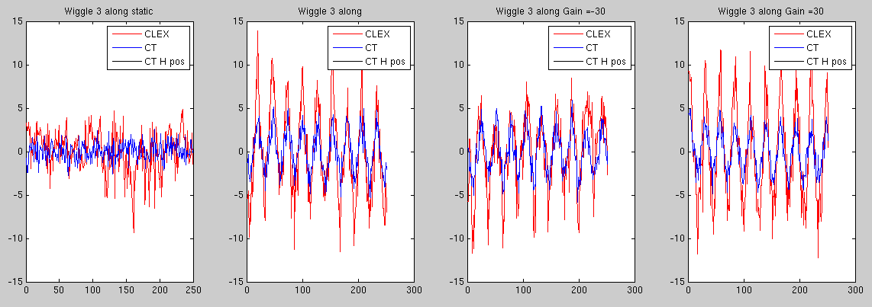
Mean Phase: 1st Corrected Peak

Slide 47
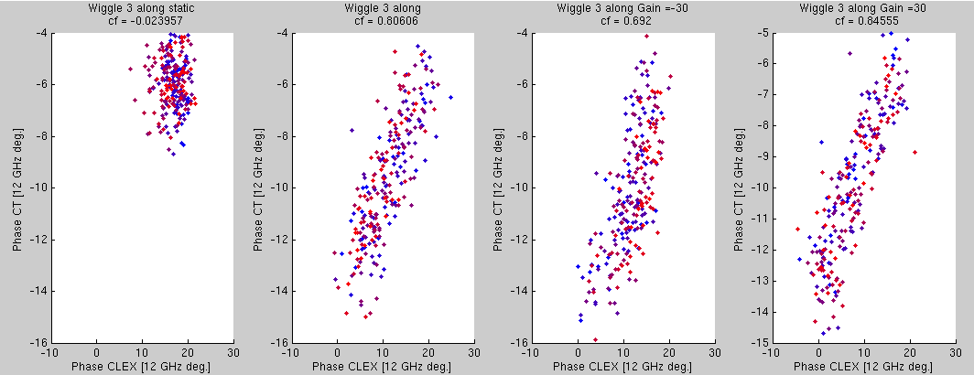
Correlation: 1st Corrected Peak

Slide 48
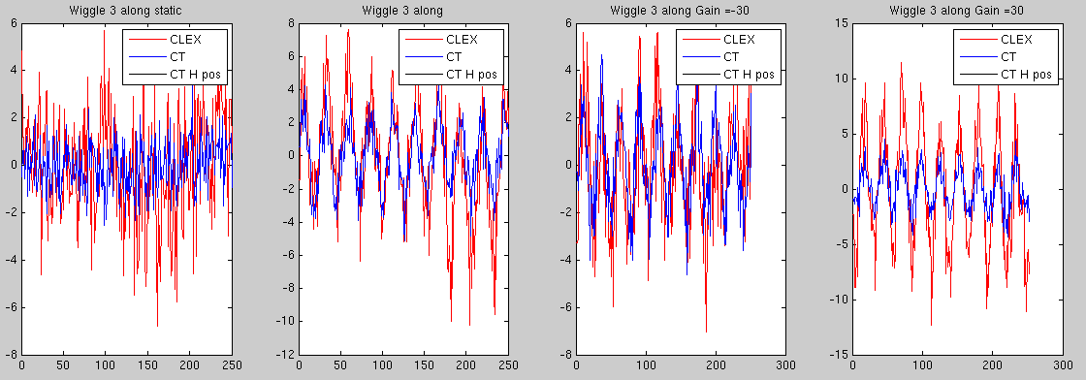
Mean Phase: 2nd Corrected Peak

Slide 49
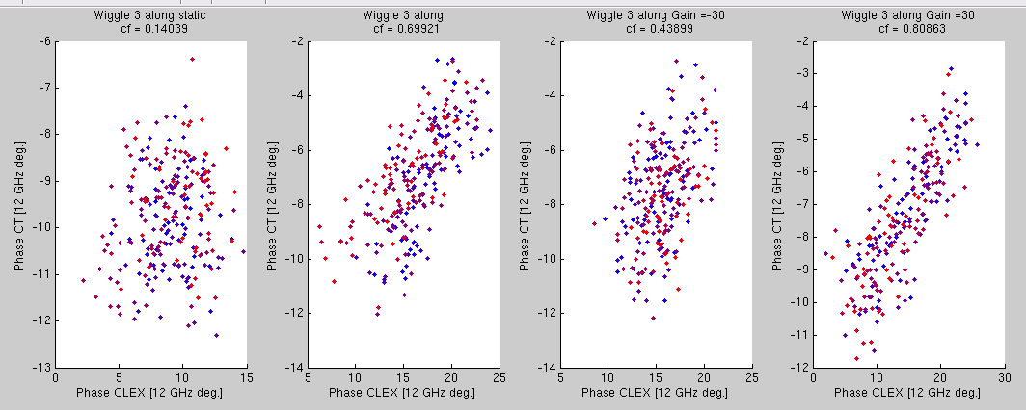
Correlation: 2nd Corrected Peak

Slide 50
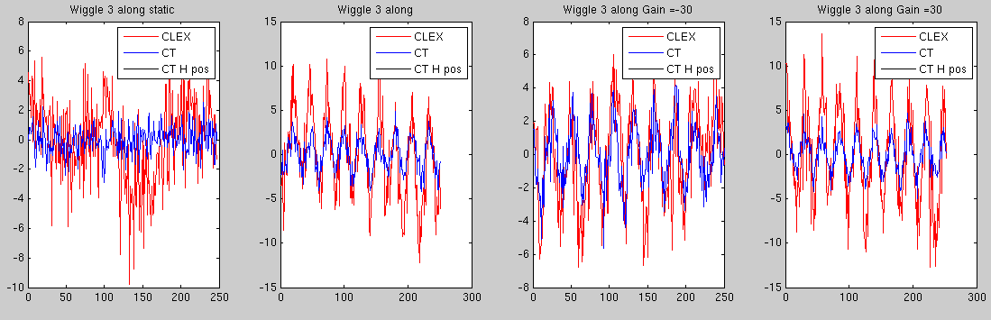
Mean Phase: 3rd Corrected Peak

Slide 51
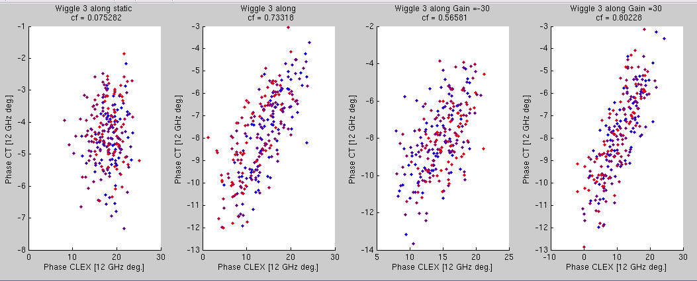
Correlation: 3rd Corrected Peak

Slide 52
Summary
We’ve managed to demonstrate the effect of the feedforward system on the phase – both in terms of reducing/amplifying correlation and jitter.
The propagation in phase between the upstream and downstream monitors is 70% at best and often half that.
  We can influence (but not necessarily greatly improve) it by varying the R56 in TL1, see 12th Dec presentation for initial results.
  We did manage to boost the correlation by wiggling klystrons.
  First look at sample by sample correlations didn’t reveal a hidden part of the pulse that is well correlated.
No beam until March/April now.
  Lots of data to analyse.
  Acquisition tools to get ready.
Merry Christmas!

