Slide 1
IP BPM Shift Report
FONT Meeting: 22 December 2014
Talitha Bromwich

Slide 2
18/12 Swing Shift
- X-alignment scans
- Minimised jitter at IPB(Y) – originally planned to compare with IPC(Y)
- AY, EY, Coup2 scans
- Calibration v charge on IPB(Y)
- Calibration constant and jitter v attenuation on IPB(Y)
- Pitch and horizontal motion scans (by Oscar) on IPB(Y)
19/12 Day & Swing Shift
- BPFs to remove static signal
- Feedback setup & kicker calibrations
- Feedback at 10dB and 0dB
- Feedback QD0FF waist scan
- Static K1 B2 Offset “banana” scan

Slide 3
18/12 Swing Shift
X-alignment scans (20dB – integrating samples 66 to 72)
IPA(X) centered at 3.16 V
IPB(X) centered at 2.42 V
IPC(X) centered at 6.37 V
Minimised jitter at IPB(Y) (to compare with IPC(Y))
274 nm at 20 dB and 10 dB
Little tuning → large beam → large jitter
Abandon plans to measure IPC(Y)
Some confusion setting the attenuation correctly on ATF interface
Scanned AY, EY, Coup2 to reduce jitter to 252 nm
Only AY generated any improvement

Slide 4
Scans of QD0FF current to reduce jitter – 274 nm minimum

Slide 5
Scans of AY, EY, Coup2 to reduce jitter – 252 nm minimum

Slide 6
18/12 Swing Shift
Calibration v charge
Calibration constant changed from 0.24 to 0.20 (ADC/ADC)/um across charge range of 0.17 to 0.76 x 10¹⁰ /pulse.
Much less variation than observed in October.
Jitter remains within 264 to 294 nm at all calibrations.
Calibration constant and jitter v attenuation (charge constant)
0 dB to 50dB, with range and step size scaling with attenuation.
50dB resolution-limited jitter 2.7um. 0dB jitter 267nm.
(Data taken with simultaneous modified Python script recording cbpm:xpos and cbpm:ypos)
Pitch and horizontal motion scans (by Oscar) on IPB(Y)

Slide 7
19/12 Day & Swing Shift
BPFs to remove static signal
Tauchi-san suggested adding a 714 +/– 10MHz band pass filter to remove the static signal in the IP BPM signals.
Tested with IPB(Y) and successfully removed the high frequency static component → applied BPF to IPA(Y), IPB(Y) and IPC(Y) instead of delay cables.

Slide 8
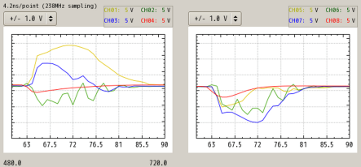
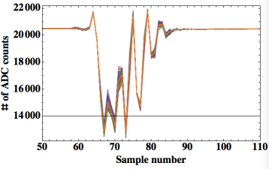
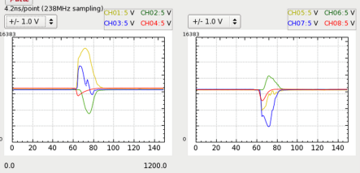
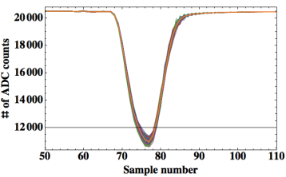
BPFs to remove static signal
Plots by Siwon

Slide 9
19/12 Day & Swing Shift
Feedback Setup and Kicker Calibrations
Font 5 Board #1 Serial port pin damaged.
Solution: Carefully bent it back, plan to replace serial port with spare next time at ATF. Could not bring FONT5 board #1 as it did not pass radiation test. FONT5A board did pass radiation test and brought back.
IPC(Y) 0 degree (I) signal is very messy – two peaks?
Solution: None. Did not use IPC for feedback.
Bunch spacing 215.6 ns, slightly larger than before.
Solution: two bunches displays for P1 and P2, not MFB1FF. Longer bunch spacing desirable to meet IP feedback latency requirement.
Intensity monitor signal arrives too soon because it is not processed through the mixer. Solution: Add 5 m delay cable.
Timing problem with 2 bunch mode after beam restart.
Solution: Adjusted using Terunuma-san’s specs.

Slide 10
19/12 Day & Swing Shift
First Feedback Run at 10dB
Gains for I and Q calculated from gradient of kicker calibration and theta from IPB(Y) calibration. Gain I = –529. Gain Q = 327.
(1) Feedback Run: Kicker is centering the beam.
Jitter feedback off = 190 nm. Jitter feedback on = 220 nm.
Therefore, not correcting the jitter.
Feedback off bunch-to-bunch position correlation = 43% at IPB.
(2) Repeat feedback run, exactly same gains:
Jitter feedback off = 190 nm. Jitter feedback on = 210 nm.
(3) Two-point latency scan: the following kicker scans gave the same gradient:
- using correct bunch strobe settings (77 bucket bunch spacing)
- using bunch 1 setting before bunch 1 data
Therefore, not latency limited at 77 bucket bunch spacing.

Slide 11
19/12 Day & Swing Shift
Second Feedback Run at 0dB
Gain I = –175. Gain Q = 81.
(1) Feedback Run: Kicker is centering the beam.
Jitter feedback off = 190 nm. Jitter feedback on = 150 nm.
Feedback off bunch-to-bunch position correlation = 52% at IPB.
(2) Repeat run with Q and I minimised using AQF7FF and AQD0FF.
Jitter feedback off = 200 nm. Jitter feedback on = 130 nm.
Feedback off bunch-to-bunch position correlation = 79% at IPB
(3) Feedback over QD0FF waist scan:
Jitter feedback 390 to 94 nm at 137.4 A: best feedback-on jitter.
Note that waist is around 136.8 A.
(4) Feedback using ‘banana correction’
Jitter feedback 410 to 67 nm. Note that beam drift not subtracted.

Slide 12
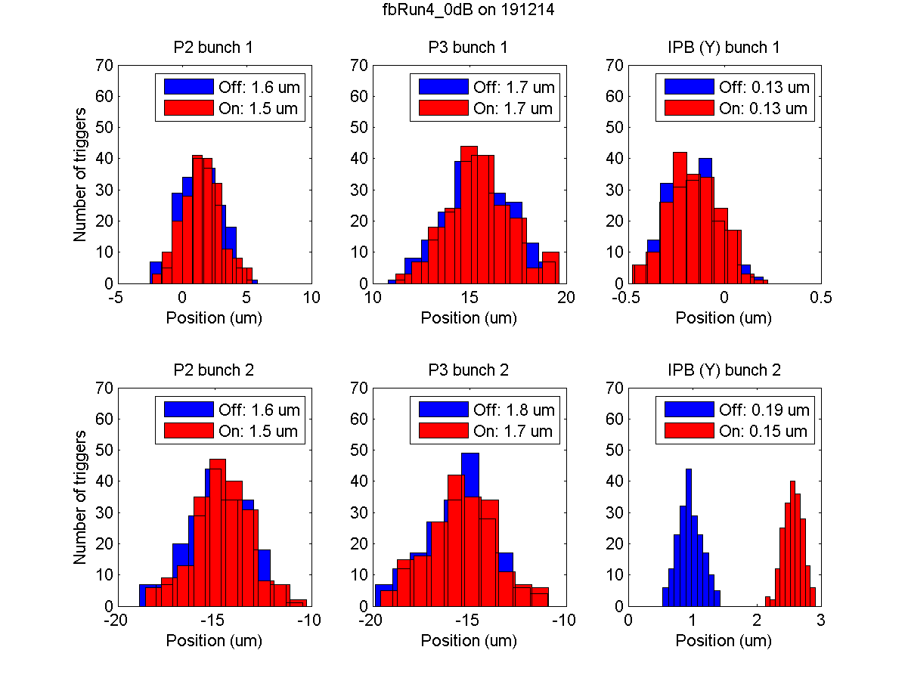
Second Feedback Run at 0dB (1) 52% correlation
Plots by Neven

Slide 13
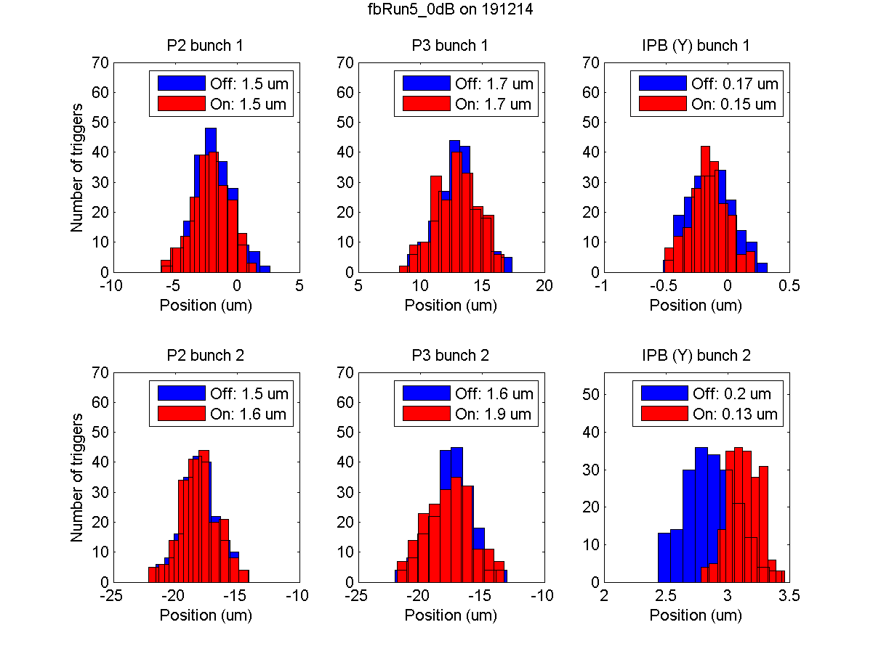
Second Feedback Run at 0dB (2) 79% correlation
Plots by Neven

Slide 14
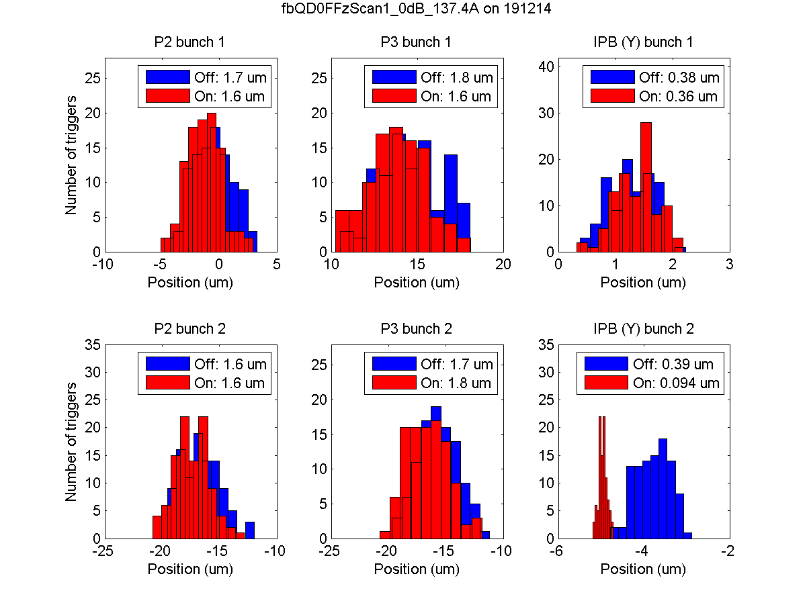
Second Feedback Run at 0dB (3) 137.4 A at QD0FF
Plots by Neven

Slide 15
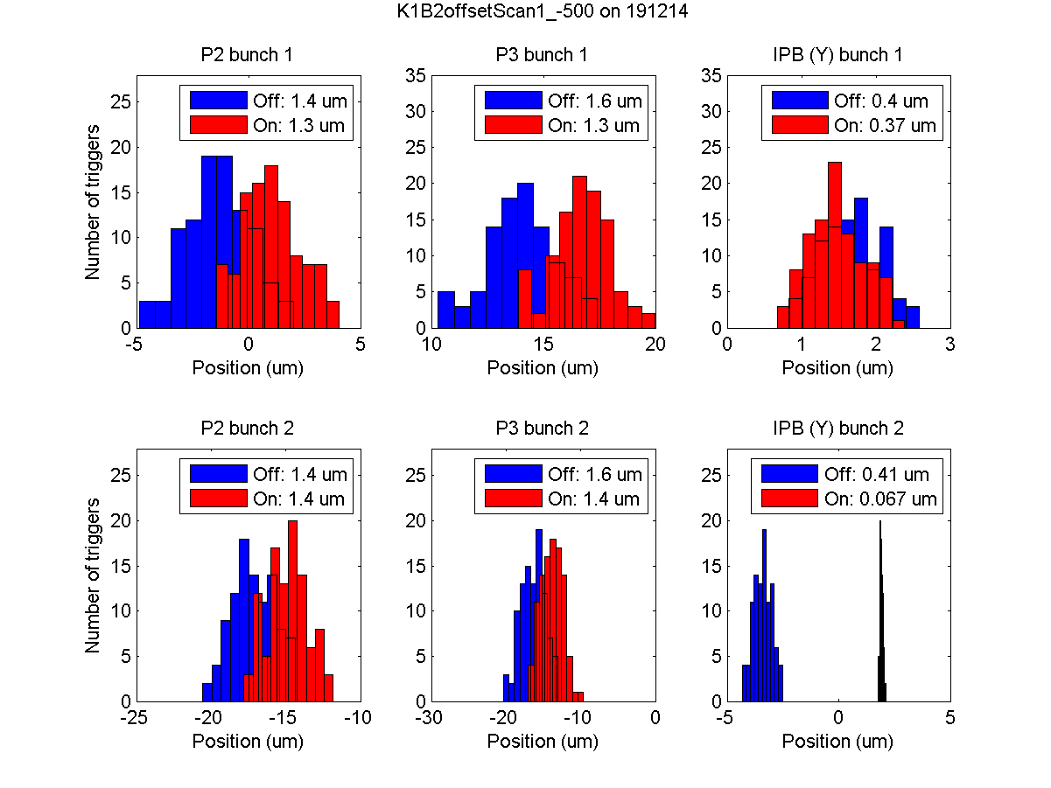
Second Feedback Run at 0dB (4) ‘banana’ correction
Plots by Neven

