Slide 1
IP BPM resolution and feedback scans
N. Blaskovic
N. Blaskovic

Slide 2
Contents
Nominal optics
  Jitter vs. attenuation, extrapolation to 0 dB
High β optics
  Jitter vs. attenuation
  3 BPM resolution vs. attenuation
IP feedback
  Position vs. trigger for best feedback run
  Position & jitter over QD0FF current scan
  Position & jitter over K1B2 offset scan
N. Blaskovic

Slide 3
Nominal optics
Plots from data on 18 Dec 2014:
  Calibration constant vs. attenuation
  Jitter vs. attenuation
Notes:
  Without 714 ± 10 MHz filter on IPB(Y) between Honda’s first and second stage
  IP ICT is 0.65 x 10¹⁰
  Jitter calculated with 10 sample averaging (samples 66 to 75)
N. Blaskovic

Slide 4
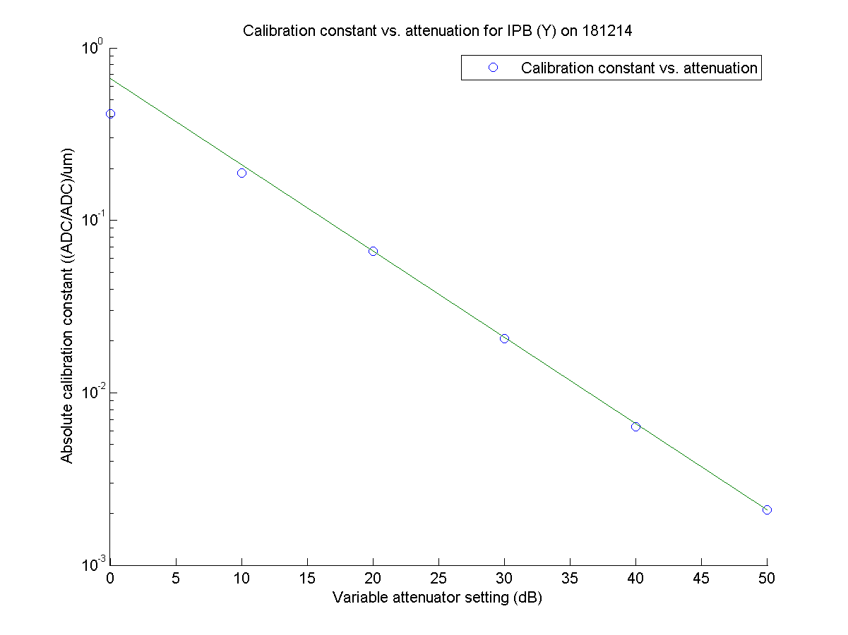
N. Blaskovic

Slide 5
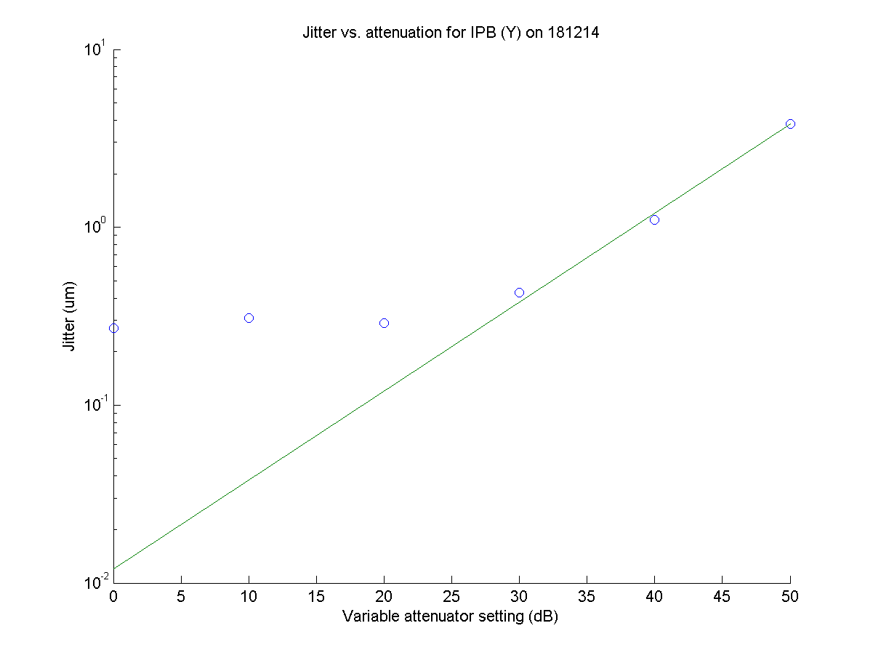
12 nm
N. Blaskovic

Slide 6
Nominal optics
Calibration constant scales well but not perfectly with attenuation
Real beam jitter likely to be > 200 nm as beam not tuned (after extraction kicker recovery)
Assuming jitter at 50 dB is resolution, extrapolated resolution at 0 dB is 12 nm at 0.65 x 10¹⁰ charge
N. Blaskovic

Slide 7
High β optics
1000 β_{y} optics (‘pencil beam’) at IP
All 3 IP BPMs instrumented in y only
Plots from data on 11 Dec 2014:
  Jitter vs. attenuation
  3 BPM resolution (by fitting) vs. attenuation
N. Blaskovic

Slide 8
High β optics
Notes:
  Without 714 ± 10 MHz filter on IPB(Y) between Honda’s first and second stage
  IP ICT is 0.4 x 10¹⁰
  Jitter calculated with 10 sample averaging (samples 51 to 60)
  Includes pedestal subtraction and empty trigger rejection
N. Blaskovic

Slide 9
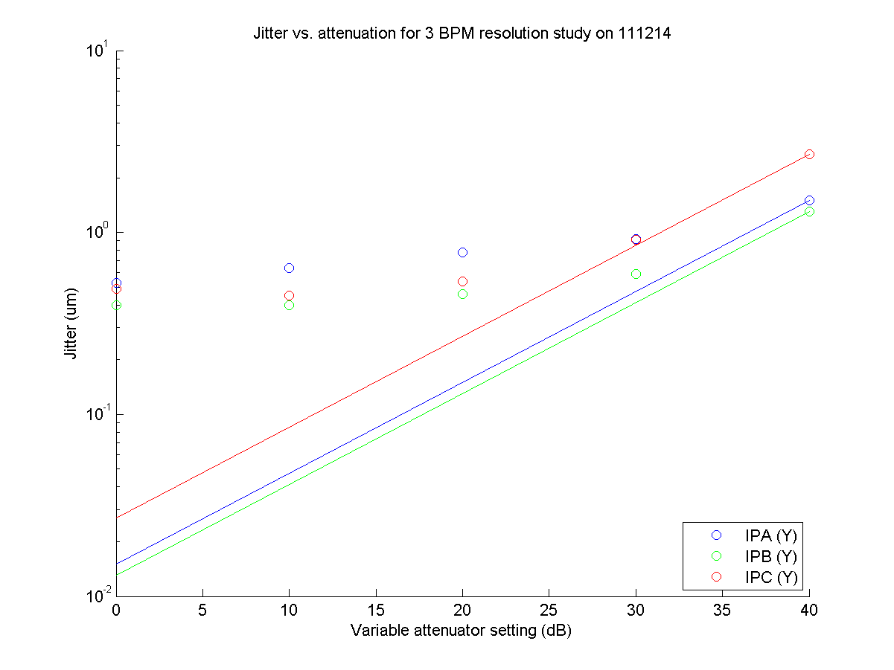
N. Blaskovic

Slide 10
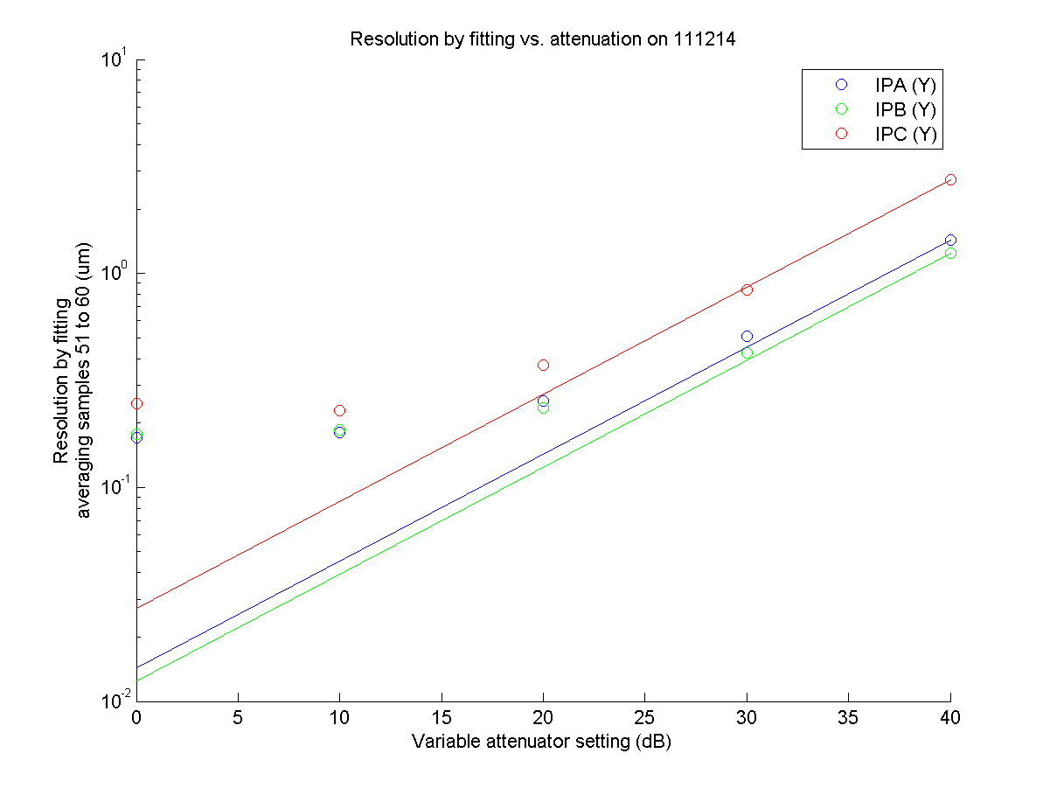
N. Blaskovic

Slide 11
High β optics
Jitter ~500 nm at all 3 BPMs for this optics
3 BPM resolution appears to be ≳100 nm
Inconsistent with measured jitters ~50 nm
N. Blaskovic

Slide 12
IP feedback
Best IP feedback run gives 67 nm jitter at IPB
Feedback on and off pulses discriminated by non-zero or zero DACs on IP board
There’s also a separation of feedback on and off distributions upstream but note that upstream feedback was not operated
N. Blaskovic

Slide 13
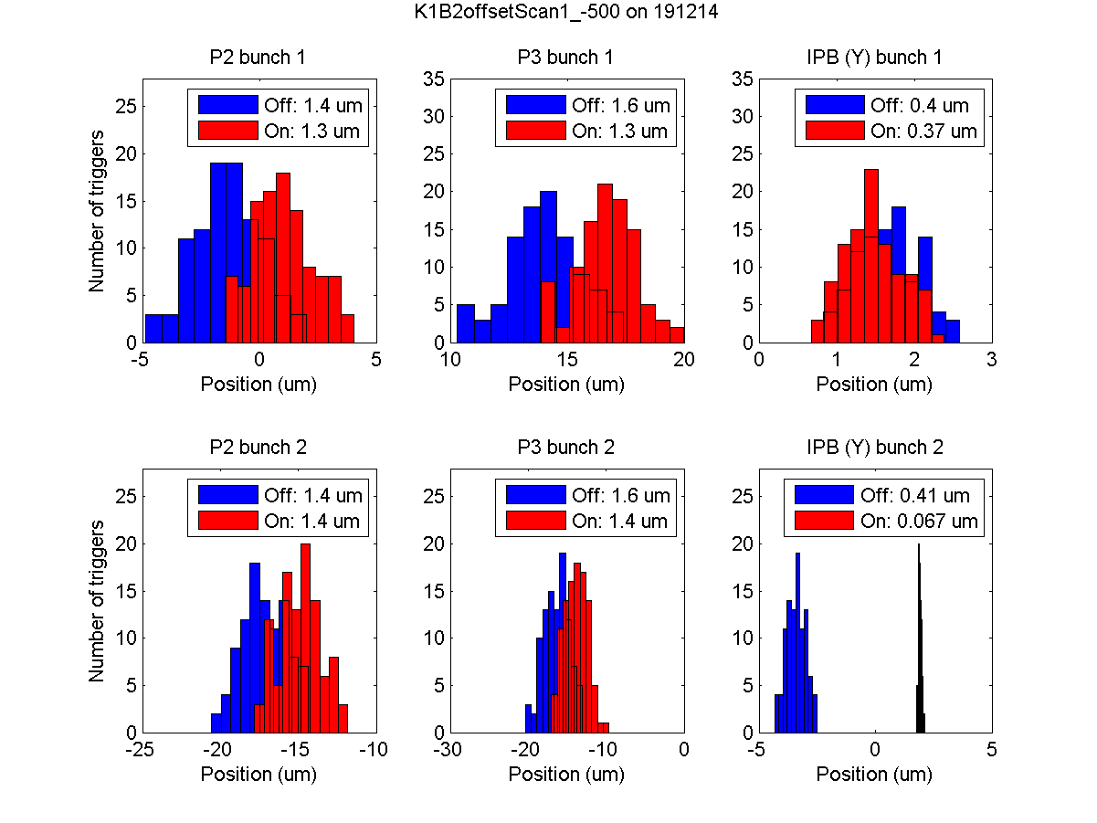
N. Blaskovic

Slide 14
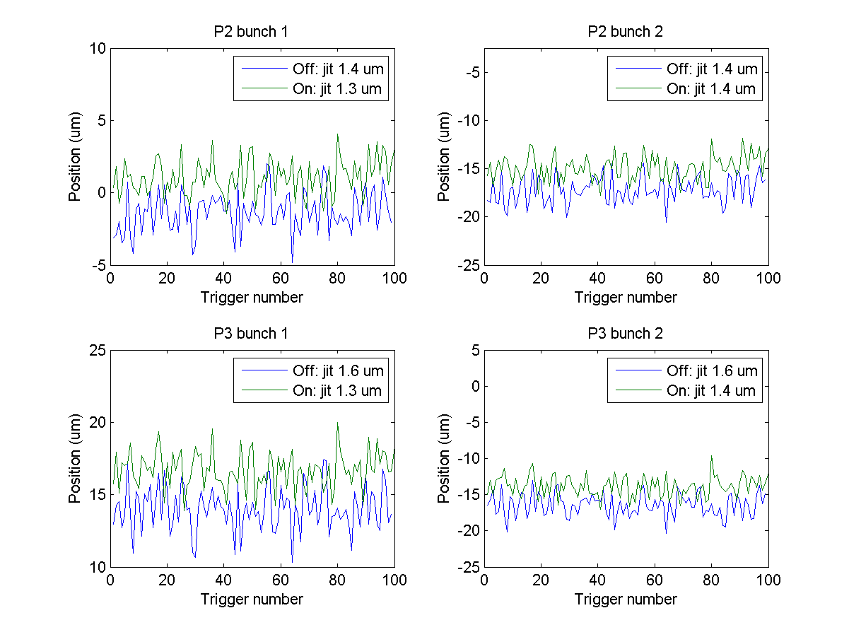
N. Blaskovic

Slide 15
IP feedback scans
Feedback performed over the following scans:
  QD0FF current scan
  IP K1B2 offset (‘banana correction’) scan
Plots show position and jitter for bunch 2 for feedback on/off over each scan
Single point sampling as used in feedback
No drift removal yet (sorry!)
N. Blaskovic

Slide 16
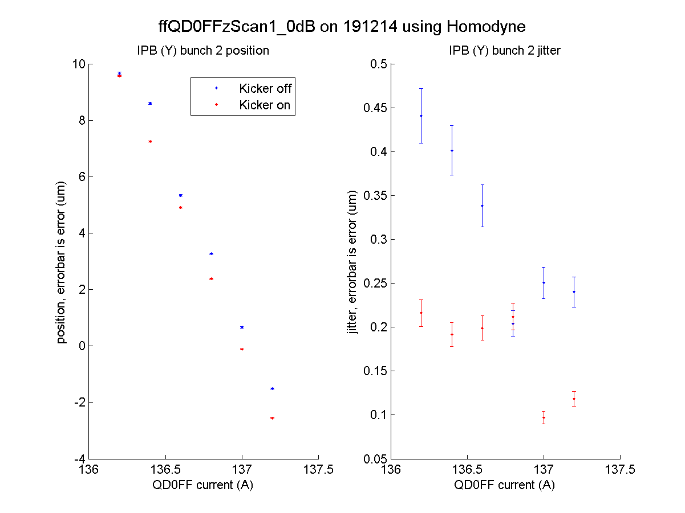
From earlier waist scans waist expected at 136.7 A
N. Blaskovic

Slide 17
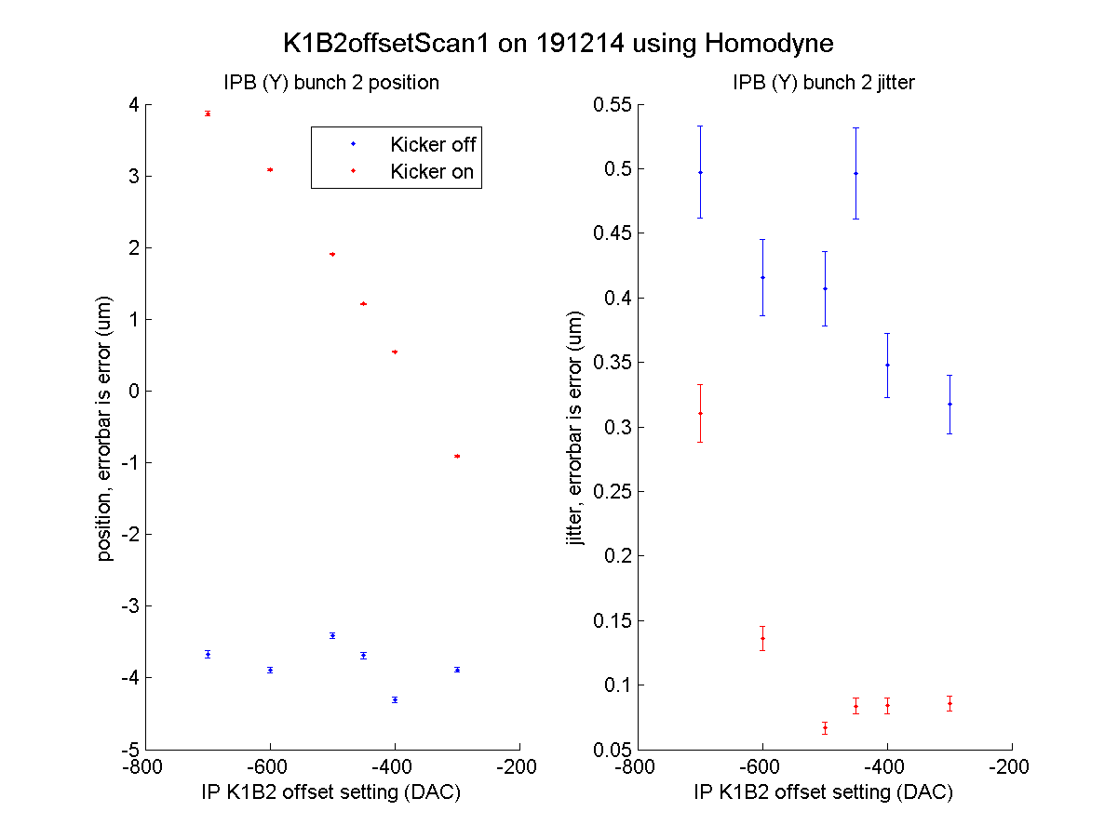
N. Blaskovic

Slide 18
IP feedback scans
QD0FF current scan changes longitudinal beam waist position and vertical offset
Kick applied by K1B2 offset can be seen from K1B2 offset scan
Feedback on measured jitter varies with bunch 2 position over K1B2 offset scan
N. Blaskovic

