Slide 1
ML (BC) Studies update
Nikolay Solyak
Arun Saini

Slide 2
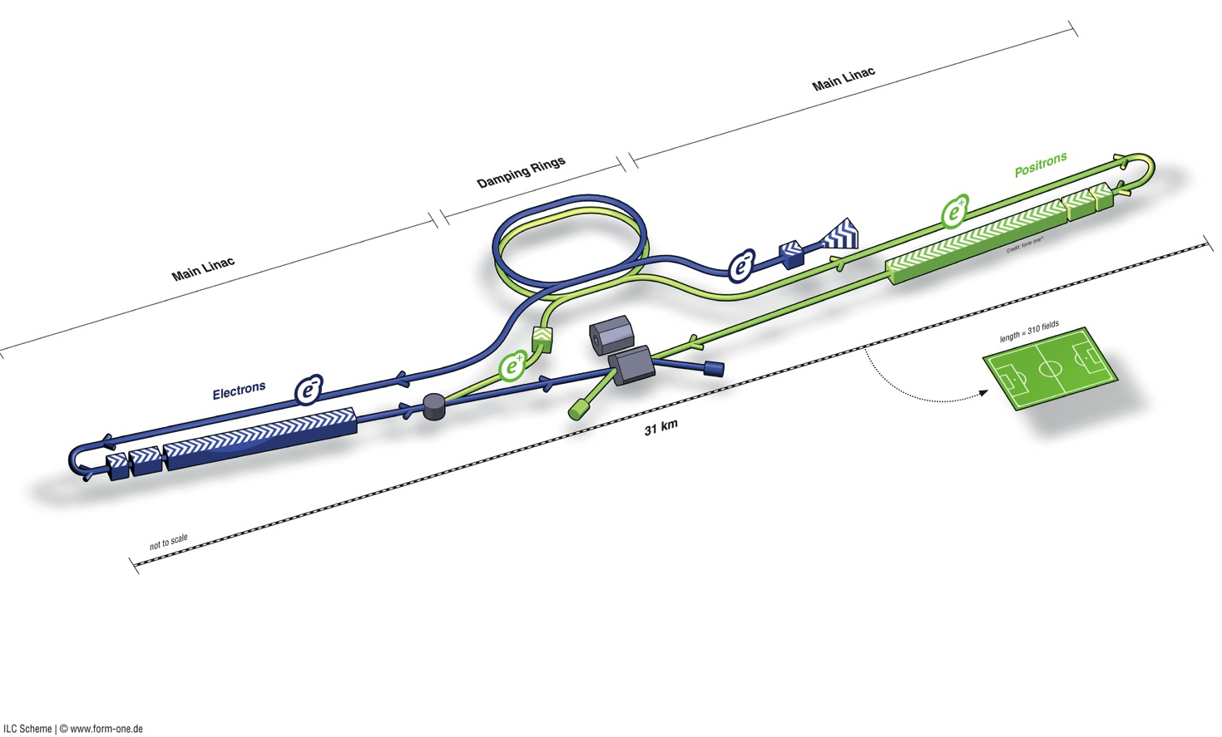
ILC schematics
Damping Rings
Polarised positron
source
Polarised electron source
Ring to Main Linac (RTML)
e+ Main Linac (incl. bunch compressor)
Beam dump
Beam Delivery System (BDS) & physics detectors
Total length (500 GeV) | 30.5 km
SCRF ML (RTML) | 22.2 km
RTML_BC | 2.8 km
Positron source | 1.1 km
BDS / IR | 4.5 km
Damping Rings | 3.2 km
e- Main Linac (incl. bunch compressor

Slide 3
Outline
Discussion of Discrepancies between EDMS Lattice and TDR lattice of Bunch Compressor
An Insight view of Bunch compressor section ( BC1 to BC2)
  Tracking nominal bunch (3sigma); acceptance plot
  Aperture limitations.Beam losses at Wiggler in BC1 even for nominal operation during tracking of 4sigma (Gaussian).
List of critical failure modes under studies
  Discussion of a case of RF Phase errors in Bunch Compressor (BC1) section.

Slide 4
Bunch Compressor : EDMS lattice vs. TDR Lattice
Parameters | EDMS Lattice |  |  | TDR Lattice
 | BC1 start | BC2 start | BC2 End | BC1 start | BC2 start | BC2 end
dp/p, % | 0.15 | 2.25 | 1.95 | 0.11 | 1.42 | 1.1
σ_{z}, mm | 9.6 | 1.4 | 0.357 | 6 | 0.89 | 0.324
E (GeV) | 5 | 4.88 | 15.00 | 5.0 | 4.80 | 14.85
Grad/RF Phase (MV/m)/ deg | 18.0 /-104.9 | 28.19/-27.57 | - | 18.66/-115 | 25.48/-24.0 | -
Total Length | - | 230.804 | 1138.72 |  | 230.845 | 1138.772
EDMS Lattice is received from M.Woodley.
TDR lattice was used for studies published in TDR report.

Slide 5
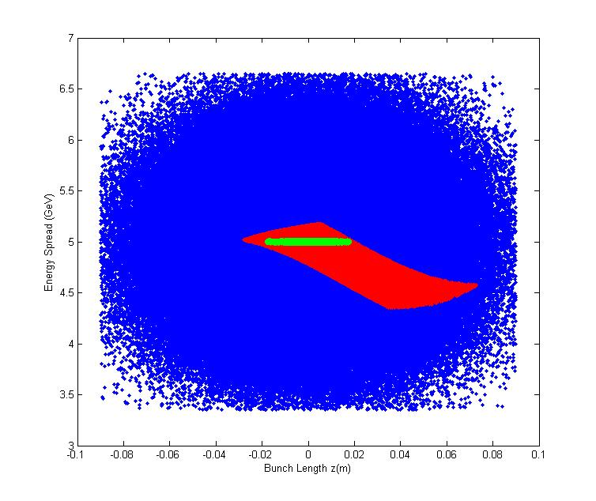
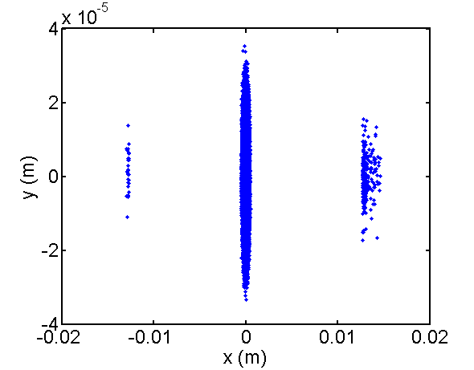
Nominal operation of BC
Longitudinal acceptance
Lost
Tracking of 4 sigma Gaussian Distribution of Beam results in Beam losses at Wiggler in BC1
Horizontal aperture/ radius of wiggler magnets is 12.7 mm ? (should be X/Y = 400mm x 25mm)
Transverse Beam Size (x,y)
Transverse Beam Size (x,y)
Longitudinal Phase Space
Lost Particles

Slide 6
Topics Under Studies: Failure Modes
In order to understand single bunch loss scenarios we need to study different failure modes and to quantify their severity at critical locations:
Failure Modes in Bunch Compressor and Main Linac :
  RF Phase and Amplitude Errors
  Magnet failure
  BPM and steering magnets failure

Slide 7
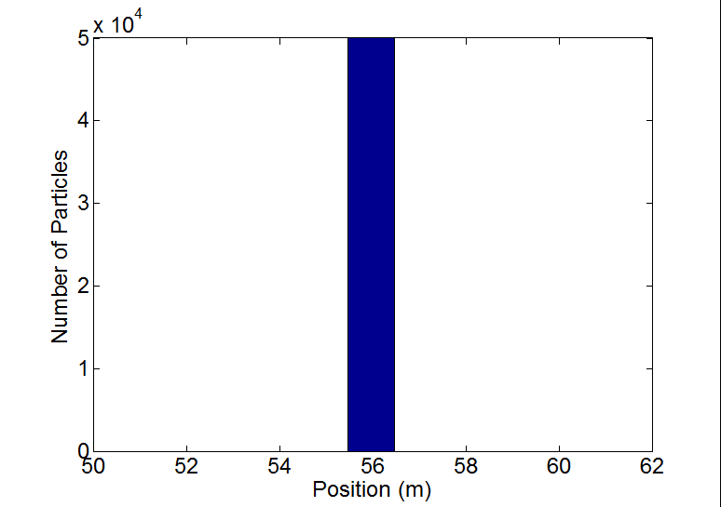
A Case Study: RF Phase errors in BC1-(1)
RF Phases in all cavities in BC1 are changed from -115⁰ deg to 0⁰ degree.
Complete beam is lost at wiggler magnet at 56 m in BC1.
RMS Transverse beam size at lost location : σ_{x} = 262 μm σ_{y} 6.1 μm.
Beam power density is lower than critical power density.
Lost Particles

Slide 8
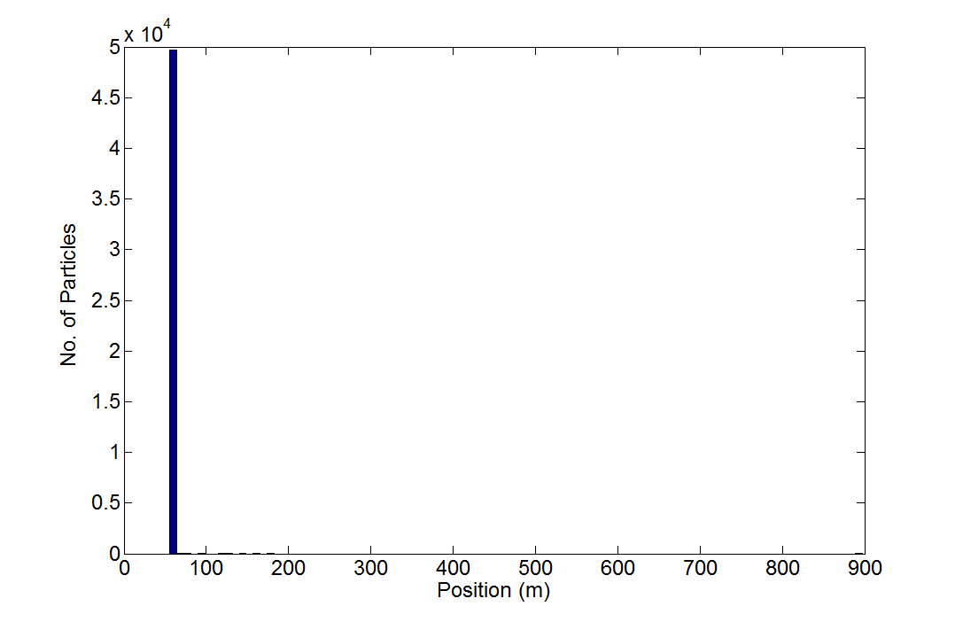
A Case Study: RF Phase errors in BC1-(2)
RF Phases in all cavities in BC1 are changed from -115⁰ deg to -180⁰ degree.
Majority of particles are lost in BC1.
RMS Transverse beam size at lost location : σ_{x} = 523 μm σ_{y} 7.8 μm.
Beam power density is lower than critical power density.
Lost Particles

Slide 9
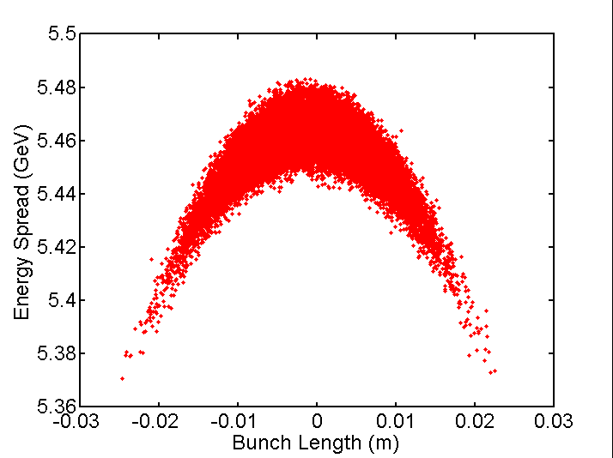
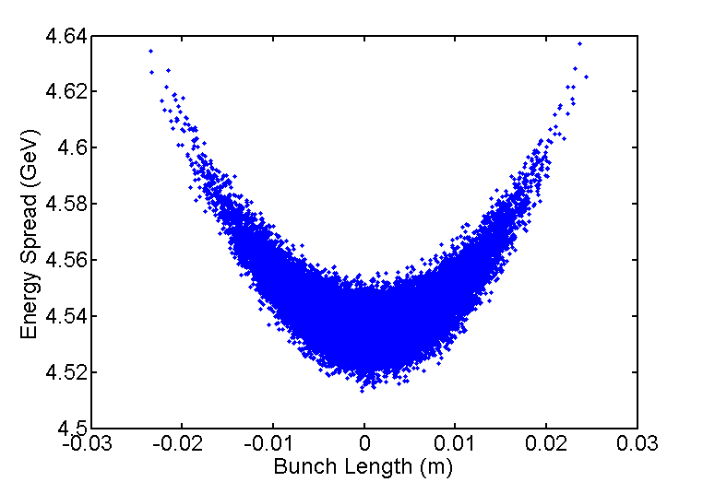
A Case Study: RF Phase errors in BC1-(3)
Longitudinal Phase Space when RF Phases in Cavities are 0⁰
Longitudinal Phase Space when RF Phases in Cavities are -180⁰
Longitudinal phase space of the beam just before beam get lost

Slide 10
Summary and next steps
Need to update Bunch compressor lattice files in EDMS database
  M. Woodley will update BC1&BC2 lattices, incl. apertures
  Treaty point before between RTML and ML (BC)
  Sergei Seletskiy will perform update in BC2 and extraction dump lines (not highest priority)
Extensive studies are required to understand criticality of failure modes. It will help
  To quantify various failure modes in terms of their severity
  To design better Machine Protection System
Different scenario of dark current generation in CM is completed (reported). Fluka model of CM will start next (with help of KEK (and SLAC/ M.Santano)

