Slide 1
40 MHz waveform ripple
N. Blaskovic
N. Blaskovic

Slide 2
Contents
IPB (Y) I & Q and Ref (Y) waveforms taken on:
30 May 2014 over charge & attenuation scans
31 October 2014 for 2-on-1 resolution study
9 December 2014 with replaced BPMs
N. Blaskovic

Slide 3
May 2014 waveforms
40 MHz ripple exists for the full duration that the mixer is driven
Ripples are charge independent
Ripples scale with RF attenuation
N. Blaskovic

Slide 4
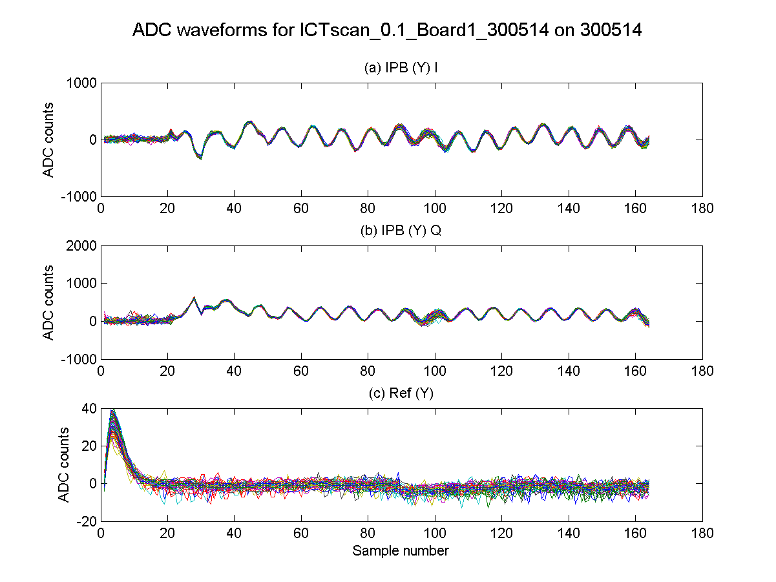
0.1x10¹⁰
0 dB
N. Blaskovic

Slide 5
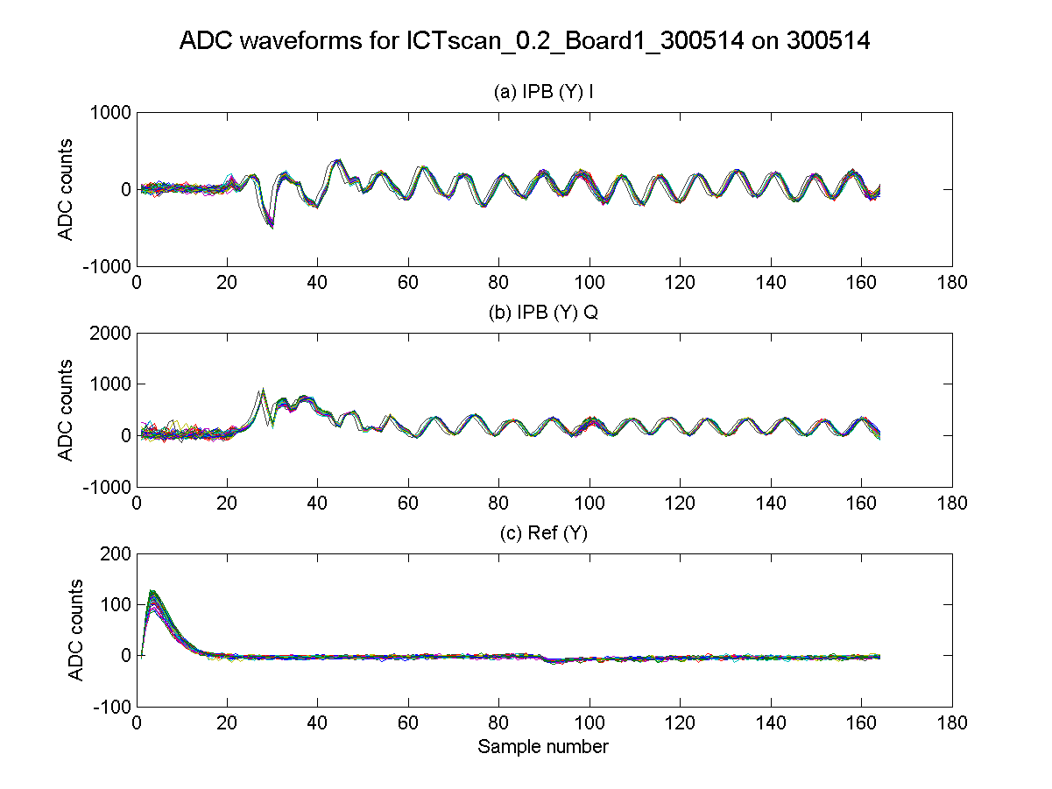
0.2x10¹⁰
0 dB
N. Blaskovic

Slide 6
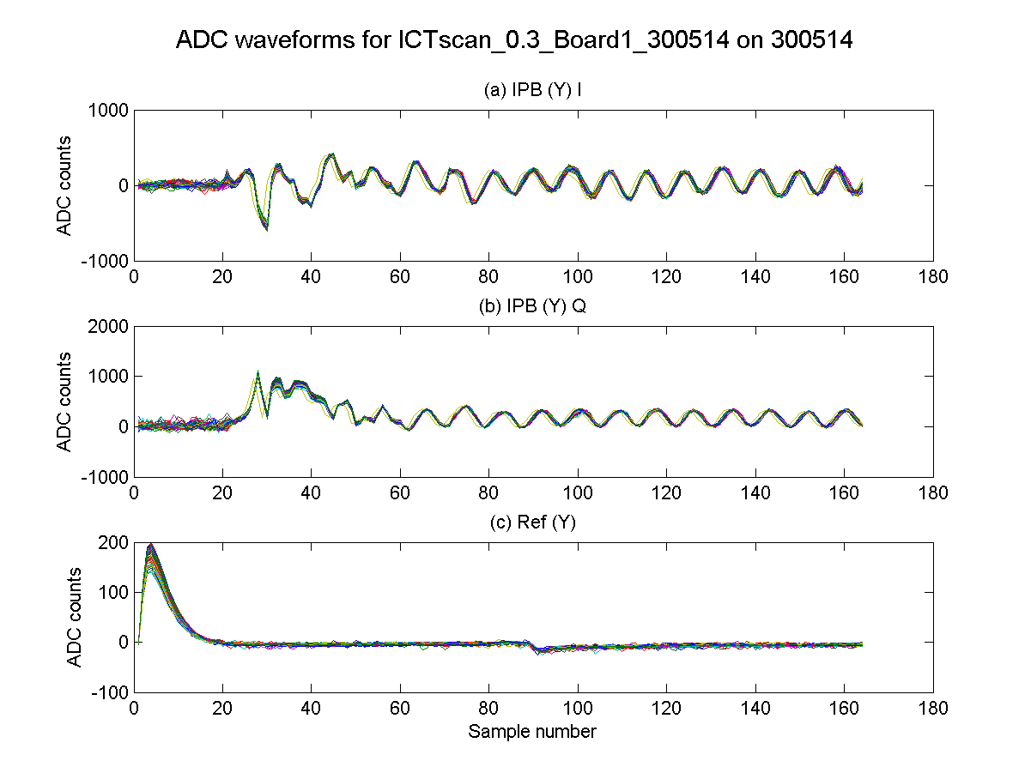
0.3x10¹⁰
0 dB
N. Blaskovic

Slide 7
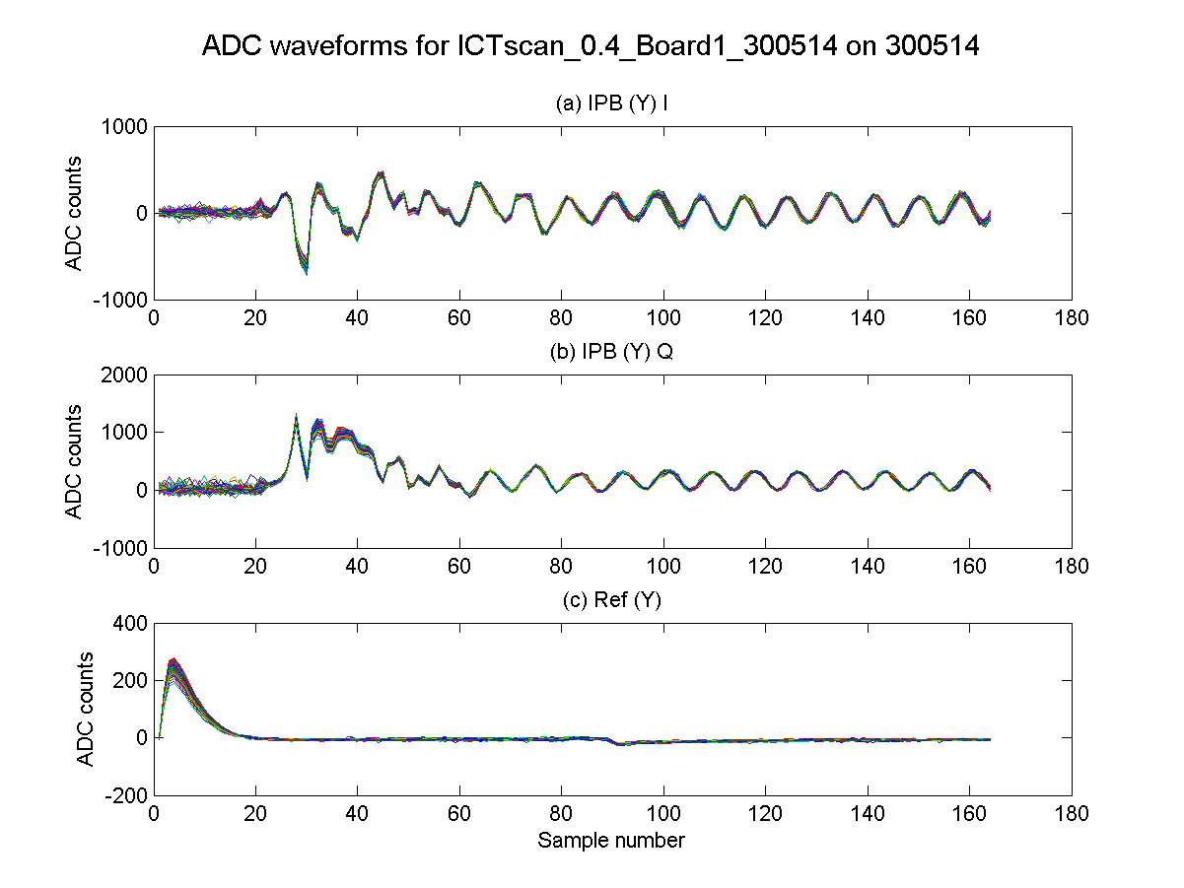
0.4x10¹⁰
0 dB
N. Blaskovic

Slide 8
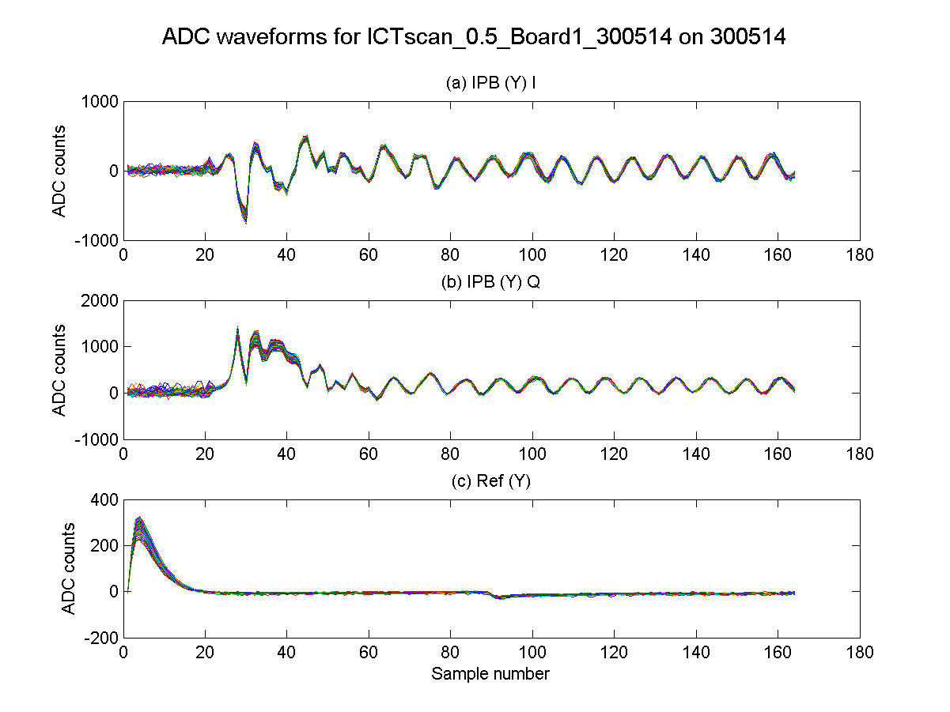
0.5x10¹⁰
0 dB
N. Blaskovic

Slide 9
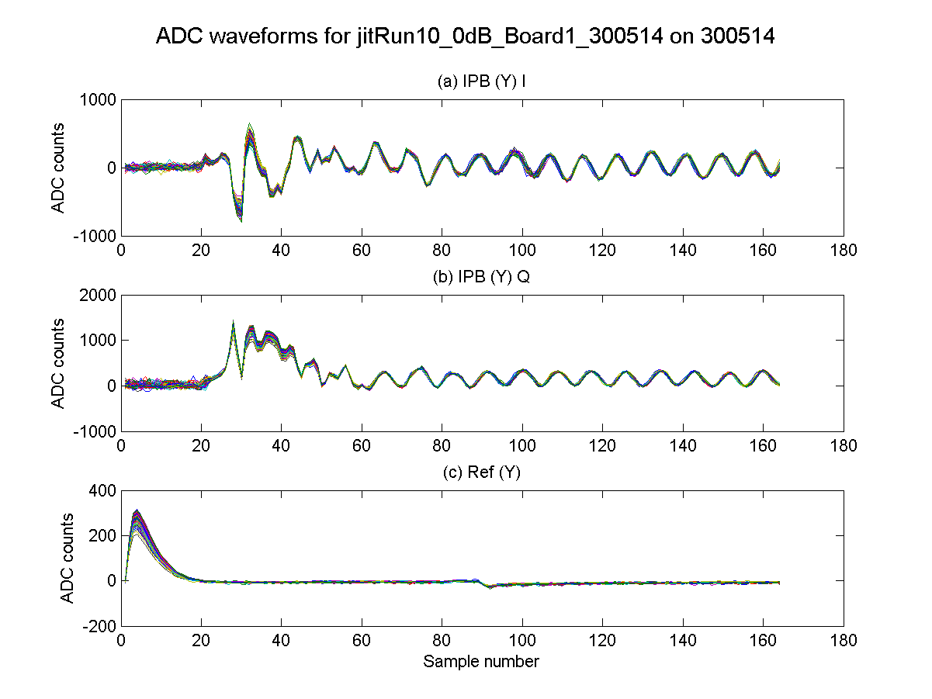
0.5x10¹⁰
0 dB
N. Blaskovic

Slide 10
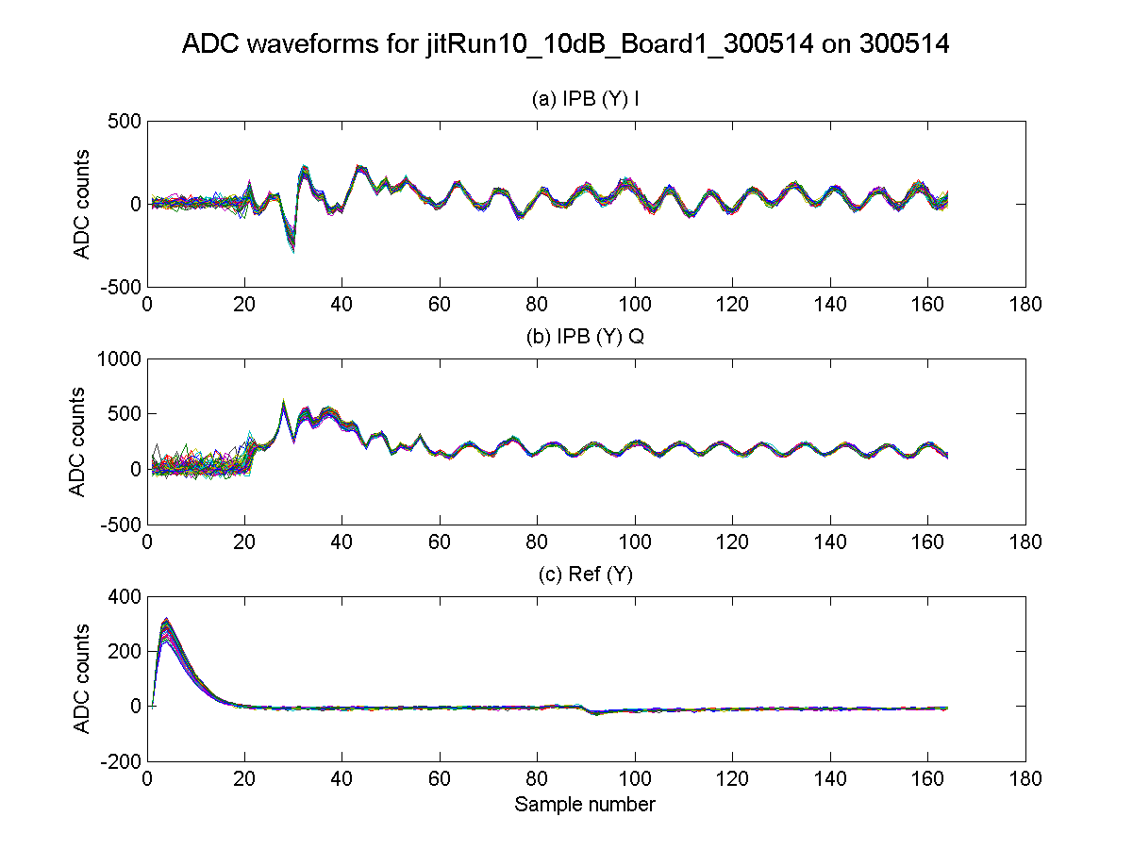
0.5x10¹⁰
10 dB
N. Blaskovic

Slide 11
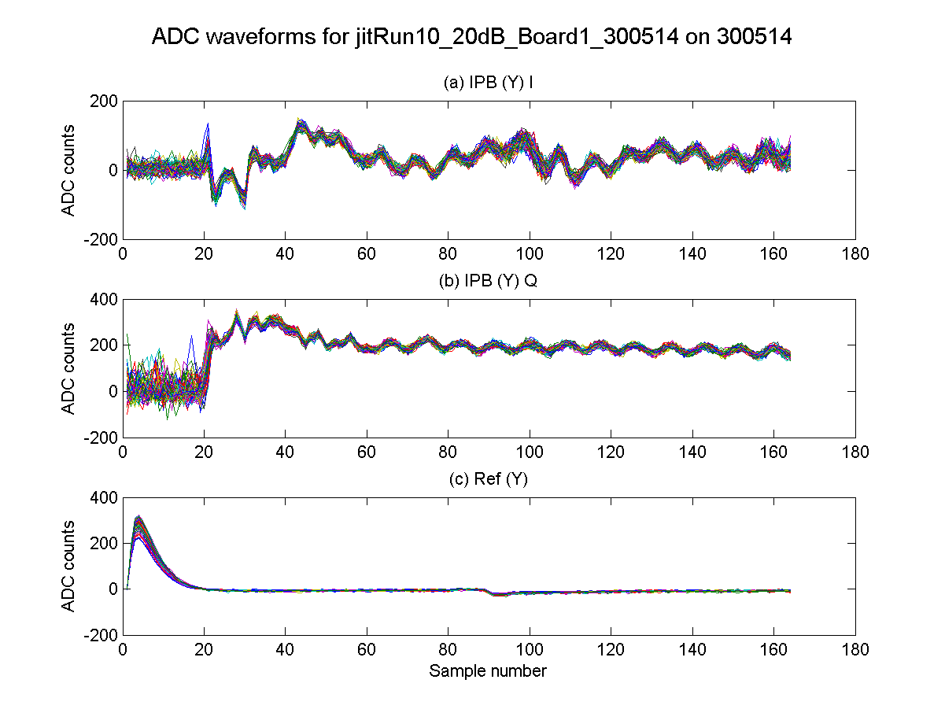
0.5x10¹⁰
20 dB
N. Blaskovic

Slide 12
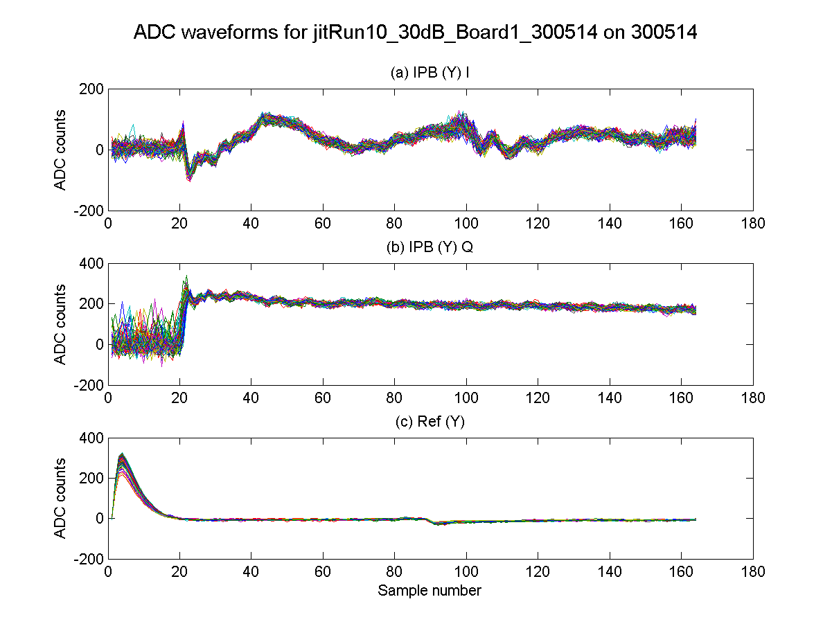
0.5x10¹⁰
30 dB
N. Blaskovic

Slide 13
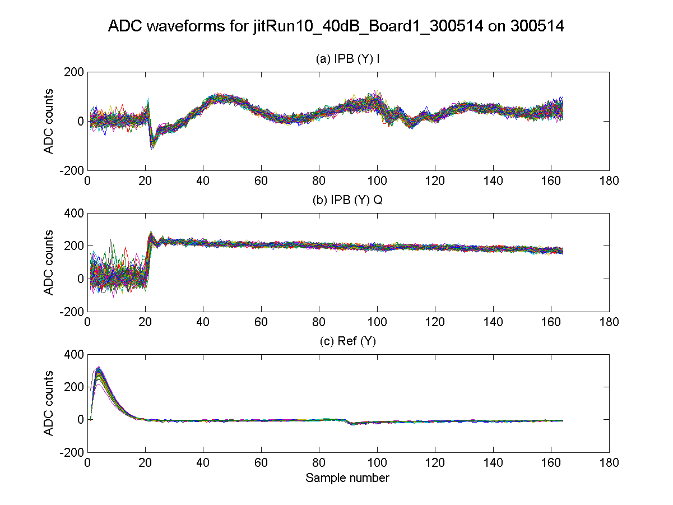
0.5x10¹⁰
40 dB
N. Blaskovic

Slide 14
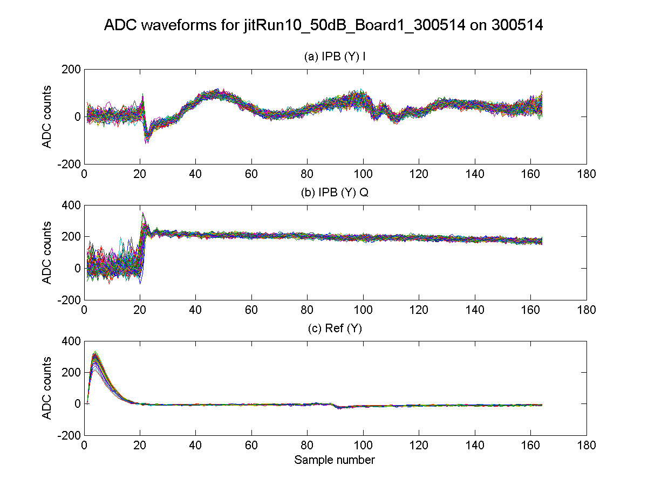
0.5x10¹⁰
50 dB
N. Blaskovic

Slide 15
October 2014 waveforms
40 MHz ripple observed during 2-on-1 resolution study on 31 October 2014
Ripple features in both sets of electronics
N. Blaskovic

Slide 16
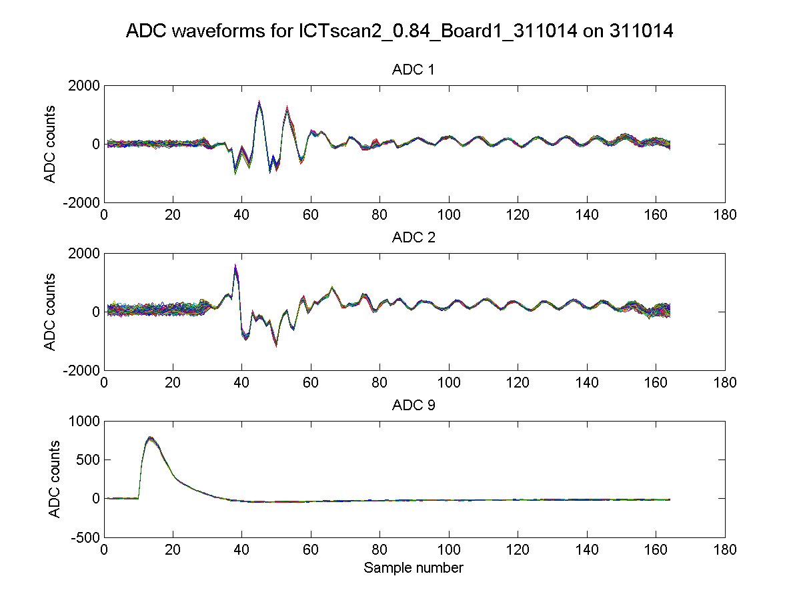
1st copy of IPB(Y) I
1st copy of IPB(Y) Q
diode output of Ref(X)
N. Blaskovic

Slide 17
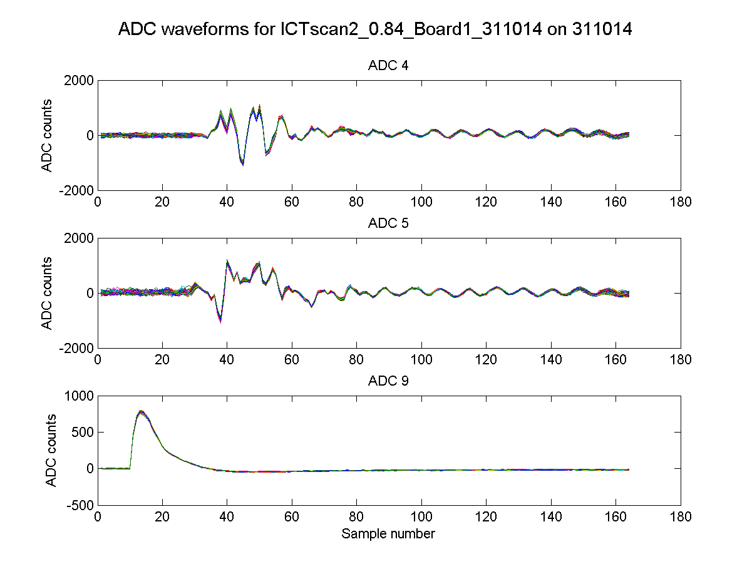
2nd copy of IPB(Y) I
2nd copy of IPB(Y) Q
diode output of Ref(X)
N. Blaskovic

Slide 18
December 2014 waveforms
40 MHz ripple absent even at 0 dB
Data also taken FONT5 board
Changes between May and December:
New IP BPMs
Faulty reference cavity cable replaced
Reference cavity signal attenuated by 40 dB
N. Blaskovic

Slide 19
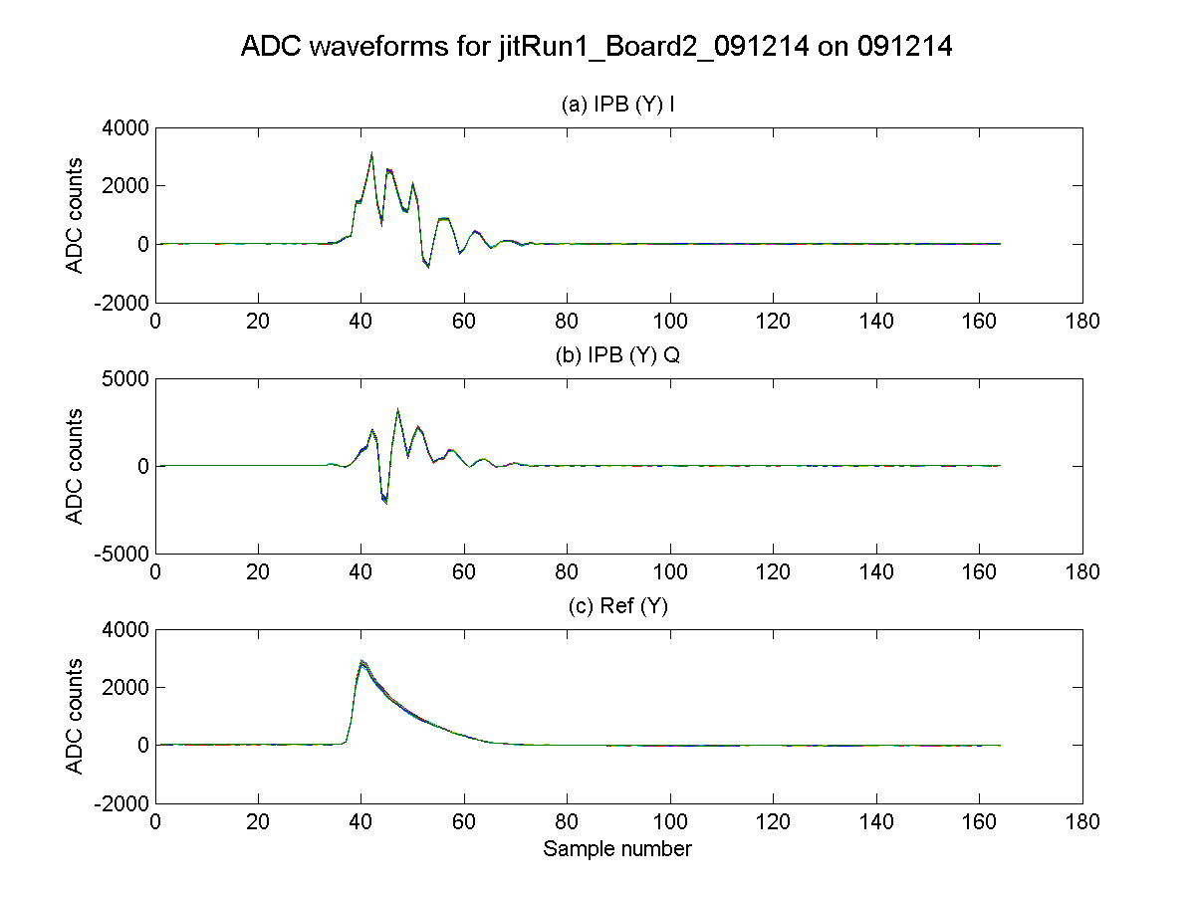
N. Blaskovic

