Slide 1
3-BPM resolution
Resol2_0db (11/12/14)
G. Christian
19/1/15

Slide 2
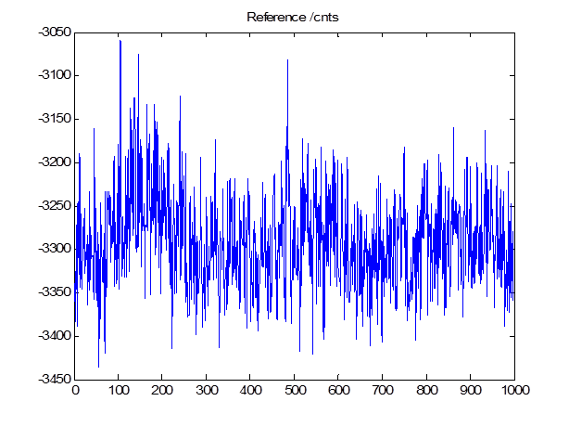
Single point analysis (sample 1/10)
All data

Slide 3
Single point analysis (sample 1/10)
All data - charge
Mean = 3290 , Sigma = 50

Slide 4
Resolution Residuals (fitting)

Slide 5
Sigma | #uncut | Position /um | Jitter /um | BPM Cor R vlaue | Res (fit) /nm | Res (geom)
All | 988 | 2.61+/-0.02 -0.84+/-0.01 38.47+/-0.03 | 0.55+/-0.01 0.42+/-0.01 0.84+/-0.02 | 0.86 (1,2) -0.31 (1,3) 0.06 (2,3) | 126+/-3 124+/-3 170+/-4 | 178
1 | 707 | 2.61+/-0.02 -0.84+/-0.02 38.45+/-0.03 | 0.54+/-0.01 0.42+/-0.01 0.81+/-0.02 | 0.87 -0.36 0.09 | 78+/-2 77+/-2 86+/-2 | 133
0.5 | 394 | 2.61+/-0.03 -0.84+/-0.02 38.48+/-0.04 | 0.55+/-0.02 0.42+/-0.02 0.79+/-0.03 | 0.88 -0.42 0.05 | 52+/-2 52+/-2 54+/-2 | 116
0.1 | 76 | 2.60+/-0.06 -0.86+/-0.04 38.4+/-0.1 | 0.52+/-0.04 0.38+/-0.03 0.85+/-0.07 | 0.83 -0.49 0.07 | 35+/-3 35+/-3 36+/-3 | 104
0.05 | 47 | 2.57+/-0.07 -0.90+/-0.05 38.4+/-0.1 | 0.49+/-0.05 0.31+/-0.03 0.91+/-0.09 | 0.77 -0.64 -0.03 | 34.9+/-0.4 34.9+/-0.4 35.5+/-0.4 | 105
0.01 | 9 | 2.4+/-0.2 -0.80+/-0.09 39.1+/-0.2 | 0.5+/-0.1 0.28+/-0.7 0.6+/-0.1 | 0.95 -0.90 -0.74 | 29+/-7 29+/-7 31+/-7 | 79

Slide 7
20/12/14 0dB dataset
Resol8 (ATF2 FB OFF)

Slide 8
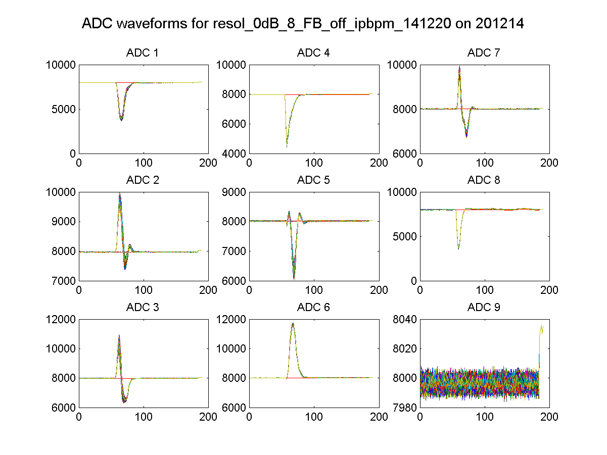

Slide 9
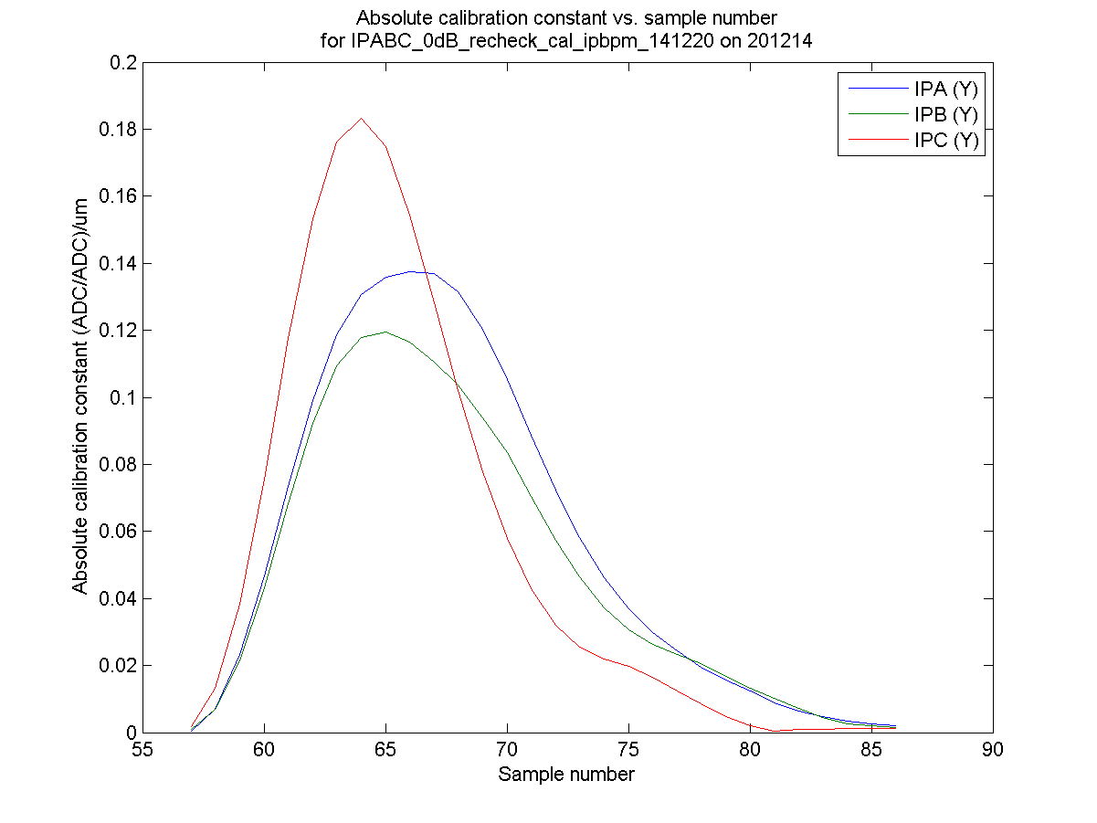

Slide 11
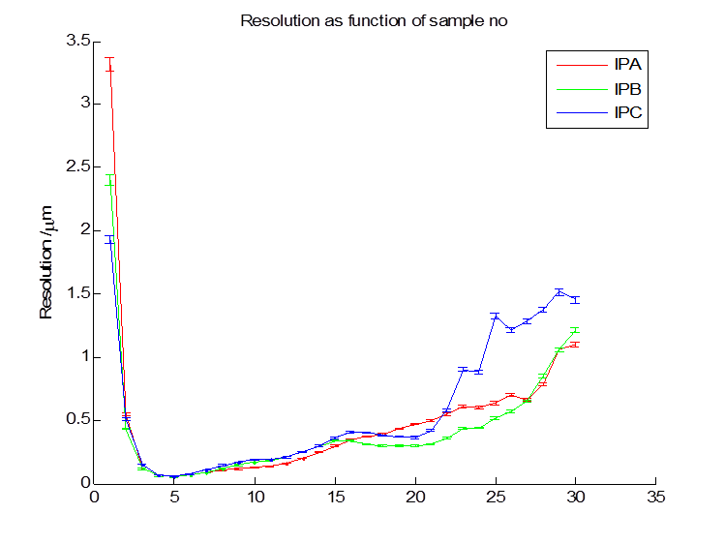
Resolution – all charge data
Fitting |  |  | Geom
52nm | 52nm | 57nm | 54nm

Slide 12
Resolution – 0.1 sigma cut on charge
(163/2001 pulses remaining)
Fitting |  |  | Geom
47nm | 47nm | 51nm | 51nm

Slide 13
Resolution – all charge, mean of samples 3 - 10
Fitting |  |  | Geom
42nm | 42nm | 47nm | 55nm
0.1 sigma cut + averaging
Fitting |  |  | Geom
42nm | 42nm | 46nm | 59nm

