Slide 1
Phase Propagation in CTF3: Correlation Between Phase and BPMs
Jack Roberts

Slide 2
Overview
Quick recap of current status.
First results from Phase-BPM correlation study.

Slide 3
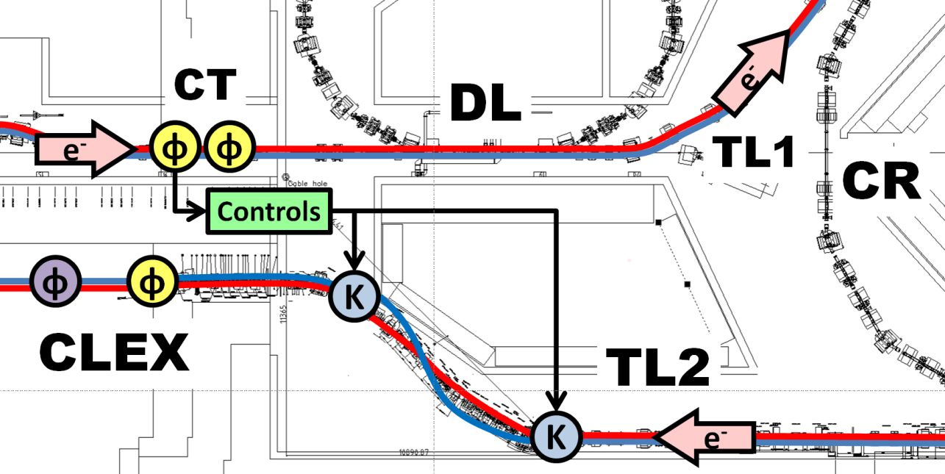
Phase Feedforward Layout
MON1
MON2
PETS
MON3
NB: Prefix CB is for TBL in CLEX (Mon3 and PETS).

Slide 4
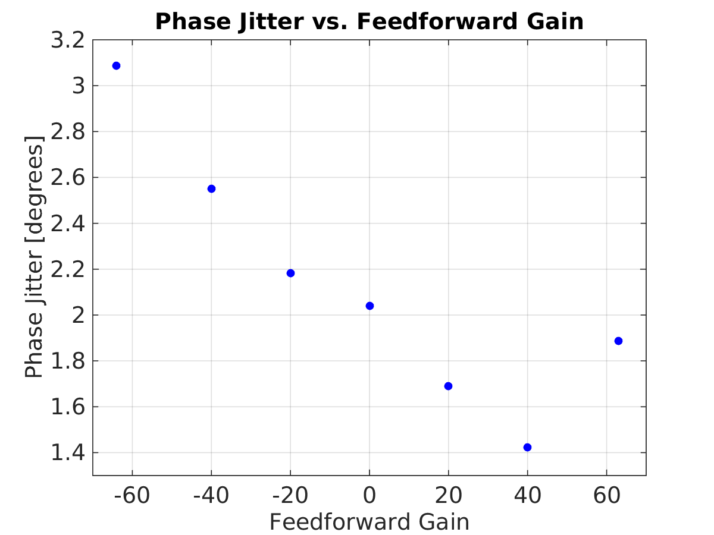
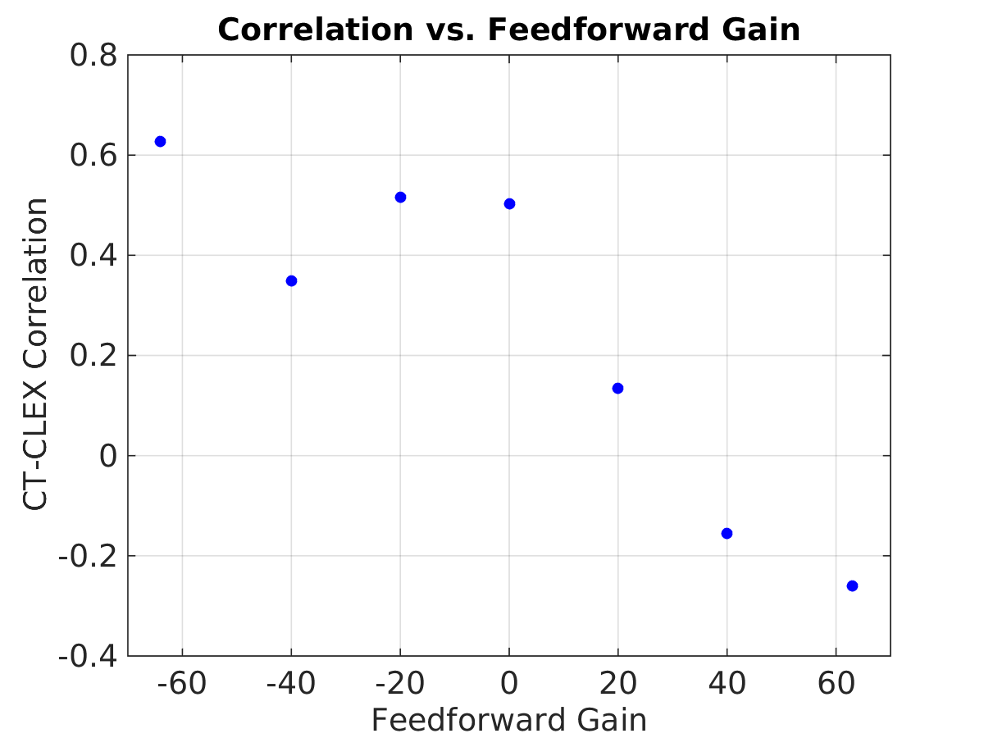
Best Feedforward Results so Far
Reduce phase jitter by around 30% and remove correlation between CT and CLEX phase.
But ultimate goal is factor of 10 reduction / 0.2 degree phase jitter.

Slide 5
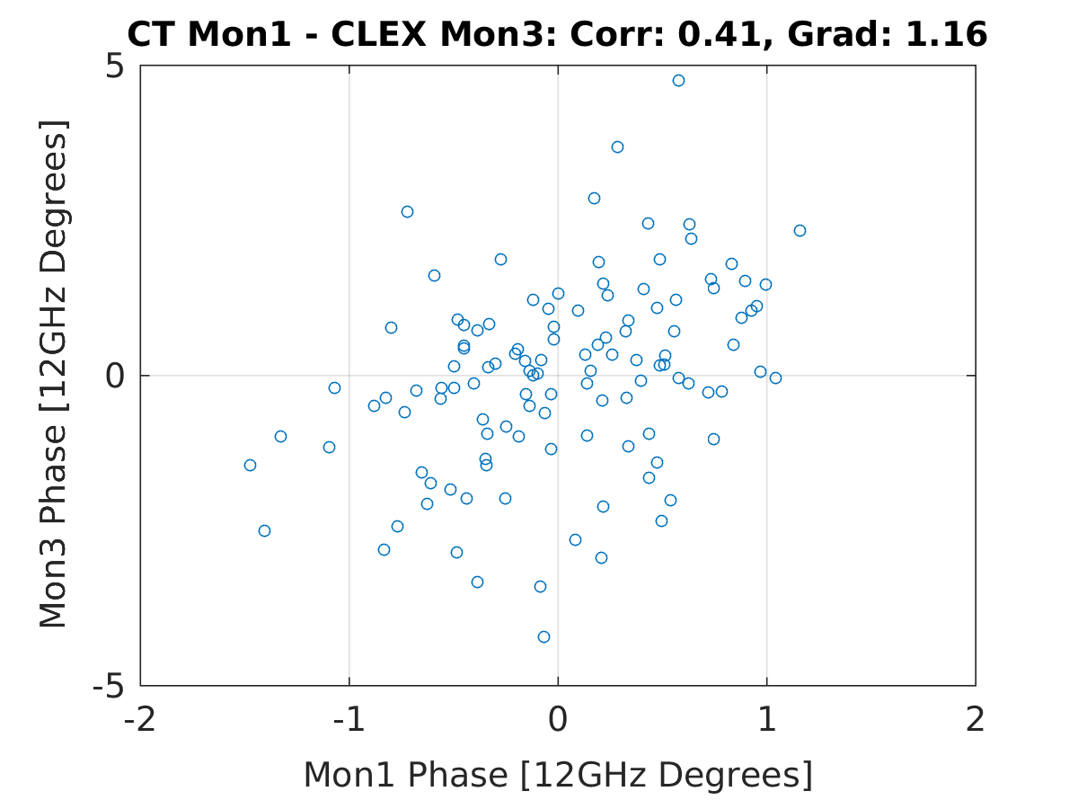
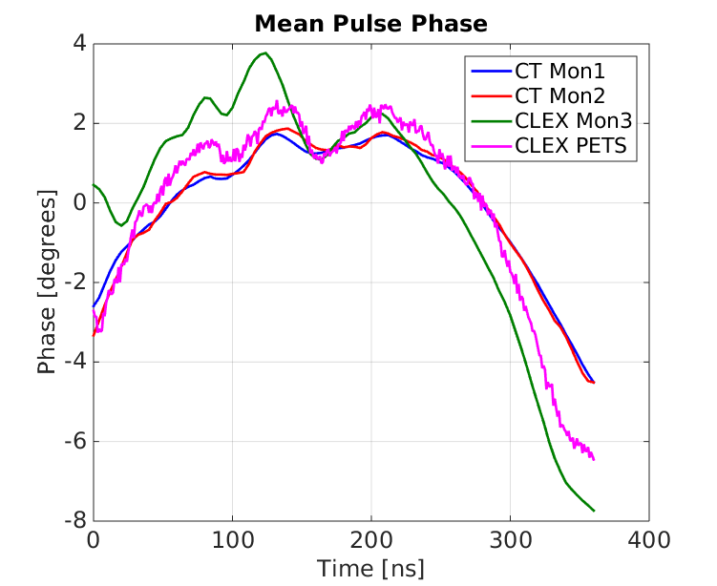
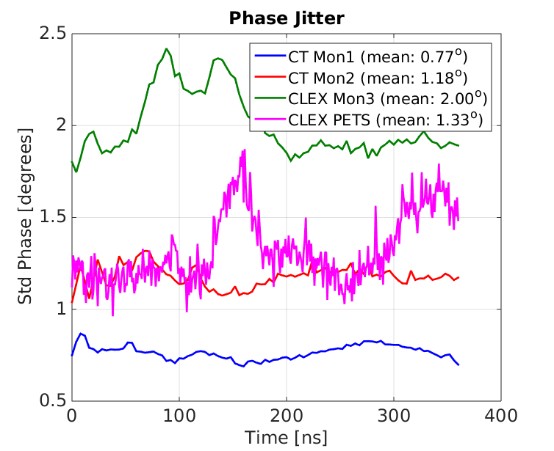
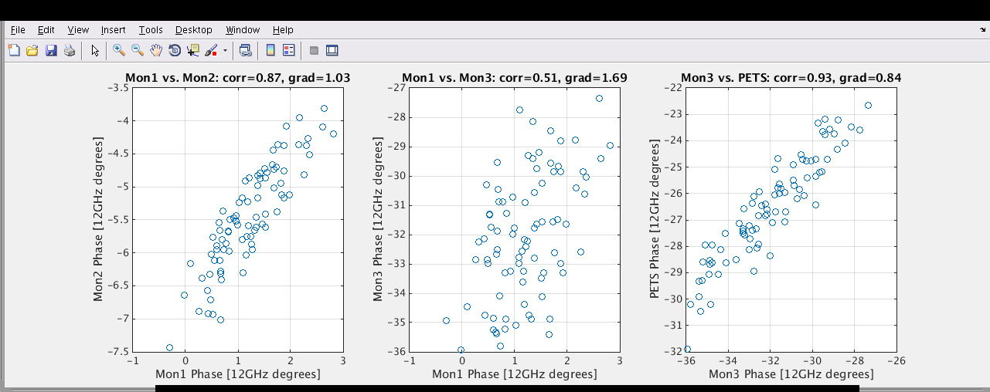
Why only a small reduction in jitter?
Correlation between CT and CLEX phase is 60% at best, often more like 30%.
Correlation between Mon3 and PETS in CLEX is ~90% -> phase measured by Mon3 is real.

Slide 6
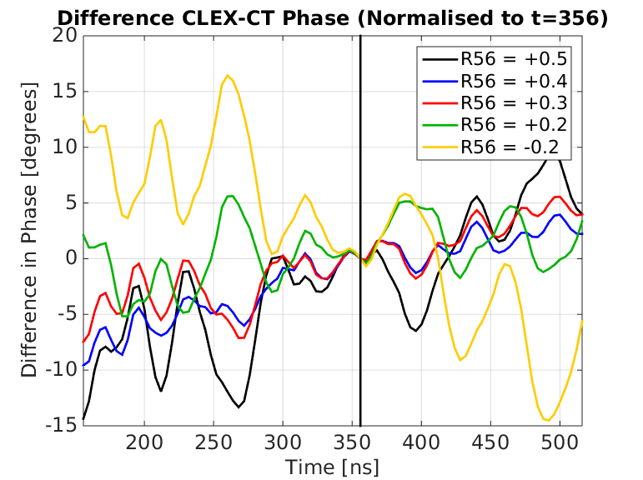
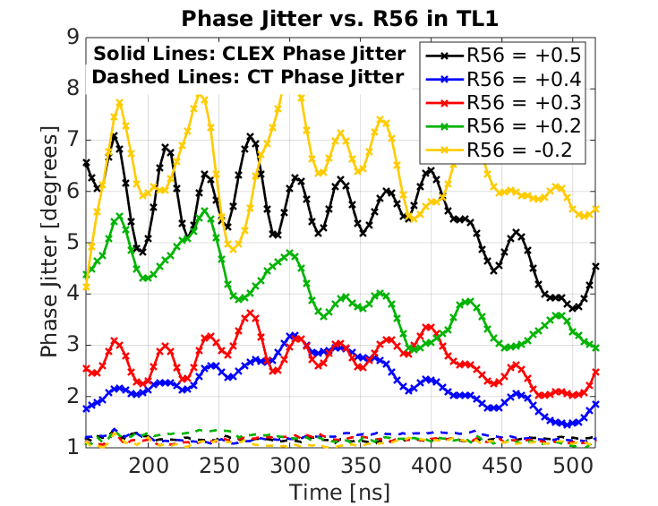
R56 Study
TL2 phase feedforward optics has R56 = -0.2 -> energy jitter causes phase jitter.
Tried varying R56 in TL1 (CT) to negate the energy dependence coming from TL2.
Clearly see the effect on phase and phase jitter (optimum around +0.3 as expected), but correlation between CT and CLEX phase remained low.

Slide 7
Phase Propagation Study
Critical to try to identify and remove the source of the low correlation between the phase in CLEX and CT.
In data sets we save: phase signals (Frascati, PETS, BPRs), BPMs (horizontal, vertical, sum), Klystrons (power, phase), optics (quadrupoles, dipoles, correctors).
I have begun to look at the correlation between phase and the BPM signals. Any correlation can be a sign of:
Dependence of phase on energy (via dispersion causing position jitter).
Dependence of phase on position in monitor.
Data set shown: 20141215_1411 (~600 pulses, no feedforward, R56 compensated in TL1).
TO BE VERIFIED

Slide 8
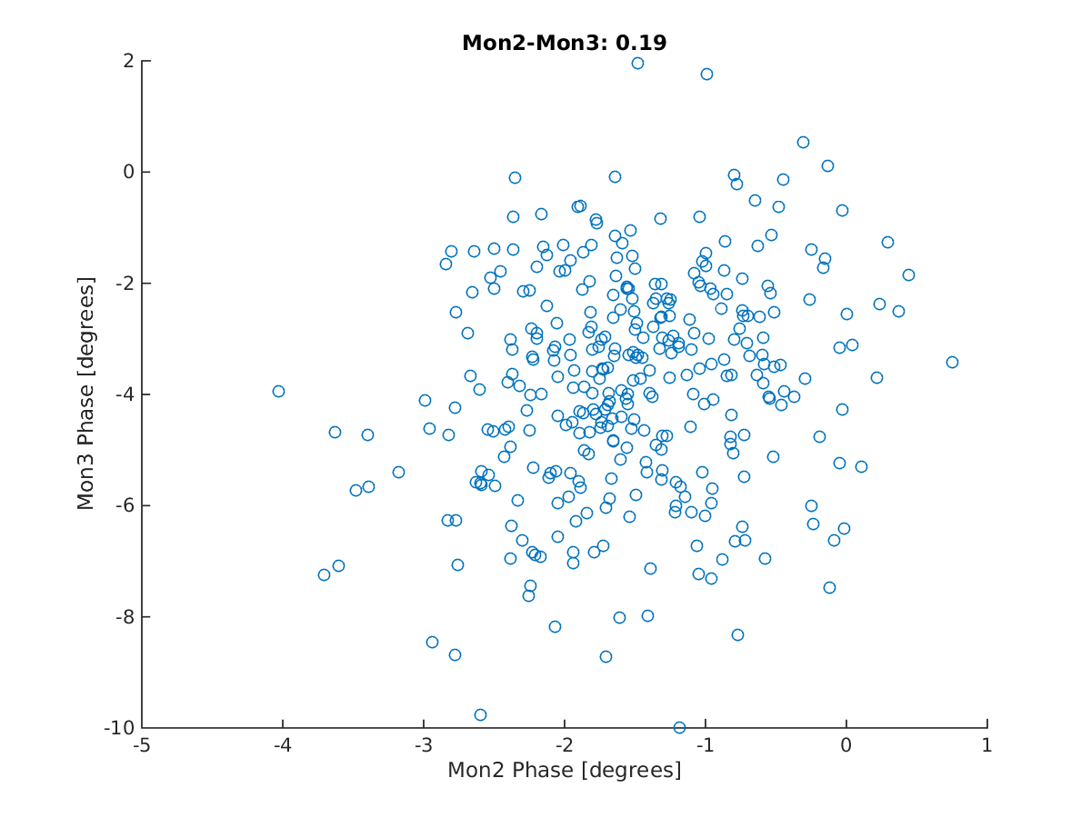
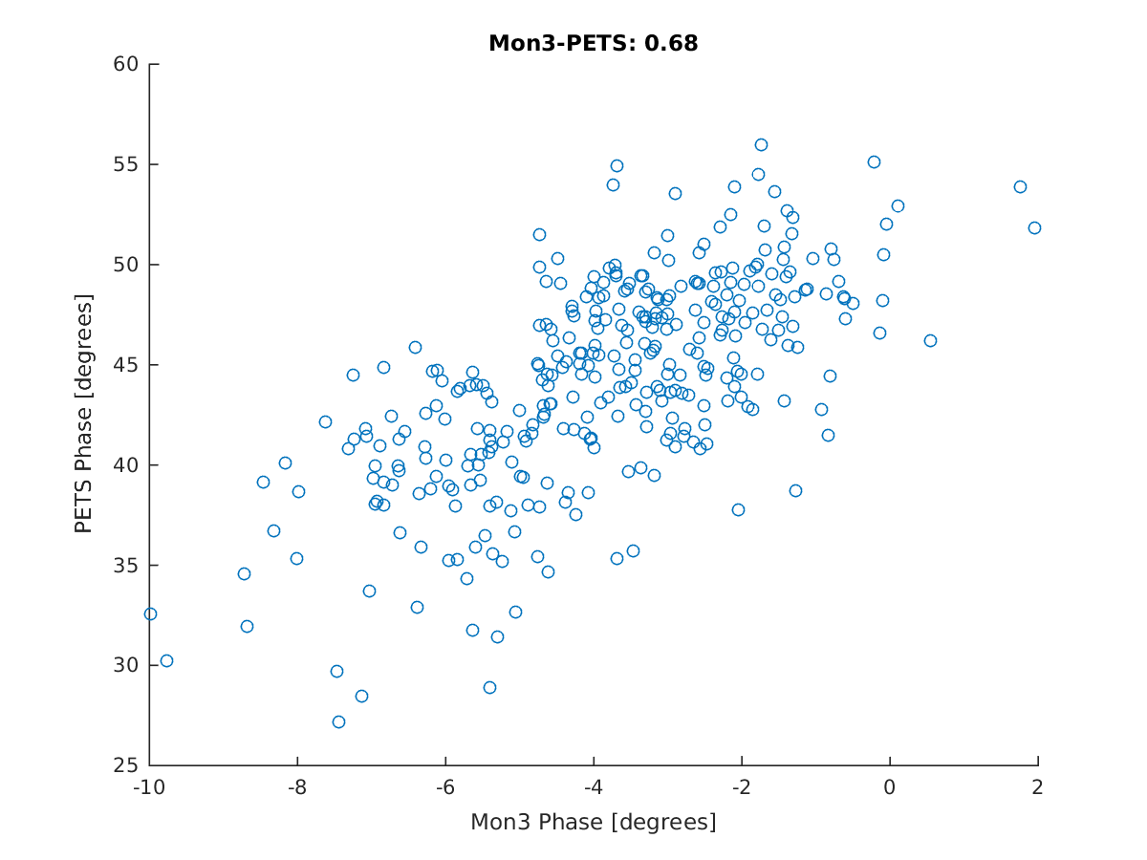
Correlation between Phase Monitors
More or less the worst case scenario in terms of phase correlation.

Slide 9
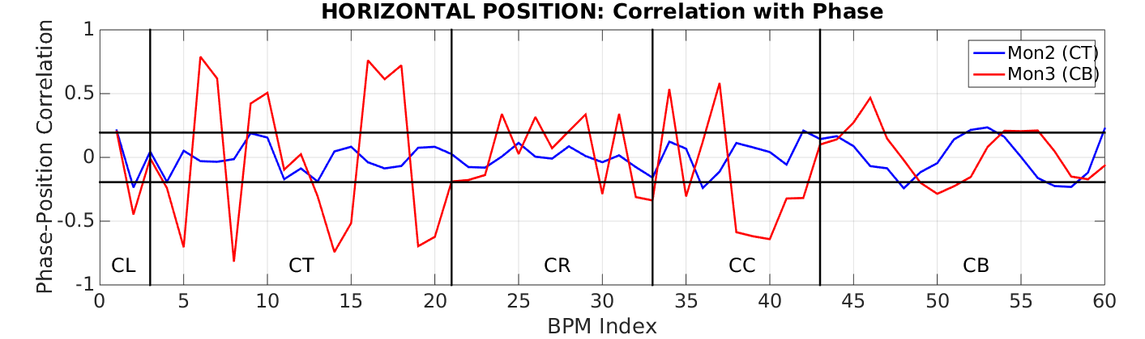
Phase Correlation with Horizontal Position
Horizontal black lines: Magnitude of phase correlation between Mon2 and Mon3 (0.19).
Vertical black lines: Mark boundaries between different sections.

Slide 10
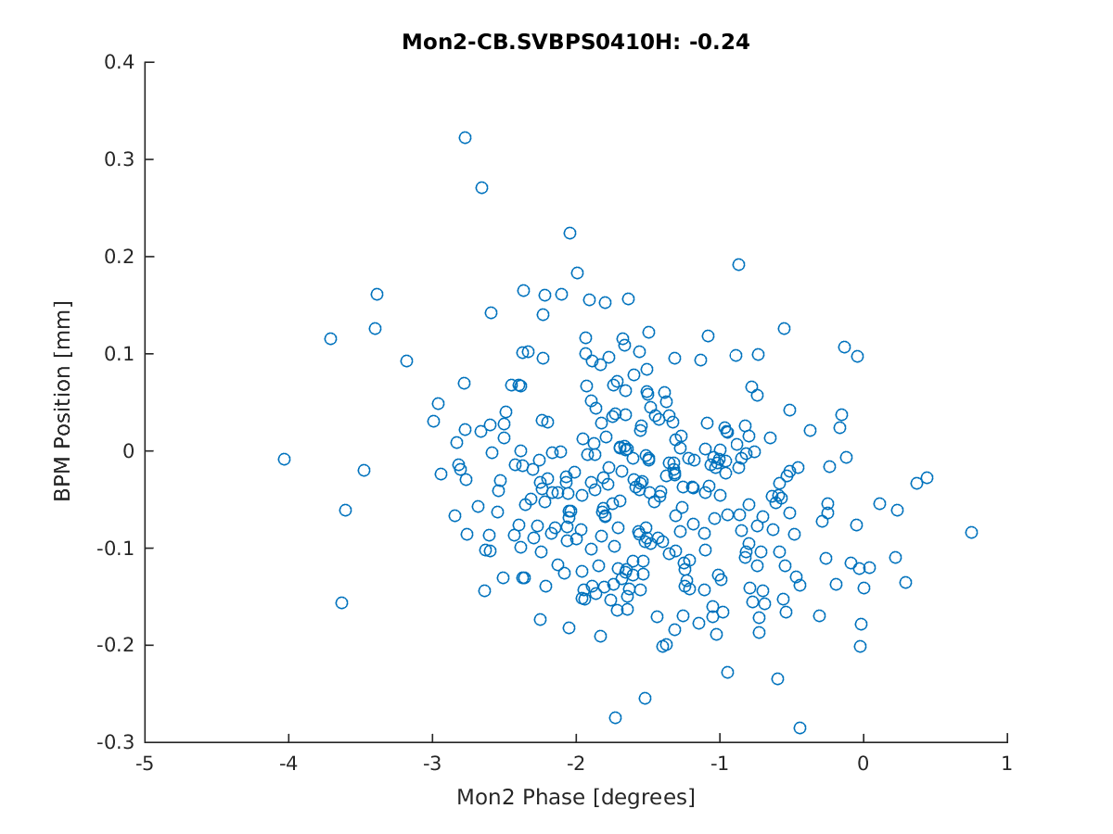
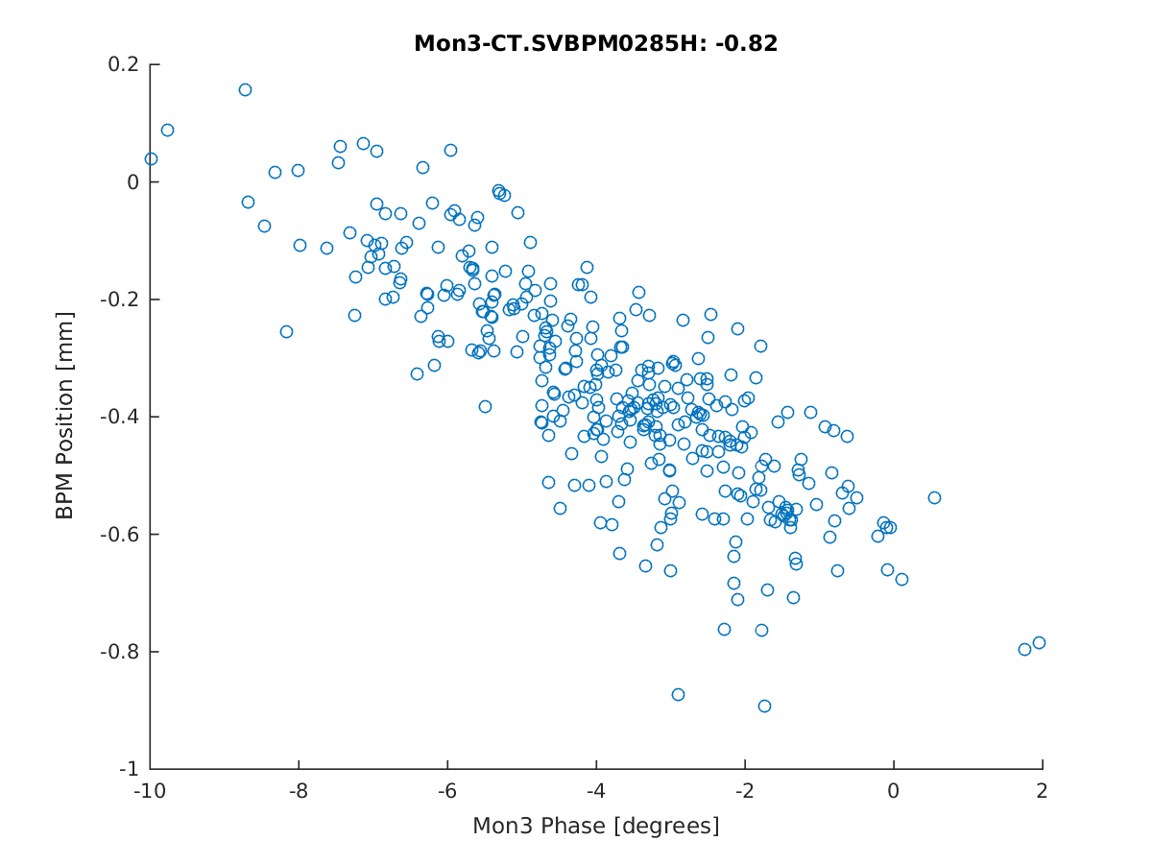
Largest Correlations with Horizontal Position

Slide 11
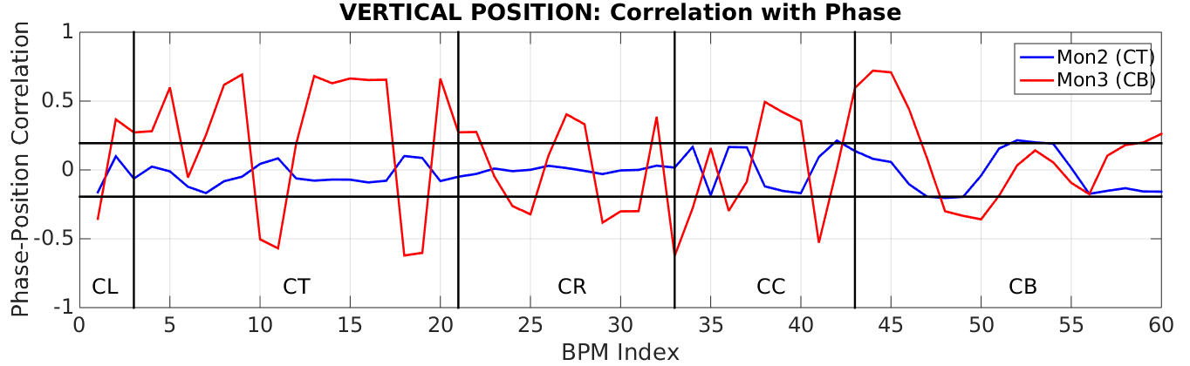
Phase Correlation with Vertical Position

Slide 12
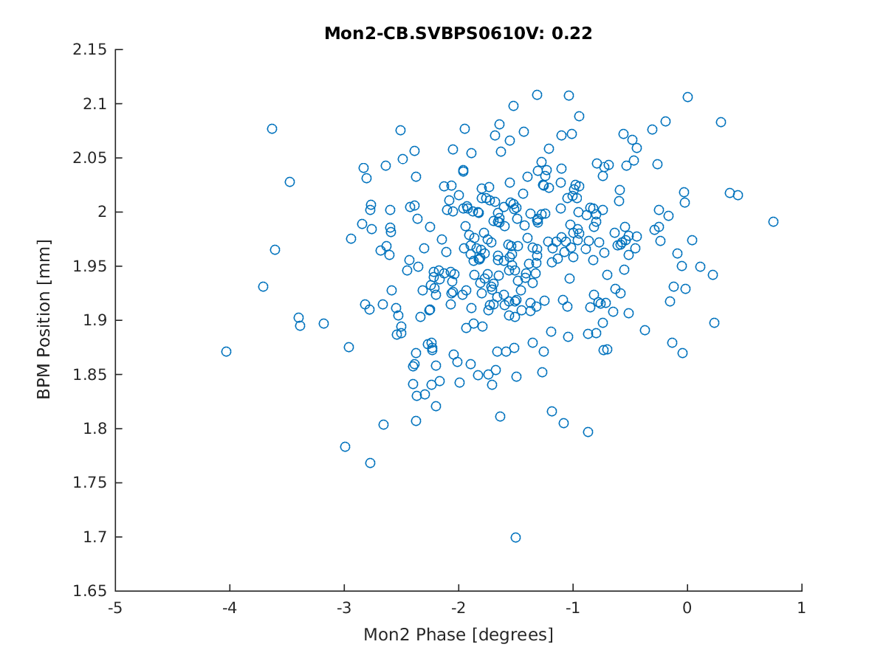
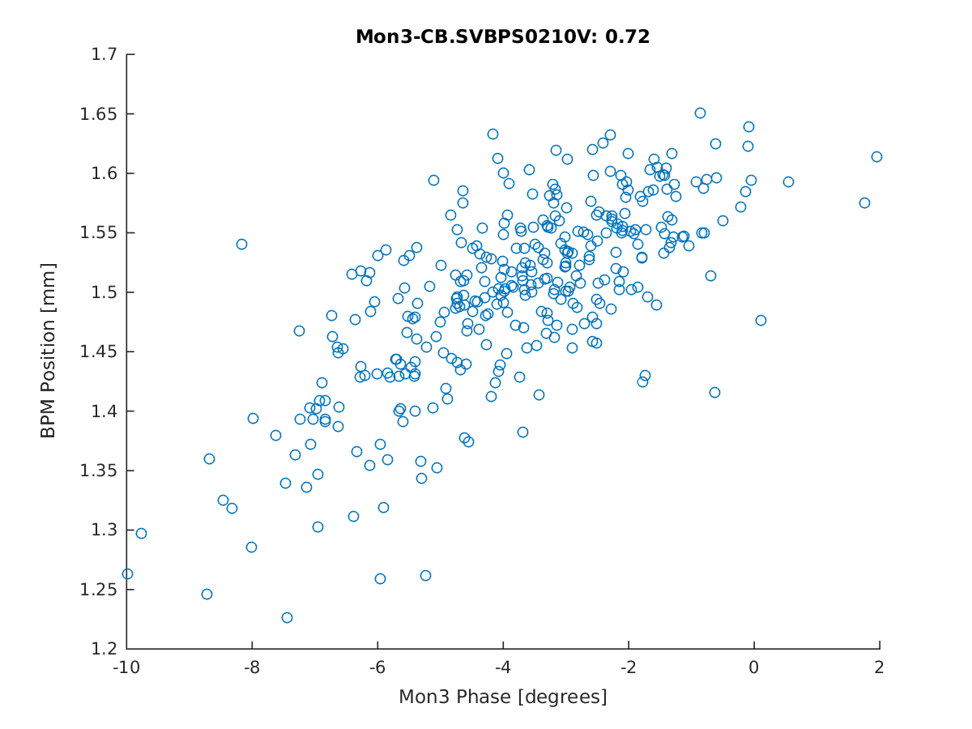
Largest Correlations with Vertical Position

Slide 13
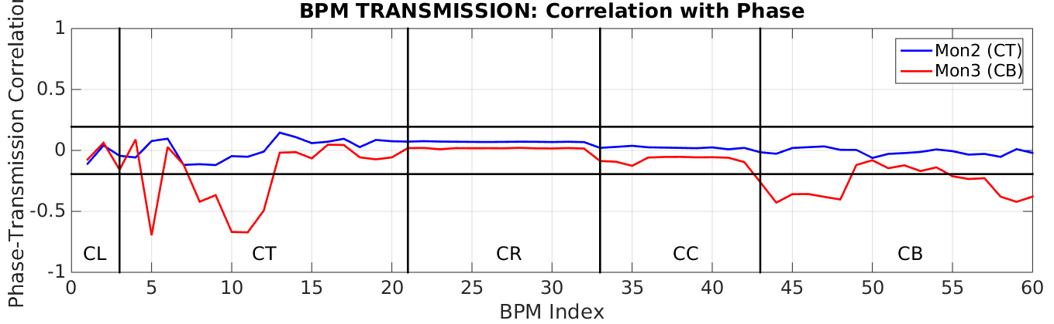
Phase Correlation with Transmission

Slide 14

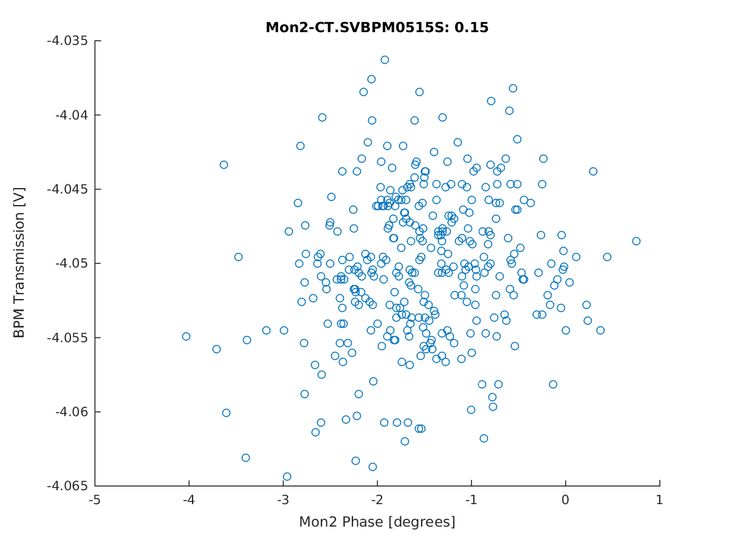
Largest Correlations with Transmission

Slide 15
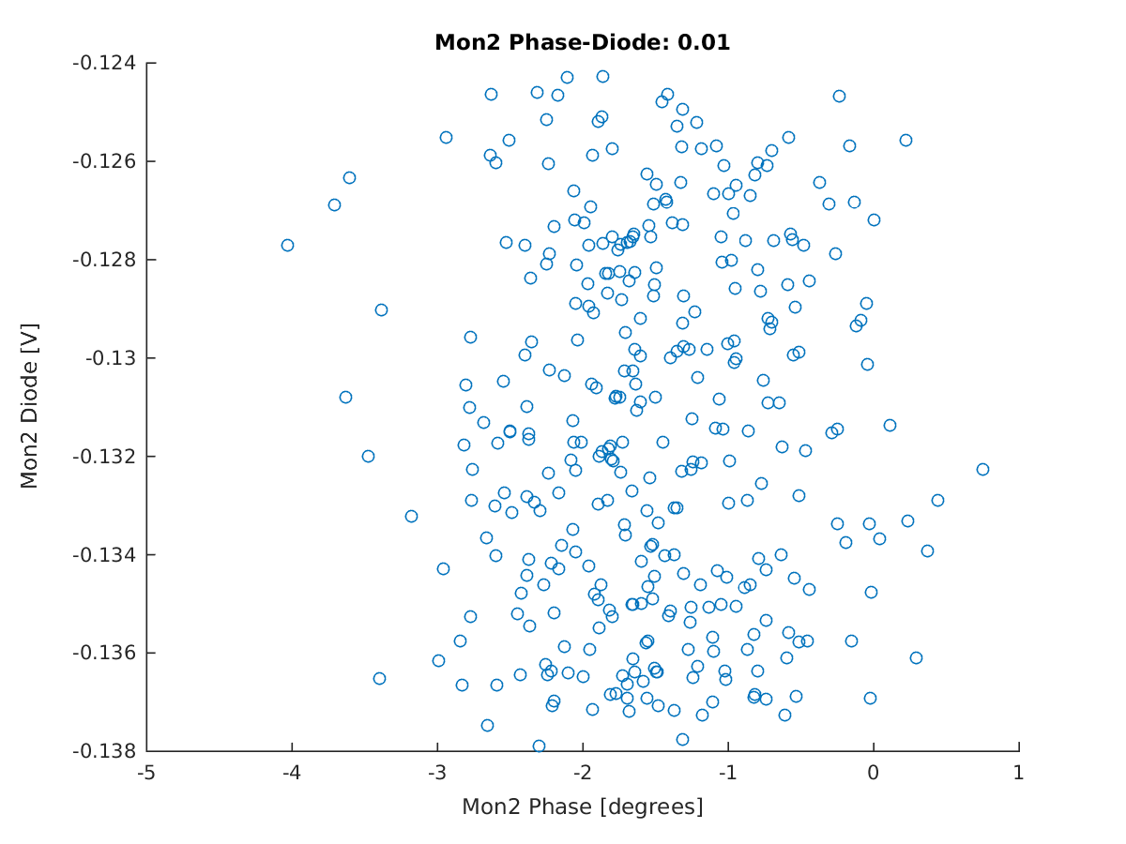
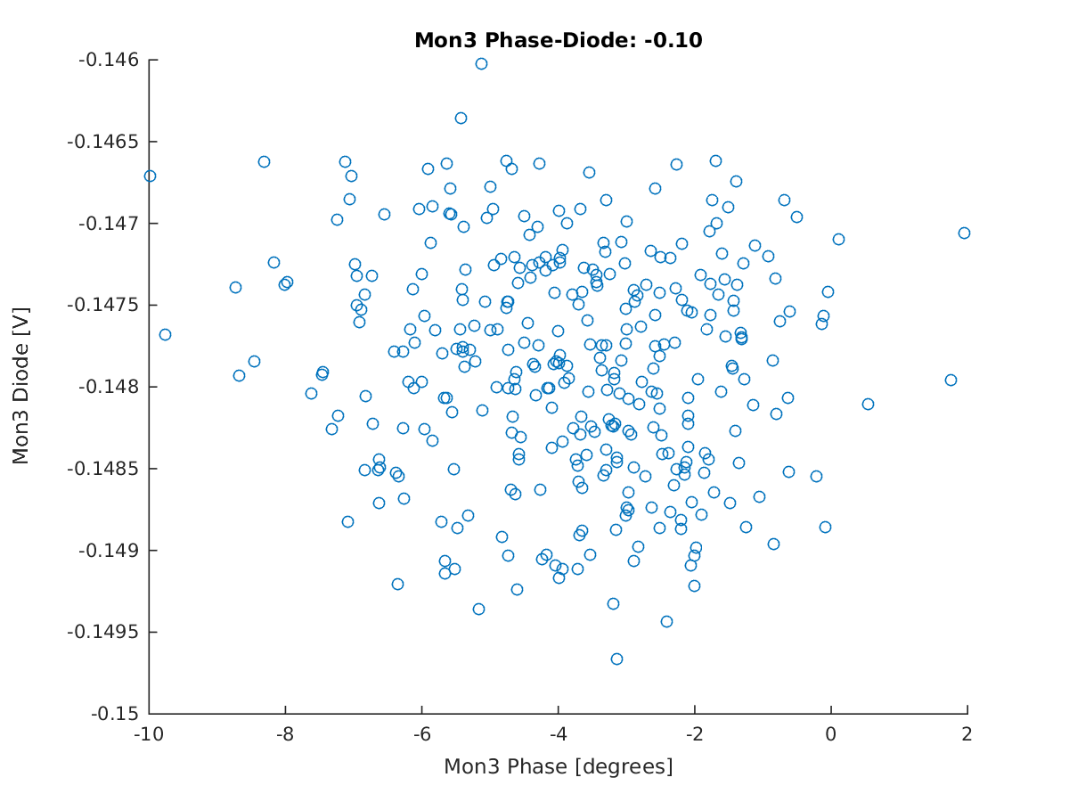
Correlation: Phase and Diode signals

Slide 16
Summary
MEASURED CORRELATIONS
Mon2 – Mon3 Phase: 0.19
Mon3 – PETS Phase: 0.68
Horizontal position (max):
Mon2: 0.24 (CB.410)
Mon3: 0.82 (CT.285)
Vertical position (max):
Mon2: 0.22 (CB.610)
Mon3: 0.72 (CB.210)
Transmission (max)
Mon2: 0.15 (CT.515)
Mon3: 0.70 (CT.215)
Diode
Mon2: 0.01
Mon3: 0.10
Maximum correlations with horizontal, vertical and sum signals in the BPMs are larger than the correlation between the phase in CT and CLEX!
Horizontal and vertical dependence most likely coming from energy.
Transmission not so clear to me… possibly losses in monitor itself or calibration issues due to issues with diode.

