Slide 1

Future of SRF technology
SRF
in the context of LC’s & FCC…

Slide 2
Outline of Talk
A BIT OF SRF HISTORY
Current “state of the art” vs ILC needs
Potential for higher gradients for ILC/ILC-upgrade
Cost reduction avenues for ILC and Upgrade
FCC (Future Circular Collider)-
  How to meet the RF needs
  New Developments underway
Conclusion
  Global impact of SRF

Slide 3

Successes of SRF R&D At the Gradient Frontier
Scientific understanding of performance limiting mechanisms => development of cures

Slide 4
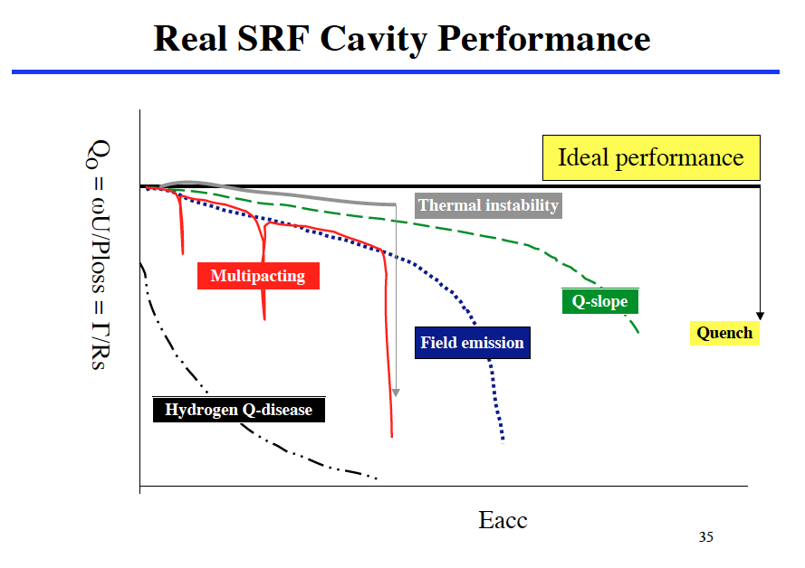
Performance limitations overcome
3
6
10
25
40
MV/m

Slide 5
Successes of SRF R&D At the Gradient Frontier
  Multipacting…limited gradient to 3 MV/m (at 1.3 GHz)
  Thermal breakdown of superconductivity…6 MV/m
  Field emission limits 10 – 20 MV/m
  Q disease due to H intake – Q falls at low field
  Q-drop at high fields – 25 MV/m
Major applications at each stage of progress
Now 1.3 GHz 9-cell ILC cavities reach 30 – 40 MV/m
CM gradients reach 30 - 31.5 MV/m

Slide 6
As Gradients reach 6 – 8 MV/m
Applications to
Nuclear Physics
  Ions (total > 1 GeV installed voltage)
    Low Energy Nuclear Physics, Nuclear Astrophysics
      ATLAS, ISAC, ALPI….
  Electrons
    CEBAF (>1 GeV installed)
High Energy Physics- Energy and Luminosity Frontiers
  Electrons (total 12 GeV installed voltage)
    TRISTAN, HERA, LEP-II, CESR, KEK-B, BEPC
  Protons
    LHC
Light Sources
  Electron Storage Rings
    CESR, DIAMOND, CANADIAN-LS, TAIWAN-LS, ESRF, SOLEIL, POHANG
  Free Electron Lasers (FELs)
    JLAB-FEL, JAERI

Slide 7
As Gradients rise to 10 – 20 MV/m
FEL Light Source
  FLASH at DESY > 1 GeV
  15 – 20 MV/m
Neutron Source
  SNS at Oak Ridge 1 GeV Protons
  15 MV/m
Accelerator Applications of SRF: 7 GeV Installed (500 cavities)

Slide 8
> 2010: Dawn of a New Age:
Major Accelerators Under Construction
CEBAF Upgrade - JLAB (80 cavities)
  Upgrade 6.5 GeV => 12 GeV electrons
XFEL – Hamburg (840 cavities)
  18 GeV electrons – for Xray Free Electron Laser – Pulsed)
LCLS-II – SLAC (300 cavities)
  4 GeV electrons –CW XFEL (Xray Free Electron Laser)
SPIRAL-II – France (28 cavities)
  30 MeV, 5 mA protons -> Heavy Ions
FRIB – MSU (340 cavities)
  500 kW, heavy ion beams for nuclear astrophysics
ESS – Sweden (150 cavities)
  1 – 2 GeV, 5 MW Neutron Source ESS - pulsed
PIP-II – Fermilab – 800 MV (115 cavities)
  High Intensity Proton Linac for Neutrino Beams
ADS (200 cavities)
  China, India
Total ≈ 2000 Nb Cavities,
Installed Voltage will rise from 7 GeV => 25 GeV

Slide 9
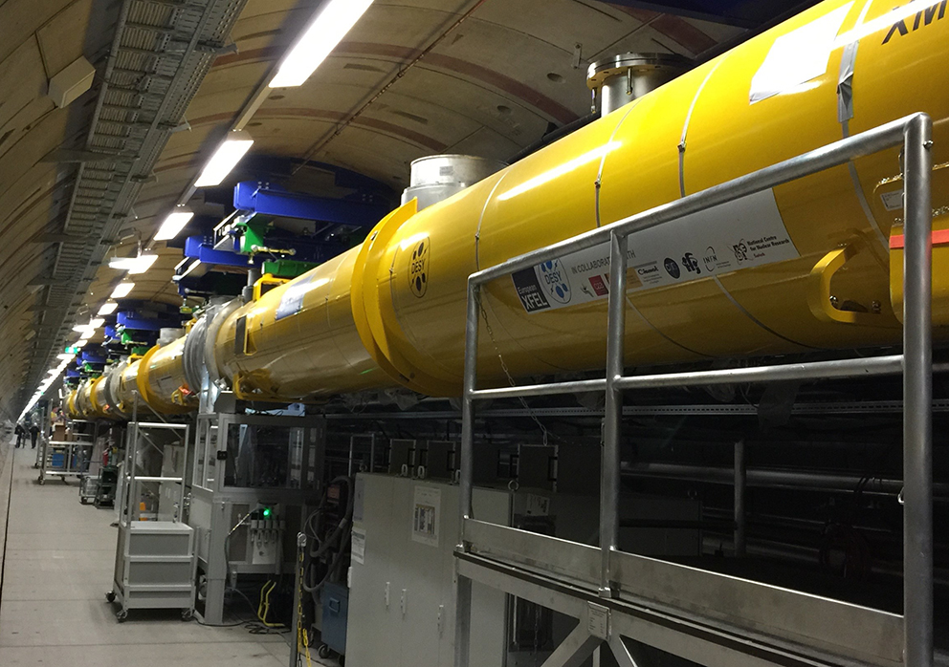
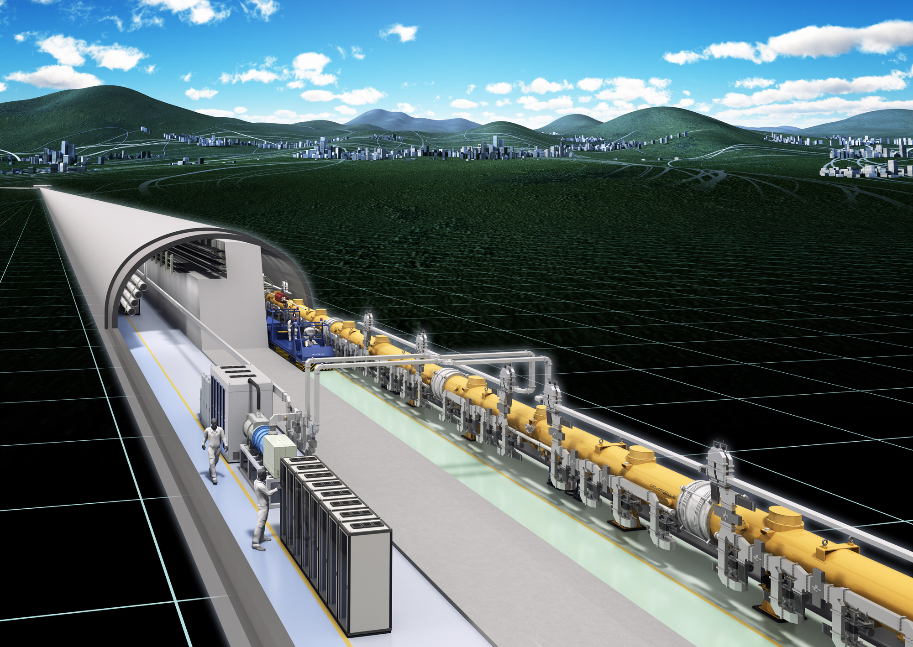

XFEL Largest SRF Application
- Model for Future ILC
Eu-XFEL
840 Nb cavities
103 Cryomodules
ILC
16, 000 Nb cavities
1855 Cryomodules

Slide 10
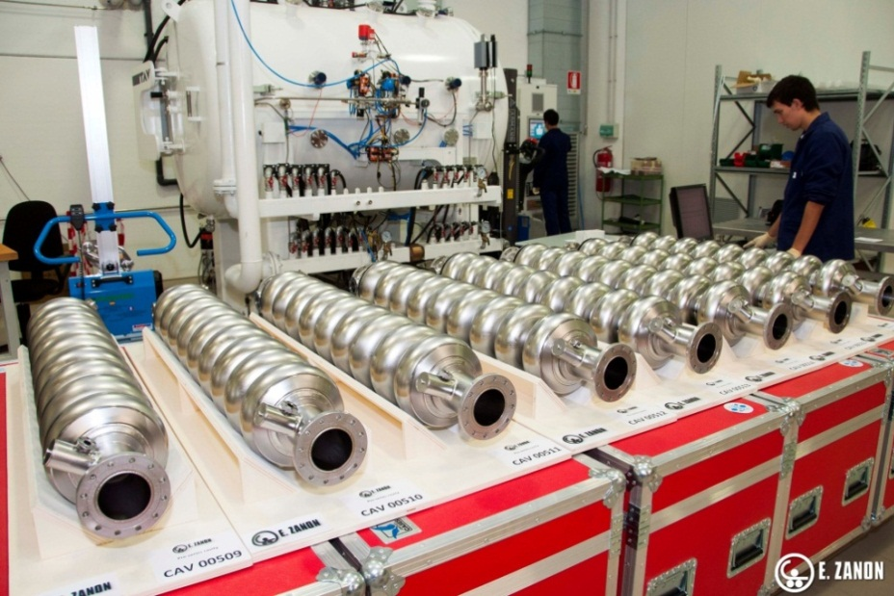
XFEL: Mass Production of Cavities Need 840

Slide 11
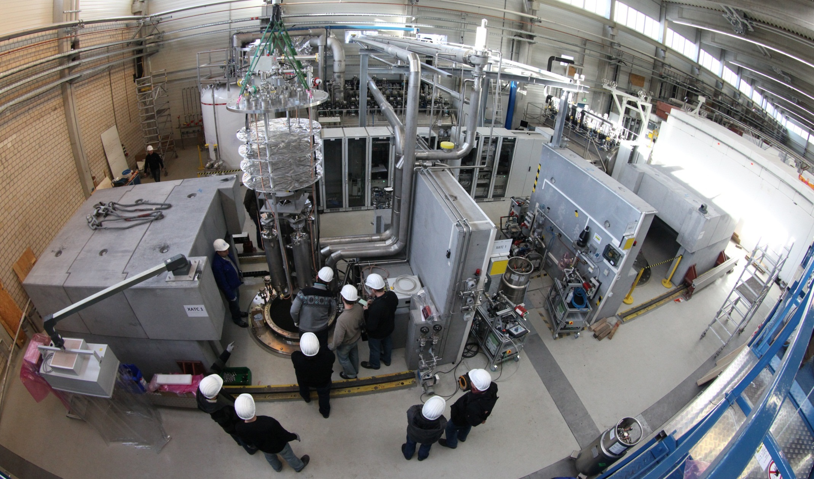
Cavity Testing at DESY – Hamburg, Germany

Slide 12
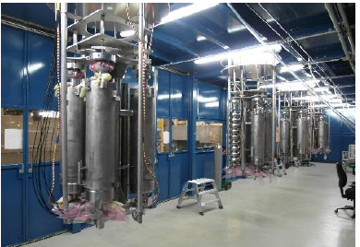
Preparation for test

Slide 13
Q vs E, Typical Vertical Test Results

Slide 14
Gradient Yield after First Treatment (as of Sept 2015)
738 cavities
  from two vendors, RI and EZ
EZ vendor used Bulk EP and Final BCP
RI vendor use Bulk EP & Final EP (as for ILC)
Final EP gives 3 – 4 MV/m higher performance
Lesson for highest gradients
  Don’t use BCP
>30%
< 10%
 | Max | Grad | ient | Usable | Grad | ient
 | RI | EZ | C | RI | EZ | C
<G>MV/m | 33 | 29.6 | 31.4 | 29.4 | 26.3 | 27.7
28MV/m | 86% | 73% | 79% | 66% | 44% | 54%
Yield at

Slide 15
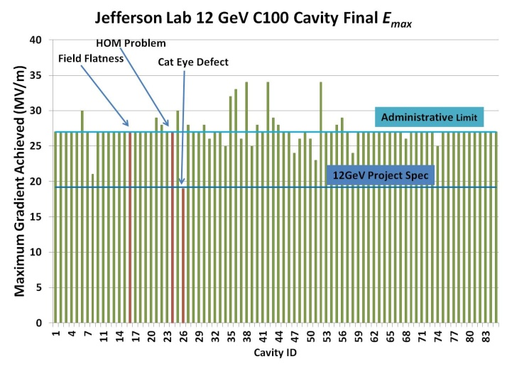
CEBAF 12 GeV Upgrade
> 80 cavities: overall performance
72/85 @ admin limit (85%)
Note: Jlab used bulk BCP (150 µm) followed by Light EP (30 µm)
Cavities made by RI (Germany);
Reported 11.2012 by F. Pilat

Slide 16
Definition of Max and Usable Gradients
R&D Needed on Medium Field Q-Slope
For this cavity
Max gradient is 30 MV/m
Usable gradient is 25.5 MV/m limited by bottom x-rays

Slide 17
2nd Treatment Increases Yield
18% of cavities with G < 20 MV/m re-treated
Mostly by HPR
Average gradient increased
From 14.3 to 25.8 MV/m
Re-treatment was not applied to higher gradient cavities
  time/cost pressures

Slide 18
Effect Of Re-treatment On “High Gradient Cavities” – Special Batch
12 cavities each from RI and EZ for High Gradient R&D
Ave Max gradient for RI cavities rises by about 3 MV/m after re-treatment
Ave Max 35.5 ± 4.7 MV/m
Average yield at 28 MV/m rises by 10%

Slide 19
Compare XFEL to ILC need
We can anticipate (optimistically)
Ave Max Gradient will rise to from 33 to 36 MV/m on 2nd treatment
  More than 25% re-treatments may be required for ILC
But yield of usable gradient needs to be improved
  We need 90% yield for gradient > 28 MV/m with average of 35 MV/m
Substantial gain possible if Medium Field Q-slope is overcome
  > 50% cavities fall below Q 10¹⁰
  Q0 for ILC can be 8x10^9 which increases yield some
Fix medium Field Q-slope
  Proper doping? to be invented?
Next addressable limit is field emission
  limits about 20% of cavities
XFEL results are tantalizingly close to ILC needs!

Slide 20
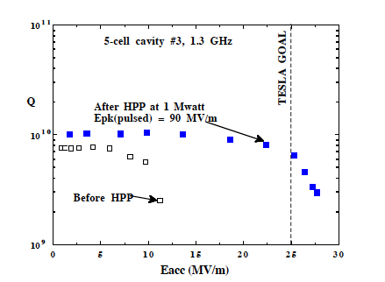
How to Counteract Field Emission ?
  Accidental dirt contamination during assembly drops Q due to Field Emission (FE)
  Apply high pulsed power conditioning to lower X-rays and raise field
  Should work for cavities stuck by field emission at lower gradients

Slide 22
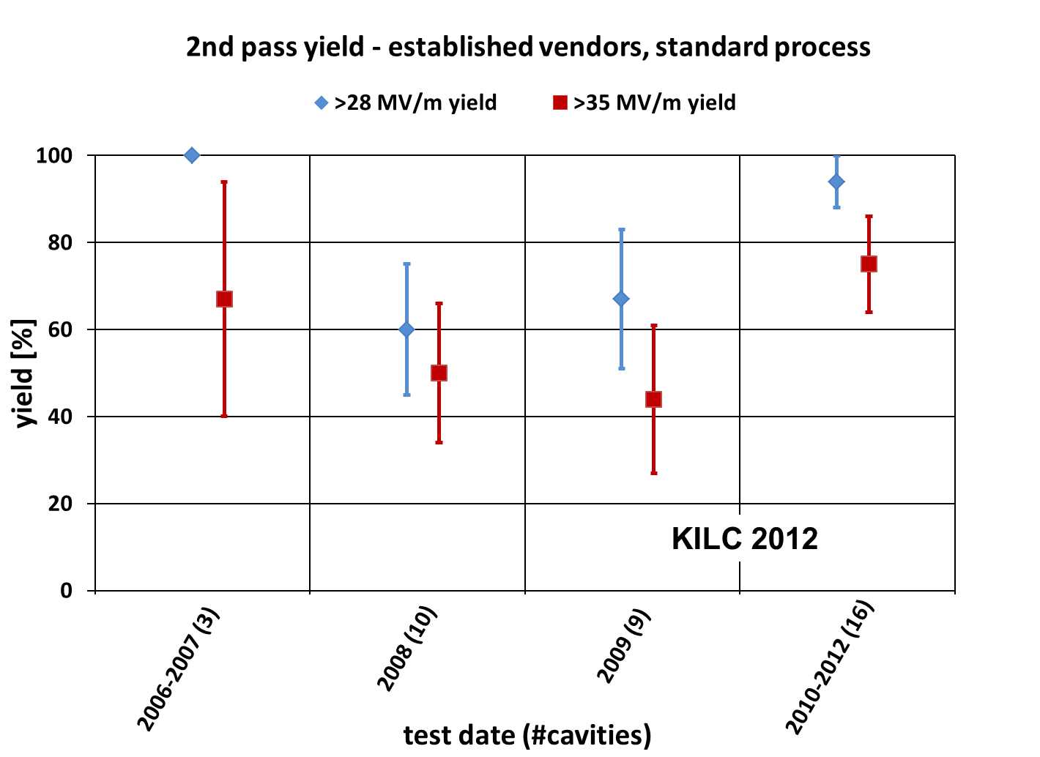
Continued Progress to Target ILC Cavity Gradient Yield R&D
(94+/-6)% acceptable for ILC mass production

Slide 23
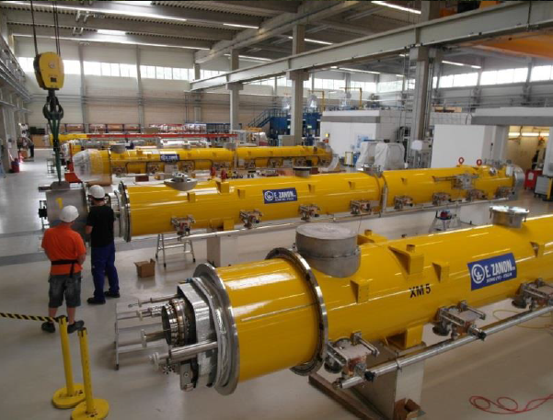
XFEL: 103 Cryomodules
XFEL goal for CM
  23 MV/m
ILC goal 31.5 MV/m
Average gradient of 60 XFEL CM now is 27.4 MV/m
  37% limited by BD
  22% by x-rays (FE)
  41% by power available for test
Several best CM reach/exceed ILC goal

Slide 24
Average gradient of 60 CM is 27.4 MV/m
Ave CM gradients need to improve!
But best CMs reach ILC goal

Slide 25
ILC

Slide 26
ILC

Slide 27
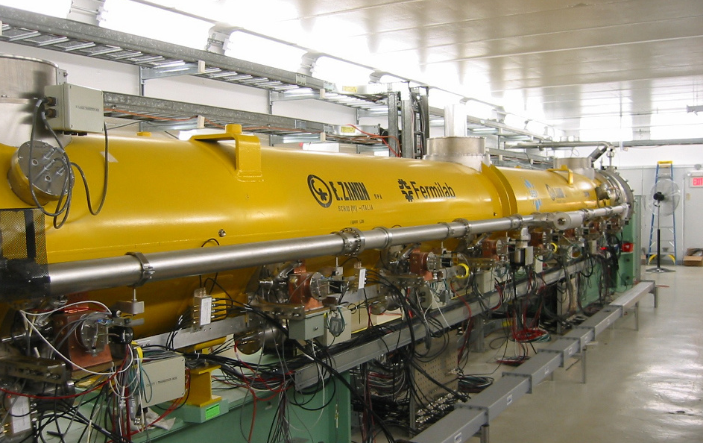
8-cavity Cryomodule at Fermilab:

Slide 29
Q Values in CM at Fermilab

Slide 30

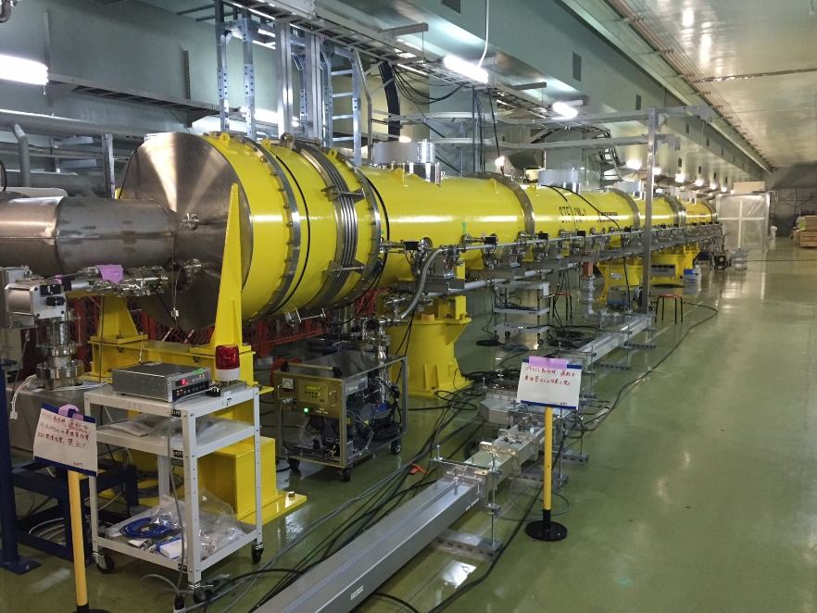
KEK Cavity RF performance in CM1/CM2a
Single cavity power test, now under progress
Module | CM1 |  |  |  |  |  |  |  | CM2a
Cavity # | 1 | 2 | 3 | 4 | 5 | 6 | 7 | 8 | 9 | 10 | 11 | 12
Cavity name | MHI-14 | MHI-15 | MHI-17 | MHI-18 | MHI-19 | MHI-20 | MHI-21 | MHI-22 | MHI-24 | MHI-23 | MHI-25 | MHI-26
E_{acc} @V.T. [MV/m] | 36.6 (power limit) | 35.7 (Cell#1 Quench) | 38.4 (power limit) | 36.2 (power limit) | 37.2 (Cell#1 Quench) | 35.1 (power limit) | 38.9 (power limit) | 35.8 (power limit) | 12.0 (heavy F.E.) | 35.9 (Cell#3 Quench) | 32.3 (Cell#1 Quench) | 31.6 (Cell#1 Quench)
E_{acc} @C.T. (short pulse) [MV/m] | >38.6 (test stop) | 36.8 (Quench) | 35.2 (Quench)
E_{acc} @C.T. (full pulse) [MV/m] | >38.7 (test stop) | 36.7 (Quench) | 35.3 (Quench)
36MV/m
(last week)
Room-Temperature Coupler Process : July – September 2015
Cavity Process at 2K : October – November 2015

Slide 31
Future R&D Areas for ILC and TeV Upgrade
Raise gradients
  Nb cavities of improved shape
  New materials, in particular Nb₃Sn
Raise Q
  Improve understanding of Q-drops
  Explore Nitrogen (or other) doping
  Reduce field emission
Lower costs
  Reduce Nb material cost
    Explore Nb-Cu composite
    Large grain Nb
  Reduce cavity fabrication cost
    Hydroforming and Spinning

Slide 32
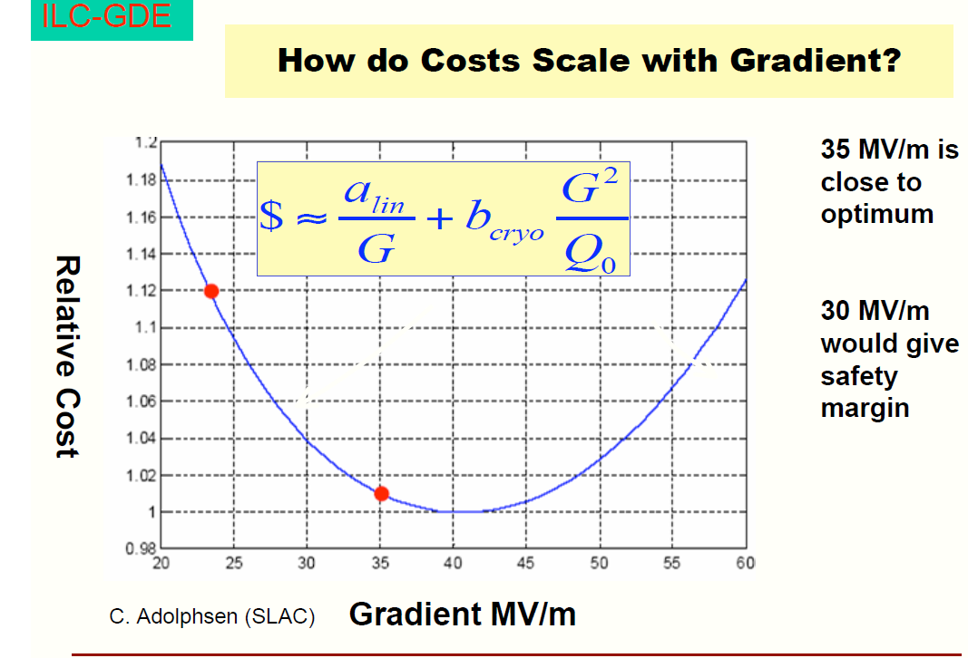

Slide 33
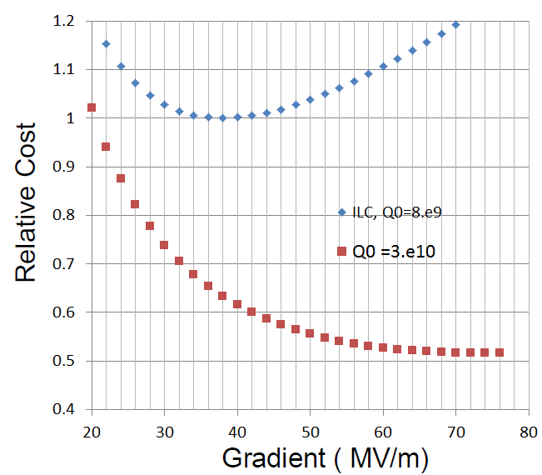
Impact of Increasing Gradient and Q on ILC cost
ILC requirements:
G > 35 MV/m/ Q0 > 0.8e10
Improving Q0 from 8e9 to 3e10 has big impact on machine cost.
Optimal gradient moves to
~ (70 - 80) MV/m

Slide 34
Quest for Higher Gradients
Best gradient in TESLA shape 9-cell cavity is 45 MV/m
Limited by
  surface magnetic field (Hpk) = fundamental rf critical field
=> Improve cavity shapes to reduce Hpk/Eacc
So that critical magnetic field is not a brick wall

Slide 35
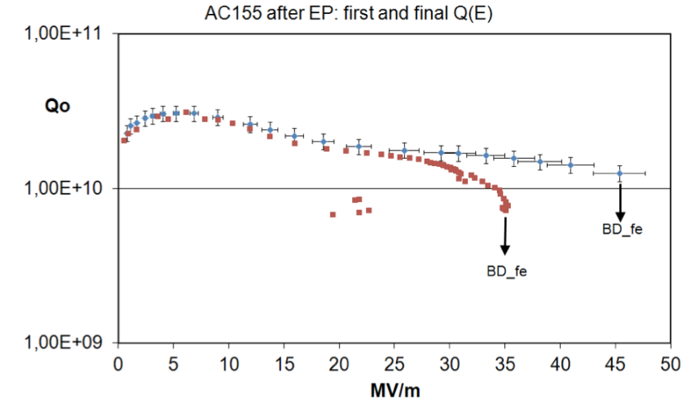
Highest Gradient TESLA Shape cavity, 45 MV/m
D. Reschke et al., SRF2011, THPO046 (2011).
Eacc

Slide 36
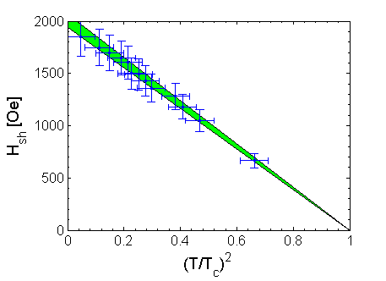
Max surface surface magnetic field reached with TESLA-shape cavities is close to “theoretical limit”
Fundamental RF Critical Field (H_{superheating}) Measurement
45 MV/m in best cavity
=> Improve Cavity Shape

Slide 37
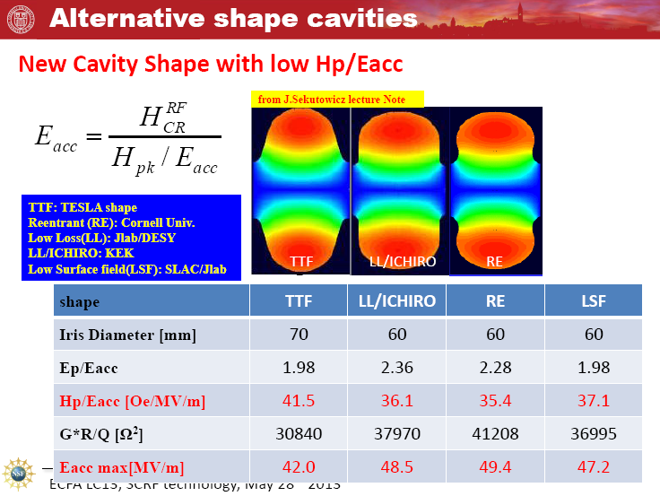
Better Cavity Shapes to Beat the Limit:
Lower H_{pk} even if you have to raise E_{pk}
Eacc = 2000/35.4 = 56 MV/m

Slide 38
Proof of principle with single cells, 52 MV/m

Slide 39
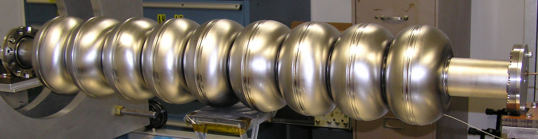
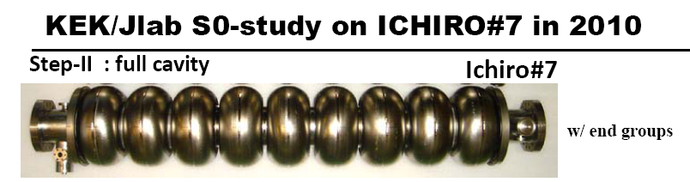
Multi-Cell Cavities with Advanced Shapes Developed
But Limited by Field Emission to ~40 MV/m

Slide 41
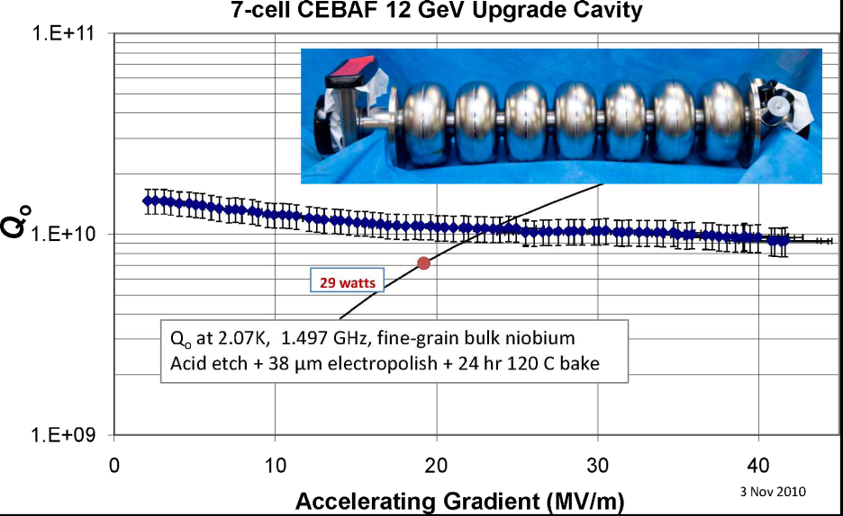
Best With Low-Loss shape : 42 MV/m
Field Emission is the problem to solve!

Slide 42
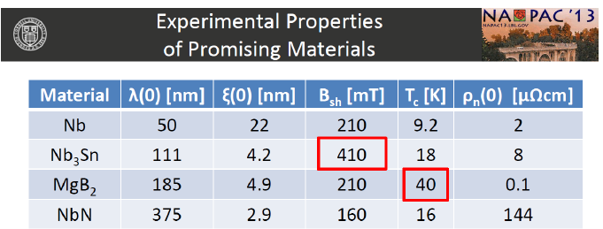
Higher Gradient with New Materials?
Best candidate Nb₃Sn
Nb₃Sn, T_{c} = 18K
Higher Q at higher operating T
Higher ultimate field possible?

Slide 43
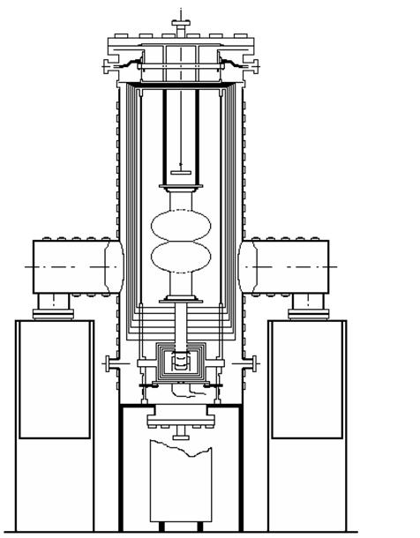
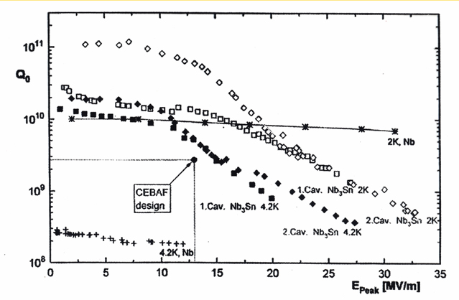
A15 Compounds – Nb₃Sn
Wuppertal, end ’1980s :
Nb3Sn cavity (1.5 GHz) obtained trough Sn vapour phase diffusion @ 1200˚C
Q vs. E_{peak} of the 1st two Nb₃Sn-coated 1.5GHZ single cell cavities in comparison to pure Nb at 4.2K and 2K from CEBAF

Slide 44
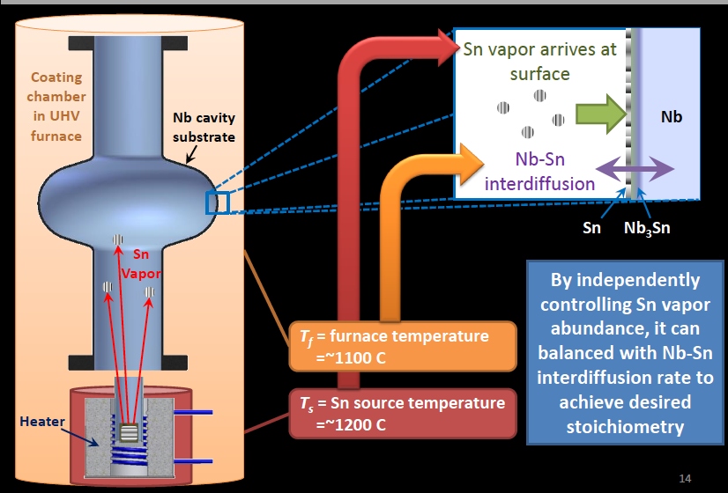
Nb3Sn Fabrication/Cornell

Slide 45

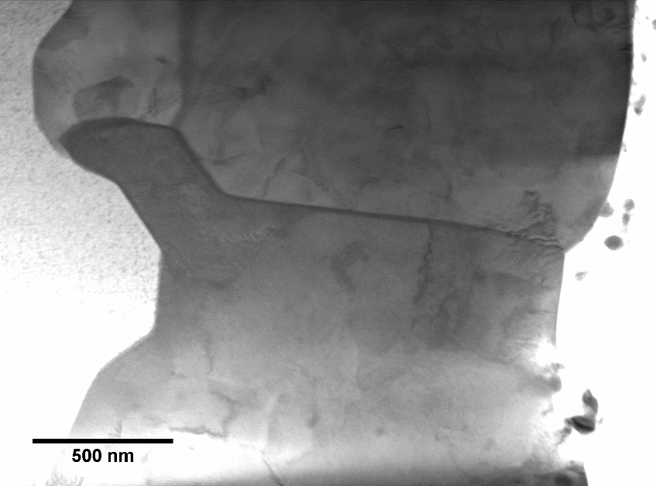

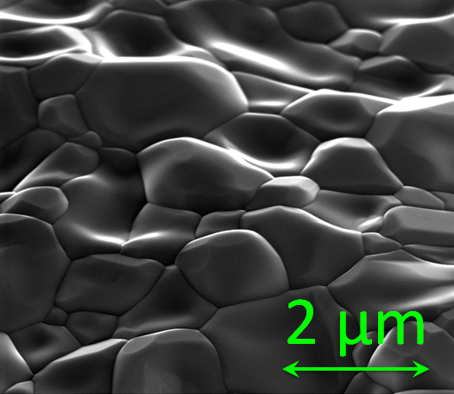
Nb₃Sn Coating by vapor diffusion
TEM Cross Section
R&D Nb₃Sn cavity achieves E_{acc} and cryogenic efficiency specification of state of the art high Q₀ projects!
Nb₃Sn
Nb
Nb₃Sn vs Nb
Still work to be done for high field applications
SEM of Surface
S. Posen, M. Liepe, and D. L. Hall, Appl. Phys. Lett. 106, 082601 (2015), C. Becker et al., Appl. Phys. Lett. 106, 082602 (2015).

Slide 46
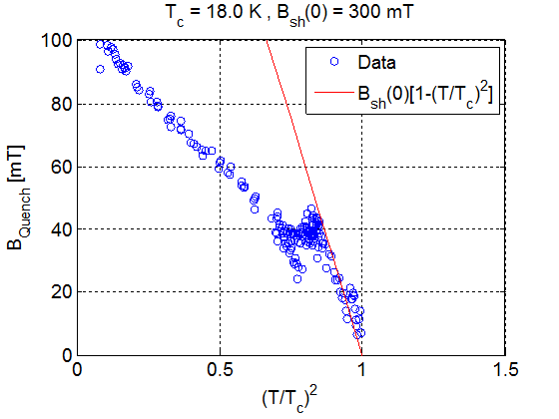
Expectations for Nb3Sn
Using high power RF (MW) with short pulses, Cornell recently demonstrated (for T>6K)
Nb3Sn follows the expected superheating field of the 18K superconductor.
When extrapolated to 2K this leads to surface magnetic fields of 300 mT
  Nb superheating field 200 mT.
These results suggest that a well prepared Nb3Sn cavity with optimal shape can reach 80-90 MV/m
And high Q (due to higher Tc of Nb3Sn)
Heating at defect/or second phase behavior takes over
Superheaing field
With intense R&D, Nb3Sn can outperform Nb.

Slide 47
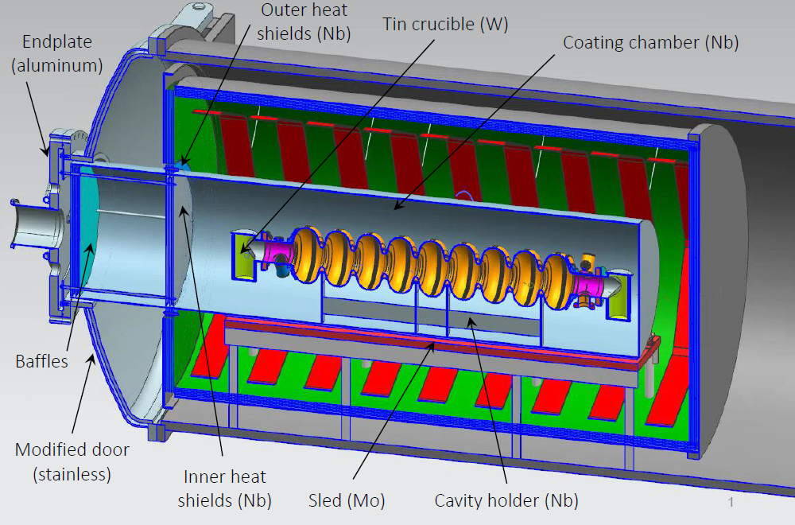
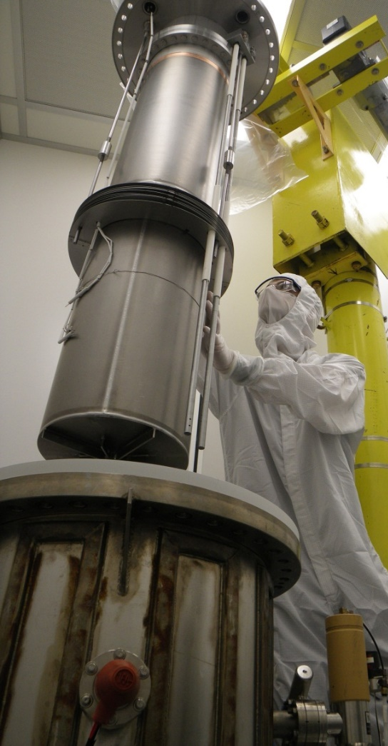
Active Nb₃Sn Programs
Cornell
Fermilab
Jefferson Lab

Slide 48
Recent Breakthroughs in High Q (without FE)
1. Reverse the falling Q-slope!
N doping exceeds familiar Q values!
  But still demands deep physical understanding.
    What is missing in simple BCS calculation for Q?
2. Reduce residual losses by completely expelling dc magnetic flux
  leads to even higher Q values.
R&D in fundamental understanding of both phenomena will reveal
  What are the ultimate limits to the best Q?
  Best parameters to optimize the preparation and cool-down protocol for highest Qs?

Slide 49
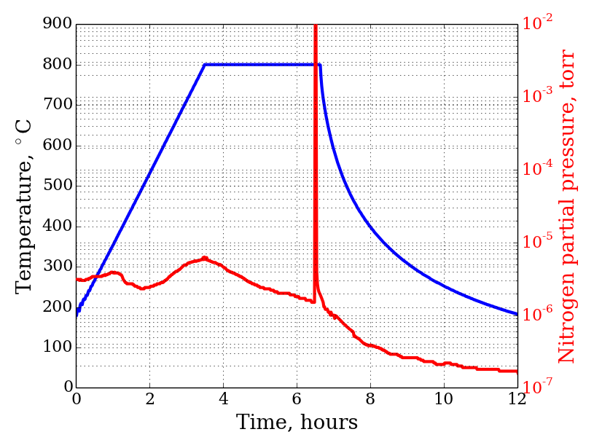
What is N doping? infuse the cavity surface at 800 C with a small concentration of nitrogen (about 50 ppm)
Injection of small nitrogen partial pressure at the end of 800C degassing-> drastic increase in Q

Slide 50
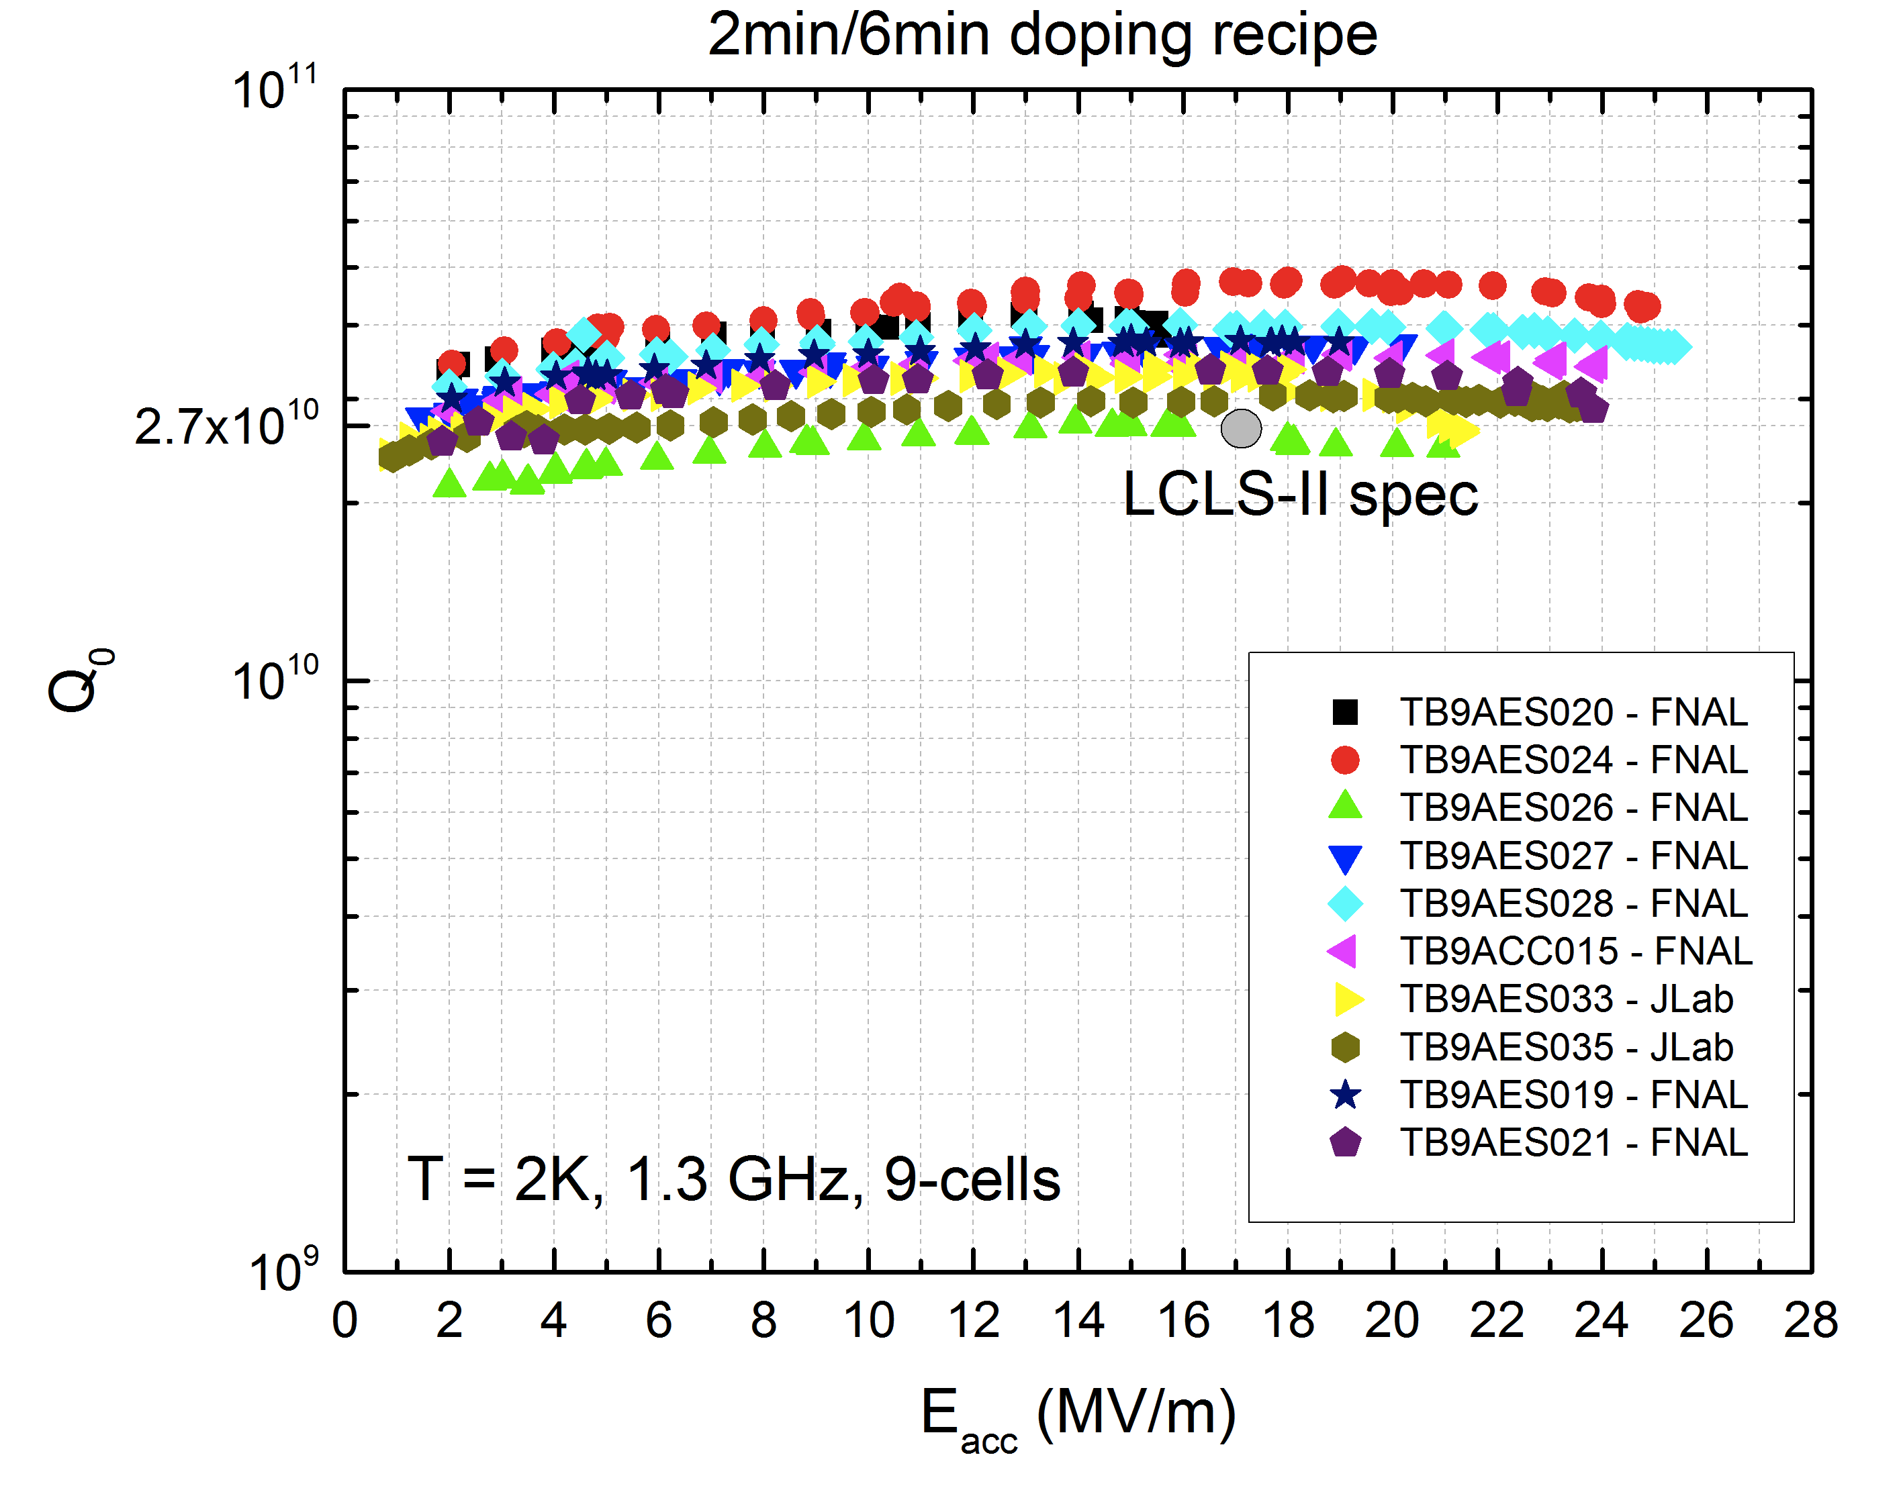
High Q values obtained by N-Doping doping repeatedly on 9-cell ILC Cavities for LCLS-II
Standard treatment Q
Pre-doping state of the art

Slide 51
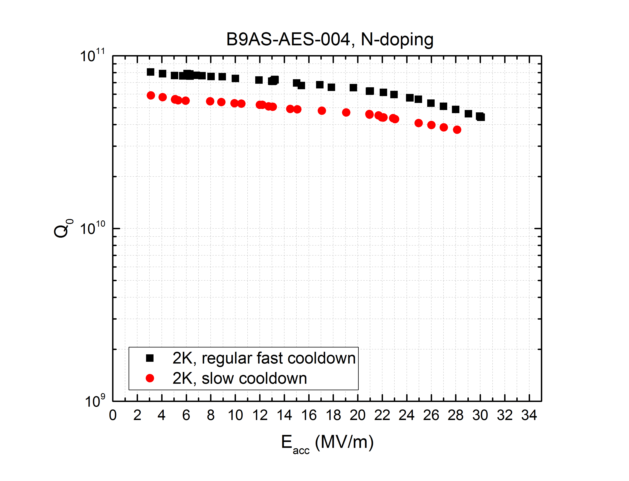
High Q to 30 MV/m (650 MHz)

Slide 52
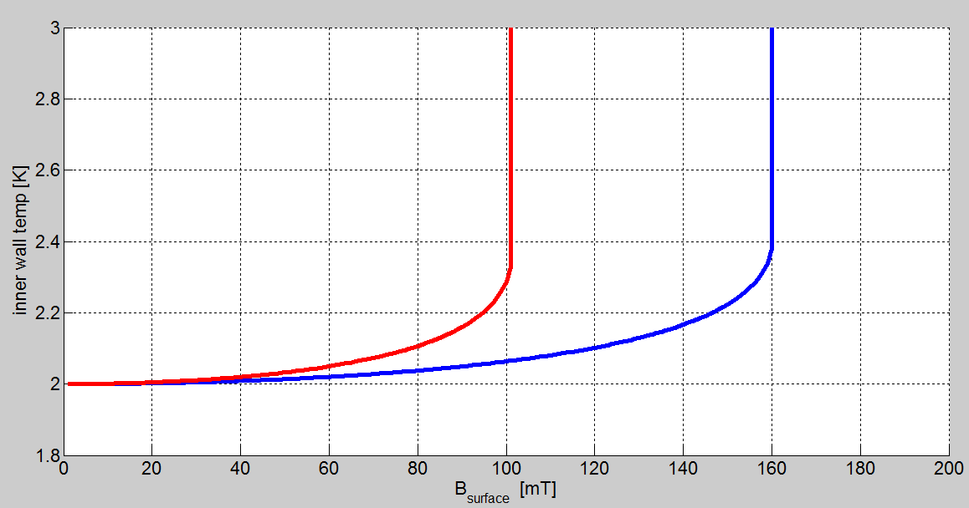
High Q Opens
Cost Reduction Possibilities: 1.3 => 2.6 GHz
1.3 GHz was originally chosen to avoid the global thermal instability ,(GTI) due to BCS resistance (increases as f²)
Pros for higher frequency
  Material cost savings for cavity and CM parts
  Optimistically 75%
Smaller surface area
  Less defects/field emission
2.6 GHz
GTI ~ 37.5 MV/m
Q = 1/3 BCS
Surface Temp
GTI ~ 33 MV/m
Q = 1/2 BCS
1.3 GHz
GTI > 45 MV/m
B_{surface}
Cons
Larger wakefields
More HOM power
If N-doping can reduce BCS resistance by factor of 3
Global thermal instability due to BCS surface resistance can be managed

Slide 53
Cavity Material-Cost Reduction
Nb cost dominates for large scale production
Cost of bulk niobium is a major factor
  especially for low frequency (<650 MHz)
  the required Nb per cell scales as 1/f².
=> Cut Nb cost

Slide 54
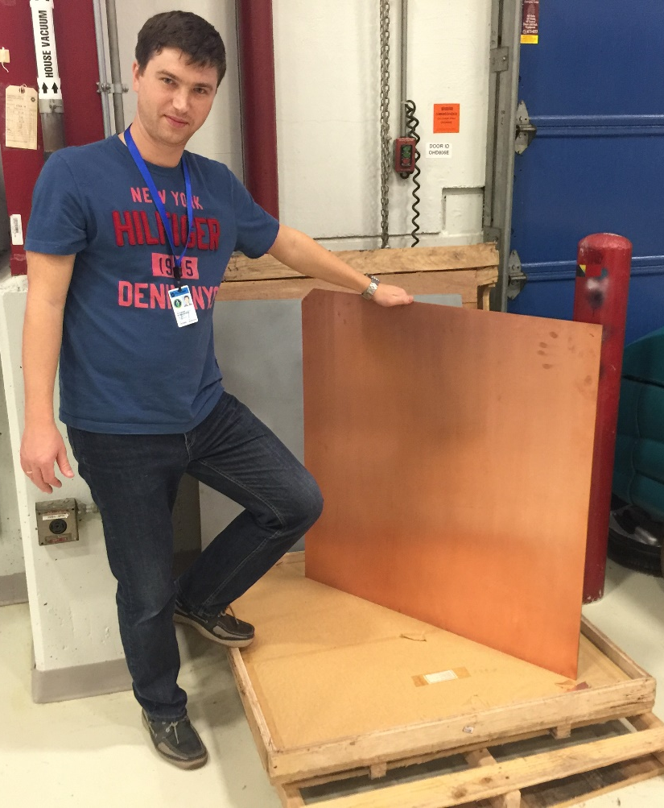
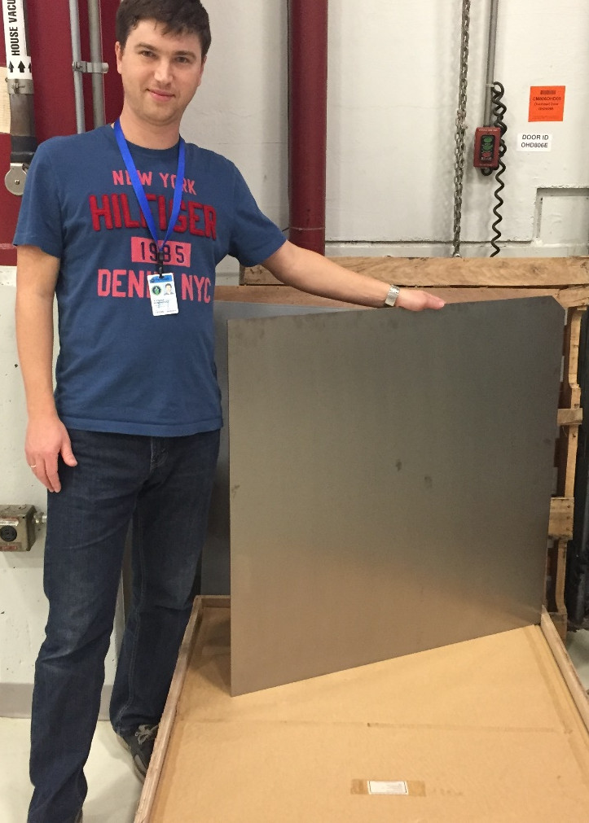
1 m² Nb-Cu Sheet Explosion Bonded
Propose cost reduction -1
  Via Nb-Cu Composites
    Nb 1 mm/Cu 4 mm,
    Material made by explosion bonding Cu with high RRR Nb
    X4 - 5 reduction over Nb
  Cavities made via hydroforming and spinning

Slide 55
Cavity Fabrication Cost Reduction via
Seamless Techniques with Nb-Cu Composites
Eliminate expensive e-beam welding and trim machining of parts
High quality surface preparation possible
  as with bulk Nb cavities that show high performance
Rapid production rate
Hydroformed and Spun 1-cell cavities already proven
  Hydroformed 3-cells Nb proved to > 35 MV/m
  Spun single cell Nb proved to 40 MV/m

Slide 56
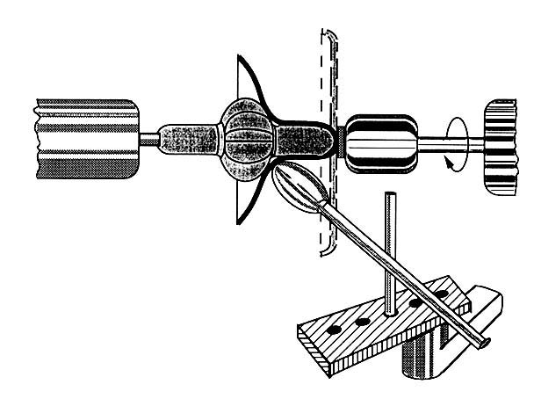
Principles of
Hydroforming and Spinning

Slide 57
Start With Nb Tubes By Flow Forming

Slide 58
Necking and Hydroforming from Tube

Slide 59
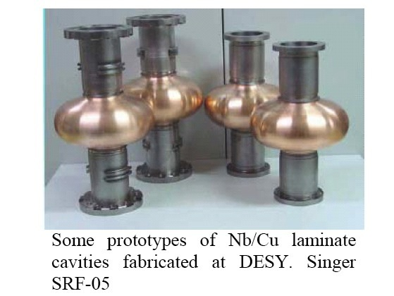
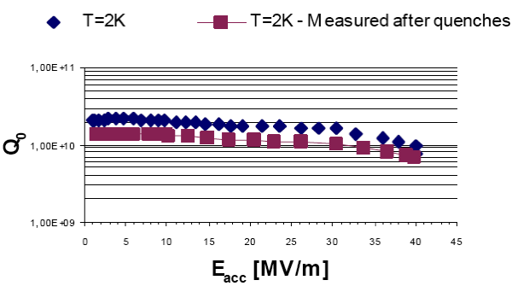
Proof of Principle
1-cell Nb-Cu Composite Hydroformed
Reaches 40 MV/m

Slide 60
Hydroformed 3-cell
Welded into 9-cells
30 – 35 MV/m Proved

Slide 61
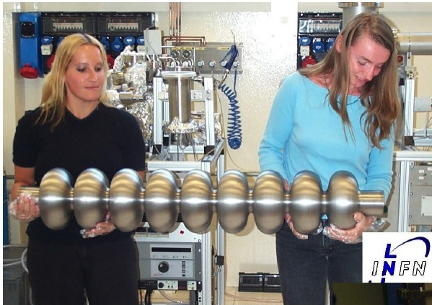
9-cell Nb Cavity Made by Spinning

Slide 62
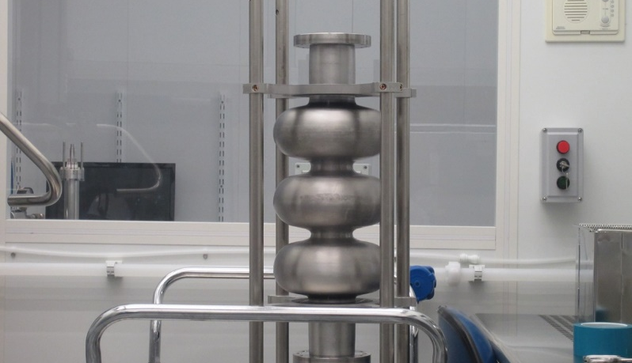
3-cell cavity made from Nb tube by spinning at INFN
Test at FNAL
E_{acc} 34 MV/m
T=2K

Slide 63
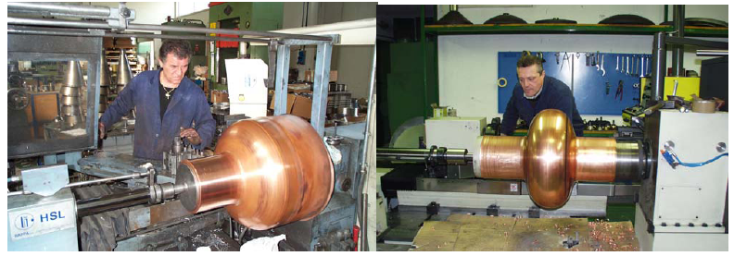
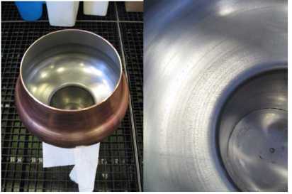
500 MHz Cavity via spinning Nb-Cu Composite
Cornell/INFN –Legnaro – in progress

Slide 64
Path 2: Simplify Nb Sheet Production
Cost Analysis of Nb Production
50% of the cost is in the e-beam melting
20% cost is in rolling, forging and scrap

Slide 65
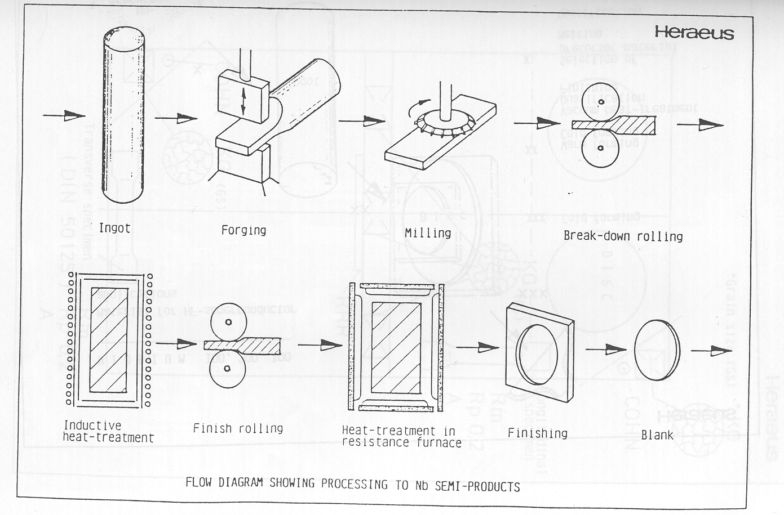
Propose Cost Reduction Path 2
  Via Nb from ingot
    15% reduction possible?
  Go Directly from Ingot to Sheet?
    Large grain Nb
    Performance benefits
    Fewer defects

Slide 67
Multi-Wire EDM Slicing of Ingot
-> Large Grain Nb, fewer defects

Slide 68
Status of Ingot Slicing
100 sheets production in < 50 hrs.
ILC scale 500 sheets per day can be realized by 3-4 machines.
Uniform sheets within 20-40 μm thickness variation.
The surface roughness is very smooth (about 5μm with Rz).
This method can reduce the material waste to 1/3 of the current production.

Slide 69
High Q₀ via Large Grain Ingot Nb, 45 MV/m
D. Reschke et al., SRF2011, THPO046 (2011).
Eacc

Slide 70
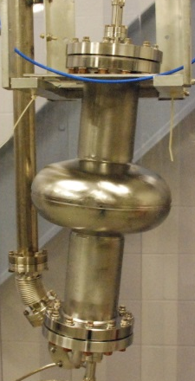
JLAB study of single-cell cavities
Shape ( LSF, LL, TTF ), Material; Large grain
10¹²
TTF shape
1.4K
10¹¹
1.8K
2.0K
10¹⁰
IPAC15, WEPWI013

Slide 71
Future of SRF for ILC - Summary
Technology Status
Paths to raise gradients
  ILC and TeV Upgrade
Paths to raise Q
Paths to Lower Costs

Slide 72
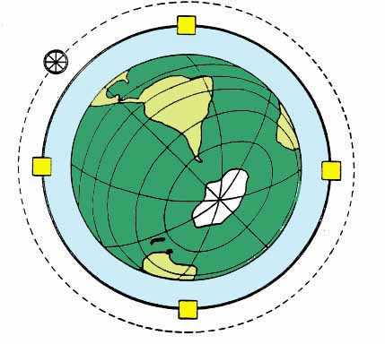
Future Circular Colliders (FCC)
FCC hadron collider with 100TeV proton cm energy
~16 T ⇒ 100 TeV pp in 100 km
~20 T ⇒ 100 TeV pp in 80 km
Fermi’s extrapolation to 1994:
2T magnets, R=8000 km (fixed target!)
E_{beam} ~ 5x10³ TeV → E_{CM} ~ 3 TeV
Cost : 170 B$
From E. Fermi’s 1954
Instead We invented colliders and superconducting magnets …
and built the Tevatron and the LHC

Slide 73
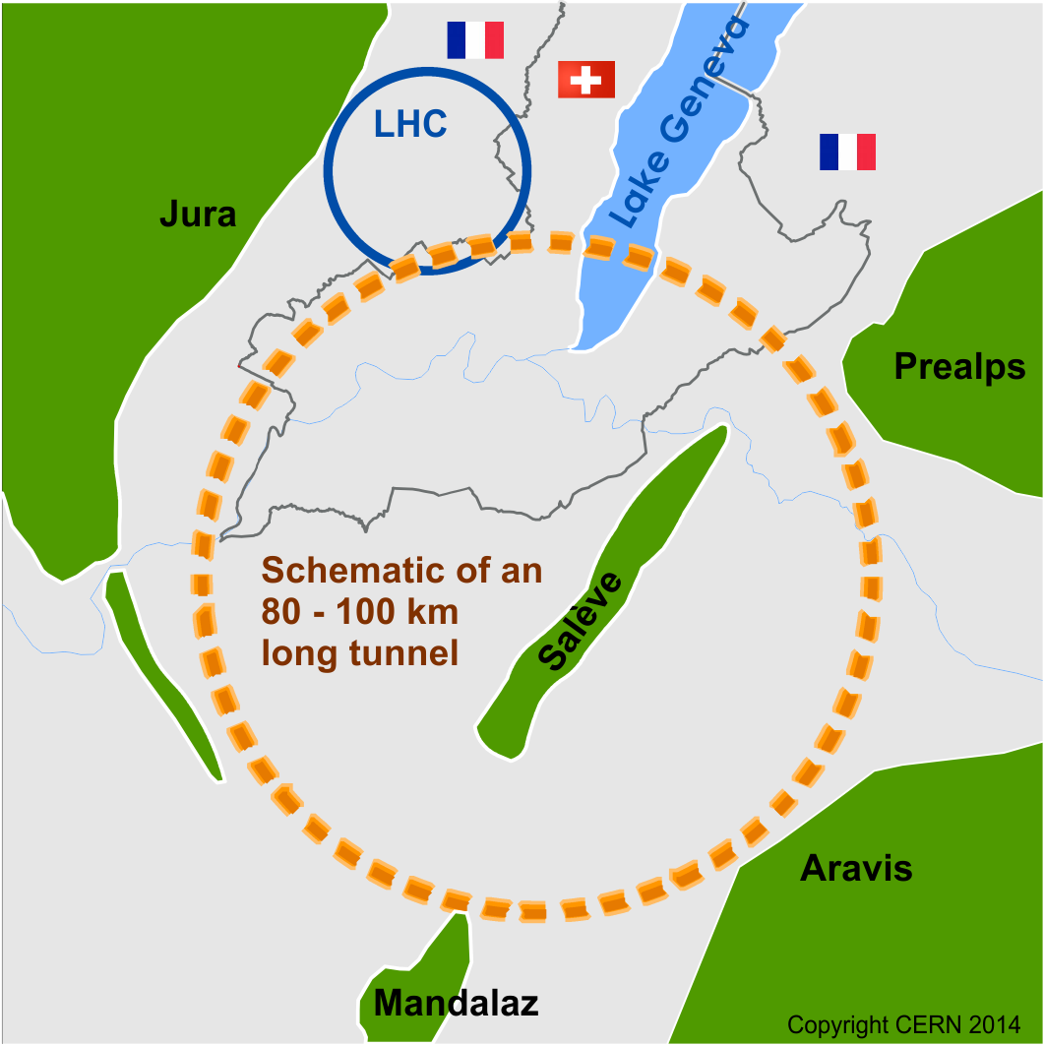
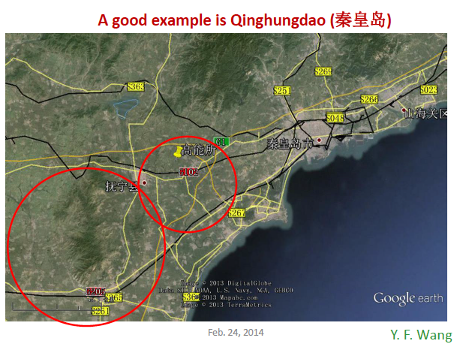
Possible Future Circular Collider (CERN or China)
First Stage could be a circular e+e- collider - Higgs Factory
A 50-70 km tunnel is relatively easier NOW in China

Slide 74
Short Comparison With ILC
Future Circular Collider (FCC)
Linear Colliders
  Completion: 2030 – 2040 ?
  1st Stage Higgs Factory
    250 GeV – 350 GeV?
    CERN 80 – 100 km ring
    China 50 – 70 km ring (650 cavities)
    300 – 350 MW
    Nb-Cu cavity technology needs development
  2nd Stage pp collider
    15 – 20 Tesla SC Magnets! Technology to be developed
    100 TeV collisions, LHC = 14 TeV
    500 - 600 MW AC power
  Completion: 2026 – 2030 ?
  500 GeV, Upgrade 1 TeV
  30 km tunnel, 16, 000 Cavities (occupy 22 km)
  Operating power: 165 MW
  LHC = 180 MW = ½ Geneva canton
  Technology close to ready, prototype XFEL under construction
  Higher gradients, cost reduction development for Upgrade to 1 TeV

Slide 75
LEP-II 3 GV
XFEL 16 – 18 GV

Slide 76
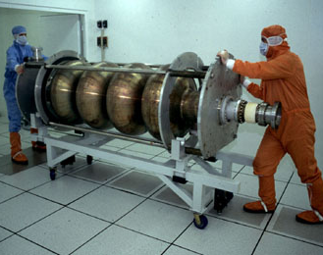
LEP-2, 350 MHz, Sputtered Nb-Cu Thin Films
Best 7 MV/m, Q = 2 x 10⁹
Problem to solve!
Much improvement in Nb-Cu technology is needed

Slide 77
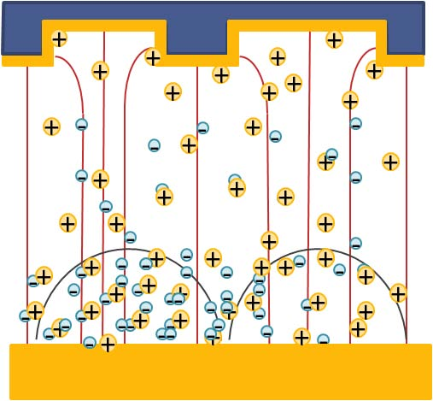
Possible Path: Hints for improvement
High Power Impulse Magnetron Sputtering (HiPIMS) produces films with enhanced properties
Target material is partly ionized
Nb ions reach substrate with a higher energy than magnetron sputtering
Produce high-quality homogeneous films.

Slide 78

Final Conclusions
SRF science and technology has taken the accelerator world by storm!
  See next slide
Enormous scientific and economic potential realized.
Biggest application could be the International Linear Collider.
  Japan is considering.
In the US, The P5 report highlights the potential exciting science if it is constructed.
Many breakthroughs in SRF technology came from R&D associated with the initial development aimed at the ILC.
SRF is an active and exciting field with many more breakthroughs ahead!

Slide 79
Impact of SRF on Accelerators for Science
Low energy nuclear physics, for nuclear shape, spin, vibration... – - -Heavy ion linacs
Medium energy nuclear physics, structure of nucleus, quark-gluon physics
  – Recirculating linac
Nuclear astrophysics, for understanding the creation of elements
  – Facility for rare isotope beams (FRIB)
X-Ray Light Sources for life science, materials science & engineering
– Storage rings, free electron lasers, energy recovery linacs
Spallation neutron source for materials science and engineering, life science, biotechnology, condensed matter physics, chemistry
  – High intensity proton linac
Future High Intensity Proton Sources for
  – Nuclear waste transmutation, energy amplifier, power generation from Thorium
High energy physics for fundamental nature of matter, space-time
  – Electron-positron storage ring colliders, linear collider, proton linacs for neutrinos

Slide 80
Concluding Thought!
We are little people serving great causes,
but because the cause is great,
something of that greatness falls upon us!
Jawaharlal Nehru

Slide 81
Back-Up Slides

Slide 82
Possible Choices among Superconducting Materials
Material | Critical Temp. T_{c} [K] | Normal-state resistivity ρ_{n}(μΩcm) | Critical Field H_{c}(0) [T] | Lower Critical field H_{c1}(0) [T] | Upper Critical field H_{c2}(0) [T] | Penetration depth λ(0) [nm] | Δ [meV] | Type
Nb | 9.23 | 2 | 0.2 | 0.18 | 0.28 | 40 | 1.5 | II
Pb | 7.2 |  | 0.08 | N/A | N/A | 48 |  | I
NbN | 16.2 | 70 | 0.23 | 0.02 | 15 | 200-350 | 2.6 | II, B1 comp.
NbTiN | 17.3 | 35 |  | 0.03 |  | 150-200 |  | II, B1 comp.
Nb₃Sn | 18 | 20 | 0.54 | 0.05 | 30 | 80-100 | 3.1 | II, A15
V₃Si | 17 |  |  |  | 24.5 | 179 |  | II, A15
Mo₃Re | 15 |  | 0.43 | 0.03 | 3.5 | 140 |  | II, A15
MgB₂ | 40 | 0.1-10 | 0.43 | 0.03 | 3.5-60 | 140 | 2.3/7.2 | II- 2 gaps
YBCO | 93 |  | 1.4 | 0.01 | 100 | 150 | 20 | d-wave
Pnictides | 30-55 |  | 0.5-0.9 | 30 | >100 | 200 | 10-20

Slide 83
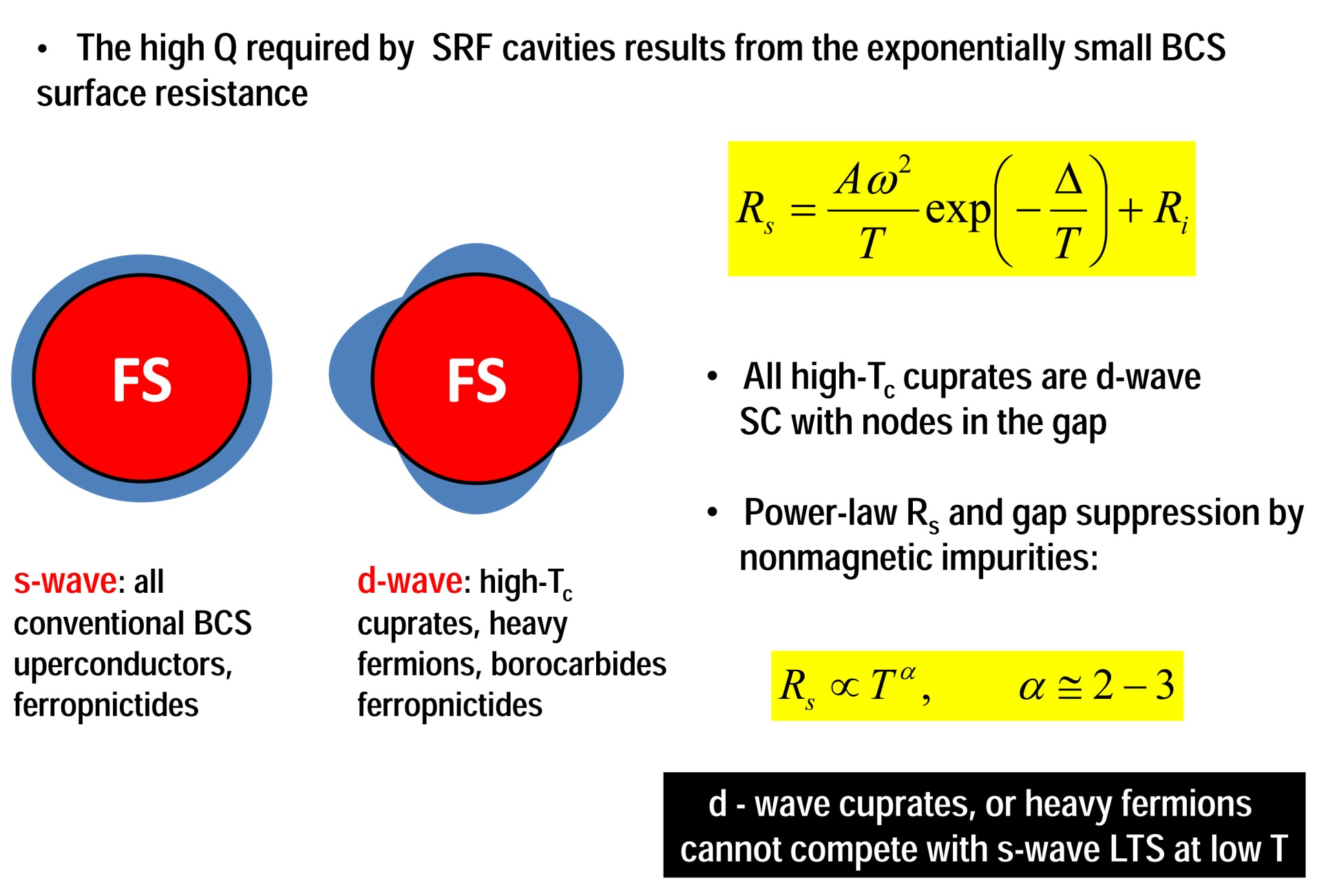
The gap symmetry is important
res

Slide 84

NIOBIUM COST versus PROCUREMENT YEAR
Data from TJNL material orders over time shows a steady escalation in the cost for RRR niobium. This data is consistent with costs observed from previous FNAL material orders.
650 MHz half-cell blanks from latest FNAL material order for Pavac cost over $400 per pound.
Reactor grade niobium also shows significant increase in cost over time.
NB: Plot courtesy of TJNL.

