Slide 1
Update on the ILC Positron source Target
- Active Sliding Contact Cooling
Wanming Liu, on behalf of AWA group
HEP, ANL
LCWS2015, Wistler, BC, Canada

Slide 2
The ILC TDR baseline target system
The 1ms ILC photon beam pulse would fracture a stationary solid titanium target.
We have never been able to design a window between the target and the positron capturing system.
We have to remove the power deposited in the target.

Slide 3
Why sliding contact cooling
Besides the direct cooling with water flow inside the target wheel used in TDR design, the heat transfer via sliding contact is another efficient way of cooling.
To avoid the need of rotating vacuum seal.
  By sliding contact cooling, the cooling water is flowing through only the stationary cooling pads and thus no rotational water feed through is needed.
  By using magnetic torque coupler, the rotating target will be driven by a motor outside vacuum without mechanical connection and thus no needs of rotational vacuum seal, which has been the unsolved issue for ILC positron source.

Slide 4
Proposed parameters
The target will be a 1 meter diameter solid disc with a rim of about 2cm wide and 1.4cm thick titanium alloy for positron production.
The disc surface area contacting with cooling pad will be coated with vacuum compatible low friction lubricant.
The cooling pad will be spring loaded and also coated with vacuum compatible low friction lubricant.
The contacting area is assumed to be 300cm^2 with a contact pressure of 1N/cm^2 . Assuming a friction coefficient of 0.1, the heat generated by the friction is estimated to be 3kW when target is rotating at full speed (~2000RPM).
If Tungsten(173 W/m/K) is used for the cooling pads, then the temperature at the surface of target will be roughly estimated at about 38 K above ambient for 20kW total power removal( the highest power deposited in target by photon beams is about 8kW).
The cooling pad will have cooling channel inside and connected with cooling liquid manifolds. As the cooling pad is stationary, a vacuum compatible cooling water manifold should be easily implemented.

Slide 5
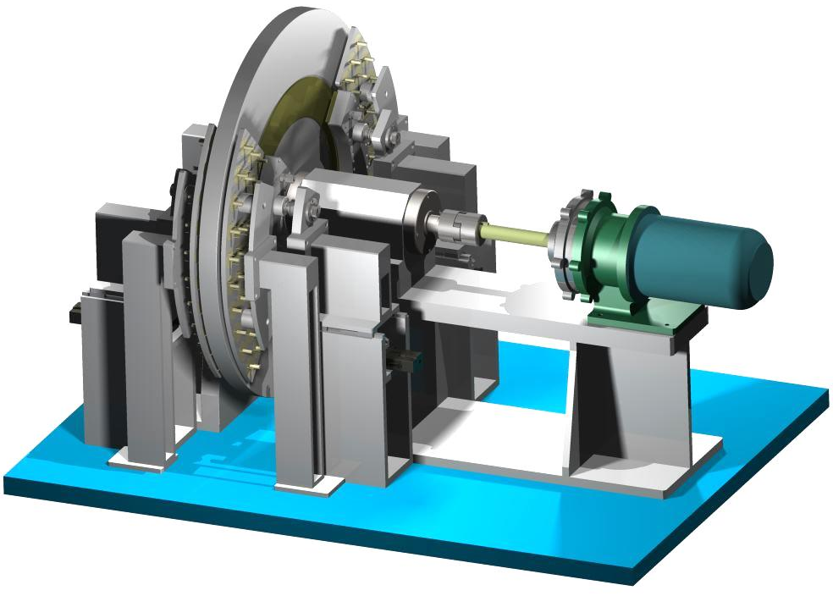
Active Sliding Contact Cooling Demo Conceptual Illustration
Overview
Rotating 1meter diameter Target Wheel at 2000 rpm (100 m/s) while extracting ~10kW by using active sliding contact cooling.
Target wheel is driven by a magnetically coupled drive motor which separates the motor from the vacuum.
Stability of wheel controlled by heavy duty machine spindle.
Temperature of wheel controlled by 4 Active Sliding Contact Cooling Pads.
Cooling Pad’s temperature controlled by water/coolant.
Heat applied to wheel using UHV radiant filament heaters.
Diagnostic feedback: RPM, Temp and Pressure of Cooling Pads, Temp of Target Wheel, Vibration, etc.
All material UHV compatible. All design parameters verified by our MathCad program.
6
1
4
3
2
Full Size Target Wheel Ready for Operations in Vacuum

Slide 6
Project plan with contingency of sufficient funding and resource
Phase 1:
  Goals: Demonstration of vacuum compatible mechanical driving system.
  Expected: By end of August 2015
  Status: Completed
Phase 2:
  Goals: Demonstration of heat removal at full speed and full heat load under rough vacuum
  Expected: 12-18 months after completion of phase 1 depends on funding level.
  Status: On track.
Phase 3:
  Goals: functional porotype ready for integration and radiation shielding engineering.
  Expected: 6-12 months after phase 2.
Beyond: collaborating with other institutes to complete the integration of the final undulator based positron source target section

Slide 7
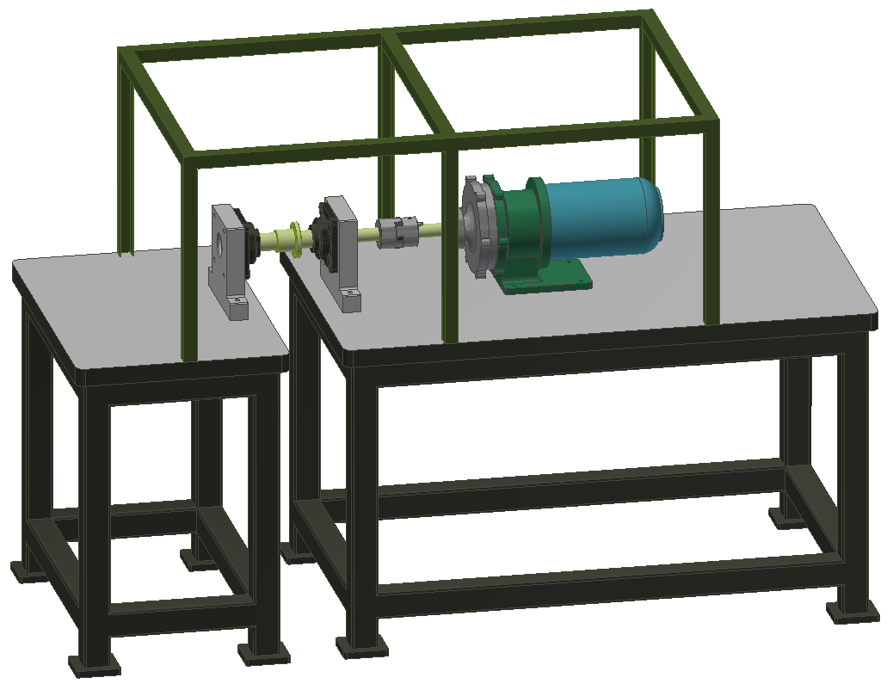
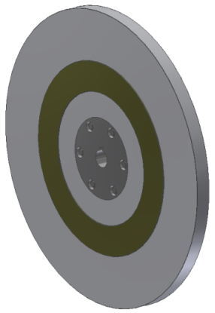
Active Sliding Contact Cooling - Phase 1
Deliverables for Phase 1 - Drive System Test - Completed By Mid-August,2015
Vacuum Compatible Drive System
Test: Motor and Controls
Purchase Test Target Wheel
7
1
5
4
3
2
TO DO
Use existing table in 366 and purchase new table. Move to end of exterior of the AWA bunker. Refinish top surface, prep for use, and secure to floor.
Receive Magnatex - Magnadrive MP221 Motor, Modified for Vacuum. Control system for motor. Secure motor to table. Run dry to verify internal bearing temperature.
Manufacture custom shafts to adapt to motor, wheel, and bearings. Purchase couplings.
Purchase bearings and support material. Machine and secure to table, align with motor, mark, and drill and tap table.
Build safety cage: Unistrut and Lexan.
Test Drive System
Procure Test Wheel
WPC Documentation
What we said we would do…
1

Slide 8
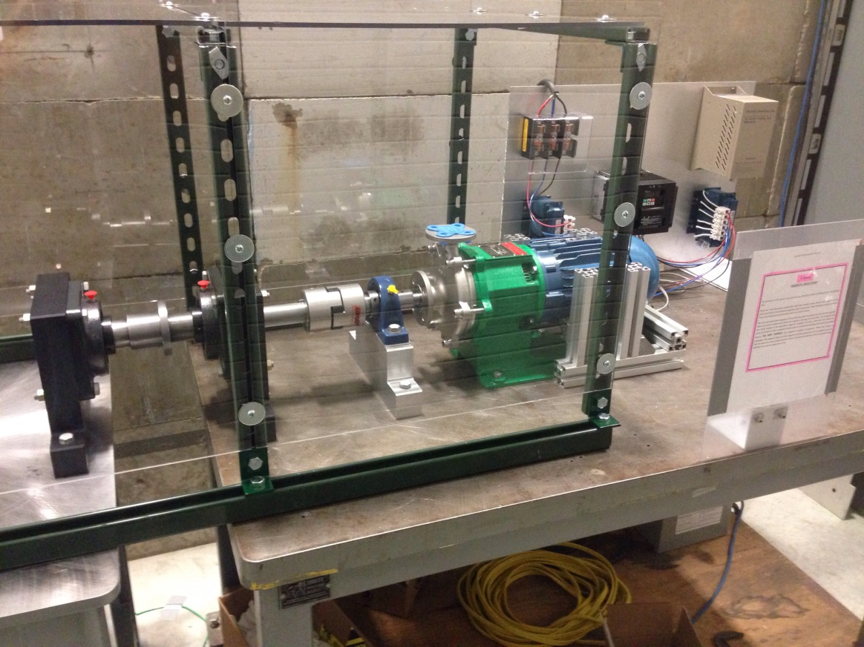
Active Sliding Contact Cooling - Phase 1
Accomplishments for Phase 1 - Drive System Test - Completed By Mid-August,2015
Vacuum Compatible Drive System
Test: Motor and Controls
Purchase Test Target Wheel
COMPLETED
What we did…

Slide 9
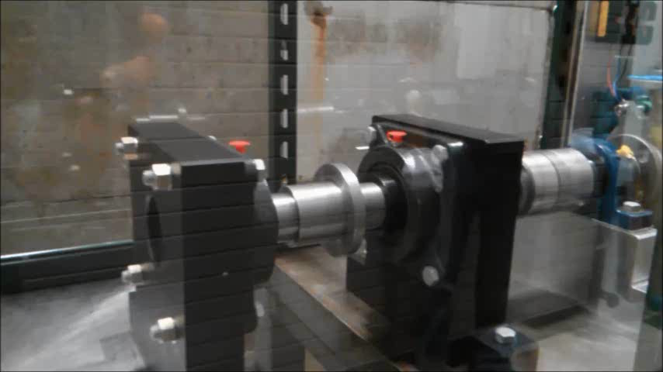
Full Speed Test of Shaft Assemblies
Due to safety regulation, we can not spin the wheel until a bunker/engineering approved safety enclosure has been setup and safety documents approved.

Slide 10
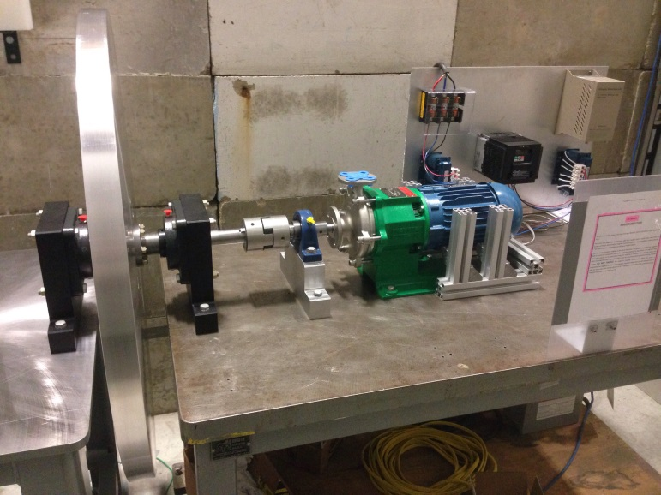
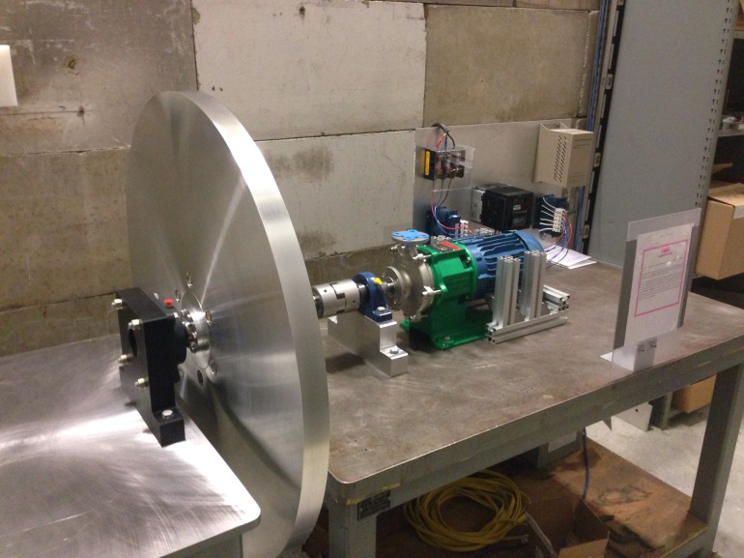
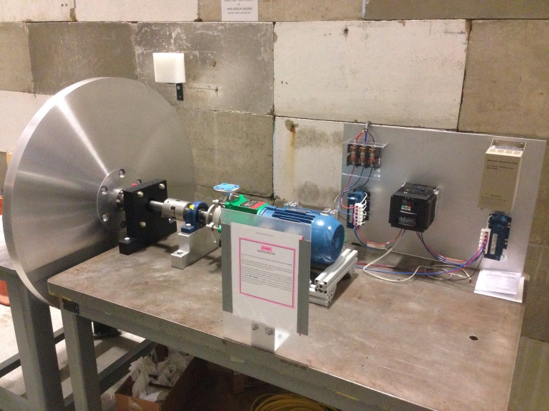
Assemblies with a test wheel

Slide 11
Transition between phase 1 and phase 2
Safety documents for rotating the wheel at ~100RPM has been iterated several times and is waiting for final approval.
Few short test runs were done while iterating the safety paper works. (We carried out these tests only for debugging purpose with extra precautions in place to avoid any unsafe operations. With all due respect to safety rules, I believe that these test runs are necessary and critical to the success of the project and we have done these debugging tests within our skill of trade. )

Slide 12
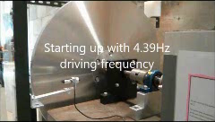
Spinning the test wheel at very low speed with tachometer installed
About 25 minutes of test run of the test wheel has proved that the commercially available magnetic torque coupler and motor we bought is capable to drive the ~350lbs test wheel. This test also confirmed that we can control the start and stop of the spinning wheel.

Slide 13
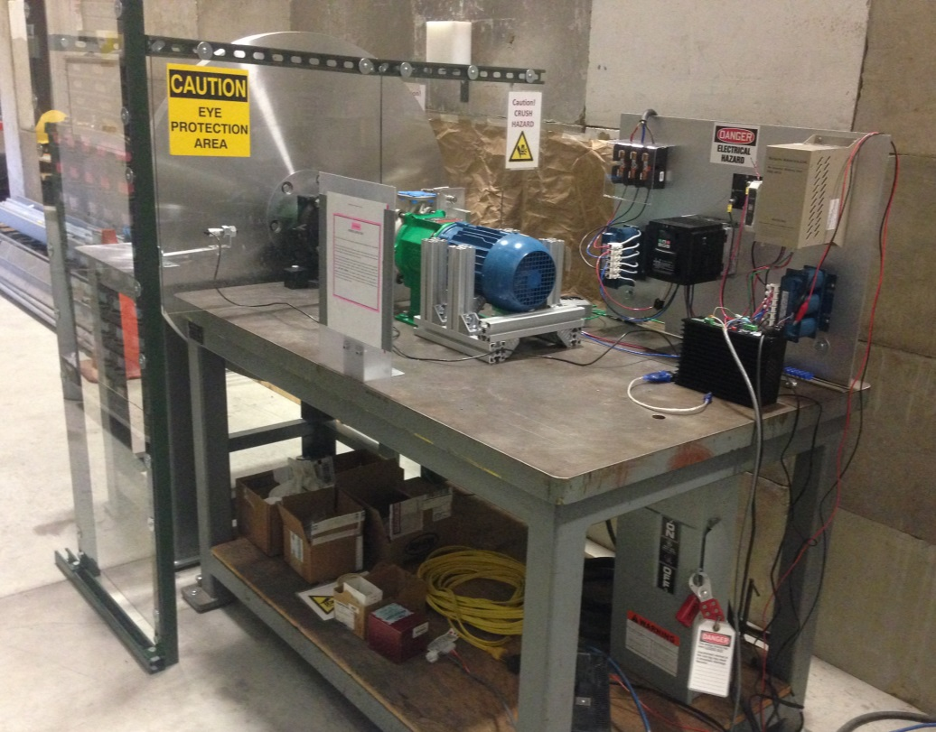
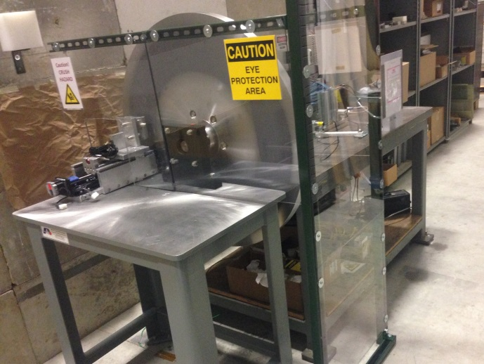
ILC Rotating Target ASCC- Phase 1.1.5
Tasks and Basic Operations
We are tasked to:
Rotate the target wheel at ~100 RPM.
Apply a metal to metal contact using Sliding Contact Cooling.
Control the temperature of the wheel.
1
Rotational Direction
4
These tasks will be completed with the target wheel assembly in it’s current location with the wheel running at a very low rpm (~100 rpm).
We will implement our Sliding Contact Cooling design which is a mechanism that applies a controlled frictional force to both sides of the target wheel simultaneously. The Sliding Contact Cooling units will use a linear actuator with a micro-stepper motor that actuates a spring loaded 304 stainless steel contact pad. The contact pad uses chilled water to overcome frictional heating and control the temperature of the contact area. The target wheel’s temperature is controlled as it’s contact area slides past the cooling pad. To reduce the coefficient of friction and the chance of galling, the contact area is it is lubricated with MoS2 (DOW Molykote D-321 R). The control system will monitor the frictional force by using a load cell that is integrated to the contact cooling unit.
The motor will wind slowly up from low power to its operational speed. The frictional force will be applied after the motor/wheel achieves its operational speed. The power to the motor will be adjusted to maintain its operational speed.
We will use a laser tachometer to monitor the wheels RPM.
We have installed a Unistrut and Lexan machine guard and safety keep-out around the target wheel and contact cooling units.
The shaft bearings that support the wheel are bolted to the tables and the tables are anchored to the floor.
5
6
5
2
6

Slide 14
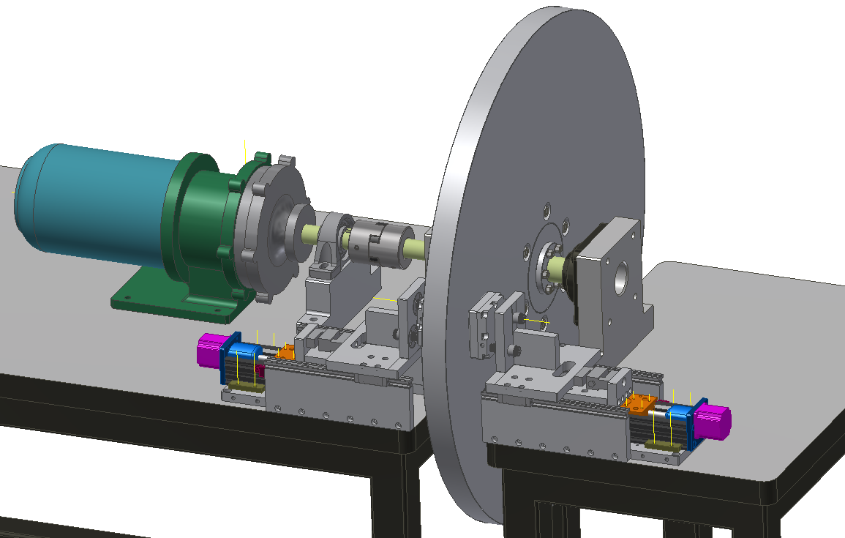
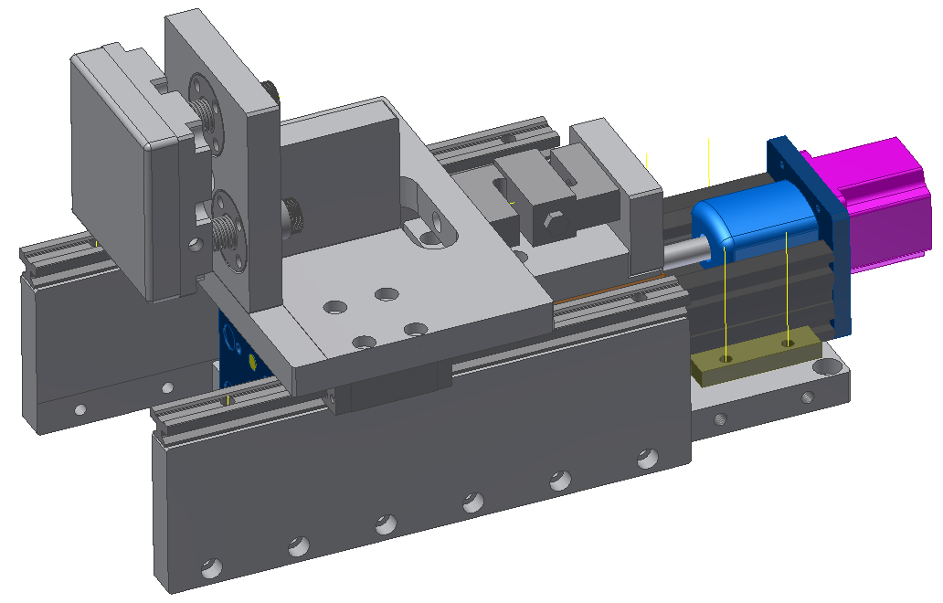
ILC Rotating Target ASCC- Phase 1.1.5
Mechanical Design and Operation
Contact Pad
Carriage on Two Linear Slides
Linear Actuator with Micro-Step Motor
Velmex# MN10-0050
Rotational Direction
Target Wheel
2” Thick Aluminum 40” Diameter
Magnetically Coupled Motor
Magnatex #
MP221-N25N-140TC
Load Cell
Phidgets# 3140
Shaft Coupling
MMCARR#
2306K184
Two 2” Shaft Bearings MMCARR# 6664K370
Two Steel Tables
Active Sliding Contact Cooling Assembly
Fig 1
The linear actuator applies a linear force to the load cell.
The load cell transfers that force to the carriage.
The carriage moves the spring loaded contact pads into contact with the rotating target.
The load cell provides feedback as to the amount of force (LBS) that contact pads are applying to the wheel.
The target amount of force is 3-5 LBS.
Molykote dry lubrication spray is used to reduce friction between the contact pads.
ILC Rotating Target Assembly
Fig 2
The motor rotates a steel shaft that passes through the target wheel.
The shaft is connected to a connecting plate with grade 8 3/8-UNC steel bolts which in turn is connected to the target wheel with grade 8 1/2-UNC steel bolts.
The target wheel and shaft (~350lbs) is captured on both sides by cast iron flange mounted steel ball bearings, each with a dynamic load capacity of 9700lbs.
The wheel will be rotated toward the AWA bunker wall (~11ft thick concrete) at ~100RPM (7200 joules) which is monitored by a laser sensor tachometer.
The cooling pads will be actuated to contact the rotating target wheel and will use chilled water, fed at ~2 gallon/minute, to control the temperature of the target wheel.

Slide 15
ILC Rotating Target ASCC- Phase 1.1.5
Safety Concerns and Mitigations
Background: This the prototype phase of the ILC Rotating Target development. The low speed tests are meant to gain knowledge about and prove the system and will be short term and limited to shorts runs.
The operation of the rotating target wheel, a circular object powered by a motor protected by a machine guard, is very similar to the operation of one of the several air handling units found on any service floor or machine lathes found in every machine shop around ANL. With the difference being we will be applying a small amount of pressure to each side of the target wheel. Below is how we will mitigate safety concerns.
Concern: During normal operations, the target wheel possess kinetic energy. 1) How is this energy mitigated?
Mitigation: 1) While rotating at ~100 rpm it is calculated that the target wheel will possess 763 joules of energy. As the target wheel is precisely machined (total runout and overall flatness of .002“/003”), aligned within the same tolerance, and the center of gravity is constrained on the axis, there are no other radial forces present as there would be, for instance, if the disk were unbalanced or oblong. To constrain the target wheel, the target wheel and shaft are captured by two flange mounted bearings that are bolted to two steel tables with four grade eight 1/2”-UNC bolts (each with a tensile strength of ~150k psi), the steel tables are in turn anchored to the cement floor with eight steel 3/8”-UNC concrete anchors (each with a pull-out strength of ~4000 lbs). The weight of the target wheel and shaft (~350 lbs) are sufficiently supported by two flanged ball bearings (each with a dynamic load capacity of ~9700 lbs). The 763 joules (in the case of power failure) will dissipate into friction into the bearings (each bearing is rated to 400F).
Concern: The contact force of the Sliding Contact Cooling units will place a lateral force onto the target wheel. 2) What solutions are in place to control these? 3) Will the force applied to the cooling pads from the target wheel will result in breakage of the cooling pad assembly?
Mitigation: 2) The force of the cooling pads will be monitored by a read-out fed directly from a load cell that is integrated to the travel of the actuator, we have a software limit placed on the length of travel of the actuator, and a redundant hardware limit switch and hard stop that will stop the actuator in case of a software failure. The software will control both cooling pads simultaneously and the software/hardware limits on the force of each cooling pad will be limited to 3-5 lbs. 3) The contact area is lubricated with Molykote. It has a very low coefficient of friction (0.2-0.5) and is designed to reduce the frictional force that the target wheel places on the cooling pad assembly. If the two safeguards fail and the cooling units over compress and do result in breakage, the downward rotational direction of the wheel will force pieces to the AWA bunker wall, the tables, and/or the floor. With machine guards in place and proper PPE utilization, this hazard will be mitigated.
1
Rotational Direction
Axial Constraint
3-2
Rotational Direction

Slide 16
ILC Rotating Target ASCC- Phase 1.1.5
Safety Concerns and Mitigations
Concern: The operation of the target wheel will create potentially hazardous areas and situations for personnel. 1) How will we control these potentially hazardous areas and situations? 2) What hazards do we address with signage and why? 3) What other general safety features will the apparatus have?
Mitigation: 1) We have provided a machine guard that covers the rotating pieces and the in-line area of the target wheel. The machine guard is ~6 feet high and covers from floor to table top to the AWA bunker wall. The machine guard has a Unistrut frame and 1/4” thick impact resistant polycarbonate. The polycarbonate has an impact strength of ~12 ft.lb./in. As it is not intended to restrain the wheel it is more than sufficient to restrain and/or block humans from accessing the target wheel while it is operating, incidental dust, or lose material that may impact it. Reminder: the wheel is rotating very slowly ~100rpm, so, any impact will be negligible. 2) We erected a “Caution Eye Protection Area” sign in the case of incidental dust and particles - eye protection is required. We erected a “Caution Crush Hazard” sign on the machine guard near the cooling pads as a warning that the contact area between the cooling pads and the wheel is a potential crush hazard. LOTO is required to remove the machine guard. There is a warning for a permanent magnet, however, the fields are only exposed when the motor is taken apart. LOTO is required to work on the motor. As a general precaution, even though there are no exposed electrified wires, we placed a Lexan cover and “Danger Electrical Hazard” sticker on the electrical panel. 3) As a general precaution, there will be a keep out area taped to the floor, in-line with the target wheel and between the AWA bunker wall and the tables, where personnel shall not stand during operations.
Concern: A potential hazard may arise during operation. 4) What are the emergency and general procedures to shut-off the power? 5) How will shutting off the power effect the motor?
Mitigation: 4) If a situation arises where it becomes necessary to shut off the power the emergency procedure is to go to the power box and pull the lever to the down position. This will shut off all power to the drive components. If the cooling pads are in contact with the wheel during a power shut down, they will act as a brake, slowing the wheel. This will have no adverse effect on the cooling pads or the wheel. During normal operations the shut-off procedure is as follows: Lower the drive frequency to ~1Hz and apply the DC breaking function of the WJ200 DBU inverter briefly in a pulsed manner until the wheel stops. 5) During an emergency shut-off, shutting off the power will have no adverse effect on the motor. If the power is shut off to the motor the torque from the wheel will force it to continue to spin. We are using an induction motor, so, if the motor continues to spin it will not gain any potential energy, the rotational energy will eventually dissipate into friction into the bearings.
Summary: All safety and operational parameters have been reviewed and approved by HEP SMEs.
2
1
Rotational Direction
2
4
2
3
4
2

Slide 17
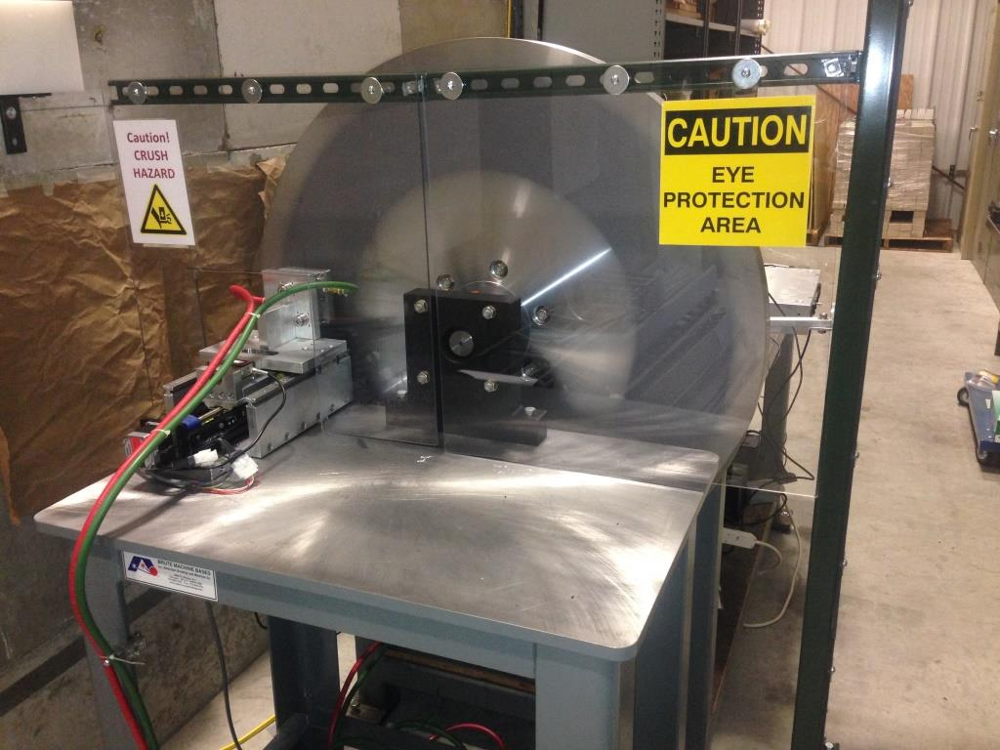
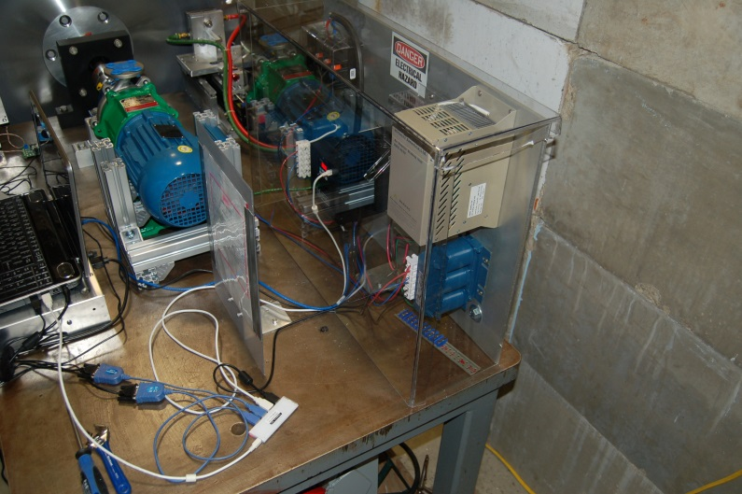
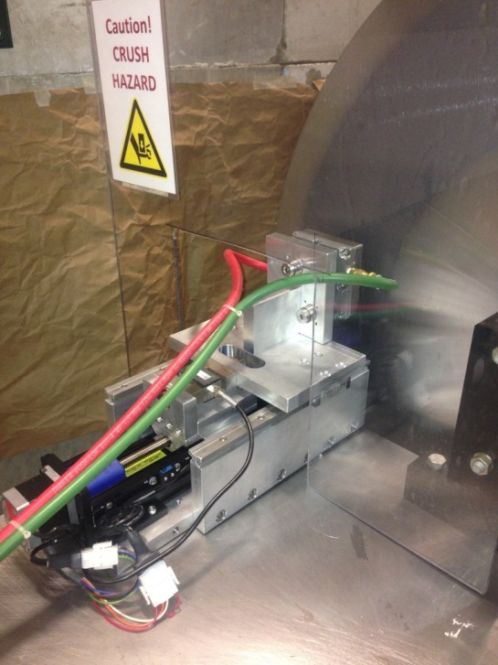
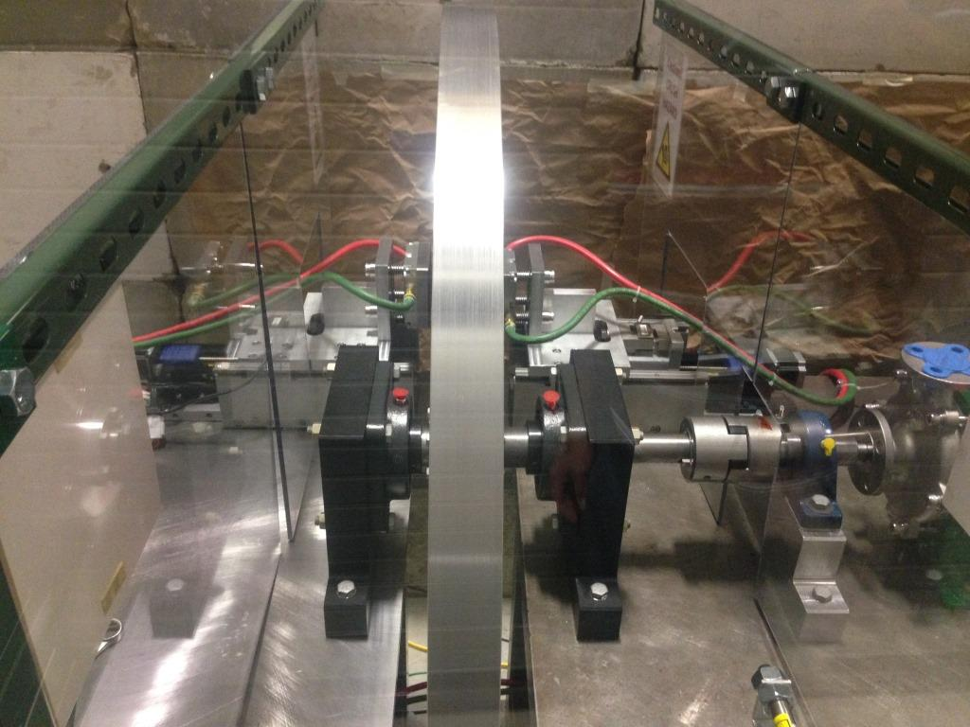
ILC Rotating Target ASCC- Phase 1.1.5
More Photos

Slide 18
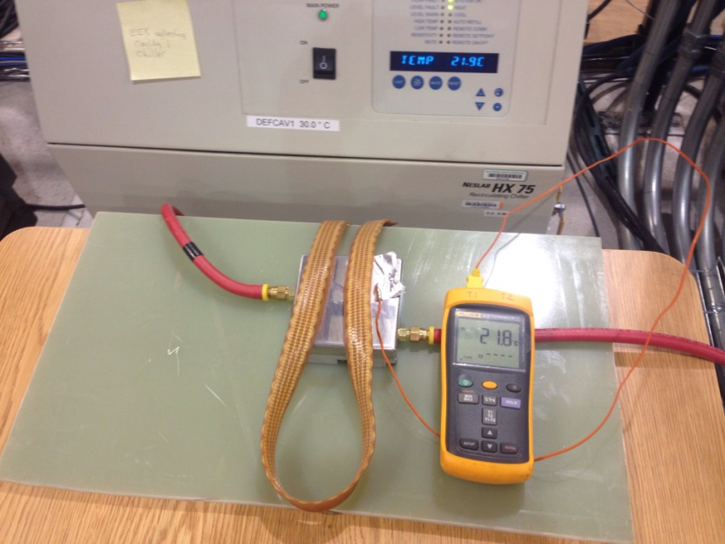
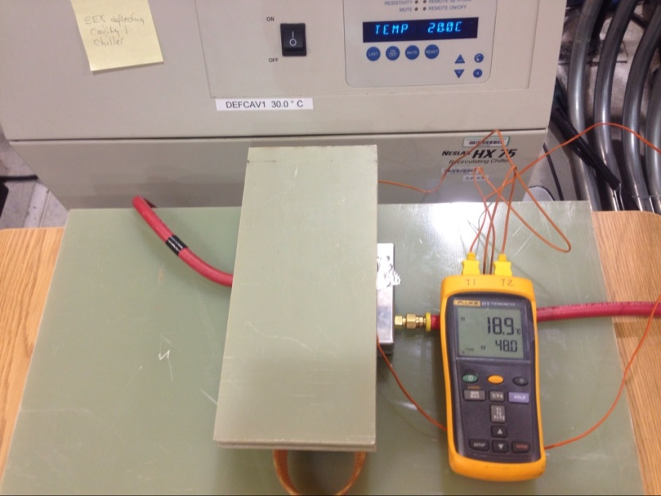
ILC Rotating Target ASCC- Phase 1.1.5
Cooling Pad Bench Test
Summary:
In order to apply contact pads to the rotating target we will need to ensure that the contact pad will not heat up which will - even with MOs2 coating - increase the potential for galling. We manufactured one contact cooling pad and water port assembly for a bench test.
Test Set-up:
Connected the cooling pad assembly to one of our chillers, 3 GPM, 68 PSI, 20C. (It has been estimated that it requires1.3GPs with 1ºC temperature change to extract 20kW heat, this chiller is not good enough for full capacity heat load)
Taped a thermocouple to cooling pad face.
Adjusted chiller temperature to 25C. Cooling pad tracked ~1 second behind chiller within .1 C. Adjusted temperature back to 20C.
Placed heat tape over cooling pad. Taped separate thermocouple to heat tape. Applied weight to heat tape to ensure contact with cooling pad.
Gradually ran the temperature of the heat tape up to 48-50C (~120W).
The cooling pad surface maintained its temperature throughout - it was actually a little cooler than the chiller. The chiller is more efficient when a heat load is applied.
We then turned the chiller off and noticed the cooling pad surface temp rose sharply.
Conclusion:
The bench test successfully showed us that our chiller is capable of controlling the surface temperature of the sst contact cooling pad.
Without Heat Load
With Heat Load

Slide 19
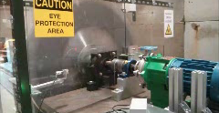
Test run with cooling pads at ~100RPM

Slide 20
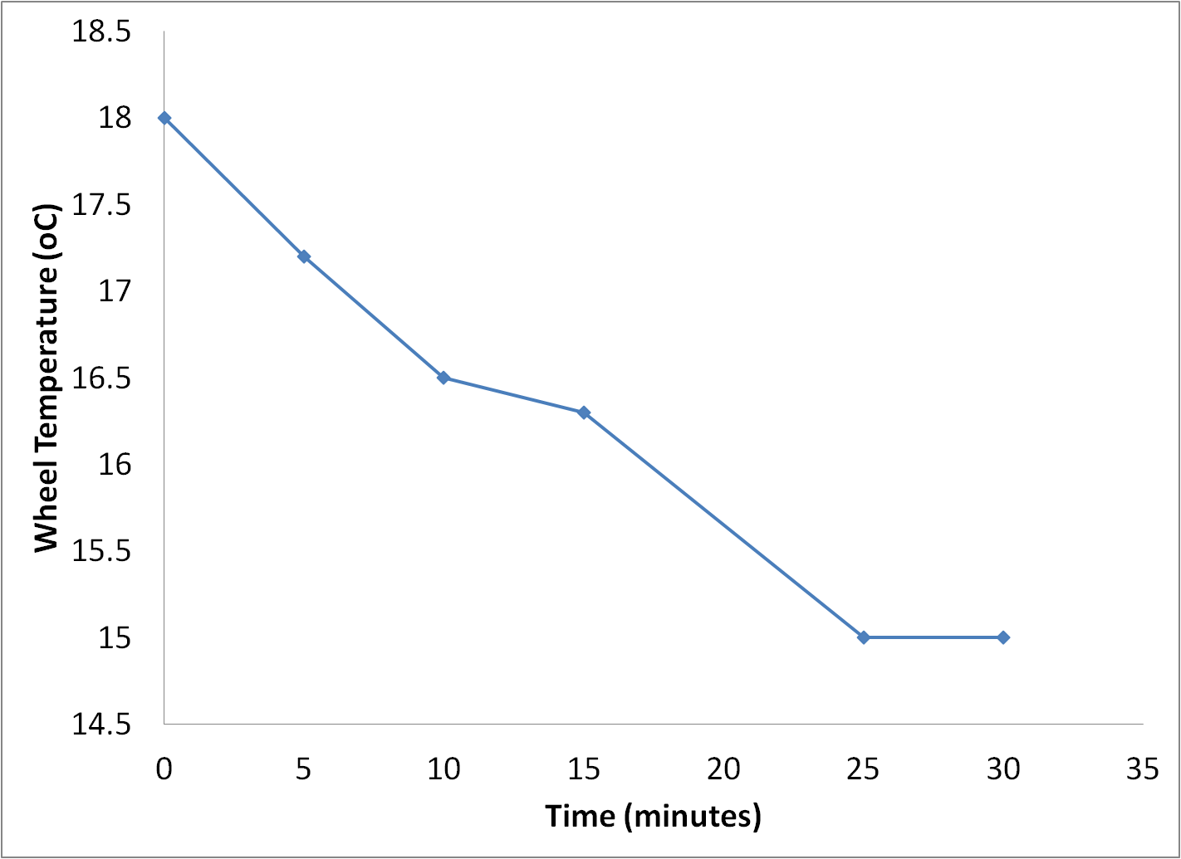
We cooled the wheel down instead of heat it up with friction!
During the ~30 minutes of test with contact cooling, a hand held IR thermal meter was used for measuring the temperature of the wheel. We stopped after we observed the stop of temperature drop. We have observed 3 degrees C cooling to spinning wheel.

Slide 21
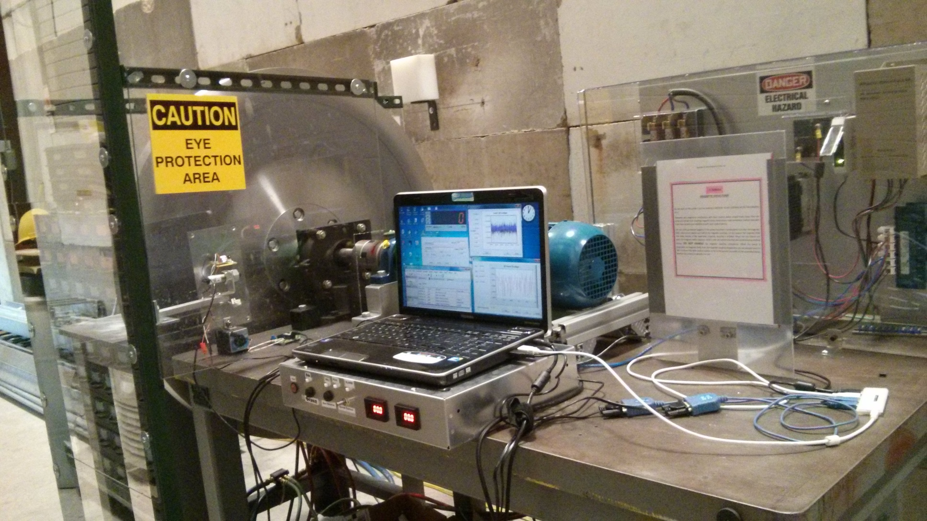
Setup with IR temperature sensor readouts
IR thermal sensor and readout.

Slide 22
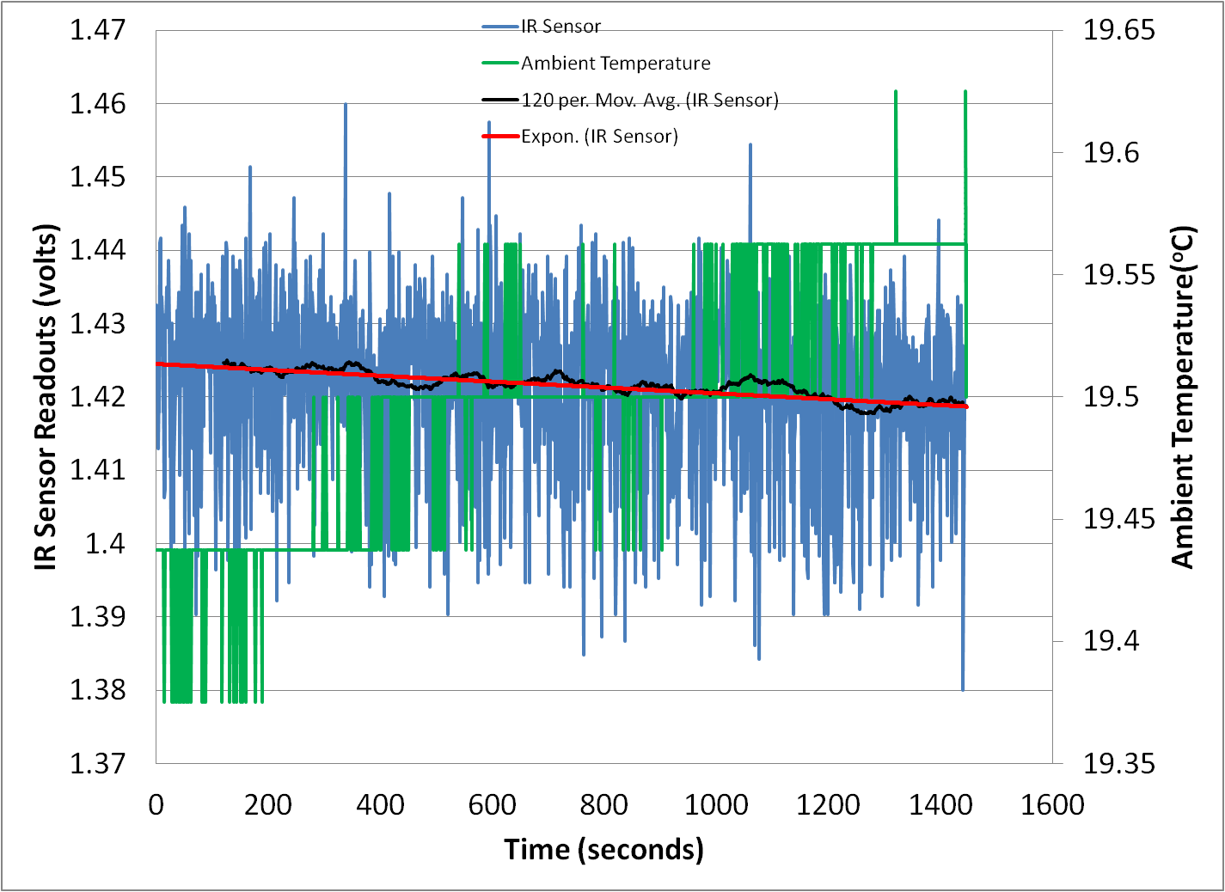
About 10 minutes of running with cooling pads pressed on with ~2lbs of force, IR sensor readout is showing the cooling of the wheel which is consistent with previous test run.
Readouts shown that temperature of wheel is trending low while ambient temperature trending high.
Will setup more monitoring point and test again after safety documents approved.

Slide 23
Tribology study of the candidate contacting materials
Goal:
  perform sliding tests of candidate materials using vacuum-compatible dry solid lubricant and report friction and wear data
  Use existing vacuum tribometer operating at maximum speed to replicate vacuum environment
  Ascertain that materials will perform for year-long duration
Materials:
  SiC rings lapped to sub wavelength flatness for counterfaces, with MoS₂ (either powder or solid) for lubrication
Current status:
  Have done some initial test, tribology group is refining their apparatus.

Slide 24
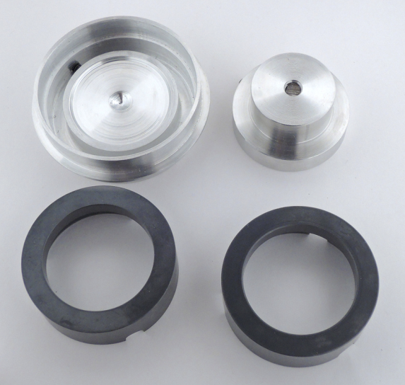
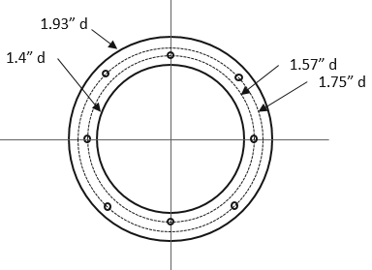
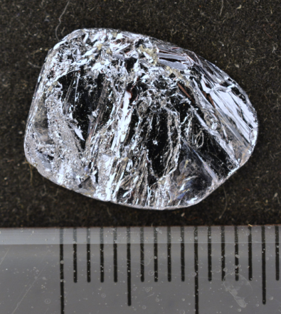
Specimen Preparation
For future exploration, two SiC rings were sent out to Cidra for drilling to make pockets for MoS₂
Photo shows solid piece of MoS₂ for solid vacuum lubrication to determine if pure solid is better than powder
Sample holders were machined by Frank and are shown above the SiC thrust-washer test ring samples

Slide 25
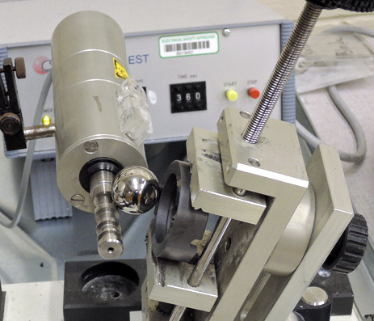
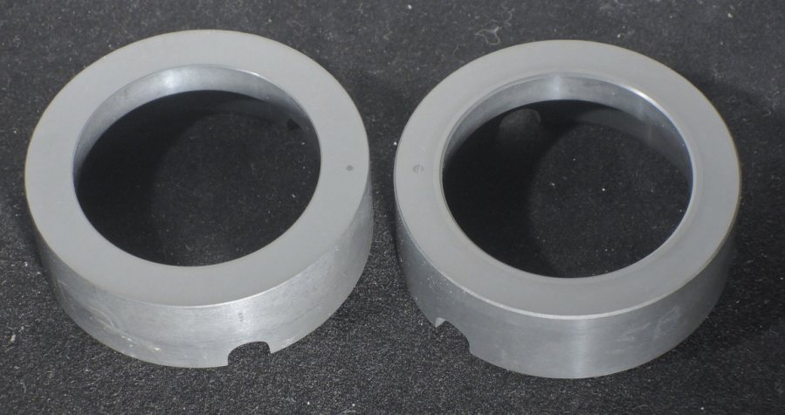
Vacuum Testing
Calotest machine was used to put small dimples into ring surfaces to serve as reference level for wear measurement
Reference dimples are small black spots

Slide 26
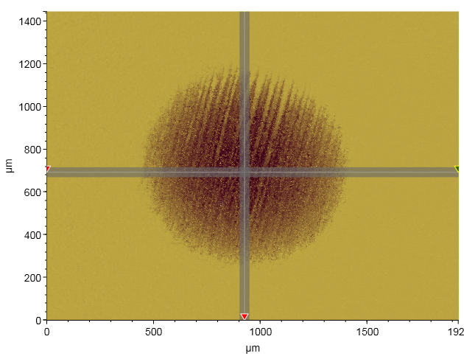
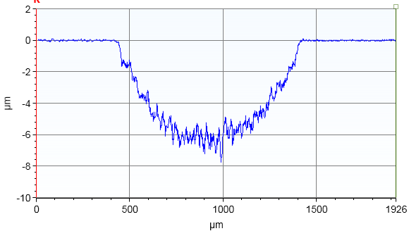
Vacuum Testing
This pseudo-color WLI image shows a dimple on the flat surface of the ring with light=high, and dark= low
The depth of the dimple is about 6.5 µm
If the top surface experiences wear then the depth will decrease
The initial wearing test is inconclusive. The depth increased by about 1μm after test. Need to run test for longer time.

Slide 27
Tribology study of vacuum compatible lubricant
An index of tests is shown here
Test # | P (mbar) | Lube | Results | T
150826a,b | Air | MoS2 p | Machine works but arm can be a problem | -
150904a | 4.9e-6 | MoS2 p | Arm disabled for correct start but no temperature is recorded. Hi µ at 0.13 hr due to µ rise | -
150905a | 2.8e-5 | MoS2 p | Machine fixed. Hi µ at 50 minutes and 47.5C | 47.5
150910a | 6.7e-5 | BN p | BN is terrible for lubrication, 15 s bad | -
150911a | 6.9e-6 | MoS2 p | Ring attached to arm, arm moves, full 60 minutes, *s | 32
150911a | 1.5e-5 | MoS2 p | ---Continuation of previous, 20 minutes | 35
p-powder, 2000 RPM= 4.4 m/s, shutoff at µ=0.5, *s – clean with 4000 grit sandpaper

Slide 28
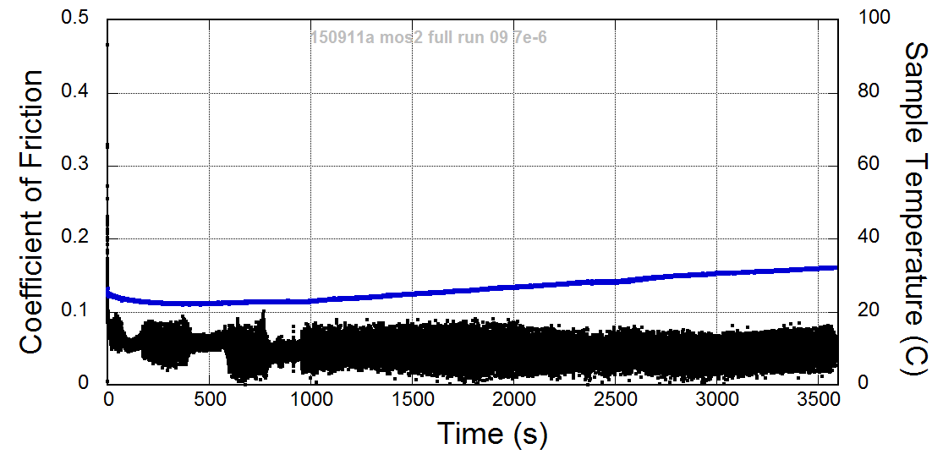
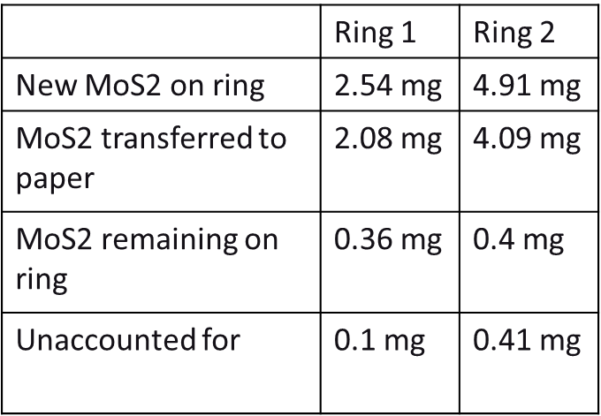
Tribology test result of MoS2 in vacuum
Test results show that small amounts of MoS2 are effective for lubrication in vacuum.
Friction was low (µ = 0.05) and temperature was modest (35C) for 1 hour duration

Slide 29
ILC Rotating Target ASCC- Phase 2 planning
Phase 2 Goals
Phase 2 Goal Summary:
Our goal for Phase 2 is to demonstrate Active Sliding Contact Cooling to the rotating test target wheel while in rough vacuum at full speed and simulated heat load.
Major Considerations:
Motor and Safety
  Convert and make vacuum compatible.
  Convert to replace or reinforce SiC thrust bearings.
  Install safety cage around wheel.
Spindle/Bearings
  Purchase spindle and balanced wheel.
  Convert/Purchase vacuum compatible components.
Contact Cooling and Heating Details
  Convert/Purchase vacuum compatible components.
Vacuum Chamber
  Integrate Vacuum chamber into new table.
  With a new table that is integrated to the vacuum chamber there will also be a safety “cage” integrated to the table to capture the wheel in case of catastrophic failure - which is highly unlikely.
Location, Location, Location
  We would like to continue to use the end of the AWA bunker as the location for Phase 2. We have all of the infrastructure in place there, power, water, crane, etc., we can take credit for the AWA bunker wall as a safety barrier, and we save cost by not using a rigging crew to make a new bunker/enclosure out in the open area of 366.
  Along with using the back wall of the AWA bunker we will also build a keep-out area where nobody will be permitted during full speed operations.
This proposal will go over each of these details.

Slide 30
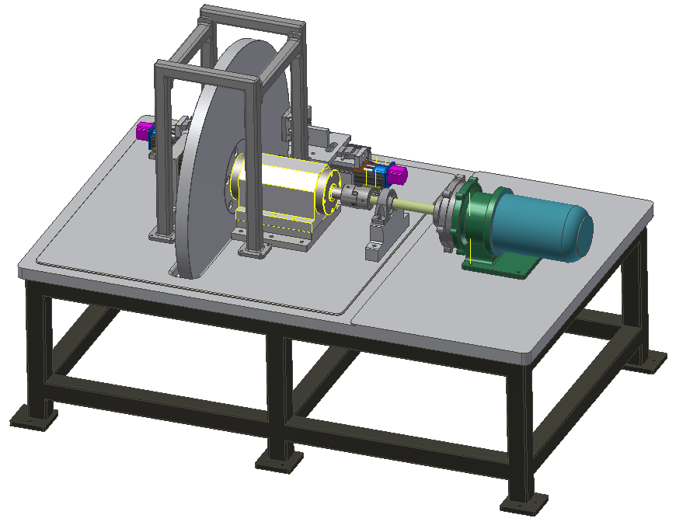
ILC Rotating Target ASCC- Phase 2 planning
Phase 2 Motor and Safety Details
The Magnatex magnetically couple motor has performed well so far, however, several items need to be addressed before it will be ready for use in vacuum and capable of rotating the test target wheel at full speed for any period of time.
Convert pump manifold from water to vacuum. This will be a medium sized aluminum or sst machined part that will have an o-ring groove for vacuum and possibly two shaft bearings.
Since the existing internal thrust bearings cannot withstand any axial load, an extra shaft bearing was installed for Phase 1, this is not an optimized configuration for vacuum or full speed operations. Solutions: Redesign the interior thrust bearings and covert them to vacuum compatible ball bearings (difficult) - or - integrate two ball bearings to support the shaft as it extends out of the motor (simple) - or - leave it and purchase a vacuum compatible shaft bearing to replace the existing one on the table (easy, but not recommended for assembly with vacuum chamber and not the best for high speed operations).
Along with the wheel being “captured” by the new table, welded tubing will be attached to the table and will provide the safety cage for the wheel. Will need engineering calculations to confirm details.
Prior to going to full speed normal operations I think it would be a good idea to integrate some of the controls for safety purposes. For instance, have a software limiter placed on the tachometer and add a vibration shutoff. More?
3
2
1

Slide 31
ILC Rotating Target ASCC- Phase 2 planning
Phase 2 Spindle Details
The “off the shelf” bearings we are using for Phase 1 to support the drive shaft have fulfilled their purpose - initial system fit-up, assist in the testing of the motor, and initial test wheel function (Phase 1.1). However, they are not vacuum compatible and not nearly as robust as a spindle. A spindle is specifically designed to do exactly what we are doing and solves several engineering issues: axial loads, axial forces, wheel alignment and balance, vacuum compatibility, etc. I met with representatives from Dynomax (specializes in heavy duty spindles). Here is how we will proceed.
We will provide Dynomax with a STEP file of our rotating parts.
We will provide Dynomax with all of the requirements:
  Stress
  Weight
  Torque
  Rotational
  Operational
  Longevity
  Vacuum
We will provide Dynomax with NRE funds to develop the spindle.
We will purchase a balanced wheel and spindle as a unit from Dynomax.
Dynomax will provide future support.
1

Slide 32
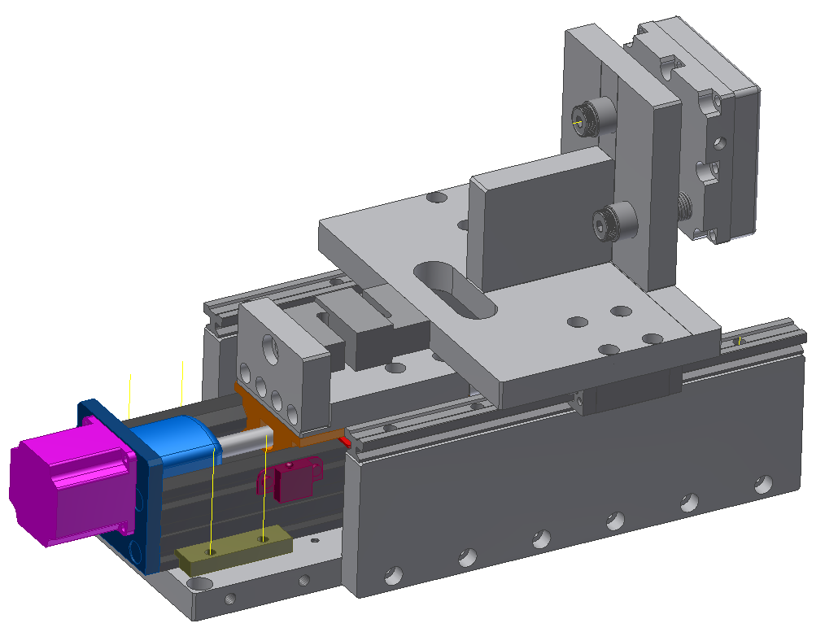
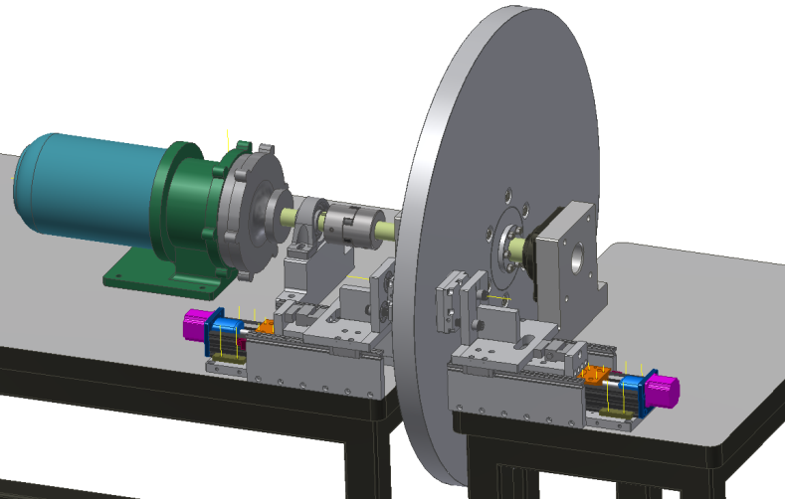
ILC Rotating Target ASCC- Phase 2 planning
Phase 2 Contact Cooling and Heating Element Details
The contact cooling units that are currently constructed are for Phase 1.1. After we finish Phase 1.1, we will evaluate the cooling units and make any and all necessary modifications. Here are a few that we already anticipate.
Purchase vacuum compatible actuators. (due to the longer lead times of the vacuum compatible versions we were unable to purchase them for Phase 1.1)
Modify the assembly so it is more compact in the direction shown.
Assess the performance for the spring loaded cooling pads.
Clean all parts for vacuum.
We will also need to evaluate heating elements for inside the vacuum. We have a ceramic heater in mind, but, will need to develop.
3
1
2
Image from Phase 1.1

Slide 33
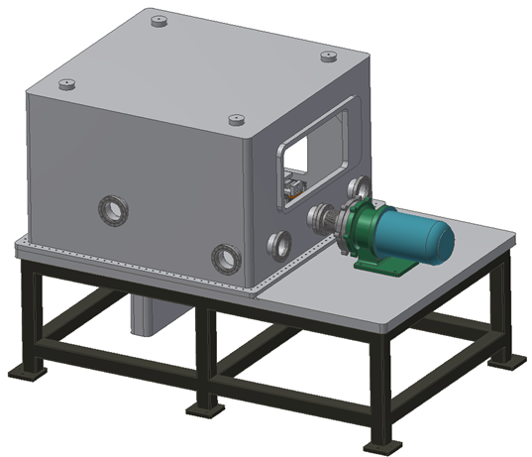
ILC Rotating Target ASCC- Phase 2 planning
Phase 2 Vacuum Chamber Details
The main goal of Phase 2 is to extract heat from a full speed (2000 rpm) target wheel while the wheel is in vacuum. Since rough vacuum is good enough we will only need an o-ring seal. Even with this simplified requirement it is not trivial to fit this apparatus inside a vacuum chamber. Here is my proposal.
The operation and configuration of this apparatus is unique, so, it needs a unique solution. We want to integrate the vacuum chamber to the support table. The table will have an aluminum top bolted to a steel frame. The table top will have finished areas for the vacuum seals and will provide for support for all other components.
The main vacuum chamber will have lifting eyes, access ports for feed thru’s and remote monitoring, and access panels so we do not have to remove the chamber to work on key areas of the apparatus.
The lower chamber will enclose the bottom part of the wheel and be used for pumping.
We will need to have some engineering analysis done to verify some small details, but, this concept is very doable.
We consulted with MDC and they are willing to supply the three piece vacuum chamber as a turn-key project. There are plenty of other options as well, but, the turn-key option would include vacuum stress analysis, testing, cleaning, etc.
1
2
3

Slide 34
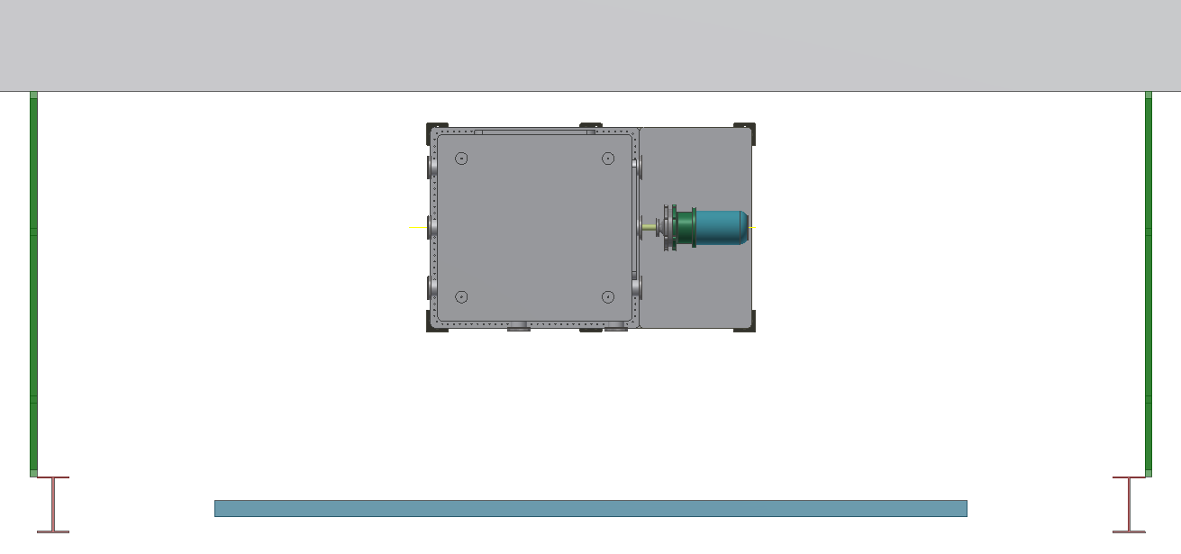
ILC Rotating Target ASCC- Phase 2 planning
Phase 2 Location Details
We would like to continue to use the end of the AWA bunker as the location for Phase 2. We have all of the infrastructure in place there, power, water, crane, etc. We can take credit for the AWA bunker wall as a safety barrier, and we save cost by not using a rigging crew to make a new bunker/enclosure out in the open area of 366. We will also install an operational safety “keep-out” area. If engineering calculations require, we can add a cement shielding block at the opening of the roll-up door.
AWA Bunker Wall
Electrical Panel
Keep-out Area
Keep-out Area
Optional
366 Sliding Door
Operations Area
366 I-Beam

Slide 35
ILC Rotating Target ASCC- Phase 2 planning
Phase 2 plan Summary
I wanted to relay some of the ideas for the long lead time items to you all now so we can wrap our minds around them and find solutions as soon as possible. There are still some details to work out, but, this is a start. The quoting process for the long lead time items is not trivial. I would like your input on these ideas, so, as we move forward, we will be ready for quoting/purchasing when we receive funding.
Thank You!!!

Slide 36
What next
Find out the pressure needed for best heat transfer.
Purchasing chiller with the needed capacity.
Purchasing a bigger motor and torque coupler. Limited by the resource we had at the beginning, the current motor and torque coupler is only rated for 2 HP and was purposed for proving the concept only.
Finish the engineering design, instrumentations and safety documents of phase 2.
Will continue the tribology study and identify the candidate contacting materials.
Will do more tests with the current setup after the safety document of phase 1.1.5 approved.
May need many phase 1.x to test/improve instrumentations and interlock for phase 2.0

Slide 37
Summary
We achieved our goals of phase 1 and have proved the concept of sliding contact cooling of rotating wheel.
We are on track to achieve our phase 2 goals: demonstrate sliding contact cooling in rough vacuum at full speed and heat loads.
A functional prototype will be delivered at the end of phase 3 with a contingency of sufficient funding and resource.

