Slide 1
Updated m_{W} Measurement from Threshold Scan Using Polarized e⁻ and e⁺ at ILC
LCWS2015 Meeting
Whistler, BC, Canada
Old TESLA study re-visited.
(LC-PHSM-2001-09)
Graham W. Wilson
University of Kansas
Nov 5th 2015

Slide 2
Outline
Give overview of methodology of polarized threshold scan including recent updates.
Address some of the issues related to the machine.
(I will focus the talk on the above – and not motivation, other m_{W} measurements, auxiliary measurements)
See recent talks on √s_{p} method (Hamburg-2013), momentum-scale calibration (Fermilab-2014) for absolute √s determination, and m_{W} generalities at ALCW2015 and backup slides.

Slide 3
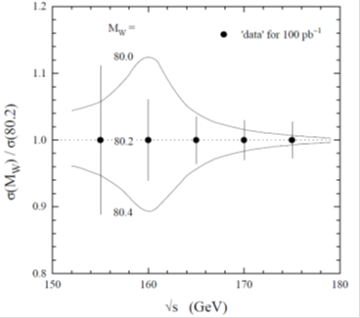
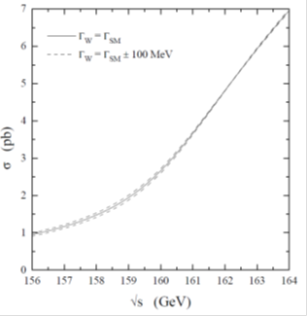
m_{W} from cross-section close to threshold
Stirling
unpolarized
Key: √s,σ
m_{W}=80.23 GeV

Slide 4
ILC Polarized Threshold Scan
GENTLE 2.0
with ILC 161 beamstrahlung*
Each set of curves has m_{W} = 80.29, 80.39, 80.49 GeV.
With |P| = 90% for e⁻
and |P| = 60% for e⁺.
Example 6 points in √s.
78% (-+),
17% (+-) 2.5%(--), 2.5%(++)
- +
Use (-+) helicity combination of e⁻ and e⁺ to enhance WW.
Use (+-) helicity to suppress WW and measure background.
Use (--) and (++) to control polarization (also use 150 pb qq events)
Need 10 ppm error on √s to target 2 MeV on mW
LEP
0 0
- -
++
+-
Experimentally very robust. Measure pol., bkg. in situ
Notes:
Lumi ratios
96.0D0 21.0D0 5*0.0D0 2*3.125D0 = 123.25 95%, 5%
6 –point scan (160.6, 161.2, 161.4, 161.6, 162.2, 170.0)
L ratios 1:5:5:5:1:6

Slide 5
Counting Experiment
Example: 6 point scan (index i), (90% e-, 60% e+ polarization) with -+, +-, ++ and - - helicity combinations (index k)
Count events in 3 WW candidate categories (lvlv, qqlv, qqqq – index j) with expectation μ_{ijk} and one Z-like category (radiative return and f fbar) with expectation ν_{ik}.
96 event counts
Data could also be taken with other helicity combinations (00, -0,+0,0-,0+ ) if warranted. (eg. further checks of polarization model)

Slide 6

Fit the Event Counts to Model Expectations
Event count expectations:
Signal, background, and Z-control sample spin factors:
Assumes A=1 for WW (actually about 0.996)

Slide 7
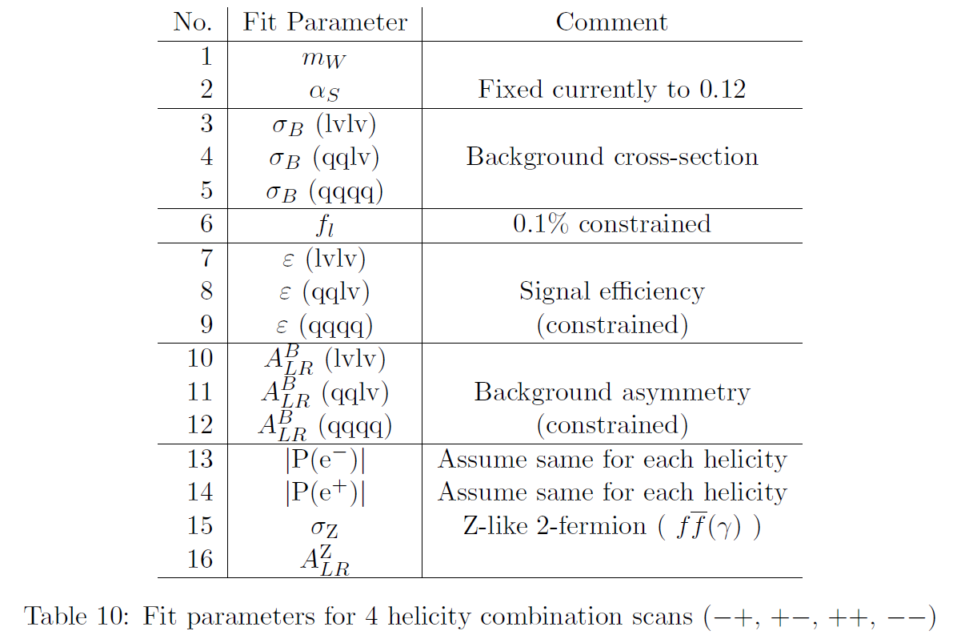

Fit Parameters
NEW
(previously assumed known perfectly)
(Note: within the SM current uncertainty on α_{S} translates to 0.06 MeV on Γ_{W})

Slide 8
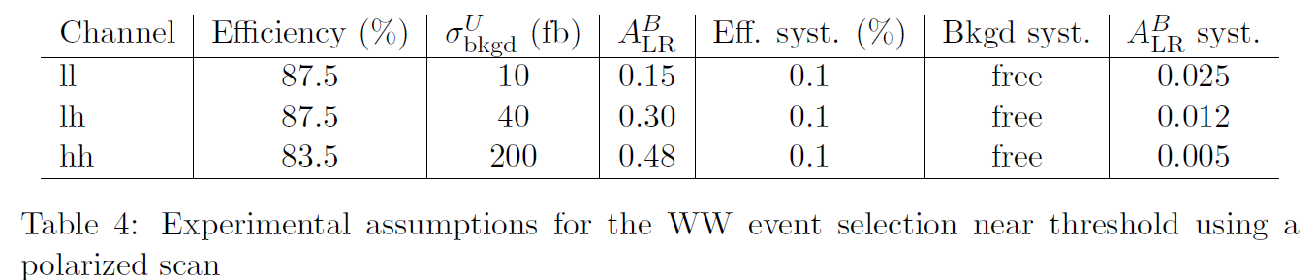
Fit Details and Experimental Assumptions
Use Poisson likelihood (also χ² as cross-check)
Include χ² penalty terms to constrain the systematic effects associated with integrated luminosity, signal efficiencies and background asymmetries.
MEASURE background cross-sections
NB. Assumed inefficiency and background is halved with respect to TESLA study – based on ILC style detector

Slide 9
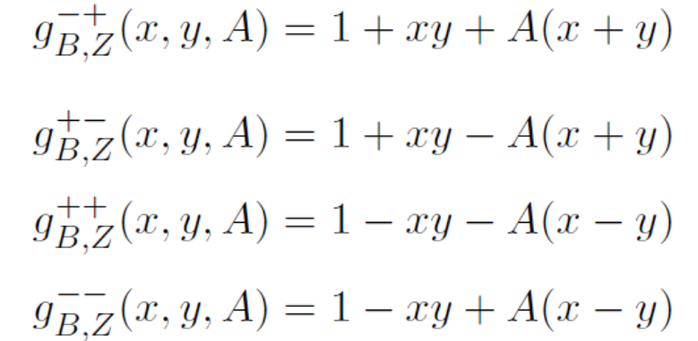
4 eqns, 4 unknowns
Using the large statistics of Z-like events (150 pb).
Can use the 4 measured Z-like event counts to determine the 4 related parameters (σ, x, y, A).
  Precise determination of the polarization values, x and y, is key to the m_{W} measurement
Suitable event selection for qq+μμ+ττ should be straight-forward
  Include inclusively full energy events and radiative return
Can also use data with one or both beams depolarized to check further/constrain beam polarization model.

Slide 10
Systematic on A_{LR}^{B}
For current studies, I have assumed that this can be controlled to 2.5% (lvlv), 1.2% (qqlv) and 0.5% (qqqq).
  Previously this systematic was neglected.
Numbers are based on the expected statistical uncertainty on A_{LR}^{B} for a background side-band with the same statistics of background events as expected for 100 fb⁻¹.
This needs more study to establish that these errors can be achieved. At this point, I am hesitant to assume that these errors will improve with more integrated luminosity.
It is also not at all obvious that the background will only couple to LR and RL chiralities (contributions from two-photon, single-W …)

Slide 11
Example Fit

Slide 12
Ensemble Tests
1000 experiments.
3.65 MeV
Use average error from fit in following.
(I just noticed that the empirical error is smaller than the error from the fit … should investigate further)
3.86 MeV

Slide 13
Results
6-point scan, (90%, 60%)
Other systematics | Δ M_{W} [MeV]
√s | 0.8
BS shape | small ?
Theory | 1 ?
Independent of m_{Z}

Slide 14
Beamstrahlung Effects
Used Guinea-Pig to simulate beamstrahlung spectrum using scaled ILC TDR parameters.
Energy-loss spectrum fitted with CIRCE1 parametrization.
WW cross-sections from GENTLE2.0/4fan (Bardin, Leike, Riemann) convolved with beam-strahlung.
Red (NoBS). Blue (With BS)
Unpolarized cross-section
Modest change to threshold shape. Up to 6% reduction, +- 2% in shape.
(Mea culpa: my original TESLA study erroneously used cross-section with no BS (bug))

Slide 15
Details on Guinea-Pig + Circe Settings
See backup slides 25&26 for more details
Leading to Circe1 parameters of
Note: A machine design with higher luminosity and worse beamstrahlung is likely to be preferred for this physics measurement
Guinea-Pig (D. Schulte)
Circe (T. Ohl)

Slide 16
Sensitivity to m_{W}
Unpolarized cross-sections
Fairly negligible effect of beam-strahlung on statistical sensitivity
No beam-strahlung (0, 0)
With ILC beam-strahlung (0, 0)

Slide 17
Sensitivity to m_{W}
Polarization of electron and positron beams at ILC (necessarily with beamstrahlung) offers MUCH better sensitivity per unit of integrated luminosity than the LEP-like unpolarized case.
No beam-strahlung (0,0)
With ILC beam-strahlung (0,0)
With BS (-80%,0)
With BS (-80%,+30%)
With BS (-90%,+60%)

Slide 18
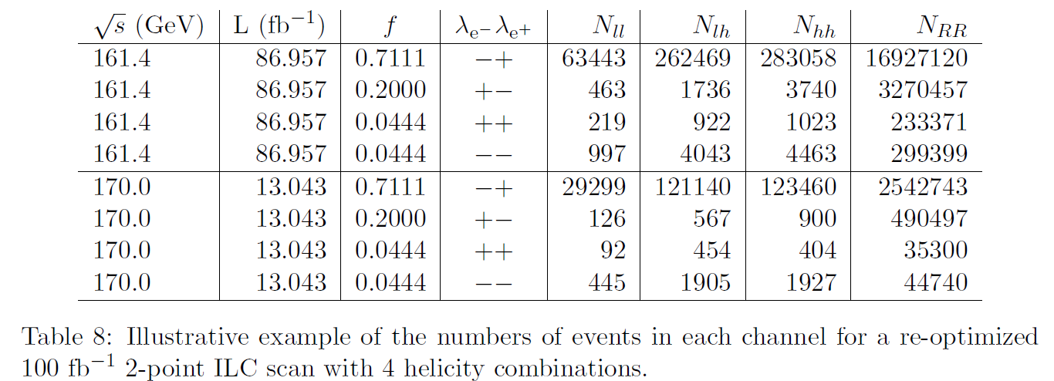
Updated Results
Use re-optimized 2-point “scan”. Working on optimizing this analytically.
Errors on m_{W} (MeV)

Slide 19
Summary I
Threshold scan can yield a precision measurement of m_{W} at a linear collider with polarized electron AND positron beams.
  Errors at the few MeV level can be envisaged.
  With 100fb⁻¹, find 2.4 (stat.) ⊕ 3.1 (syst.) ⊕ 0.8 (√s) ⊕ theory (MeV)
ILC design can and should evolve to make this feasible (proof of concept is in the TESLA TDR).
  Supported machine parameters would be helpful.
  Better awareness of these issues by LCC management …
Regressing to no positron polarization should be avoided!
  Controlling the background is very challenging without it.
    I am not confident that a useful m_{W} measurement can be made at threshold with no positron polarization. Limited by absolute polarization measurement – 0.5% systematic.
    I am certain that a competitive m_{W} measurement at threshold is very challenging with no beam polarization at all

Slide 20
Take-Home Messages
ILC has very good prospects for measuring m_{W} with very high precision
  Not much work yet on measurements at standard ILC √s values (√s ≥ 250 GeV). Needs more effort.
  Measurement at threshold expected to be very robust with polarized electrons and polarized positrons (experimentally and theoretically).
Precision m_{W} needs precision √s.
  √s_{P} method very promising
  Need precise momentum scale.
    J/psi method using Z’s needs 40M Z’s…..
  Error on m_{W} from √s knowledge of 0.8 MeV can be targeted.
ILC accelerator
  Need to preserve the option to run with high L and highly polarized electrons AND POSITRONS at WW threshold. No experimental show-stoppers.
    This is a great advantage of ILC over other accelerator concepts.
  We should DEMAND capability for high luminosity for calibration at the Z.
  We should DEMAND capability for reasonable luminosity at the Z with polarized beams for physics.

Slide 21
Backup Slides

Slide 22
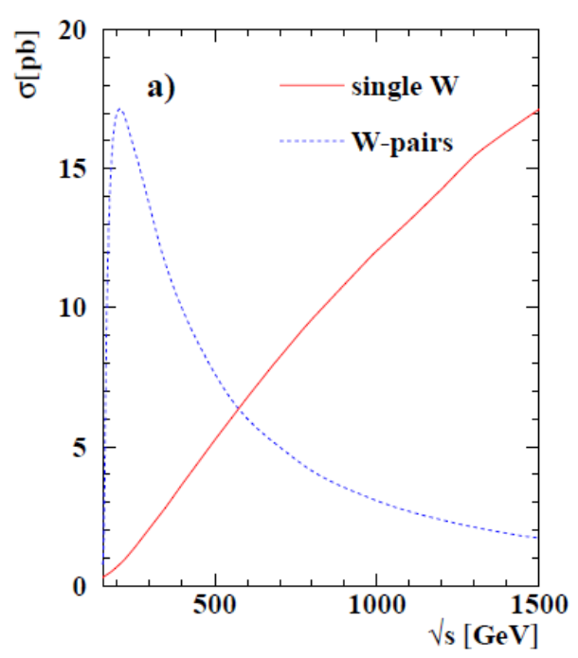
W Production in e⁺e⁻
etc ..
e+e- → W+W-
e+e- → W e ν
arXiv:1302.3415
unpolarized cross-sections

Slide 23
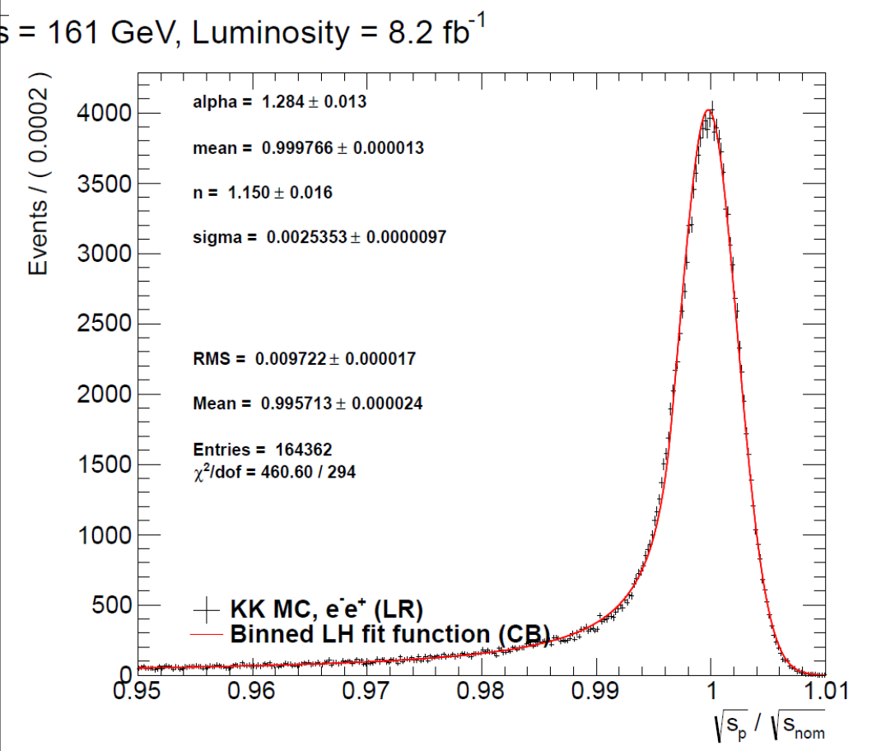
“New” √s_{P} In-Situ Beam Energy Method
GWW
e⁺ e⁻ → μ ⁺μ⁻(γ)
with J. Sekaric
preliminary
Use muon momenta.
Measure E₁ + E₂ + |p₁₂| as an estimator of √s
(no assumption that m₁₂ ≈ m_{Z})
ILC detector momentum resolution (0.15%), gives beam energy to better than 5 ppm statistical for nominal luminosity. Momentum scale to 10 ppm => 0.8 MeV beam energy error projected on m_{W} (J/psi)
Beam Energy Uncertainty should be controlled for √s <= 500 GeV

Slide 24
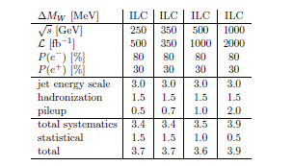
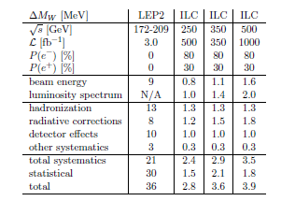
m_{W} Prospects
1
1
Polarized Threshold Scan (GWW)
Kinematic Reconstruction
Hadronic Mass (GWW, BvD, KT)
Method 1: Statistics limited.
Method 2: With up to 1000 the LEP statistics and much better detectors. Can target factor of 10 reduction in systematics.
Method 3: Depends on di-jet mass scale. Plenty Z’s for 3 MeV.
3
2
See Snowmass document for more details
Bottom-line: 3 different methods with prospects to measure mW with error < 5 MeV

Slide 25
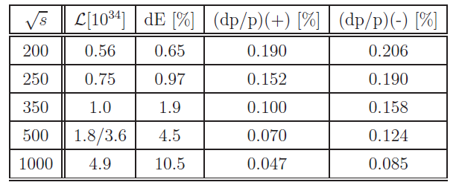
ILC Accelerator Features
L ~ (P/E_{CM}) √(δ_{E} / ε_{y,N}) H_{D}
P ∼ f_{c} N
δ_{E} ∼ (N² γ²)/( ε_{x,N} β_{x} σ_{z}) U₁ (Ψ_{av})
Machine design has focused on 500 GeV baseline
dp/p same as LEP2 at 200 GeV
dp/p typically better than an e⁺e⁻ ring which worsens linearly with √s
Scope for improving luminosity performance.
Increase number of bunches (f_{c})
Decrease vertical emittance (ε_{y})
Increase bunch charge (N)
Decrease σ_{z}
Decrease β_{x}
3,4,5 => L, BS trade-off
Can trade more BS for more L or lower L for lower BS.
Notes:
Check.
Eqn 1 is 1.3.4 in Ch 1 of TESLA TDR Part II.
From p57 of my logbook. Seems to be based on TESLA CDR discussion and Yokoya-Chen.
Looks like I missed a factor of gamma in the delta_E term previously.
P= beam power.

Slide 26
Beamstrahlung
Average energy loss of beams is not what matters for physics.
Average energy loss of colliding beams is factor of 2 smaller.
Median energy loss per beam from beamstrahlung typically tiny compared to beam energy spread.
Parametrized with CIRCE functions.
f δ(1-x) + (1-f) Beta(a₂,a₃)
Define t = (1 – x)^{1/5}
Scaled energy of colliding beams
161 GeV
161 GeV
71%
500 GeV
500 GeV
43%
In general beamstrahlung is a less important issue than ISR. Worse BS could be tolerated in the WW threshold scan
t=0.25 => x = 0.999
x >0.9999 in first bin

Slide 27
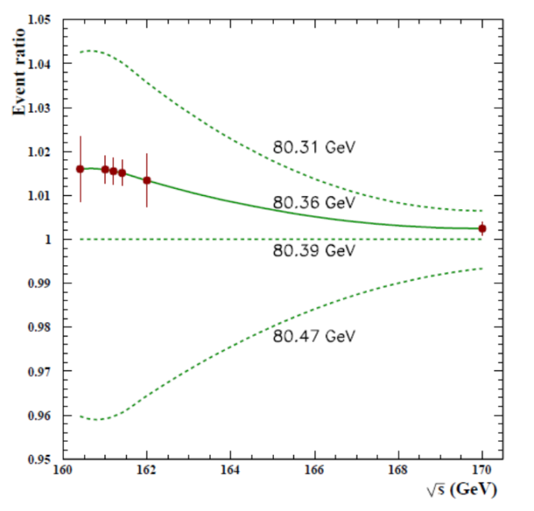
m_{W} Measurement Prospects Near Threshold
LEP2 numbers
Measure at 6 values of √s, in 3 channels, and with up to 9 different helicity combinations.
Use RR (100 pb) cross-section to control polarization
Estimate error of 6 MeV (includes Eb error of 2.5 MeV from Z γ) per 100 fb⁻¹ polarized scan (assumed 60% e+ polarization)

Slide 28
Systematics are treated as nuisance parameters that can be fitted. Errors should scale statistically.

Slide 29
Polarized Threshold Scan Errors
conservative – viewed from + 15 years ....
Non-Ebeam experimental error (stat + syst)
  5.2 MeV
 | Scenario 0 | Scenario 1 | Scenario 2 | Scenario 3
L (fb⁻¹) | 100 | 160*3 | 100 | 100
Pol. (e⁻/e⁺) | 80/60 | 90/60 | 90/60 | 90/60
Inefficiency | LEP2 | 0.5*LEP2 | 0.5*LEP2 | 0.5*LEP2
Background | LEP2 | 0.5*LEP2 | 0.5*LEP2 | 0.5*LEP2
Effy/L syst | 0.25% | 0.25% | 0.25% | 0.1%
Δm_{W}(MeV) | 5.2 | 2.0 | 4.3 | 3.9

Slide 30
In-situ Physics Based Beam Energy Measurements
Potential Mass-Scale References for Energy Calibration
Particle | ΔM/M (PDG) (ppm)
J/psi | 3.6
Upsilon | 27
Z | 23
W | 190
H | 2400
Conventional wisdom has been to use Z’s, but with ILC detector designs J/psi’s look attractive.
Prefer not to use something that one plans to measure better or something that will limit the precision.
Use J/psi from Z for momentum scale.

Slide 31
Momentum Scale with J/psi
With 10⁹ Z’s expect statistical error on mass scale of 1.7 ppm given ILD momentum resolution and vertexing based on fast simulation.
Most of the J/psi’s are from B decays. J/psi mass is known to 3.6 ppm. < p > = 20 GeV.
Can envisage also improving on the measurement of the Z mass (23 ppm error)
ILD fast simulation
(no vertex fit)
10⁷ Z’s
√s=m_{Z}
χ²/dof = 90/93
CDF
Double-Gaussian + Linear Fit
Notes:
Include mean momentum

Slide 32
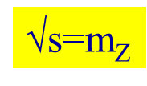
Full Simulation + Kalman Filter
10k “single particle events’’
Work in progress – likely need to pay attention to issues like energy loss model and FSR.
Preliminary statistical precision similar.
More realistic material, energy loss and multiple scattering.
No vertex fit nor constraint
-46±13 ppm
Empirical Voigtian fit.
Need consistent material model in simulation AND reconstruction

Slide 33
“Calibration” Run at √s=m_{Z} for detector p-scale calibration
Assume 2.0 ppm statistical for 10⁹ Z’s.
Asymptotic error of 3.6 ppm driven by J/psi PDG mass uncertainty.
If detector is stable and not pushed, pulled and shaken, one could hope that such a calibration could be maintained long term at high energy.
Plot assumes negligible systematics from tracking modeling …
√s=91GeV
Need at least 40 M hadronic Z’s for 10 ppm
Corresponds to ≥ 1.3 fb⁻¹ (L ≥ 1.3 × 10³³ for 10⁶s) assuming unpolarized beams
Notes:
The required instantaneous luminosity is about 1/10th of the 250 GeV Luminosity Upgrade when scaled down by a factor of gamma.

Slide 34
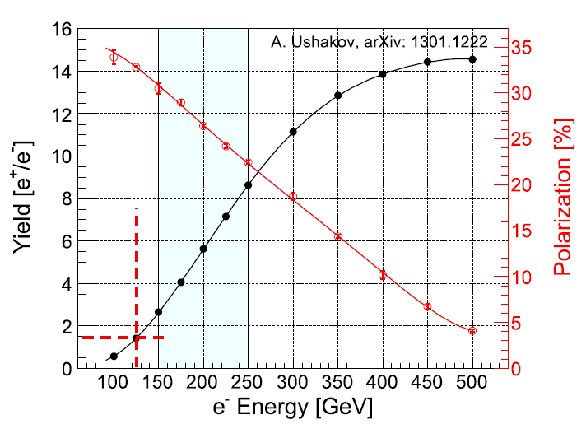
Positron Source
231m undulator
For √s  250 GeV, still need a high energy e⁻ beam for adequate e⁺ production.

