Slide 1

A scale-invariant Higgs sector with large anomalous
Higgs self-coupling
K.E. and Y. Sumino (Tohoku U.), JHEP 1505 (2015) 030 [arXiv:1503.02819].
K.E. and K. Ishiwata (Kanazawa U.), PLB 749 (2015) 583 [arXiv:1507.01739].
Kazuhiro Endo (Tohoku U., Japan)
@ LCWS 2015 (Whistler, Canada)
3rd November, 2015

Slide 2
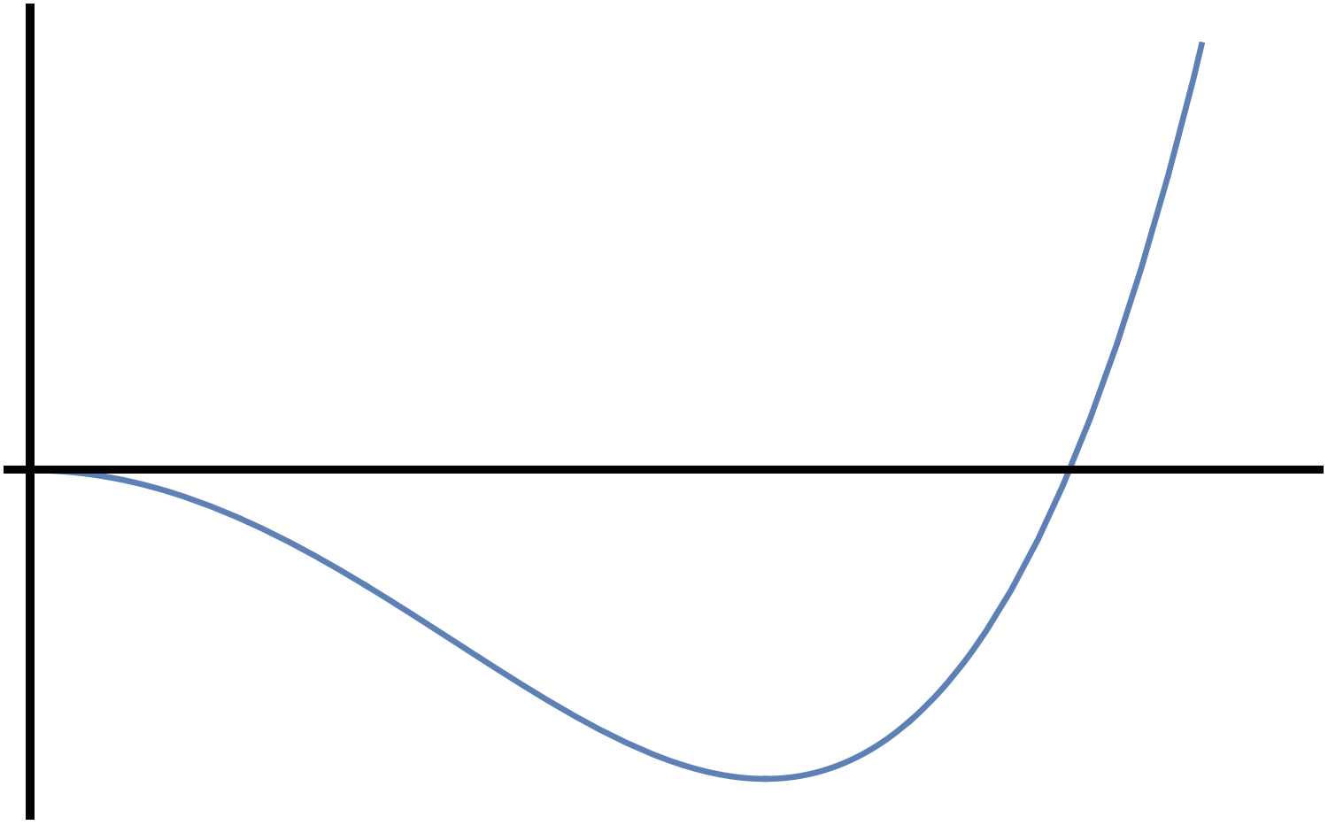
Higgs sector in the Standard Model
Higgs boson was discovered in 2012.
Its properties are consistent with the Higgs boson in SM.
Higgs sector is characterised by the Higgs potential.
Higgs potential:
Induce EWSB
Origin of the EW scale as VEV
Origin of the Higgs boson as fluctuation of the Higgs field around the vacuum
V
<H>

Slide 3
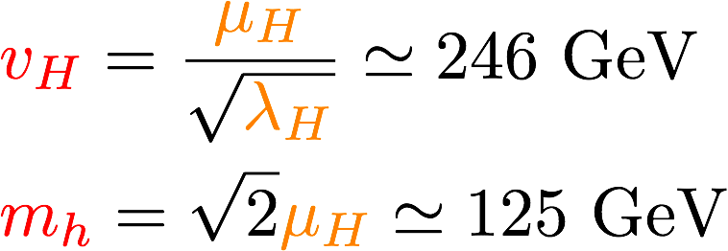
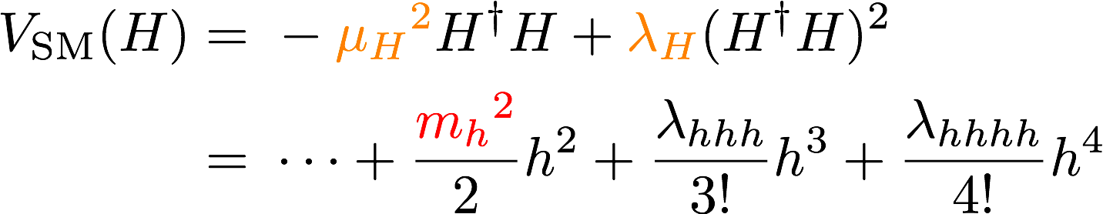
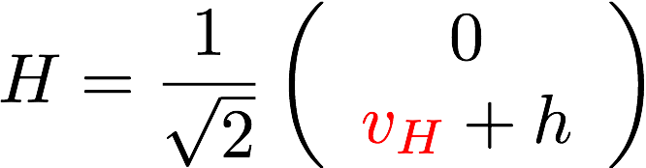
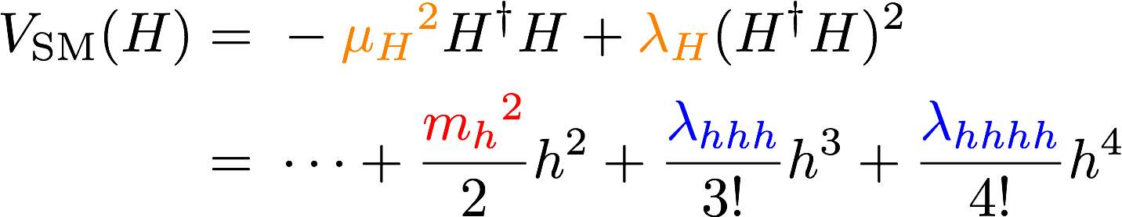




Higgs sector in the Standard Model
two parameters: μ_{H}, λ_{H} ↔️ VEV v_{H} , mass m_{h}
V
Higgs self-couplings are also predicted in SM.
But they haven't been measured yet. = SM hasn't been confirmed yet.
They give information about vicinity of our vacuum = shape of the potential.
<H>
・・・

Slide 4

Motivation
Is there possibility that ONLY self couplings deviate (substantially) from SM predictions?
which gives an interesting shape of potential?
One candidate: Scale-invariant extension
as a phenomenological model near EW.
→ EWSB via Coleman-Weinberg (CW) mechanism
[S. R. Coleman, E. J. Weinberg, PRD 7 (1973) 1888]
→ Effective potential is like
・irregular at the origin (e.g. QCD, BCS theory)
・realise correct VEV and mass of the Higgs,
・large deviations in self-couplings?
We dealt with singlet-extension.

Slide 5
Contents
Introduction
Model and Our method of analysis
Couplings among the scalar bosons
Veltman’s condition for the Higgs mass
Singlets as dark matter?
Summary

Slide 6
Model
SM-singlet, global-O(N) multiplet
K. A. Meissner et.al. [hep-ph/0612165],
R. Foot et. al. [0704.1165]
etc.
Singlet sector interacts through the portal coupling λ_{HS} .
We re-analysed the model and its effective potential,
and found the consistent vacuum by more precise perturbation.
(cf. R. Dermisck et.al. [1308.0891], C. Tamarit [1404.7673])

Slide 7
Particle content
SM-singlet, global-O(N) multiplet
SM particles
+
N real singlet scalar bosons (s_{i})
・mass² ~ λ_{HS}v_{H}²
・singlet field VEV <S> = 0 eventually
・thus singlet cannot decay (= stable)

Slide 8

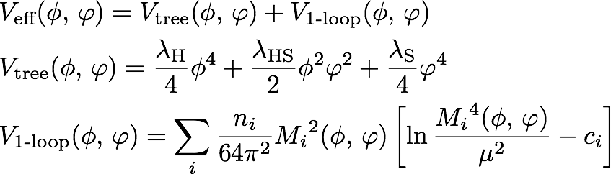

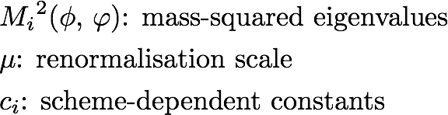
Effective potential
Definition of classical fields
Fixed-order potential
← determined in tree level
→ set to Higgs VEV 246GeV hereafter

Slide 9
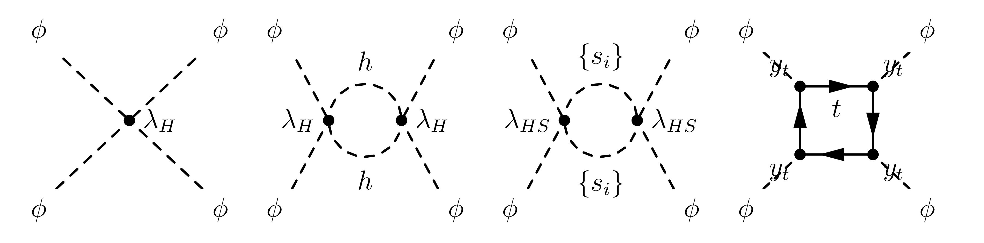
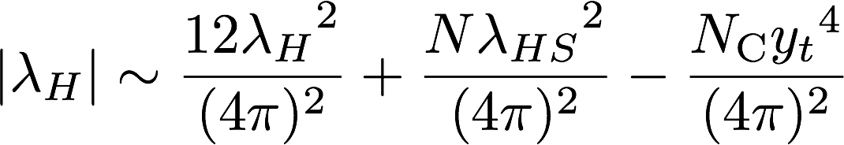
Contributions to effective potential
It is known that quantum effects have to balance with
tree-level effects, otherwise CW mechanism doesn't work
in perturbative regime.
(only dominant contributions)
・・・
<< 1
becomes a higher-order contribution since λ_{H} << 1

Slide 10
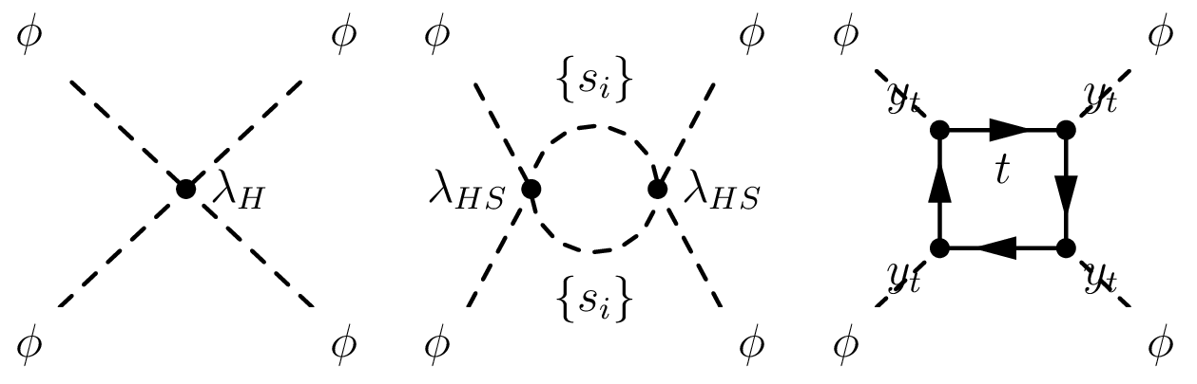

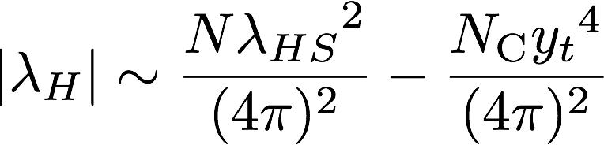
Order-counting in perturbation
Analogy of massless scalar QED:
<< 1
λ_{H} needs to be counted as different orders from other couplings because |λ_{H}| << |λ_{HS}|.
Thus correct order-counting must be taken into account for the effective potential.
By this requirement, N and λ_{HS} are no longer independent.

Slide 11
Contents
Introduction
Model and Our method of analysis
Couplings among the scalar bosons
Veltman’s condition for the Higgs mass
Singlets as dark matter?
Summary

Slide 12
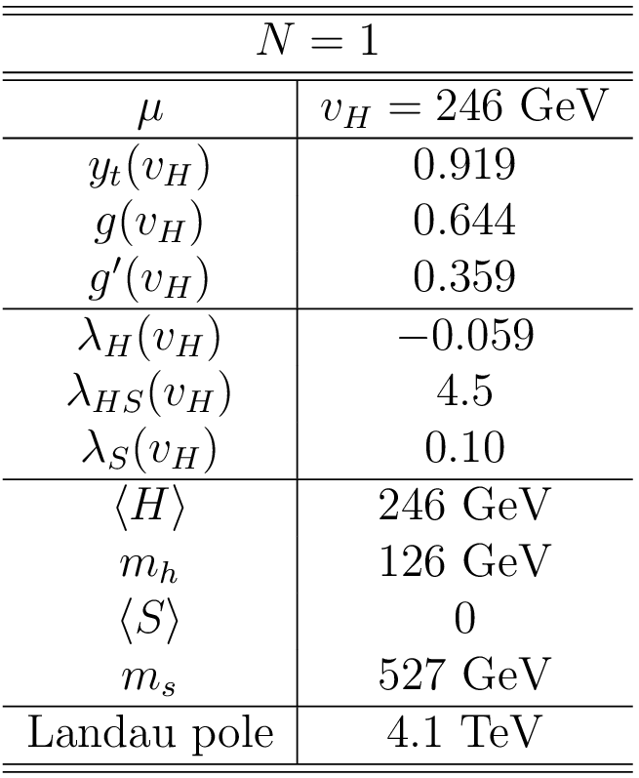
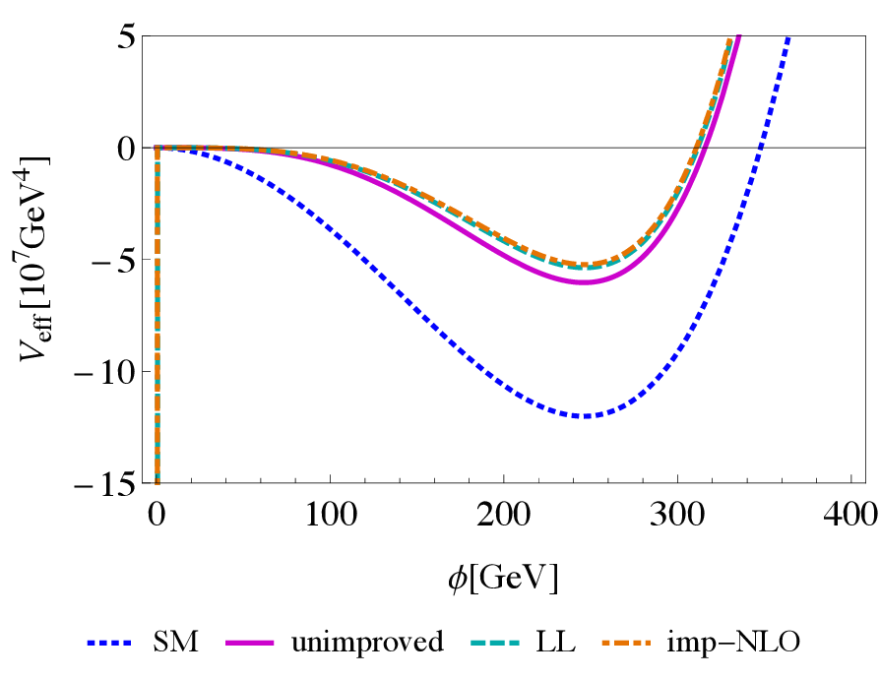
Results: N = 1 case
Result
SM
K.E. and Y. Sumino
There is no mixing between Higgs and singlet.
Perturbation is valid at the vacuum.
Landau pole appears at TeV.
Consistent with the previous work [R. Dermisck et.al., 1308.0891].

Slide 13
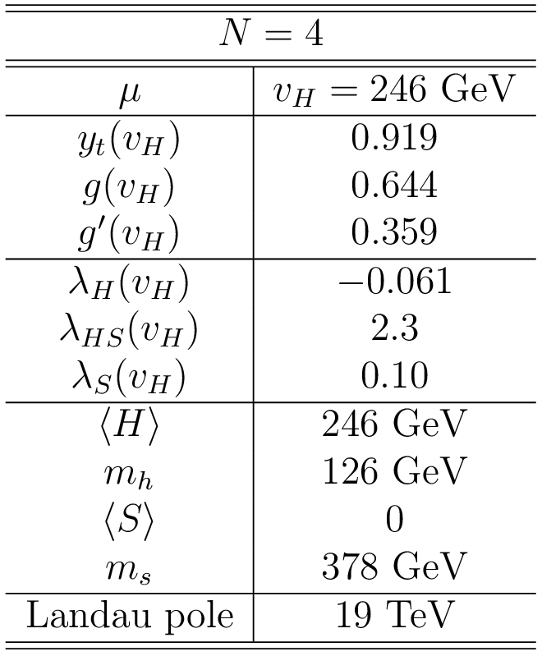
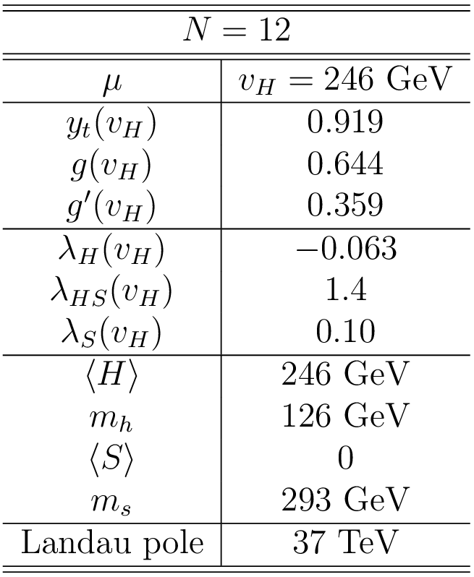

Results: N = 4 and 12 cases
K.E. and Y. Sumino
As N increases…
λ_{HS} becomes small.
Singlet mass becomes small ( ).
Landau pole goes far away.

Slide 14
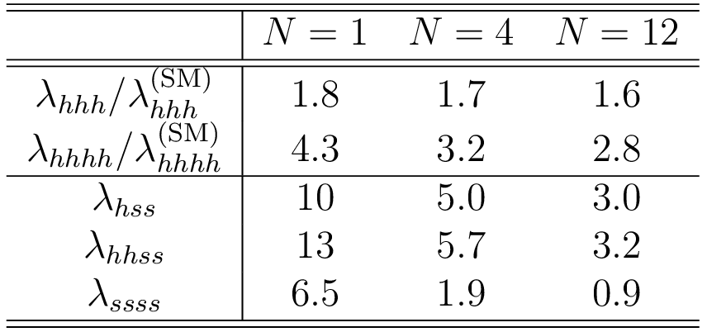
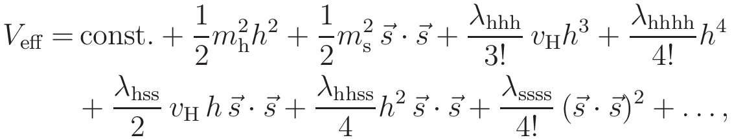
Results:
Couplings of the Higgs and Singlets
K.E. and Y. Sumino, values from V_{LL}

Slide 15
Comparison with conventional method
There is the conventional ``Gildener-Weinberg's method''.
[E. Gildener and S. Weinberg, 1976]
But couplings involving the singlet scalars, λ_{hss} and λ_{hhss}, are derived using tree-level interactions.
By our method,
Loop effects are included in all couplings.
Higgs self-couplings are consistent with GW.
Higgs-singlet couplings are correctly determined including loop effects.

Slide 16
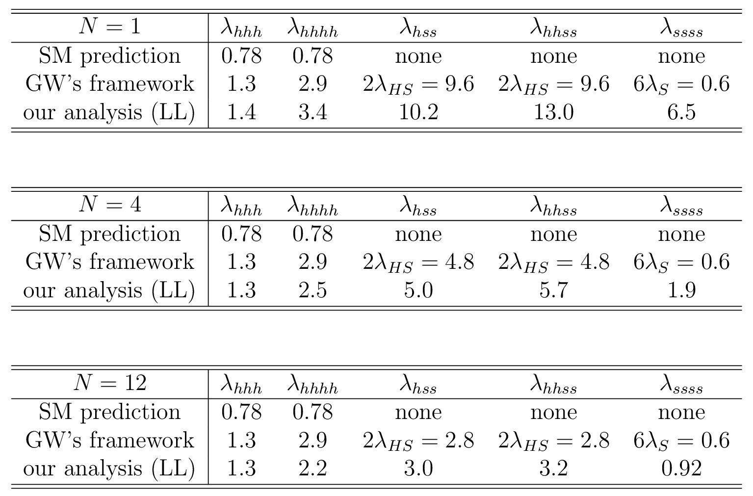
Comparison with conventional method
K.E. and Y. Sumino, values from V_{LL}

Slide 17
Contents
Introduction
Model and Our method of analysis
Couplings among the scalar bosons
Veltman’s condition for the Higgs mass
Singlets as dark matter?
Summary

Slide 18
Veltman’s condition for Higgs mass
[What is Veltman’s condition?]
Coefficient of quadratic divergence vanishes
in quantum corrections for Higgs mass.
Then there is no fine-tuning if it is satisfied.
Cutoff-regularised quantum correction:
[O. Antipin et. al, 1310.0957v3] etc.
Coefficient of quadratic divergence:
→ How much is it in our model?
(next slide)

Slide 19
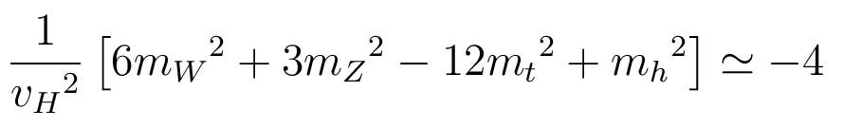
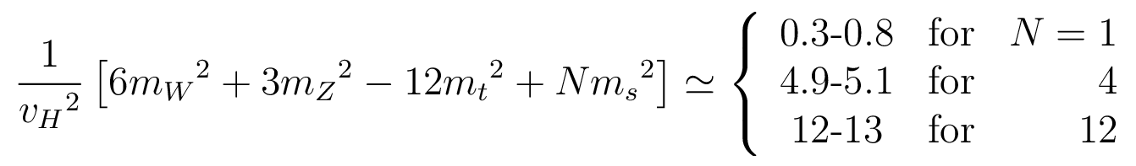
Is Veltman’s condition favoured?
Coefficient of quadratic divergence
in correction for Higgs mass
SM case
Our model
based on K.E. and Y. Sumino
N = 1 case seems to be relatively and approximately
favoured, so that Fine-tuning seems to be relaxed.

Slide 20
Contents
Introduction
Model and Our method of analysis
Couplings among the scalar bosons
Veltman’s condition for the Higgs mass
Singlets as dark matter?
Summary

Slide 21
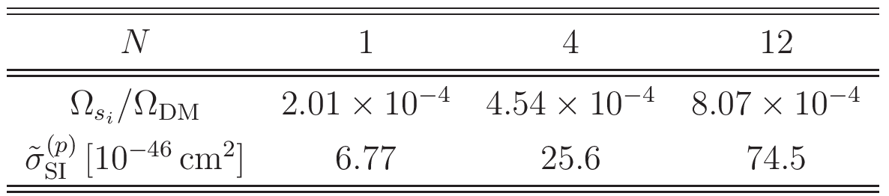
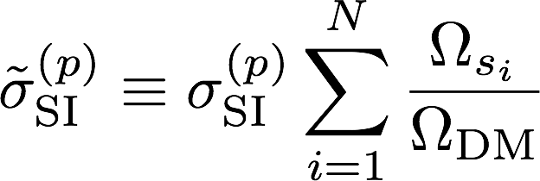
Singlets as dark matter
K.E. and K. Ishiwata
Thermal relic abundances are very small.
Spin-independent cross sections with proton are predicted in detectable region. (next slide)
Accurate calculation framework is used [J. Hisano, K. Ishiwata and N. Nagata, '15].

Slide 22
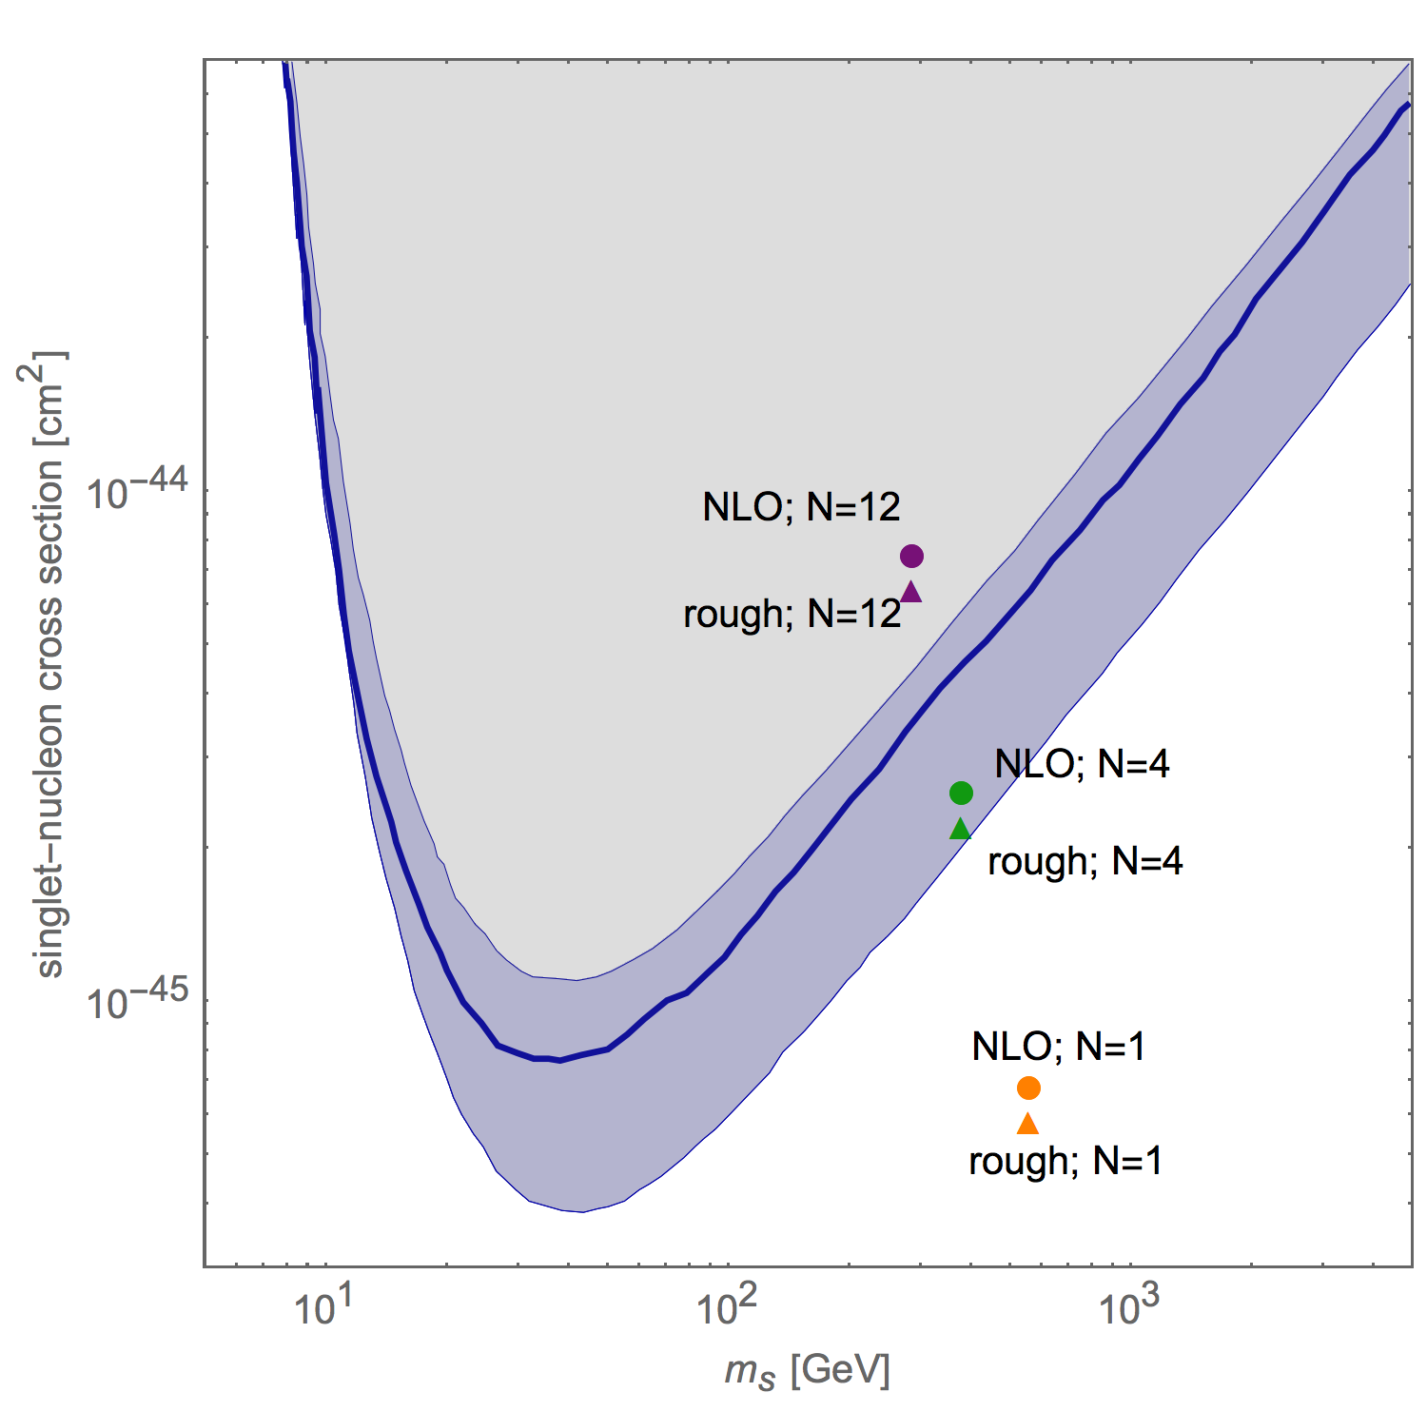
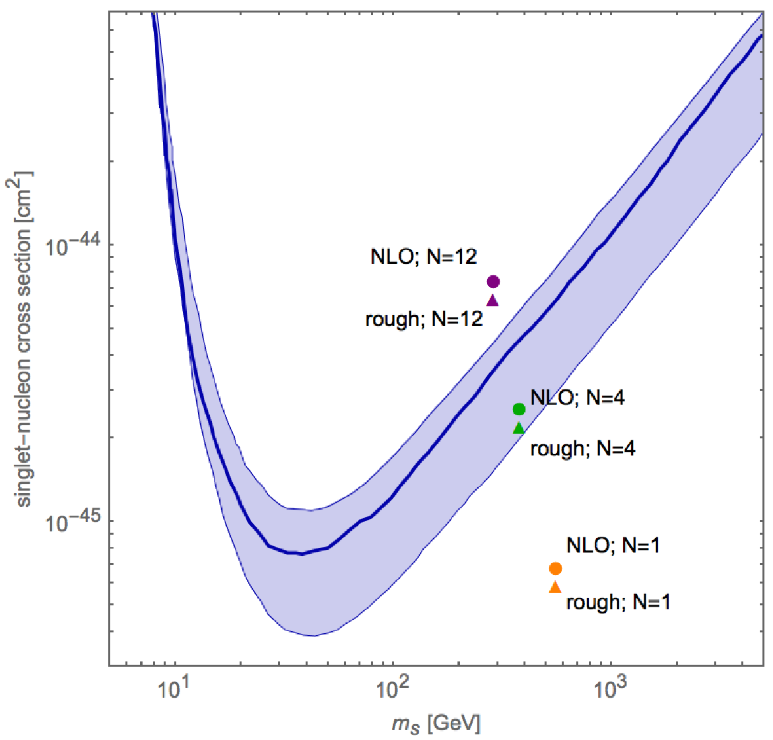
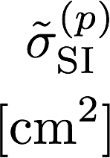
Direct detection
LUX bound
Excluded
あ
あ
あ
あ
あ
あ
あ
あ
あ
spin-independent cross section with proton
m_{s} [GeV]
K.E. and K. Ishiwata

Slide 23
Contents
Introduction
Model and Our method of analysis
Couplings among the scalar bosons
Veltman’s condition for the Higgs mass
Singlets as dark matter?
Summary

Slide 24
Summary
・Can only Higgs self couplings deviate (significantly) from SM predictions? → classically scale-inv. model
・We found perturbatively valid vacuum taking into account consistent order counting.
・Higgs self couplings:
・Singlet scalars get mass around 300-500GeV
and are only pair-produced.
・N = 1 case ・・ Singlet can be dark matter;
small relic abundance, but detectable.
・・ approximately satisfy Veltman’s condition.

Slide 25
Thank you for your attention.

