Slide 1
MDI Sessions Summary
(a few points to take home)
Karsten Buesser (DESY)
Lau Gatignon (CERN)
Sabine Riemann (DESY)
Marco Oriunno (SLAC) Toshiaki Tauchi (KEK)
Tomoyuki Sanuki (Tohoku)
T. Markiewicz/SLAC
LCWS 2015, Whistler CA
2015-11-06

Slide 2
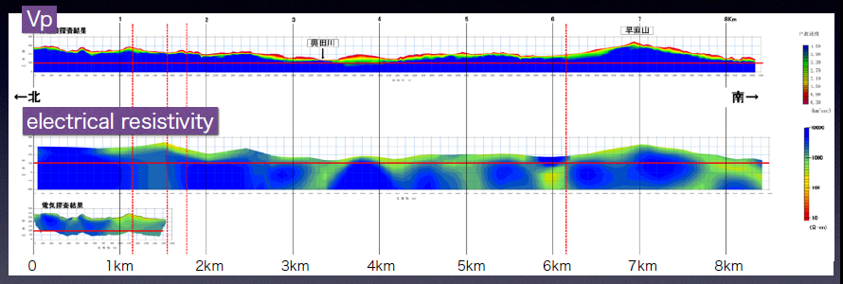
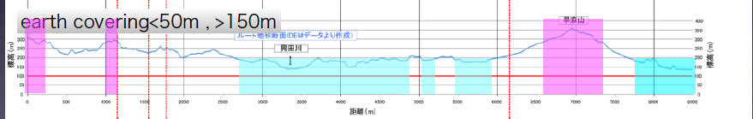
New IP Location Selected ~5km N of previous site
Tomo Sanuki
2015-10 IP
2014-09 IP
Vp and Resistivity Maps led to decision to take 1-bore sample at new site
New site is also a “vertical shaft” access site
ILC CFS ~transparent to this shift of IP

Slide 3
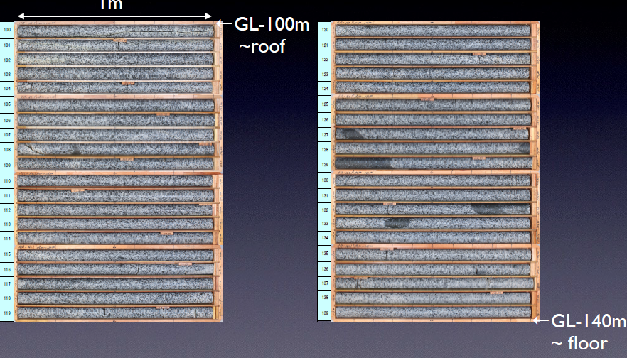
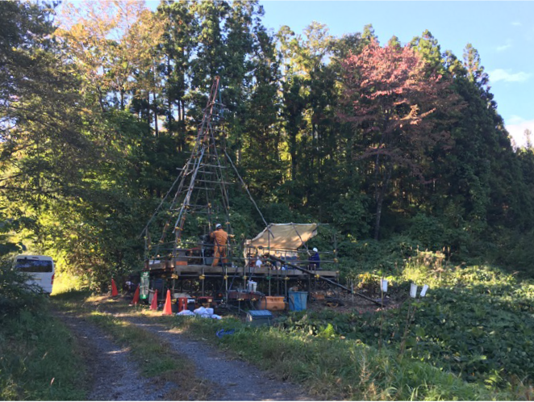
Bore samples at new site look excellent
Tomo Sanuki

Slide 4
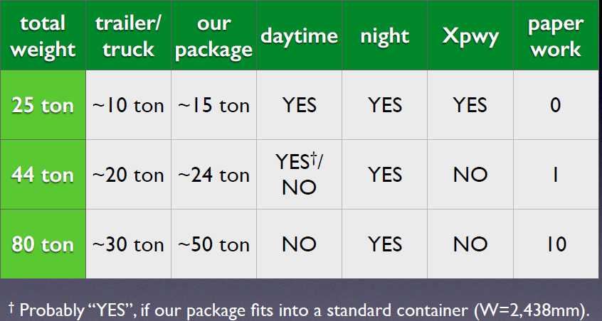
Road weight limits even lower than previously thought
< ~24T payloads for normal transportation (was <60T)
Tomo Sanuki

Slide 5
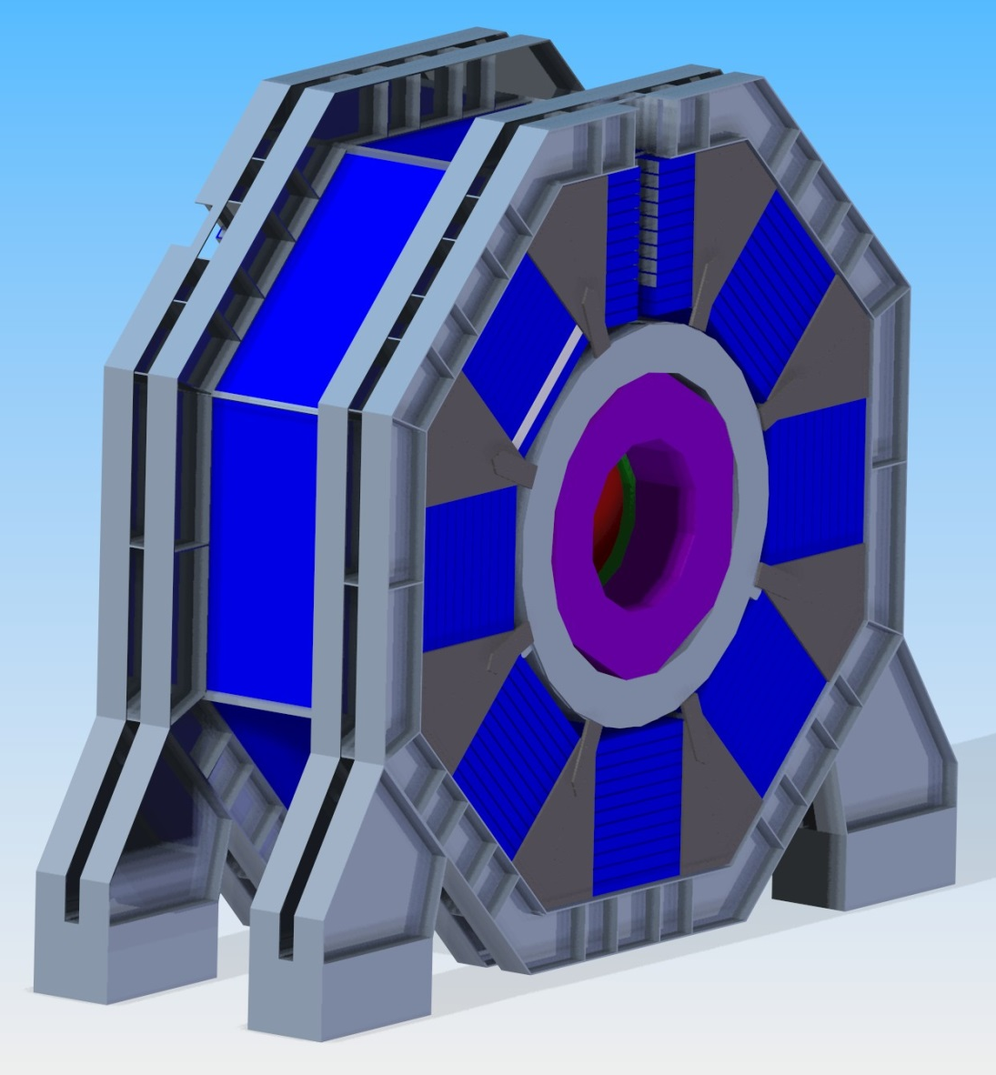
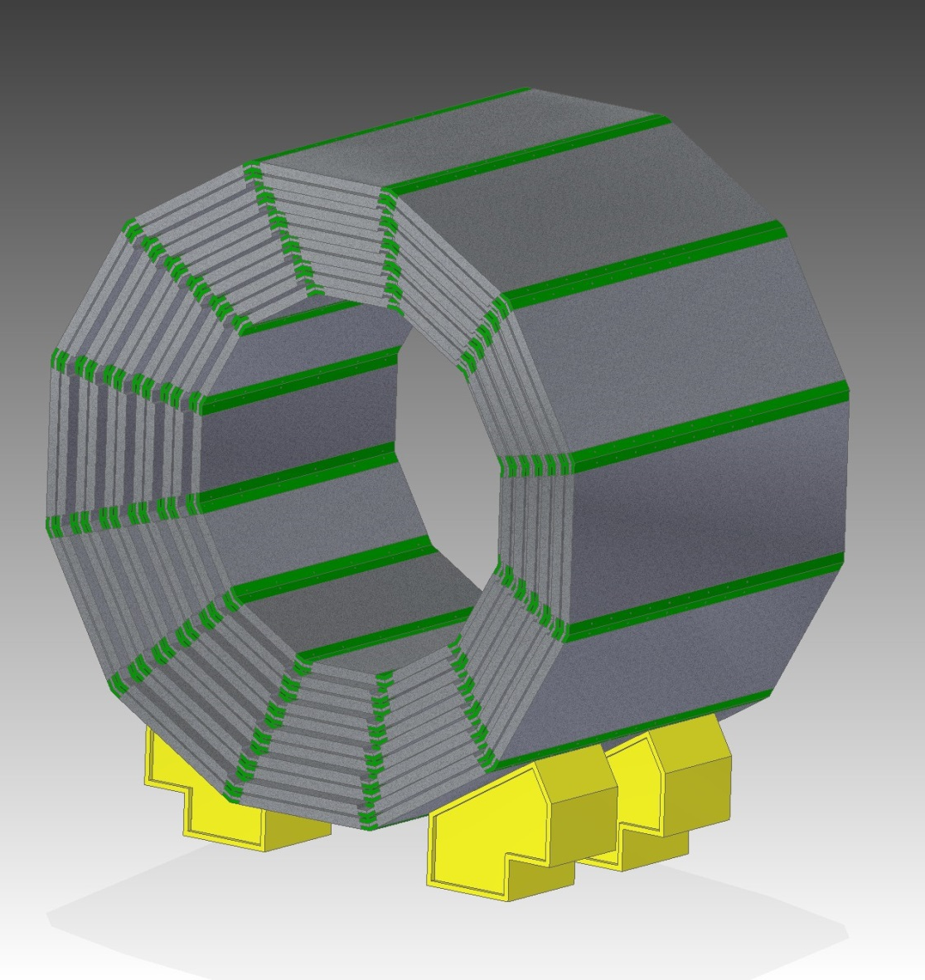
New SiD Iron Yoke Design Requires 5000 Ton Gantry
Marco Oriunno
DBD:
Layers in Barrel Constant Length
8-sided in Phi
Arches with Plates Joining Layers
2015
Barrel Plates Mate with Door Plates at 30°
12-sided in Phi
Support Feet & Plates with Connectors

Slide 6
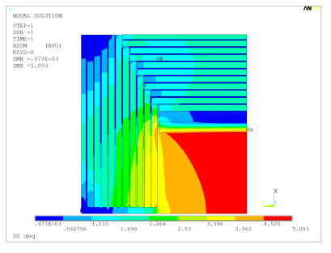
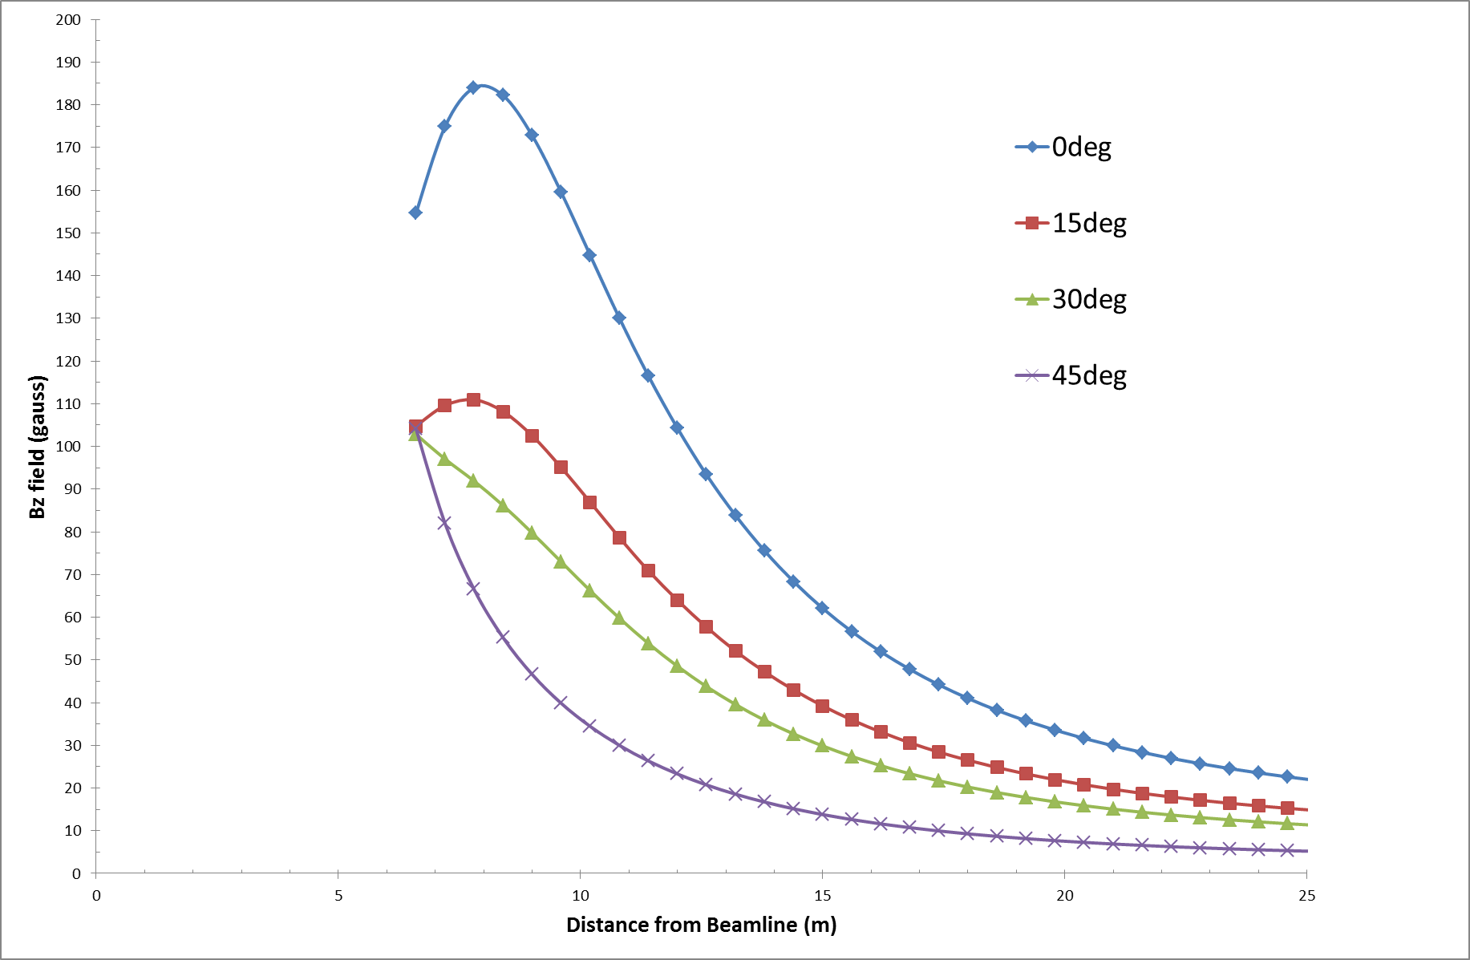
Fringe Field Improved in New Design
Marco Oriunno

Slide 7
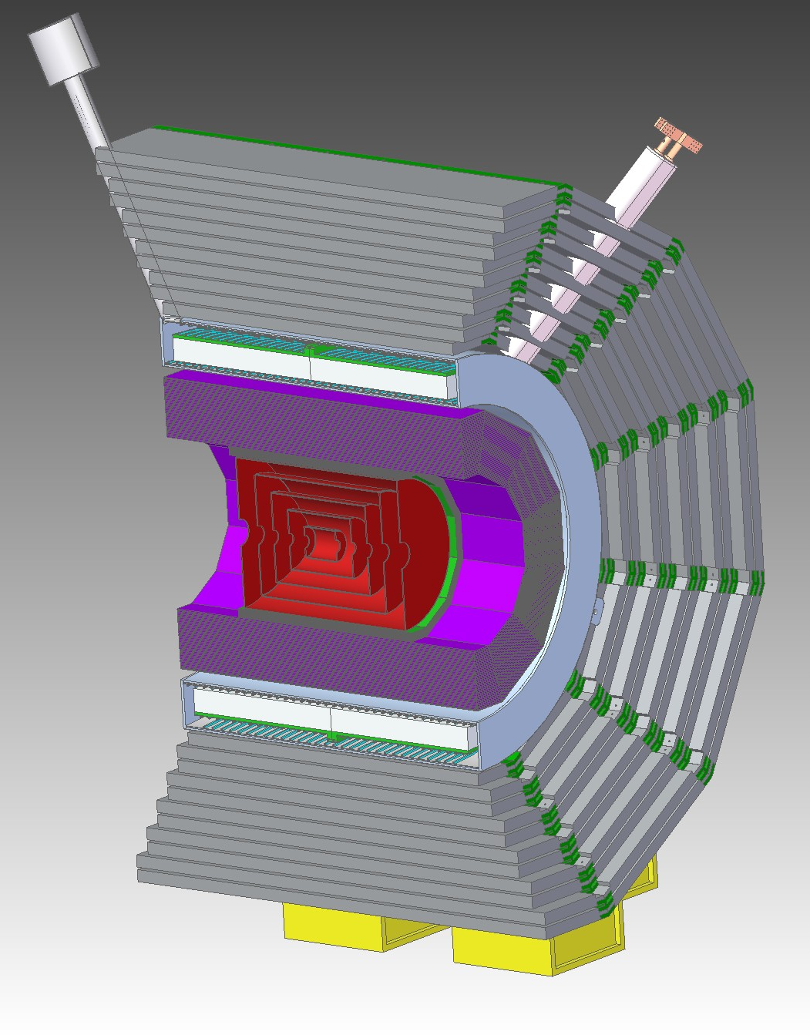
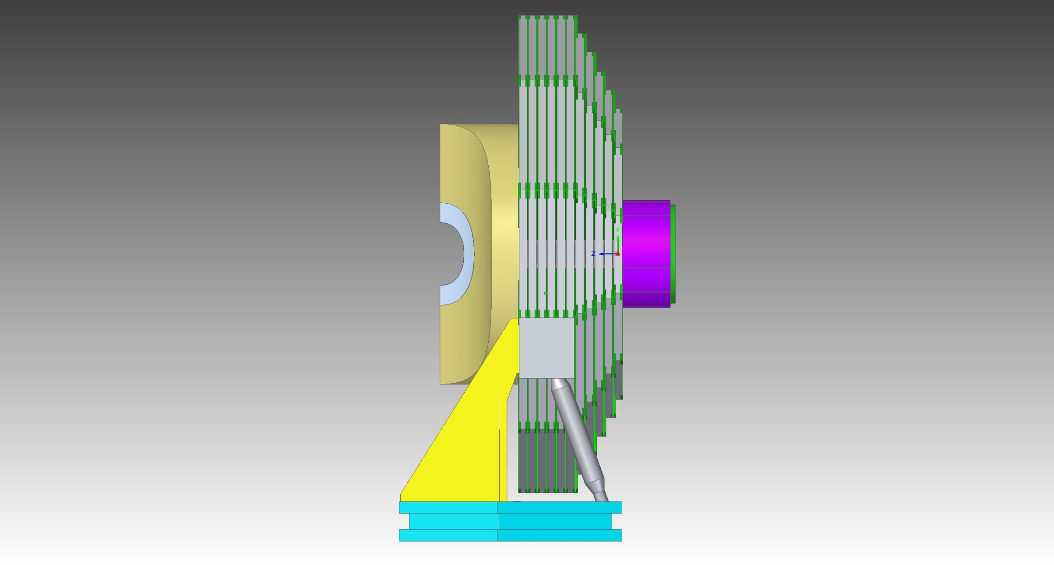
Mass Moves Doors to Barrel as Joint Angle 0°→45°
Marco Oriunno
Total Barrel with Coil, HCAL and Feet: Mass=4540 Tons
Total Mass 2,312 tons
C.G.

Slide 8
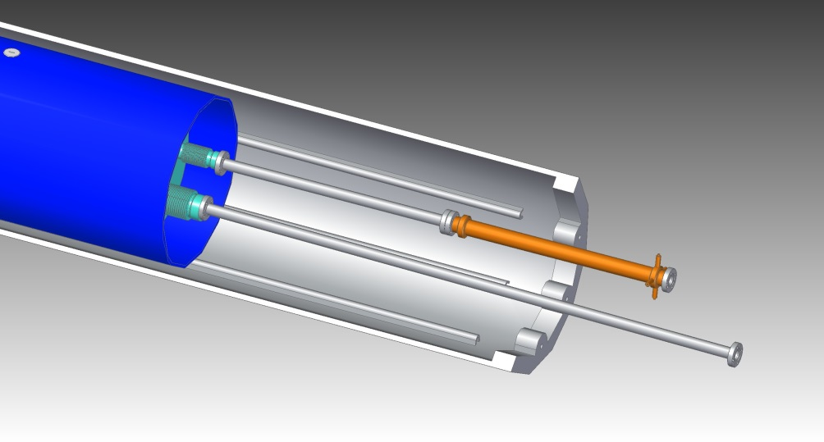
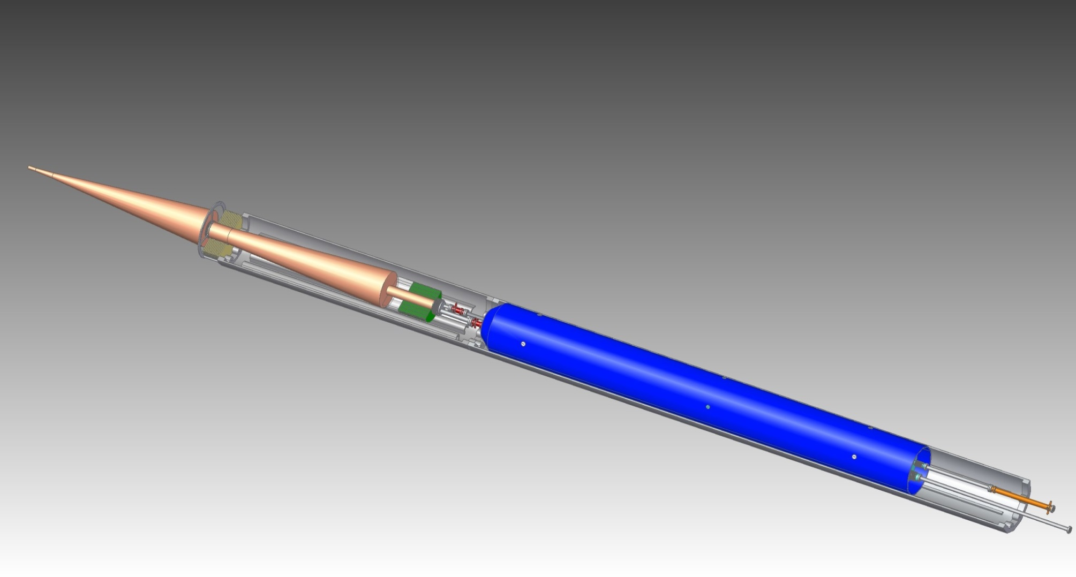
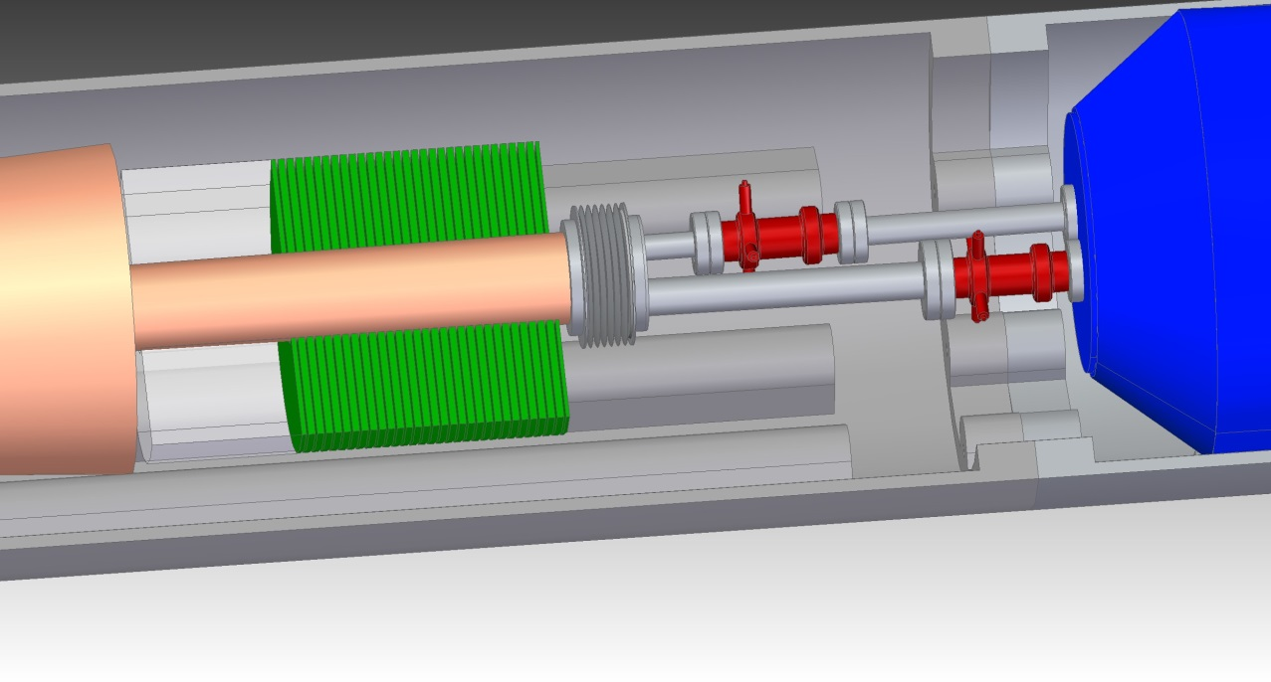
Engineering Work for SiD for L*=4.1m has Begun
Marco Oriunno
QD0
Kicker
Support Tube
BPM
PolyC
QD0
BeamCal
BPM

Slide 9
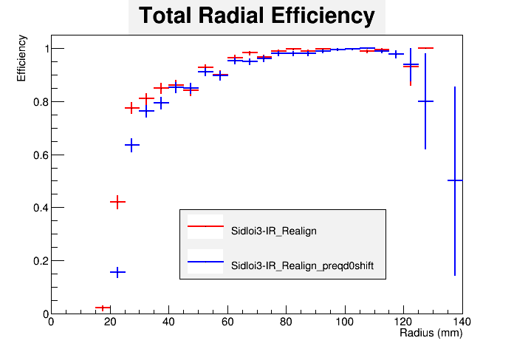
UCSC Study of SiD VXD & EC Tracker Backgrounds
Change to L*=4.1m (from 3.5m) looks OK
Bruce Schumm
to Identify 50 GeV e-
L* = 4.1m
L* = 3.5m

Slide 10
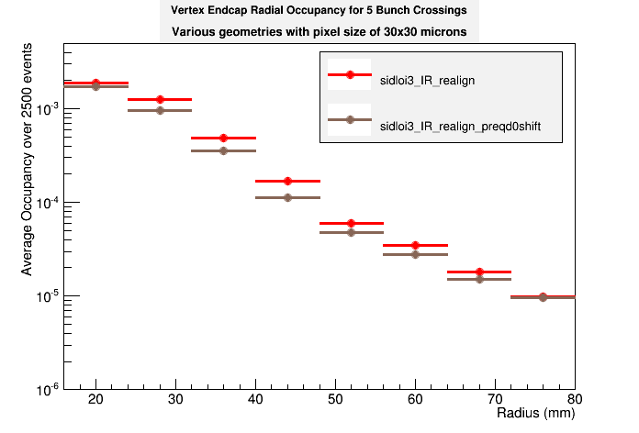
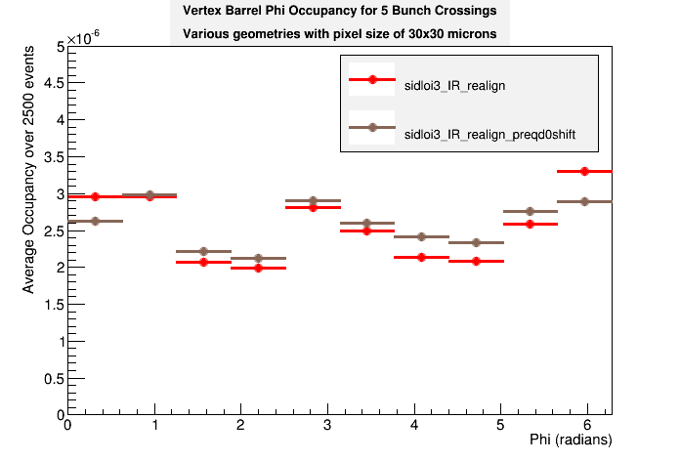
VXD & EC Occupancy versus L*
AntiDID not necessary
Bruce Schumm
L* = 3.5m
30 x 30
5 BX
x10⁻⁴
L* = 4.1m
Not much difference
Sign of difference depends on radius
10

Slide 11
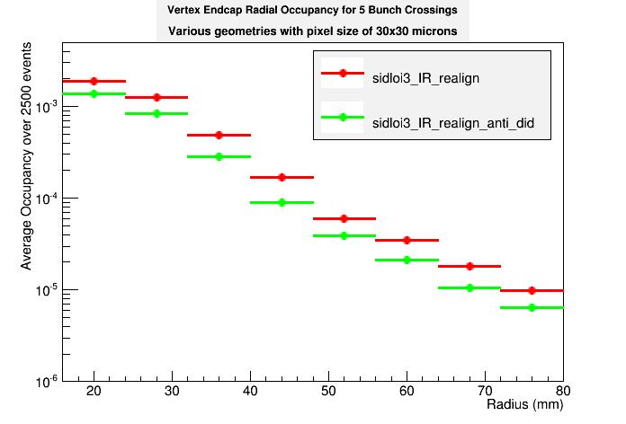
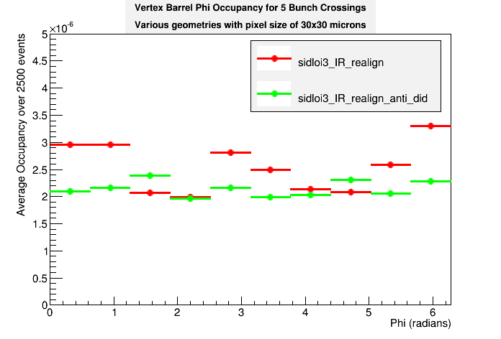
VXD & EC Occupancy versus anti-DID ON or OFF
Bruce Schumm
Plug is in place!
With antiDiD
x10⁻⁴
30 x 30
5 BX
Some improvements without antiDiD; but is occupancy low enough anyway?
11

Slide 12
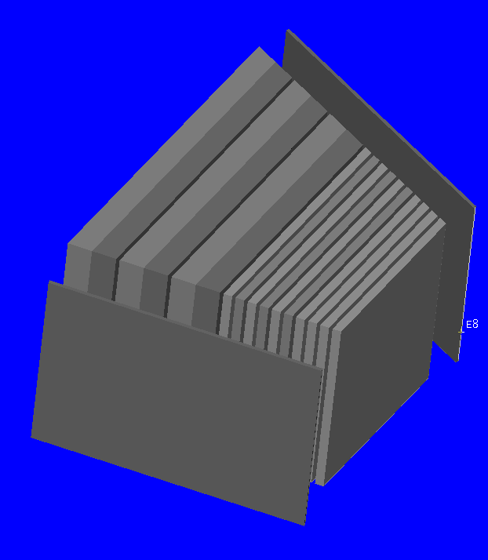
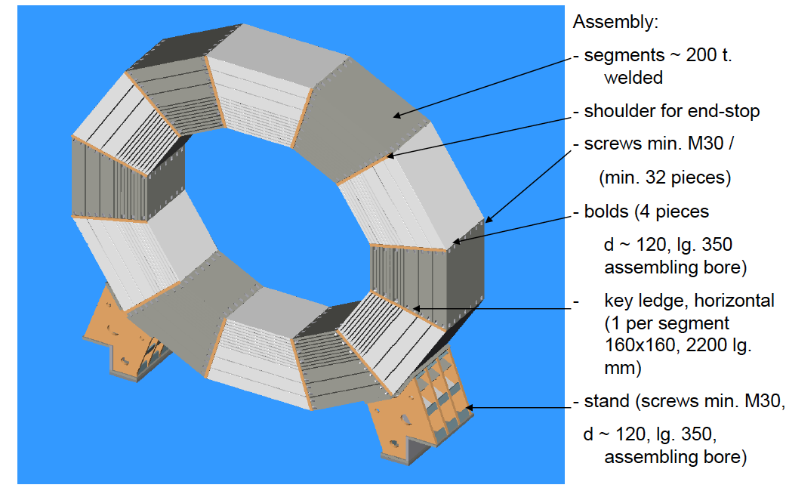
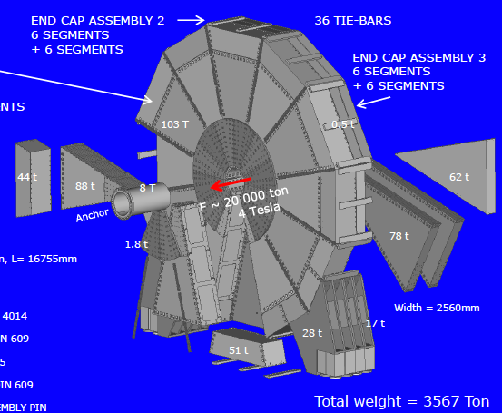
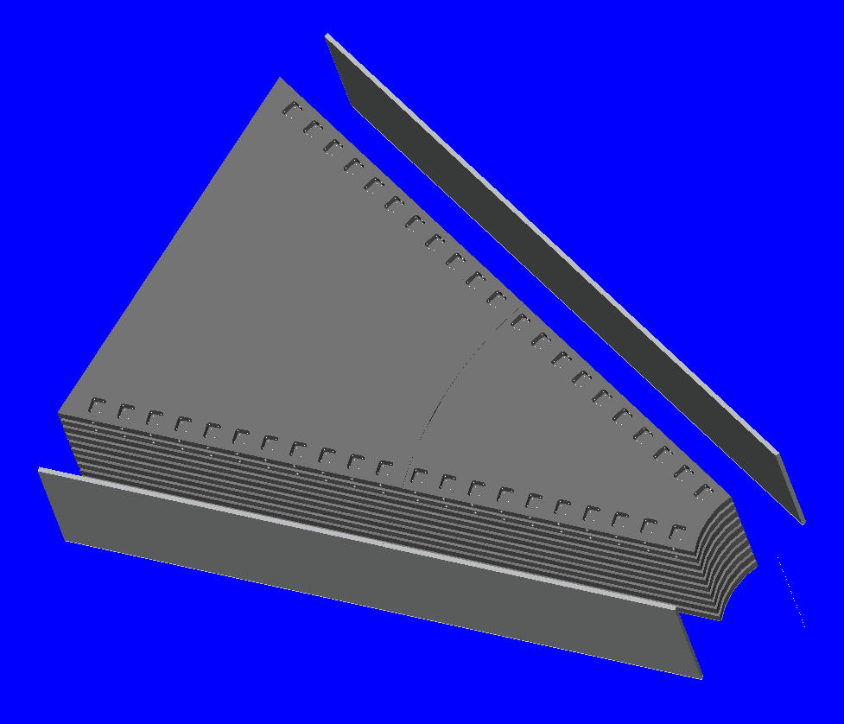
ILD Yoke Design and Assembly
Responding to road weight limits
Uwe Schneekloth
Bolted Assembly on Site, Many Truck Loads, Crane and Storage Requirements, Lots of Detailed Procedures developed……

Slide 13
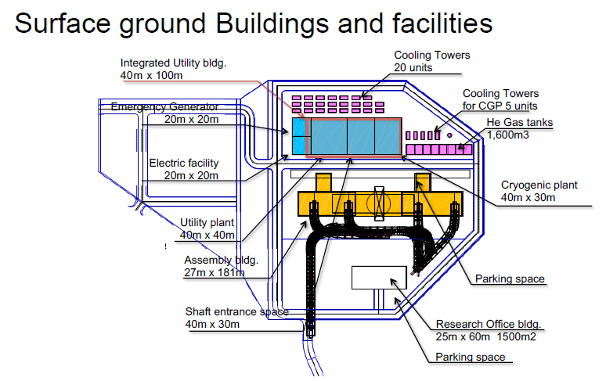
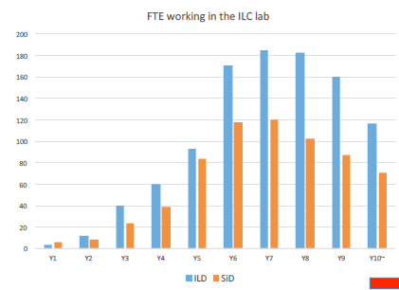
Kitakami Infrastructure and ILD Integration & Scheduling
ILC Infrastructure Group: 31.08.-01.09.2015 at KEK
Discussion on ILD construction, assembly and maintenance in Kitakami
October 8-9, LAL Orsay, France
Various Labor Estimates
Karsten Buesser

Slide 14
ILD Sequential Procedures and Schedules
Yasuhiro Sugimoto

Slide 15
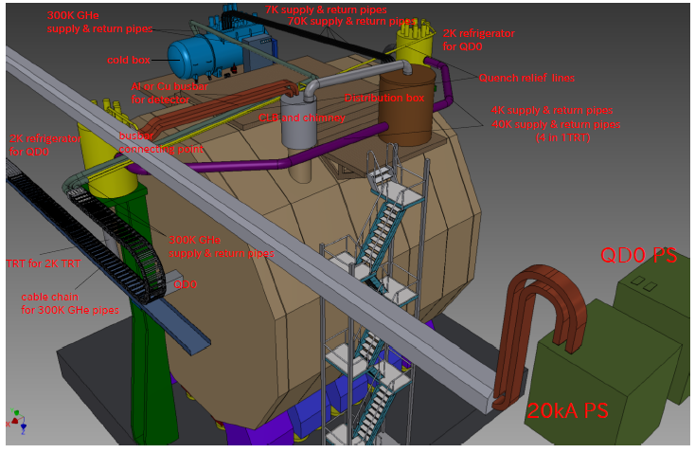
ILD Cryo-Distribution Design
Takahiro Okamura

Slide 16
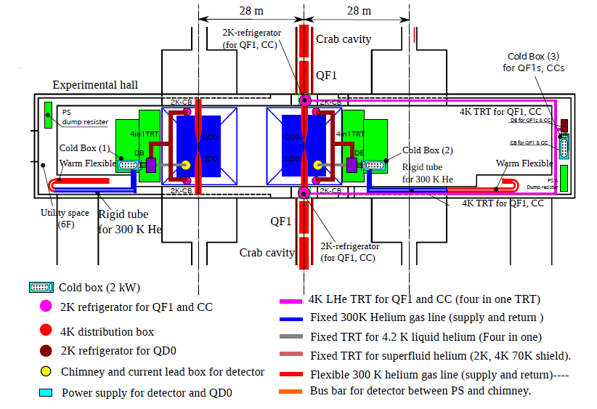
IR Hall CRYO Distribution
Takahiro Okamura

Slide 17

Summary
Not bad progress for organizations working with no resources who are waiting for approval from an organization who may have already said “no”

