Slide 1
Status: Cooling of the ILC e+ target
by thermal radiation
LCWS 2015, Whistler, Canada
3rd November 2015
Felix Dietrich (DESY), Sabine Riemann (DESY), Peter Sievers (CERN), Andriy Ushakov (Hamburg U)

Slide 2
Outline
Radiative thermal cooling of e+ target
Status
  Target temperature distribution
  Design considerations
    mechanical issues
  Our next steps
Summary

Slide 3
e+ target for E_{cm} = 250 … 500GeV
E_{cm} and luminosity determine energy depsited in target
(P_{e+} ≤30%)
Target wheel design appropriate for all E_{cm} ?
  radiative surface A sufficient to remove deposited energies W for all E_{cm}?
  Thermal contact Ti-Cu radiator is important
E_{beam} [GeV] | E_{dep} [kW] | ΔT_{max}/pulse [K] | E_{dep} [kW] | ΔT_{max}/pulse [K]
 | Nominal luminosity |  | High luminosity
120 | 5.0 | 66 | - | -
175 (ILC EDMS) | 3.9 | 125 | - | -
250 (ILC EDMS) | 2.0 | 130 | 4.1 | 195
250 | 2.3 | 85 | 4.6 | 165
A. Ushakov,
2015
A. Ushakov,
Update 2015

Slide 4
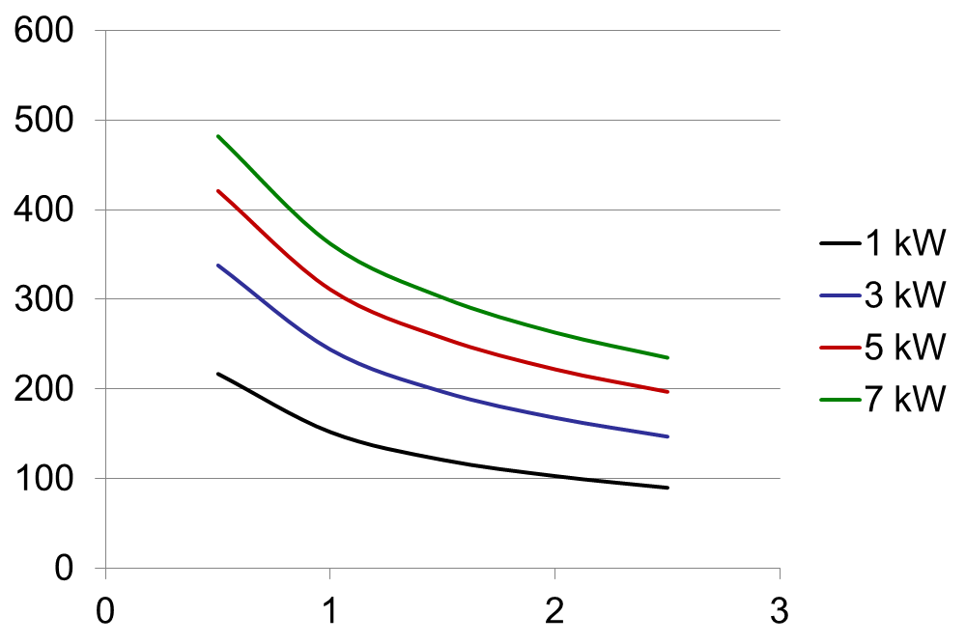
Area A of thermal radiation
  σ = Stefan-Boltzmann constant = 5.67 × 10⁻⁸ W/(m²K⁴)
  ε = emissivity = 0.7
  G = geometric form factor = 1
Target wheel
r = 0.5m
Simple full disk
→ 1.6m²
T[°C]
A[m²]

Slide 5
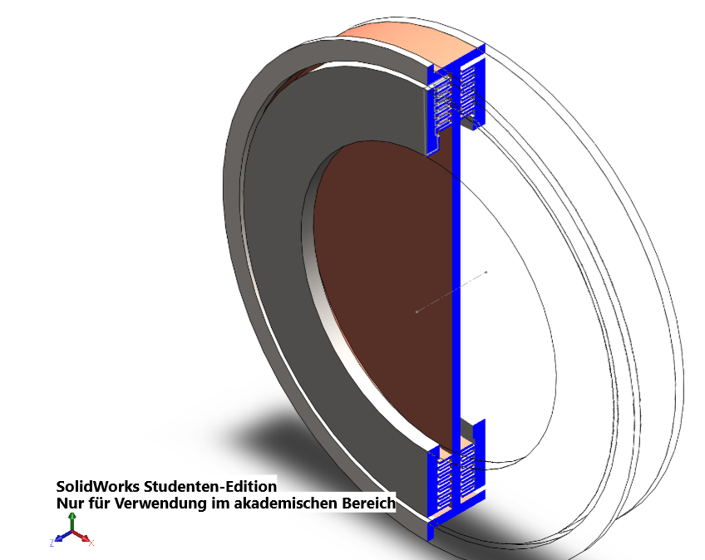
Ti6Al4V
photons
Radiative cooling – considered so far
Radiator (Cu)
Cooler (Cu)
e+ target located very close to the optical matching device
Rotating target wheel consists of Ti rim (e+ target) and Cu (radiator)
Heat path:
  thermal conduction Ti → Cu wheel
  Thermal radiation from Cu to stationary water cooled coolers
Target, radiator and cooler are in vacuum
Cooling area can be easily increased by additional fins
Target position must be close to OMD
Felix Dietrich

Slide 6
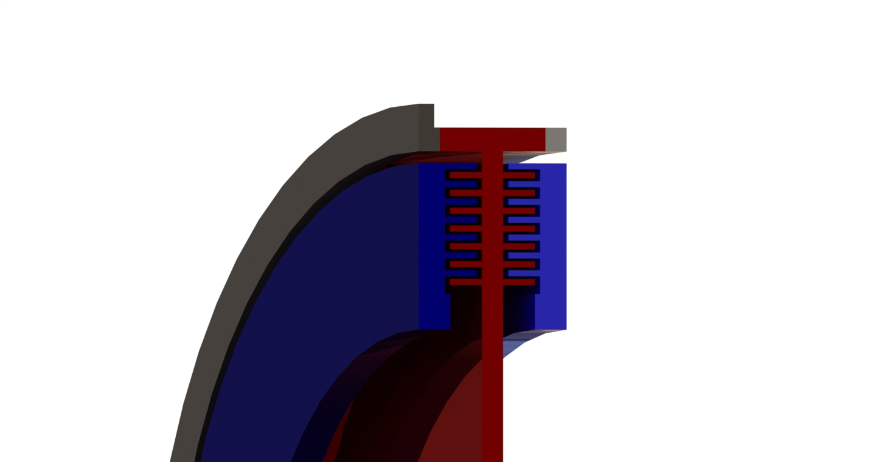
So far, Felix considered a cooling area of 2.8 m² near the target created by 2×7 fins (length of fin is 3cm, height 0.5cm)
→ Including almost full disc in radiative cooling, max temperature in target decreases
Max average temperature in target goes down with area:
Design (fins) must be optimized to avoid mechanical problems/stress at high rotation speed

Slide 7
So far, Felix considered a cooling area of 2.8 m² near the target created by 2×7 fins (length of fin is 3cm, height 0.5cm)
→ Including almost full disc in radiative cooling, max temperature in target decreases
Max average temperature in target goes down with area:
Design (fins) must be optimized to avoid mechanical problems/stress at high rotation speed

Slide 8
Design issues
Temperature distrubution
  Heat transfer from target to radiator
    Titanium has a low heat conductivity
  maximum and average temperatures in Ti
  Ti-Cu contact
Stress
  Stress in Ti target rim
  thermal expansion of Ti, Cu
  Optimum design of radiator

Slide 9
Heat transfer in the target
Ti
Temperature distribution in target depends on
  deposited energy
  Target parameters (material, size,..)
  PEDD ⬄ ΔT_{max} = 120K / 200K (nominal / high lumi)
Speed of heat transfer
  determines
    Average temperature in target
    time until equilibrium temperature is reached
  Depends on thermal conductivity λ:
Ti target
  Photon beam hits after ~7seconds the same position at the target
  Thermal diffusion vs time:
    x_{Ti} = 0.68 cm for 7s; 2.2 cm for 70s
    x_{Cu} = 2.8 cm for 7s; 9.0 cm for 70s
  7s are not sufficient to remove the heat from target
  temperature accumulates over many bunch trains up to equilibrium
→ Temperature gradient from beam path area to contact surface to radiator
Cu

Slide 10
Heat flux through Ti-Cu contact
Consider 2 options:
    (see also Felix Dietrich’s talk at POSIPOL 2015)
a = 5cm
a = 4cm
Temperature distribution along the target
Temperature distribution along Ti – Cu contact
Ti
a
Cu
2 cm

Slide 11
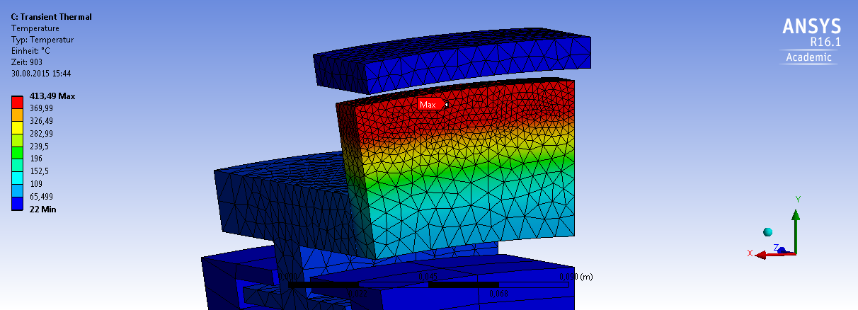
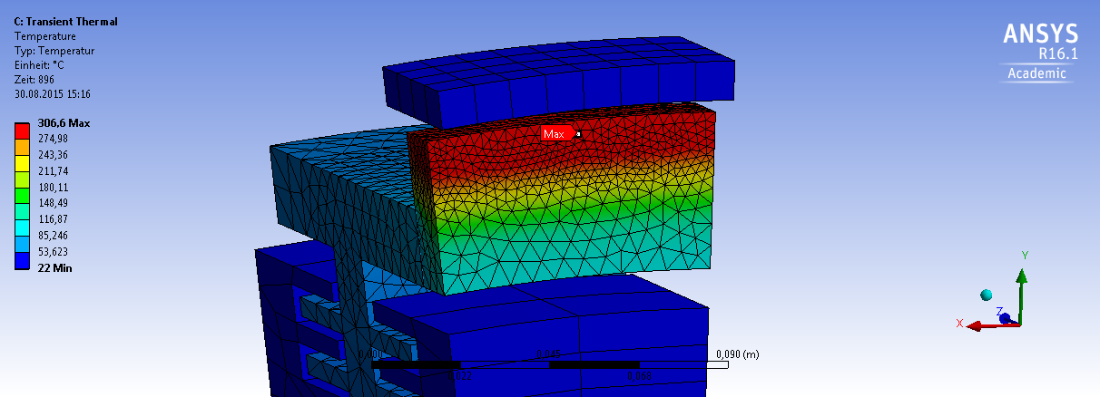
Temperature distribution in the target after 903s
(128 bunch trains hit the same target area, shortly before 129th)
Target height
a = 5cm
T_{max} = 414°C
Target height
a = 4cm
T_{max} = 307°C

Slide 12
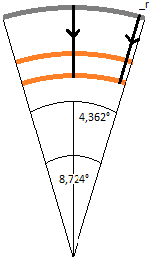
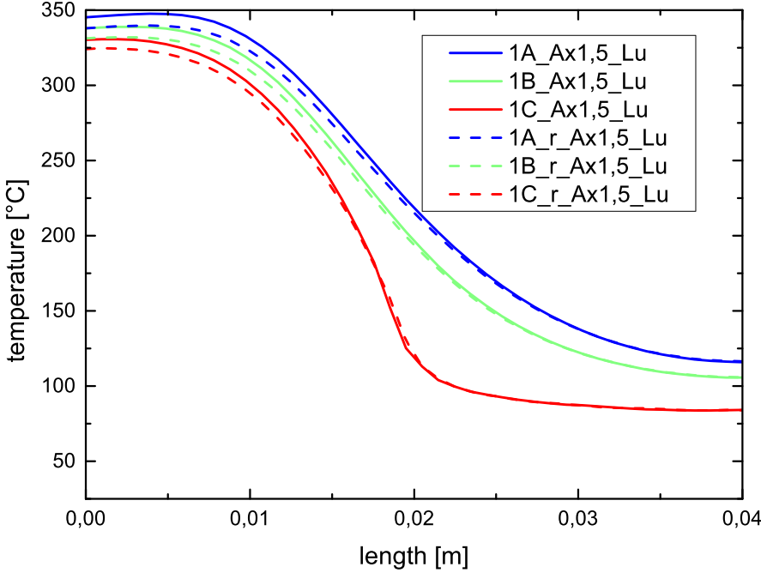
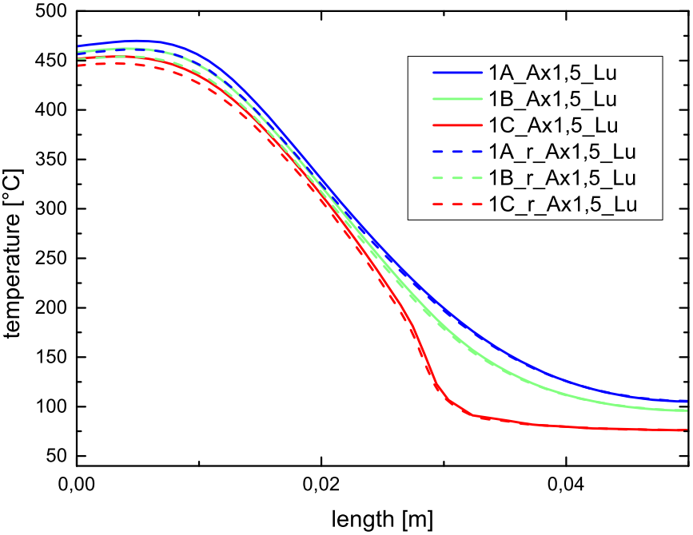
Heat distribution in Ti target
Consider 2 options (see also Felix Dietrich’s talk at POSIPOL 2015)
a = 5cm
a = 4cm
Temp along the target (896s) 128 pulses at same target area
P = 2.3 kW, ε_{Cu} = ε_{Ti} = 0.7
Ti
a
Cu
2 cm
Ti
a = 4cm
a = 5cm

Slide 13
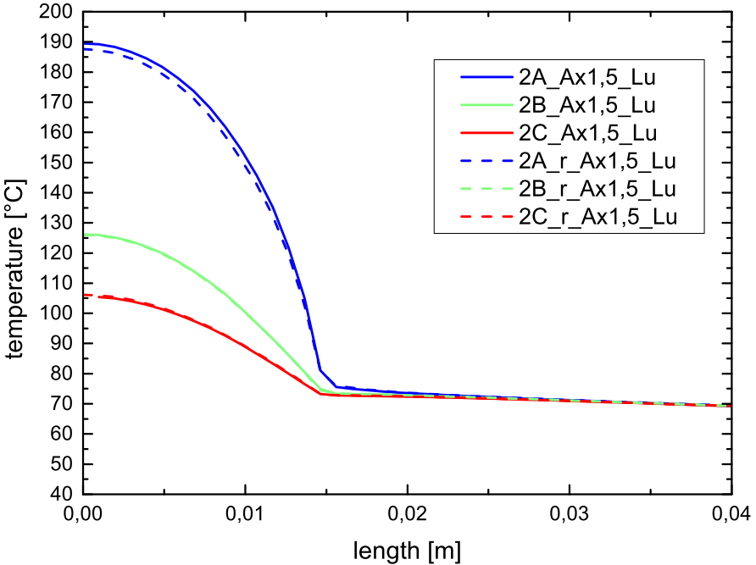
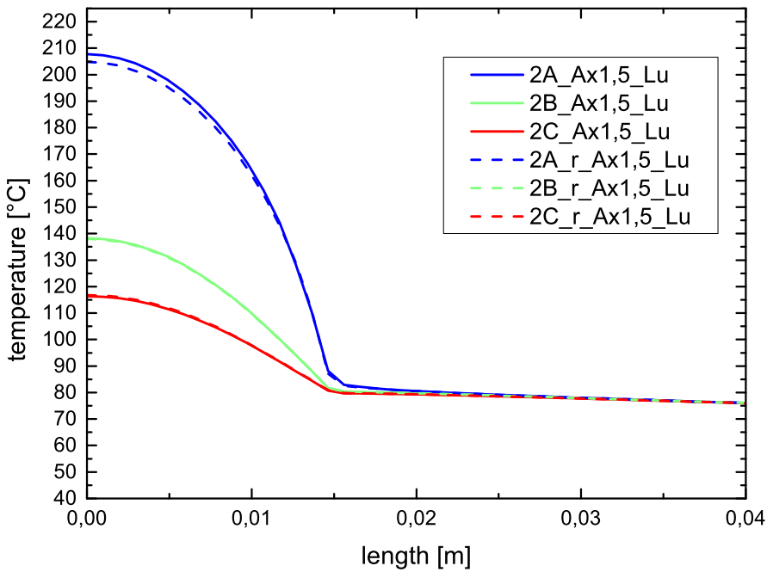
Heat distribution along Ti-Cu contact
Consider 2 options (see also Felix Dietrich’s talk at POSIPOL 2015)
a = 5cm
a = 4cm
Temp along Ti-Cu contact (896s)
128 pulses at same target area
P = 2.3 kW, ε_{Cu} = ε_{Ti} = 0.7
Ti
a
Cu
2 cm
a = 4cm
a = 5cm
Ti
Cu
Ti
Cu

Slide 14
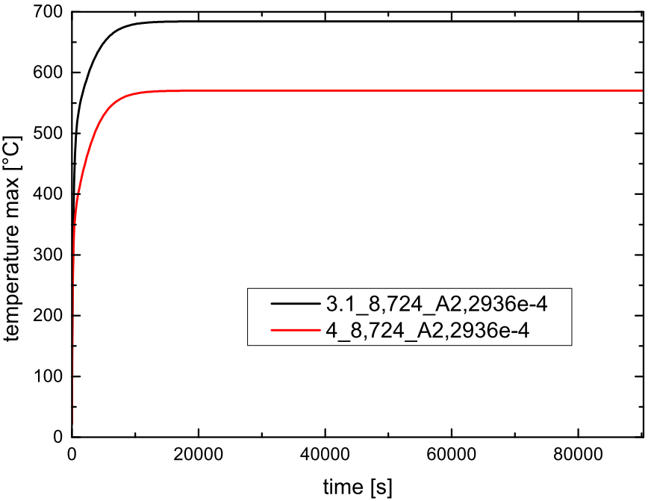
Equilibrium temperature in the target
Temperature evolution over time, ANSYS
E_{cm} = 500GeV; E_{dep} = 2.3 kW
Radiator area ~2.8 m²
After ~3 hours equilibrium temperature distribution reached
height a ⬄ max temperature
  T_{max} ≈ 680°C (a = 5cm)
  T_{max} ≈ 570°C (a = 4cm)
Distance beam path to Ti-Cu contact is important
Temperature in Cu (near Ti) ≈280°C (a = 5cm), ≈270°C (a = 4cm)
Felix Dietrich
Ti
a
Cu
Max average temperature in Ti target
(area along beam path)
2 cm
a = 5cm
a = 4cm

Slide 15
Temperature distribution at the target rim
adjust revolution frequency to distribute energy deposition almost uniformly over rim
for example:
  bunch train occupies angular range θ_{pulse}
  f_{rev} = 1922rpm instead of 2000rpm
  → pattern: 1st second: 0, 144, 288, 72, 216,
  2nd second: 0 + θ_{pulse} ….,
  3rd second: 0 + 2θ_{pulse} ….
  after ~7s the rim is almost uniformly heated
  unbalances due to non-uniform heating are avoided

Slide 16
Lower rotation speed?
  F. Staufenbiel et al.: assuming water cooling channels, 1500rpm or even 1000rpm seems possible in case of nominal luminosity @E_{cm}=500GeV
  Radiative cooling is slower due to λ value and longer heat transfer distances → even higher average temperature in the rim for lower rotation speed
  → spinning with about 2000rpm for radiation cooling
  M. Jenkins @ POSIPOL15 considered realistic undulator. Peak intensity of photon beam may be lower; this could help → studies needed

Slide 17
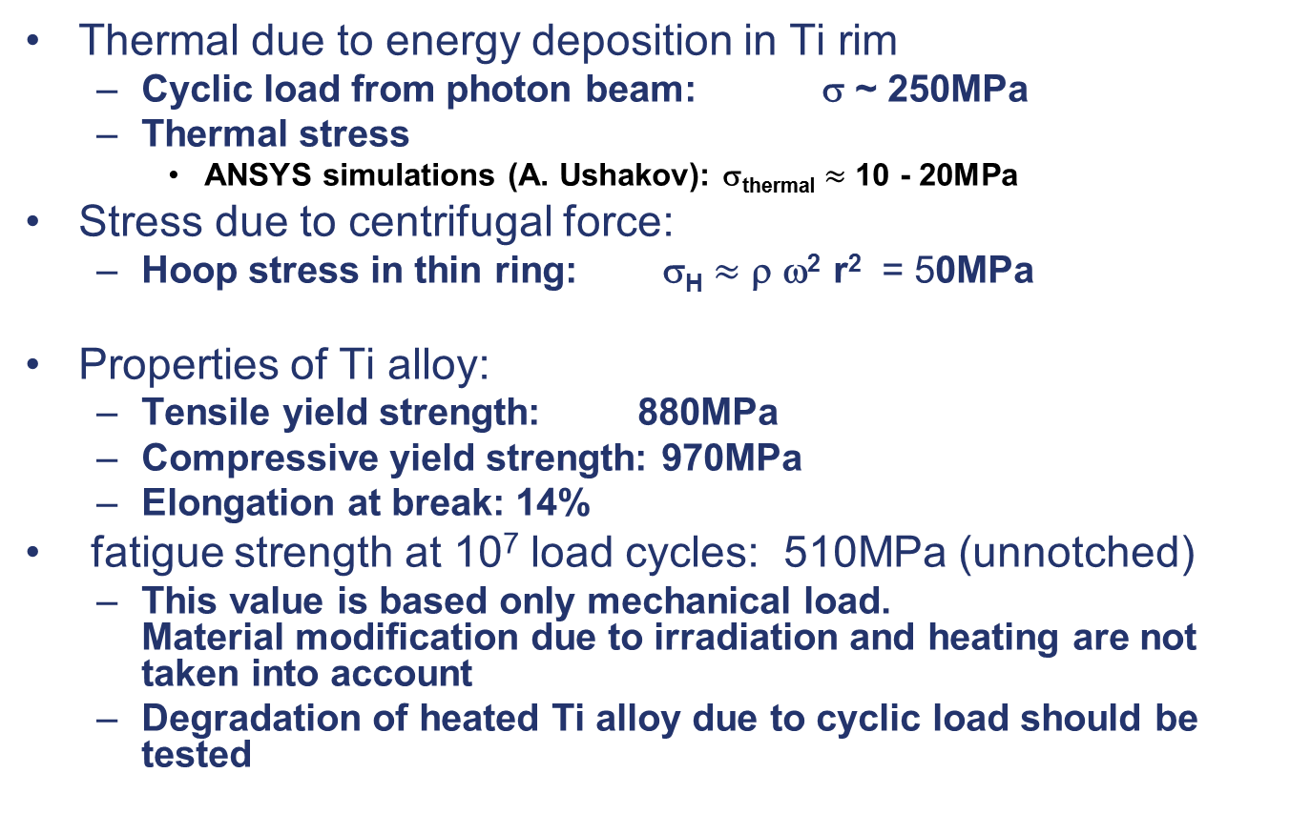
Stress consideration in Ti rim
Thermal due to energy deposition in Ti rim
  Cyclic load from photon beam: σ ~ 250MPa
  Thermal stress
    ANSYS simulations (A. Ushakov): σ_{thermal} $≈$ 10 - 20MPa
Stress due to centrifugal force:
  Hoop stress in thin ring: σ_{H} $≈$ ρ ω² r² = 50MPa
Properties of Ti alloy:
  Tensile yield strength: 880MPa
  Compressive yield strength: 970MPa
  Elongation at break: 14%
fatigue strength at 10⁷ load cycles: 510MPa (unnotched)
  This value is based only mechanical load. Material modification due to irradiation and heating are not taken into account
  Degradation of heated Ti alloy due to cyclic load should be tested

Slide 18
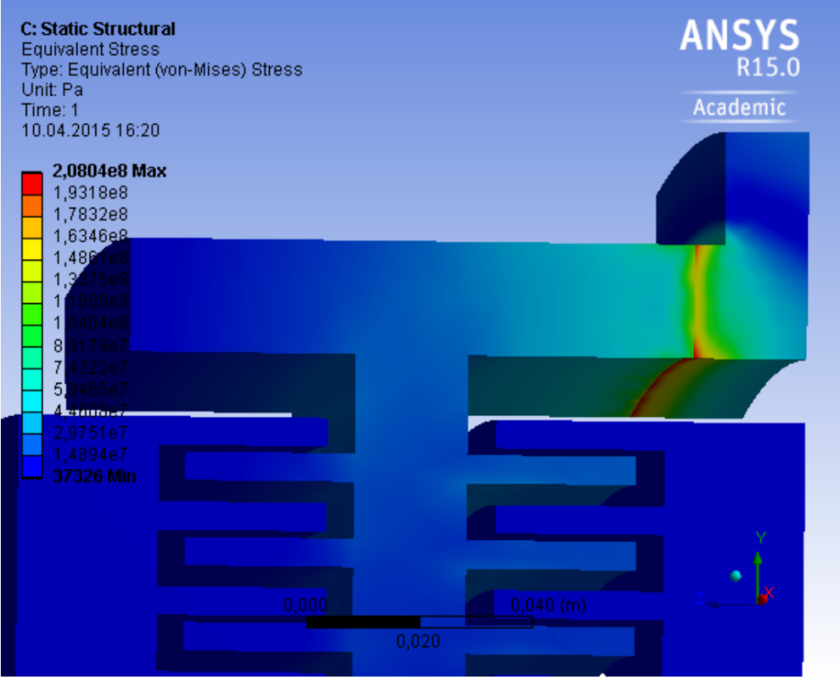
Stress at Ti-Cu contact
Thermal expansion and resulting distortion ⬄ stress at the Ti-Cu contact depends on temperature profile in radiator and target
α_{Ti} = 8.6 × 10⁻⁶/K α_{Cu} = 16.5 × 10⁻⁶/K
  Max temperature in Ti wheel ~500°C → Δh ~ 0.43% (0.2mm)
  Max temperature in Cu radiator (near Ti-Cu contact) is ~200°C → Δr ~ 0.33% (≤1mm)
Additionally, stress due to centrifugal force
  Not yet taken into accouSurface roughness
  Contact pressure
Are there substances, vacuum-capable, to minimize thermal resistance?
ANSYS simulation (prel.) by A. Ushakov:
assumed brazed Ti-Cu contact
P= 5170W,
ε_{Cu} = 0.7, ε_{Ti} = 0.25 → v.Mises stress < 200MPa
  P. Sievers: bolting at 10 MPa could allow frictionless, lateral thermal expansion maintaining the thermal contact
  → bolting is ok, brazing is not ok
Still to be done: implement ‘real’ contact in ANSYS simulations.

Slide 19
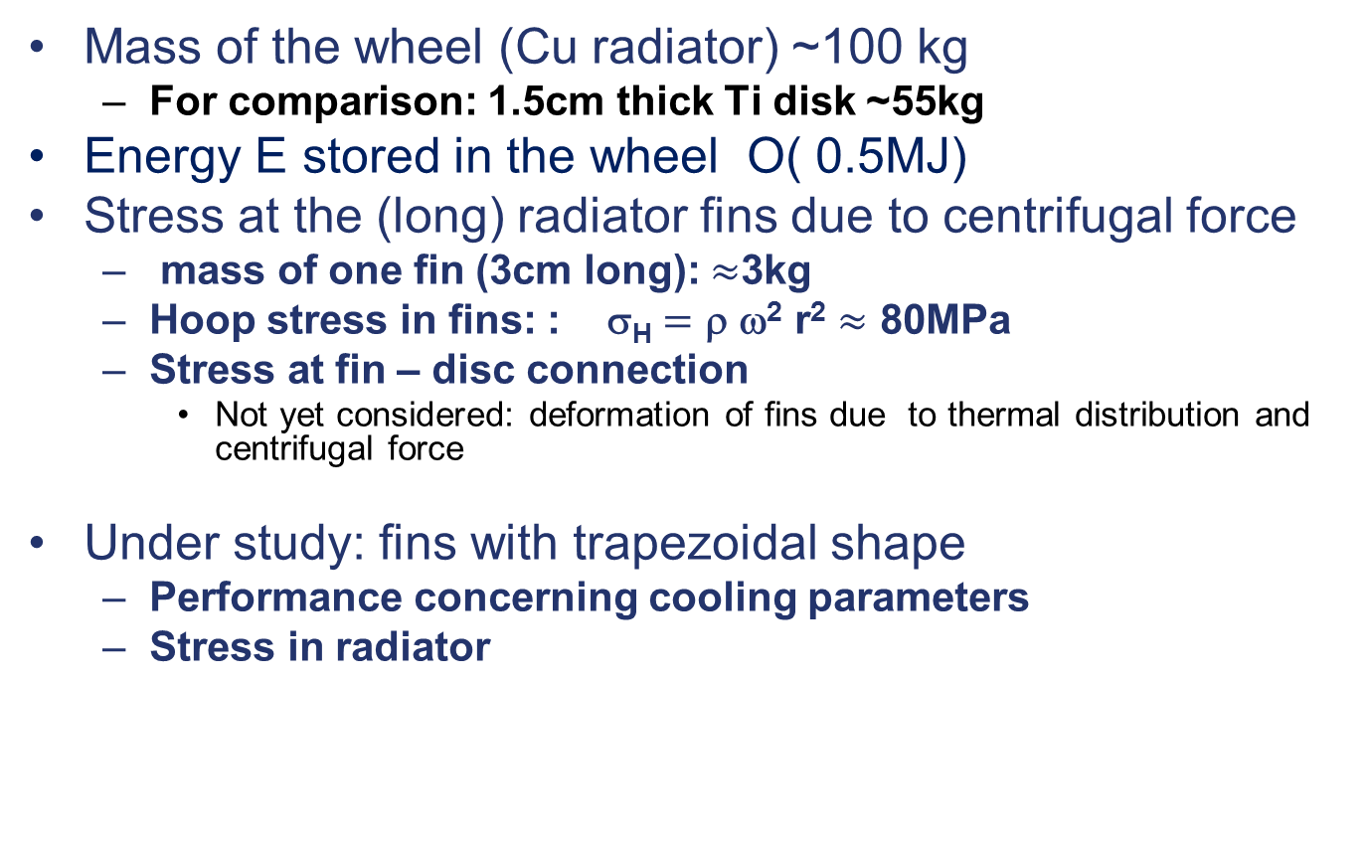
Radiator: Mechanical aspects and stress
Mass of the wheel (Cu radiator) ~100 kg
  For comparison: 1.5cm thick Ti disk ~55kg
Energy E stored in the wheel O( 0.5MJ)
Stress at the (long) radiator fins due to centrifugal force
  mass of one fin (3cm long): $≈$3kg
  Hoop stress in fins: : σ_{H} $=$ ρ ω² r² $≈$ 80MPa
  Stress at fin – disc connection
    Not yet considered: deformation of fins due to thermal distribution and centrifugal force
Under study: fins with trapezoidal shape
  Performance concerning cooling parameters
  Stress in radiator

Slide 20
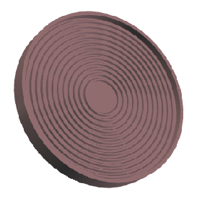
Distribution, number and shape of fins is decisive for cooling power
Design with long outer fins is not the optimum concerning mechanical properties of the spinning wheel
Example: distribute n fins (trapezoidal shape) on radiator disk
⬄ area for radiation cooling,
mass of all fins
→ temperature distribution in target,
mech. issues, …
n | Trapez a/b/h [cm] | A [m2] | M_{all Fins} [kg]
12 | 2.15 / 0.42 / 1.5 | 2.1 | 30.3
16 | 1.3 / 0.4 / 1.5 | 2.6 | 38.4
18 | 1.04 / 0.27 / 1.0 | 2.3 | 28.5
b
h
a

Slide 21
In principle, Ti keeps its stability in the temperature range 200 - 635°C (http://form-technik.biz/titan-material-eigenschaften/)
Stability of Cu decreases with temperature, but this shouldn’t be a problem for T ~ 200 and choice of special alloy
  Permanent stress due to tangential force ⬄ creeping effects ? → to be checked
Thermal expansion ⬄ slightly changed momentum of inertia → wheel slows down slightly if no correction
Non-uniform average temperatures, deformations around the wheel → unbalances
  All unbalances have to be monitored and corrected; has to be discussed with engineers
Long term material degradation due to irradiation must be tested experimentally
  Target material tests
    German Ministry of Science supports work for intense sources; period: July 2015 – 2019 (manpower), collaboration of U HH, U Mainz, U Darmstadt and DESY
    Simulation of cyclic load at Mainz using e- beam (MAMI, later MESA facility)
    Collaboration with Mainz U and Darmstadt U

Slide 22
Our next steps @ DESY/ U Hamburg
Temperature evolution in the whole system (including optimized shape of fins)
stress at the target + radiator wheel
optimize system to be flexible for all energies and luminosities
  Thermal contact target-radiator
  Aspects important for magnetic bearings (forces, imbalances,…)
  Figure out safety factors for long-term operation
Material tests in collaboration with U Mainz

Slide 23
Summary
Radiative cooling will work, no showstopper identified
    see also POSIPOL15
Scheme is under study & optimization
  Prototyping:
    Desired: design an experimental mock up in real size
    DESY/Uni HH: no hardware resources
      Experience of ANL/China R&D is very helpful
  Material tests at Mainz (e- beam)
Also important and has to be done: polarization issues
  Upgrade to higher polarization: photon collimation
  Realistic undulator B field ( → PEDD in target, polarization)
Our Resources at DESY and Uni HH are unchanged since POSIPOL15
Ideas and support are highly welcome

Slide 24
Thank you!

