Slide 1
IP feedback performance prediction
N. Blaskovic
N. Blaskovic

Slide 2
Contents
Sample number check
Histograms for best feedback run
Bunch-to-bunch correlations
Position and measured & predicted jitter:
over QD0FF current scan
over K1B2 offset (‘banana’ correction) scan
N. Blaskovic

Slide 3
Sample numbers
Analysis uses single point sampling like firmware
Analysis omitted 5 sample delay on Q signal for IP feedback data on 191214
5 sample delay re-introduced into analysis now – effect is small
N. Blaskovic

Slide 4
Sample numbers
 | ADC channel | Sample number
 |  | Before | Now
I | 5 | 24, 101 | 24, 101
Q | 8 | 24, 101 | 29, 106
Ref (bank I) | 6 | 24, 101 | 24, 101
Ref (bank Q) | 9 | 29, 106 | 29, 106
N. Blaskovic

Slide 5
Result changes
 | Result
 | Before | Now
θ_{IQ} for bunch 1 (deg) | -24.8 | -23.6
Kicker calib. ((ADC/ADC)/DAC) | 0.00519 | 0.00518
Gain for I | -175 | -177
Gain for Q | 81 | 77
Lowest jitter (nm) | 67±5 | 73±5
N. Blaskovic

Slide 6
IP feedback
IP feedback results for best run
Histograms
Bunch-to-bunch position correlation
N. Blaskovic

Slide 7
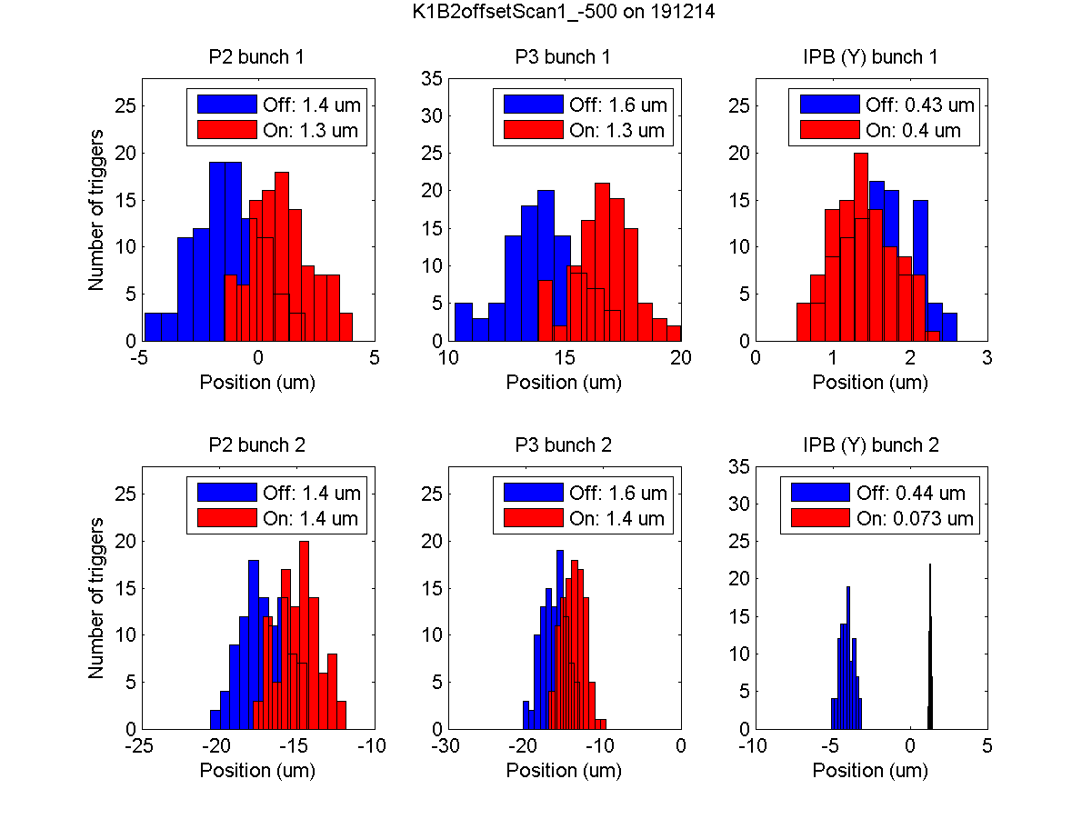
N. Blaskovic

Slide 8
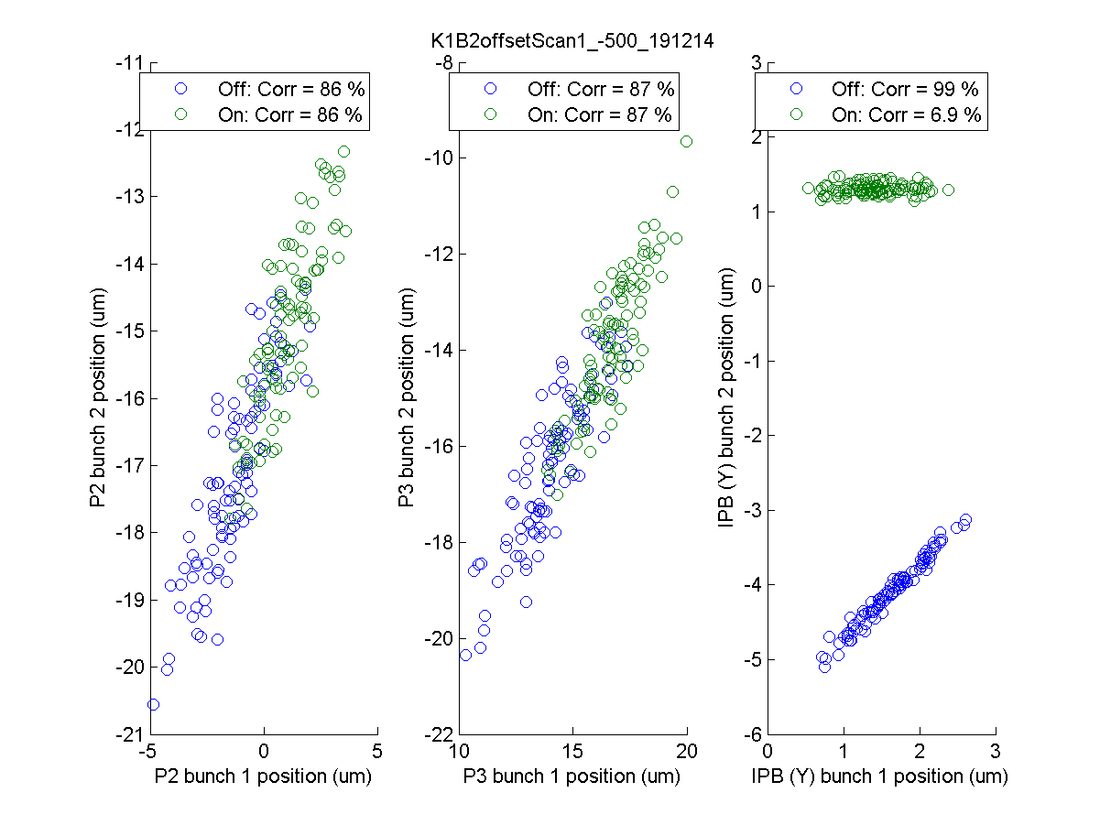
N. Blaskovic

Slide 9
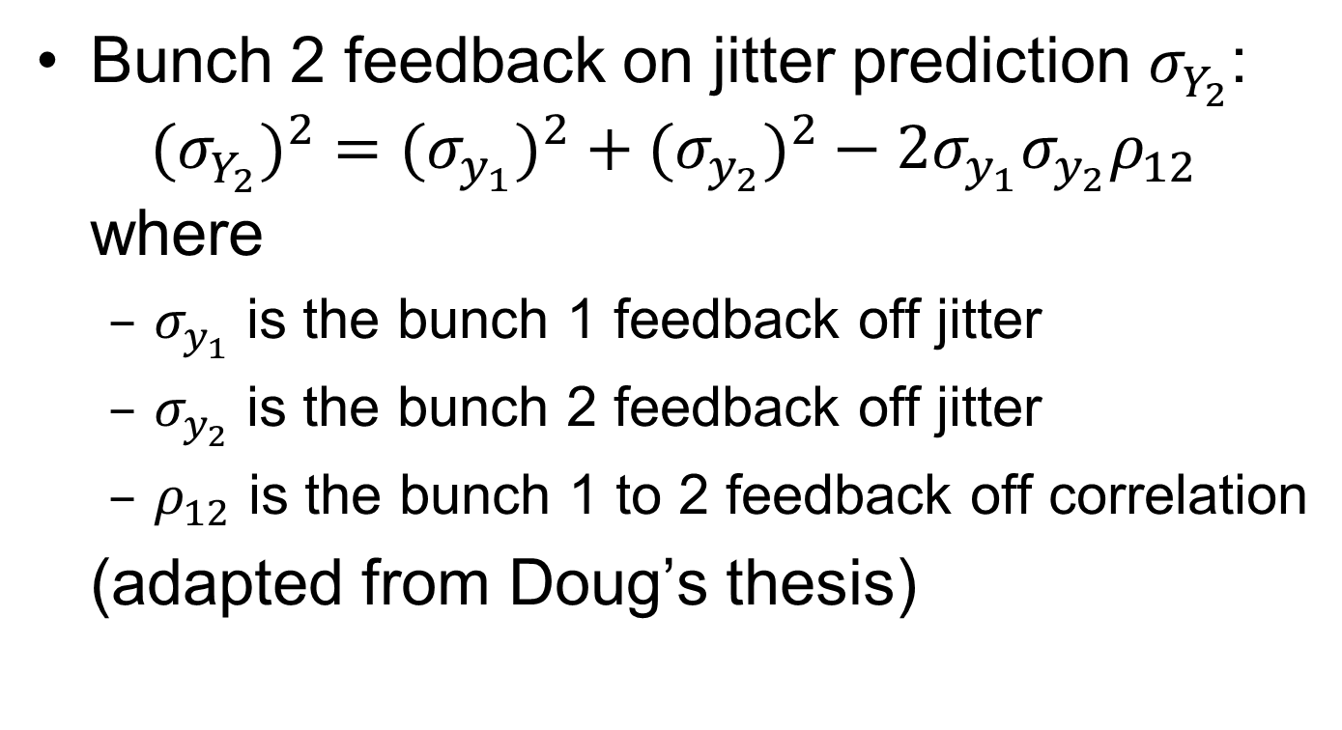
Feedback jitter prediction
Bunch 2 feedback on jitter prediction $σ_{Y_{2}}^{}$: ${{(σ}_{Y_{2}}^{})}^{2}={{(σ}_{y_{1}}^{})}^{2}+{{(σ}_{y_{2}}^{})}^{2}−2σ_{y_{1}}^{}σ_{y_{2}}^{}ρ_{12}$ where
$σ_{y_{1}}^{}$ is the bunch 1 feedback off jitter
$σ_{y_{2}}^{}$ is the bunch 2 feedback off jitter
$ρ_{12}$ is the bunch 1 to 2 feedback off correlation
(adapted from Doug’s thesis)
N. Blaskovic

Slide 10
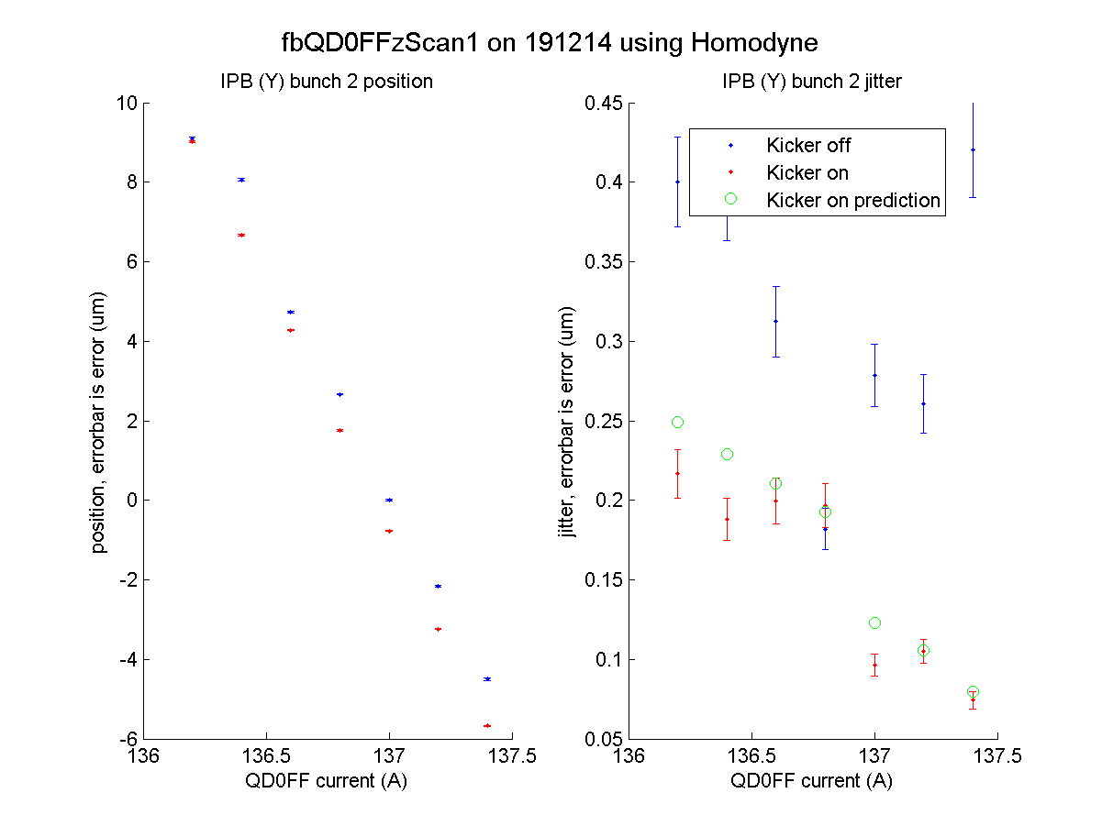
waist expected at 136.7 A
N. Blaskovic

Slide 11
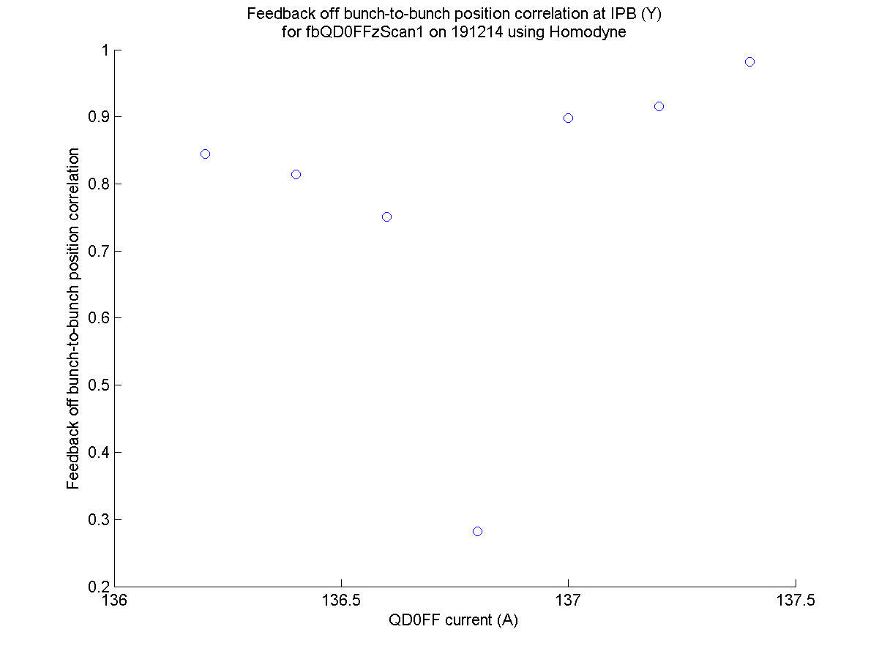
N. Blaskovic

Slide 12
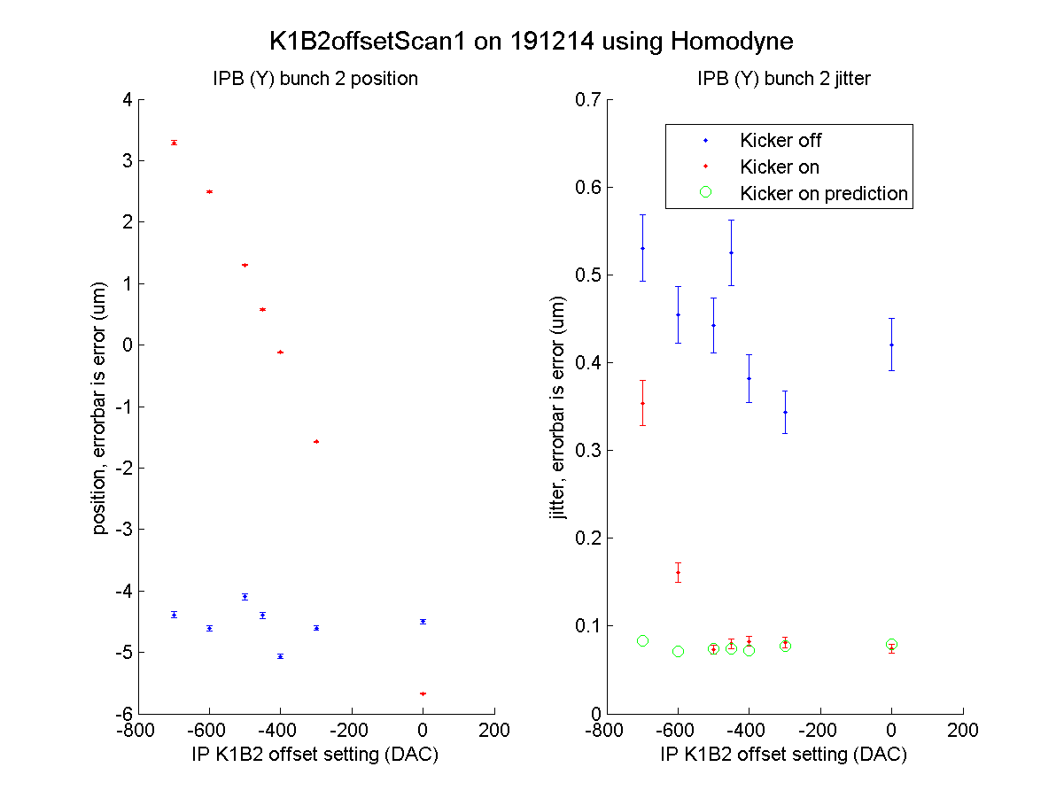
N. Blaskovic

Slide 13
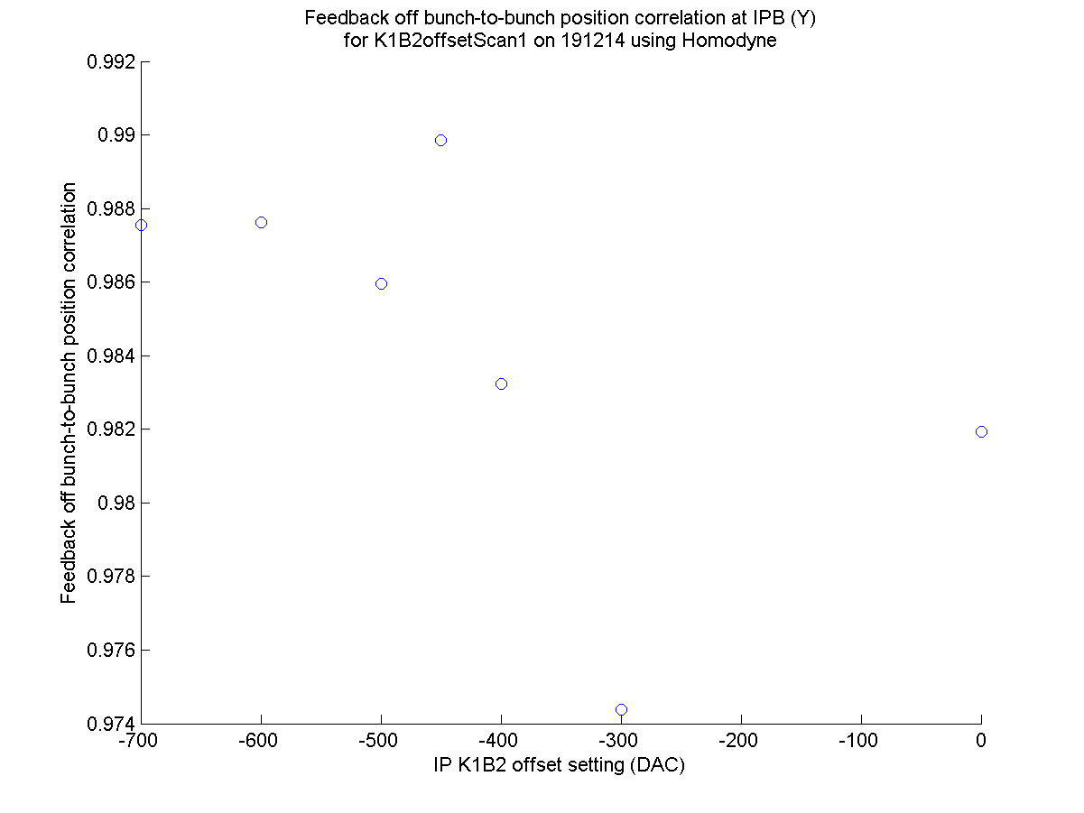
N. Blaskovic

Slide 14
Conclusions
Feedback-on jitters largely agree with prediction from feedback-off jitters and bunch-to-bunch position correlations
Feedback performance uniform across ~7 um dynamic range
N. Blaskovic

