Slide 1
Phase Propagation in CTF3: Correlation Between Phase and BPMs (Update)
Jack Roberts

Slide 2
Recap
Looked at the correlation of the phase with the BPMs for a dataset with what we thought was optimal R56 in TL1 tyo compensate for TL2.
Results looked like this….

Slide 3
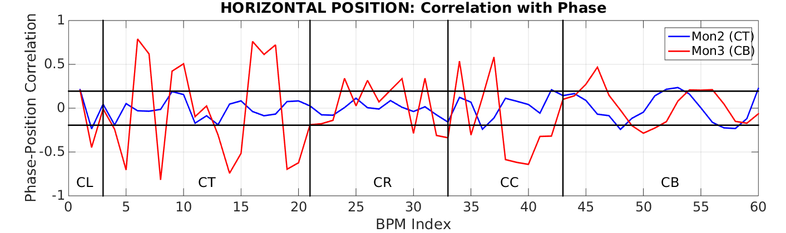
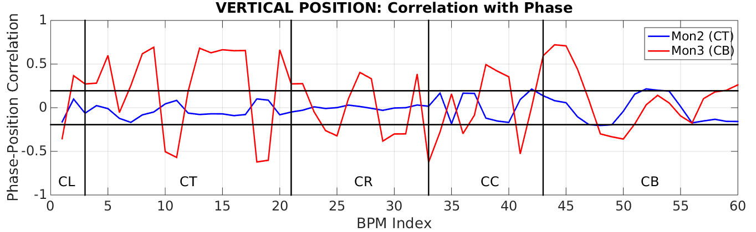
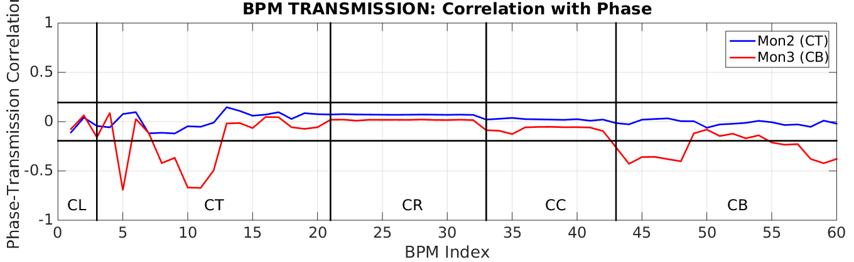

Slide 4
Recap
High correlation points roughly correspond to dispersive regions -> still looks like an energy effect.
To verify this I’ve compared the correlations with the phase to correlations with position in a dispersive BPM in the Frascati chicane (CT.0285), i.e.
Before: Mon2/Mon3 Phase vs. BPM H/V/S
Now added: CT.0285 H vs. BPM H/V/S

Slide 5
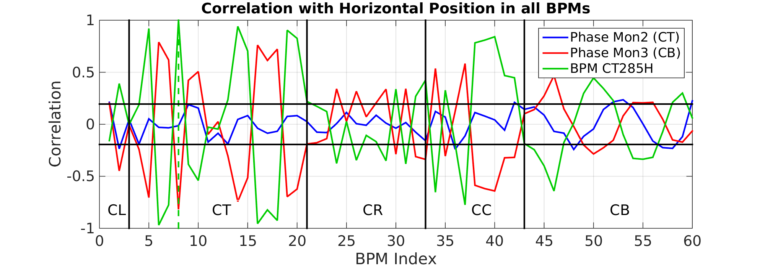
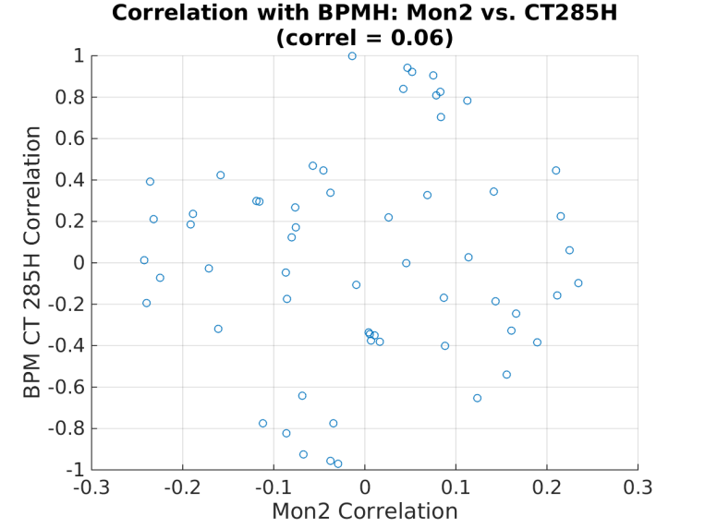
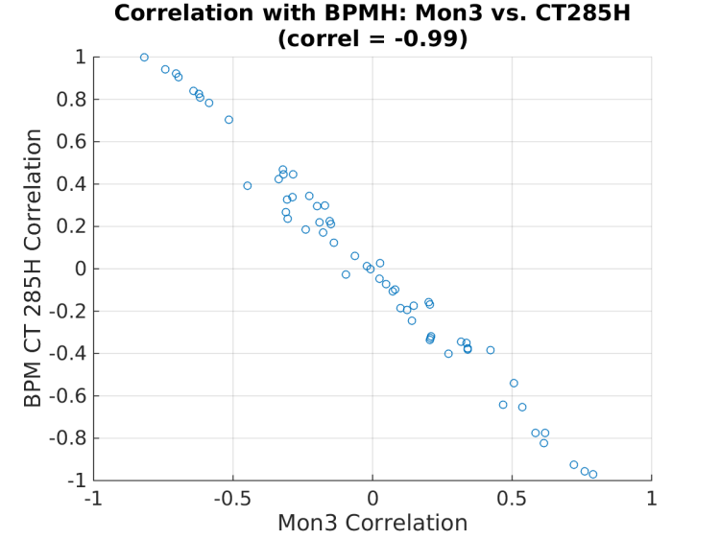
Results: Horizontal

Slide 6
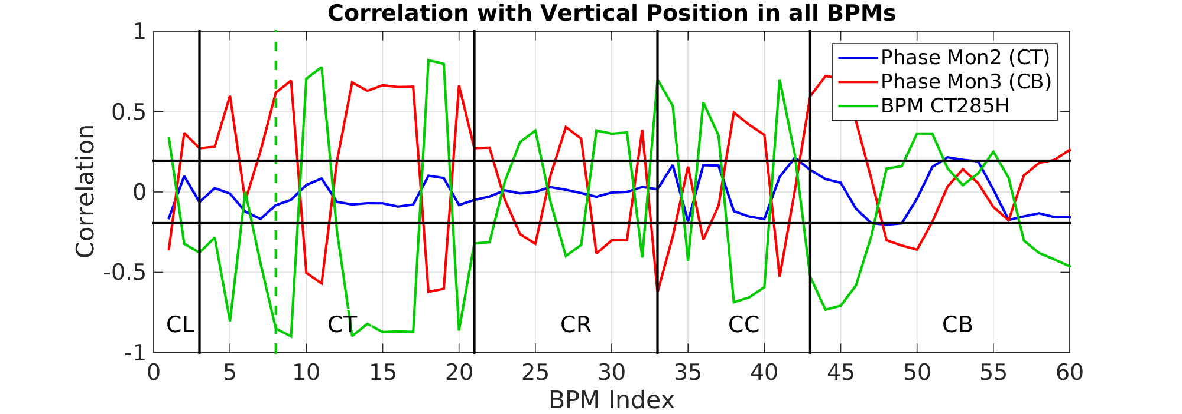
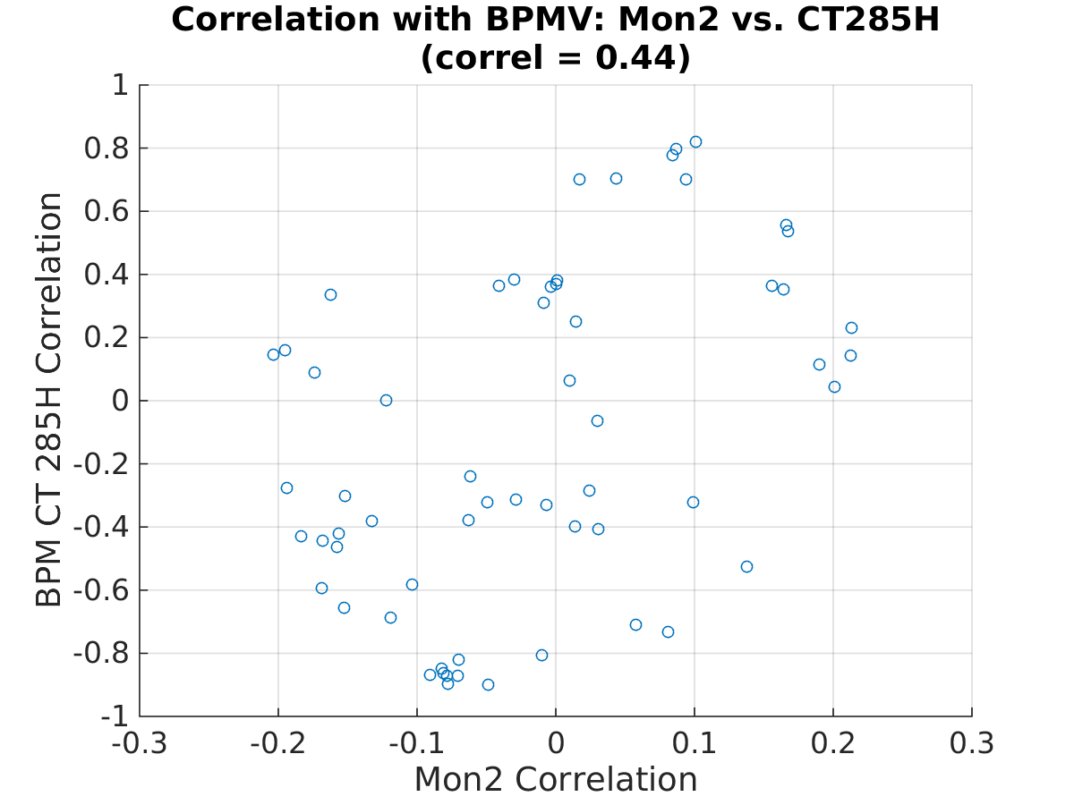
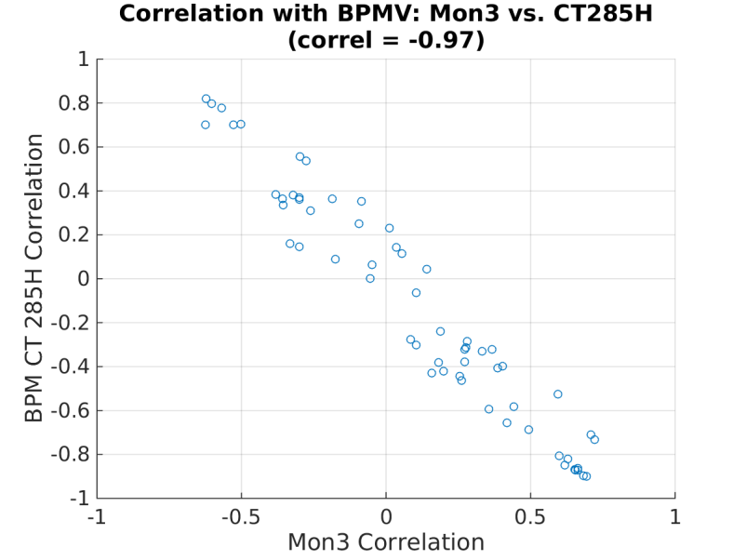
Results: Vertical

Slide 7
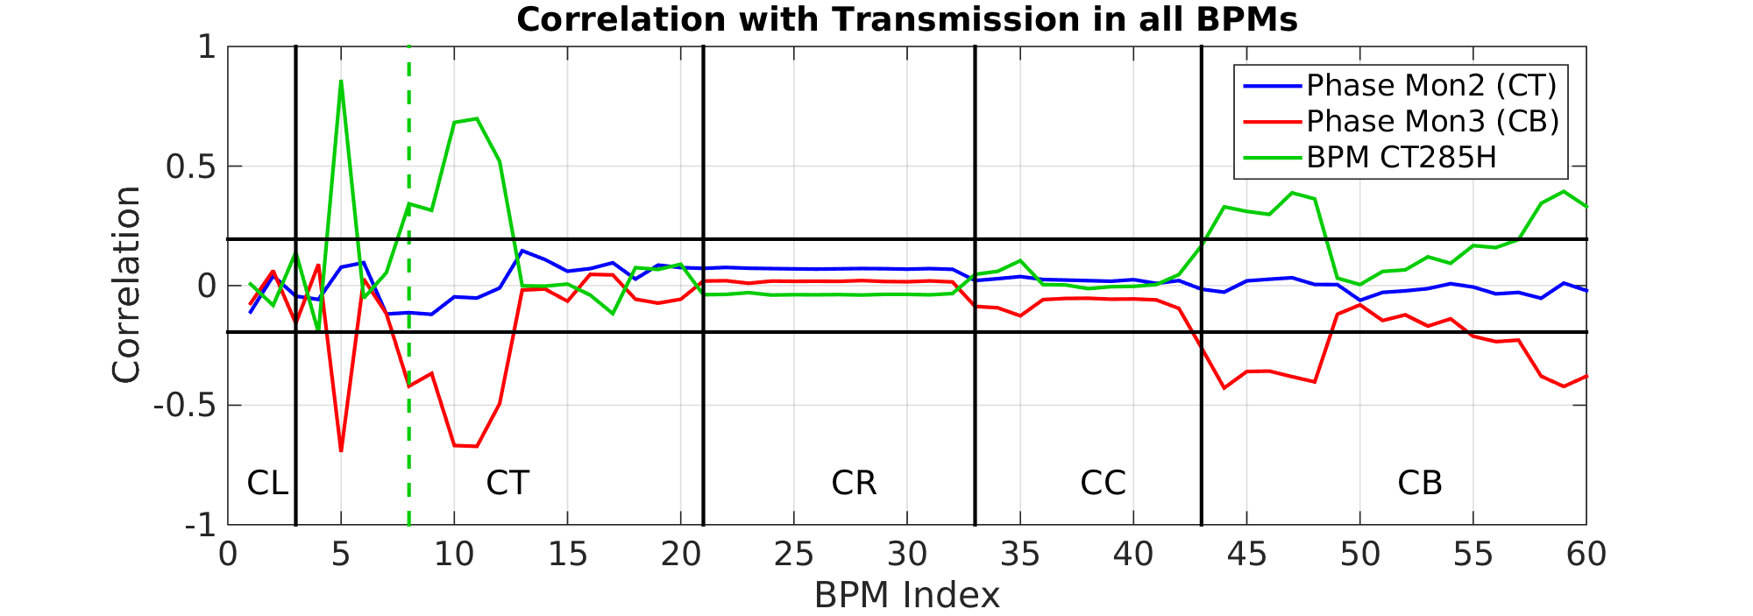
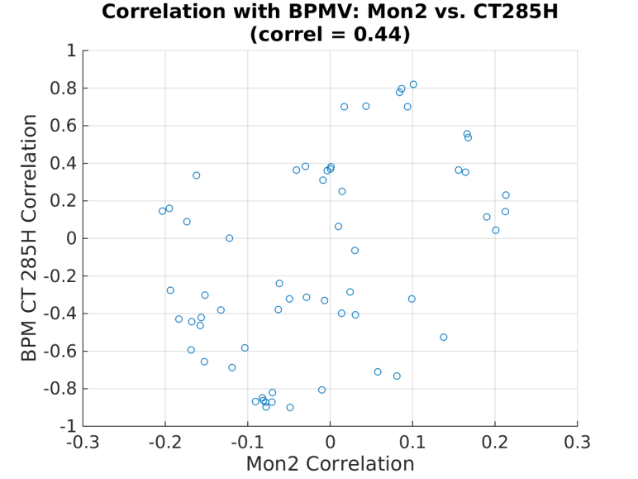
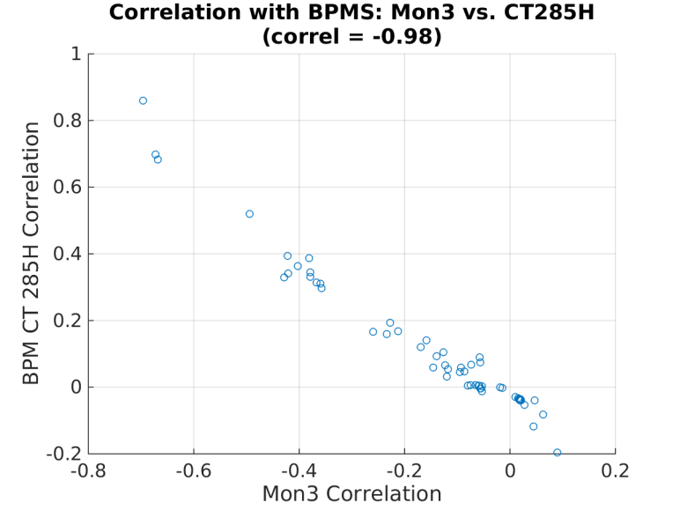
Results: Sum

Slide 8
Summary
The correlation patterns of CT.0285H and Mon3 (CLEX) match perfectly.
We are definitely seeing energy effects.
The correlation with Mon2 is much lower, so the energy effects are at least reasonably well controlled up to that point. However, it does correlate well with some other signals, e.g…

Slide 9
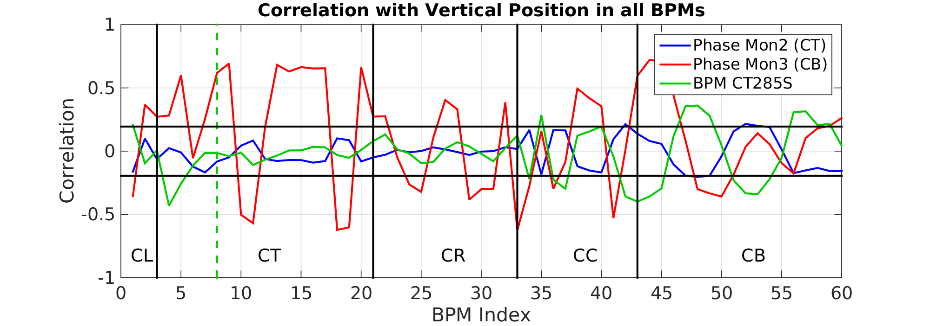
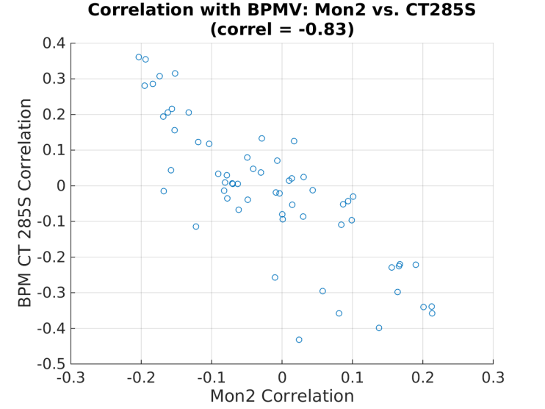
Correlation with Vertical: Mon2 vs. CT.0285 Sum signal.

Slide 10
Conclusions
Effect of energy on Mon3 phase is now clearly demonstrated.
Will run simulations to compare expected results.
Suggestion from Piotr is that we can move to non-zero R56 in the Frascati chicane so the energy effects are also seen in Mon2.
There are some effects in Mon2 as well, but they are less clear.
Meeting to discuss ideas was postponed to next week, but:
Stephane will be looking at the phase monitor electronics.
~No possibility to install additional phase monitor now, but looks likely that we’ll have support to do it in May.

Slide 11
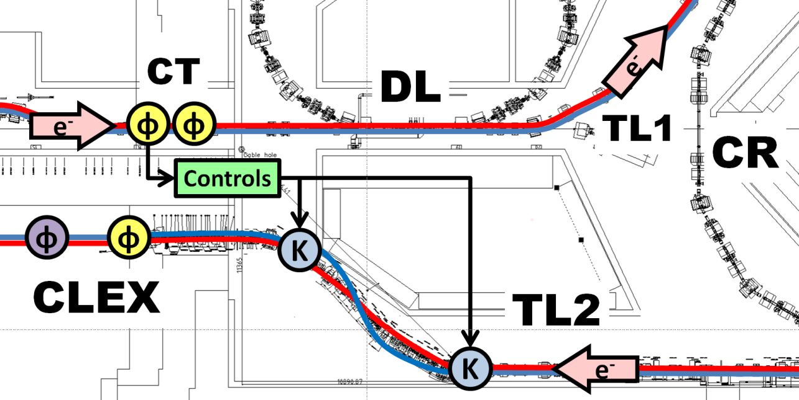
Phase Feedforward Layout
MON1
MON2
PETS
MON3
NB: Prefix CB is for TBL in CLEX (Mon3 and PETS).

