Slide 1
Transverse Beam Phase-Space Tomography at CTF3
Alexandra Rollings

Slide 2
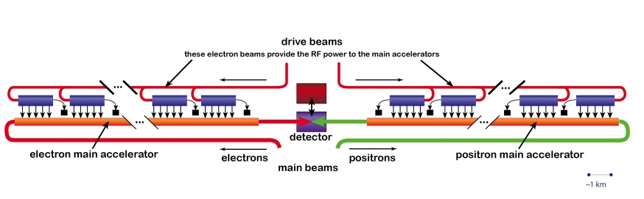
CLIC Design

Slide 3
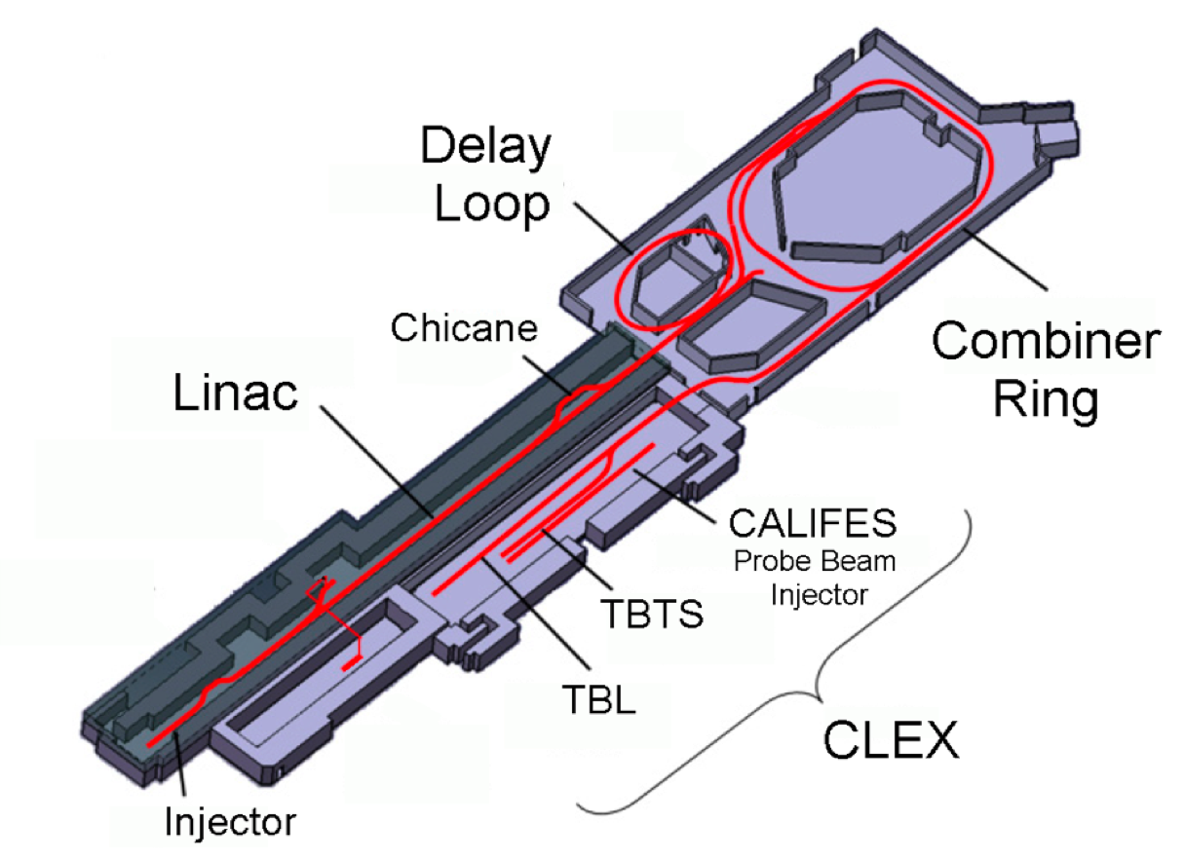
CTF3

Slide 4
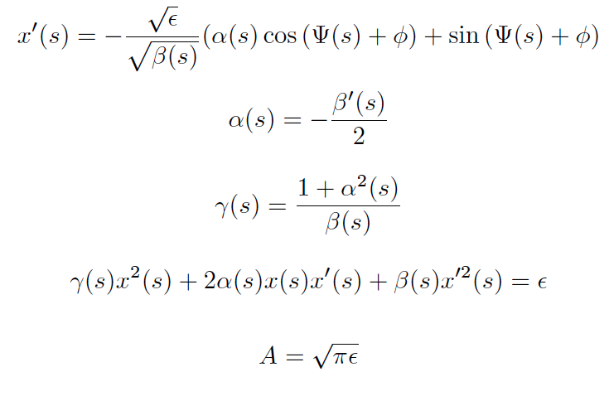
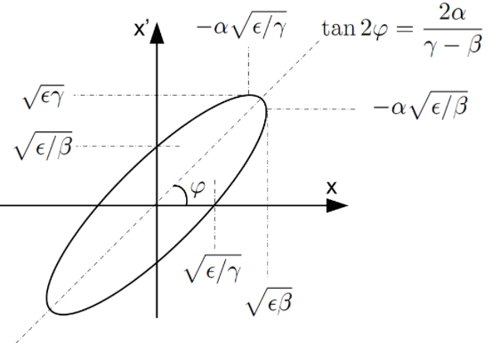
Motion in Transverse Phase Space
Invariant Area

Slide 5
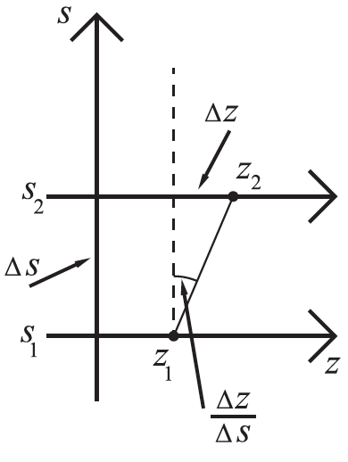
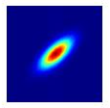
Motion in Transverse Phase Space
X’
ΔX
X
X
ΔX

Slide 6
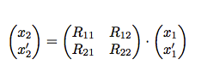
Tomography Method
Generate beam (bi-gaussianly distributed) at location 1 with specified Twiss parameters.
Transport the particles at location 1 downstream to location 2 using the Transfer Matrix.
Calculate the projection onto the x-axis of the particles at 2 as would be measured by a beam profile monitor.

Slide 7
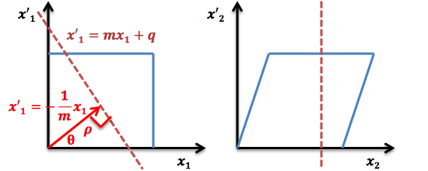
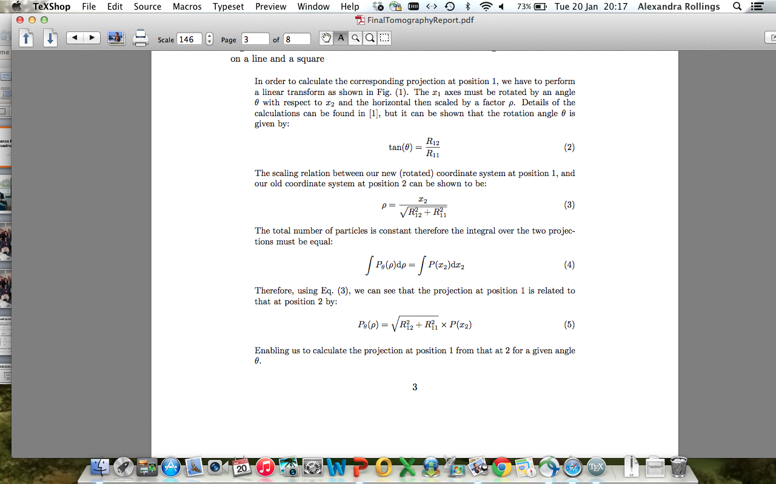
Tomography Method
4. Calculate the angle of rotation and scaling factor needed in order to transform the projection at 2 onto the projection at 1.

Slide 8
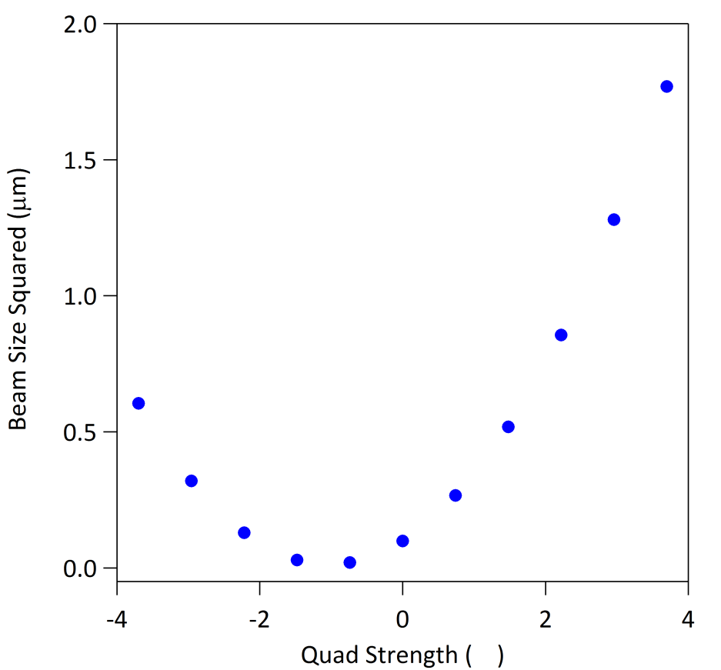
Tomography Method – Quad Scan
Repeat processes 2-3 over a range of rotation angles using a scan over different quadrupole strengths.
T

Slide 9
Tomography Method
Reconstruct the distribution at position 1 using an inverse radon transform and compare it to the image of the distribution of initial, generated particles.
An inverse radon transform reconstructs the image using the method of Filtered Back Projection.

Slide 10
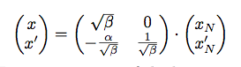
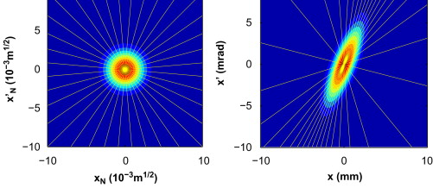
Normalised Phase-Space
Fig. 3 (a) Normalised phase space with rays at uniform angular intervals. (b) Real phase space.
K.M. Hock , M.G. Ibison , D.J. Holder , A. Wolski , B.D. Muratori
Beam tomography in transverse normalised phase space
Nuclear Instruments and Methods in Physics Research Section A: Accelerators, Spectrometers, Detectors and Associated Equipment, Volume 642, Issue 1, 2011, 36 - 44
http://dx.doi.org/10.1016/j.nima.2011.04.002

Slide 11
(Degrees)
(T)

Slide 12
Results

