Slide 1
Limitations to IP feedback performance
N. Blaskovic
N. Blaskovic

Slide 2
Introduction
Feedback over QD0FF and K1B2 offset scans taken on 19 December 2014
Try to identify limitations to IP feedback performance in terms of:
  True bunch-to-bunch correlation degradation
  Dependence on bunch charge and phase
  Kicker system saturation
Thanks to Glenn for helpful e-mails
N. Blaskovic

Slide 3
Sample numbers
Sample numbers used for analysis are as used by FONT5 board feedback firmware:
 | ADC channel | Sample number
I | 5 | 24, 101
Q | 8 | 29, 106
Ref (bank I) | 6 | 24, 101
Ref (bank Q) | 9 | 29, 106
N. Blaskovic

Slide 4
Feedback for QD0FF scan
Position and jitter for QD0FF current scan
  Bunch 1
  Bunch 2 with predicted correction
Bunch 1 re-centred at each setting
Bunch 2 position offset changes because bunch-to-bunch offset varies with QD0FF current setting
N. Blaskovic

Slide 5
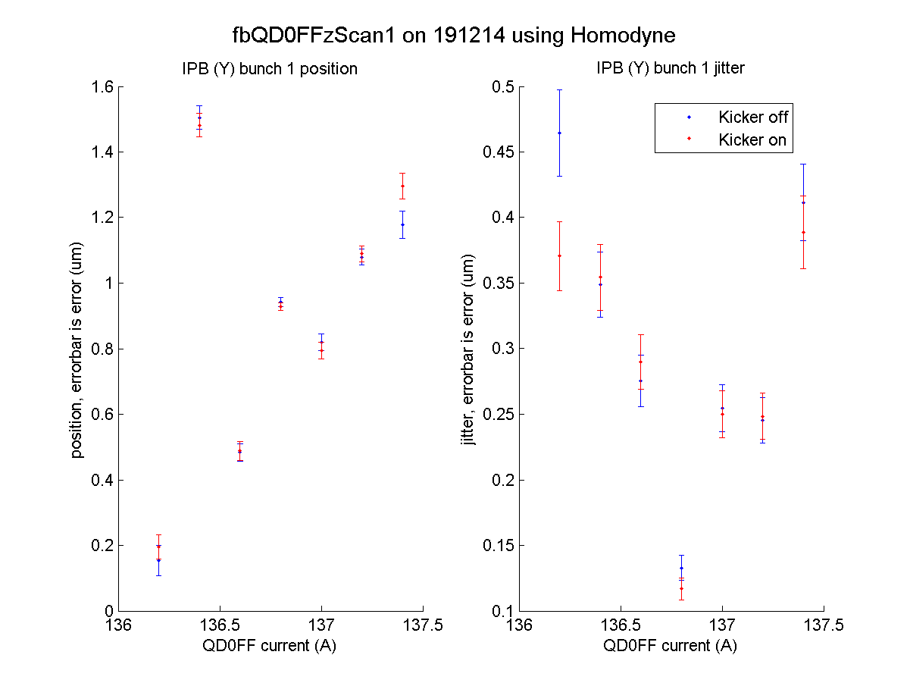
N. Blaskovic

Slide 6
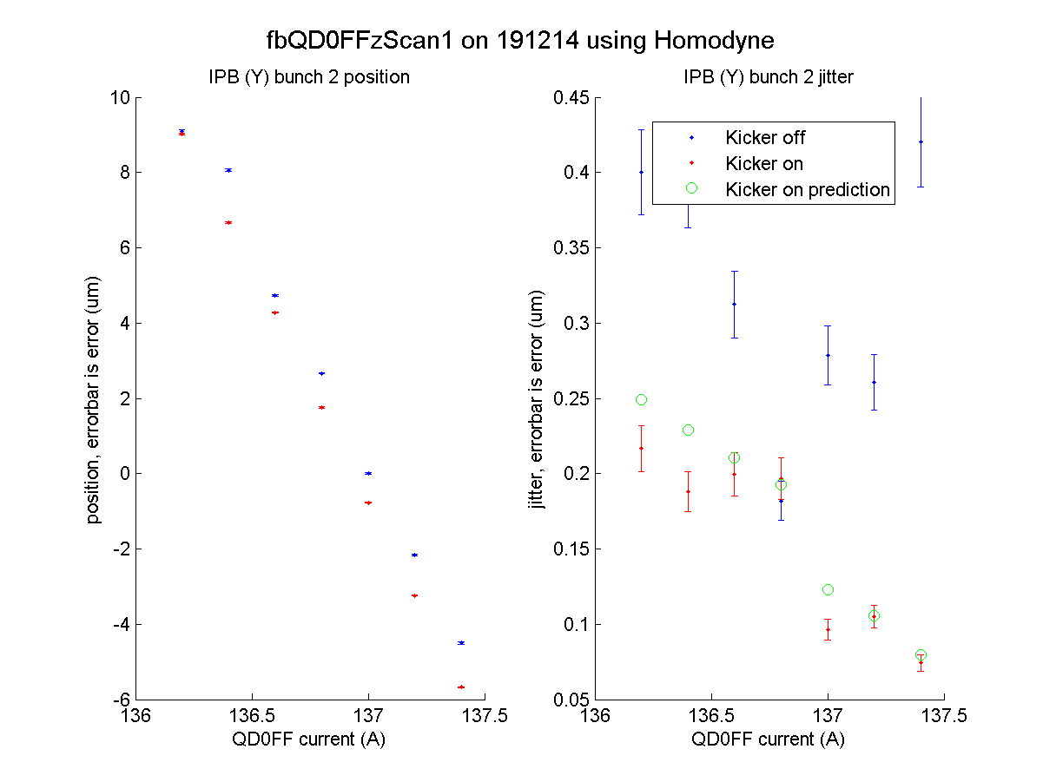
N. Blaskovic

Slide 7
P2 and P3 propagation to IP
P2 and P3 data propagated to IP using set14dec19_2009
Waist located in model as point where jitter is minimised
On-waist vertical jitter is 6 nm
On-waist bunch-to-bunch offset is 10 nm
Bunch-to-bunch vertical offset varies at
~8 um per 1 A change in QD0FF current
N. Blaskovic

Slide 8
Feedback for QD0FF scan
Achieved and predicted feedback-on jitter improves greatly over range of scan
Upstream bunch-to-bunch correlation:
  95 % at P2 when QD0FF current is 136.8 A
  83 % at P2 when QD0FF current is 137.2 A
If true beam conditions remain unchanged over scan then IP BPM resolution changed
N. Blaskovic

Slide 9
Charge and phase stability
Both bunches seem to have stable charge
Charge jitter is 1 % of mean charge
Bunch phase jitter varies from 0.5° to 0.3°
Bunch-to-bunch charge correlation:
  Stripline Σ_{I} reports low charge correlation
  Reference signal reports higher correlation
Bunch-to-bunch phase correlation > 90 %
N. Blaskovic

Slide 10
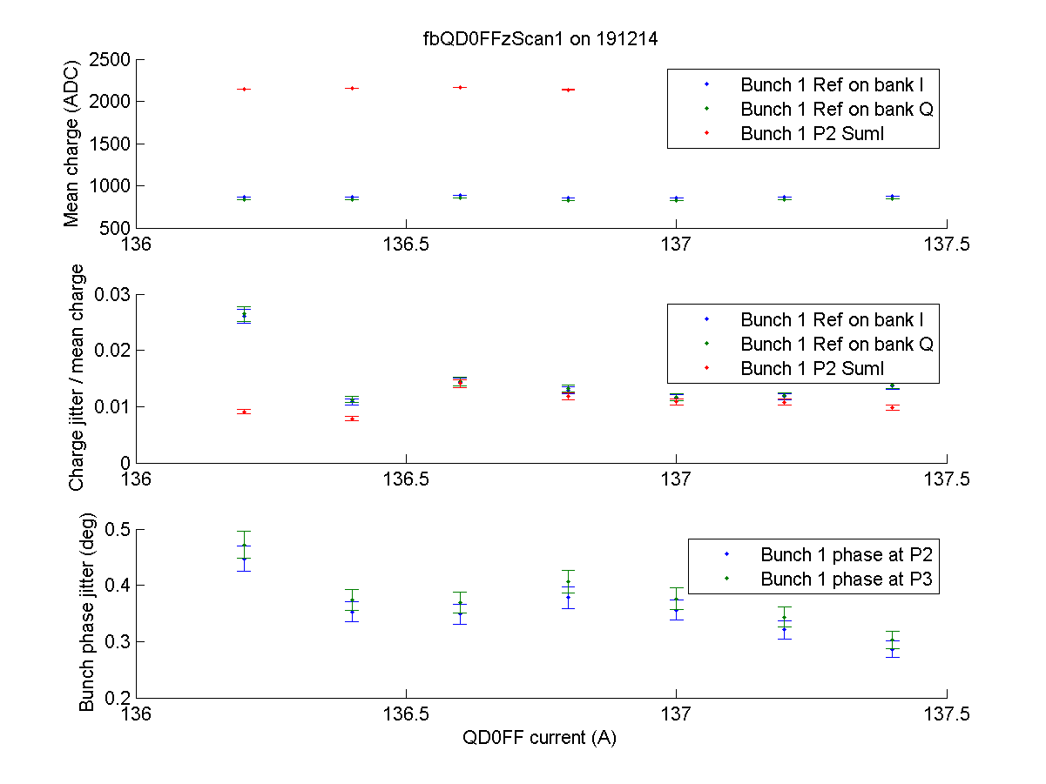
N. Blaskovic

Slide 11
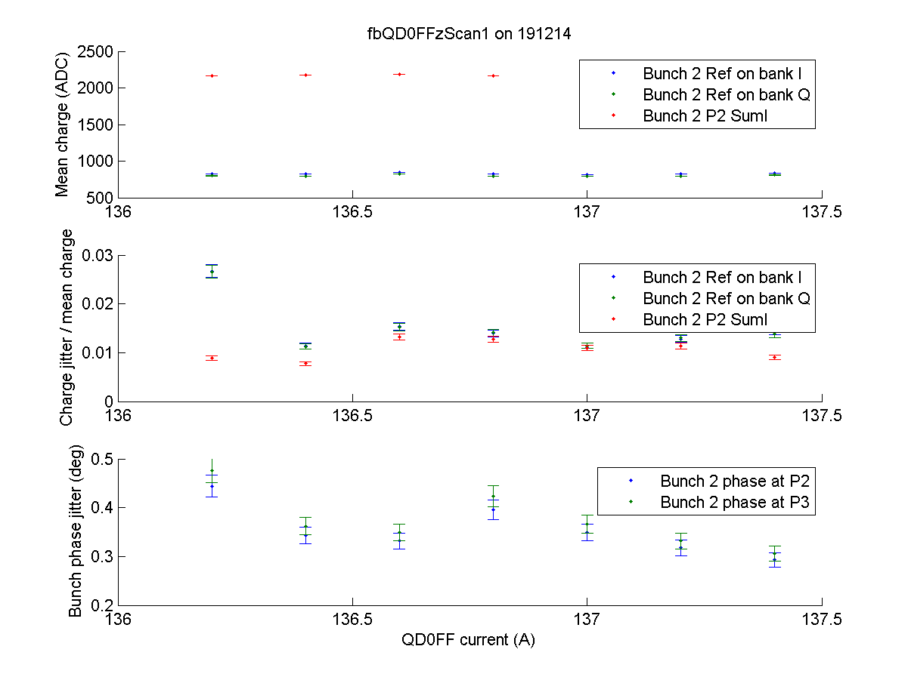
N. Blaskovic

Slide 12
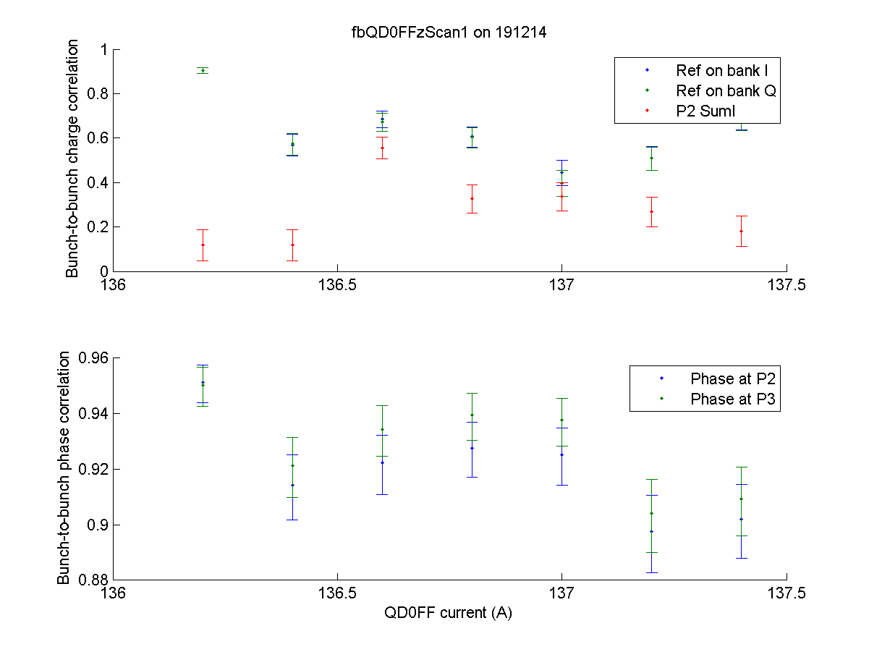
N. Blaskovic

Slide 13
Feedback for K1B2 offset scan
Position and jitter for K1B2 offset scan
  Bunch 1
  Bunch 2 with predicted correction
N. Blaskovic

Slide 14
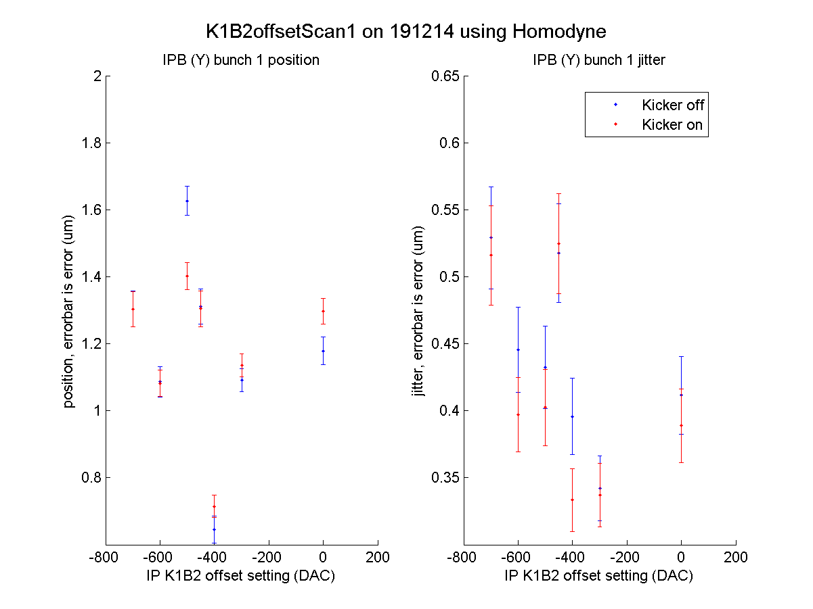
N. Blaskovic

Slide 15
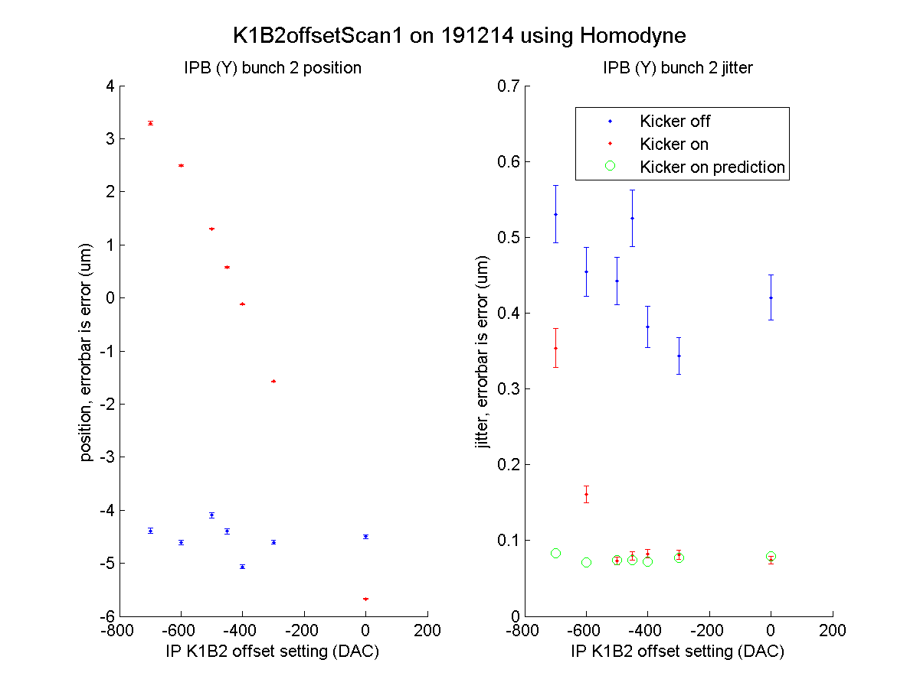
N. Blaskovic

Slide 16
Kicker saturation
Feedback performance does not reach predicted levels for K1B2 offset settings of -600 and -700
DAC outputs are more negative than -400 DAC counts for these files
Kicker scan only linear in range of -400 to 400 DAC counts
N. Blaskovic

Slide 17
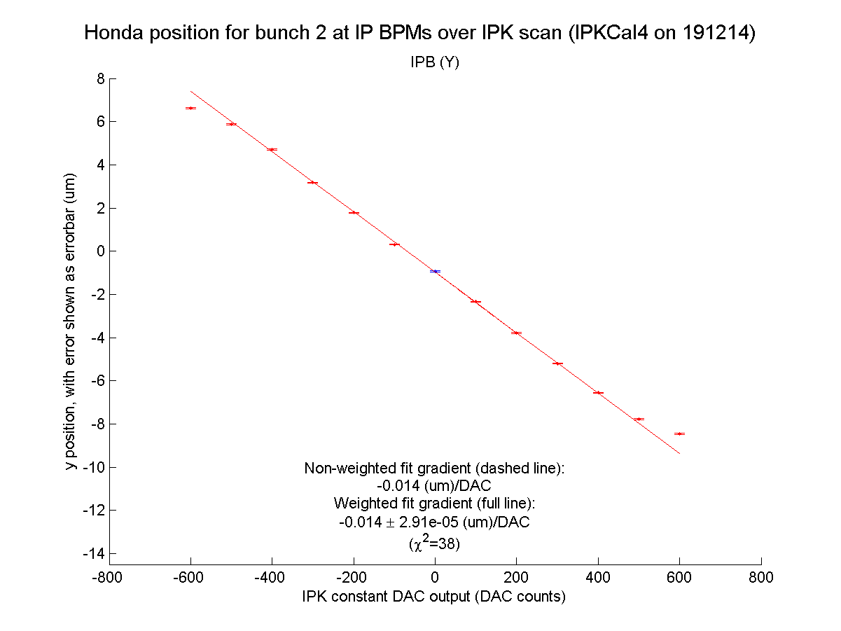
N. Blaskovic

Slide 18
Charge and phase stability
Plots as for QD0FF scan
Charge jitter: reference cavity signal gives double the jitter than stripline Σ_{I} signal
N. Blaskovic

Slide 19
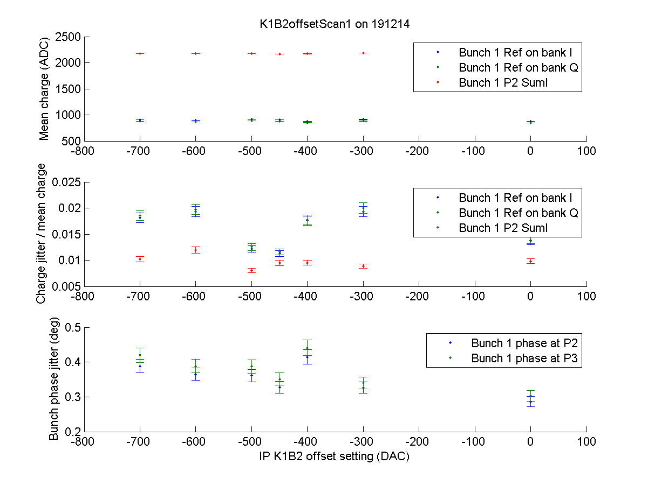
N. Blaskovic

Slide 20
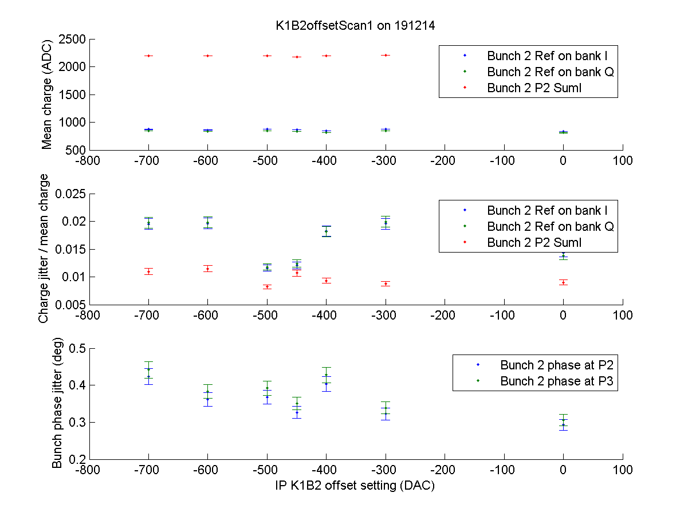
N. Blaskovic

Slide 21
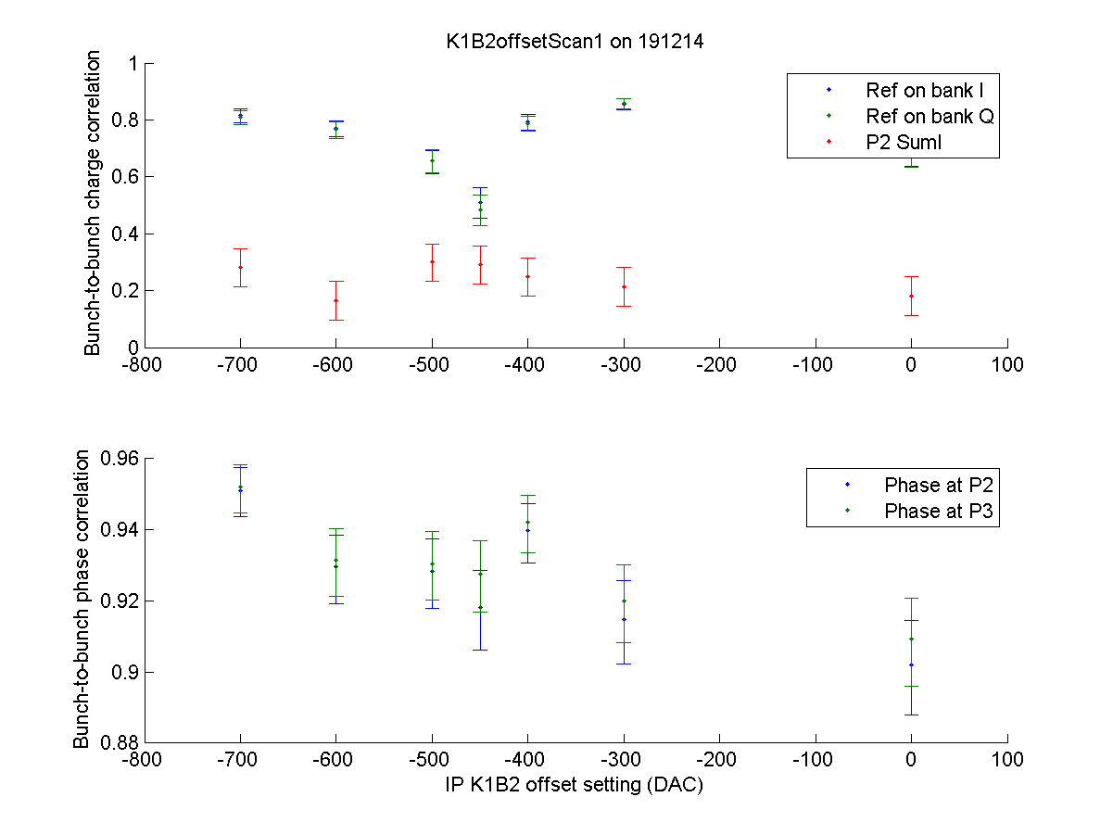
N. Blaskovic

Slide 22
Conclusions
Achieved & predicted feedback jitter drops from 250 to 80 nm in QD0FF current scan:
  P2 & P3 do not see relevant bunch-to-bunch correlation changes
  Dependence on bunch charge and phase unclear
Limited feedback performance at large K1B2 offset settings due to the kicker system saturation at large DAC settings
N. Blaskovic

Slide 23
Appendix
Position and jitter for both bunches
for all feedback runs at 0 dB
on 19 December 2014
N. Blaskovic

Slide 24
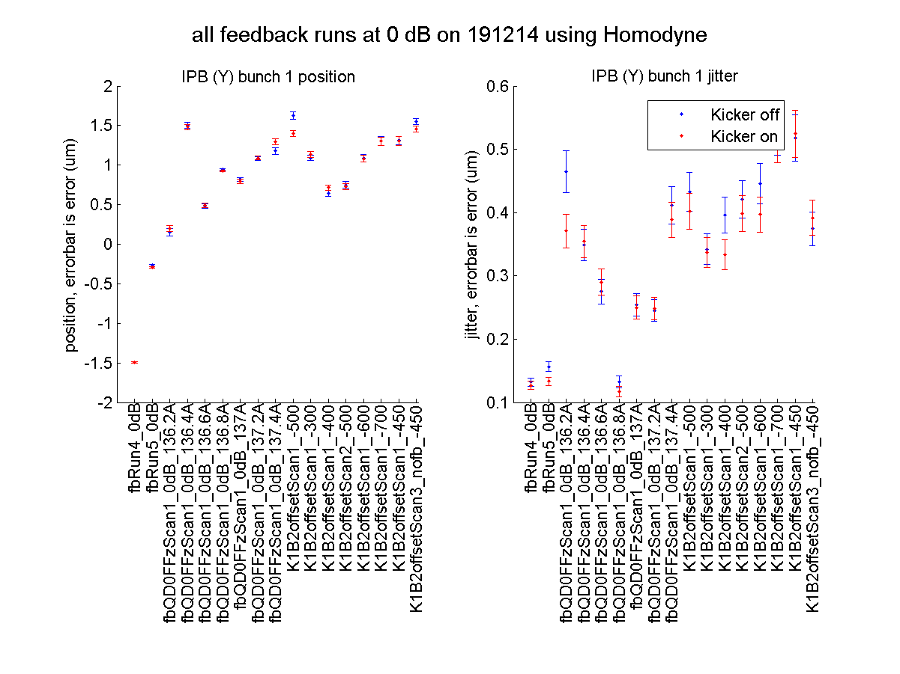
N. Blaskovic

Slide 25
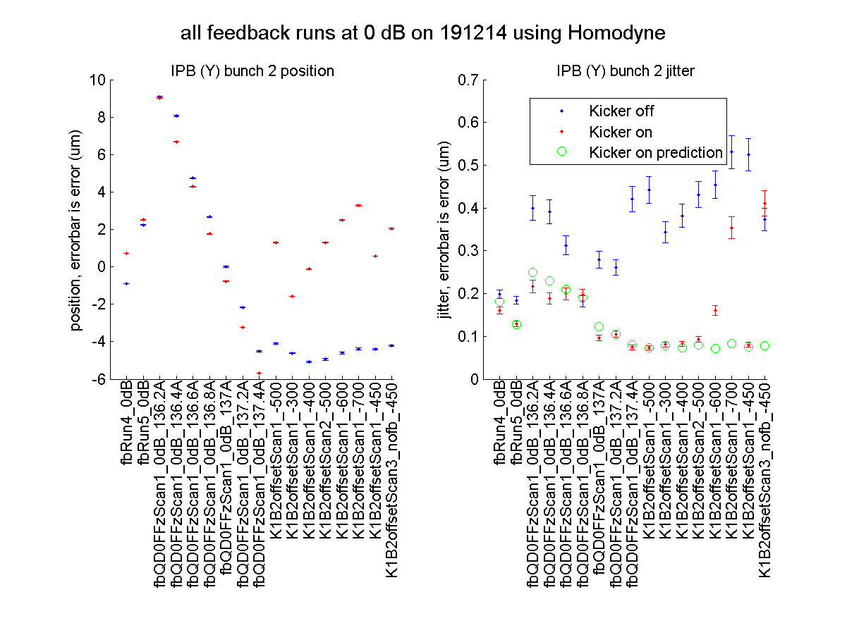
N. Blaskovic

