Slide 1
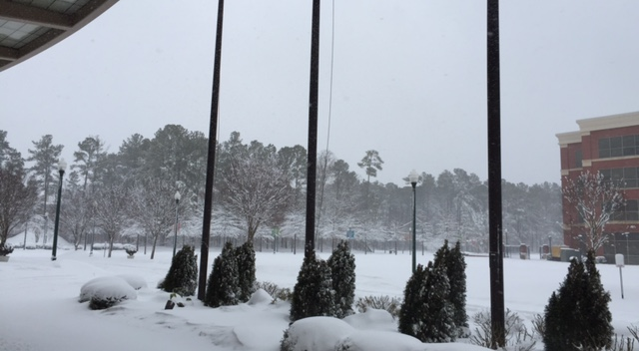
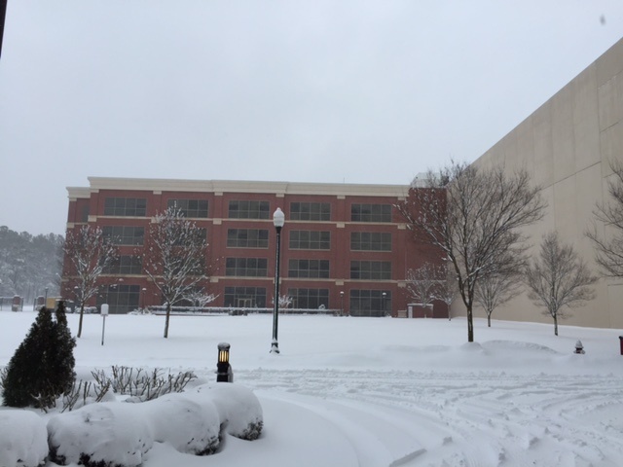
LCB/ICFA meeting at Newport News with full snow, 26-27 February
This is only for TB meeting
Presentation and not for
Distribution. (2015-3-3)

Slide 2
Linear Collider Board Meeting: at JLab, 15-02-26
09:00 – Linear Collider Overview (Evans; 30 + 10)
09:40 – ILC Status (Evans/Harrison → Yamamoto; 50 + 10)
10:40 – Break
11:00 – CLIC Status (Stapnes; 30 + 10)
11:40 – Linear Collider Detector Status (H. Yamamoto; 50 + 10)
12:40 – Lunch
14:00 – April 2015 PAC Meeting (Komamiya; 15 + 5)
14:20 – LCB Subcommittee 1 on Governance (Foster; 30 + 5)
14:55 – LCB Subcommittee 2 on an International Agreement
for the ILC Project (Komamiya 15+ 5)
15:15 – Break
15:35 – Regional Reports (Gao, Le Diberder, Weerts; 3 x 10)

Slide 3
ILC Accelerator Status
Akira Yamamoto (LCC, KEK/CERN)
for L. Evans and M. Harrison
Technical Advances in 2014
Post-TDR Design Updates based on a specific model-site,
TDR Verification ongoing by MEXT-WG

Slide 4
Technical Highlights in 2014
Nano-beam
    ATF2: reached 44 nm at the final focus, closing the primary goal of 37 nm
      Corresponding to 7 nm at the ILC energy (250 GeV/beam) with the goal of 6 nm
SRF
    EXFEL: exceeded 50 % ( 400/800) cavity production, and 10 % (10/100 ) cryomodule assembly and test
    Fermilab-ASTA: reached the ILC specification gradient
    SLAC-LCLS: started the project in consortium with the US SRF laboratories
    KEK-STF2: completed CM1+CM2a installation into the beam line
Accelerator Design and Integration (ADI)
    LCC: processed Post-TDR design update with a model-site assumption
      Common L* for both detectors of ILD and SiD
      Vertical access at Detector Hall at IR points
      Extension of ML tunnel for optimizing e+e- collision timing and for redundancy of ML SRF cavity gradient integration
    LCC: is continuing to seek for potential cost saving in balance to necessary increase

Slide 5
Plan to prepare for ILC realization
Pre. Green-Sign for preparation
Green-Sign for Int’l ILC Lab starting
Stage |  | Pre-Prep | Pre-Prep |  | Prep. 1 | Prep. 2 | Prep. 3 |  |  | Prep. 4 | Construction |  |  | Beam
Year (anticipated) | We are Here→ | 1st |  |  | 3rd |  |  |  |  |  | 7th |  |  | 16th (~2030)
JP | Committee/WGs
ILC Stage | Pre-prep. (w/o ded. Fund. ) |  |  |  | Preparation (w/ dedicated funding) |  |  |  |  |  | Construction (9 yrs) |  |  | Beam op.
CFS | Pre. Land-survey, & Localization |  |  |  | L. survey, Assess., Eng. plan & design/drawing
ADI | Acc. Parameters fixed, |  |  |  | Engineering Design optimized
SRF | Prod. Technology, & stabilization |  |  |  | Cost-effect. Production., Hub-lab functioning,
Nano-beam | FF beam size demonstration |  |  |  | FF: beams stability
Sources | e+ source tech. |  |  |  | Prototype demonstrated
SRF-Linac worldwide (for photon science):
EXFEL | EXFEL construction |  |  | EXFEL beam operation (2016 E)
LCLS | LCLS tech. feasibility |  | LCLS Construction |  |  |  |  | LCLS beam operation (2019 E)
CERN-LHC (hadron)
HL-LHC | LS1 | LHC-Run2 (2015-2017) |  |  |  | LS2 |  |  | Run 3 (2020 - ) |  |  | LS3 | Run 4 (2024-)

Slide 6
Plan to prepare for ILC realization
Pre. Green-Sign for preparation
Green-Sign for Int’l ILC Lab starting
Stage |  | Pre-Prep | Pre-Prep |  | Prep. 1 | Prep. 2 | Prep. 3 |  |  | Prep. 4 | Construction |  |  | Beam
Year (anticipated) | We are Here→ | 1st |  |  | 3rd |  |  |  |  |  | 7th |  |  | 16th (~2030)
JP | Committee/WGs
ILC Stage | Pre-prep. (w/o ded. Fund. ) |  |  |  | Preparation (w/ dedicated funding) |  |  |  |  |  | Construction (9 yrs) |  |  | Beam op.
CFS | Pre. Land-survey, & Localization |  |  |  | L. survey, Assess., Eng. plan & design/drawing
ADI | Acc. Parameters fixed, |  |  |  | Engineering Design optimized
SRF | Prod. Technology, & stabilization |  |  |  | Cost-effect. Production., Hub-lab functioning,
Nano-beam | FF beam size demonstration |  |  |  | FF: beams stability
Sources | e+ source tech. |  |  |  | Prototype demonstrated
SRF-Linac worldwide (for photon science):
EXFEL | EXFEL construction |  |  | EXFEL beam operation (2016 E)
LCLS | LCLS tech. feasibility |  | LCLS Construction |  |  |  |  | LCLS beam operation (2019 E)
CER
HL-LHC | LS1 | LHC-Run2 (2015-2017) |  |  |  | LS2 |  |  | Run 3 (2020 - ) |  |  | LS3 | Run 4 (2024-)

Slide 7
Plan to prepare for ILC realization
Pre. Green-Sign for preparation
Green-Sign for Int’l ILC Lab starting
Stage |  | Pre-Prep | Pre-Prep |  | Prep. 1 | Prep. 2 | Prep. 3 |  |  | Prep. 4 | Construction |  |  | Beam
Year (anticipated) | We are Here→ | 1st |  |  | 3rd |  |  |  |  |  | 7th |  |  | 16th (~2030)
JP | Committee/WGs
ILC Stage | Pre-prep. (w/o ded. Fund. ) |  |  |  | Preparation (w/ dedicated funding) |  |  |  |  |  | Construction (9 yrs) |  |  | Beam op.
CFS | Pre. Land-survey, & Localization |  |  |  | L. survey, Assess., Eng. plan & design/drawing
ADI | Acc. Parameters fixed, |  |  |  | Engineering Design optimized
SRF | Prod. Technology, & stabilization |  |  |  | Cost-effect. Production., Hub-lab functioning,
Nano-beam | FF beam size demonstration |  |  |  | FF: beams stability
Sources | e+ source tech. |  |  |  | Prototype demonstrated
SRF-Linac worldwide (for photon science):
EXFEL | EXFEL construction |  |  | EXFEL beam operation (2016 E)
LCLS | LCLS tech. feasibility |  | LCLS Construction |  |  |  |  | LCLS beam operation (2019 E)
CERN-LHC (hadron)
HL-LHC | LS1 | LHC-Run2 (2015-2017) |  |  |  | LS2 |  |  | Run 3 (2020 - ) |  |  | LS3 | Run 4 (2024-)

Slide 8
ILC Accelerator Design: Post-TDR Updates
Objectives: :
    Further optimize the ILC accelerator design parameters, assuming a site model in Japan, and to seek for the best cost-effective construction,
Process for the Change Management:
    Changes
 |  | Propose (Creator) | Review | Decide | Implement
CR-001 | Add return “Dogleg” to target by-pass | 2014/08/27 (K.Yokoya) | done | Rejected
CR-002 | Adapt equal L* for both detectors | 2014/09/02 (G. White) | done | Differed to Review Panel | L* to be settled to ~ 4 m
CR-003 | Detector hall with vertical shaft access | 2014/09/16 (K. Buesser) | done | Accepted | In progress
CR-004 | Extension of the e-e+ ML tunnels by about 1.5 km | 2014/12/18 (N. Walker) | In progress
CR-005 | …

Slide 9
MEXT’s Organization for Studying ILC
140913
SCJ
Recommendation in 2013
MEXT
ILC Taskforce
formed in 2013
Academic Experts Committee
formed in 2014
Particle & Nuclear Phys.
Working Group
formed in 2014
TDR Validation
Working Group
formed in 2014

Slide 10
Progress in MEXT Academic Expert Committee for the ILC http://www.mext.go.jp/b_menu/shingi/chousa/shinkou/038/attach/1353571.htm
 | Particle and Nuclear Physics WG |  | TDR Verification WG (* closed mtg）
1st Academic Expert Committee (14/05/08)
1st : 6/24 | Status and Prospect for Particle Physics ILC Project and the Physics | 1st: 6/30 | TDR and the cost, generally reported
2nd : 7/29 | Strategies at EU and Ams | 2nd : 7/28* | SRF and the cost
3rd : 8/27 | Cosmic-ray and astrophysics ILC Science Objectives | 3rd: 9/8* | SRF and the cost (continued) CFS
4th : 9/22 | Flavor and Neutrion Physics IILC Science Objectives | 4th: 11/4* | ILC construction cost
5th : 10/21 | Summary discussion for a report
2nd Academic Expert Committee (14/11/14)
6th : 1/8 | Experience from SSC ILC Science Objectives | 5th：1/26* | ILC Accelerator and human resources
7th : 2/17 | Science Objectives per | 6th ：3/2* | Summary discussions
8th : 3/30 | Summary discussion for a report
3rd Academic Expert Committee (15/4/21)

Slide 11
ICFA Meeting at JLab, 2015/2/26~27
FALC Report (Lockyer, 15 + 5)
ILC Progress in Japan (Nozaki; 20 +5)
Discussion on ICFA and accelerator science (Mnich; 45)
Proposal for a new ICFA Panel on Sustainable Acc./Colliders (Nozaki; 15 + 5)
Global Planning for HEP, including a 100 TeV Collider (Mnich; 45)
ICFA Seminar—lessons learned and any suggestions for changes (Wang; 10 + 5)
InterAction Report (Yurkewicz; 20 + 5)
Report on ICFA-ICUIL activities (Tajima; 10 + 5)
Linear Collider School (Stapnes; 10 + 5)
ICFA Panel Reports (n x 10 where n ≤ 6)
Reports from Labs and Regions
  → M. Yamauchi (new DG expected) attend ICFA, first tiem.
Future ICFA Meetings (8/19, Selvia?)
Any Other Business

