Slide 1
Trim dac levels
TALITHA BROMWICH

Slide 2
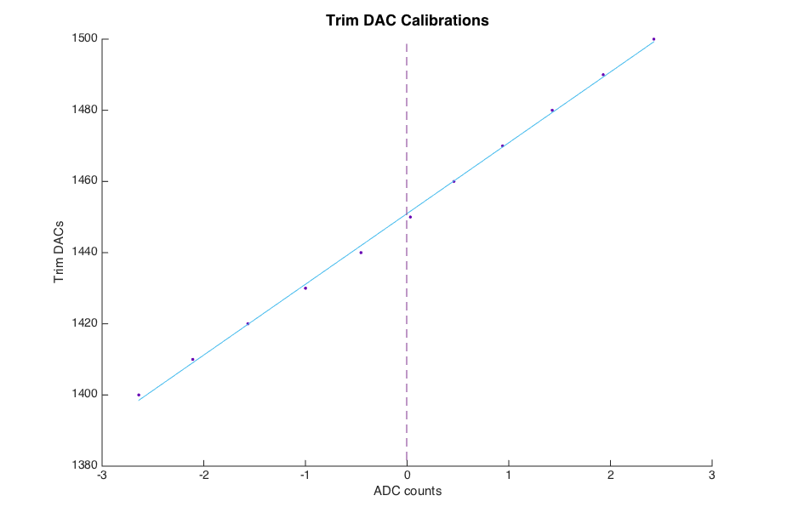
Trim DAC calibrations
Aim: Find trim DAC levels required to zero all ADCs.
Vary trim DAC settings around zero ADC counts.
Average 1000 samples over 25 triggers to find the ADC count level for each trim DAC setting.
Fit to find the zero intercept.

Slide 3
Results
Trim DAC settings to zero all ADCs
A1 | TRIM DAC
1 | 1398
2 | 1413
3 | 1580
4 | 1520
5 | 1584
6 | 1650
7 | 1547
8 | 1515
9 | 1419
A2 | TRIM DAC
1 | 1494
2 | 1228
3 | 1350
4 | 1604
5 | 1535
6 | 1429
7 | 1706
8 | 1415
9 | 1649
A3 | TRIM DAC
1 | 1632
2 | 1529
3 | 1573
4 | 1518
5 | 1498
6 | 1573
7 | 1645
8 | 1771
9 | 1582
A4 | TRIM DAC
1 | 1444
2 | 1400
3 | 1742
4 | 1828
5 | 1571
6 | 1933
7 | 1539
8 | 1678
9 | 1595
A5 | TRIM DAC
1 | 1451
2 | 1447
3 | 1217
4 | 1539
5 | 1640
6 | 1670
7 | 1597
8 | 1503
9 | 1458

Slide 4
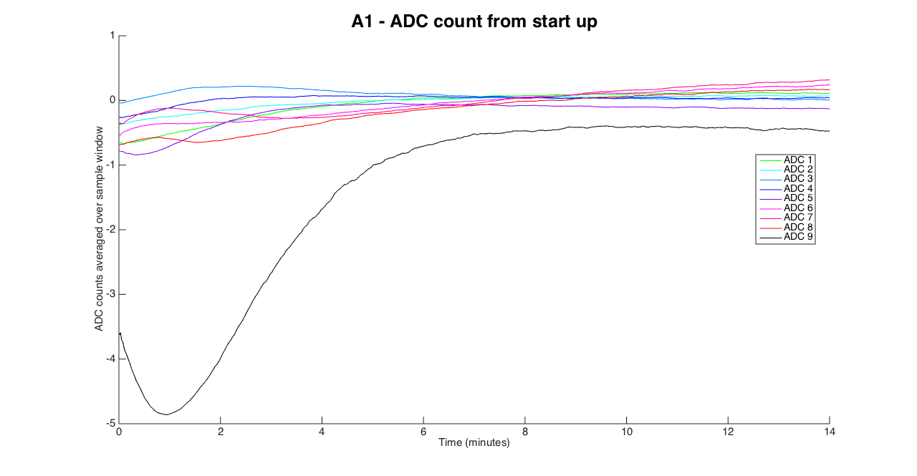
ADC levels with time
Noticed some ADCs take a while to settle after first powering the board

Slide 5
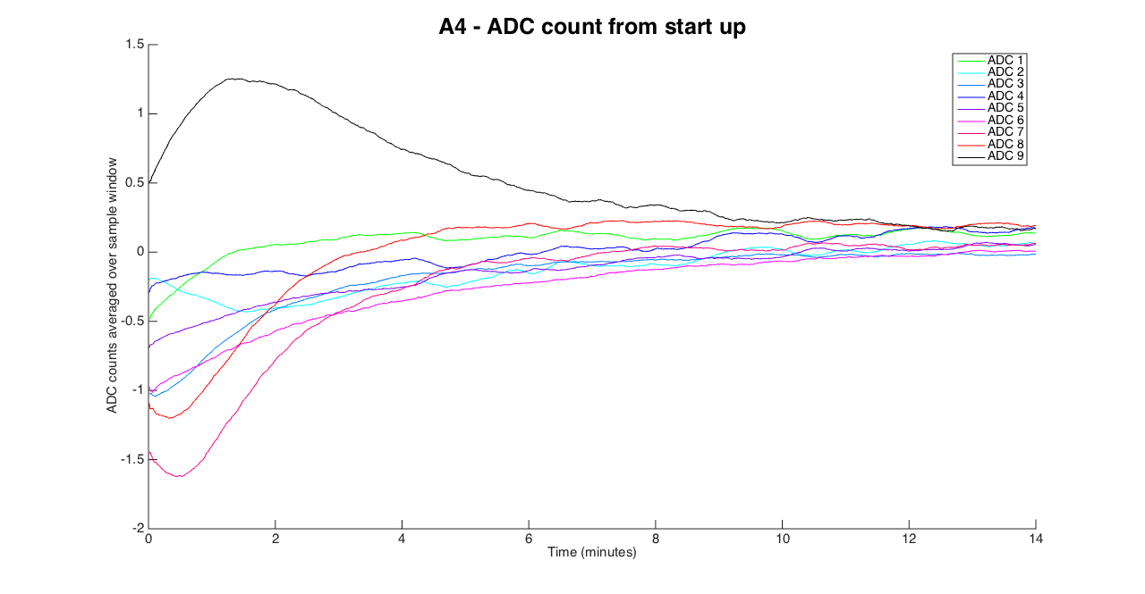
ADC levels with time
Noticed some ADCs take a while to settle after first powering the board

Slide 6
Next …
Glenn is helping set up tests to systematically check all board inputs and outputs are functioning: digin (A/B), dir io (A/B), AUXin (A/B), AUXout (A/B)
Check thresholds on digin A and B
Check DAC volts vs counts – there are now 4 DACs
Background noise analysis on ADCs
Cross talk tests on ADCs

