Slide 1
R56, Resolution Simulations and Calculations
Jack Roberts

Slide 2
Overview
Residual R56 calculation.
Correlation vs. R56.
Optimum Phase/energy mix for feedforward input.
Correlation vs. monitor resolution.

Slide 3
Residual R56 Calculation
What residual value of R56 between the upstream and downstream phase monitors is needed to explain the increase in phase jitter?
Sanity check that first order energy effects are a feasible source of the problem.
Fairly easy to calculate/estimate from the data…

Slide 4
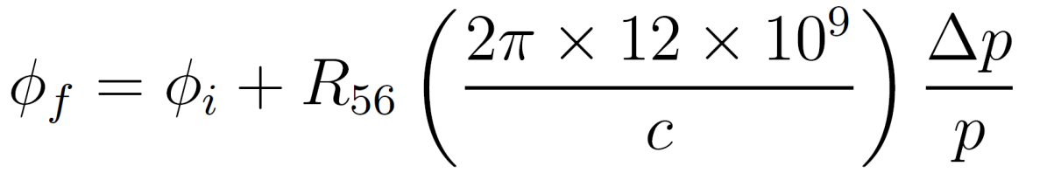
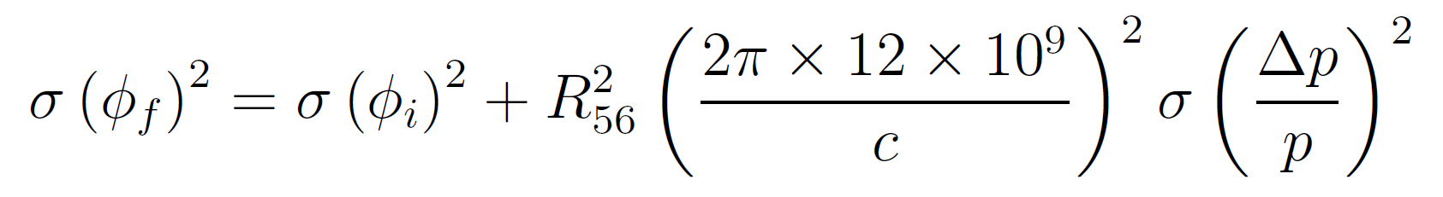
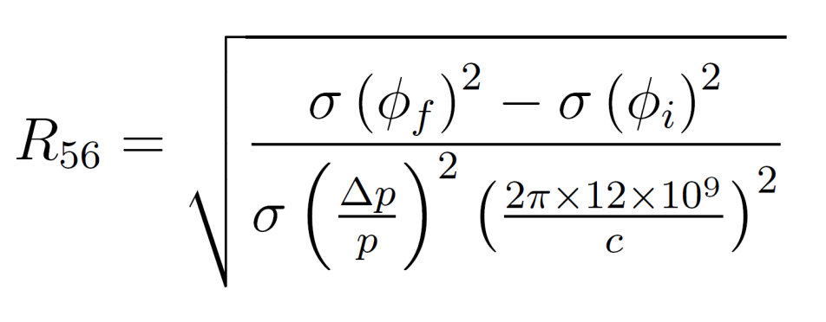
Residual R56 Calculation - Derivation
Final phase
[12GHz radians]
Fractional energy offset.
Initial phase
[12GHz radians]
Transfer matrix, phase-energy dependence [m]
Converts metres to 12GHz radians.
In terms of jitter:
How to calculate?

Slide 5
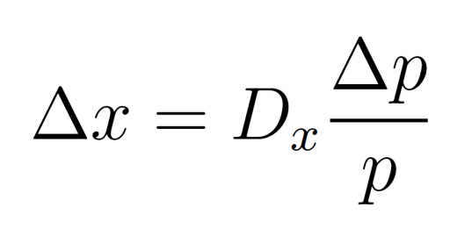
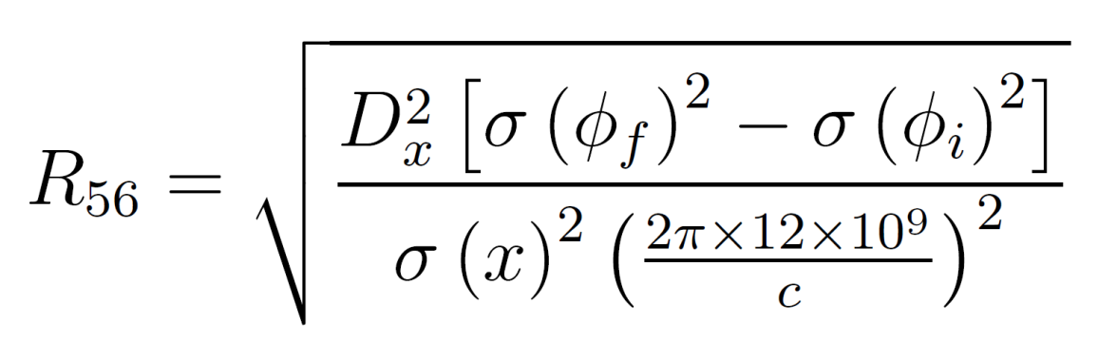
Residual R56 Calculation - Derivation
Use position jitter at a dispersive BPM:
Dispersion (taken from optics)
I have used position jitter in CT.285 (Frascati chicane). Nominal dispersion at this BPM is 0.17 m.
Calculated energy jitter is typically about 0.1%.
Caveats: assumes dispersion is nominal and that all position jitter is coming from energy.

Slide 6
Residual R56 Calculation - Results
Dataset Name | R56 set in TL1 [m] | CT Phase Jitter [deg] | CB Phase Jitter [deg] | CT.285 Pos Jitter [mm] | Residual R56 [m]
20141205_1125_Gain+26 | -0.2 | 0.75 | 4.63 | 0.09 | 0.58
20141205_1125_Gain-26 | -0.2 | 0.69 | 5.01 | 0.12 | 0.47
20141215_1411_AllForStability | 0.3 | 0.79 | 1.87 | 0.18 | 0.11
20141205_1330 | 0.3 | 0.81 | 2.02 | 0.13 | 0.17
20141216_1915_Wiggle23 | 0.3 | 1.29 | 2.54 | 0.13 | 0.20
20141215_1823 | 0.3 | 1.04 | 2.48 | 0.24 | 0.11
20141205_1125 | 0.4 | 0.69 | 1.36 | 0.09 | 0.15
20141205_1125 | 0.5 | 0.85 | 4.48 | 0.15 | 0.36
Most feedforward tests with R56 = 0.3 m in TL1. Residual R56 calculated to be 0.1 – 0.2 m in these conditions.
Similar residual R56 for R56 = 0.3 and 0.4 m in TL1 suggests optimum may be around 0.35 m.

Slide 7
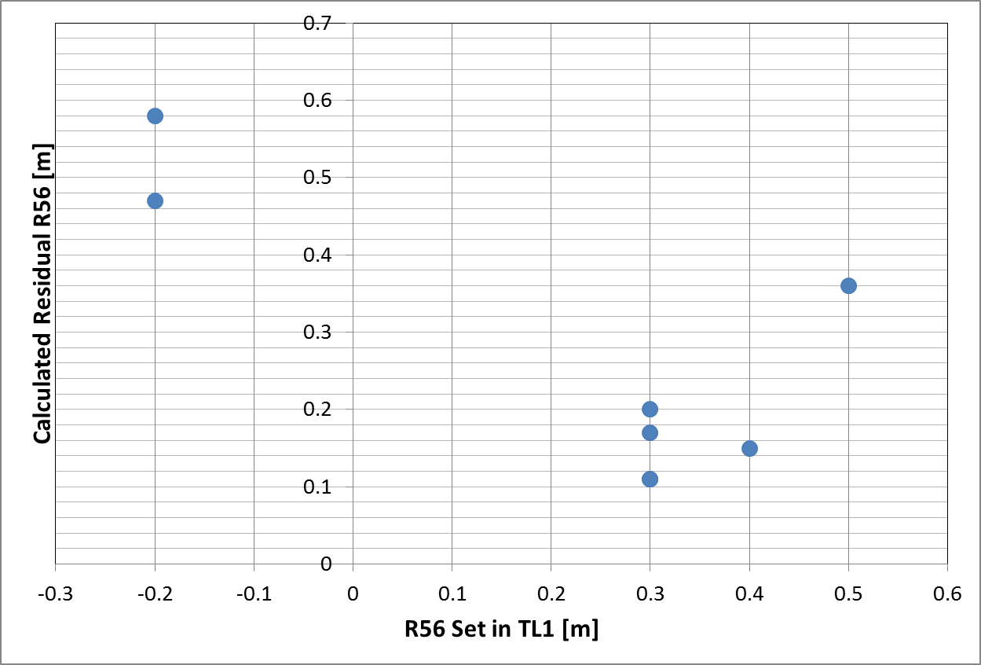
Residual R56 Calculation - Results
Only a few different R56 values tried in TL1.
Might expect larger residual R56 with R56 = -0.2 m in TL1.

Slide 8
Simulations: Effect of R56 on Jitter/Correlation
Using the same equations I’ve done some simulations of the effect of residual R56 on the downstream phase jitter and upstream-downstream phase correlation.
Based on previous results, I assume:
0.1% energy jitter.
0.8 degrees upstream phase jitter.

Slide 9
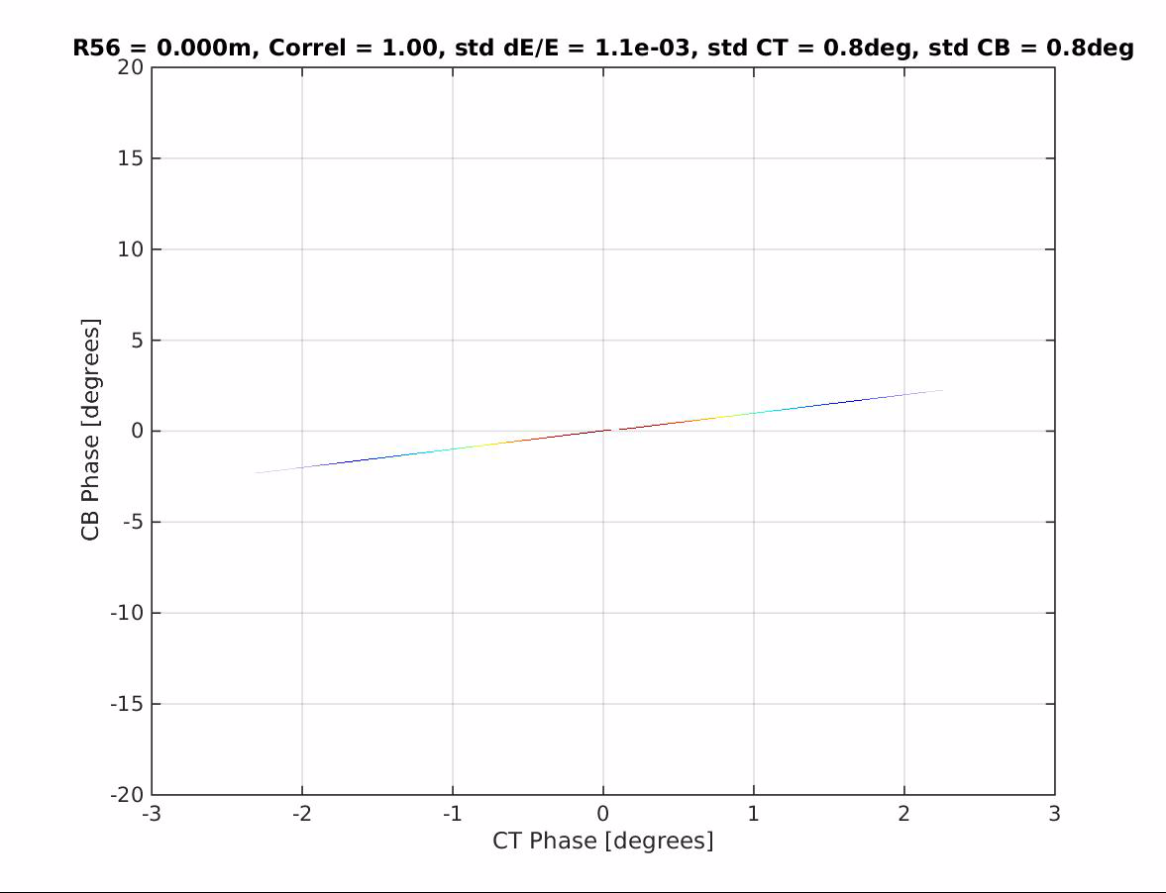
Simulations: Effect of R56 on Jitter/Correlation

Slide 10
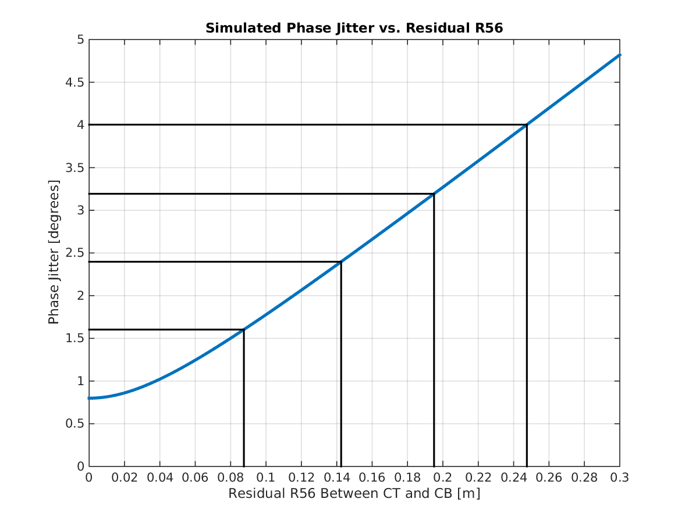
Simulations: Effect of R56 on Jitter
More than double the phase jitter with residual R56 = 0.1 m.

Slide 11
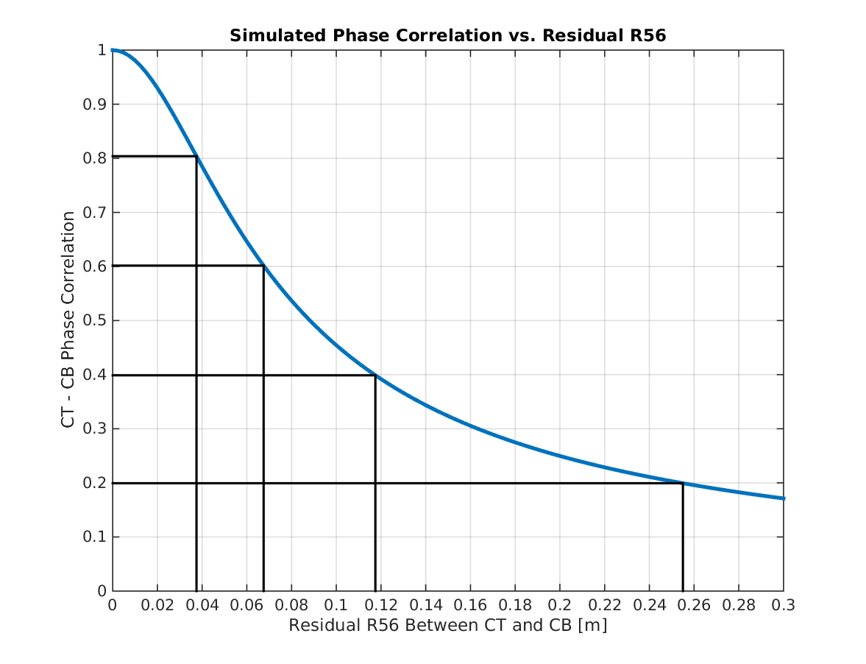
Simulations: Effect of R56 on Correlation
Correlation >90% requires R56 to be controlled to better than 0.03 m.

Slide 12

Optimal Energy Gain in Feedforward Input
What is the optimal combination of the upstream phase and energy (position in CT.285) that maximises correlation with the downstream phase?
Scanned through different values of g in this equation, correlated it with downstream phase:
$${FF}_{input}=φ_{CT}+gΔx$$
Position in CT.285
Simulated input to feedforward system.
Upstream phase.
Gain factor.

Slide 13
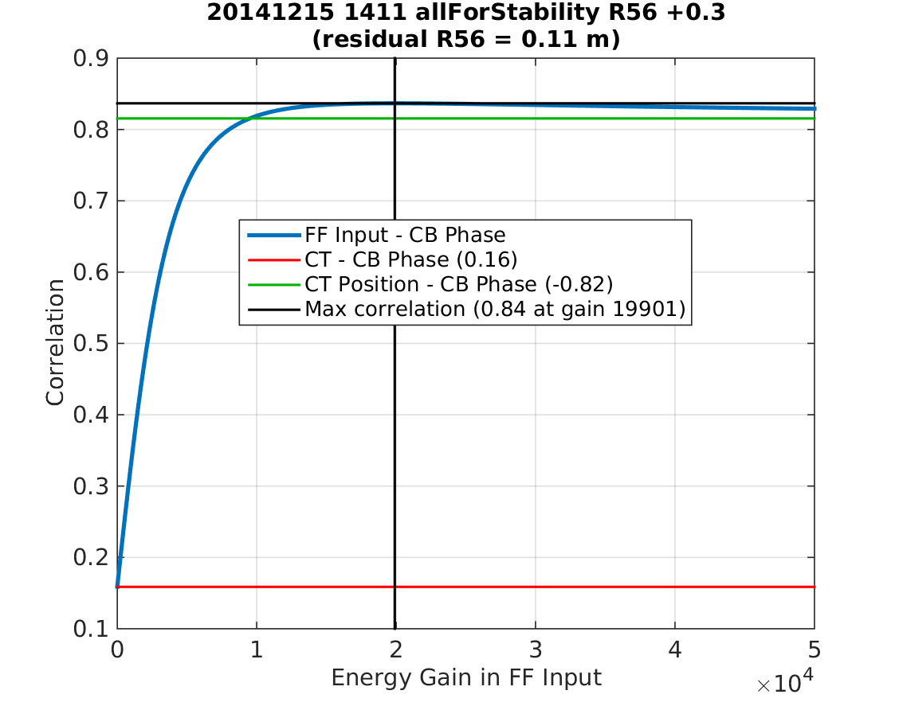
20141215_1411_allForStability

Slide 14
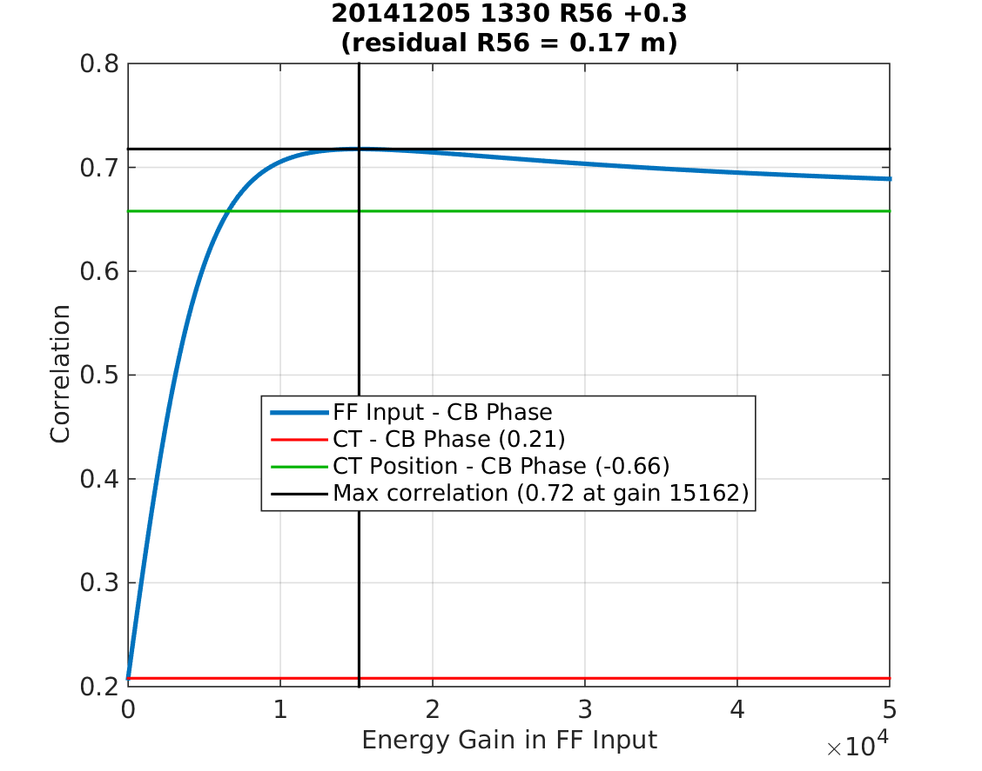
20141205_1330_R56_+0.3

Slide 15
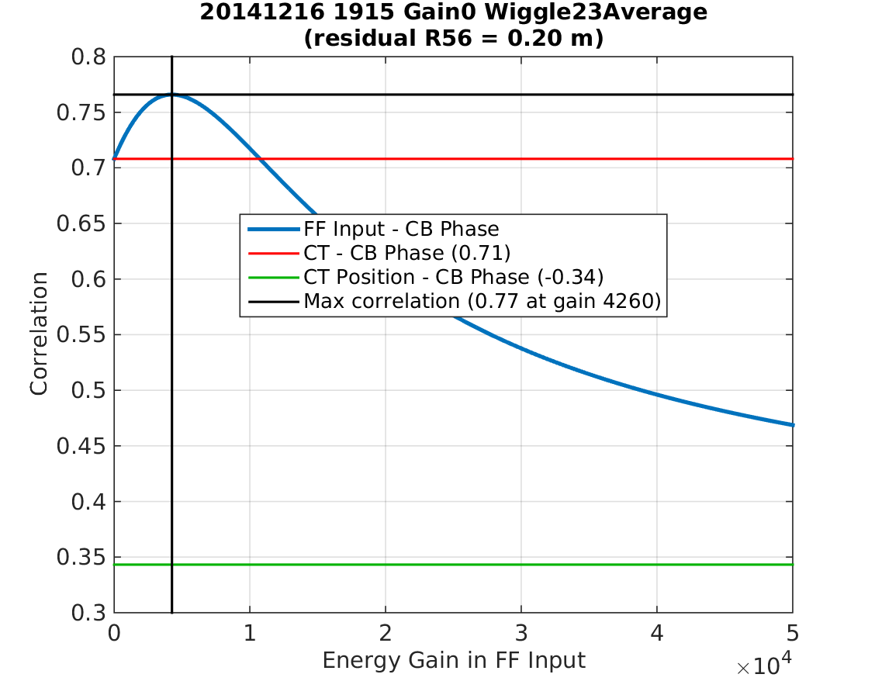
20141216_1915_Wiggle23Average

Slide 16
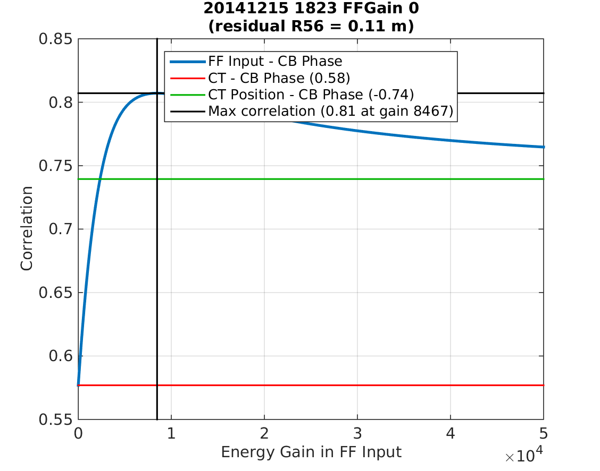
20141215_1823

Slide 17
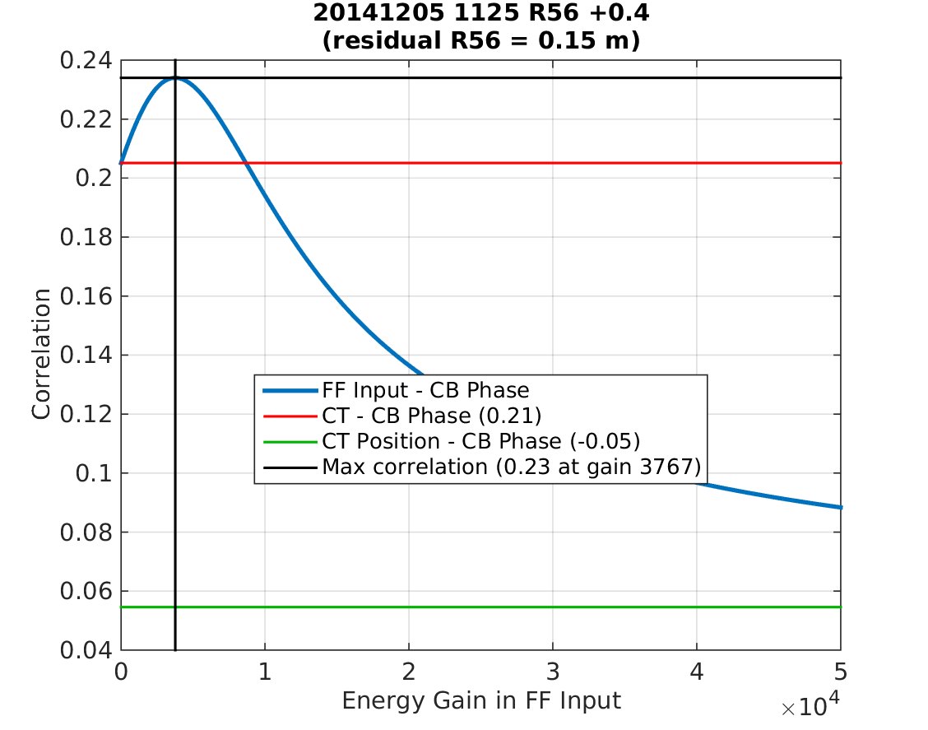
20141205_1125_R56_+0.4

Slide 18
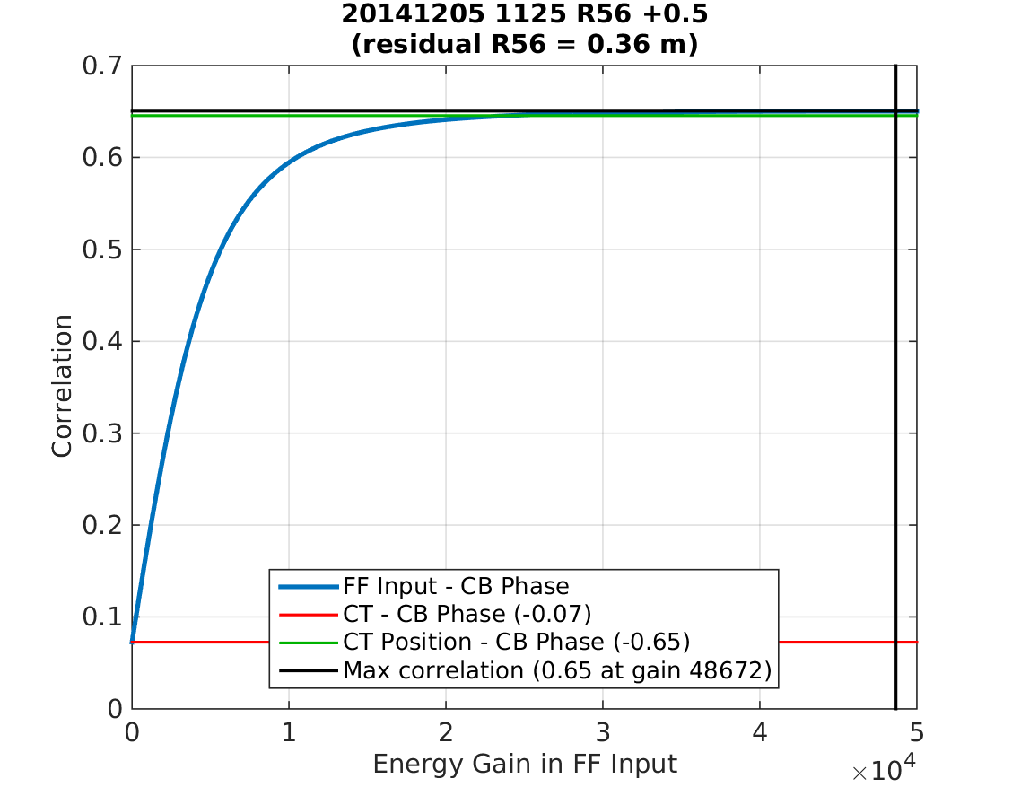
20141205_1125_R56_+0.5

Slide 19
Optimal Energy Gain in Feedforward Input
Increase in correlation compared to only using phase or position is quite small, 10% maximum.
Expected optimal gain factor to be R56/Dx, but this is not the case.
It should be possible to derive an equation that determines the optimal gain for given correlations etc.

Slide 20


Correlation vs. Monitor Resolution
What correlation should we expect between the two upstream phase monitors given their resolution?
Simulations again assuming 0.8 degree real beam phase jitter:
Measured phase
Beam phase
Measurement error
$$φ_{m}=φ_{b}+δ$$
$$σ\left(δ\right)=\text{resolution}$$

Slide 21
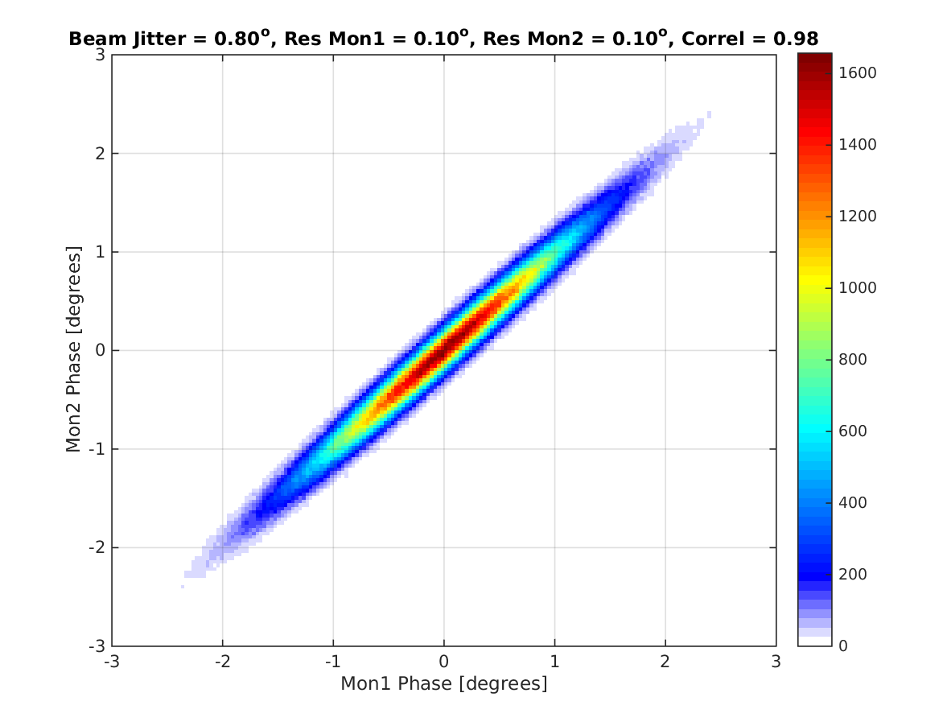
0.1 degree resolution, 98% correlation
Best Possible

Slide 22
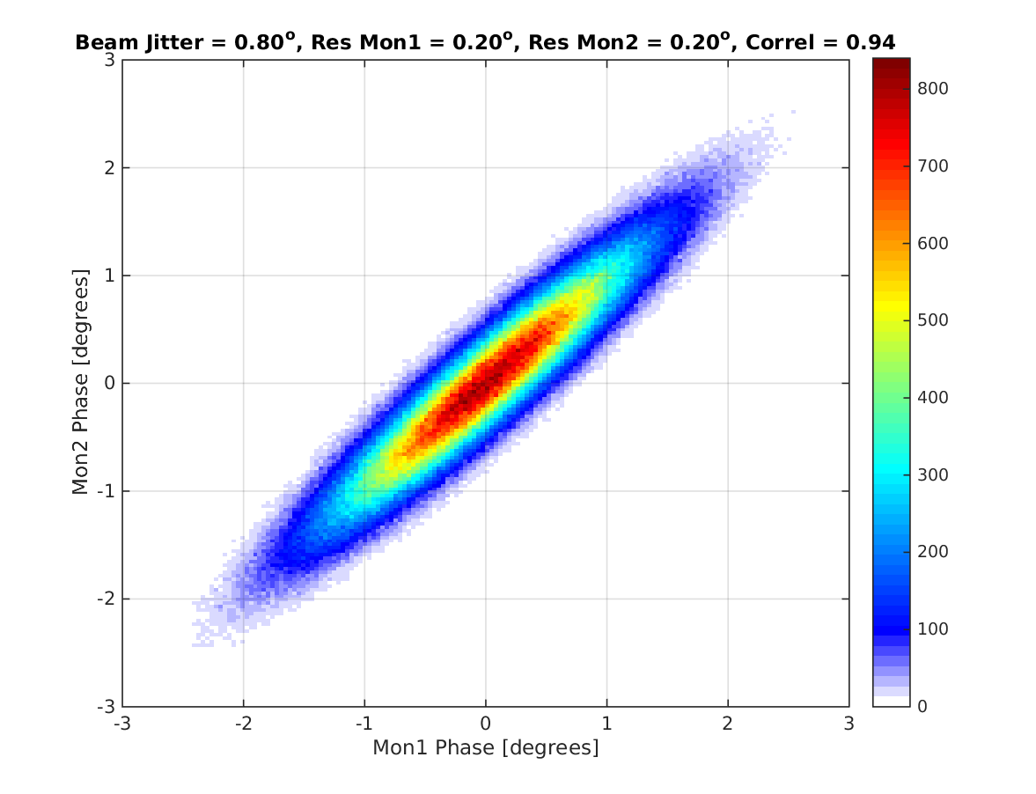
0.2 degree resolution, 94% correlation

Slide 23
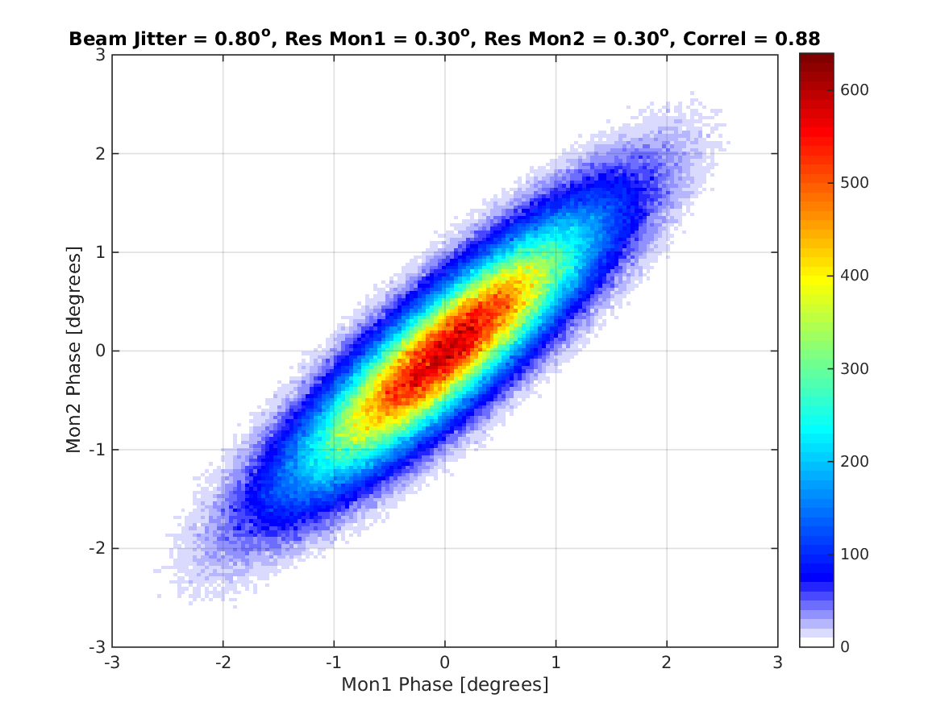
0.3 degree resolution, 88% correlation

Slide 24
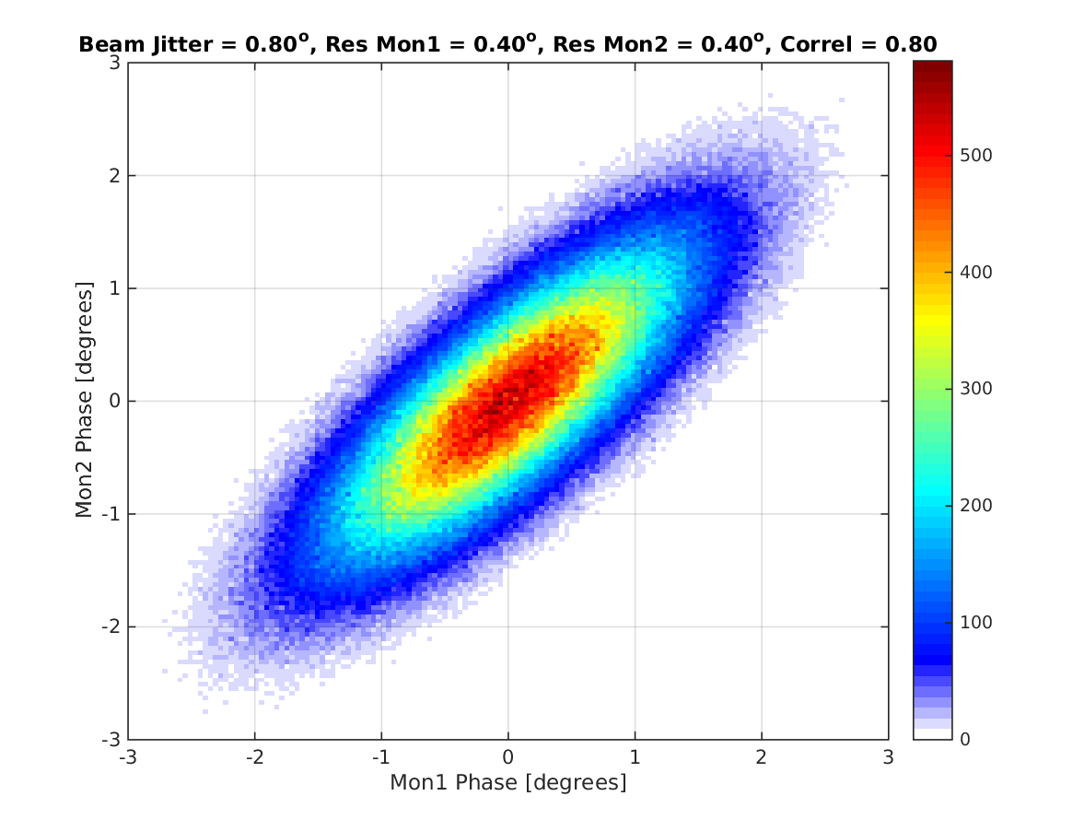
0.4 degree resolution, 80% correlation

Slide 25
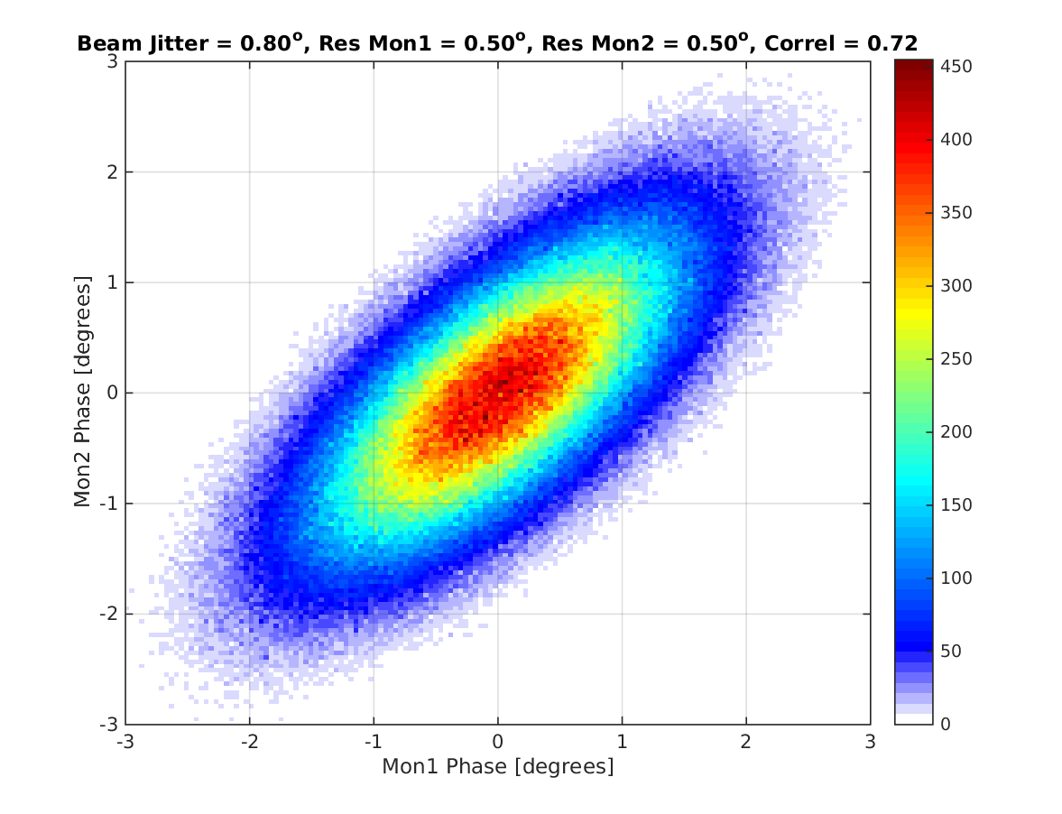
0.5 degree resolution, 72% correlation

Slide 26

Resolution: Mon1 0.15º, Mon2 0.35º, 90% correl
Estimated 2014 Conditions

Slide 27
Summary
Residual R56 between Mon1 and Mon3 during data taking last year calculated to be 0.1 – 0.2 m.
To achieve correlation >90% between upstream and downstream phase R56 must be controlled to better than 0.03 m.
Benefit from using a combination of phase/energy in the feedforward input maybe not as large as I expected.
All these results for pulse mean, I want to do some checks sample by sample as well.
IPAC abstract accepted for poster presentation. Still waiting for confirmation of student grant.

