Slide 1
IP BPM resolution
N. Blaskovic
N. Blaskovic

Slide 2
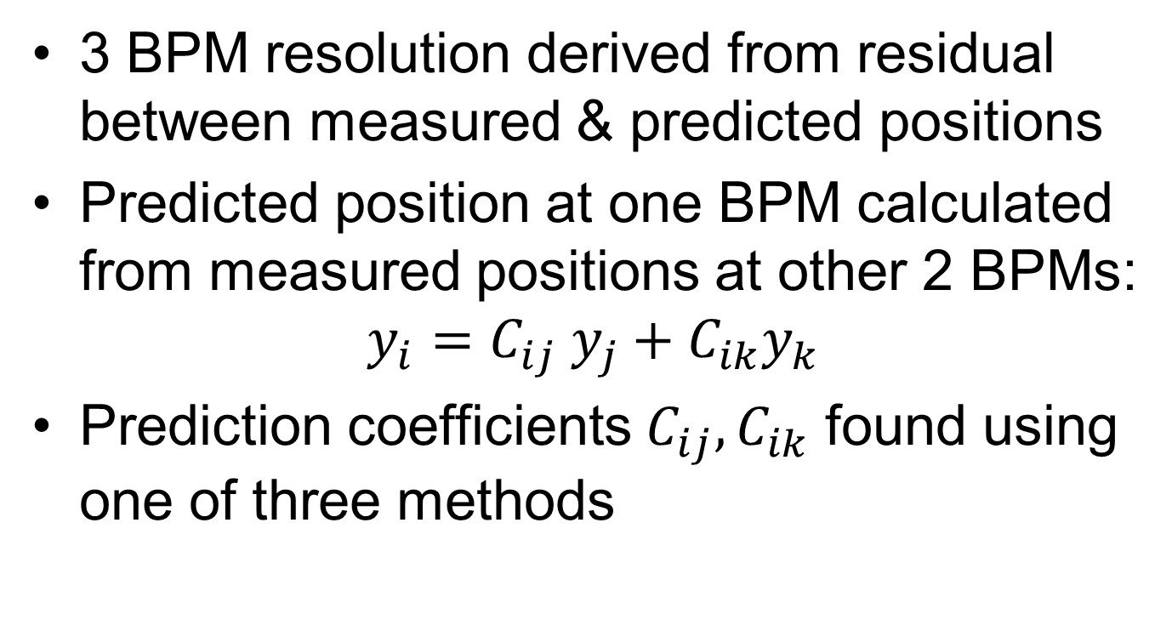
3 BPM resolution
3 BPM resolution derived from residual between measured & predicted positions
Predicted position at one BPM calculated from measured positions at other 2 BPMs:
$$y_{i}=C_{ij} y_{j}+C_{ik}y_{k}$$
Prediction coefficients $C_{ij},C_{ik}$ found using one of three methods
N. Blaskovic

Slide 3
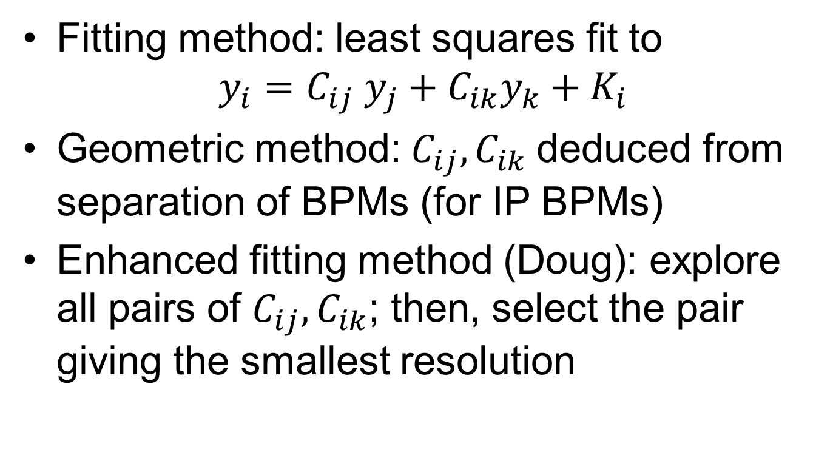
Prediction coefficients
Fitting method: least squares fit to
$$y_{i}=C_{ij} y_{j}+C_{ik}y_{k}+K_{i}$$
Geometric method: $C_{ij}, C_{ik}$deduced from separation of BPMs (for IP BPMs)
Enhanced fitting method (Doug): explore all pairs of $C_{ij}, C_{ik}$; then, select the pair giving the smallest resolution
N. Blaskovic

Slide 4
Resolution
Using resol_0dB_8_FB_off from 201214
Resolution obtained over samples 60–62 from Gaussian fit
Method | Resolution (nm)
 | IPA | IPB | IPC
Fitting | 54±1 | 53±1 | 57±1
Geometric | 54±1
Enhanced fitting | 53±1
N. Blaskovic

Slide 5
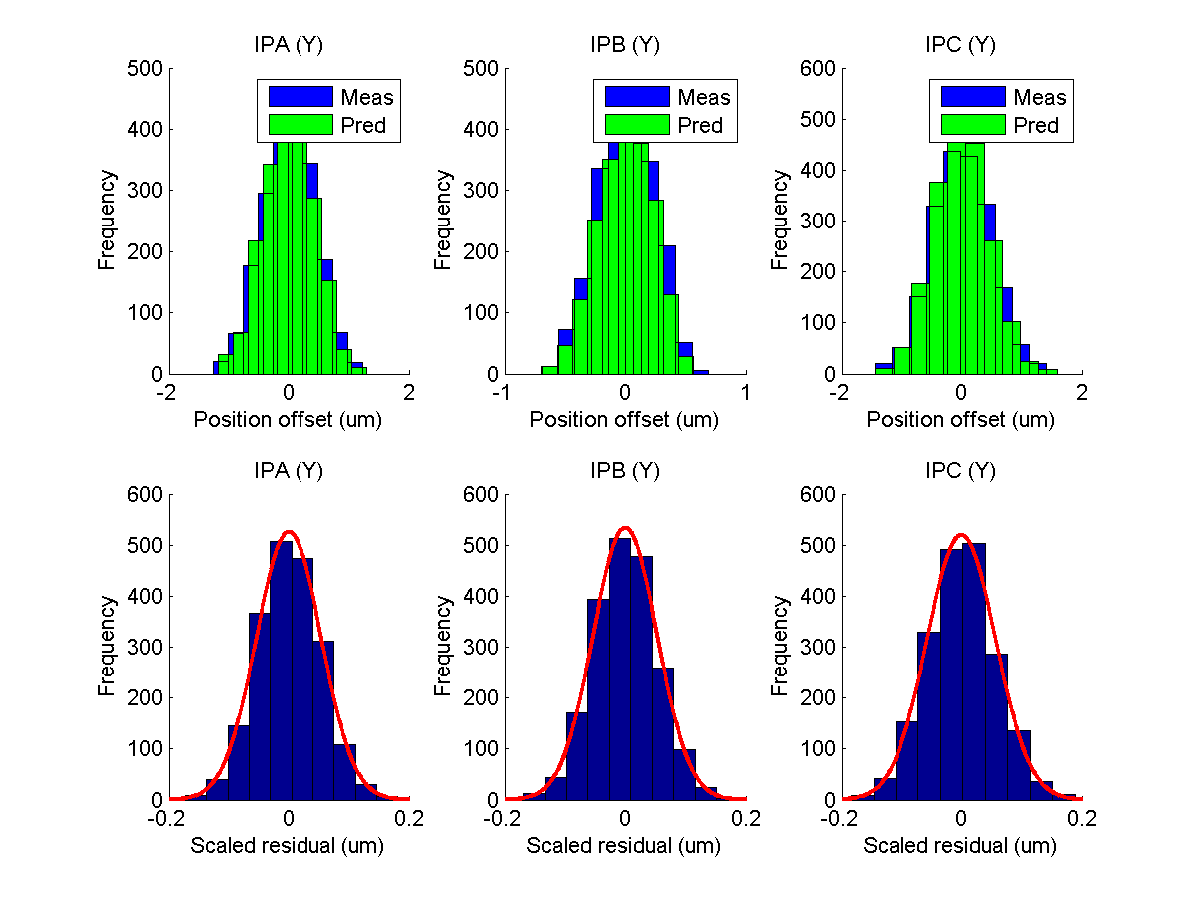
Fitting
N. Blaskovic

Slide 6
Predicted vs. measured
Predicted vs. measured position for the three IP BPMs
Would have (naively) expected the gradient to be 1 when using fitting method as fit coefficients deduced from data
N. Blaskovic

Slide 7
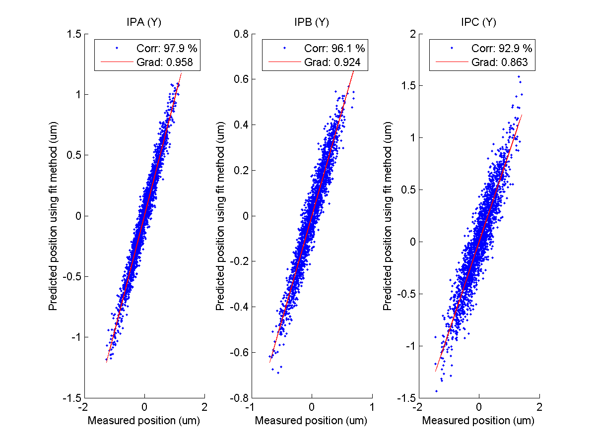
Fitting
N. Blaskovic

Slide 8
Gradient
What is the implication of gradient < 1?
Take pairs of arbitrary variables v, w
Consider scatter plots and linear fits to
w vs. v
v vs. w
N. Blaskovic

Slide 9
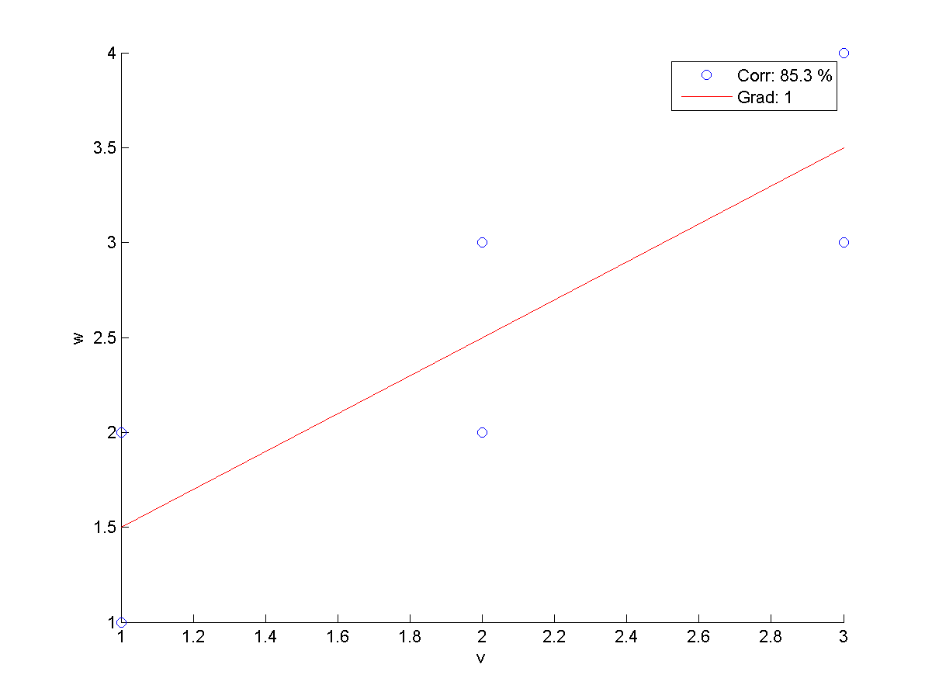
w vs. v
N. Blaskovic

Slide 10
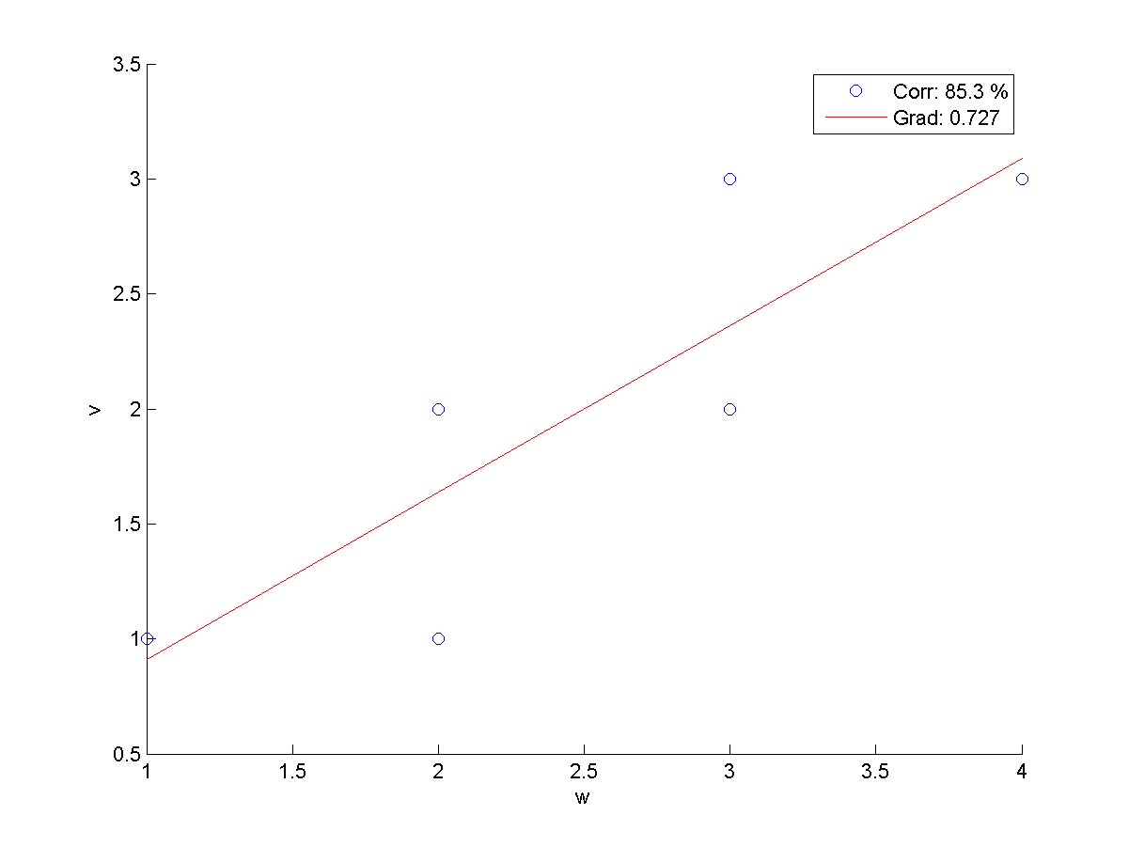
v vs. w
N. Blaskovic

Slide 11
Appendix
Position & residual distributions and predicted vs. measured positions for geometric and enhanced fit methods
N. Blaskovic

Slide 12
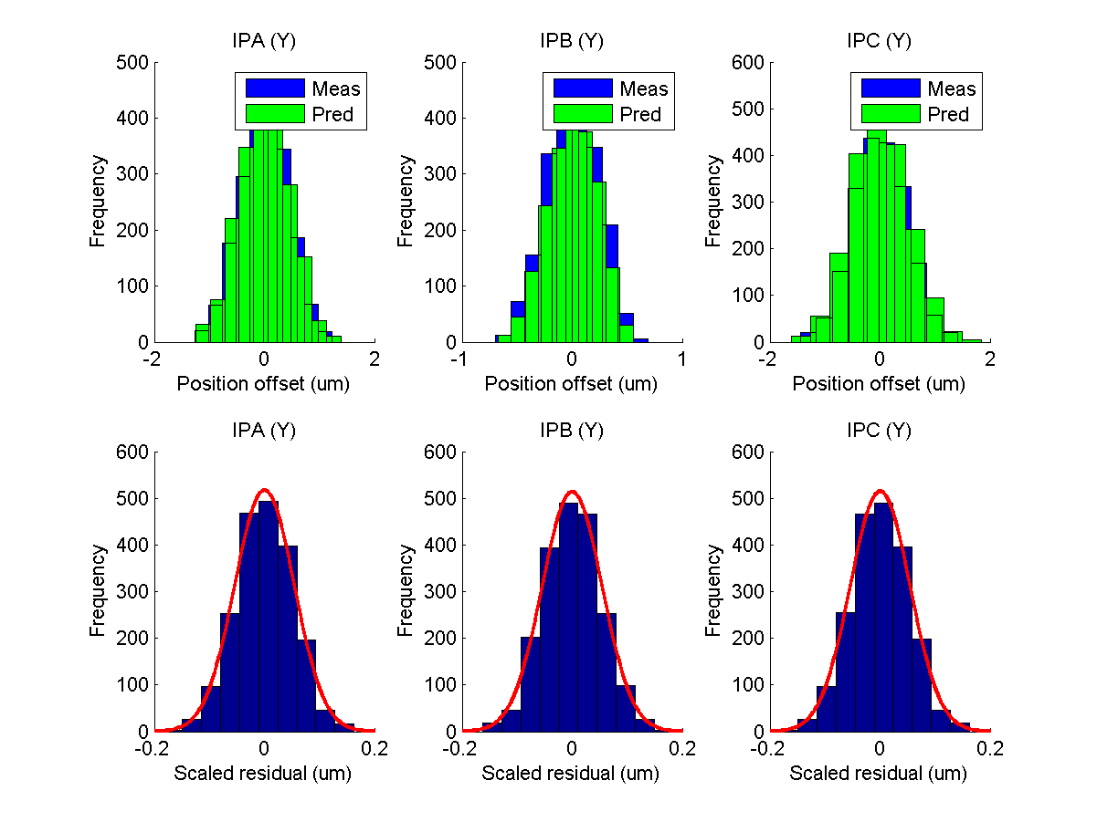
Geometric
N. Blaskovic

Slide 13
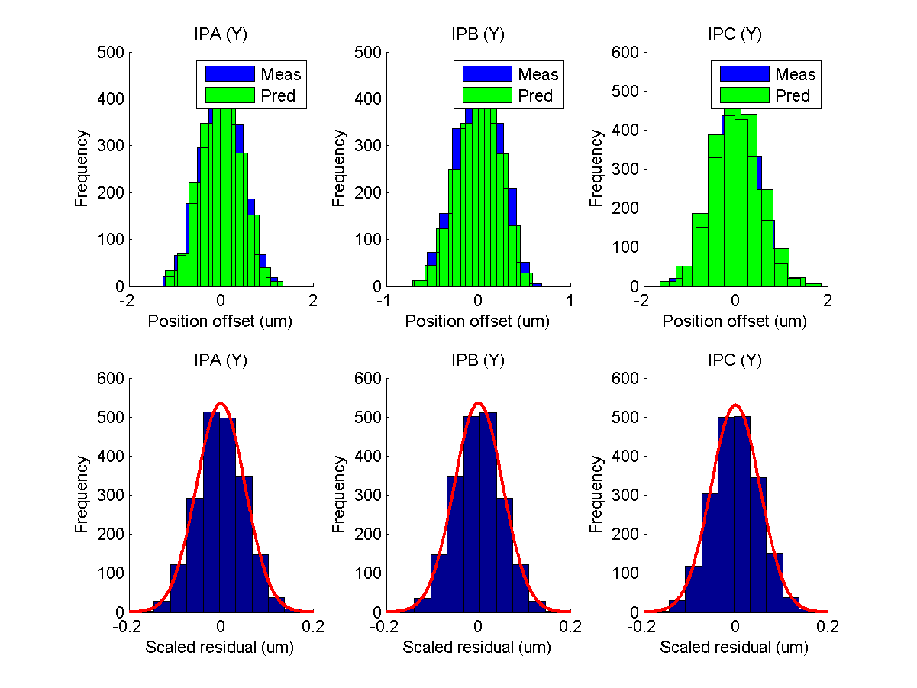
Enhanced fit
N. Blaskovic

Slide 14
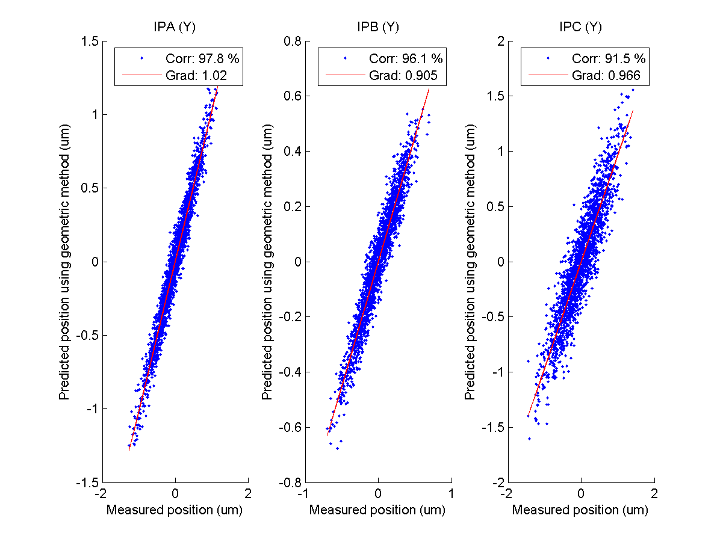
Geometric
N. Blaskovic

Slide 15
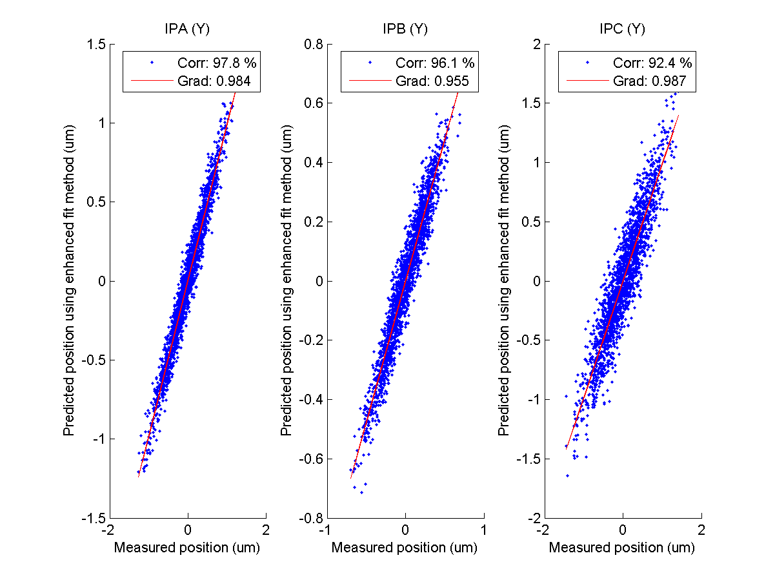
Enhanced fit
N. Blaskovic

