Slide 1

5A BOARD TESTS
TALITHA BROMWICH
DIG IN THRESHOLDS
ADC LEVELS FROM STARTUP
GENERAL INPUT/OUTPUT TESTS

Slide 2
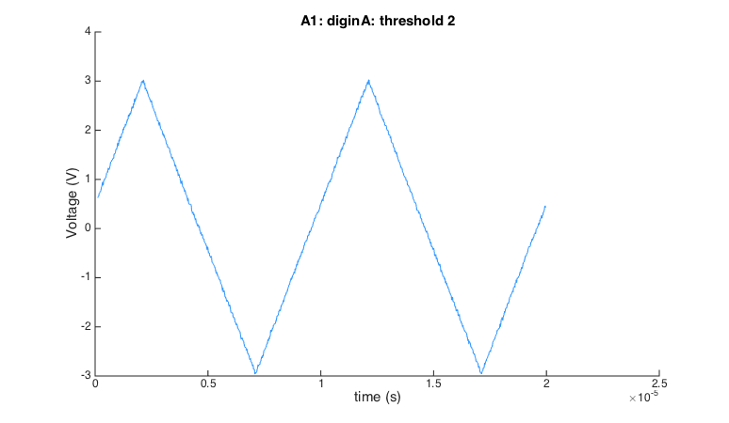
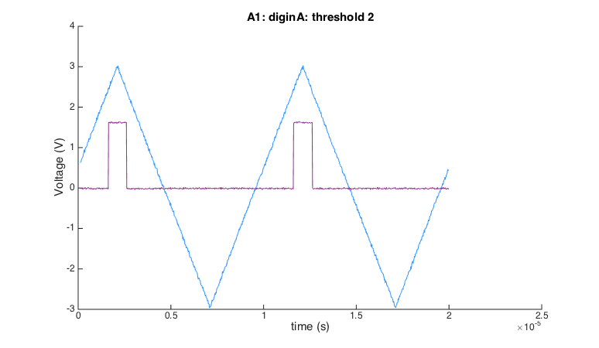
Digital input thresholds
Aim: Determine the threshold settings for the FONT 5a board digital inputs.
Currently only have settings 0 to 8 and do not have a record of what voltage thresholds these correspond to.
1 Send a 100kHz triangular signal into dig in A.
2 Observe output through aux out A and identify the voltage threshold from the width of the positive signal.

Slide 3
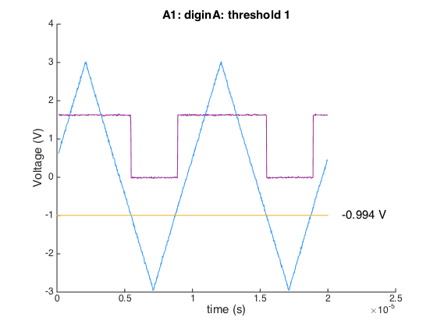
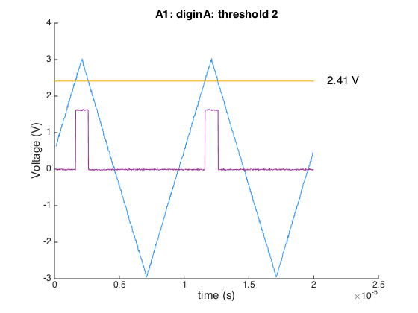
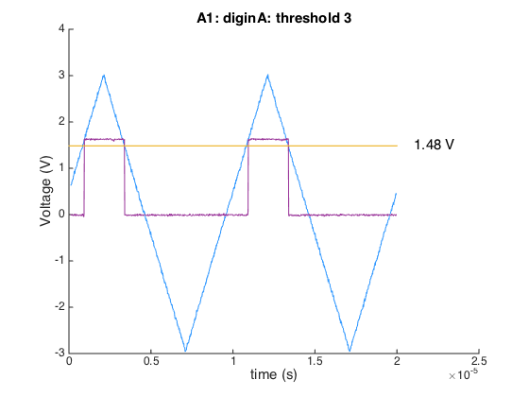
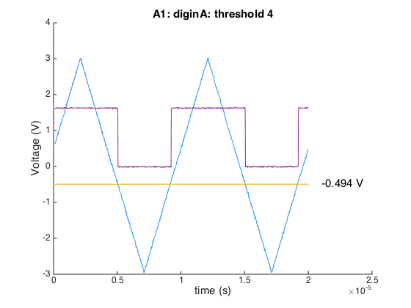
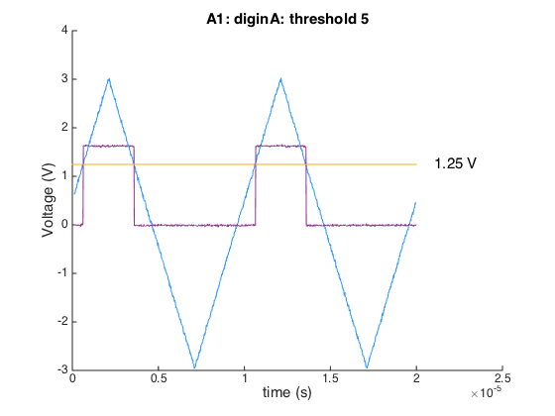
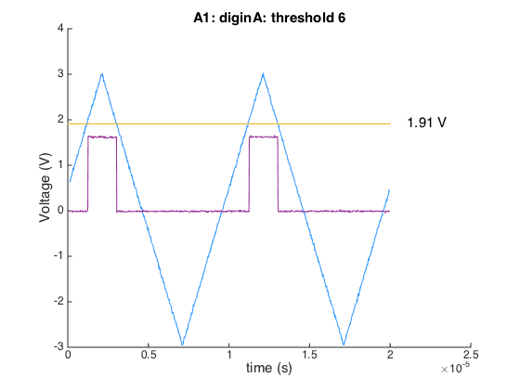
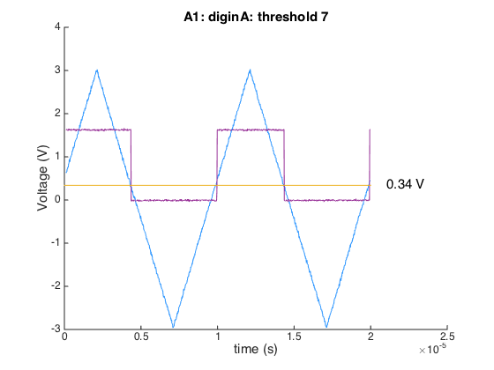
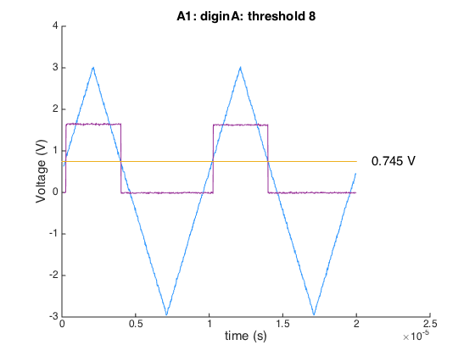
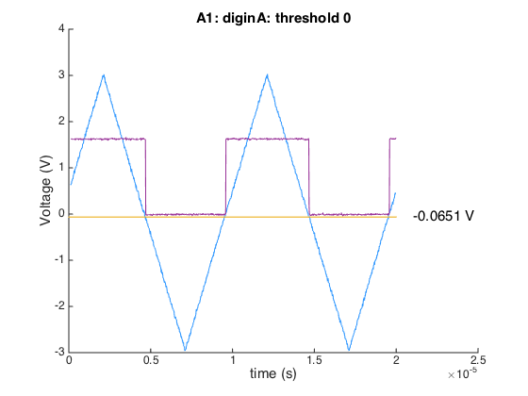

Slide 4
Results: board A1 dig in A
 | THRESHOLD (V)
0 | -0.065
1 | -0.994
2 | 2.412
3 | 1.483
4 | -0.494
5 | 1.245
6 | 1.912
7 | 0.340
8 | 0.745
UNCERTAINTIES
Synchronisation of input triangular signal and output step function signal was achieved by eye on the oscilloscope using ‘de-skew’ function to align the centre of each waveform.
Time discrepancy between two signals appears to be ~110 ns. But frequency of test signal is low (100kHz / 10,000 ns).

Slide 5
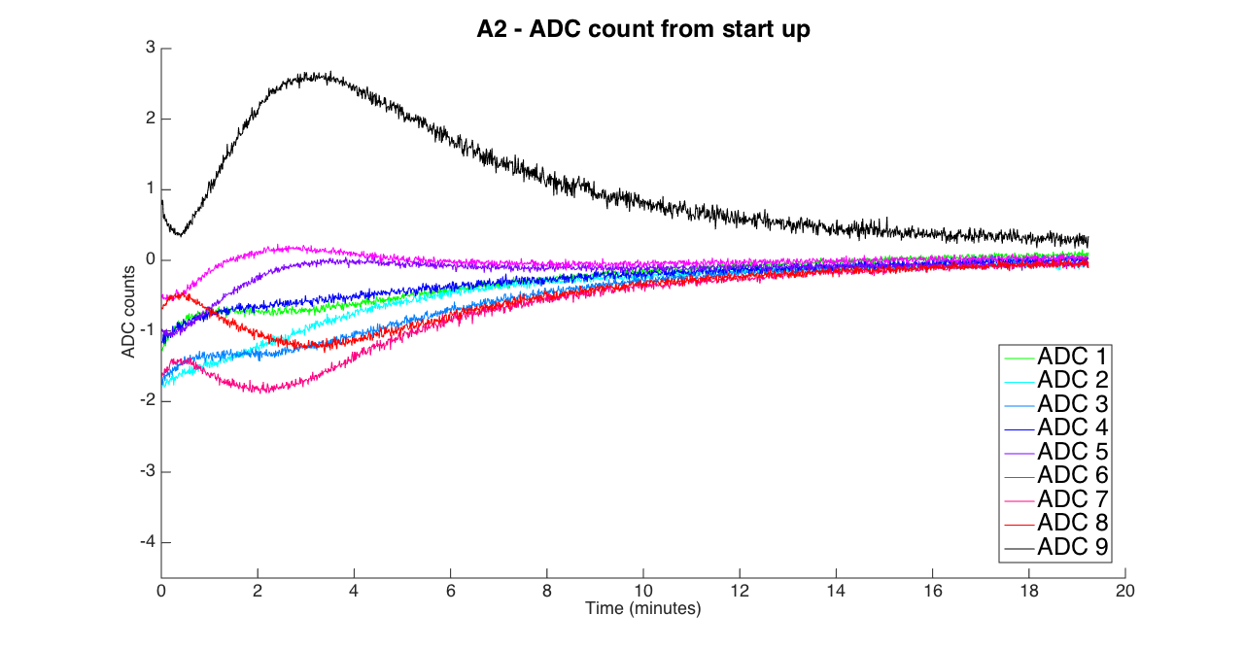
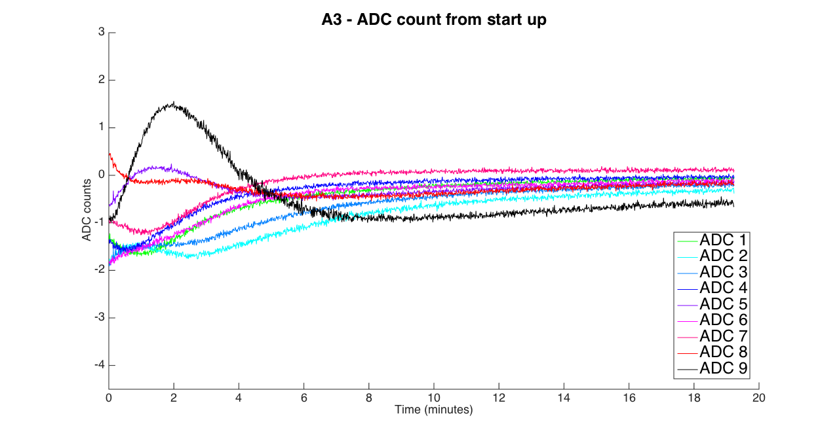
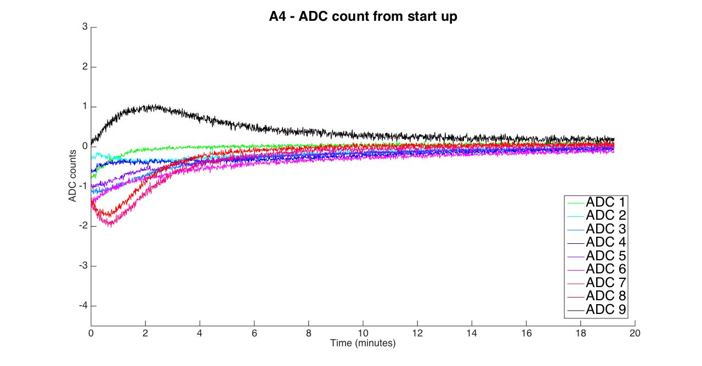
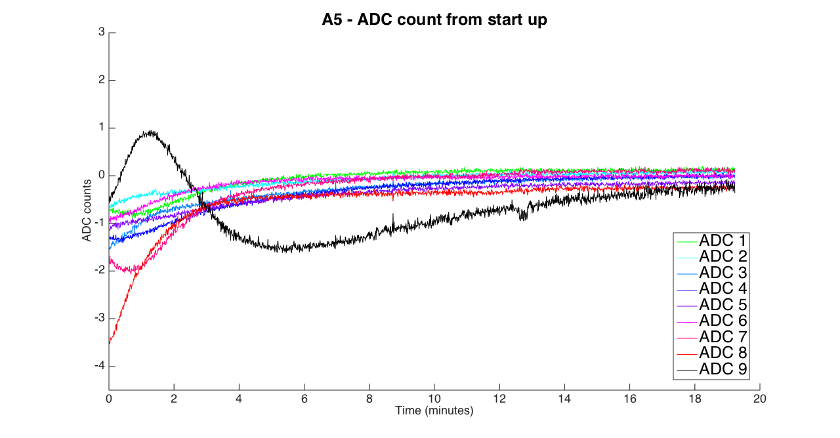
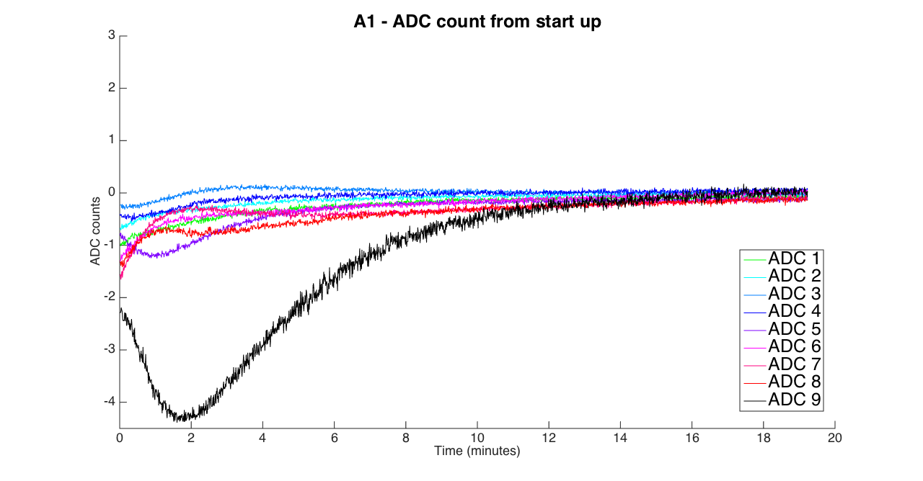
ADC levels from startup
Aim: Characterise the ADC trim DAC level variation with time from initial startup (Excluding the first 20 seconds it takes to launch data taking software)
Average level across 1000 sample window for 1800 triggers (20 minutes)
RESULTS
After 15 minutes all ADCs stabilise to +/- 1 count
ADC 9 is the most erratic
Variation is never more than 4.5 counts

Slide 6
GENERAL INPUT/OUTPUT TESTS
Aim: Test the functionality of all board inputs and outputs
Method: Load .bit file by Glenn on FPGA to map different inputs to different outputs, changing mapping via ChipScope
External ring clock → dig in A → aux out A (test aux out A)
External trigger → dig in B → aux out B (test aux out B)
Internal clock → dir IO A (test dir IO A)
External fast clock → fast clock → dir IO B (test dir IO B)
External ring clock → aux in A → aux out A (test aux in A)
External ring clock → aux in B → aux in B (test aux in B)
Tested on board A1 (known to work) … now need to repeat on other 4 boards

