Slide 1
ILC SRF
Hitoshi Hayano (KEK), and
Akira Yamamoto (KEK-CERN)
Introduction
Advances of ILC-SRF since TDR published, 2013
Plan for preparing the ILC SRF
Summary

Slide 2
Outline
Introduction
Advances of ILC-SRF since TDR published, 2013
Plan for preparing the ILC SRF
Summary

Slide 3
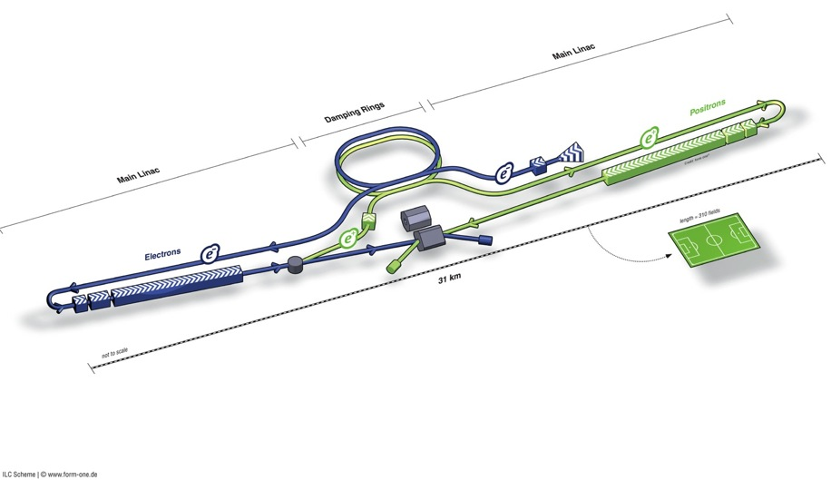
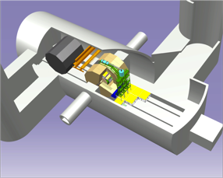
ILC Accelerator in TDR
Damping Rings
Polarised electron source
Ring to Main Linac (RTML)
(including
bunch compressors)
e+ Main Linac
e- Main Linac
Parameters | Value
C.M. Energy | 500 GeV
Peak luminosity | 1.8 x10³⁴ cm⁻²s⁻¹
Beam Rep. rate | 5 Hz
Pulse duration | 0.73 ms
Average current | 5.8 mA (in pulse)
FF beam size (y) | 5.9 nm
E gradient in SCRF acc. cavity | 31.5 MV/m +/-20% Q₀ = 1E10
E+ source

Slide 4
ILC Accelerator in TDR
Damping Rings
Polarised electron source
Ring to Main Linac (RTML)
(including
bunch compressors)
e+ Main Linac
e- Main Linac
Parameters | Value
C.M. Energy | 500 GeV
Peak luminosity | 1.8 x10³⁴ cm⁻²s⁻¹
Beam Rep. rate | 5 Hz
Pulse duration | 0.73 ms
Average current | 5.8 mA (in pulse)
FF beam size (y) | 5.9 nm
E gradient in SCRF acc. cavity | 31.5 MV/m +/-20% Q₀ = 1E10
E+ source
Demonstrated in TDR
Progress in 2014

Slide 5
SRF Main Linac Parameters, Demonstrated
Characteristics | Parameter | Unit | Demonstrated
Average accelerating gradient | 31.5 (±20%) | MV/m | DESY, FNAL, JLab, Cornell, KEK,
Cavity Q₀ | 10¹⁰
(Cavity qualification gradient | 35 (±20%) | MV/m)
Beam current | 5.8 | mA | DESY-FLASH, KEK-STF
Number of bunches per pulse | 1312 |  | DESY
Charge per bunch | 3.2 | nC
Bunch spacing | 554 | ns
Beam pulse length | 730 | ms | DESY-FLASH, KEK-STF
RF pulse length (incl. fill time) | 1.65 | ms | DESY-FLASH, KEK-STF, FNAL-ASTA
Efficiency (RF→beam) | 0.44
Pulse repetition rate | 5 | Hz | DESY, KEK
FF beam size (y) | 5.9 | nm | Closing at KEK-ATF
Peak beam power per cavity at 31.5 MV/m | 190 | kW

Slide 6
Outline
Introduction
Advances of ILC-SRF since TDR published, 2013
Plan for preparing the ILC SRF
Summary

Slide 7
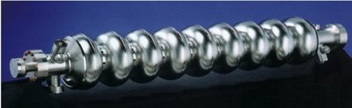
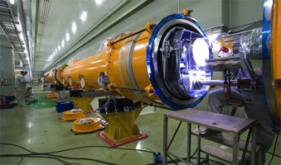
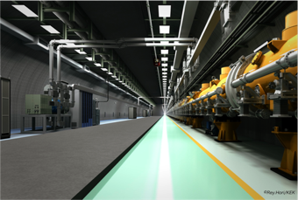
SRF Linac Technology
1.3 GHz Nb 9-cellCavities | 16,024
Cryomodules | 1,855
SC quadrupole pkg | 673
10 MW MB Klystrons & modulators | 436 *
* site dependent
Approximately 20 years of R&D worldwide
→ Mature technology, overall design and cost

Slide 8


ILC SRF Global Cooperation
TRIUMF
◉
STFC
IHEP, PKU, China
◉
Cornell
◉
DESY
◉
FNAL, ANL
◉
JLAB
LAL-Orsay
CEA-Saclay
◉
KEK, Japan
SLAC
◉
◉
◉
◉
◉
CERN
◉
INFN Milan
BARC, RRCAT,
I UAC India
◉
GDE → LCC

Slide 9
Advances in SRF Technology highlighted, since 2013
  EXFEL: exceeded ~ 3/4 of 800 cavity production, and ~ 1/3 of 100 cryomodule assembly and test
    (to be reported by Nick Walker and Olivier Napoli)
  Fermilab ASTA: CM2 reached the ILC specification gradient (35 V/m),
  the first e- beam acceleration, and
  basic research: high-Q with N2 doping.
  JLab: New SRF laboratory functioning,
    basic research: Jlab-PKU-OTIC 1-cell cavity reached > 45 MV/m
  IHEP: New SRF facility in commissioning.
    Collaboration with ADS is reinforcing the facility investment
  KEK: the first in-house built cavity reached the ILC specification (>35 MV/m),
  STF2: completed CM1+CM2a installation into the beam line
  SLAC-LCLS: started the project in cooperation of the US DOE laboratories

Slide 10
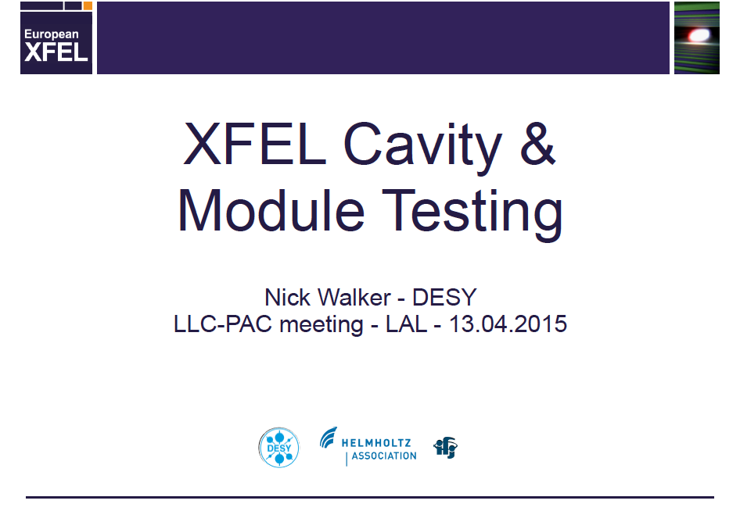
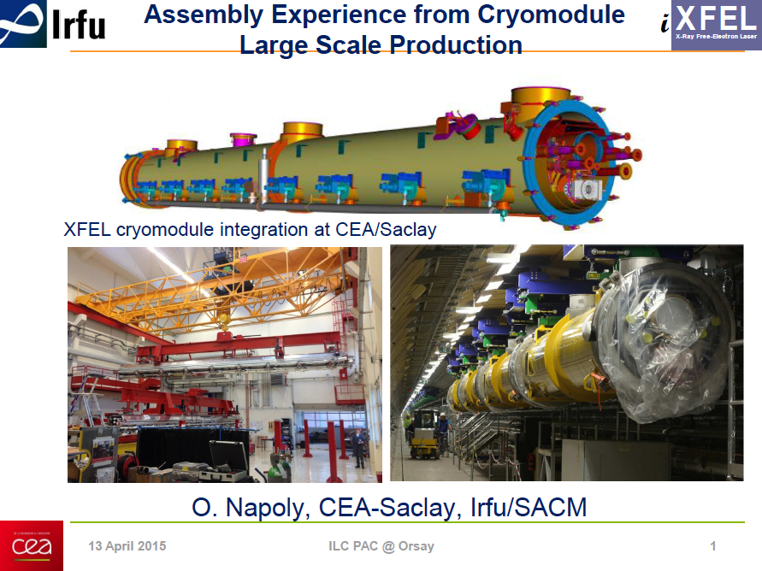
XFEL SRF Progress
to be reported, later, by Nick Walker and Olivier Napoli
Congratulations to excellent progress for the XFEL SRF production and performances !
Keeping the gradient performance after CM assembly is still an important issue to realize the ILC-SRF CM gradient performance.

Slide 11
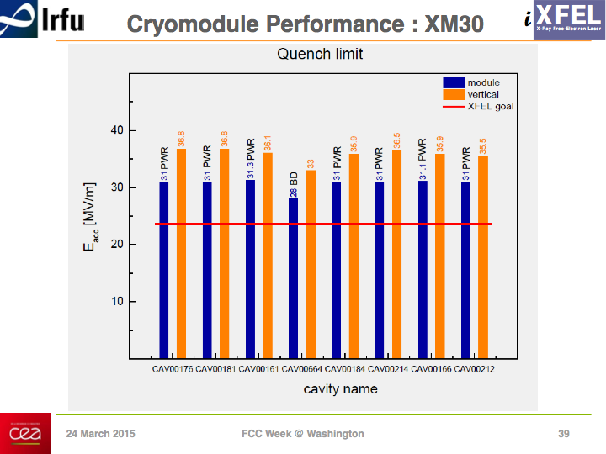
An Excellent Result from E-XFEL CM Test
O. Napoly
To be reported by O. Napoli

Slide 12
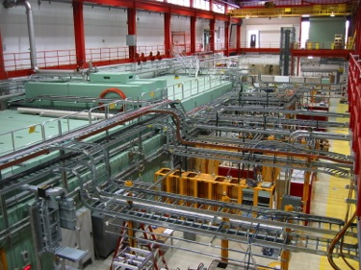
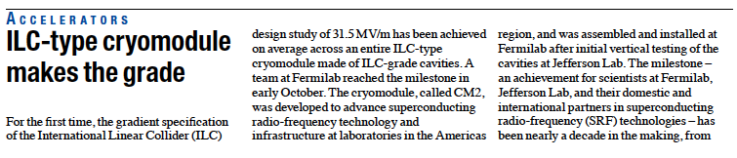
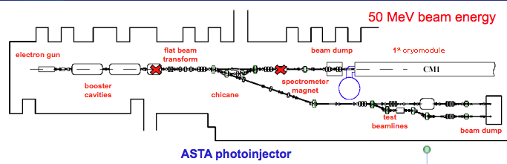
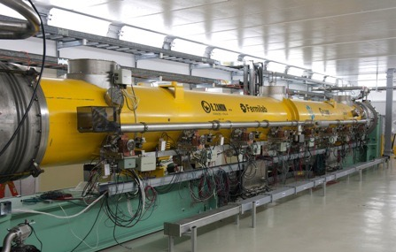
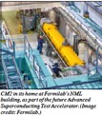
CM2 reached <31.5 MV/m > at Fermilab in 2014
Cavity | Gradient (MV/m)
1 | 31.9
2 | 30.8
3 | 31.8
4 | 31.7
5 | 31.5
6 | 31.3
7 | 31.6
8 | 31.4
Cryomodule test at Fermilab reached < 31.5 > MV/m, exceeding ILC specification

Slide 13
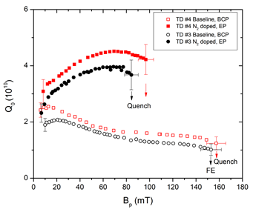
N-Doping highlighted in 2013
FCC2015:Oliver Kugeler
Nitrogen doping: higher Q₀
1.3 GHz
TESLA type cavity
T = 2 K
1.3 GHz single-cell cavities, RRR>300
Standard state-of-the art
Preparation w/o doping
Fermilab recipe: Bake cavity
0.03 mbar N₂ , 800 - 1000 °C , 1h
Remove nitride layer, EP 80µm
Jlab recipe: 800°C/3h, ~25 mTorr N₂ for 20 min,
N₂ evacuated, 30 min at 800°C
~10 μm Electropolishing
A. Grassellino et al, 2013 Supercond. Sci. Technol. 26 102001
(Rapid Communication) – highlights of 2013
G. Ciovati 2014

Slide 14
JLab Status: High Q₀ at 45 MV/m
Courtesy: R. Geng
Two single-cell large-grain niobium cavities under processing and testing for high Q₀ at ultra high gradient regime of > 45 MV/m
  New LSF shape 1-cell large-grain cavities (two each)
    In collaboration with Peking University, Ningxia Large grain material.
    Processing procedure: BCP + 800C x 2hr + BCP + 120C bake.
    Both cavity reached > 35 MV/m and Q0 ~ 2E10 at 2K at max. Eacc.
    Next step processing using standard ILC recipe: light EP + 120C bake.
One new single-cell large-grain niobium cavity under processing and testing
  Cavity PJ1-2
    In collaboration with Peking University and OTIC, Ningxia large-grain Nb material and fabrication.
    CEBAF upgrade cavity Low-loss shape, 1.5 GHz.
    Processing procedure: BCP(60um) + 800C x 2hr + BCP(60um) + HPR + 120C x 48hr.
    Final test result see next slide (reported at AWLC14, , May12-16, 2014)
    On-going testing for ZFC (Zero Field Cooled) test for mitigation of medium field Q-slope (preliminary result reported at LCWS14, October 6-10, 2014)

Slide 15
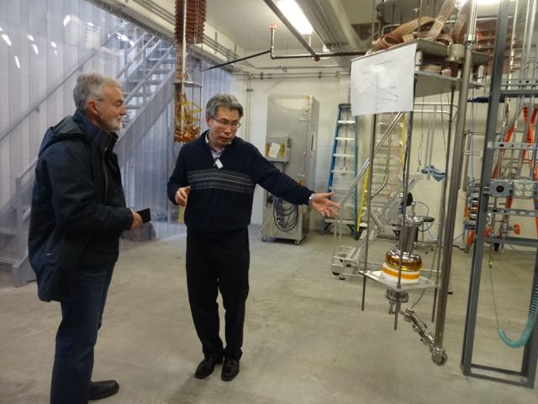
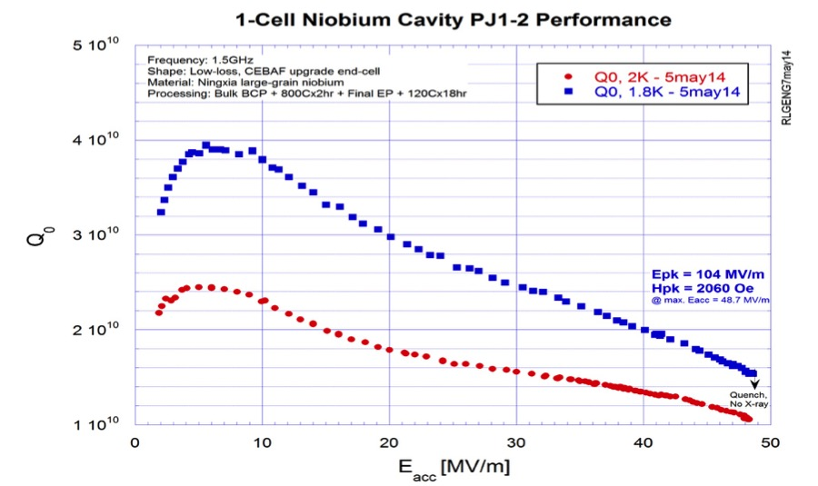
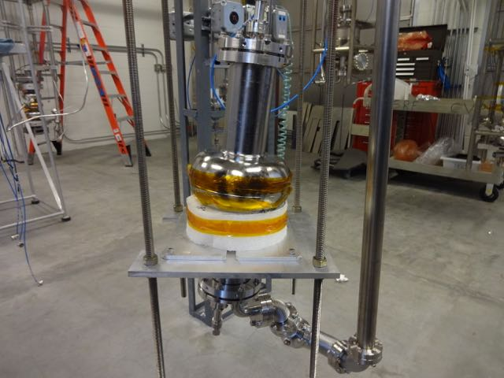
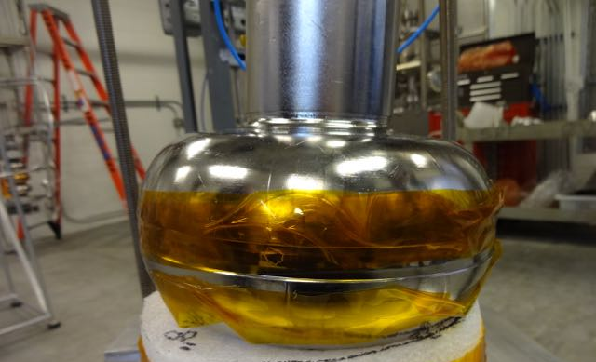
JLab-PKU-OTIC Cooperation
Courtesy : R. Geng
1-Cell LG cavity fabricated by OTIC (China) using Ningxia large grain Nb material, and
processed/tested by JLab

Slide 16
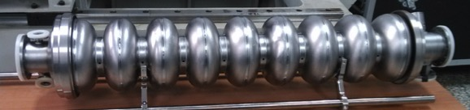
IHEP: SRF Cavity R&D
Courtesy : J. Gao, J. Zhai
TESLA-like 9-cell Cavity (IHEP-03, FG)
  IHEP-KEK collaboration; EBW completed in end 2014
  Tumbling at IHEP in March-April, process and test at KEK in May-June
TESLA 9-cell Cavity (HER-01, FG)
  with full end groups, plan to complete in end 2015
  A spoke024 cavity welded by IHEP EBW machine in 2014, => 4+4 spoke
High Q study by nitrogen doping
  1.3 GHz single cell using IHEP’s new furnace
A. Yamamoto, PAC-150413
ILC SRF

Slide 17
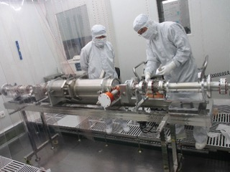
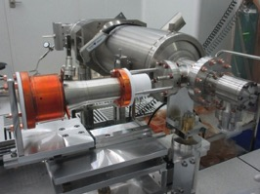
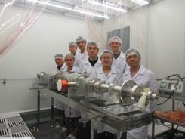
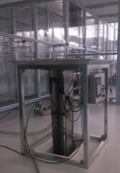
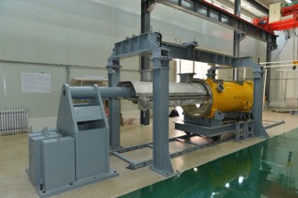
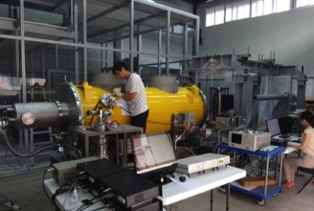
IHEP 1.3GHz 9-cell Cavity Assembly and Test
Courtesy : J. Gao, J. Zhai
1.3 GHz 9-cell cavity
vertical test 20 MV/m, Q₀=1.4E10
1.3 GHz Acc. Unit Assembly and
Cold tested at 80K

Slide 18
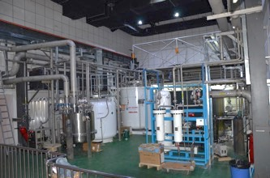
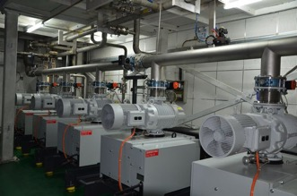
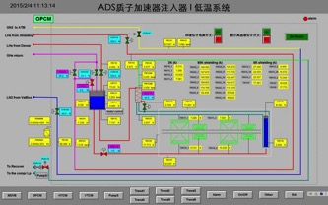
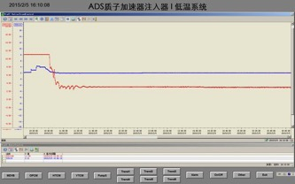
New Cryogenic Plant in Operation
Courtesy : J. Gao, J. Zhai
Tested in Jan. 2015
Refrigeration:
1020 W @ 4.5 K
Liquefaction:
302 L/h
Mixed mode:
352 W + 200 L/h
Total pumping:
8000 m³/h @ 3100 Pa (200 W @ 2 K)
System now in operation for China ADS injector TCM1 (two spoke012 cavities with solenoids, 10 mA CW), and later for ADS cryomodules (14 spoke cavities), ILC test cryomodule, FEL-ERL test facility cryomodules, and vertical test stand)

Slide 19

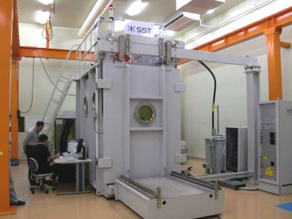
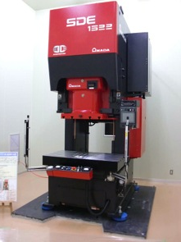
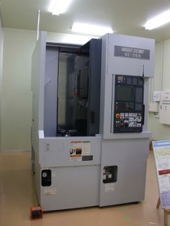
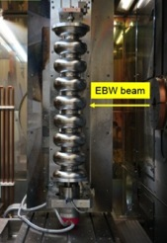
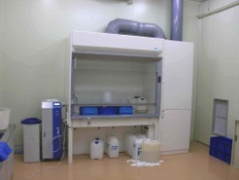
Effort to lead industrialization technology at KEK
EBW
Press
Trim
SST EBOCAM KS-110 – G150KM
Chamber (St. St. chamber)
AMADA digital-survo-press SDE1522
150t, 50stroke/min, 225mmstroke
MORI VKL-253
Vertical CNC lathe
Chemical
process

Slide 20
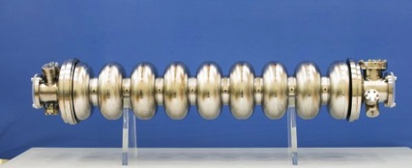
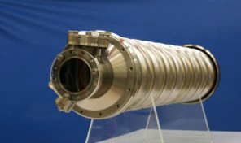
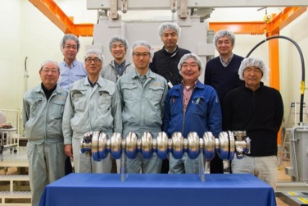
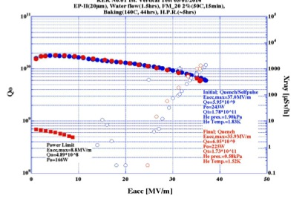
KEK (in-house) 9-Cell Cavity (KEK-01)
Courtesy : M. Yamanaka
completed, and tested, April, 2014
Reached 36 MV/m at Q = 7 x10⁹ at the first vertical RF Test at 1.9 K, April, 2014

Slide 21
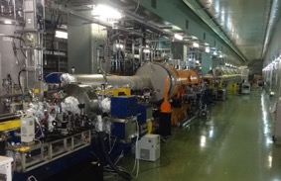
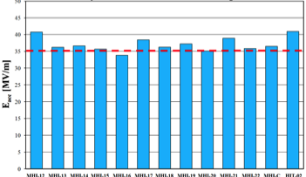
KEK-STF2 is to be a SRF Beam Accelerator Facility
Objective:
High Gradient (31.5 MV/m)
＝＞Demonstration of full cryomodule
Pulse and CW operation
Better efficiency power sources
(SRF electron gun in future)
Plan:
Multiple CM for system study
In-house Cavity to be installed
in cooperation with industry
Wide range application including
Photon Science
Electron Gun
Full Cryomodules
Undulators (in future)
Detector
CM0
BC
SC RF-Gun
CM1
CM2a+2b
CM3a +3b,
Beam Dump
2013-12-18
Gradient achieved at Cavity VT:
35 MV/m (+/-20%) with the yield ~ 90 %

Slide 22
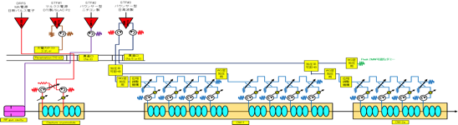

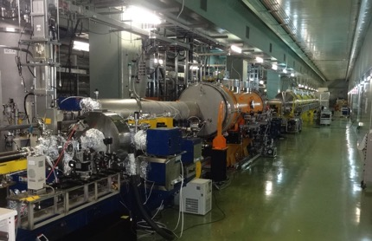
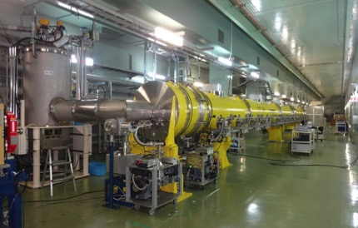
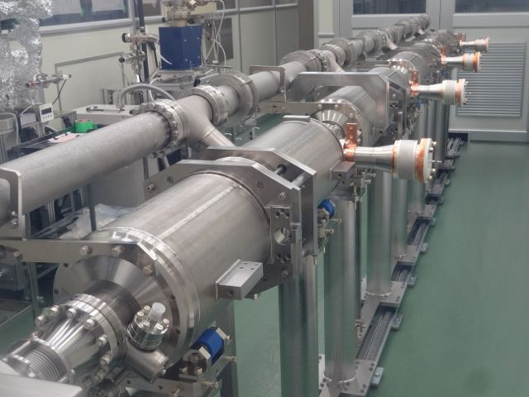
CM1 + CM2a installation completed in 2014
STF2-RF distribution to be installed in 2015, and the beam acceleration expected in 2016.
Beam acceleration w/ capture CM
(40 MV), w/ 6.7 mA, 1 ms, in 2012
Beam acceleration w/ CM1 expected in 2016, after power dist. system installed in 2015
CM1+CM2a in Nov. 2014
A. Yamamoto, LCB-150226
ILC Acc. Status

Slide 23
Outline
Introduction
Advances of ILC-SRF since TDR published, 2013
Plan for preparing the ILC SRF
Summary

Slide 24
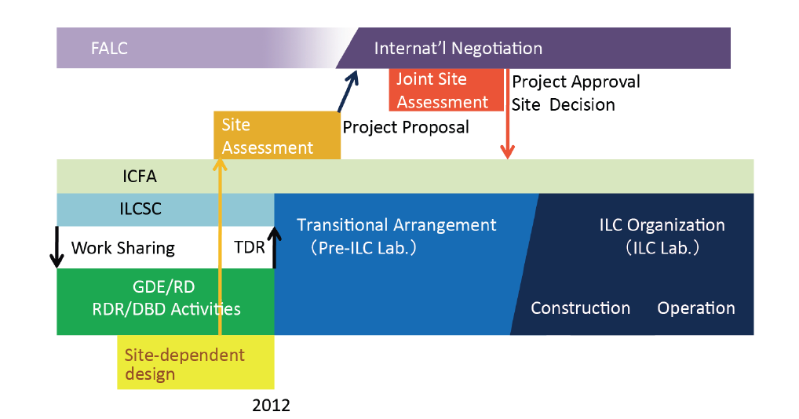
ILC Time Line: Progress and Prospect
Preparation Phase
Expecting 2+4 year
We are here, 2015

Slide 25
Issues and Plan for preparing the ILC SRF
Category | Specific subject | Cooperation w/
SCRF Cavity & Integration Plug-compatibility Cost effective fabrication | Nb material/surface Power Input Coupler Tuner He-Vessel Magnetic Shield | JLab-KEK and others KEK-CEA-CERN-DESY Fermi/SLAC-CEA-KEK DESY-KEK KEK and others
CM integration & test Gradient performance SCQ magnet | String assembly process Conduction-cooled SCQ Radiation shield | EXFEL experience Fermi-KEK
RF power & control | Efficient modulator and klystrons | SLAC-CERN-KEK
Cryogenics Safe & Efficient design | System engineering He inventry High p. Gas Safety | CERN-Fermi-KEK
“Hub-lab” functioning | CM assembly and SRF tests | Regional consortiums anticipated to be established
It should be noted that TTC is leading a key role to exchange worldwide information and to provide general guidance for SRF technology.

Slide 26
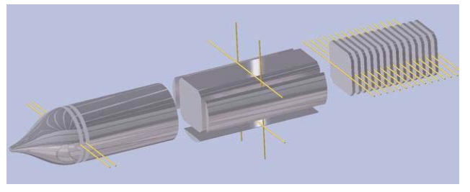
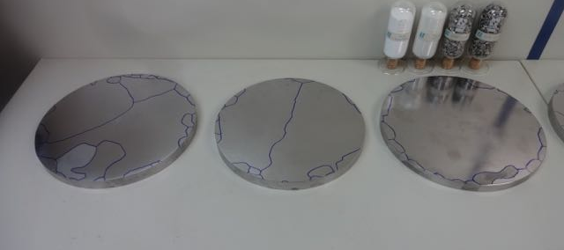
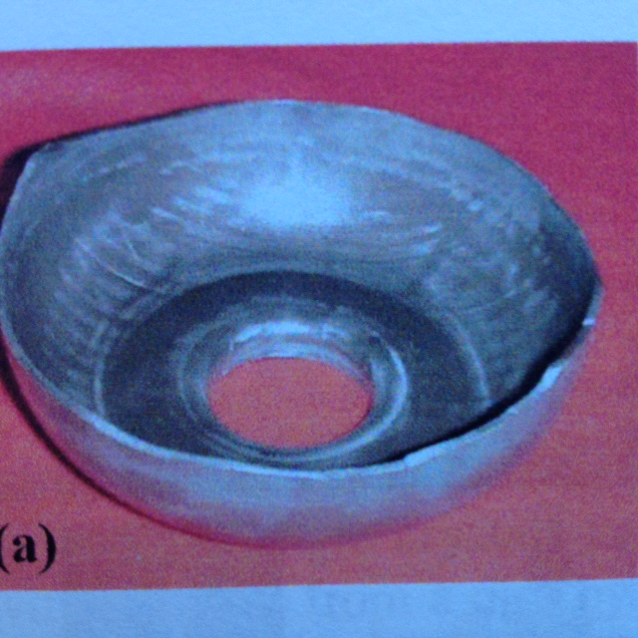
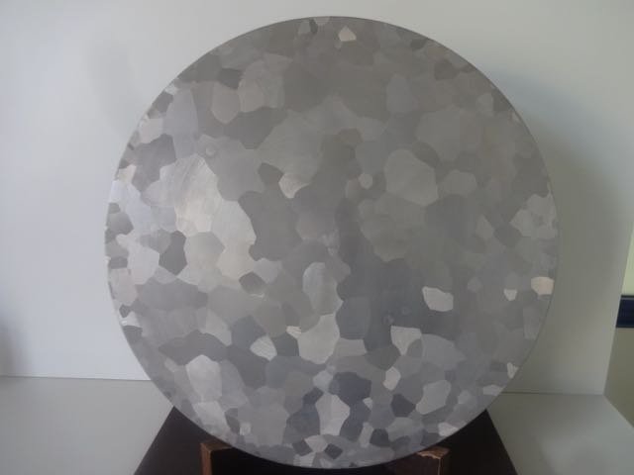
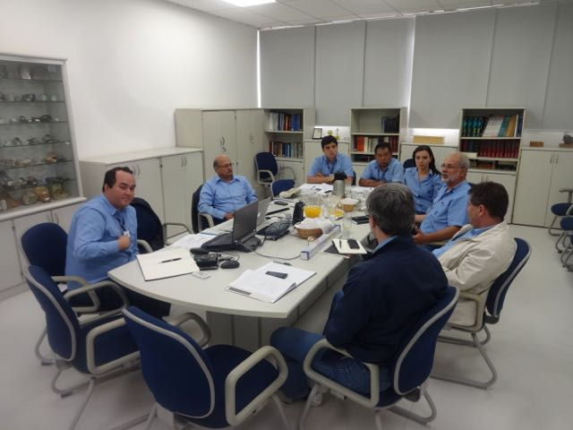
Nb sheet w/ clean Surface and Mech. Stability
Fabrication of Nb sheets
  Size: 260 mm diameter, ~ 3 mm thick
  Quantity: ~ 18,000 x 20 = 360,000 disks (~1.2 kg/disk)
  Purity, Residual Resistance Ratio
    RRR < 300 to be investigated (currently > 300 )
  Mechanical uniformity
    Grain-size : to be optimized
    How it can be expected with industrial process?
Best solution expected
  Nb Ingot with medium grain-size to be optimized
  The study in progress with Jlab-KEK and CBMM

Slide 27


Plug-compatible Conditions
Item | Varieties | Baseline
Cavity shape | TESLA / LL | TESLA
Length |  | Fixed
Beam pipe flange |  | Fixed
Suspension pitch |  | Fixed
Tuner | Blade/ Slide-Jack | Blade (to be re-visited)
Coupler flange (cold end) | 40 or 60 | 40 mm
Coupler pitch |  | Fixed
He –in-line joint |  | Fixed
Plug-compatible interface established in 2008

Slide 28









S1-Global hosted at KEK, 2010 - 2011:
Global cooperation to demonstrate SCRF system with various designs
DESY, FNAL, Jan., 2010
DESY, Sept. 2010
FNAL & INFN, July, 2010
INFN
and
FNAL
Feb.
2010
March, 2010
DESY, May, 2010
June, 2010 ~

Slide 29

S1-Global hosted at KEK, 2010 - 2011:
Global cooperation to demonstrate SCRF system with various designs
DESY, FNAL, Jan., 2010
DESY, Sept. 2010
FNAL & INFN, July, 2010
INFN
and
FNAL
Feb.
2010
March, 2010
DESY, May, 2010
June, 2010 ~

Slide 30

S1-Global hosted at KEK, 2010 - 2011:
Global cooperation to demonstrate SCRF system with various designs
DESY, FNAL, Jan., 2010
DESY, Sept. 2010
FNAL & INFN, July, 2010
INFN
and
FNAL
Feb.
2010
Lessoned and Leaned
Successful CM operation harmonized with variety of cavity design
Every design may function for the ILC-SRF
March, 2010
June, 2010 ~
DESY, May, 2010

Slide 31








Cavities, Tuners, Couplers in S1-G Cryomodule
TESLA Cavity (DESY/FNAL)
Tesla-like Cavity (KEK)
Slide-Jack Tuner (KEK)
Blade Tuner (INFN/FNAL)
Saclay Tuner
(DESY)
TTF-III Coupler
(DESY/FNAL/SLAC)
STF-II Coupler (KEK)

Slide 32


A new plug-compatible Coupler Design required
DESY/FNAL Cavity Package
KEK Cavity Package
40mm
60mm → 40 mm
TTF3 Coupler
STF2 Coupler
In view of “Plug compatibility”, the use of STF2 coupler should be evaluated for 40mm diameter.
What is the simplest and convenient design update?

Slide 33






coupler assembly
TTF-III Coupler:
various support required.
KEK STF:
Coupler:self standing

Slide 34


Comparison of TTF-3 and STF2 Coupler (plug-compatible)
Cold-end flange to be 40 mm)

Slide 35




New KEK-STF plug-compatible Coupler fabricated
Two, new design approach
- Cold end flange to be 40 mm dia.
- Ceramic window using
Lower resistance and
Lower secondary electron emission co-efficient

Slide 36
Comparison of Measurement Value for Evaluated Ceramic
<Ref. Data>
 |  |  |  |  | 99.8% Alumina for RF Application (A479B) | AH100A | Sample Material
Electrical Property | Volume Resistivity |  |  | ohm･cm | min. 1 X 10¹⁴ | min. 1 X 10¹⁴ | -
 | Surface Resistivity |  |  | ohm/□ | 8.9 X 10¹⁴ | 7.4 X 10¹⁵ | 1.2 X 10¹⁴
 | SEE Coefficient |  |  | - | 11.4 | 4.6 | 3.2
 | Dielectric Constant |  | 1MHz | - | 9.9 | 10.2 | -
 |  |  | 8GHz | - | 9.9 | 10.0 | 10.0
 | Dielectric Loss Angle |  | 1MHz | - | 1 X 10⁻⁴ ^{*1} | 1 X 10⁻⁴ ^{*1} | -
 |  |  | 8GHz | - | 4 X 10⁻⁵ | 1 X 10⁻⁴ | 3 X 10⁻³
Mechanical Property | Ave. Flexural Strength(RT) ASTM D2442 TYPE3 |  |  | MPa | 300 | 330 | -
 | Young’s Modulus |  |  | GPa | 370 | 380 | -
 | Poisson Ratio |  |  | - | 0.23 | 0.25 | -
Thermal Property | Thermal Conductivity (RT) |  |  | W/mK | 29 | 24 | -
 | Coeff. Thermal Expansion | RT-400deg.C |  | ppm/K | 7.0 | 7.4 | -
*1:Lower limitation of measurement method
S-band RF Transmission Test Sample
Notes:
This is the summary of the properties of “Sample material” in comparison with AH100A and 99.8% alumina KYOCERA A479B for RF applications.
A479B was selected as the comparison material in the following S-band RF Transmission test and its dielectric loss was the lowest among these 3 materials.
The surface resistivity of “Sample material” is lower than those of other materials.
SEE coefficient of “Sample material” is even lower than AH100A.
However, dielectric loss of “Sample material” is larger than others.
Sample materialの材料特性についてまとめます。
比較のためAH100Aの値も示します。
また、この後示しますS-band RF Transmission testにおいて比較試験体としてる弊社RF用途材料99.8%アルミナA479Bの特性も示します。
誘電損失が低いことが特徴のアルミナです。
Sample materialの表面抵抗率が他の材料と比較して低く、これにより２次電子放出係数がAH100Aよりも更に低くなっています。
反対に誘電損失は大きくなっています。

Slide 37




ILC CM Assembly
Type-B module
Type-A has 9 cavities and no quadrupole
cavities (8)
SC quad package
12.652 m (slot length)

Slide 38



Inter-Cavity Spacing Issue
ILC Type-IV
XFEL
105
82
105
105
108
140
292
353
Reduction in inter-cavity spacing = 61 mm
Bellows: = 108→82 = 26 mm
“Long” cavity end = 140→105 = 35 mm

Slide 39


LCLS-II Cavity: a Tuner Design Option
LCLS Tuner design covering the beam
Pipe flanges, overcoming a constraint
with a shorter beam pipe
T. Peterson, C. Grimm, et al.,
EXFEL, Tesla type tunder assembly

Slide 40


LCLS II Tuner (designer Evgueniy Borissov)
Yu.Pischalnikov, CERN Sept. 5, 2014
Electromechanical actuator & piezo can to be replaced through special port

Slide 41

Access-ability of the Tuner
It is important for adequate operational availability.
We would thank LCLS-II team for their cooperation.

Slide 42



Conduction-Cooled Split-able Quadruple
Advantages;
Q-magnet may be assembled separately,
Keep “best clean” during cavity string assembly
No additional cryostat and cryogenics
Highly accurate alignment without LHe vessel

Slide 43



Conduction Cooling Test using Cryo-Cooler
Kimura, Kashikhin, Tartaglia
Cool-down : 8 days w/ 1 W CC
Excitation test up to 30 A (30%)
Ramp rate test : 0.4 A/s
( x 40 faster than ILC-ML op.)
Temperature rise : ~ 0.5 K
Critical Temp > 8 K
Max. Temp; < 5 K
0 to 30 A , 0.4 A/s

Slide 44



SRF CM SC Quadrupole conduction cooled

Slide 45



SRF CM SC Quadrupole conduction cooled

Slide 46

ILC- Cryogenics Design
Major update of the Major Cryogenics Plants on Surface:
No cryogen storage underground for safety reason (anoxia, suffocation),
He inventory during long-term shutdown
Easier access for He (cold) and liquid N2 (cold) supplies from companies,
Easier Heat removal from compressors
Shorter 2K transfer line for effective cryogen transport, underground
Issues to be further settled:
Radio-activation of He during long-term operation to be justified
Minimize noise and mechanical vibration from compressors and cooling towers, w/ half underground layout, for better conservation of natural environment
High pressure gas safety code

Slide 47


Current Cryogenics Configuration
New Baseline to be proposed to CMB
ILC-TDR Baseline

Slide 48

Current Cryogenic Flow

Slide 49
Cooperation of Hub-Labo and industry
ILC Host-Lab
- Manufacturing
by Industry
- Qualification
by Hub-lab
Technical Coordination
for Lab-Consortium
Regional Hub-Lab:
A
Regional Hub-Lab:
E, & …
World-wide
Industry responsible to
‘Build-to-Print’ manufacturing
Regional Hub-Lab:
B
Regional Hub-Lab:
D
Regional Hub-Lab:
C: responsible to
Hosting System Test and Gradient Performance
Hub-laboratories responsible to regional procurements to be open for any world-wide industry participation
: Technical
coordination link
: Procurement link

Slide 50
A Model for Cavity and CM
Production and Qualification Process
Step hosted | Industry | Industry/Laboratory | Hub-laboratory | ILC Host-laboratory
Regional constraint | no | yes or no | yes | yes
Sub-comp/material - Production/Procurement | Nb, Ti, specific comp. … |  | Procurement
9-cell Cavity - Manufacturing | 9-cell-cavity, Process, He-Jacketing |  | Procurement
9-cell Cavity - Performance Test |  |  | Cold, gradient test
Cryomodule component - Manufacturing | V. vessel, cold-mass ... |  | Procurement
Cryomodule/Cavity - Assembly |  | Cav-string/ CM-assembly
SCRF Cryomodule - Perofrmance Test |  |  | Cold, gradient test
Accelerator integration, Commissioning |  |  |  | Accelerator sys. Integ.

Slide 51
ILC Hub-Laboratories/Consortiums to be established
Function for Qualification | Europe | Americas | Asia
SRF Cavity qualification/test | DESY-AMTF | FNAL,Jlab | KEK-STF
Power-Input Coupler conditioning | LAL-Orsay | SLAC | KEK-STF
Cryomodule Assembly | Saclay | FNAL, Jlab | KEK/ILC
Cryomodule qualification/test | DESY-AMTF | FNAL | KEK/ILC
Current status | EXFEL in progress 100module 800cavities | LCLS-II to be realized 35module 280cavities | STF Full-CM facility in progress
TDR (Ecm=500GeV)
1850 cryomodule, 18,000 cavities (~ 6 years construction)
=> ~100 CM/year/region, ~1,000 cavities/year/region

Slide 52






SRF Facilities anticipated to be Hub/Consortium
DESY, E-XFEL
TRIUMF
FNAL/ILCTA, ANL
IHEP, PKU
Cornell
CEA-Saclay, LAL
JLAB
KEK
SLAC, LCLS-II
RRCAT
AMTF @DESY/E-XFEL, CM
STF-CFF @ KEK
ASTA @ FNAL, TEDF @ JLab

Slide 53





XFEL Cavity/CM Assembly/Test Station
Courtesy:
H. Weise, O. Napoli
CEA – Saclay (SRF Village)
DESY-AMTF
In case of 100 % test/assembly of CM:
If we may have ~ x 2 DESY-CEA facilities , ILC can be managed as follows:
~ x 2 ( = 20 / (3 x period) / 3 regions ) of DESY-CEA facilities required in 3 regions
In case of ( ~ 40 % (> 1/3 + x ), we may understand that it is enough,
~ x 1 DESY-CEA facility can be shared in 3 region.

Slide 54




H. Hayano
Superconducting Application Promotion Center
As of January, 2015
Control room
Vertical test area
Panolama view of exp. hall

Slide 55

H. Hayano
A Full CM Assembly and Test Facility at KEK-STF
to demonstrate a Hub-Lab functioning
As a model facility for ILC assembly & Testing
Clean-room
He Cryogenics
EP(vertical-EP)
Cavity Testing(4-cavities-test)
Cryomodule Assembly(cantilever)
Cryomodule Testing
Building just completed

Slide 56
A Plan for Preparing ILC SRF
Pre. Green-Sign necessary for preparation w/ authorizing a site, budget
Period |  | Pre-Prep | Pre-Prep |  | Prep. 1 | Prep. 2 | Prep. 3 |  |  | Prep. 4 | Construction // | Beam
Time : year (anticipated) |  | 1st |  |  | 3rd |  |  |  |  |  | 7th | 16th
MEXT | Experts Committee
Stage | Pre-prep (w/o specific funding ) |  |  |  | Preparation ( 4 yrs w/ specific funding) |  |  |  |  |  | Construction (9 yrs) | Beam op.
ADI | Acc. Design & Integ. Parameters fixed, based on a specofoc mode-site |  |  |  | Engineering Design optimized
CFS | Pre. Land-survey, Env. Assess. & Acc. Layout |  |  |  | L. survey, Env. Assess., Land-prep., Basic plan, Eng. design/drawing |  |  |  | Procurement process
SRF | Cav. Production technology Prep. Hub-lab functioning SRF beam-tech. demonstrated |  |  |  | Mass production technology Hub-lab functioning SRF beam-technology advanced |  |  |  | Procurement process
Nano-beam | FF nano-beam size & stability demonstrated |  |  |  | FF: Smaller nano-beams & stability established |  |  |  | Same as above
e-e+ Sources | Technology demonstrated. |  |  |  | Prototype demonstrated
SRF-linac worldwide (lepton-photon):
EXFEL | EXFEL construction |  |  | EXFEL beam operation
LCLS | LCLS preparation |  | LCLS Construction |  |  |  |  | LCLS beam operation

Slide 57
Main issues in the ILC Preparation Phase
分野 (field) | 課題 (Issues/Subjects) | 協力体制 (Global Cooperation)
施設設計 CFS | 候補地特性を反映した地質環境調査： Site-specific CFS design, env. assess. 基本計画、詳細設計、図面整備 General plan, eng. Design, drawings | JP-CFSがコアとなり国際連携、 候補地域との連携 JP-CFS to take a central role in cooperation with global experts and regional experts.
加速器設計 Acc. Design Int. | 詳細設計・パラメータ最適化 Engineering design, Parameter optim. | LCC-ILCを中心とした国際連携による検討 LCC-ILC to take a central role with global cooperation
SRF技術 SRF | 製造・性能検証技術、 Fabrication and Testing technology 性能の安定化 Stabilization of the performance | Tesla Tech. Collab., as common community - KEK-STF: Hub-Lab function - EXFEL: mass production and testing - LCLS : mass production and testing
ナノビーム技術 Nano-beam | 低エミッタンス、 極小ビームの安定的実現、運用 Ultra low emittance, nano-beam to be realized and stabilized | ATF Collab. As common community - KEK-ATF to be maximized in use, as a global unique facility for next generation training as well as the advance studies.
研究所運営 Management | 新国際研究所の設立準備 Preparation for the int’l ILC laboratory | 今後の検討課題 A main Issue for the ILC to be prepared

Slide 58
ILC 加速器建設にむけた研究所人材構想
[人・年（FTE) 国際協力分担の仮定を含む]
[A HR proposal for the ILC preparation, linked to the construction （FTE) ]
Stage | Preparation |  |  |  | Construction |  |  |  |  |  |  |  |  | Sum
 | 1 | 2 | 3 | 4 | 1 | 2 | 3 | 4 | 5 | 6 | 7 | 8 | 9
Prep. CFS-jp CS-ww Acc -jp Acc-ww Admin. | 77 4+4 1 30+20 10 8 | 96 5+5 1 35+25 15 10 | 116 6+6 2 40+30 20 12 | 134 7+7 2 45+35 25 13 |  |  |  |  |  |  |  |  |  | 423 22+22 6 150+110 70
Const. |  |  |  |  | 410 | 922 | 1208 | 1350 | 1589 | 1480 | 1374 | 1106 | 679 | 10,118
Install. |  |  |  |  |  |  | 80 | 80 | 80 | 768 | 1140 | 683 | 522 | 3,353
Sum |  |  |  |  | 410 | 922 | 1288 | 1430 | 1669 | 2248 | 2514 | 1789 | 1201 | 13,471
Notes: HR required for the ILC preparation (CFS, Acc., and administration): - HR in the 1st preparation year to be filled from the existing staff in fraction of ~80%), - HR needs to be gradually increased to reach a factor 1/5 ~ 2, during the prep. phase, - The guideline is to provide 10 %level in fraction to the staff required for the ILC laboratory, - The global collaborators anticipated from a fraction of 5 % to 20% of existing ones, - The Japanese HR needs to be boosted/complemented by using “sub-contract, Worldwide fraction in japan, CFS: ~ 90 % , Acc. 60^70%, and (1/3 ~ 1/2 to be subcontracted)
New estimate
Given in TDR
Average/yr: ~ 1,100

Slide 59
ILC 加速器建設にむけた研究所人材構想
[人・年（FTE) 国際協力分担の仮定を含む]
[A HR proposal for the ILC preparation, linked to the construction （FTE) ]
Stage | Preparation |  |  |  | Construction |  |  |  |  |  |  |  |  | Sum
 | 1 | 2 | 3 | 4 | 1 | 2 | 3 | 4 | 5 | 6 | 7 | 8 | 9
Prep. CFS-jp CS-ww Acc -jp Acc-ww Admin. | 77 4+4 1 30+20 10 8 | 96 5+5 1 35+25 15 10 | 116 6+6 2 40+30 20 12 | 134 7+7 2 45+35 25 13 |  |  |  |  |  |  |  |  |  | 423 22+22 6 150+110 70
Const. |  |  |  |  | 410 | 922 | 1208 | 1350 | 1589 | 1480 | 1374 | 1106 | 679 | 10,118
Install. |  |  |  |  |  |  | 80 | 80 | 80 | 768 | 1140 | 683 | 522 | 3,353
Sum |  |  |  |  | 410 | 922 | 1288 | 1430 | 1669 | 2248 | 2514 | 1789 | 1201 | 13,471
Notes: HR required for the ILC preparation (CFS, Acc., and administration): - HR in the 1st preparation year to be filled from the existing staff in fraction of ~80%), - HR needs to be gradually increased to reach a factor 1/5 ~ 2, during the prep. phase, - The guideline is to provide 10 %level in fraction to the staff required for the ILC laboratory, - The global collaborators anticipated from a fraction of 5 % to 20% of existing ones, - The Japanese HR needs to be boosted/complemented by using “sub-contract, Worldwide fraction in japan, CFS: ~ 90 % , Acc. 60^70%, and (1/3 ~ 1/2 to be subcontracted)
New estimate
Given in TDR
Average/yr: ~ 1,100

Slide 60
Cavity-CM 性能試験に必要な研究所人材数の検証 (EXFELとの比較）
Evaluation of Cavity-CM labor work, in comparison with EXFEL
 | EXFEL (in progress） |  | ILC（TDR estimate）
Cavity – CM性能試験 (Tests) |  |  |  | Generally Consistent with EXFEL labor fact.
Cavity：required（% tested） |  | 800 (x 100%) | 16,000 (x 100%)
CM： required （% tested） |  | 100 (x 100%) = 100 | 1,850 (x 38%) = 703
試験従事者数x 年数 （FTE integrated) |  | ~50 x 2.5 yr = 125 p-y | 2089 p-y x0.43 = 898 p-y
FTE/CM |  | 1.25 p-y/CM | 1.28 p-y/CM
Power Input Coupler Process |  |  |  | Auto-test process progressed in EXFEL, and ILC to become redundant
Coupler: required (% proc.) |  | 800 (x 100%) | 16,000 (x 100%)
試験従事者数x 年数 （FTE integrated) |  | ~6 x 2.5 yr = 15 p-y | 2089 p-y x0.38 = 794 p-y
FTE/Coupler |  | 0.019 p-y/Coupler | 0.050 p-y/Coupler
SRF-ML における主要な人材必要数は、EXFEL の進捗により、整合性が裏付け。
ILC (SRF-ML, cavity-CM) labor estimate is being verified with the EXFEL progress/fact.

Slide 61
Outline
Introduction
Advances of ILC-SRF since TDR published, 2013
Further Plan to prepare for the ILC
Summary

Slide 62
Summary
ILC SRF Technology is sufficiently advanced to get into the preparation (engineering design) stage.
The best cost-effective manufacturing will become inevitably important, and needs to be established.
We would thank EXFEL and LCLS-II programs, particularly with the SRF industrialization experiences as a reality.
Global cooperation is inevitably important to prepare for the construction, and to establish “Hub-laboratory” consortiums.

Slide 63
Appendix

