Slide 1
Possible cryo layout - Akira

Slide 2
ML Tunnel Section variation
LCC guidance to base the shielding wall design on the need for SRF power-on access but NO beam-on access
This is different than the TDR design rules which had assumed that personnel access was necessary for reliability reasons.
Solid state modulators and 10MW klystron lifetime estimated MTBF has increased since TDR
CR-04 increases potential energy O/H and allows the design to be a bit more aggressive.

Slide 3
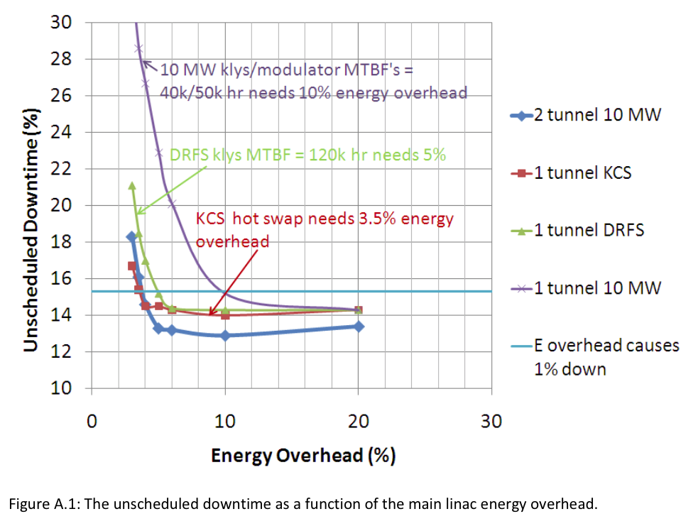
SB2009
Base Line
SW3.5m
%

Slide 4
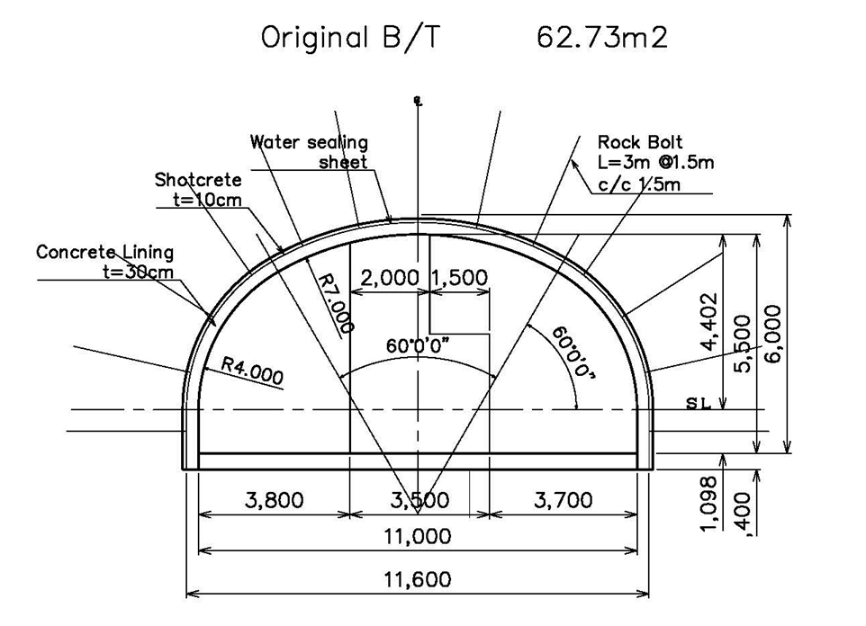
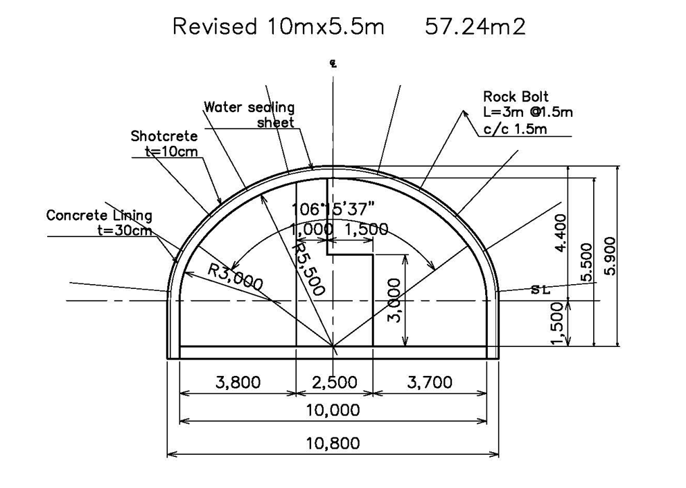
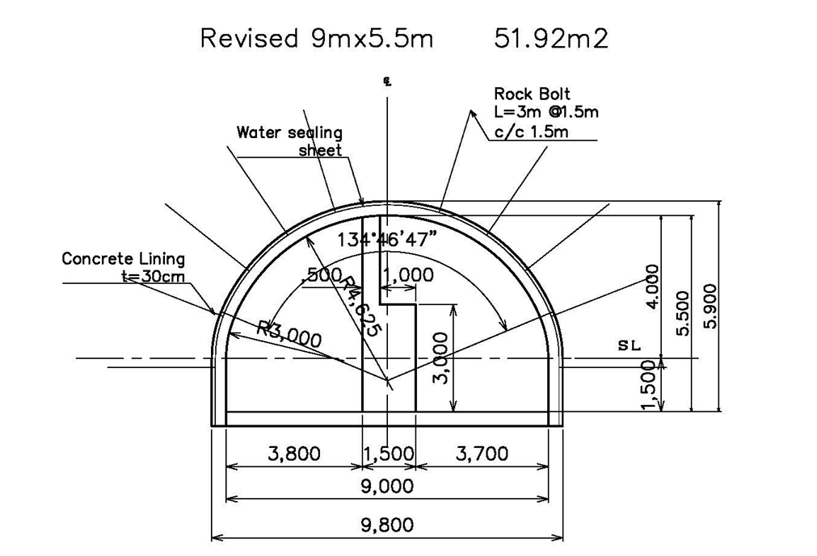
Summary of MLT shield wall thickness impact
Confidential
 | Baseline SW3.5m | Option-1 SW2.5m | Option-2 SW1.5m
Cross Section
Cross Section | W11m x H5.5m Designed Ex Area 62.7 m2 | W10m x H5.5m Designed Ex Area 57.2 m2 | W9m x H5.5m Designed Ex Area 51.9 m2
Reduction % | 0 % | 8.8 % | 17.2 %
Schedule | 64.7 Month | 62.1 Month | 59.7 Month
Base Line
SW3.5m
%

Slide 5
We will consider CR-04
EXENSION OF THE ELECTRON AND POSITRON MAIN LINAC TUNNELS BY APPROXIMATELY 1.5 KM
It is proposed to extend both the electron and positron main linac tunnels by approximately 1.5 km (total machine length approximately 3 km). For the baseline the additional tunnel length will be filled with simple passive beam transport lines.
RATIONALE
The additional tunnel length will be used to: (i) adjust the total beamline path length on the positron side by 2946.x metres in order to fulfil the timing constraint imposed by the baseline method of positron production; (ii) allow the capacity in the tunnel layout (on both sides) for additional margin (overhead) in the maximum beam energy, thus mitigating risk in achieving a centre-of-mass energy of ≥500 GeV.
The need to allow possible space for additional linac (cryomodules) is justified by the physics requirements (threshold of e+e–→ttH at 475 GeV) which has become evident since the discovery of the Higgs. Allowing for a possible increase in the length of the linacs allows some additional margin in both achievable average accelerating gradient and top-end energy reach of the machine, and significantly reduces the risk of achieving 500 GeV cm.
The path length adjustment (i) is consistent with the existing TDR damping ring design (circumference) and bunch patterns, and while potentially not the cheapest solution, when taken together with (ii) appears to be the more straightforward approach.

