Slide 1
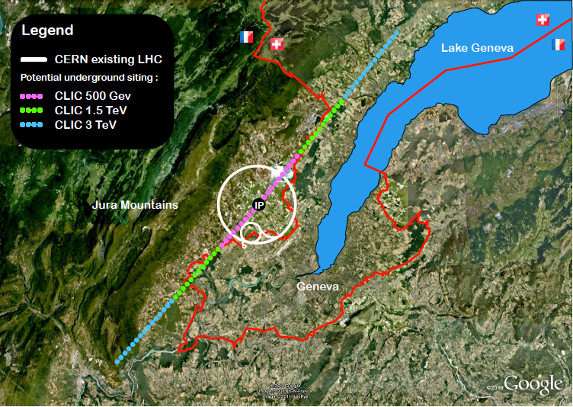
LCC report
ILC SCHEMATIC
Lyn Evans
FALC. CERN 19th June 2015

Slide 2
ILC in Linear Collider Collaboration
As of April, 2015
ICFA
Chair: J. Mnich
FALC
Chair: J. Womersley
Program Adv. Committee
PAC – Chair: N. Holtkamp
Linear Collider Board
LCB – Chair: S. Komamiya
KEK
Planning Office
for the ILC
Regional Directors
B. Foster (EU)
H. Weerts (AMs)
A. Yamamoto (AS)
Linear Collider Collab. LCC
- Director: L. Evans
Deputy (Physics)
– H. Murayama
Assoc. Directors
ILC
– M. Harrison
(Deputy)
H. Hayano, N. Walker
CLIC
– S. Stapnes
Physics & Detectors
– H. Yamamoto
ILC Project Unit,
Coordination Unit

Slide 3
Key points
The ILC and CLIC accelerator studies are organised under the leadership of the Linear Collider Collaboration with goals:
Strongly support the Japanese initiative to construct a linear collider as a staged project in Japan
Prepare CLIC machine and detectors as an option for a future high-energy linear collider at CERN
Further improve collaboration between CLIC and ILC machine experts
Beyond the significant progress on the basic RF studies, increased and successful effort on system-studies of various types (FACET, ATF, etc)
Many common challenges with 3rd generation light sources and FELs, the latter providing very important industrial/lab production experiences
Comprehensive physics studies – and in parallel technical detector R&D and concept studies – demonstrate the realism and unique impact of LC e+e- measurements and searches at energy scales from 250 to 3 TeV
The on-going process in Japan for ILC is nevertheless (by some margin) the most central activity right now

Slide 4
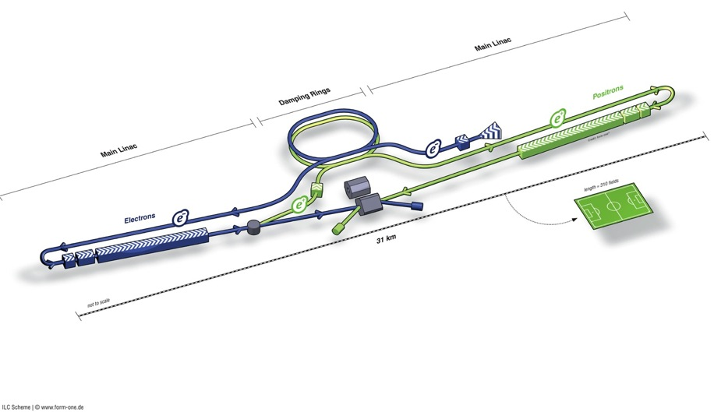
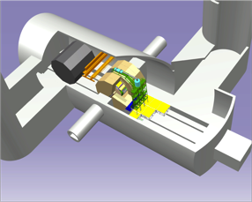
ILC Accelerator in TDR
Damping Rings
Polarised electron source
Ring to Main Linac (RTML)
(including
bunch compressors)
e+ Main Linac
e- Main Linac
Parameters | Value
C.M. Energy | 500 GeV
Peak luminosity | 1.8 x10³⁴ cm⁻²s⁻¹
Beam Rep. rate | 5 Hz
Pulse duration | 0.73 ms
Average current | 5.8 mA (in pulse)
FF beam size (y) | 5.9 nm
E gradient in SCRF acc. cavity | 31.5 MV/m +/-20% Q₀ = 1E10
E+ source
Demonstrated in TDR
Progress in 2014

Slide 5
Technical Highlights in 2014
Nano-beam
    ATF2: reached 44 nm at the final focus, closing the primary goal of 37 nm
      Corresponding to 7 nm at the ILC energy (250 GeV/beam) with the goal of 6 nm
SRF
    EXFEL: exceeded 50 % ( 400/800) cavity production, and 10 % (10/100 ) cryomodule assembly and test
    Fermilab-ASTA: reached the ILC specification gradient
    SLAC-LCLS: started the project in consortium with the US SRF laboratories
    KEK-STF2: completed CM1+CM2a installation into the beam line
Accelerator Design and Integration (ADI)
    LCC: processed Post-TDR design update with a model-site assumption
      Common L* for both detectors of ILD and SiD
      Vertical access at Detector Hall at IR points
      Extension of ML tunnel for optimizing e+e- collision timing and for redundancy of ML SRF cavity gradient integration
    LCC: is continuing to seek for potential cost saving in balance to necessary increase

Slide 6
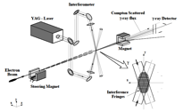
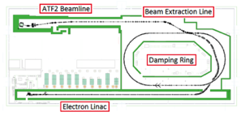

Progress in Beam Size at ATF2
IPAC2014, K. Kubo
ICHEp2014, S. Kuroda
Beam Size 44 nm observed,
(Goal : 37 nm
corresponding to 6 nm at ILC)

Slide 7
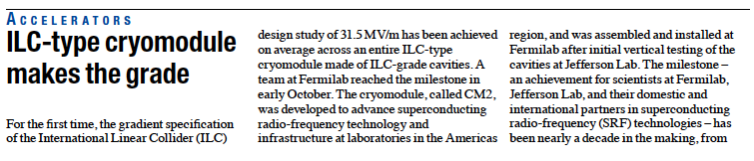
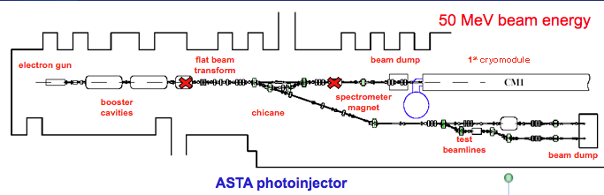
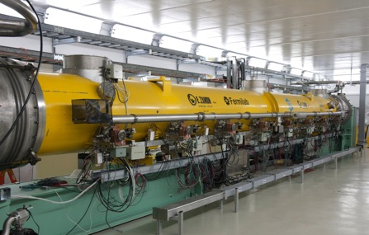
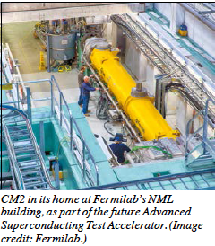
CM2 reached <31.5 MV/m > at Fermilab in 2014
Cavity | Gradient (MV/m)
1 | 31.9
2 | 30.8
3 | 31.8
4 | 31.7
5 | 31.5
6 | 31.3
7 | 31.6
8 | 31.4
Cryomodule test at Fermilab reached < 3.15 > MV/m, exceeding ILC specification

Slide 8
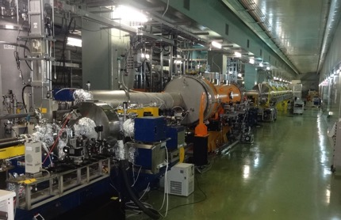
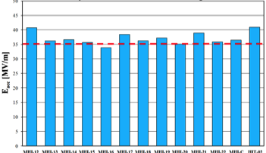
KEK-STF2 is to be a SRF Beam Accelerator Facility
Objective
High Gradient (31.5 MV/m)
＝＞Demonstration of full cryomodule
Pulse and CW operation (for effective R&D)
Better efficiency power sources
SRF electron gun
Training for next generation s
Plan:
Multiple Cryomodule for system study
In-house Cavity to be installed
in cooperation with industry
Wide range application including
Photon Science
Electron Gun
Full Cryomodules
Undulators (in future)
Detector
CM0
BC
SC RF-Gun
CM1
CM2a+2b
CM3a +3b,
Beam Dump
Gradient achieved at Cavity VT:
> 35 MV/m with the yield of > 90 %
2013-12-18

Slide 9

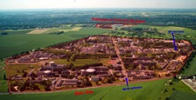
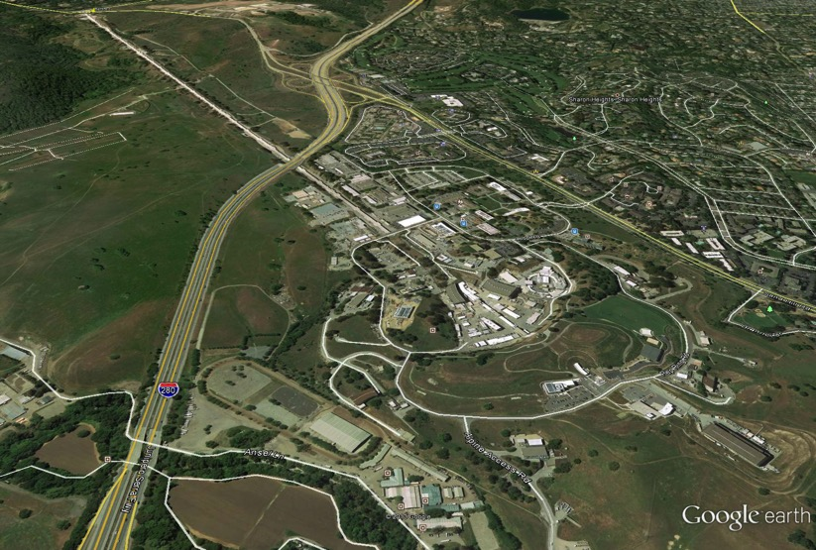
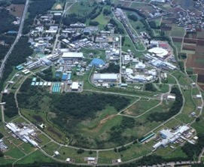
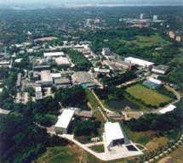
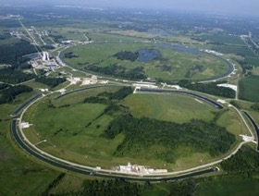
SRF Facilities anticipated for Hub/Consortium
DESY, E-XFEL
FNAL/ILCTA, ANL
IHEP, PKU
Cornell
CEA-Saclay, LAL
JLAB
KEK
SLAC, LCLS-II
RRCAT
AMTF @DESY/E-XFEL, CM
STF-CFF @ KEK
ASTA @ FNAL, TEDF @ JLab

Slide 10
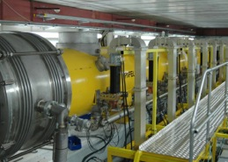
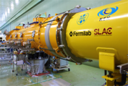
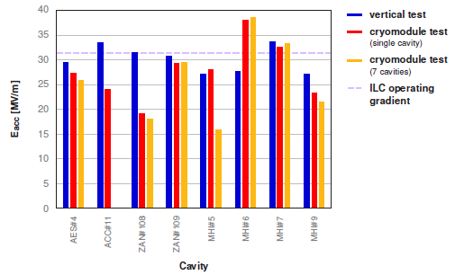
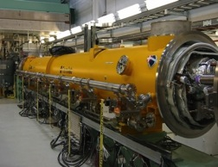
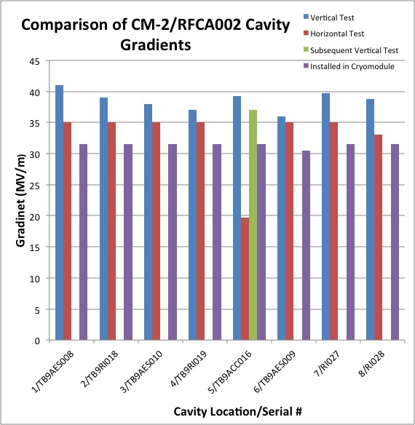
Cryomodule System Tests
DESY: FLASH
1.25 GeV linac (TESLA-Like tech.)
ILC-like bunch trains:
600 ms, 9 mA beam (2009);
800 ms 4.5 mA (2012)
RF-cryomodule string with beam → PXFEL1 operational at FLASH
XFEL Prototype at PXFEL1
← Demonstrated
PXFEL1 : ~ 32MV/m>
KEK: STF/STF2
S1-Global: completed (2010)
Quantum Beam Accelerator (Inverse Llaser Compton): 6.7 mA, 1 ms
CM1 test with beam (2014 ~2015)
STF-COI: Facility to demonstrate
CM assembly/test in near future
S1 Global Cryomodule at STF:
← Demonstrated
Cavity string: < 26MV/m>
  FNAL: ASTA
  (Advanced Superconducting Test Accelerator)
CM1 test complete
CM2 operation (2013)
CM2 with beam (soon)
CM2 at NML Facility:
CM2: > 31.5 MV/m>

Slide 11
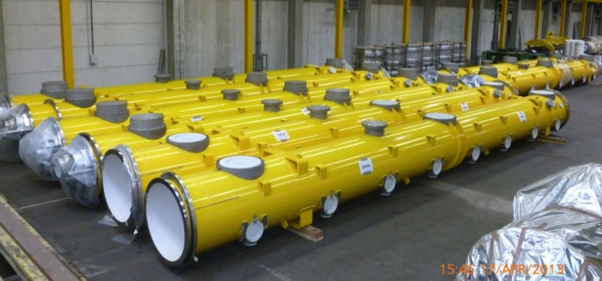
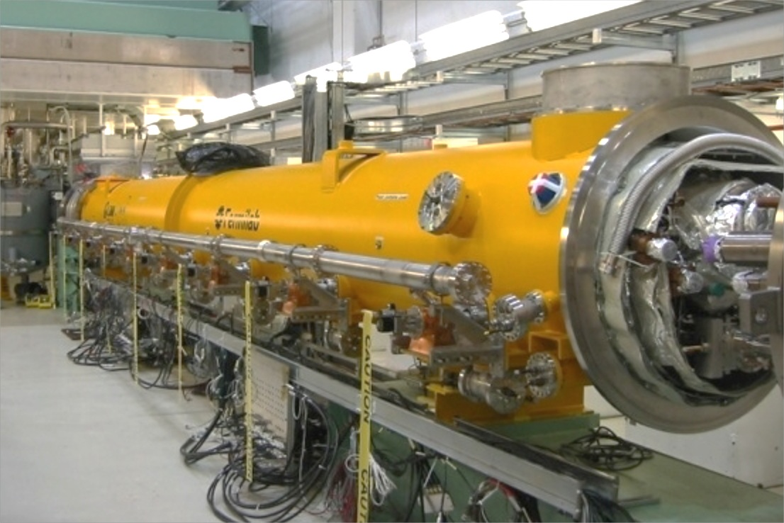

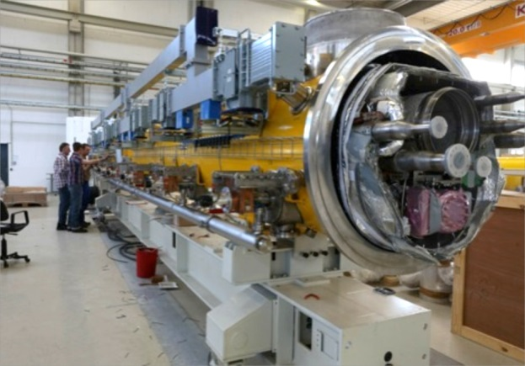

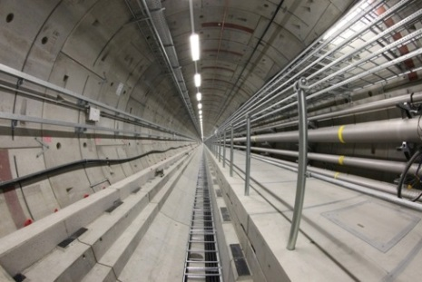
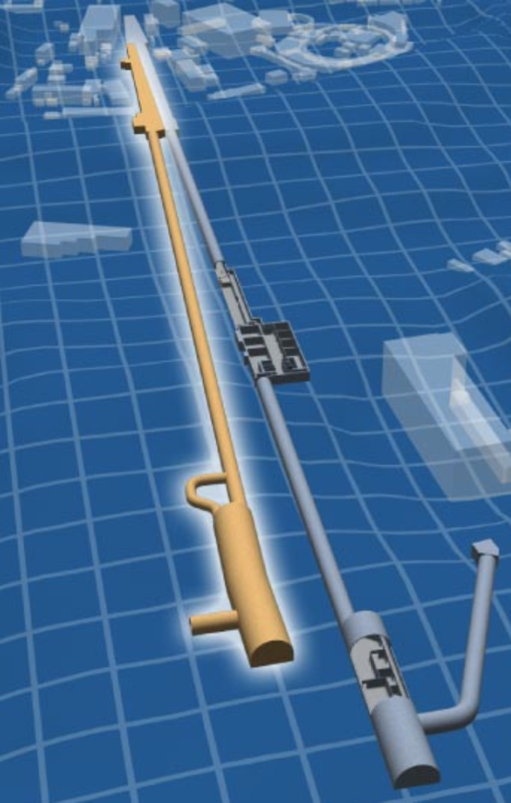
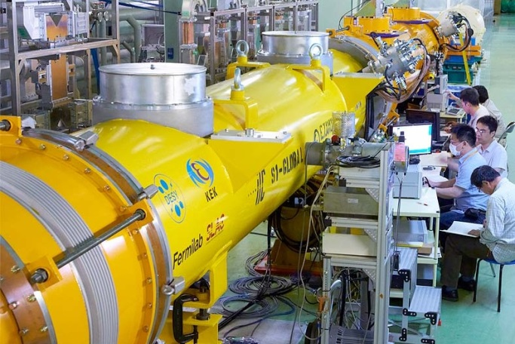
FEL and advanced linacs with SCRF modules
Largest deployment of this technology to date
100 cryomodules
800 cavities
17.5 GeV (pulsed)
Kitakami
proposed site
TRIUMF
FNAL/ANL
SLAC
◉
◉
◉
◉
Cornell
IHEP
PKU
JLab
◉
DESY
◉
LAL
Saclay
CERN
◉
KEK
LCLS-II
INFN Milan
◉
IUAC
RRCAT
preliminary data; results are not published
US infrastructure for
35 cryomodules
280 cavities
4 GeV (CW)
US and EU (industrial) production and test capacity.
Perfectly placed for start of ILC construction end
of this decade.
8

Slide 12
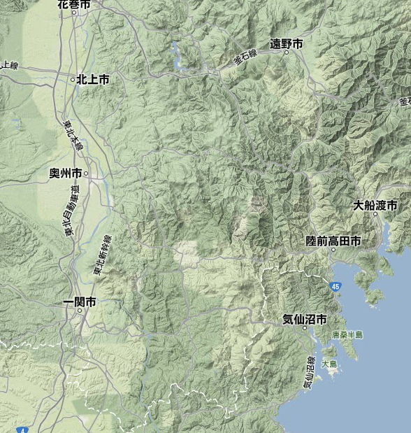
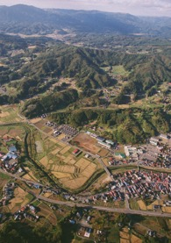
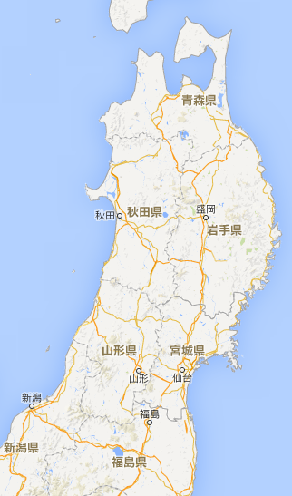
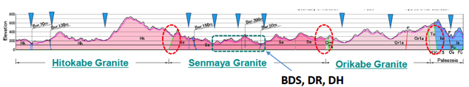
ILC Site Candidate Location in Japan: Kitakami
Proposed by JHEP community
Endorsed by LCC
To be authorized by Government
High-way
Oshu
Express-
Rail
Ofunato
Kesen-numa
Sendai
Ichinoseki
IP Region

Slide 13
ILC Global Accelerator Organization
ILC Director: M. Harrison, Deputies: N. Walker and H. Hayano
Sub-Group | Global Leader Deputy/Contact p. |  | Sub-Group | Global Leader Deputy/Contact P.
Acc. Design Integr. | N. Walker (DESY) K. Yokoya(KEK) |  | SRF | H. Hayano (KEK) C. Ginsburg (Fermi), E. Montesinos (CERN)
Sources (e-, e+) | W. Gai (ANL) M. Kuriki (Hiroshima U.) |  | RF Power & Cntl | S. Michizono (KEK) TBD (AMs , EU)
Damping Ring | D. Rubin (Cornell) N. Terunuma(KEK) |  | Cryogenics (incl. HP gas safety) | H. Nakai: KEK T. Peterson (Fermi), D. Delikaris (CERN)
RTML | S. Kuroda (KEK) A. Latina (CERN) |  | CFS | V. Kuchler (Fermi), M. Miyahara J. Osborne (CERN),
Main Linac | N. Solyak (Fermi) K. Kubo (KEK) |  | Radiation Safety | T. Sanami (KEK) S. Roesler (CERN) TBD (Ams,)
BDS | G. White (SLAC), R. Tomas (Cern), T. Okugi(KEK) |  | Electrical Support (P. Supply etc.) | TBD
MDI | K. Buesser (DESY) T. Tauchi (KEK) |  | Mechanical S. (Vac. & others) | TBD

Slide 14
ILC being studied in Japan
150421
SCJ
Recommendation
in 2013
MEXT
ILC Taskforce
formed in 2013
Commissioned Survey by NRI
( in 2014, and 2015)
Academic Experts Committee
in JFY 2014 ~ 2015
Particle & Nuclear Phys.
Working Group
in 2014 ~ 2015
TDR Validation
Working Group
in 2014 ~ 2015
Human Resource
Working Group
in 2015
planned
planned

Slide 15
JFY2014, Commissioned Survey
- deliverable given in a public report -
Technical/economical benefits from ILC
  ILC, General plan and technical features
  Current, technical status and subjects for further development
  Prospects for industrial applications and benefits
  Analysis for economical impacts, base on direct and indirect effects to be expanded ( estimated, ~ > 2 )
Scientific prospects and future plans
  for particle and nuclear physics, in Europe, north America, and in China
  Observation and suggestions for ILC, obtained through worldwide visiting and Interviews

Slide 16
JFY2015, Commissioned Survey by MEXT contracted with Nomura Research Institute (NRI)
Subjects for survey and analysis:
  Technical feasibility to realize the ILC
    Regarding components, system design, management, and infrastructure
  Technical issues to prepare for the ILC construction
    Regarding industrial technology, and necessary time-scale, and prototype works.
    Cost increase risk
  Cost reduction possibility
    with technical approaches not described in TDR

Slide 17
LCC-ILC Progress Report in preparation to be useful for further surveys and studies
It contains the LCC-ILC technical progress after TDR, respecting:
  Civil engineering studies
  Accelerator hardware design/development updates
  Accelerator system layout updates for preferred site
  Integration/test facilities to be prepared for “hub-laboratory functioning
  Project Implementation Plan
  Further preparatory work
It may be useful as a reference document for any survey and/or evaluation on the ILC activities, updated.

